Slide 1
Bubble Nucleation and Hadronic Phase Conversion in an
Expanding Quark–Gluon Plasma
Noriyuki Sogabe (University of Osaka)
XQCD 2026 July 14 PKNU
Misha Stephanov and Ho-Ung Yee
(University of Illinois Chicago)

Slide 2
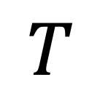

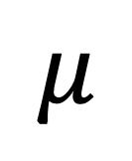
From fluctuations to first-order dynamics
$$T$$
Supercooled QGP
→ Bubble nucleation
→ Hadronic states
Any consequences at the freeze-out?
$$\sqrt{s_{1}}>...>\sqrt{s_{4}}$$
Critical Fluctuation?
STAR (CPOD2024)
PRL (2025)
Color Superconductors
$$μ$$

Slide 3


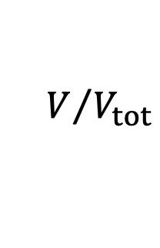
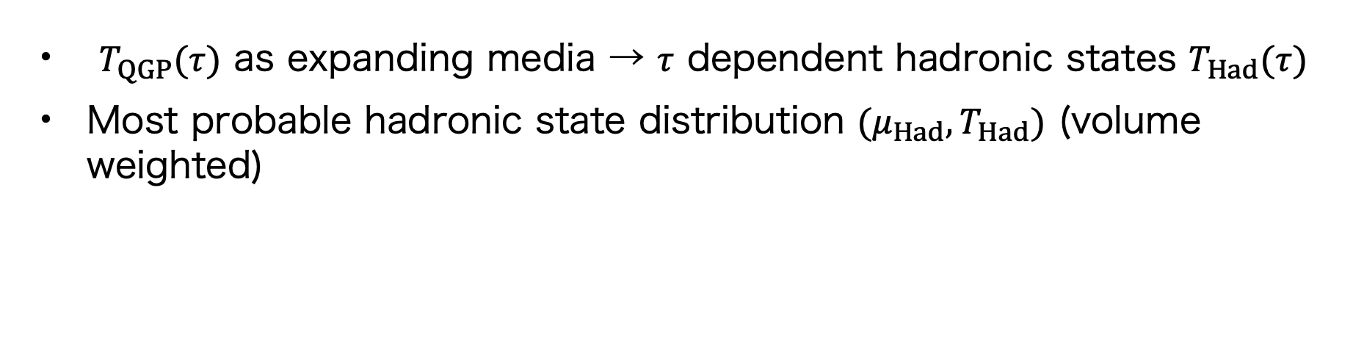



Bubble nucleation and growth in expanding media
$$τ=τ_{c}$$
$$τ$$
$$V/{V_{tot}}$$
$$T_{QGP}(τ)$$
$$T_{Had}(τ)$$
$$T_{Had}$$
$T_{QGP}(τ)$ as expanding media → $τ$ dependent hadronic states $T_{Had}(τ)$
Most probable hadronic state distribution $(μ_{Had},T_{Had})$ (volume weighted)

Slide 4
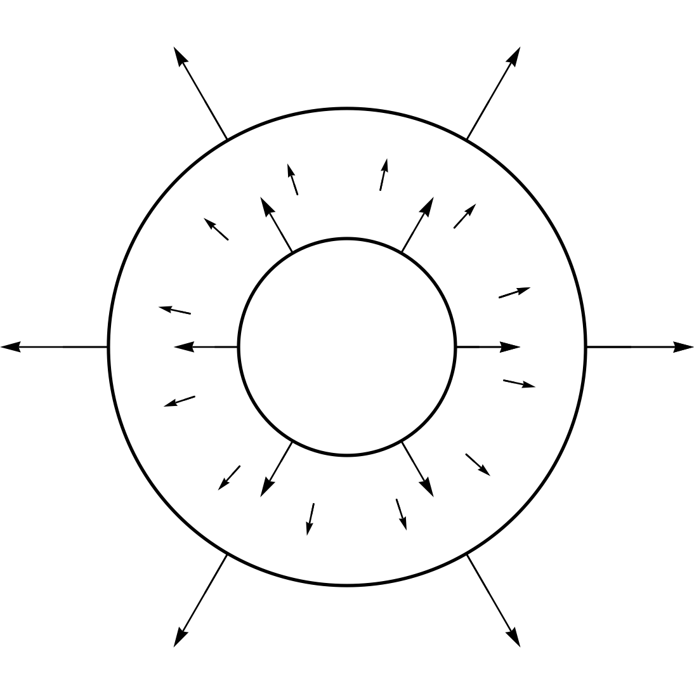










Setup
$$Q_{2}$$
$$μ_{2},T_{2}$$
$$Q_{1}$$
Three-layer problem:
Gyulassy, Kajantie, Kurki-Sunio, McLerran (1984)
$Q_{2}$ : Supercooled QGP
$Q_{1}$ : Reheated QGP (required by kinematics)
$H$ : Hadronic state
BEST EOS (3D Ising + lattice data)
+ metastable extension beyond mean-field approximation (MFA).
c.f., see also Karthein, Koch, and Ratti (2025) for the metastable BEST MFA
Bjorken expansion of $Q_{2}$
$s_{2}=s_{2c}\frac{τ_{2c}}{τ},$ ${\hat{s}}_{2}≡\frac{s_{2}}{n_{2}}={\hat{s}}_{ini}$ $⇒$ $T_{2}=T_{2}\left(τ\right),$ $μ_{2}=μ_{{\hat{s}}_{2}}(T_{2})$
$$μ_{1},T_{1}$$
$$H$$
$$v_{def}$$
$$μ_{0},T_{0}$$
$$v_{f}$$
$$v_{sh}$$

Slide 5






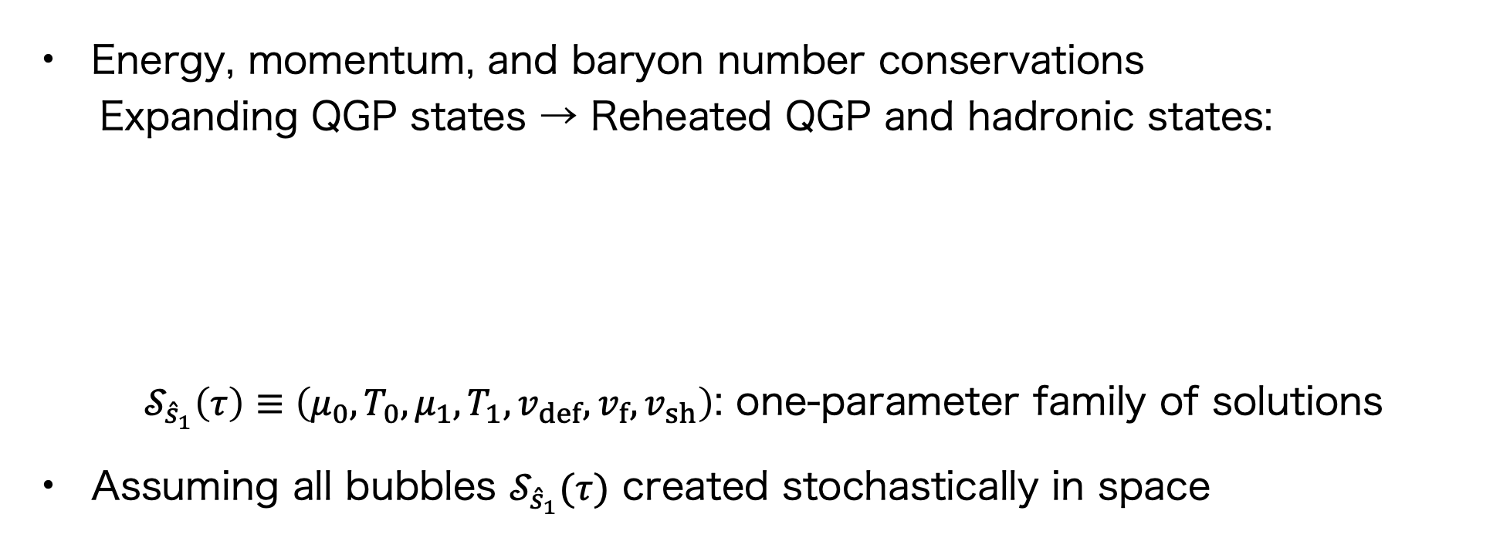









Hydrodynamic matching
Energy, momentum, and baryon number conservations
Expanding QGP states → Reheated QGP and hadronic states:
$𝒮_{{\hat{s}}_{1}}\left(τ\right)≡\left(μ_{0},T_{0},μ_{1},T_{1},v_{def},v_{f},v_{sh}\right)$: one-parameter family of solutions
Assuming all bubbles $𝒮_{{\hat{s}}_{1}}(τ)$ created stochastically in space
3 eqs.
3 eqs.
$$H$$
$$Q_{1}$$
$$Q_{2}$$
$$(μ_{2}(τ),T_{2}(τ))$$
$${\hat{s}}_{1}(≥{\hat{s}}_{2})$$
$$(μ_{1},T_{1})$$
$$(μ_{0},T_{0})$$
$$(μ_{0},T_{0})$$
$$(μ_{1},T_{1})$$
$$(μ_{2},T_{2})$$
$$v_{sh},v_{f}$$
$$v_{def}$$
$$v_{def}$$
$$v_{f}$$
$$v_{sh}$$

Slide 6
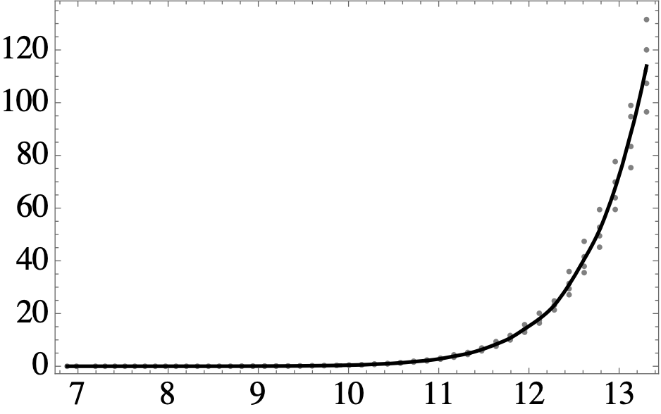
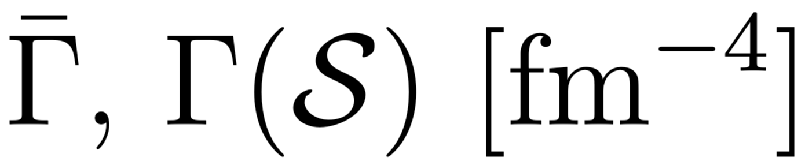
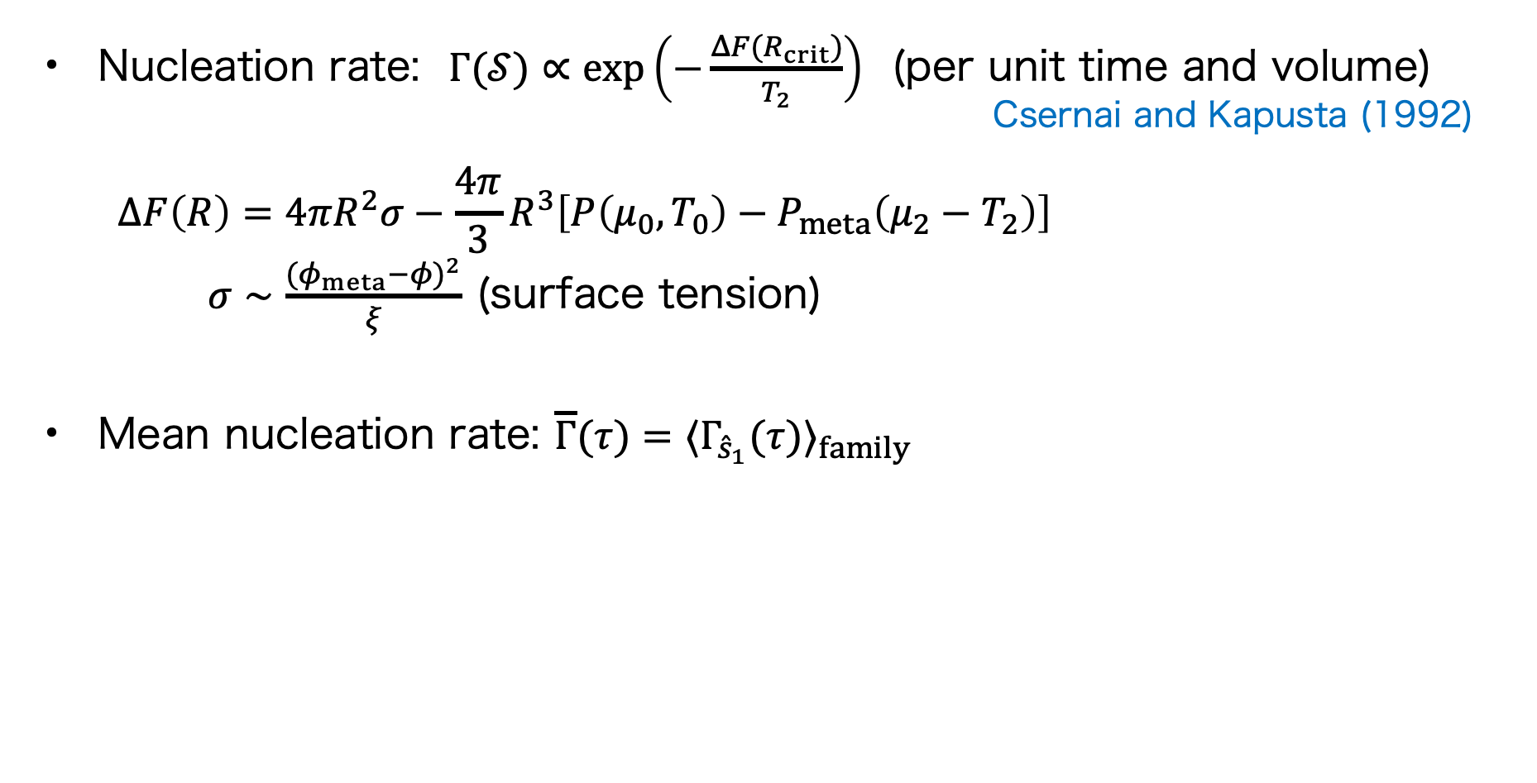



Nucleation rate
Nucleation rate: $Γ(𝒮)∝exp\left(−\frac{ΔF(R_{crit})}{T_{2}}\right)$ (per unit time and volume)
Csernai and Kapusta (1992)
$$ΔF\left(R\right)=4πR^{2}σ−\frac{4π}{3}R^{3}\left[P\left(μ_{0},T_{0}\right)−P_{meta}\left(μ_{2}−T_{2}\right)\right]$$
$σ∼\frac{(φ_{meta}−φ)^{2}}{ξ}$ (surface tension)
Mean nucleation rate: $\overline{Γ}(τ)=⟨Γ_{{\hat{s}}_{1}}(τ)⟩_{family}$
$$P(μ_{0},T_{0})$$
$$P_{meta}(μ_{2},T_{2})$$
$$τ [fm/c]$$

Slide 7
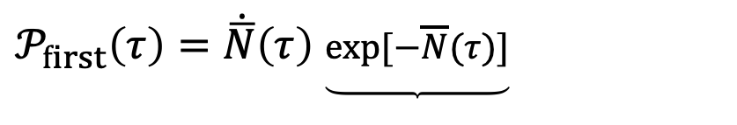



First nucleation
Total nucleation: $\overline{N}(τ)≡∫_{τ_{2c}}^{τ}dτ^{′}\overline{Γ}(τ^{′})V_{tot}(τ^{′}),$ $V_{tot}(τ)=πR_{sys}^{2}τΔη$
$\left(R_{sys}=4 fm, τ=5 fm/c, Δη=0.5 fm\right)$
The first nucleation probability density:
The first nucleation time: ${\dot{𝒫}}_{first}(τ_{first})=0$
$𝒫_{first}\left(τ\right)=\dot{\overline{N}}\left(τ\right)$ $\underset{ }{\underbrace{exp[−\overline{N}(τ)]}}$
Nucleation at $τ$
No nucleation until $τ$

Slide 8
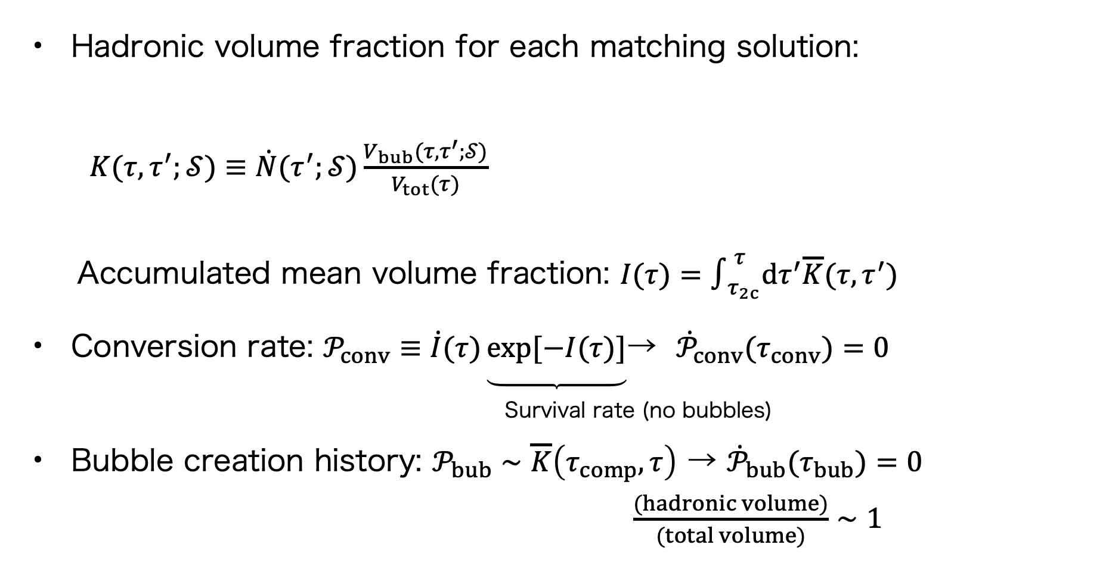




Bubble growth and conversion dynamics
See also Kolmogorov (1937), Johnson and Mehl (1939), Avrami (1939)
Hadronic volume fraction for each matching solution:
$K(τ,τ^{′};𝒮)≡\dot{N}(τ^{′};𝒮)\frac{V_{bub}(τ,τ^{′};𝒮)}{V_{tot}(τ)}$
Accumulated mean volume fraction: $I(τ)=∫_{τ_{2c}}^{τ}dτ^{′}\overline{K}(τ,τ^{′})$
Conversion rate: $𝒫_{conv}≡\dot{I}(τ)\underset{ }{\underbrace{exp[−I(τ)]}}$ → ${\dot{𝒫}}_{conv}(τ_{conv})=0$
Survival rate (no bubbles)
Bubble creation history: $𝒫_{bub}∼\overline{K}\left(τ_{comp},τ\right)$ → ${\dot{𝒫}}_{bub}(τ_{bub})=0$
$\frac{(hadronic volume)}{(total volume)}∼1$
$$τ$$
$$τ^{′}$$
$$\dot{N}$$
$$R_{bub}(τ,τ^{′};𝒮)=v_{def}(𝒮)(τ−τ^{′})$$

Slide 9
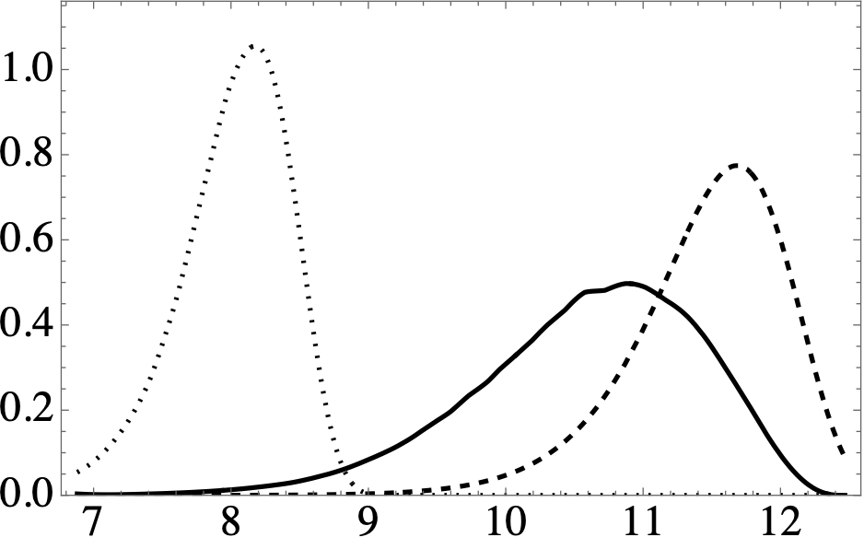
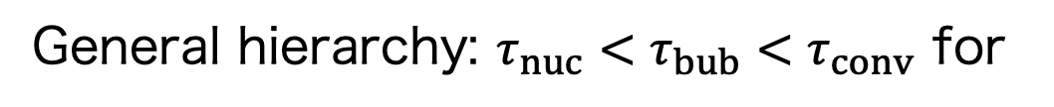


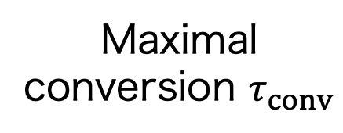
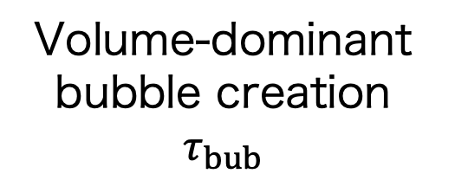
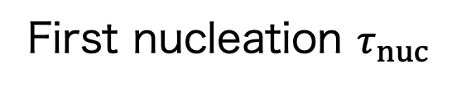
Three characteristic stages
NS, Stephanov, Yee (in preparation)
Volume-dominant bubble creation $τ_{bub}$
First nucleation $τ_{nuc}$
Maximal conversion $τ_{conv}$
$$𝒫_{first},𝒫_{bub},𝒫_{conv} [{fm}^{−1}]$$
$$τ [fm/c]$$
BEST EOS
Bag model
General hierarchy: $τ_{nuc}<τ_{bub}<τ_{conv}$ for

Slide 10
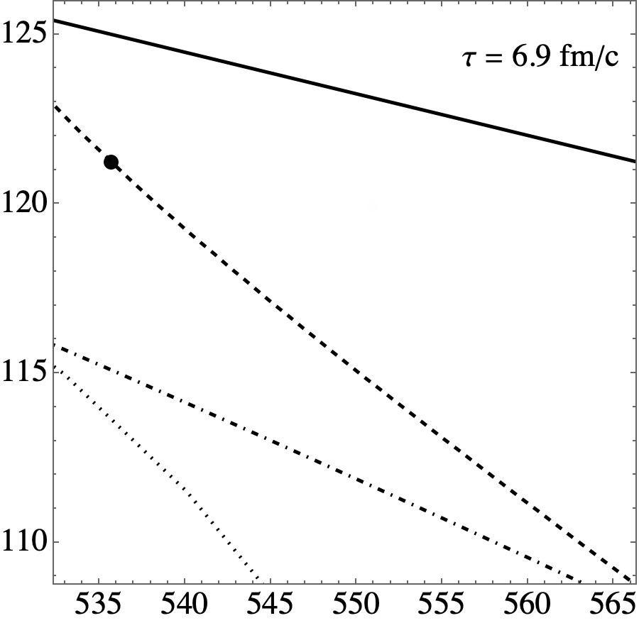
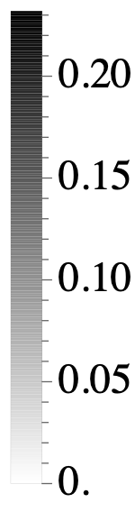
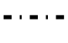










Hadronic state distribution
NS, Stephanov, Yee (in preparation)
$$𝒲(τ,μ,T)∼∫_{τ_{2c}}^{τ}dτ^{′}{⟨K(τ,τ^{′};𝒮)δ(μ−μ_{0}^{(𝒮)}(τ^{′}))δ(T−T_{0}^{(𝒮)}(τ^{′}))⟩}_{family}$$
$$𝒲$$
Phase transition
$Q_{2}$ Bjorken evolution
Freeze-out curve
$$T [MeV]$$
Metastable boundary
BEST EOS
$$μ_{c}=450MeV$$
$$T_{c}=136MeV$$
$$α_{1}=7^{∘}$$
$$α_{2}=−5^{∘}$$
$$ρ=1.0$$
$$w=0.5$$
$$μ [MeV]$$
(Animation available in the PowerPoint version)

Slide 11
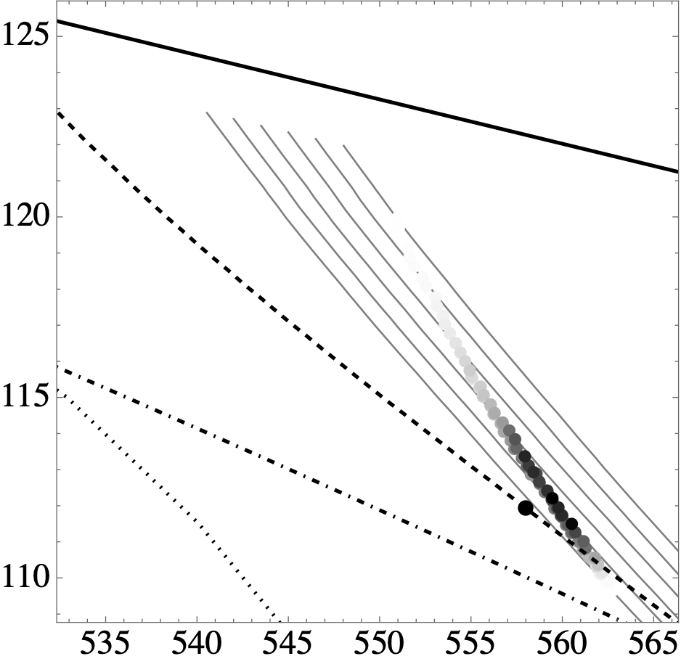
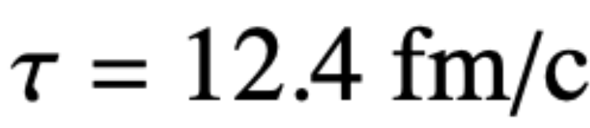
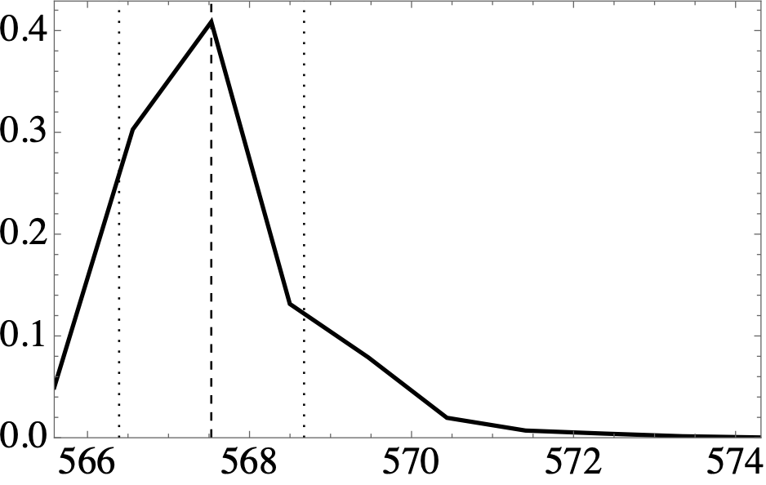




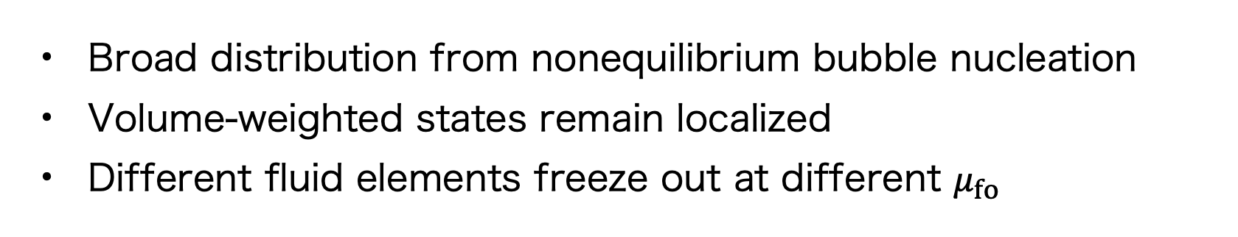

Hadronic state evolution
NS, Stephanov, Yee (in preparation)
$$𝒲(τ_{comp},μ,T)$$
$$T [MeV]$$
$$𝒲_{proj.}(τ_{comp},μ_{fo})$$
$$μ_{fo}$$
$$μ [MeV]$$
Broad distribution from nonequilibrium bubble nucleation
Volume-weighted states remain localized
Different fluid elements freeze out at different $μ_{fo}$

Slide 12
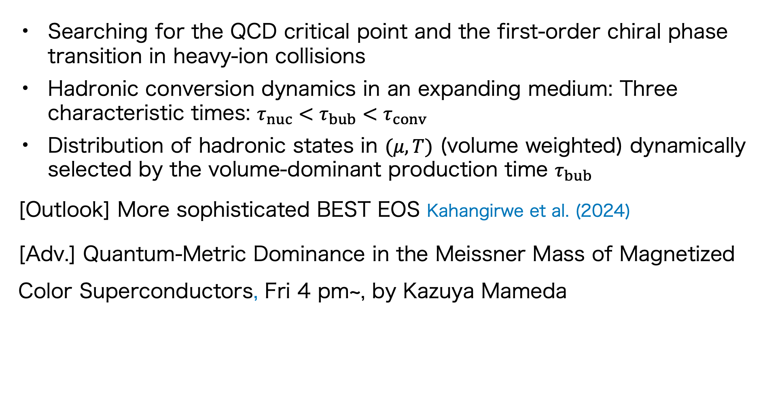
Summary and Advertisment
NS, Stephanov, Yee (in preparation)
Searching for the QCD critical point and the first-order chiral phase transition in heavy-ion collisions
Hadronic conversion dynamics in an expanding medium: Three characteristic times: $τ_{nuc}<τ_{bub}<τ_{conv}$
Distribution of hadronic states in $(μ,T)$ (volume weighted) dynamically selected by the volume-dominant production time $τ_{bub}$
[Outlook] More sophisticated BEST EOS Kahangirwe et al. (2024)
[Adv.] Quantum-Metric Dominance in the Meissner Mass of Magnetized Color Superconductors, Fri 4 pm~, by Kazuya Mameda

