Slide 1



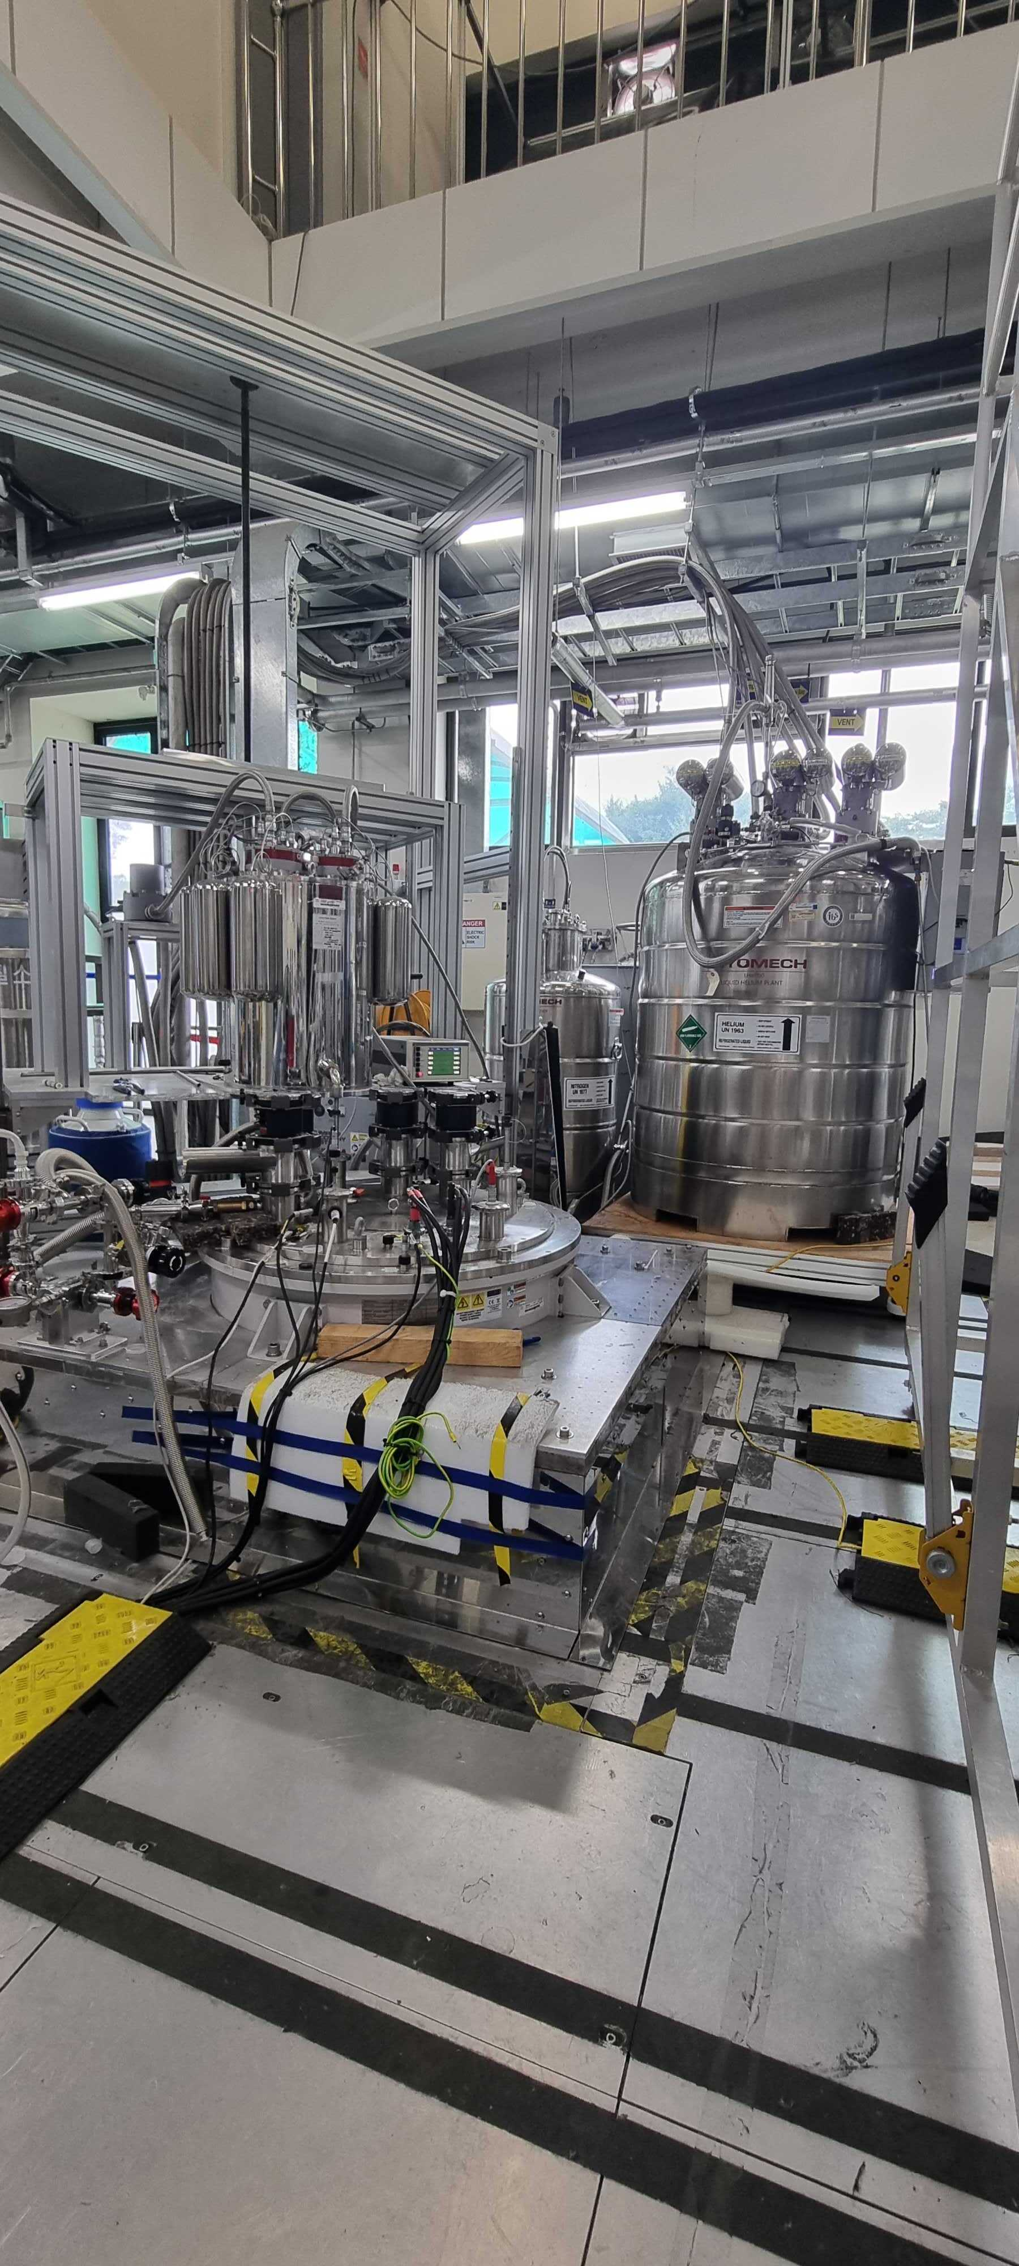



Haloscope Axion Search Experiments at Dark Matter Axion Group
Boris Ivanov ¹ on behalf of DMAG
¹Dark Matter Axion Group, Institute for Basic Science, Daejeon, South Korea
in collaboration with
Arjan F. van Loo ^{2,3} and Yasunobu Nakamura ^{2,3}
²RIKEN Center for Quantum Computing (RQC),
³Department of Applied Physics, The University of Tokyo
Notes:
AHN Saebyeok ¹, UCHAIKIN Sergey V.¹, KWON Ohjoon ¹, YOUN SungWoo *

Slide 2
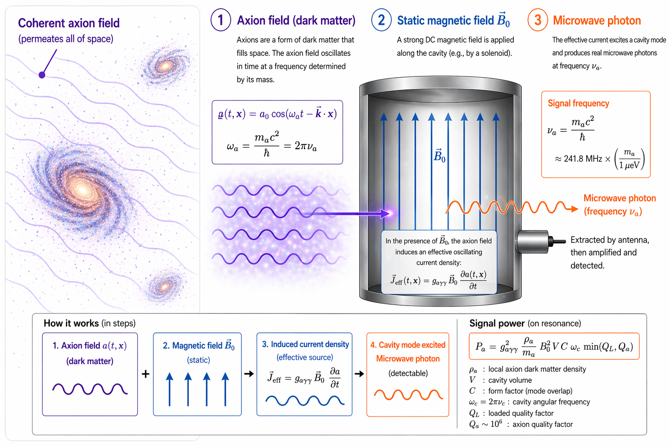
AXION GENERATION PRINCIPLE
Notes:
Axion dark matter permeates space. The axion field oscillates in time at a frequency set by its mass.

Slide 3
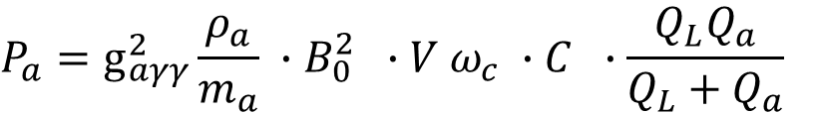
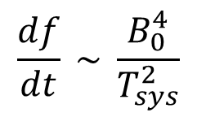
AXION GENERATION PRINCIPLE
Magnet
Cavity
$$P_{a}=g_{aγγ}^{2}{\frac{ρ_{a}}{m_{a}} ∙B}_{0}^{2} ∙V ω_{c} ∙C ∙\frac{Q_{L}Q_{a}}{Q_{L}+Q_{a}}$$
$$\frac{df}{dt} \sim \frac{B_{0}^{4}}{T_{sys}^{2}}$$
Notes:
Grenoble, resis tive-hybrid magnet with 35 T

Slide 4
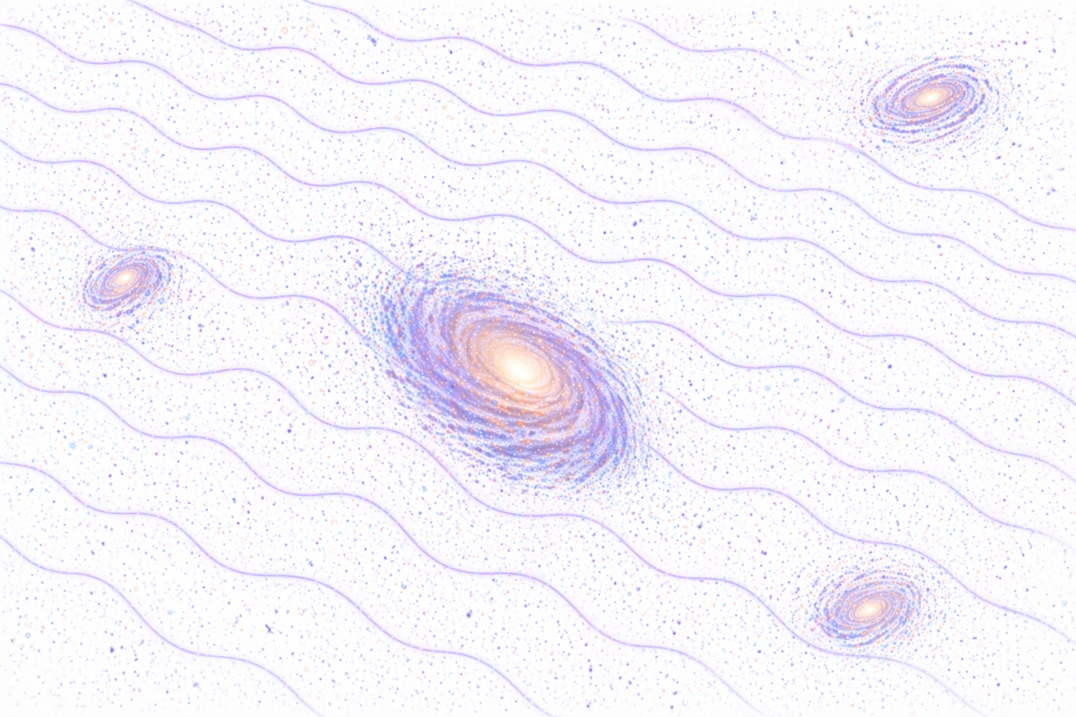
OUTLINE
Axion scanning systems
Superconducting magnet
Cavity design
Quantum-noise-limited amplifiers
Preliminary Axion search results
Notes:
Here is the outlie of my talk. First I would like to show the axion haloscope experiment proposed by Sikivie, than I will show you the current quantum noise limited amplifier readout for the experiment, next I will mention about the single photon detector based on the underdamped Josephson junction. After it I will explain the main idea of using the Josephson junction as a microwave photon detector, where I will remind you about the washboard potential. Next, the CBJJ as a single photon counter will be show with the main parameters and the measurement setup. And as a final I will show you the main diagram of the axion measurement system based on the CBJJ.

Slide 5
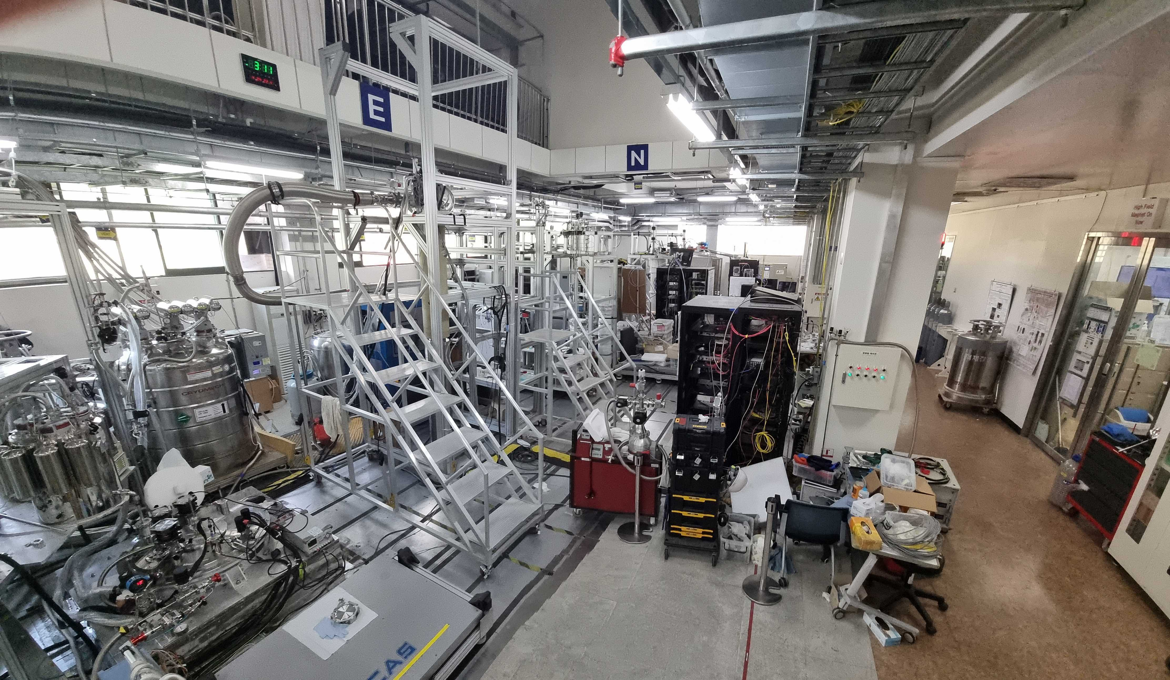
Axion scanning systems
DMAG-12TB
⁴He
Liquefier
³He/ ⁴He DR
from Leiden
DMAG-8TB
⁴He
Re-liquefier
DMAG-8T
DMAG-12T
DMAG-QS
12T magnet
Oxford Instruments
Notes:
Here is the outlie of my talk. First I would like to show the axion haloscope experiment proposed by Sikivie, than I will show you the current quantum noise limited amplifier readout for the experiment, next I will mention about the single photon detector based on the underdamped Josephson junction. After it I will explain the main idea of using the Josephson junction as a microwave photon detector, where I will remind you about the washboard potential. Next, the CBJJ as a single photon counter will be show with the main parameters and the measurement setup. And as a final I will show you the main diagram of the axion measurement system based on the CBJJ.

Slide 6
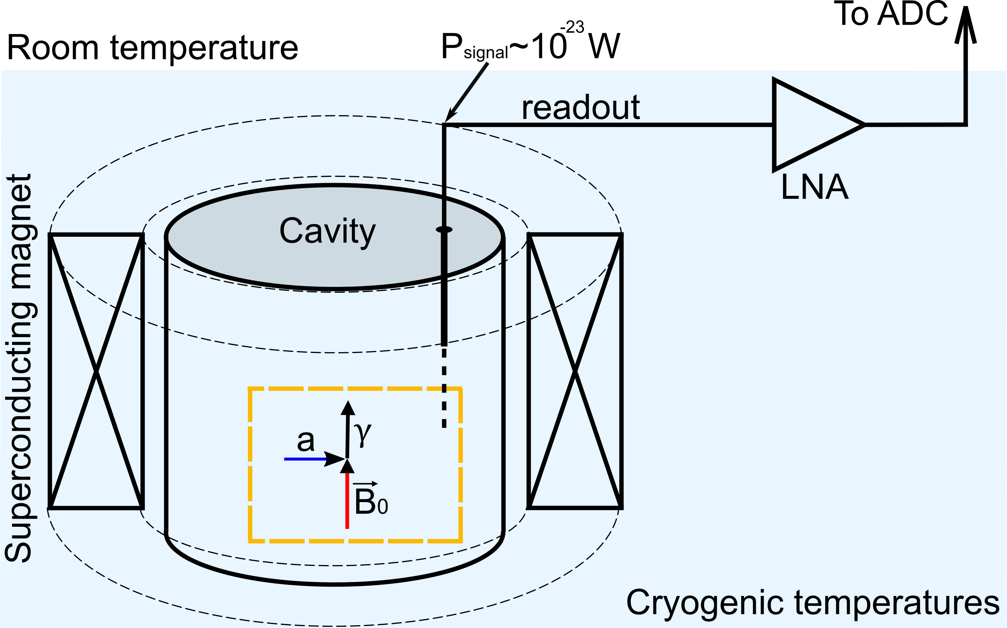



Haloscope search experiment
The axion search haloscope principal proposed by Sikivie [1]
$$P_{a}^{γγ}=22.51×{10}^{−24} [W] {\left(\frac{g_{γ}}{0.36}\right)}^{2}{\left(\frac{B_{avg}}{10.55 T}\right)}^{2}\left(\frac{V}{31 L}\right)\left(\frac{C}{0.5}\right)\left(\frac{Q_{L}}{35000}\right)\left(\frac{ν}{1.4 GHz }\right)$$
Axion photon conversion power:
Magnet
Cavity
[1] P. Sikivie, Phys. Rev. Lett. 1983, 51, 1415.
Notes:
- The experiment was proposed by Sikivie
Typical microwave detectors are based on linear ampliﬁers, that however have an irreducible noise level even at zero temperature, coming from quantum ﬂuctuations of the vacuum.
This quantum limit is now being reached by the most advanced detectors of this type (e.g. Josephson Parametric Ampliﬁers), and the truly frontier at this moment is deﬁning strategies to overcome this limit.

Slide 7
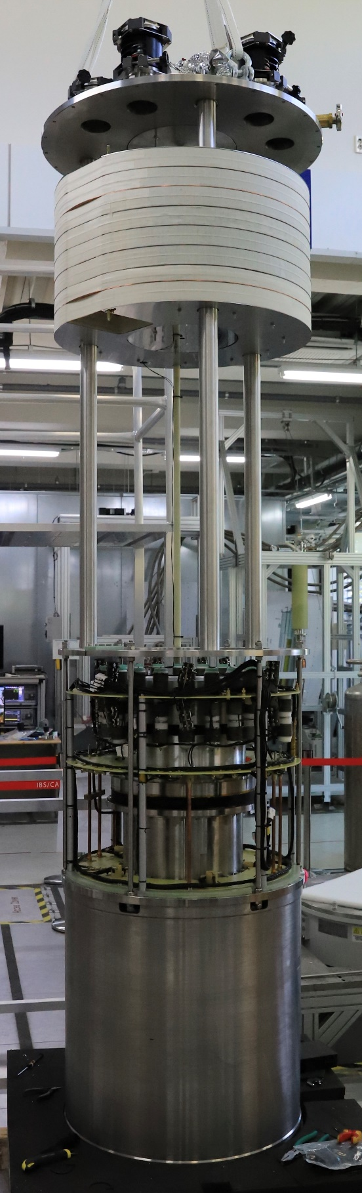
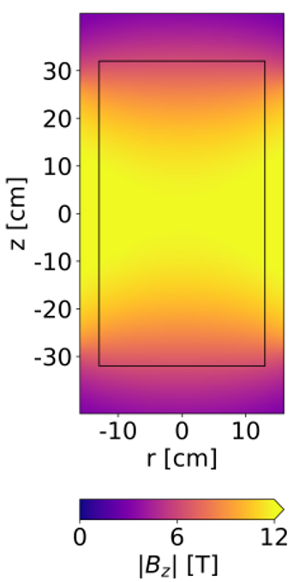
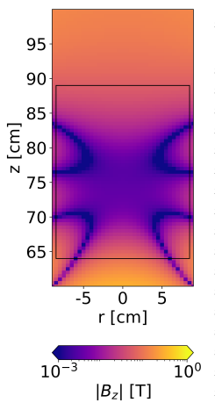
12T Big-bore superconducting magnet
$$P_{a}^{aγγ}=22.51×{10}^{−24} [W] {\left(\frac{g_{γ}}{0.36}\right)}^{2}{\left(\frac{B_{avg}}{10.55 T}\right)}^{2}\left(\frac{V}{31 L}\right)\left(\frac{C}{0.5}\right)\left(\frac{Q_{L}}{35000}\right)\left(\frac{ν}{1.4 GHz }\right)$$
The magnetic field maps in the cavity region
The magnetic field maps in the cancelation region
Superconducting “wet” magnet^{[2]}:
Two different low-temperature superconductors: Nb3Sn for the inner coil and NbTi for the outer one;
12 T cylindrical magnet;
320 mm bore diameter.
MICROWAVE CAVITY RESONATOR!
12T
10⁻³T
The field cancellation region:
750 mm above the center of the magnet.
Less than 100 G
[2] https://www.oxinst.com.
Notes:
The FOM in axion haloscope searches is dominated by the strength and volume of the magnet, making it the key factor in CAPP-MAX.
Our superconducting magnet, classified as “wet,” necessitates direct contact with liquid helium (LHe) to keep the coils in the superconducting state. Its main characteristics are the following three:
The cylindrical magnet used in our experiment, manufactured by Oxford Instruments [51], can operate at a central magnetic field of 12 T when cooled to a temperature of 4.2 K using LHe. In Figure 1, the magnetic field map in the cavity region is shown in the plot on the left
The solenoidal magnet used in CAPP-MAX has a cold bore diameter of 320 mm. The magnet is composed of two different low-temperature superconductors: Nb3Sn for the inner coil and NbTi for the outer one. These coils are nested together to form a concentric solenoid. The inner coil has a length of 560 mm, while the outer has a length of 640 mm. Considering the dimensions of the coil and the radiation shields of the dilution refrigerator
The average root mean square (rms) magnetic field along the magnet axis over this volume measures 10.55 T.
3. The field cancellation region, located 750 mm above the center of the magnet, with dimensions 100 mm in both diameter and length in cylindrical coordinates. Within this region, the magnetic fields generated are weaker than 100 G, as illustrated on the right of Figure 2. The presence of this cancellation region is of utmost importance for ensuring the proper operation of the Quantum noise limited amplifiers, which serves as the initial stage RF-amplifier, as well as for the required microwave circulators and other RF components in the setup.

Slide 8



Notes:
Axion haloscope experiments aim to directly identify axions in the dark matter halo of our galaxy by exploiting the fact that axions transform into photons when exposed to an external magnetic field. Since it is predicted that the conversion power of the axion is extremely low, approximately ${10}^{−22}$ W^{[1]}, haloscope is required to be very sensitive.
Axion search experiments are desire to resolve fundamental questions in physics: the strong CP problem and the nature of dark matter. One of the leading experiments is the CAPP-MAX experiment at the Center for Axion and Precision Physics Research (CAPP) of Institute for Basic Science (IBS) in South Korea.
This experiment featuring a 12 T big bore (32 cm) Nb3Sn superconducting magnet, 37-liter cylinder copper cavity and a state-of-the-art microwave readout system based on Josephson Parametric Amplifier (JPA) that approaches the quantum noise limit.
We show the technical details of the detector chain, features of the dilution refrigerator immersed into the liquid He dewar, and the operation of the closed cycle helium recovery system.
The system temperature is kept near to 25 mK, which is the lowest temperature of any axion experiment to date.
Recent advances in low noise amplifier technology have opened up new possibilities for exploring a wide range of plausible axion masses with high sensitivity.
Our results demonstrate the potential of the CAPP-MAX experiment to significantly improve the speed of axion dark matter search and contribute to a deeper understanding of the universe's fundamental nature.
In this presentation, we provide the technical details of the CAPP-MAX experiment, discuss the current status of the experiment, and outline future plans.
Fig.1 description:
It exploits the axion-photon coupling gaγγ in a microwave cavity permeated with a static magnetic field B0, which results in resonant conversions of axions to photons when the axion mass m a matches the frequency of the cavity mode ν.

Slide 9
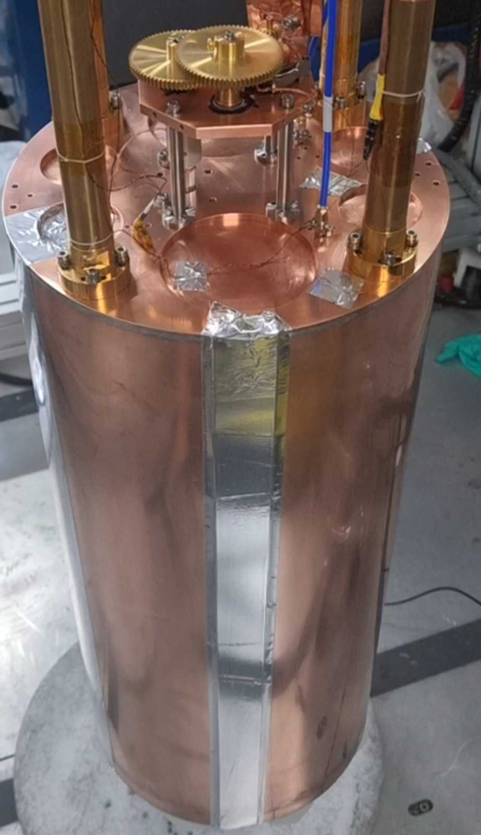
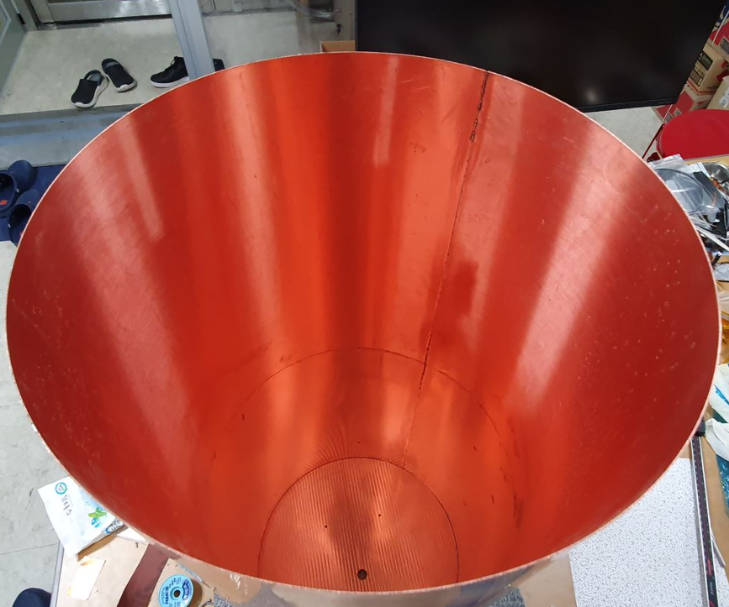
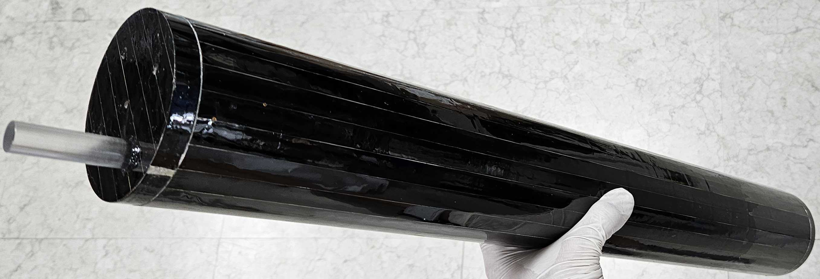
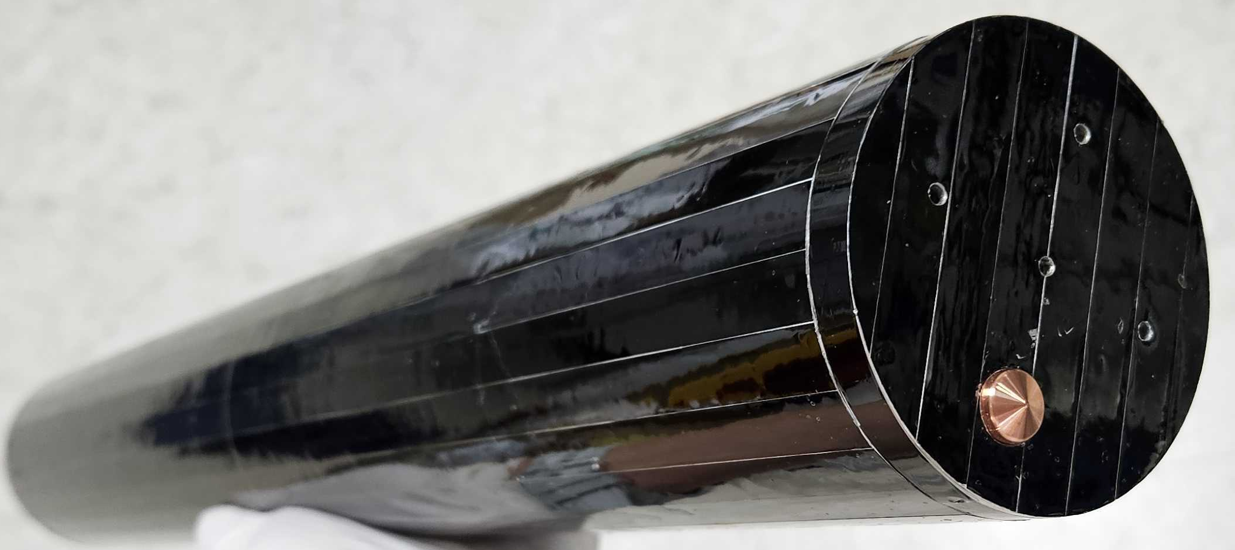
31 L Ultra-light microwave cavity (ULC) resonator
$$P_{a}^{aγγ}=22.51×{10}^{−24} [W] {\left(\frac{g_{γ}}{0.36}\right)}^{2}{\left(\frac{B_{avg}}{10.55 T}\right)}^{2}\left(\frac{V}{31 L}\right)\left(\frac{C}{0.5}\right)\left(\frac{Q_{L}}{35000}\right)\left(\frac{ν}{1.4 GHz }\right)$$
Cavity
ULC features:
Cavity outer diameter: 274 mm; defined by the thermal shields of dilution refrigerator;
Frequency range from 1.2 to 1.5 GHz;
Superconducting rod based on the Fujikura tape;
Unloaded Q-factor 95 000 - 150 000;
Low weight (totally ~ 5 kg);
OFHC copper for cavity walls and tuning rod;
Gear box for the tuning rod;
ANC 350 piezo controller for both gear box and cavity antenna coupling tuning;
Notes:
The modes relatively sensitive to the rotation of the rod around its axis are identified as labeled, from the simulated modes overlapped with them.

Slide 10
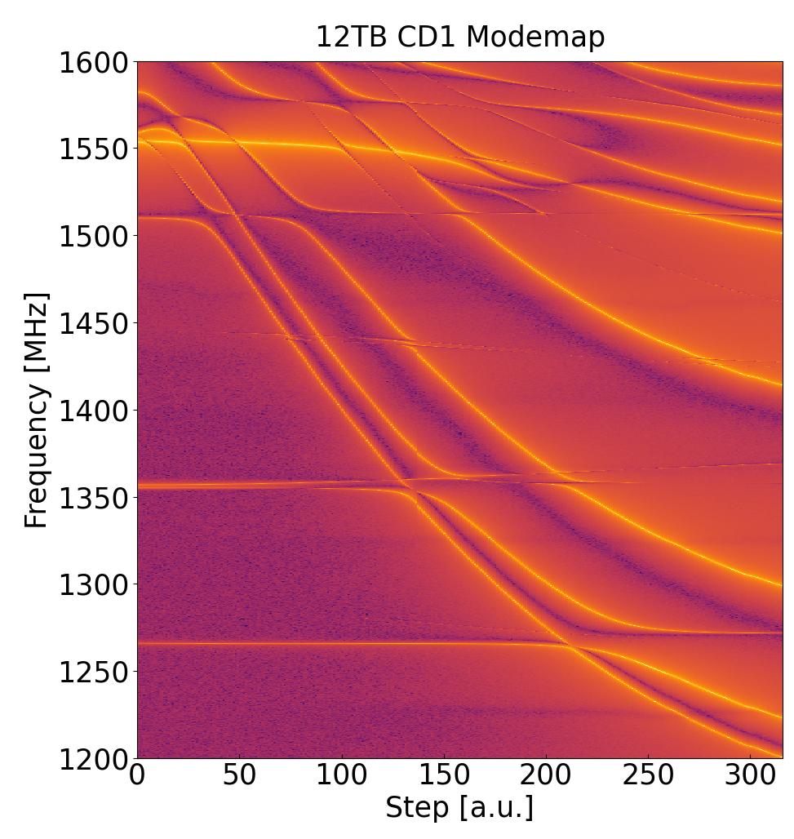
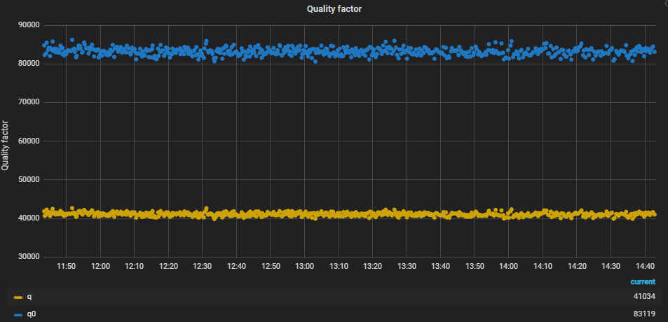
ULC mode map at 4K and 0T
Loaded and unloaded quality factor at 40 mK and 12T
TM010
Notes:
The modes relatively sensitive to the rotation of the rod around its axis are identified as labeled, from the simulated modes overlapped with them.

Slide 11
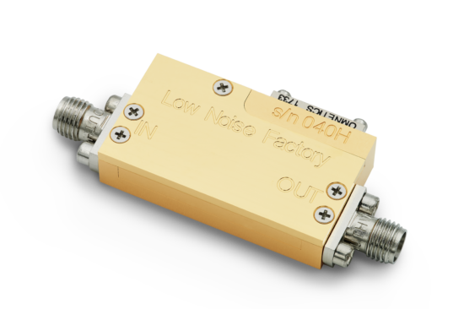

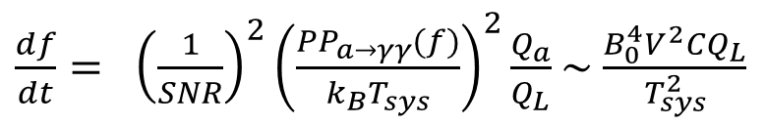
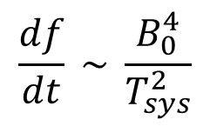

High electron mobility transistor amplifier (HEMT)
G ~ 30 dB,
T_{n} < 4 K.
Scanning rate
$\frac{df}{dt}= {\left(\frac{1}{SNR}\right)}^{2}{\left(\frac{PP_{a→γγ}(f)}{k_{B}T_{sys}}\right)}^{2}\frac{Q_{a}}{Q_{L}}$ ~ $\frac{B_{0}^{4}V^{2}CQ_{L}}{T_{sys}^{2}}$
$$\frac{df}{dt} \sim \frac{B_{0}^{4}}{T_{sys}^{2}}$$
Notes:
- The experiment was proposed by Sikivie
Typical microwave detectors are based on linear ampliﬁers, that however have an irreducible noise level even at zero temperature, coming from quantum ﬂuctuations of the vacuum.
This quantum limit is now being reached by the most advanced detectors of this type (e.g. Josephson Parametric Ampliﬁers), and the truly frontier at this moment is deﬁning strategies to overcome this limit.

Slide 12
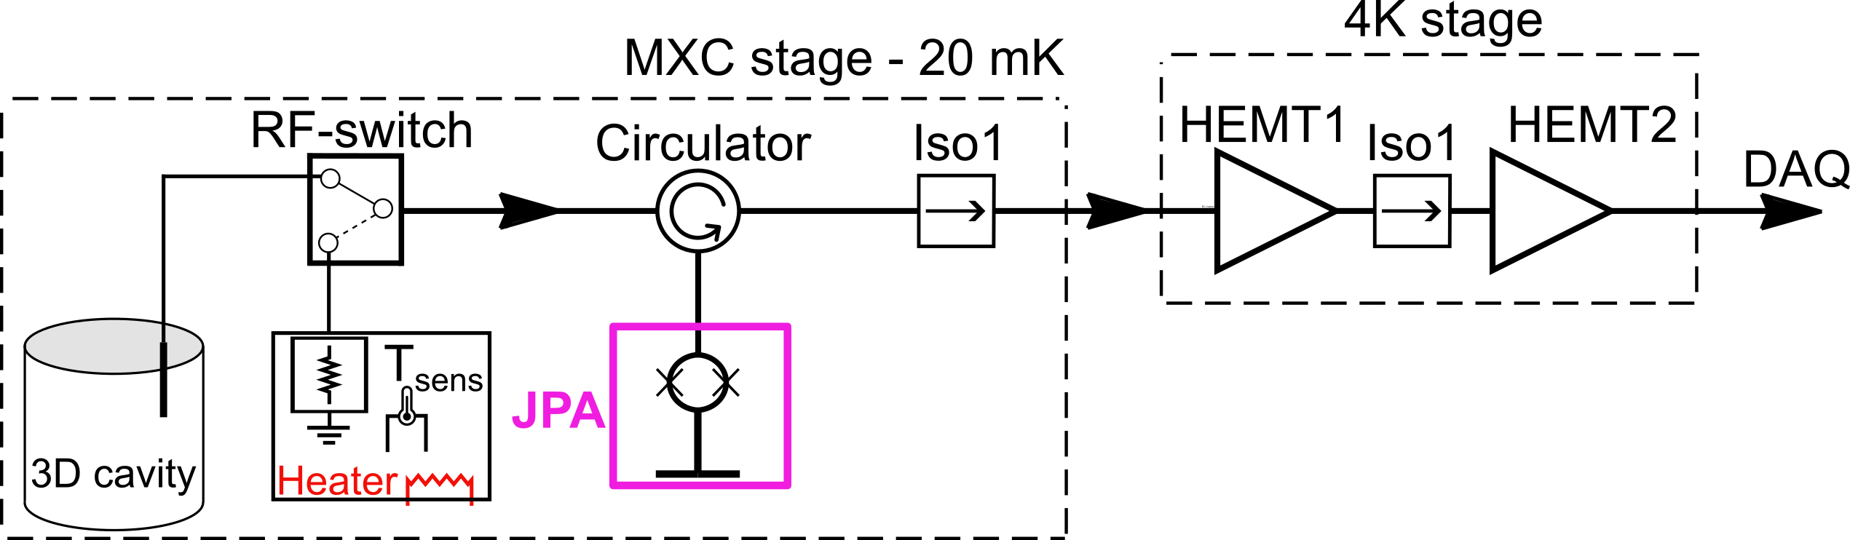



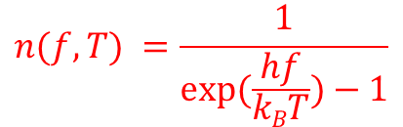
Josephson Parametric Amplifier (JPA) – quantum-noise-limited linear amplifier
Quantum-noise-limited amplifier is required
$Texp$ = 20 mK, considering the Plank expression:
$$Pn=hfn\left(f,T\right)B$$
- noise power
$$n(f,T) =\frac{1}{exp⁡(\frac{hf}{kBT})−1}$$
- Bose-Einstein mean photon number at frequency f
If we consider f = 5 GHz, and 20 mK, we obtain:
2.04 x 10⁻²⁹ W/Hz → - 256,9 dBm/Hz
$$Tsys=Ts+Tjpa+\frac{Tiso}{Gjpa}+\frac{THEMT1}{GjpaGiso}+\frac{THEMT2}{GjpaGisoGHEMT1}…$$
$Ts$- source noise
Noise source
(basically matched load)
cavity

Slide 13
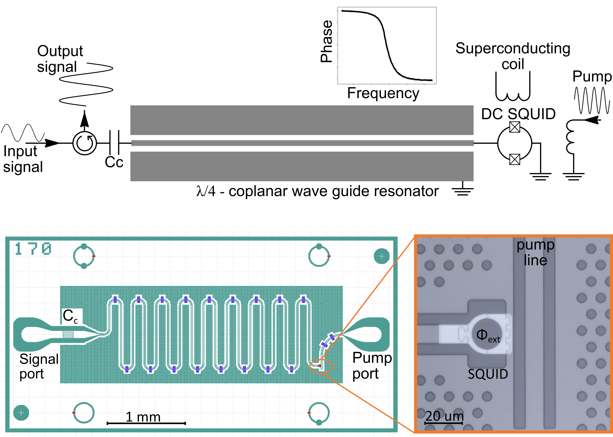
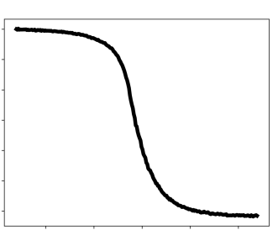
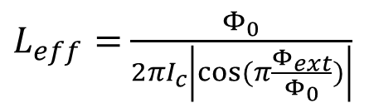
JPA - linear amplifier
$L_{eff}=$ $\frac{Φ_{0}}{2πI_{c}\left|cos⁡(π\frac{Φ_{ext}}{Φ_{0}})\right|}$
Resonator phase
Resonance frequency (GHz)
[2] S.V. Uchaikin, et al. J Low Temp Phys 216, 14-20 (2024)
[3] S.V. Uchaikin et al. Front. Phys. 12, (2024)

Slide 14
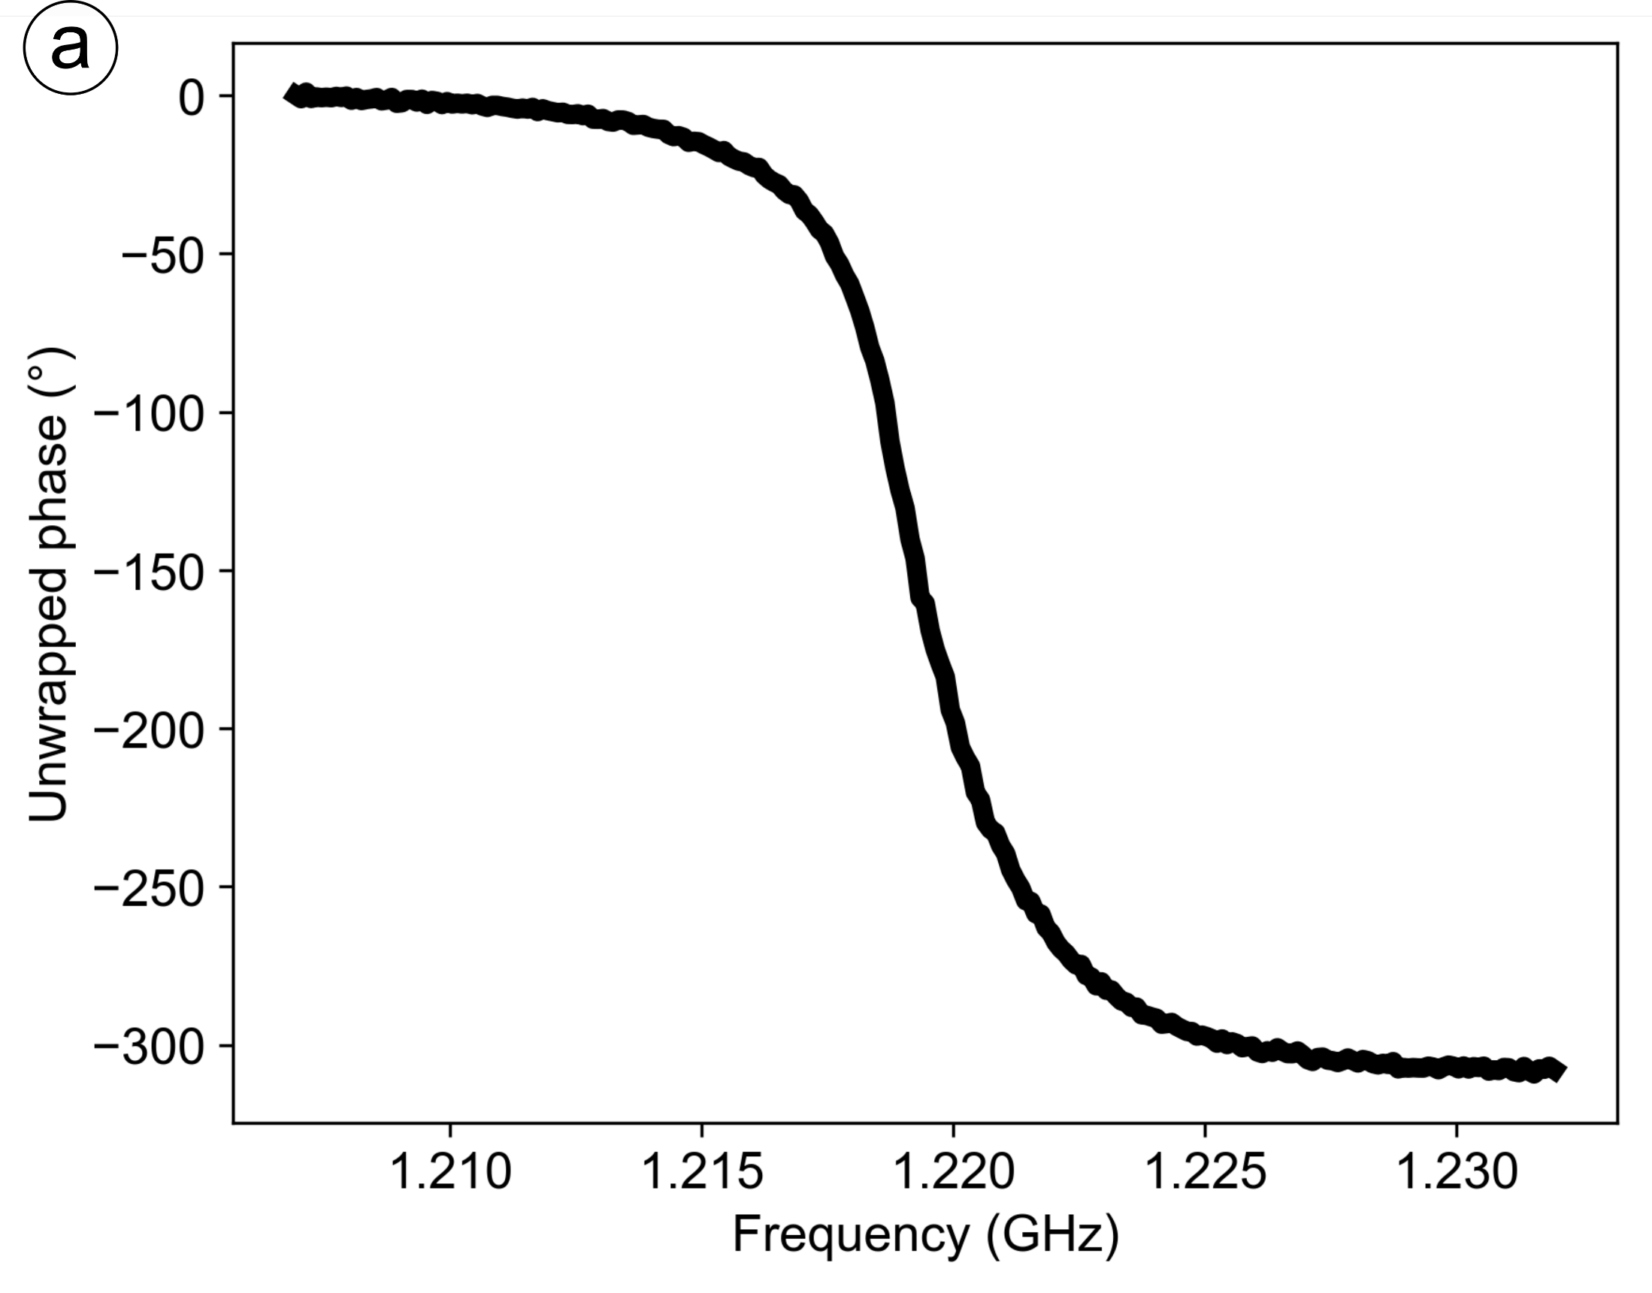
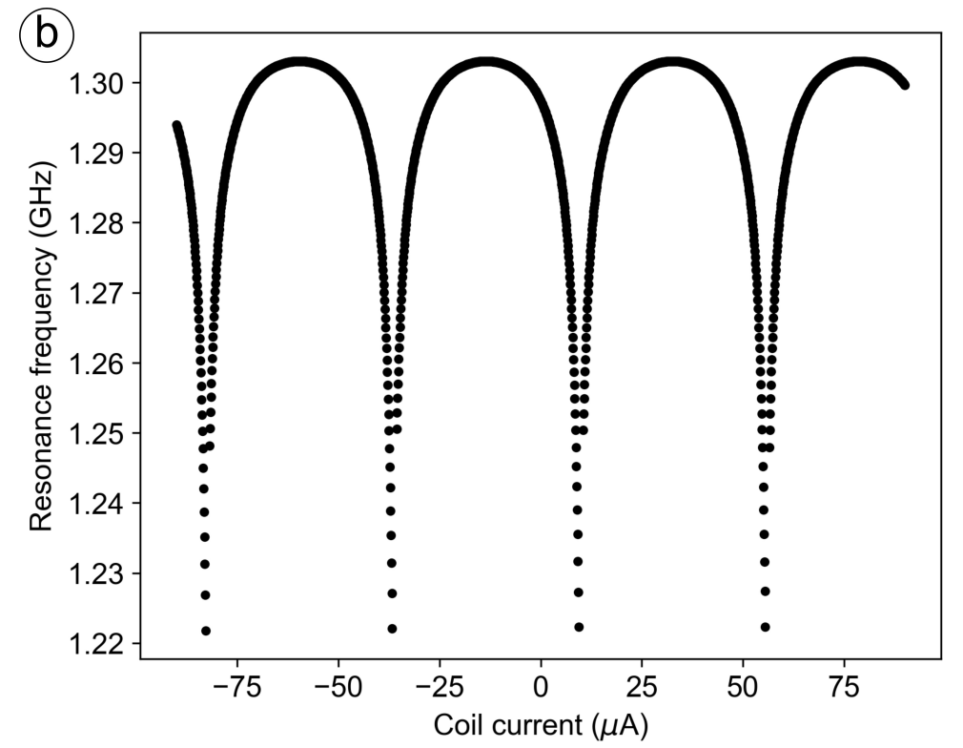
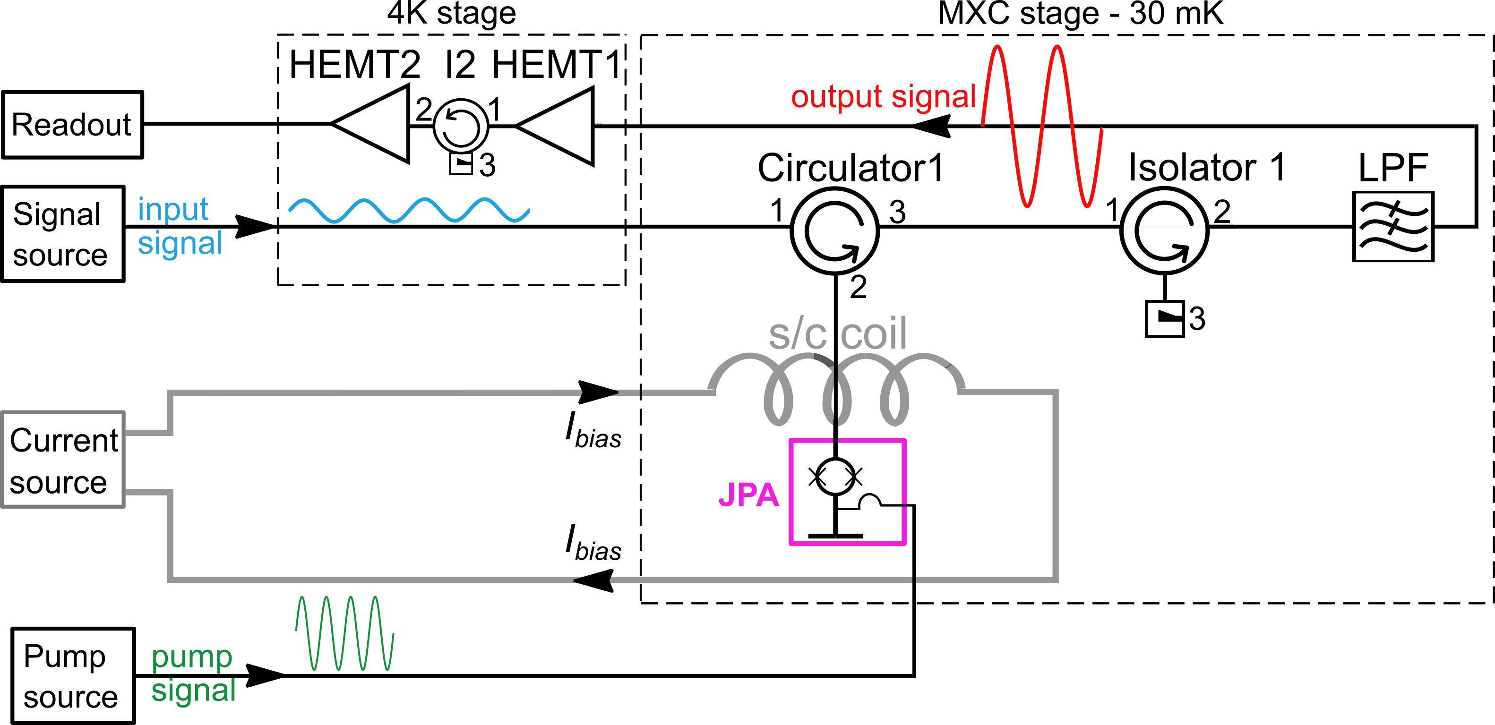
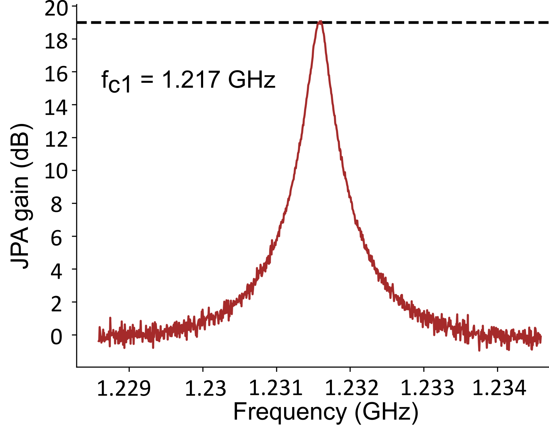
JPA - linear amplifier
[2] S.V. Uchaikin, et al. J Low Temp Phys 216, 14-20 (2024)
[3] S.V. Uchaikin et al. Front. Phys. 12, (2024)

Slide 15
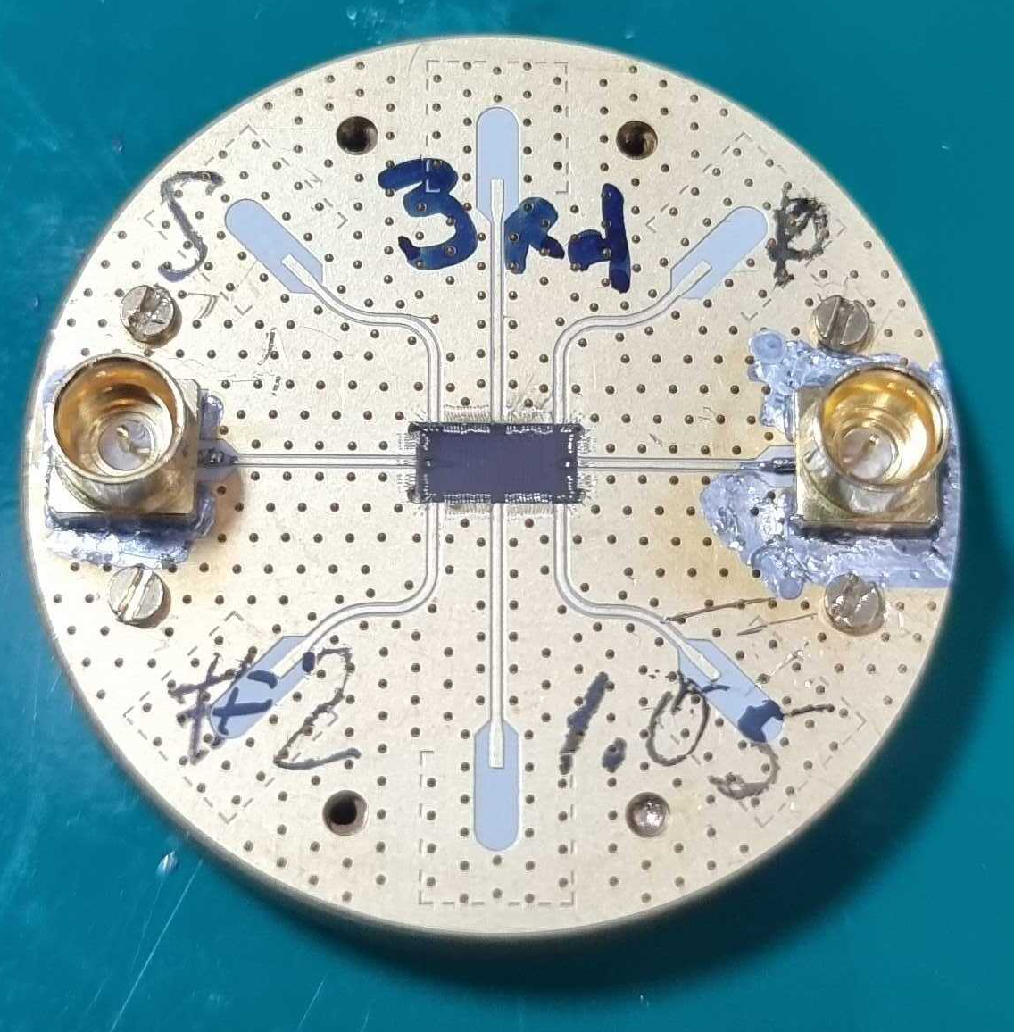
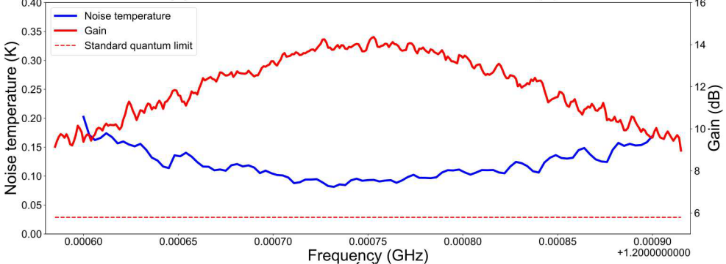
JPA - linear amplifier
Gold plated printed circuit board for the single JPA chip
60 MHz operating frequency range
vs
300 MHz
60 MHz
[2] S.V. Uchaikin, et al. J Low Temp Phys 216, 14-20 (2024)
[3] S.V. Uchaikin et al. Front. Phys. 12, (2024)

Slide 16
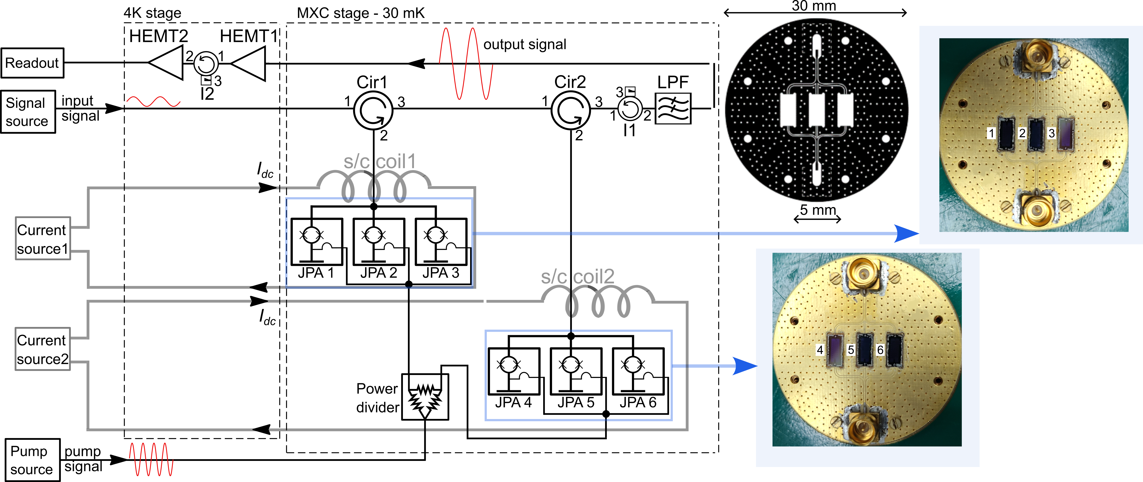
Multiple JPA configuration
[3] S.V. Uchaikin et al. Front. Phys. 12, (2024)
[4] B.I. Ivanov et al. Supercond. Sci. Technol. 39, 025011 (2026)

Slide 17
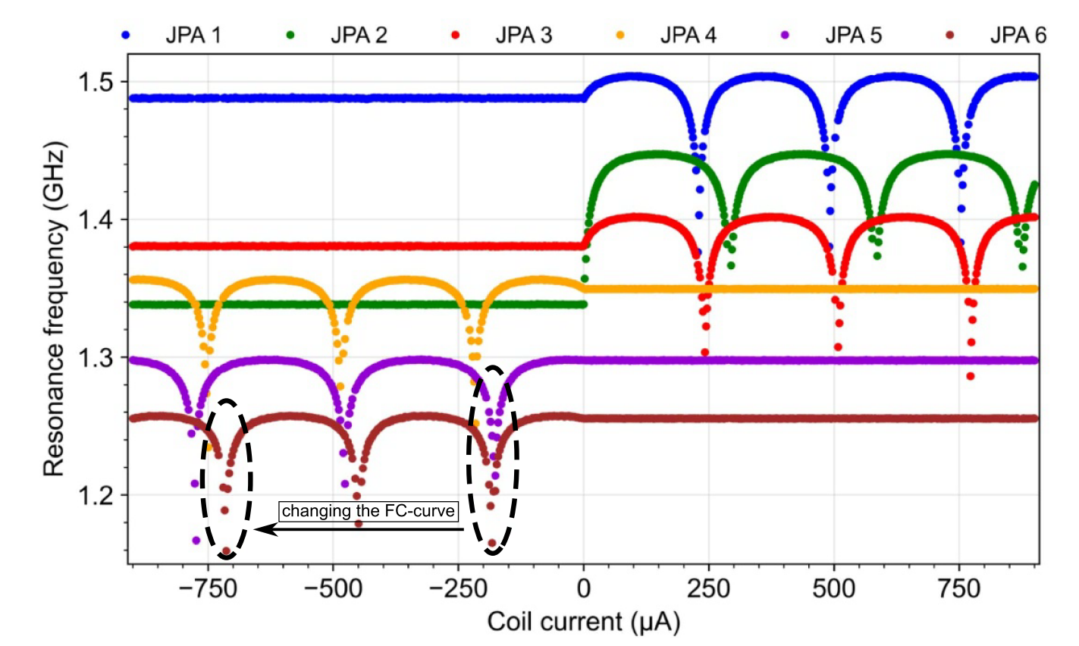
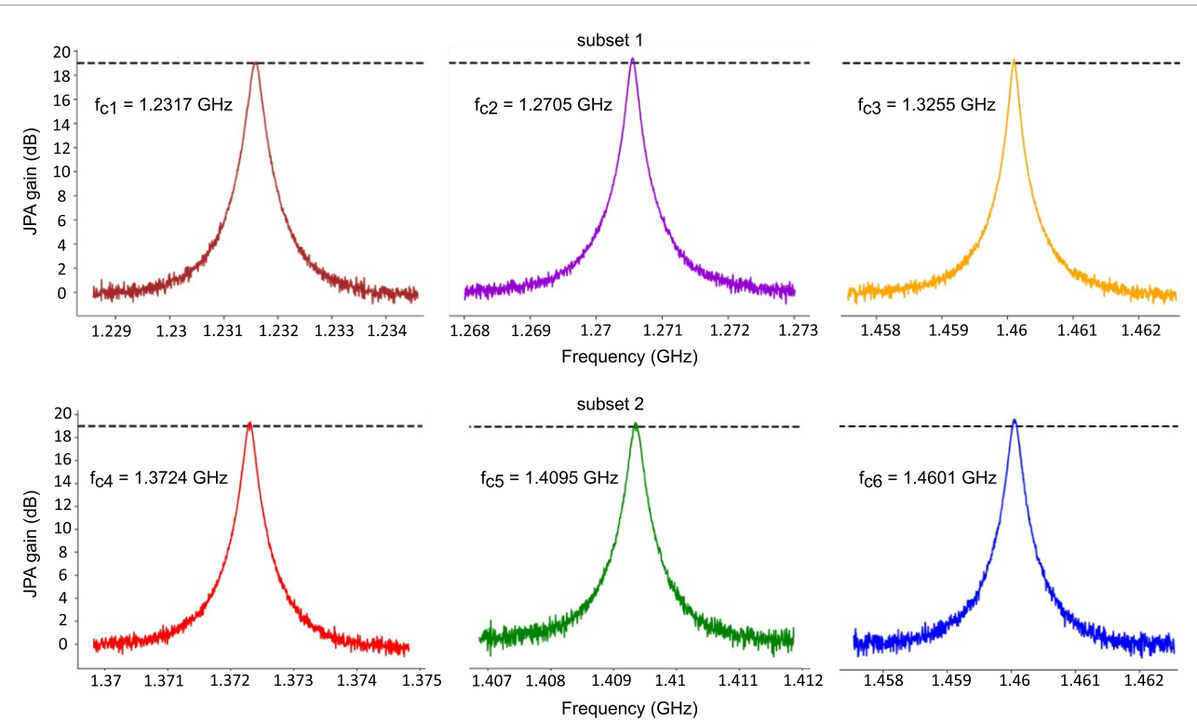
Multiple JPA configuration
[3] S.V. Uchaikin et al. Front. Phys. 12, (2024)
[4] B.I. Ivanov et al. Supercond. Sci. Technol. 39, 025011 (2026)

Slide 18
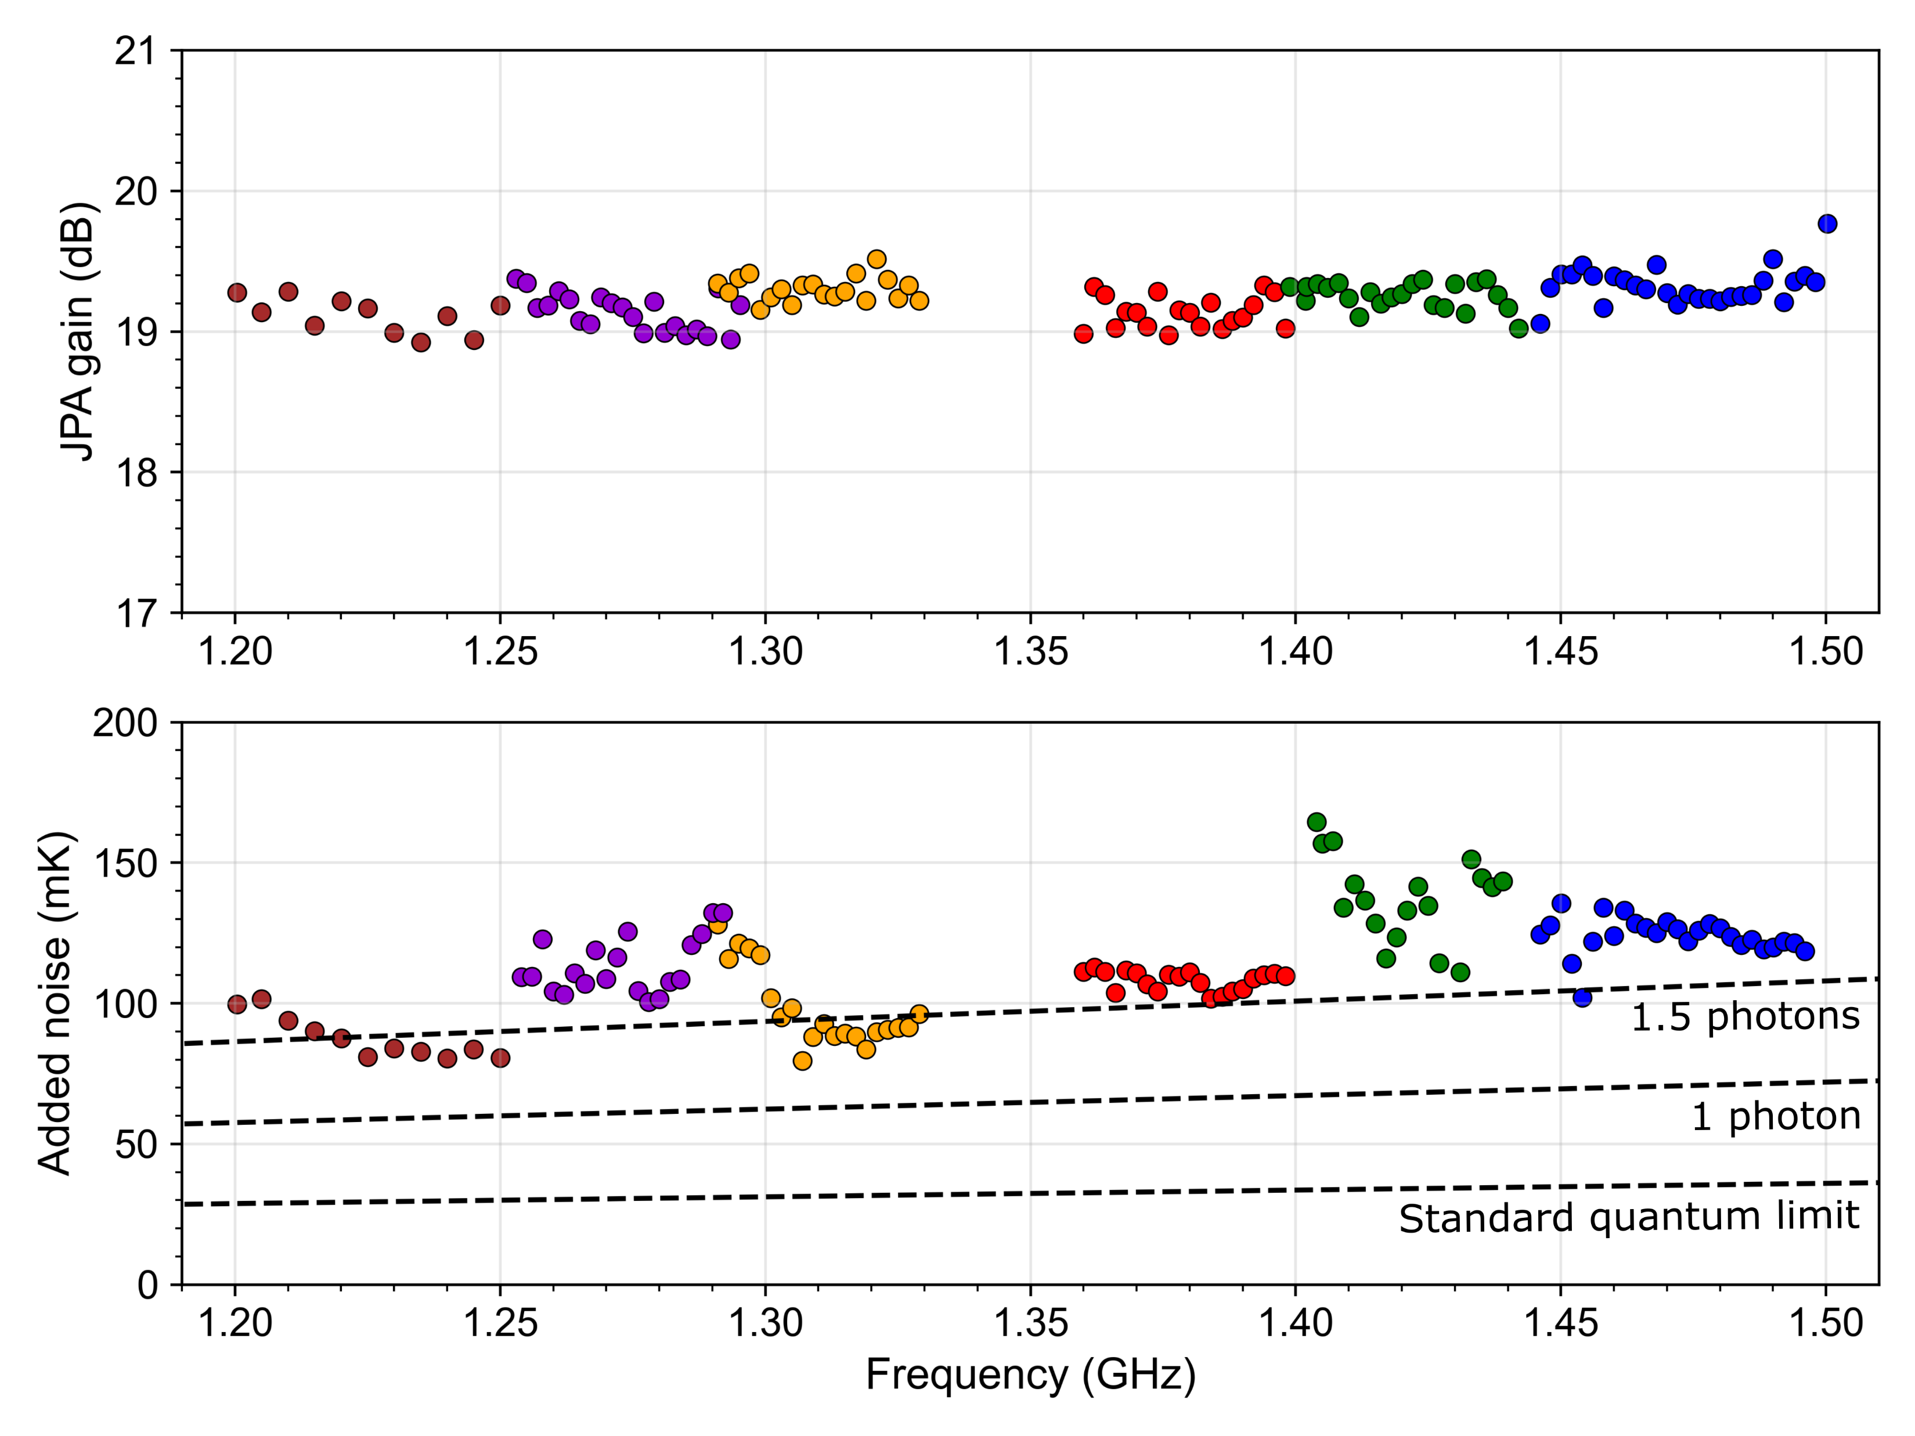

Multiple JPA configuration
JPA1
JPA2
JPA3
JPA4
JPA5
JPA6
$$\frac{hf}{k_{B}}$$
[3] S.V. Uchaikin et al. Front. Phys. 12, (2024)
[4] B.I. Ivanov et al. Supercond. Sci. Technol. 39, 025011 (2026)

Slide 19

Notes:
Axion haloscope experiments aim to directly identify axions in the dark matter halo of our galaxy by exploiting the fact that axions transform into photons when exposed to an external magnetic field. Since it is predicted that the conversion power of the axion is extremely low, approximately ${10}^{−22}$ W^{[1]}, haloscope is required to be very sensitive.
Axion search experiments are desire to resolve fundamental questions in physics: the strong CP problem and the nature of dark matter. One of the leading experiments is the CAPP-MAX experiment at the Center for Axion and Precision Physics Research (CAPP) of Institute for Basic Science (IBS) in South Korea.
This experiment featuring a 12 T big bore (32 cm) Nb3Sn superconducting magnet, 37-liter cylinder copper cavity and a state-of-the-art microwave readout system based on Josephson Parametric Amplifier (JPA) that approaches the quantum noise limit.
We show the technical details of the detector chain, features of the dilution refrigerator immersed into the liquid He dewar, and the operation of the closed cycle helium recovery system.
The system temperature is kept near to 25 mK, which is the lowest temperature of any axion experiment to date.
Recent advances in low noise amplifier technology have opened up new possibilities for exploring a wide range of plausible axion masses with high sensitivity.
Our results demonstrate the potential of the CAPP-MAX experiment to significantly improve the speed of axion dark matter search and contribute to a deeper understanding of the universe's fundamental nature.
In this presentation, we provide the technical details of the CAPP-MAX experiment, discuss the current status of the experiment, and outline future plans.
Fig.1 description:
It exploits the axion-photon coupling gaγγ in a microwave cavity permeated with a static magnetic field B0, which results in resonant conversions of axions to photons when the axion mass m a matches the frequency of the cavity mode ν.

Slide 20
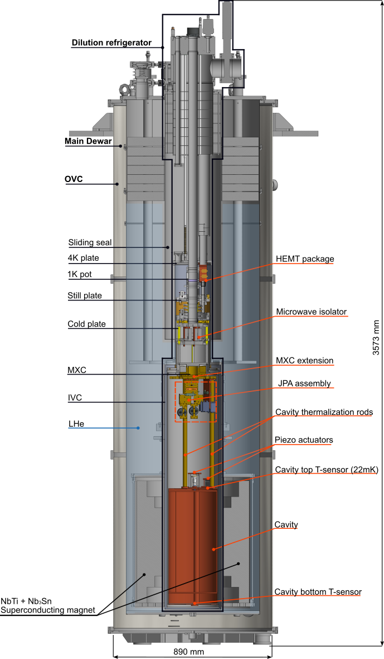
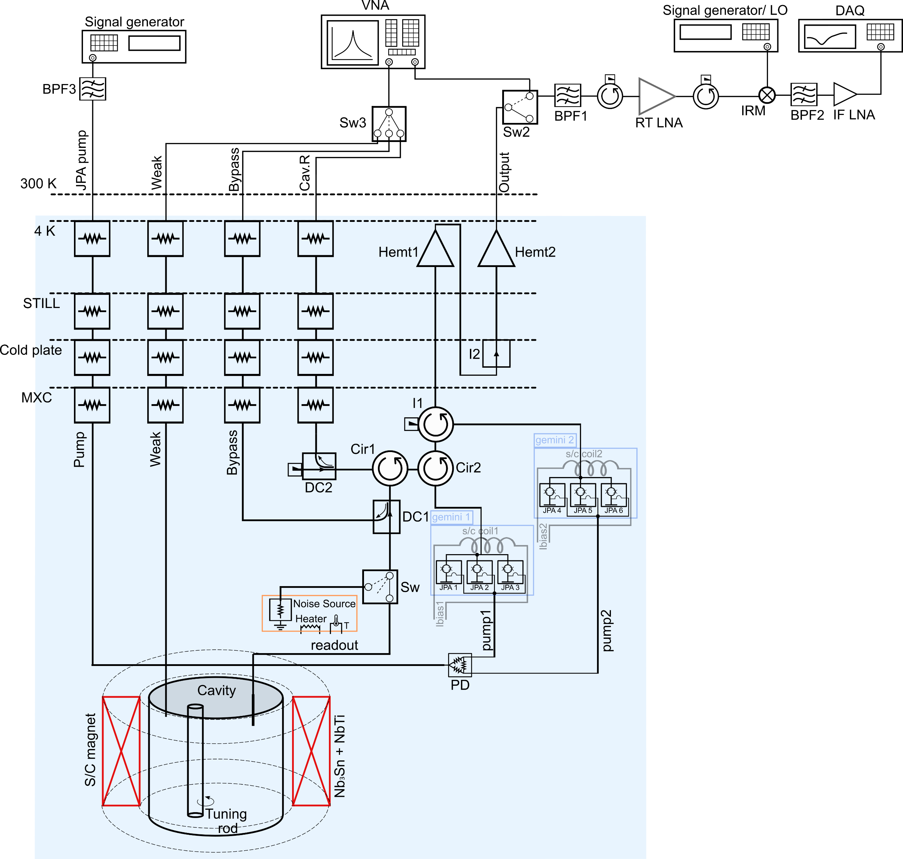
12 TBig-bore magnet system
Notes:
Axion haloscope experiments aim to directly identify axions in the dark matter halo of our galaxy by exploiting the fact that axions transform into photons when exposed to an external magnetic field. Since it is predicted that the conversion power of the axion is extremely low, approximately ${10}^{−22}$ W^{[1]}, haloscope is required to be very sensitive.
Axion search experiments are desire to resolve fundamental questions in physics: the strong CP problem and the nature of dark matter. One of the leading experiments is the CAPP-MAX experiment at the Center for Axion and Precision Physics Research (CAPP) of Institute for Basic Science (IBS) in South Korea.
This experiment featuring a 12 T big bore (32 cm) Nb3Sn superconducting magnet, 37-liter cylinder copper cavity and a state-of-the-art microwave readout system based on Josephson Parametric Amplifier (JPA) that approaches the quantum noise limit.
We show the technical details of the detector chain, features of the dilution refrigerator immersed into the liquid He dewar, and the operation of the closed cycle helium recovery system.
The system temperature is kept near to 25 mK, which is the lowest temperature of any axion experiment to date.
Recent advances in low noise amplifier technology have opened up new possibilities for exploring a wide range of plausible axion masses with high sensitivity.
Our results demonstrate the potential of the CAPP-MAX experiment to significantly improve the speed of axion dark matter search and contribute to a deeper understanding of the universe's fundamental nature.
In this presentation, we provide the technical details of the CAPP-MAX experiment, discuss the current status of the experiment, and outline future plans.
Fig.1 description:
It exploits the axion-photon coupling gaγγ in a microwave cavity permeated with a static magnetic field B0, which results in resonant conversions of axions to photons when the axion mass m a matches the frequency of the cavity mode ν.

Slide 21
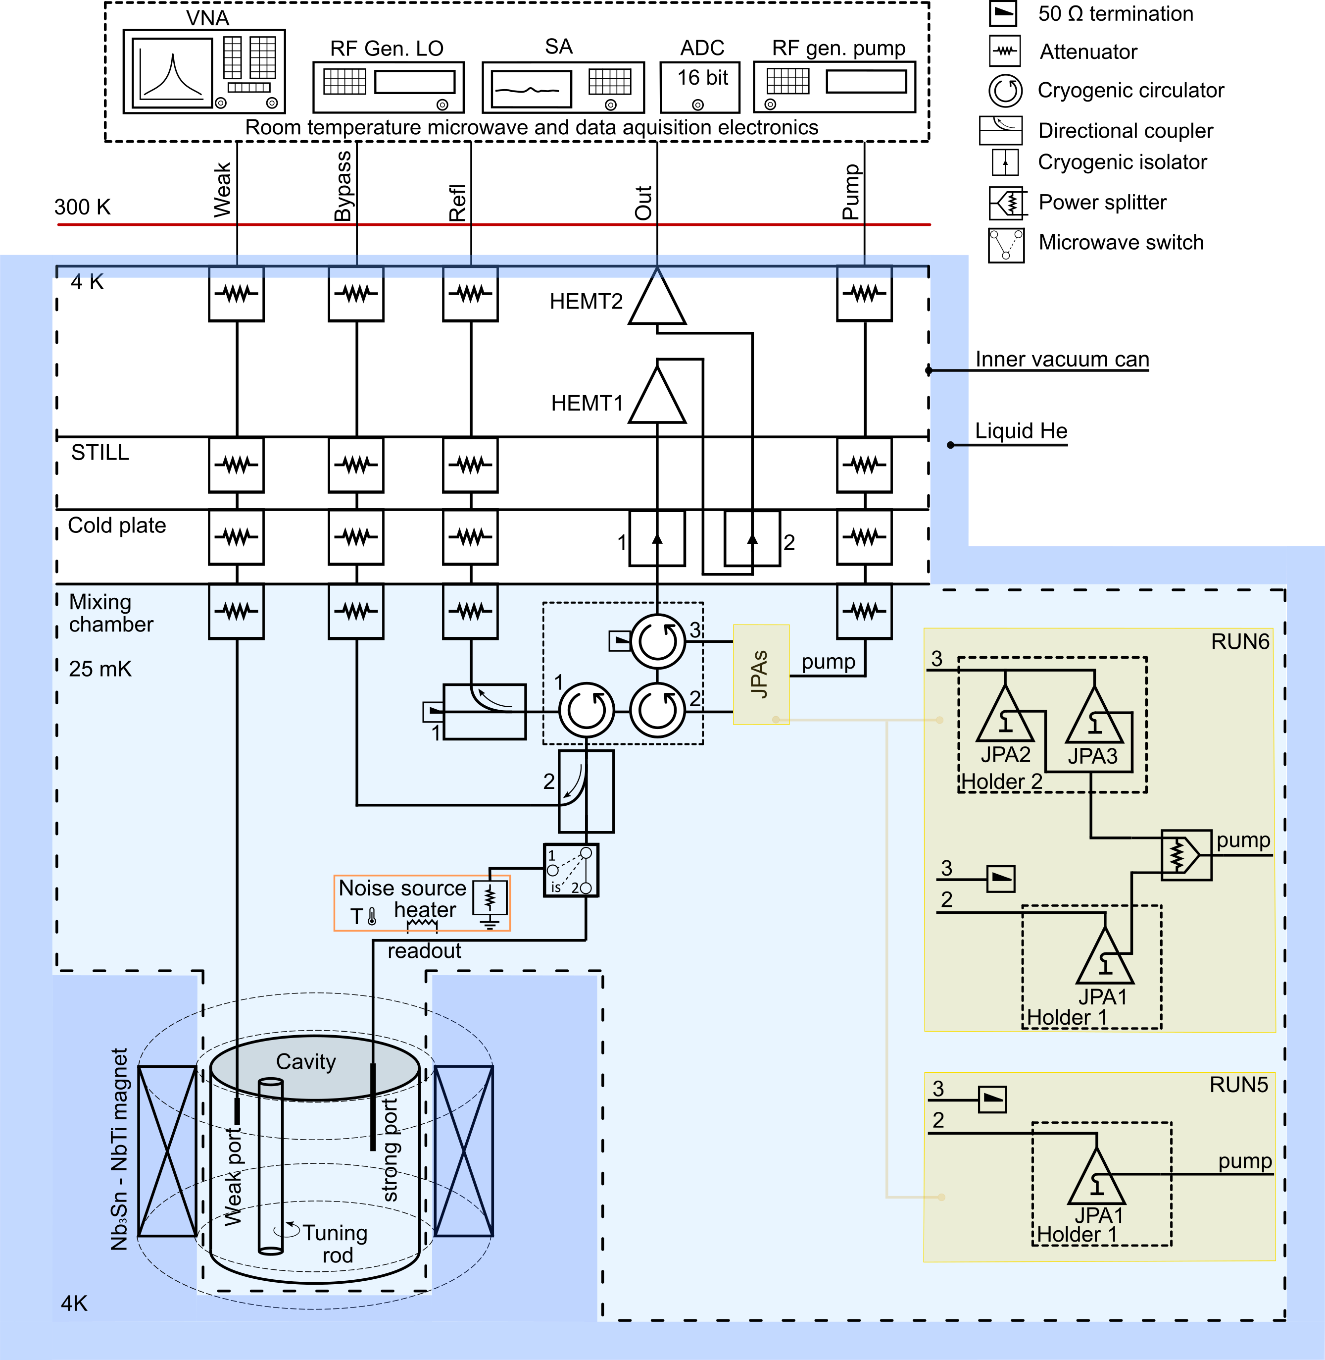
Main readout diagram
Data taking:
A strong port is connected directly to the output chain;
JPA assembly is used as a first stage amplifier (defines SNR);
Additional measurements:
Measurements of the cavity coupling coefficient to the output chain using the strong port;
Measurements of the cavity resonance frequency and quality factor over the weak port;
Measurements of total system gain via bypass line;
Measurements of the total system noise temperature (T_{sys}) over the cryogenic noise source.

Slide 22
Data taking sequence
Before data taking:
Measurement of the cavity resonance frequency (f_{r}) and the quality factor (Q_{c}) over the weak and strong ports (JPA pump off);
Measurement of the cavity coupling to the readout chain over the strong port;
Measurement of the total system gain (JPA pump on) via bypass line.
Data taking:
Real time data digitizing;
Cavity next frequency tuning.

Slide 23
Data taking sequence
Before data taking:
Measurement of the cavity resonance frequency (f_{r}) and the quality factor (Q_{c}) over the weak and strong ports (JPA pump off);
Measurement of the cavity coupling to the readout chain over the strong port;
Measurement of the total system gain (JPA pump on) via bypass line.
Data taking:
Real time data digitizing;
Cavity next frequency tuning.

Slide 24
Data taking sequence
Before data taking:
Measurement of the cavity resonance frequency (f_{r}) and the quality factor (Q_{c}) over the weak and strong ports (JPA pump off);
Measurement of the cavity coupling to the readout chain over the strong port;
Measurement of the total system gain (JPA pump on) via bypass line.
Data taking:
Real time data digitizing;
Cavity next frequency tuning.

Slide 25
Data taking sequence
Before data taking:
Measurement of the cavity resonance frequency (f_{r}) and the quality factor (Q_{c}) over the weak and strong ports (JPA pump off);
Measurement of the cavity coupling to the readout chain over the strong port;
Measurement of the total system gain (JPA pump on) via bypass line.
Data taking:
Real time data digitizing;
Cavity next frequency tuning.

Slide 26
Data taking sequence
Before data taking:
Measurement of the cavity resonance frequency (f_{r}) and the quality factor (Q_{c}) over the weak and strong ports (JPA pump off);
Measurement of the cavity coupling to the readout chain over the strong port;
Measurement of the total system gain (JPA pump on) via bypass line.
Data taking:
Next frequency: data digitizing;
Cavity next target frequency

Slide 27
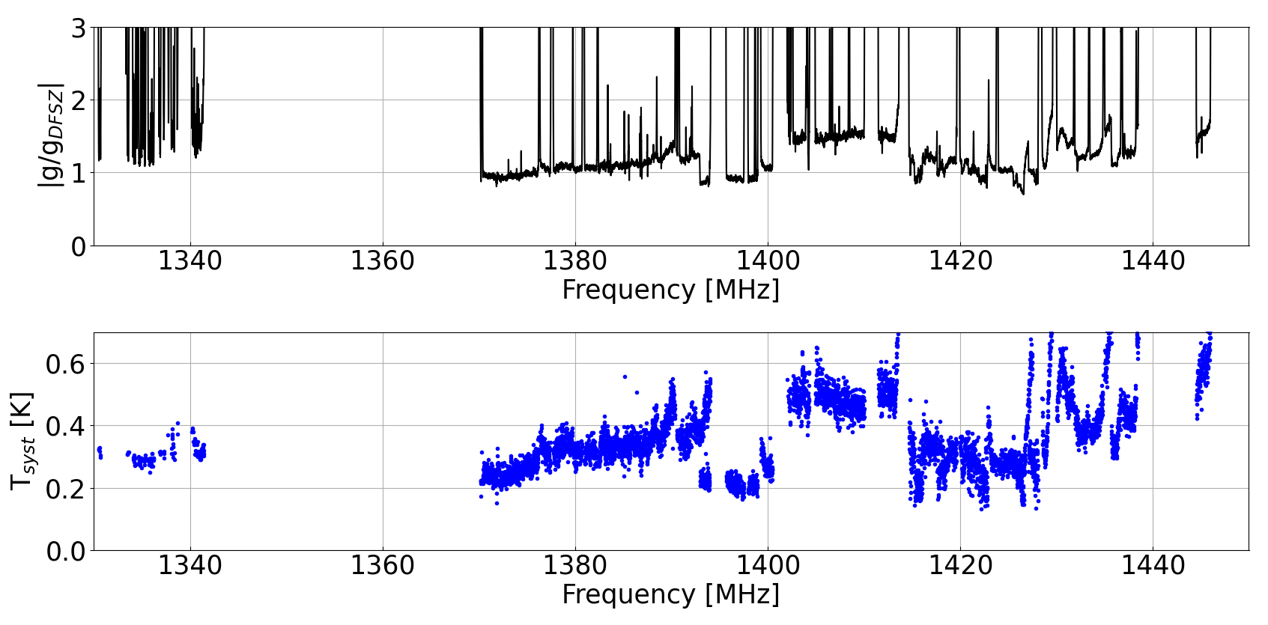
12TB Axion search scanned range
JPA5
JPA4
JPA3
The data is obtained by the 20th of April 2026

Slide 28
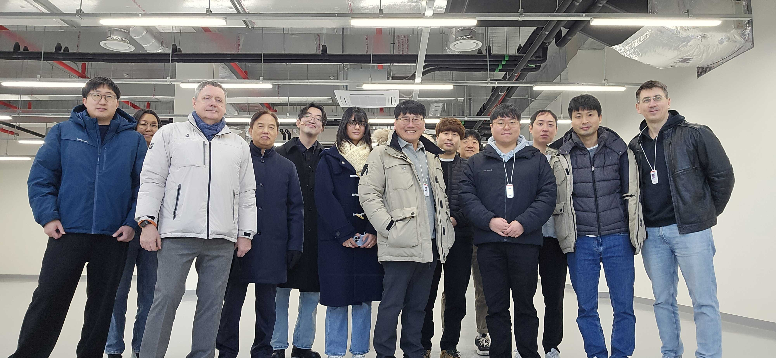
Thank you for your attention!
Dark Matter Axion Group

Slide 29
