Slide 1
Simulation of Neutron and Gamma particles on A WIMP Detector using GEANT4
제주대학교 기초과학연구소
11.06.2023
고재우

Slide 2
Overview of the Simulation
GEANT4 is a toolkit for the simulation of the passage of particles through matter.
It is used in a variety of fields, including high energy, nuclear and accelerator physics, as well as studies in medical and space science.

Slide 3
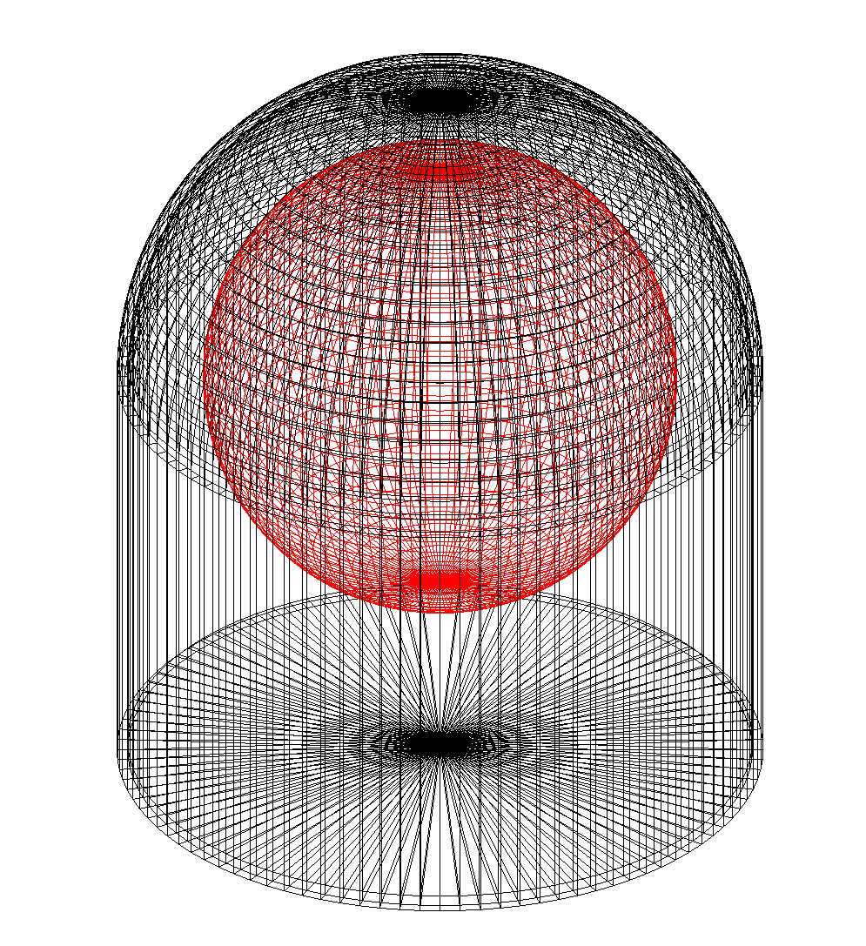
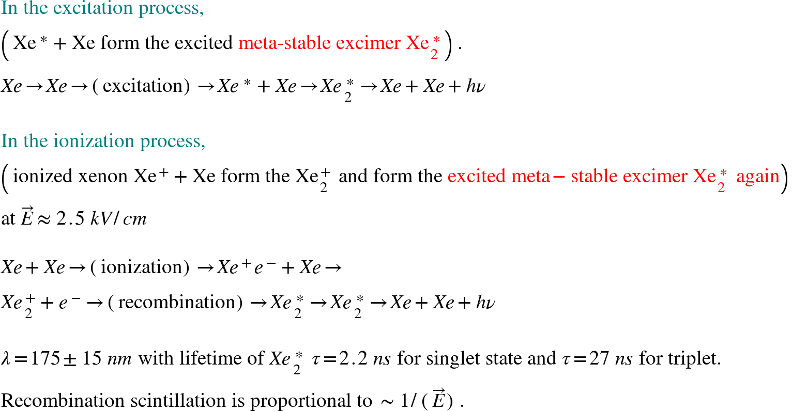
Research Objectives
WIMP
WIMP
DRIFT TIME (DEPTH)
Primary signal
Secondary signal
TIME

Slide 4
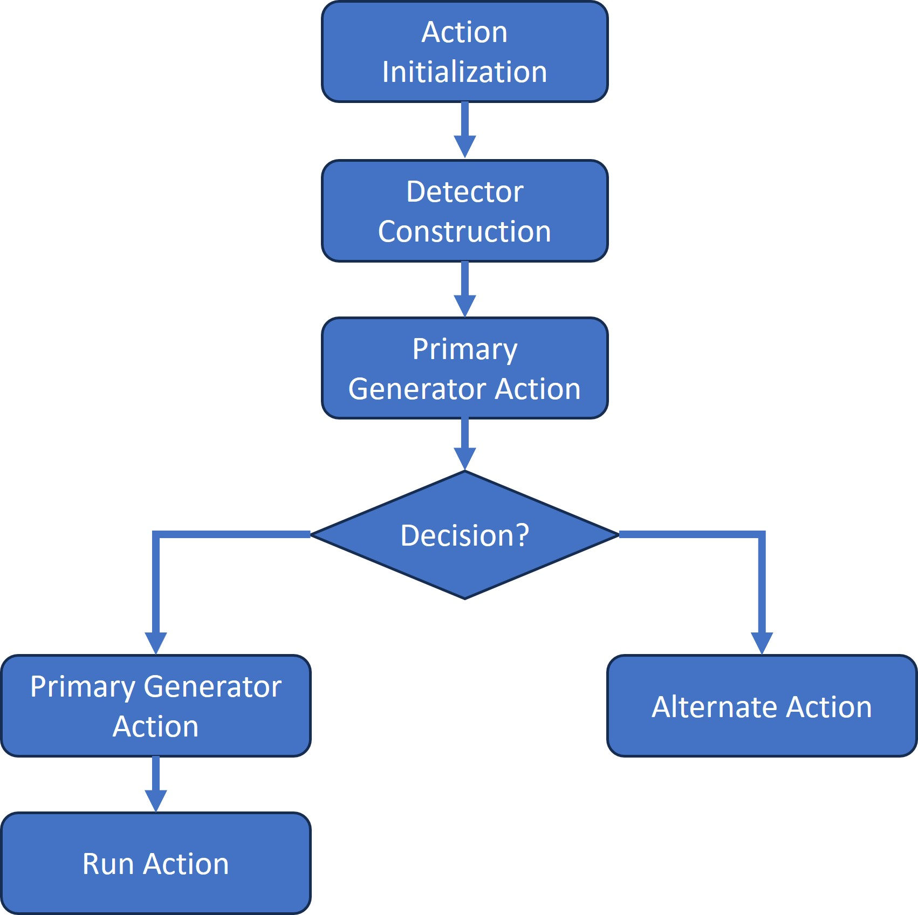
Flow Chart
The ActionInitialization.cc file defines a class that inherits from G4VUserActionInitialization, which is part of the Geant4 toolkit.
The DetectorConstruction.cc file is responsible for defining the geometry and materiaals of the detectors used in the Geant4 simulation.
The PrimaryGeneratorAction.cc file contains the definition of a class that is responsible for generating primary particles in a Geant4 simulation. In Geant4, a "primary" particle is one that is introduced into the simulation by the user, as opposed to secondary particles that are produced as a result of interactions in the simulation.
The RunAction.cc file defines a class that inherits from G4UserRunAction. In the context of Geant4 simulations, a "run" is a set of events that are processed together, typically representing a simulation under a specific set of conditions. This class is responsible for defining the actions that should be taken before and after a run.

Slide 5
Action Initialization
#include "ActionInitialization.hh"
#include "PrimaryGeneratorAction.hh"
#include "RunAction.hh"
#include "EventAction.hh"
ActionInitialization::ActionInitialization()
: G4VUserActionInitialization()
{
}
ActionInitialization::~ActionInitialization()
{
}
void ActionInitialization::BuildForMaster() const
{
SetUserAction(new RunAction);
}
void ActionInitialization::Build() const
{
SetUserAction(new PrimaryGeneratorAction);
SetUserAction(new RunAction);
SetUserAction(new EventAction);
}

Slide 6
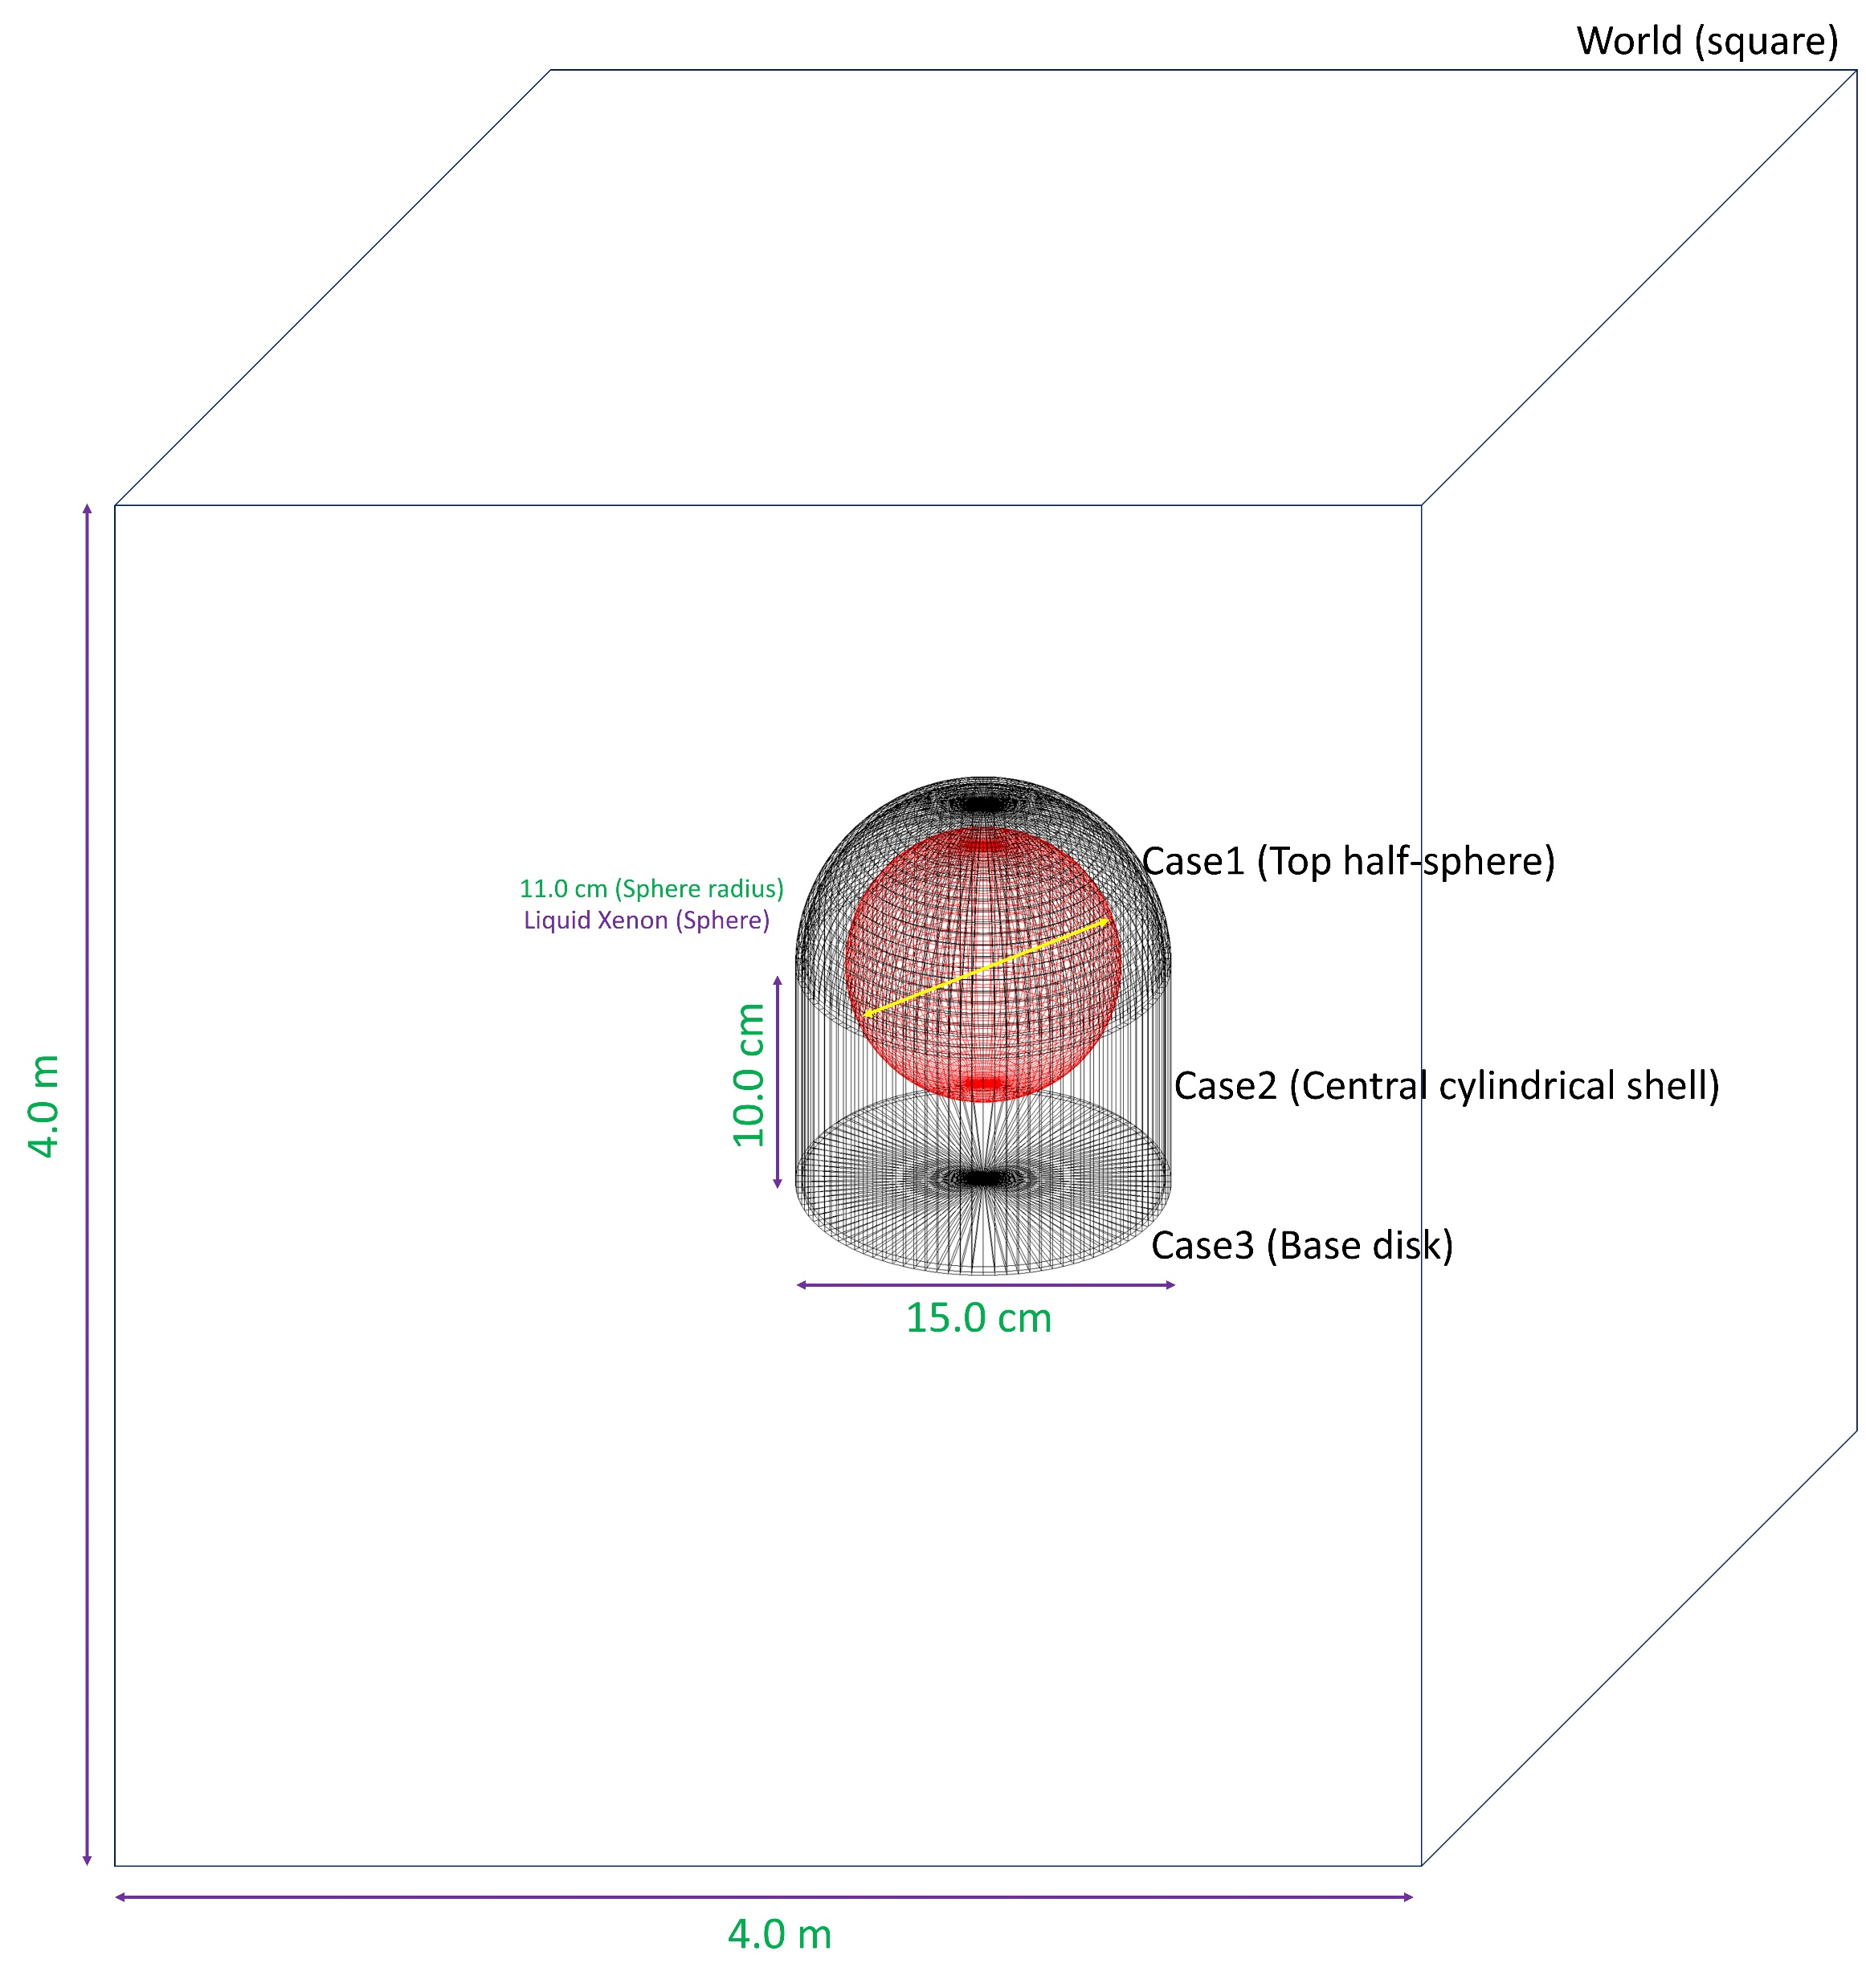
Detector Construction
1. Materials
The detector is made from several materials: Vacuum (or "G4_Galactic"), Iron (or "G4_Fe"), Air (or "G4_AIR"), Liquid Xenon, and Stainless Steel (304 grade). These materials are created and defined within the "DefineMaterials()" function.
2. World Volume
The world volume is defined as a box filled with vacuum, with a size of 4 meters in each dimension (length, width, and height). This is the space in which the detector and other components of the simulation will exist.
3. Stainless Steel Cover
The detector is encased in a stainless steel cover, which is composed of three parts: two half-spheres and a cylinder. The first half-sphere ("cover1") is centered at the origin and has an inner radius of 14.5 cm and an outer radius of 15 cm. The cylindrical section ("cover2") is centered 10 cm below the origin, with the same inner and outer radii, and a height of 20 cm. The second half-sphere ("cover3") is located 19.75 cm below the origin and forms a flat base for the detector with a radius of 14.5 cm.
4. Liquid Xenon Sphere (detector)
The actual detector is a sphere of liquid xenon with a radius of 11 cm. This is the sensitive volume where the interactions of interest (i.e., the particles hitting the detector) will be recorded.
5. Sensitive Detector and Field Construction
The "ConstructSDandField()" function defines the detector as a "G4MultiFunctionalDetector" and assigns it the name "Detector". It registers the energy deposit process (the "G4PSEnergyDeposit" primitive) to the detector and sets an electron filter to it. This means that the detector will only record interactions involving electrons.

Slide 7
Material and Methods
void DetectorConstruction::DefineMaterials()
{
// define liquid Xenon136
G4double a; // mass of a mole;
G4double z; // z=mean number of protons;
G4double density;
new G4Material("liquidXenon",
z=54. , a= 135.91 * g/mole , density=3.0 * g/cm3);
// define 304 Stainless Steel
G4Element* elMn = new G4Element("Manganese", "Mn", z=25., a=54.94 *g/mole);
G4Element* elSi = new G4Element("Silicon", "Si", z=14., a=28.09 *g/mole);
G4Element* elCr = new G4Element("Chromium", "Cr", z=24., a=52.00*g/mole);
G4Element* elNi = new G4Element("Nickel", "Ni", z=28., a=58.70*g/mole);
G4Element* elFe = new G4Element("Iron", "Fe", z=26., a=55.85*g/mole);
G4Element* elC = new G4Element("Carbon", "c", z=6, a=12.011*g/mole);
}
G4VPhysicalVolume *DetectorConstruction::DefineVolumes()
{
// Stainless Cover
auto coverMaterial = G4Material::GetMaterial("Stainless-Steel-304");
auto cover1Pos = G4ThreeVector(0., 0., 0.);
auto cover1Sol = new G4Sphere("cover1",
14.5 * cm, //inner radius
15. * cm, //outer radius
0 * degree, //starting phi
360 * degree, //Delta phi
0 * degree, //starting theta
90 * degree); // Delta theta
Xenon 정의하는곳
검출기 정의하는곳

Slide 8
Primary Generator Action
WIMP Particle 정의하는곳
PrimaryGeneratorAction::PrimaryGeneratorAction()
: G4VUserPrimaryGeneratorAction(){
fPrimary = new G4ParticleGun(); //fPrimary is G4ParticleGun's class instance
new G4ParticleDefinition("WIMP", //particle name
60. *GeV, //mass (10~100 GeV/c2)
0.5 *MeV, //width. refer to G4Electron.hh
0., //charge
0, //2*spin
//0, parity
-1, //parity
//0, C-conjugation
-1, //C-conjugation
0, //2*Isospin
0, //2*Isospin3
//0, G-parity
1, //G-conjugation
"dark_matter", //type
0, //lepton number
0, //baryon number
0, //PDG encoding
true, //stable
1., //lifetime
NULL, //decay table
false, //shortlived
"WIMP" //subType
);
}

Slide 9
Event Action
void EventAction::EndOfEventAction(const G4Event* anEvent)
{
auto HCE = anEvent->GetHCofThisEvent();
if (!HCE)
return;
if(fHCID == -1)
fHCID = G4SDManager::GetSDMpointer()->GetCollectionID("Detector/EDep");
auto hitsMap = static_cast<G4THitsMap<G4double> *>(HCE->GetHC(fHCID));
auto analysisManager = G4AnalysisManager::Instance();
for (const auto &iter : *(hitsMap->GetMap()))
{
auto eDep = *(iter.second);
if (eDep > 0.)
{
//G4cout << "--- Energy Deposit:" << eDep / MeV << G4endl;
analysisManager->FillH1(0, eDep / keV);
analysisManager->FillNtupleDColumn(0, eDep /keV);
analysisManager->AddNtupleRow();
}
}
}

Slide 10
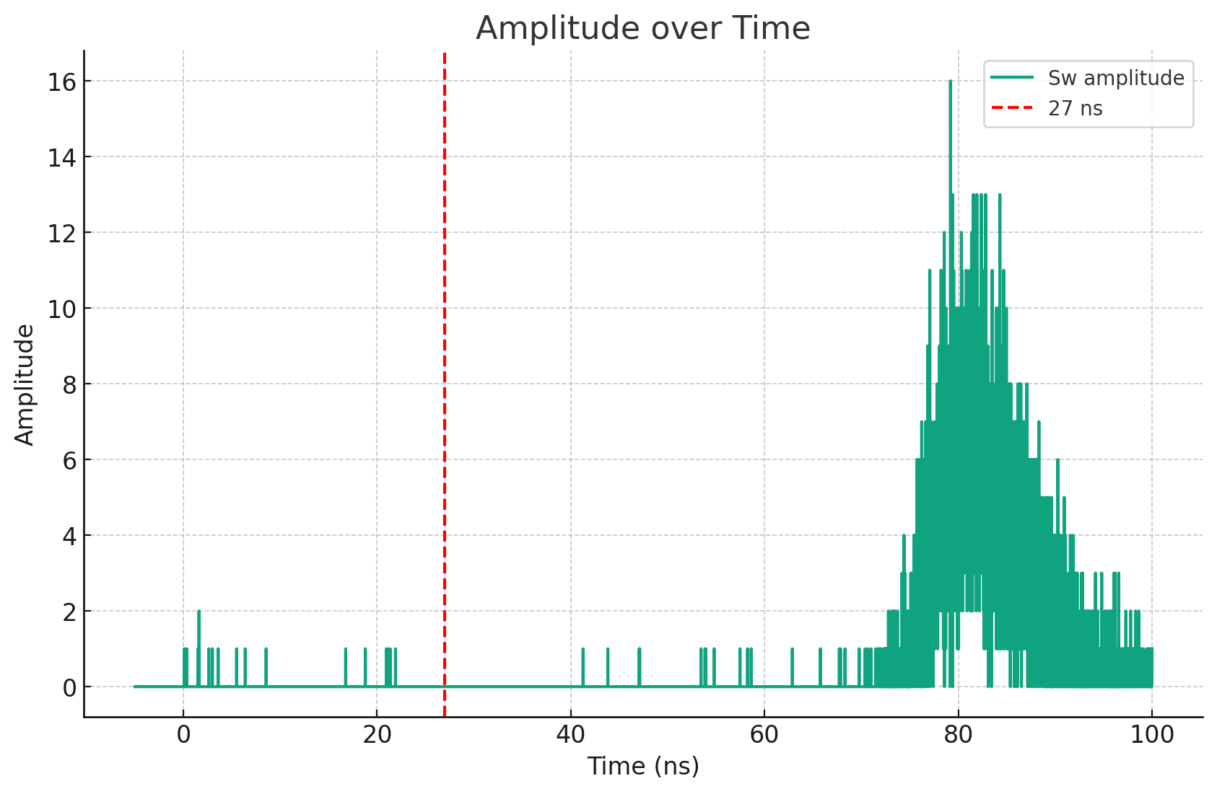
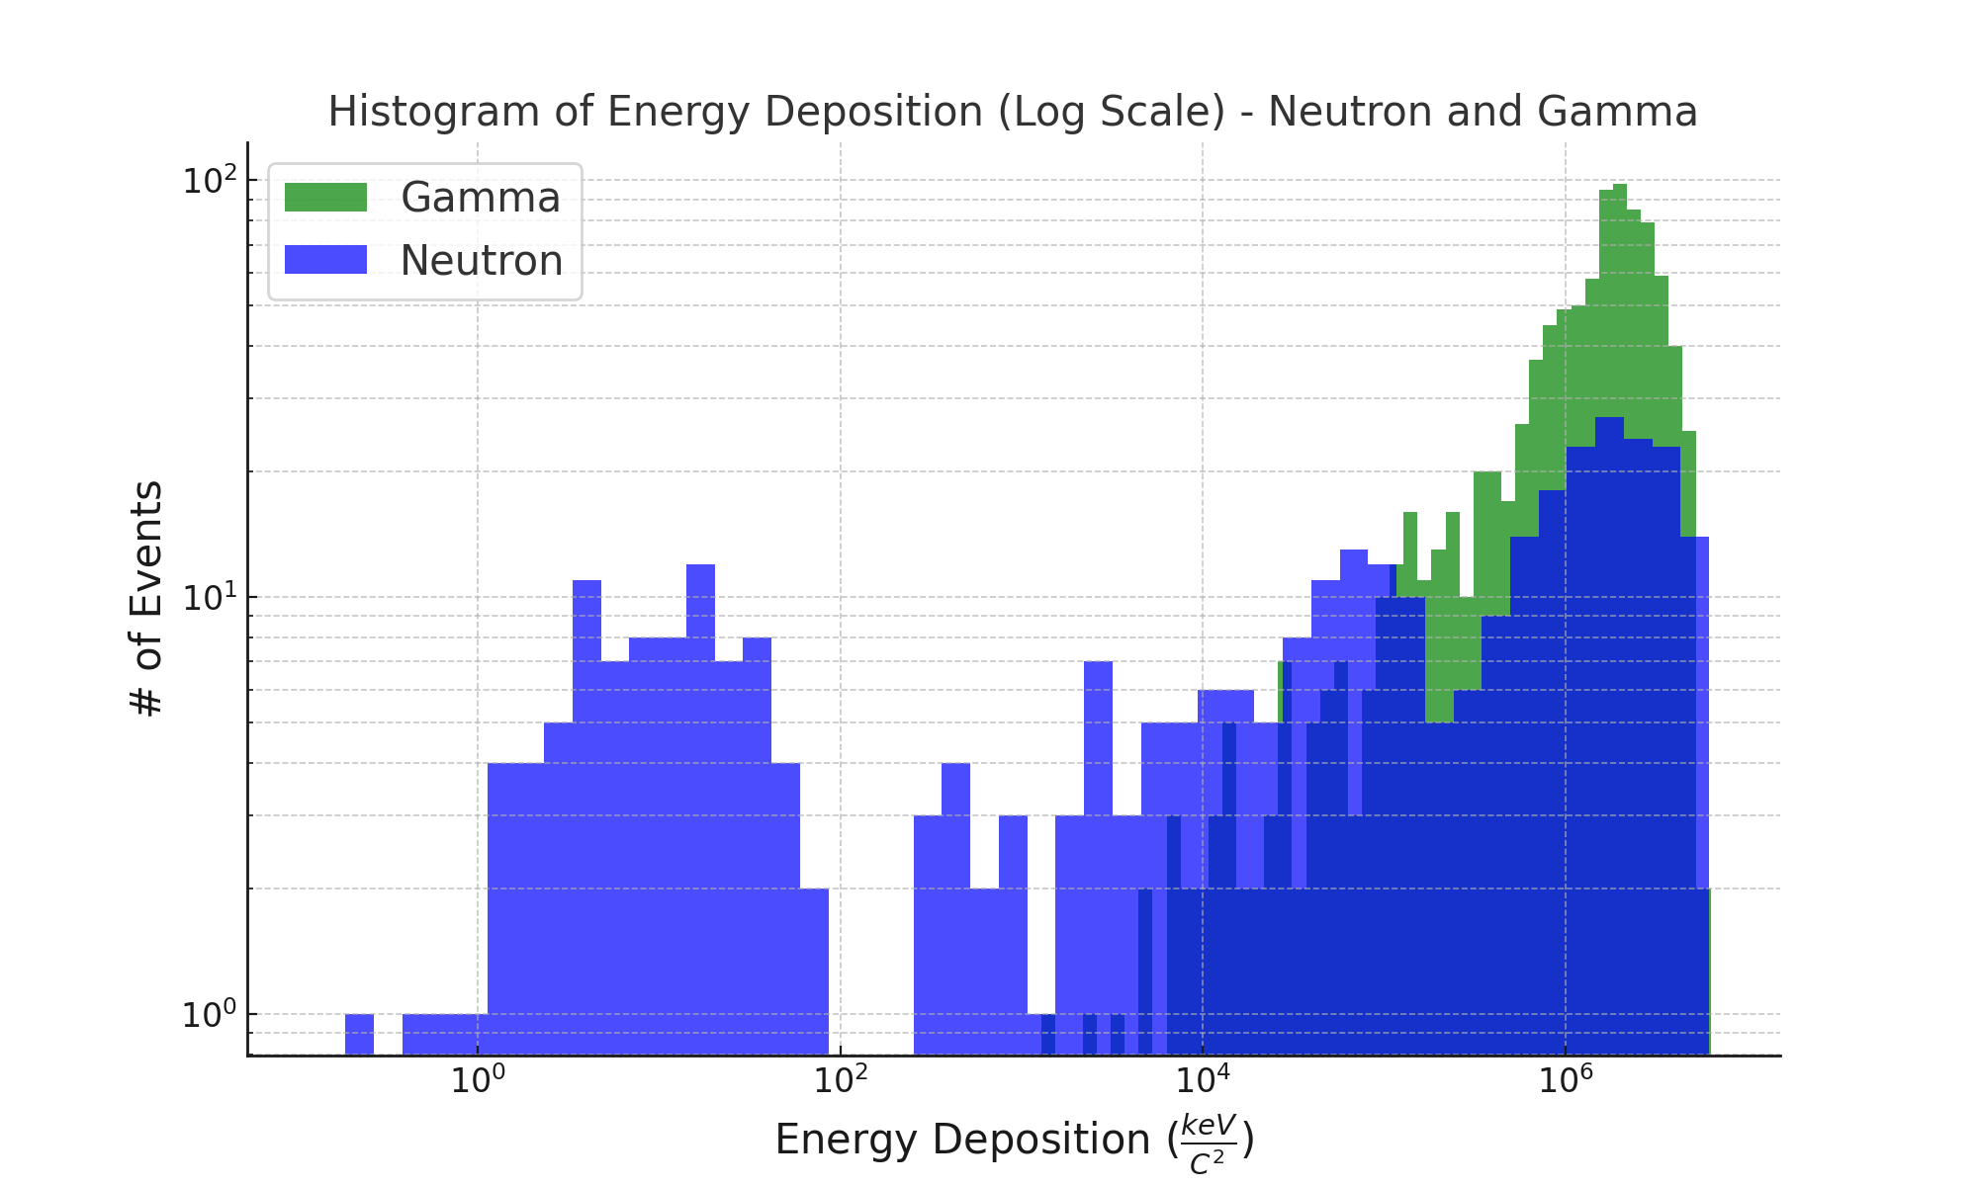
Results
Our simulations showed that the depth information deposited by a proton in a Xenon detector, it shows clearly Primary Signal and Secondary Signal as well.
Primary signal (below 27 ns)
Secondary signal
This histogram can differentiate between neutron and gamma’s deposit energy from ranges about

Slide 11
Conclusion
The detector design consists of a spherical core of liquid xenon, which is sensitive to electron interactions, surrounded by a stainlesssteel cover, all situated within a 4-meter cubed vacuum world volume.

