Slide 1

Geant4 Simulation using
KISTI-5 supercomputer
2022.12.
KISTI/UST
Kihyeon Cho, Kihong Park
http://kacademy.kisti.re.kr
Notes:
.

Slide 2
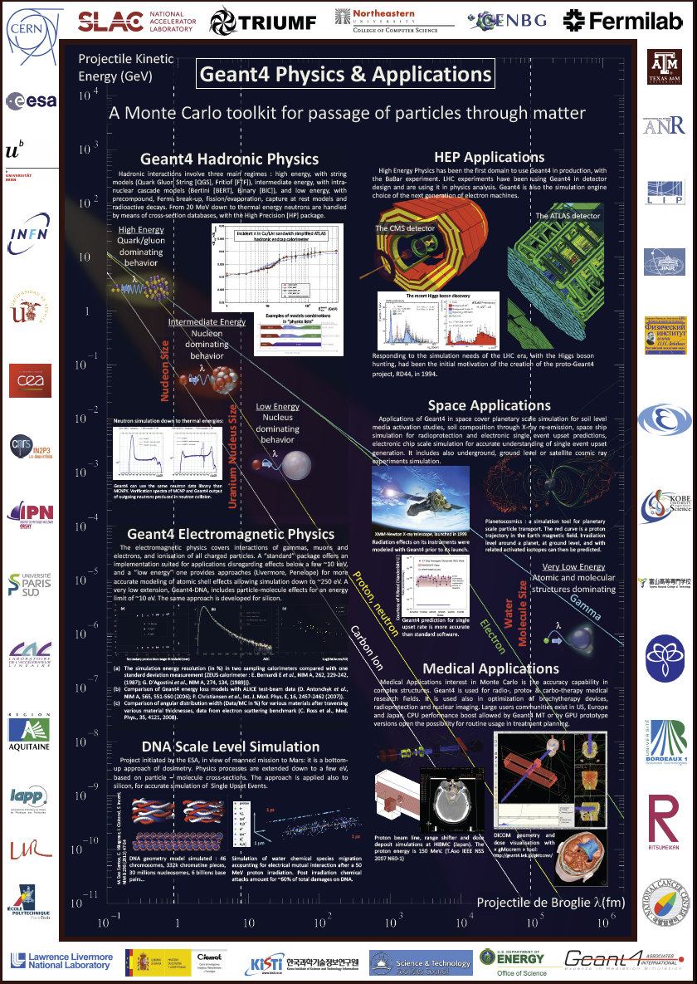
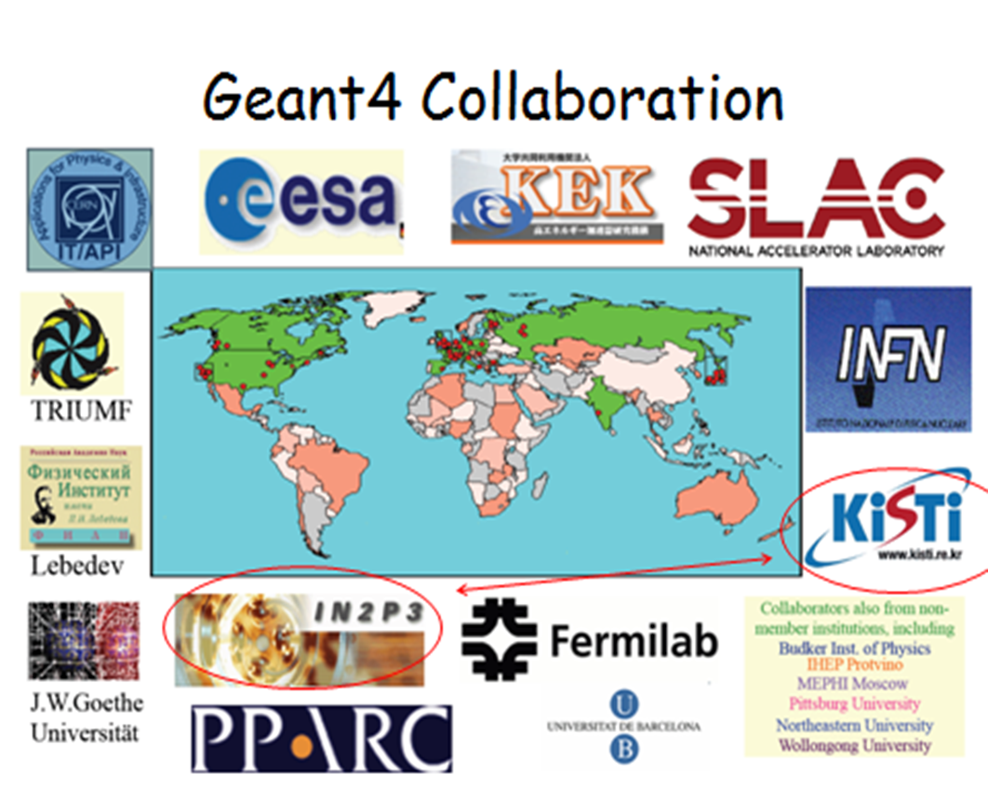
Geant4 Simulation
입자와 물질 상호작용간 정밀 시뮬레이션
Geant4 is not upgrade version of GEANT3, but totally different simulation tool kit.
KISTI joined Geant4 collaboration in 2012.
  - started International Geant4 Tutorial
KISTI and NCC are the official and leading institute of Geant4 in Korea.

Slide 3
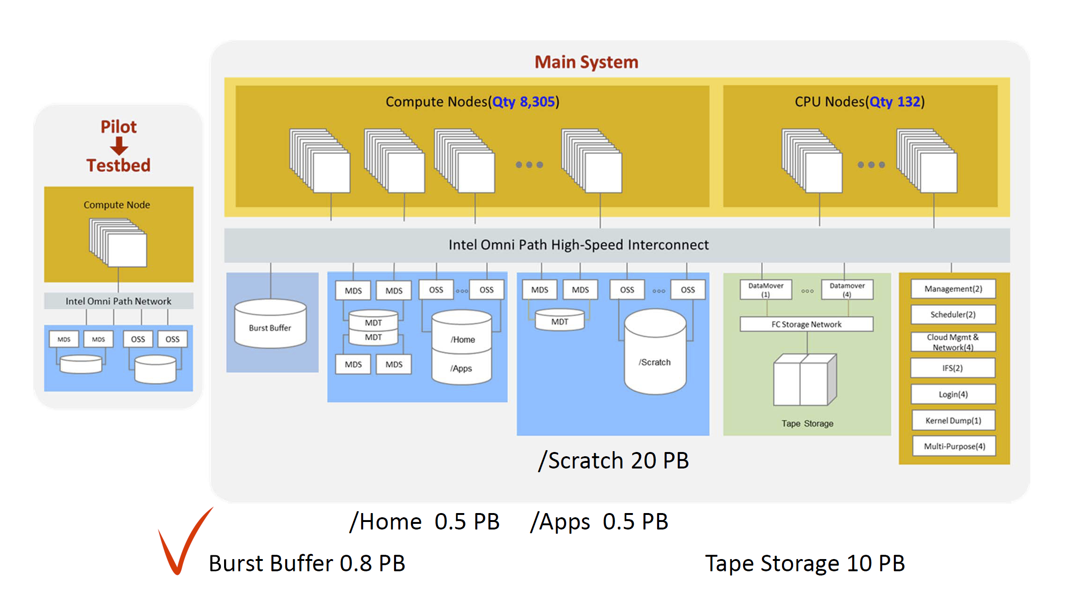
Architecture of
KISTI-5 supercomputer
(SSD)
@ Available KNL CORE Time = Available SRU Time x 4,352
@ Available SKL CORE Time = Available SRU Time x 1,280
1 구좌: 100 SRU Time = 3200 hour (전용), 6400 hour (공용) KNL
M.S. Joh

Slide 4
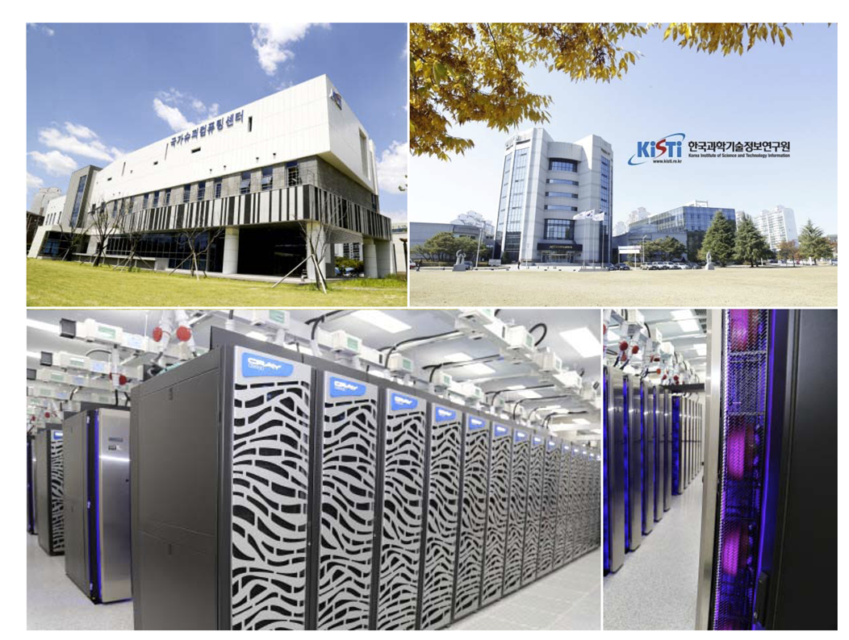

Lab #1 Geant4
KISTI 슈퍼컴5호기

Slide 5
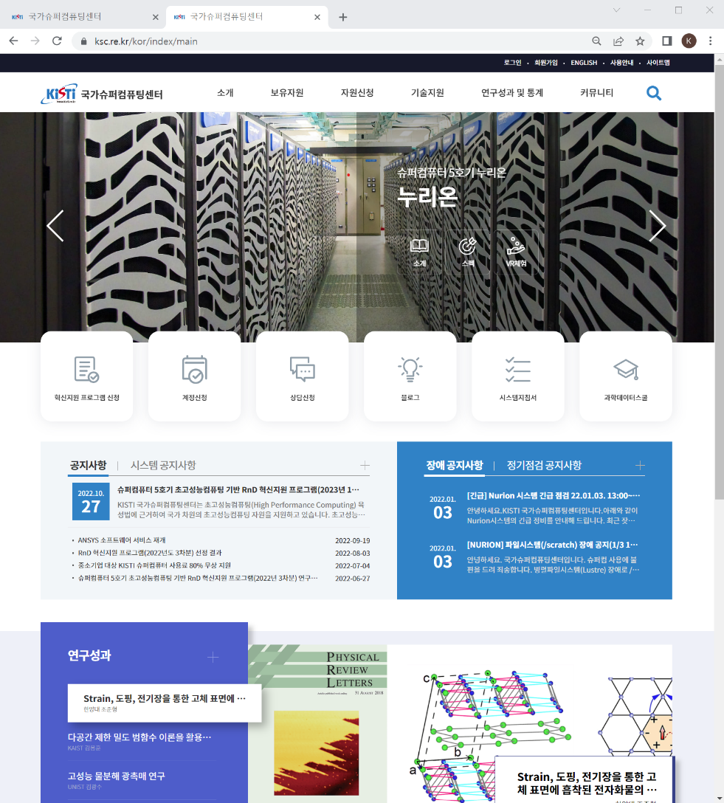
KSC helpdesk
https://helpdesk.ksc.re.kr/

Slide 6
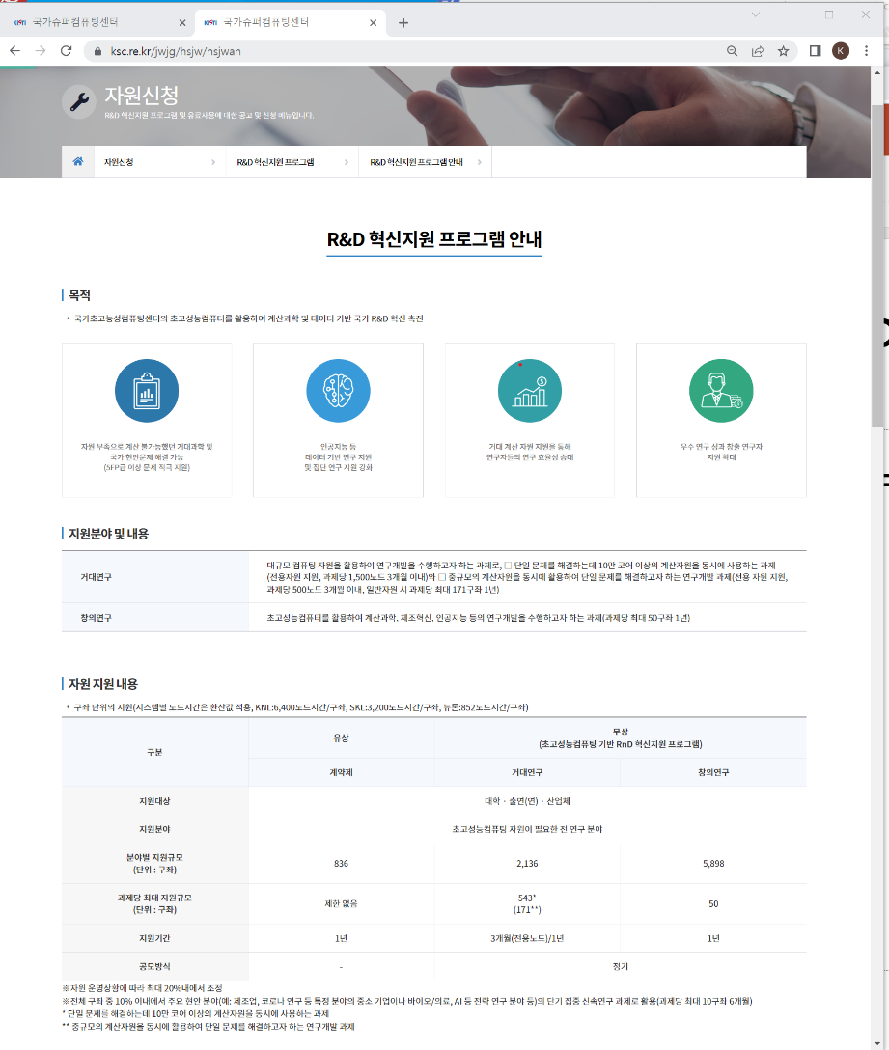
Support Program(R&D혁신지원)
https://www.ksc.re.kr/jwjg/hsjw/hsjwan/

Slide 7
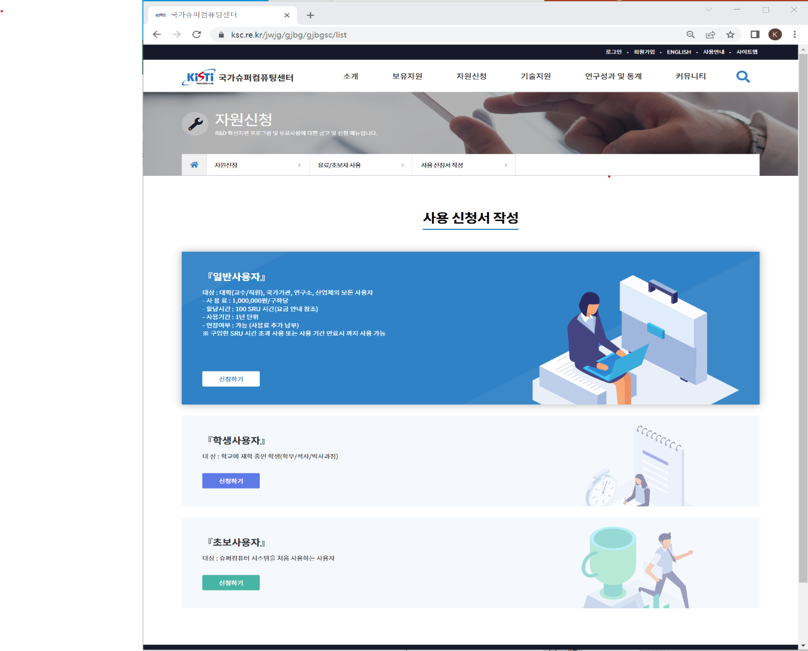
Account(초보사용자)
https://www.ksc.re.kr/jwjg/gjbg/gjbgsc/list

Slide 8
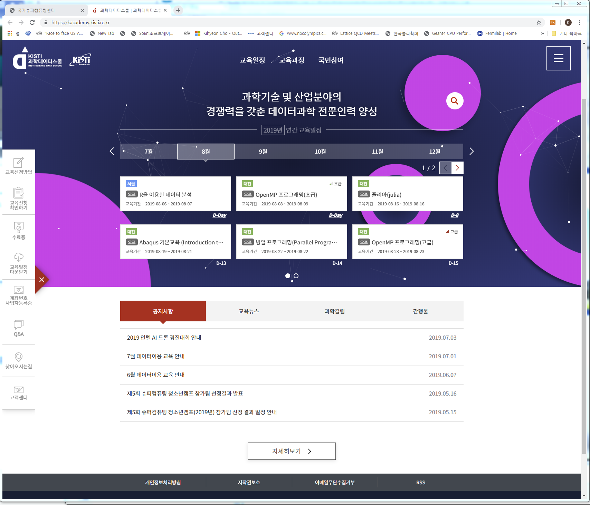
Education(교육)
https://kacademy.kisti.re.kr/

Slide 9
시스템 접속
노드 구성
 |  | 호스트 명 | CPU Limit | 비고
로그인 노드 |  | nurion.ksc.re.kr | 20분 | ssh/scp/sftp 접속 가능 컴파일 및 batch 작업제출용 ftp 접속 불가
Datamover 노드 |  | nurion-dm .ksc.re.kr | - | ssh/scp/sftp 접속 가능 ftp 접속 가능 컴파일 및 작업 제출 불가
계산 노드 | KNL | node[0001-8305] | - | PBS 스케줄러를 통해 작업 실행 가능 일반사용자 직접 접근 불가
 | CPU-Only | cpu[0001-0132] | -

Slide 10
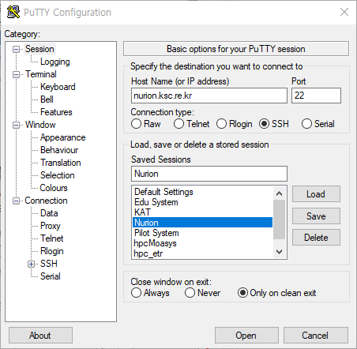
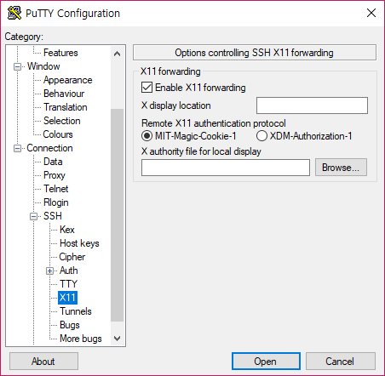
시스템 접속
Xming
  X 환경 실행을 위해 필요
Putty 사용
  Host Name : nurion.ksc.re.kr( port : 22)
※ Xming 실행 필요

Slide 11
시스템 접속
접속 ID & otp
  sedu##( 01~50)
  OTP : xxxx
  Passwd : xxxxxxxxx
Last login: Mon Jan 7 10:00:35 2019 from xxx.xxx.xxx.xx
================ KISTI 5th NURION System ====================
* Compute Nodes(node[0001-8305],cpu[0001-0132)
- KNL(XeonPhi 7250 1.40GHz 68C) / 16GB(MCDRAM),96GB(DDR4)
- CPU-only(XeonSKL6148 2.40GHz 20C x2) / 192GB(DDR4)
* Software
- OS: CentOS 7.4(3.10.0-693.21.1.el7.x86_64)
- System S/W: BCM v8.1, PBS v14.2, Lustre v2.10
* Current Configurations
- All KNL Cluster modes - Quadrant
- Memory modes
: Cache-node[0001-7980,8281-8300]/Flat-node[7981-8280]
: PBS job sharing mode-Exclusive(running 1 job per node)
(Except just the commercial queue)
…
* Policy on User Job
….
(Use the # showq & # pbs_status commands for more queue info.)

Slide 12
시스템 접속
Policy on User Job
  KISTI 큐 정책에 의해 변경될 수 있음
Queue | Wall-Clock Limit | Max Running jobs | Max Active Jobs (running+waiting)
exclusive | unlimited | 100 | 100
normal | 48h | 30 | 50
burst_buffer | 48h | 10 | 20
long | 120h | 10 | 20
flat | 48h | 10 | 20
debug | 48h | 2 | 2
commercial | 48h | 3 | 10
norm_skl | 48h | 7 | 14

Slide 13
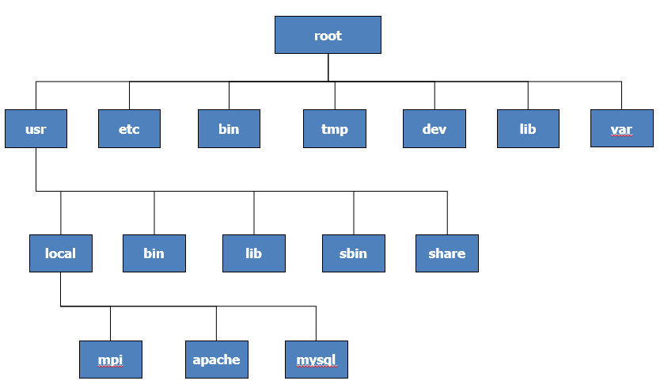
Linux 기초
File Hierarchy
경로
  절대 경로 : /home/userid/MPI/examples
  상대 경로 : ../../MPI/example

Slide 14
Basic Environment
작업 디렉터리 및 쿼터 정책
  현재 사용량 확인
  홈 디렉터리는 용량 및 I/O 성능이 제한되어 있기 때문에, 모든 계산 작업은 스크래치 디렉터리에서 이루어져야 함.
구분 | 디렉터리 경로 | 용량 제한 | 파일 수 제한 | 파일 삭제 정책 | 파일 시스템 | 백업 유무
홈 디렉터리 | /home01 | 64GB | 100K | N/A | Lustre | O
스크래치 디렉터리 | /scratch | 100TB | 1M | 15일 동안 접근하지 않은 파일은 자동 삭제 |  | X
$ lfs quota /home01
Disk quotas for usr sedu01 (uid 1000163):
Filesystem kbytes quota limit grace files quota limit grace
/home01 104 67108864 67108864 - 26 100000 100000 -
$ lfs quota /scratch
Disk quotas for usr sedu01 (uid 1000163):
Filesystem kbytes quota limit grace files quota limit grace
/scratch 4 107374182400 107374182400 - 1 1000000 1000000 -
Disk quotas for grp in0163 (gid 1000163):

Slide 15
HEP software: /apps/applications/hep/
drwxr-xr-x 3 hepkisti in0056 4096 Jan 18 2019 CLHEP
drwxr-xr-x 3 hepkisti in0056 4096 May 15 2020 ROOT
drwxr-xr-x 5 hepkisti in0056 4096 Jan 30 2019 backup_folder
drwxr-xr-x 6 hepkisti in0056 4096 Jan 18 2019 belle
drwxr-xr-x 8 hepkisti in0056 4096 May 6 2016 boost_1_61_0
drwxr-xr-x 6 hepkisti in0056 4096 Jan 18 2019 cern
drwxr-xr-x 2 hepkisti in0056 4096 Jan 28 09:22 conf_scripts_new
drwxr-xr-x 2 hepkisti in0056 4096 Mar 23 2015 etc
drwxr-xr-x 17 hepkisti in0056 4096 Jan 23 2019 expat-2.1.1
drwxr-xr-x 7 hepkisti in0056 4096 Mar 5 2019 fast
-rwxr-xr-x 1 hepkisti in0056 1430871 Jan 21 2019 fast-0.06.02.tgz
drwxr-xr-x 6 hepkisti in0056 4096 Jan 27 18:06 geant4_update
drwxr-xr-x 3 hepkisti in0056 4096 Jan 28 11:06 tachyon2
drwxr-xr-x 2 hepkisti in0056 4096 Mar 12 2021 tmp
drwxr-xr-x 3 hepkisti in0056 4096 May 15 2020 xerces-c

Slide 16
Geant4 versions
>source /apps/applications/hep/conf_scripts_new/g4.11.0.0_user_conf.bash
>source /apps/applications/hep/conf_scripts_new/g4.11.0.0_user_conf.tcsh
>source /apps/applications/hep/conf_scripts_new/g4.11.0.1_user_conf.bash
>source /apps/applications/hep/conf_scripts_new/g4.11.0.1_user_conf.tcsh
>source /apps/applications/hep/conf_scripts_new/g4.11.0.2_user_conf.bash
>source /apps/applications/hep/conf_scripts_new/g4.11.0.2_user_conf.tcsh
>source /apps/applications/hep/conf_scripts_new/g4.11.0.3_user_conf.bash
>source /apps/applications/hep/conf_scripts_new/g4.11.0.3_user_conf.tcsh
>source /apps/applications/hep/conf_scripts_new/g4.11.0.0_user_conf_OPENGL_OFF.bash
>source /apps/applications/hep/conf_scripts_new/g4.11.0.0_user_conf_OPENGL_OFF.tcsh
>source /apps/applications/hep/conf_scripts_new/g4.11.0.1_user_conf_OPENGL_OFF.bash
>source /apps/applications/hep/conf_scripts_new/g4.11.0.1_user_conf_OPENGL_OFF.tcsh
>source /apps/applications/hep/conf_scripts_new/g4.11.0.2_user_conf_OPENGL_OFF.bash
>source /apps/applications/hep/conf_scripts_new/g4.11.0.2_user_conf_OPENGL_OFF.tcsh
>source /apps/applications/hep/conf_scripts_new/g4.11.0.3_user_conf_OPENGL_OFF.bash
>source /apps/applications/hep/conf_scripts_new/g4.11.0.3_user_conf_OPENGL_OFF.tcsh
>source /apps/applications/hep/conf_scripts_new/g4mt.11.0.0_user_conf.bash
>source /apps/applications/hep/conf_scripts_new/g4mt.11.0.0_user_conf.tcsh
>source /apps/applications/hep/conf_scripts_new/g4mt.11.0.1_user_conf.bash
>source /apps/applications/hep/conf_scripts_new/g4mt.11.0.1_user_conf.tcsh
>source /apps/applications/hep/conf_scripts_new/g4mt.11.0.2_user_conf.bash
>source /apps/applications/hep/conf_scripts_new/g4mt.11.0.2_user_conf.tcsh
>source /apps/applications/hep/conf_scripts_new/g4mt.11.0.3_user_conf.bash
>source /apps/applications/hep/conf_scripts_new/g4mt.11.0.3_user_conf.tcsh

Slide 17
Geant4 versions
>source /apps/applications/hep/conf_scripts_new/g4.10.03.p03_user_conf.bash
>source /apps/applications/hep/conf_scripts_new/g4.10.03.p03_user_conf.tcsh
>source /apps/applications/hep/conf_scripts_new/g4.10.04_user_conf.bash
>source /apps/applications/hep/conf_scripts_new/g4.10.04_user_conf.tcsh
>source /apps/applications/hep/conf_scripts_new/g4.10.05.p01_user_conf.bash
>source /apps/applications/hep/conf_scripts_new/g4.10.05.p01_user_conf.tcsh
>source /apps/applications/hep/conf_scripts_new/g4.10.06.p03_user_conf.bash
>source /apps/applications/hep/conf_scripts_new/g4.10.06.p03_user_conf.tcsh
>source /apps/applications/hep/conf_scripts_new/g4.10.7.3_user_conf.bash
>source /apps/applications/hep/conf_scripts_new/g4.10.7.3_user_conf.tcsh
>source /apps/applications/hep/conf_scripts_new/g4mt.10.03.p03_user_conf.bash
>source /apps/applications/hep/conf_scripts_new/g4mt.10.03.p03_user_conf.tcsh
>source /apps/applications/hep/conf_scripts_new/g4mt.10.04_user_conf.bash
>source /apps/applications/hep/conf_scripts_new/g4mt.10.04_user_conf.tcsh
>source /apps/applications/hep/conf_scripts_new/g4mt.10.05.p01_user_conf.bash
>source /apps/applications/hep/conf_scripts_new/g4mt.10.05.p01_user_conf.tcsh
>source /apps/applications/hep/conf_scripts_new/g4mt.10.06.p03_user_conf.bash
>source /apps/applications/hep/conf_scripts_new/g4mt.10.06.p03_user_conf.tcsh
>source /apps/applications/hep/conf_scripts_new/g4mt.10.7.3_user_conf.bash
>source /apps/applications/hep/conf_scripts_new/g4mt.10.7.3_user_conf.tcsh

Slide 18
Example B1
For bash users,
bash
source /apps/applications/hep/conf_scripts_new/g4.11.0.0_user_conf.bash
cd MY_WORKING_DIR
cp -r /apps/applications/hep/geant4_update/downloads/source_codes/geant4.11.0.0/examples/basic/B1 ./
cd B1
mkdir bintest
cd bintest
cmake –DGeant4_DIR=$GEANT4_DIR ..
make
./exampleB1
> run/beamOn 1
> exit

Slide 19
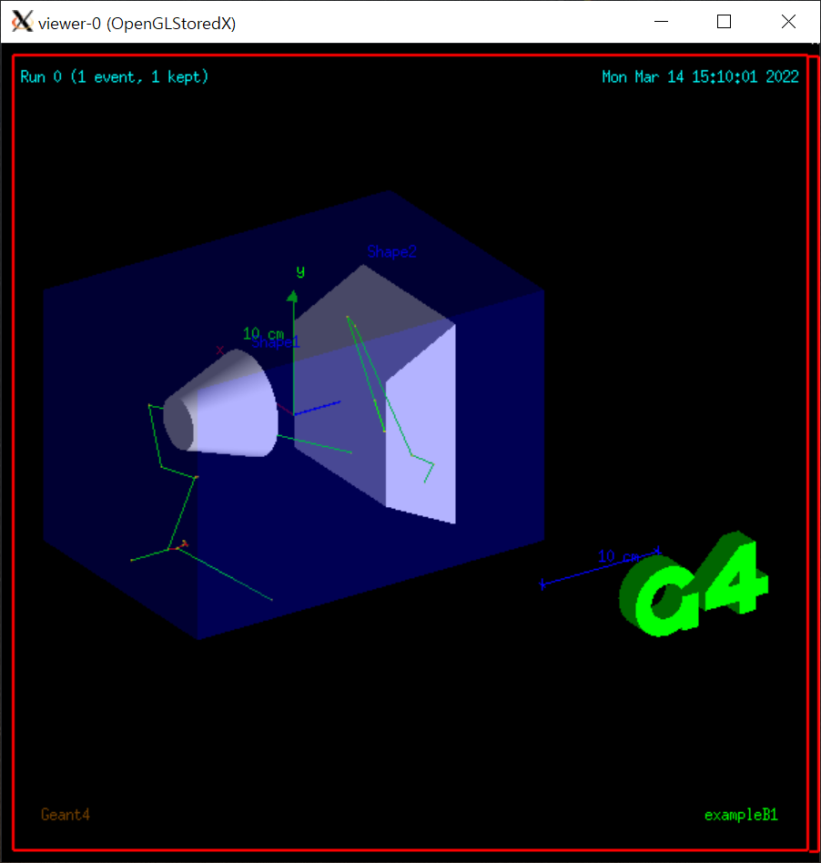
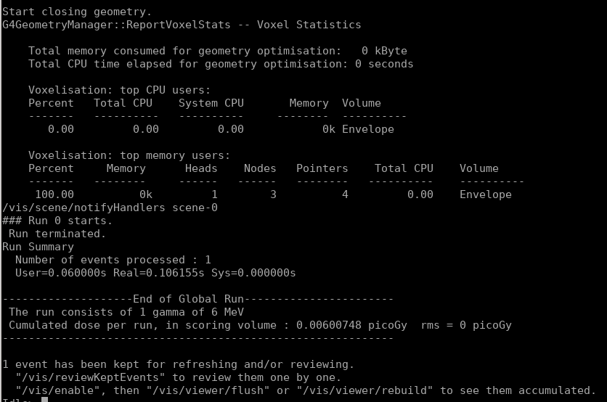
Example B1 practice
=========================================================
example)
bash
source /apps/applications/hep/conf_scripts_new/g4.11.0.0_user_conf.bash
cd /scratch/khcho/tmp/
cp -r /apps/applications/hep/geant4_update/downloads/source_codes/geant4.11.0.0/examples/basic/B1 ./
cd B1
mkdir bintest
cd bintest
cmake -DGeant4_DIR=$Geant4_DIR ..
make
./exampleB1
> run/beamOn 1
> exit

Slide 20
Example B2
For bash users,
bash
source /apps/applications/hep/conf_scripts_new/g4.11.0.0_user_conf.bash
cd MY_WORKING_DIR
cp -r /apps/applications/hep/geant4_update/downloads/source_codes/geant4.11.0.0/examples/basic/B2 ./
cd B2/B2a
mkdir bintest
cd bintest
cmake –DGeant4_DIR=$GEANT4_DIR ..
make
./exampleB2a
> run/beamOn 1
> exit

Slide 21
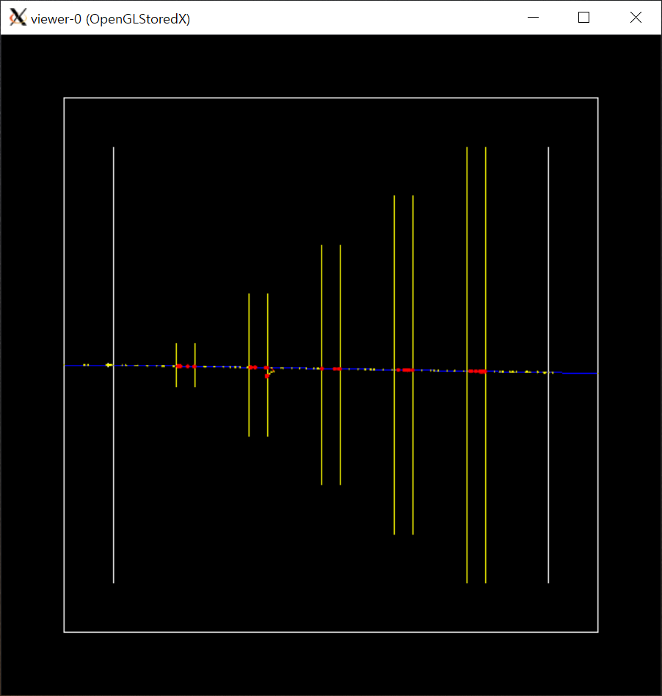
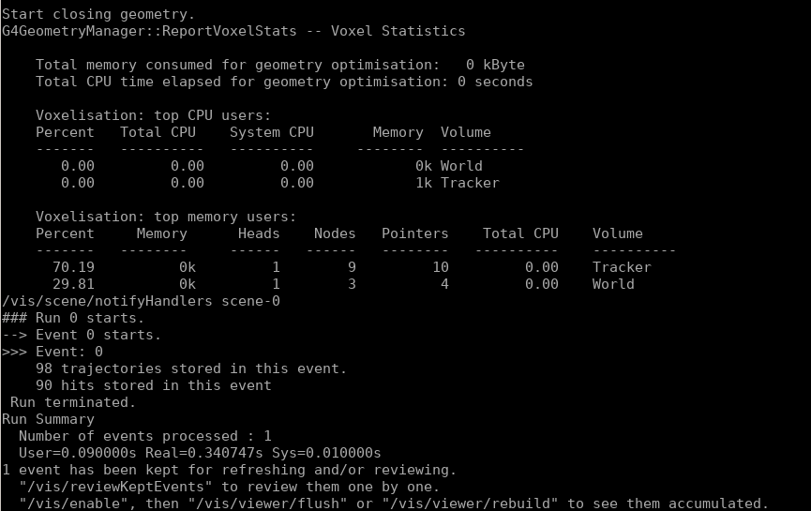
Example B2 practice
=========================================================
example)
bash
source /apps/applications/hep/conf_scripts_new/g4.11.0.0_user_conf.bash
cd /scratch/khcho/tmp/
cp -r /apps/applications/hep/geant4_update/downloads/source_codes/geant4.11.0.0/examples/basic/B2 ./
cd B2/B2a
mkdir bintest
cd bintest
cmake -DGeant4_DIR=$Geant4_DIR ..
make
./exampleB2a
> run/beamOn 1
> exit

Slide 22
Example B3
For bash users,
bash
source /apps/applications/hep/conf_scripts_new/g4.11.0.0_user_conf.bash
cd MY_WORKING_DIR
cp -r /apps/applications/hep/geant4_update/downloads/source_codes/geant4.11.0.0/examples/basic/B3 ./
cd B3/B3a
mkdir bintest
cd bintest
cmake –DGeant4_DIR=$GEANT4_DIR ..
make
./exampleB3a
> run/beamOn 1
> exit

Slide 23
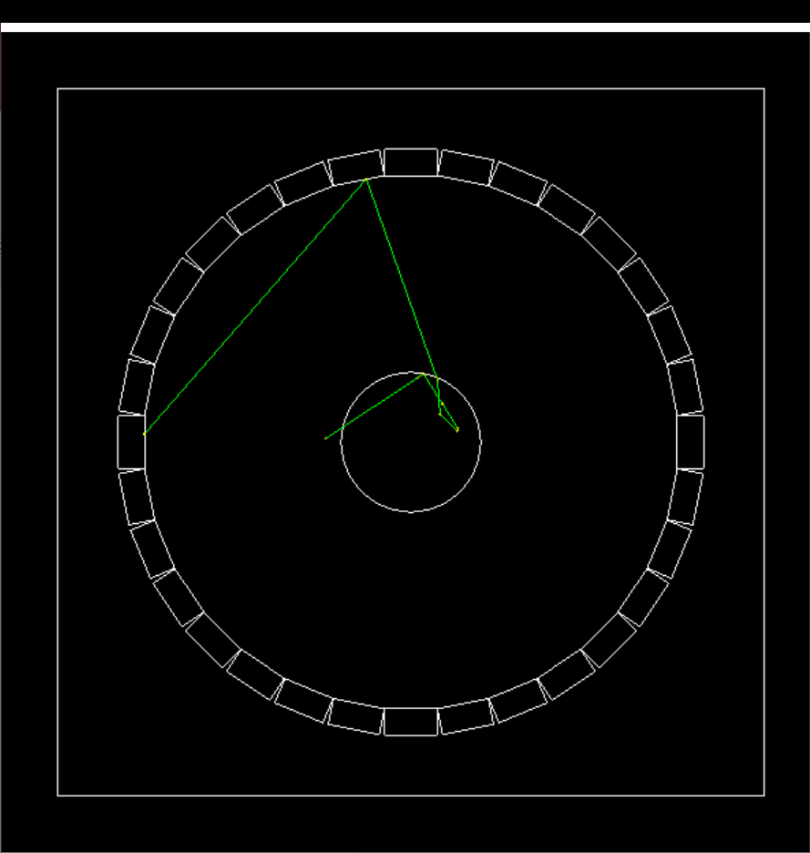
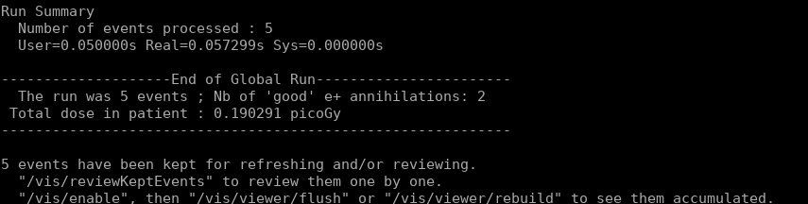
Example B3 practice
=========================================================
example)
bash
source /apps/applications/hep/conf_scripts_new/g4.11.0.0_user_conf.bash
cd /scratch/khcho/tmp/
cp -r /apps/applications/hep/geant4_update/downloads/source_codes/geant4.11.0.0/examples/basic/B3 ./
cd B3/B3a
mkdir bintest
cd bintest
cmake -DGeant4_DIR=$Geant4_DIR ..
make
./exampleB3a
> run/beamOn 1
> exit

Slide 24
Example B4
For bash users,
bash
source /apps/applications/hep/conf_scripts_new/g4.11.0.0_user_conf.bash
cd MY_WORKING_DIR
cp -r /apps/applications/hep/geant4_update/downloads/source_codes/geant4.11.0.0/examples/basic/B4 ./
cd B4/B4a
mkdir bintest
cd bintest
cmake –DGeant4_DIR=$GEANT4_DIR ..
make
./exampleB4a
> run/beamOn 1
> exit

Slide 25
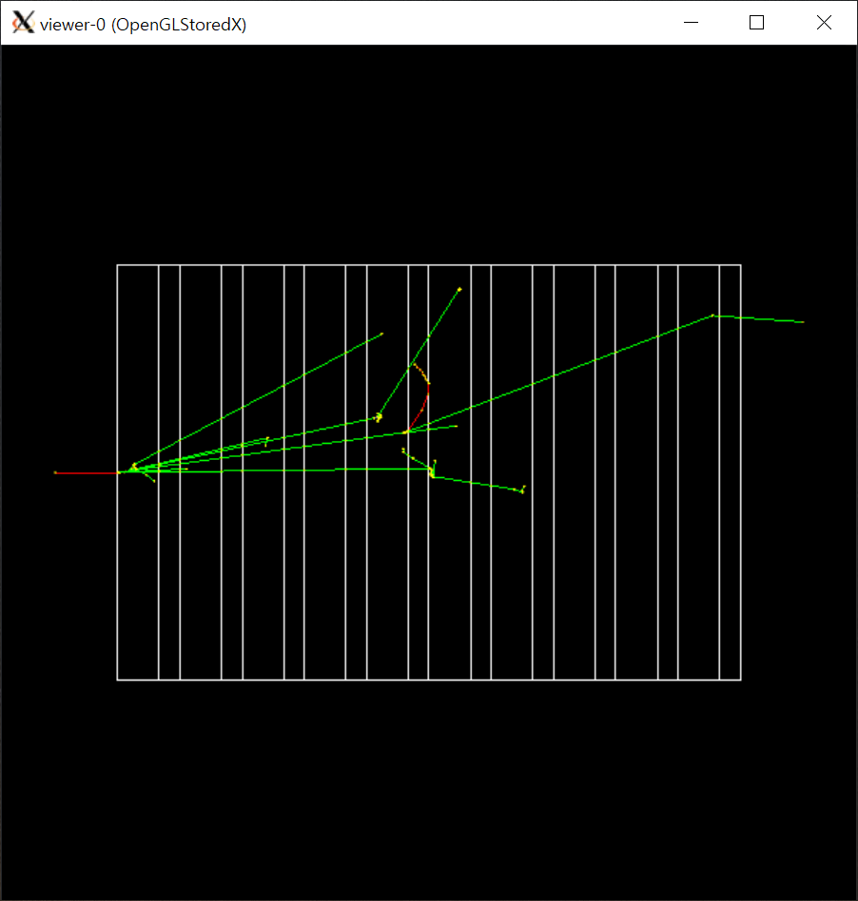
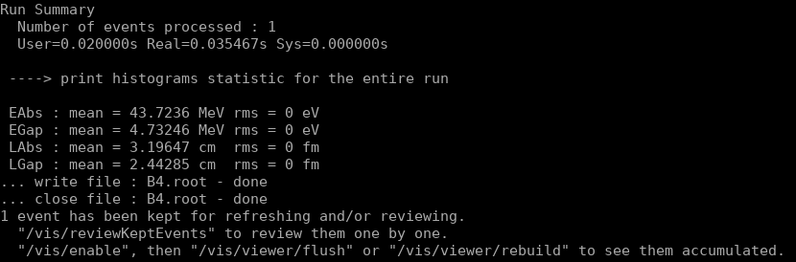
Example B4 practice
=========================================================
example)
bash
source /apps/applications/hep/conf_scripts_new/g4.11.0.0_user_conf.bash
cd /scratch/khcho/tmp/
cp -r /apps/applications/hep/geant4_update/downloads/source_codes/geant4.11.0.0/examples/basic/B4 ./
cd B4/B4a
mkdir bintest
cd bintest
cmake -DGeant4_DIR=$Geant4_DIR ..
make
./exampleB4a
> run/beamOn 1
> exit

Slide 26
Example B5
For bash users,
bash
source /apps/applications/hep/conf_scripts_new/g4.11.0.0_user_conf.bash
cd MY_WORKING_DIR
cp -r /apps/applications/hep/geant4_update/downloads/source_codes/geant4.11.0.0/examples/basic/B5 ./
cd B5
mkdir bintest
cd bintest
cmake –DGeant4_DIR=$GEANT4_DIR ..
make
./exampleB5
> run/beamOn 1
> exit

Slide 27
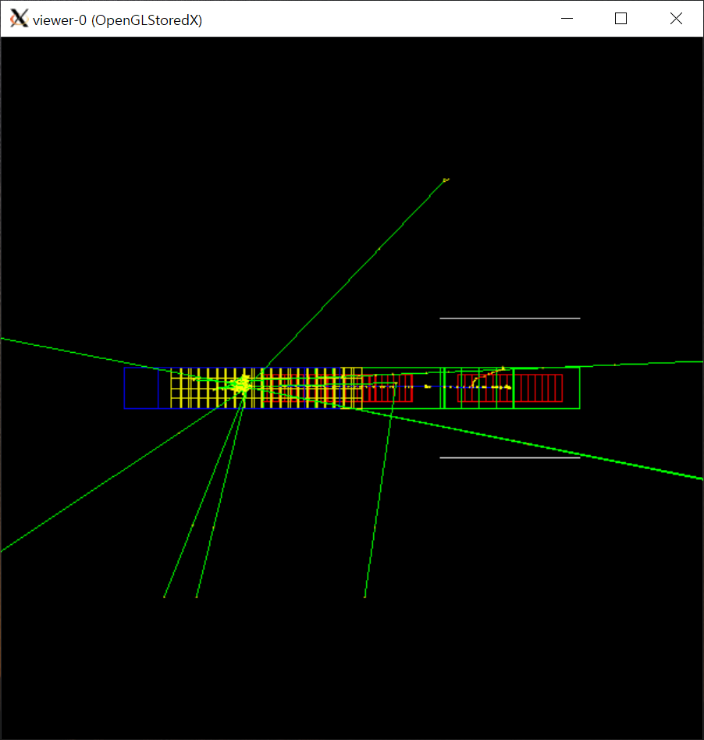
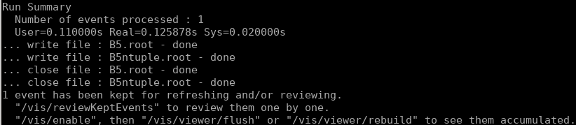
Example B5 practice
=========================================================
example)
bash
source /apps/applications/hep/conf_scripts_new/g4.11.0.0_user_conf.bash
cd /scratch/khcho/tmp/
cp -r /apps/applications/hep/geant4_update/downloads/source_codes/geant4.11.0.0/examples/basic/B5 ./
cd B5
mkdir bintest
cd bintest
cmake -DGeant4_DIR=$Geant4_DIR ..
make
./exampleB5
> run/beamOn 1
> exit

Slide 28
Summary
KISTI launched evolving computing architecture - KISTI-5 supercomputer.
⇒ KISTI-5 plays an important role in Geant4 community.

Slide 29

Q&A

Slide 30


