Slide 1
Detector Simulations Using Geant4
9th International Geant4 Tutorial in Korea 2022
Young-su Kim
Korea Atomic Energy Research Institute
Notes:
Hello. I am Young-su Kim in Korea Atomic Energy Research Institute, KAERI.
Today I would like to share my experience on detector simulations using Geant4.
First of all I would like to apologize to present this in Korean. Because I think it will not be well delivered if I use English.

Slide 2
Contents
Scintillator & Imaging System Modeling
Gamma-ray Spectrum Generator
Closing
Notes:
First item is scintillation detector and imaging system modeling and the second one is gamma-ray spectrum generator.

Slide 3
Scintillator & Imaging System Modeling

Slide 4

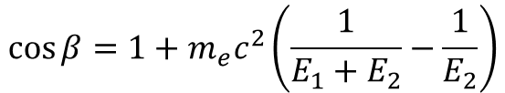

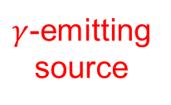




Principle of Compton Camera
Compton camera — the eye to see radiation
Scatter
Absorber
$$E_{2},P_{2}$$
$$β$$
$$E_{1},P_{1}$$
$$E_{2},P_{2}$$
$γ$-emitting source
$$β$$
$$E_{1},P_{1}$$
$$\cos{β}=1+m_{e}c^{2}\left(\frac{1}{E_{1}+E_{2}}−\frac{1}{E_{2}}\right)$$
Notes:
The imaging system, I participated to develop one, was Compton camera.
Compton camera is so-called the eye to see radiation, which is able to image the location of gamma-ray emitting radio isotopes.
By using the formula to calculate Compton scattering angle, shown here, and by using the energy and position information of each component detector,
we can draw a cone that cross the point of the source gamma emitted.
By overlapping these cones over and over, the source location can be imaged.

Slide 5
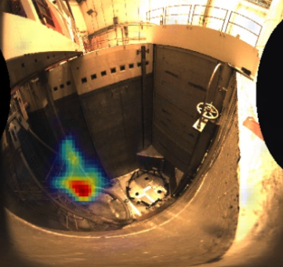
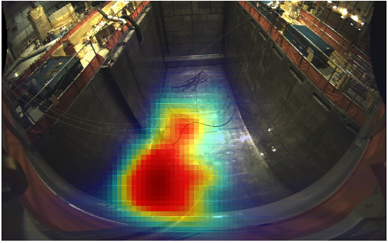
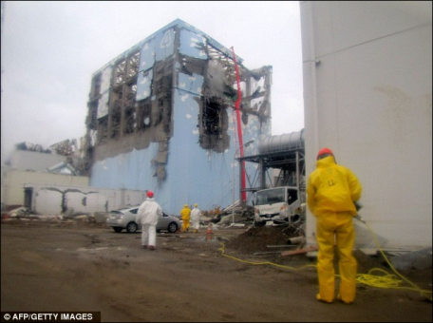
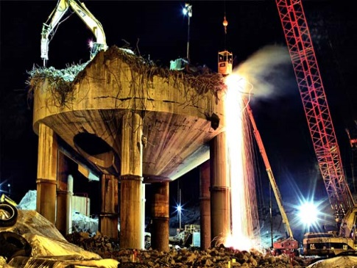
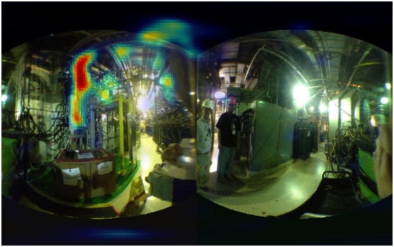
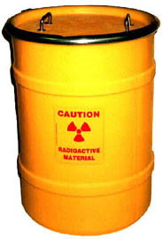
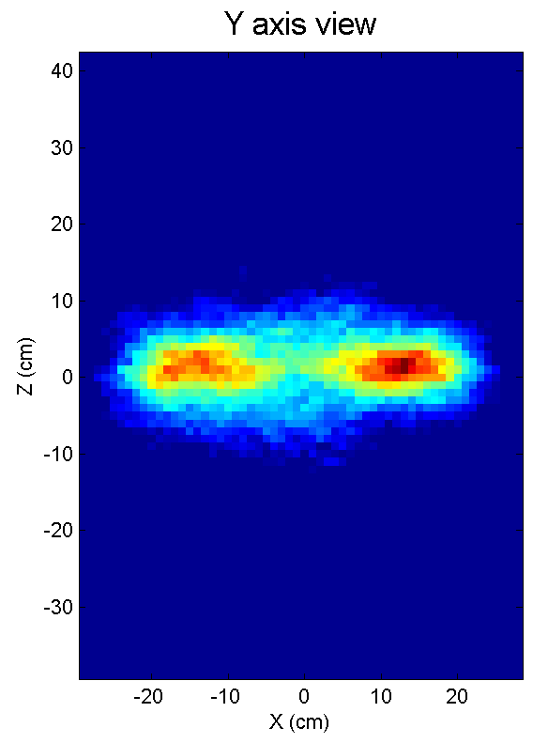
Application of Compton Camera (1/2)
Nuclear industry
- Localization of primary source term / clean-up verification
- Localization of radioactive contamination (nuclear accident, decommissioning)
- Locating and tracking crud in pipe and valves / tracking sources through time
- Radioactive waste characterization
Geant4 simulation: ⁶⁰Co and ¹³⁷Cs hot spots
- Identifying fuel failures
- Shielding design and optimization
- Etc.
Notes:
Compton camera has special advantage of imaging high energy gamma-ray emitting radio-isotope
So it is widely applied in various industries including …

Slide 6
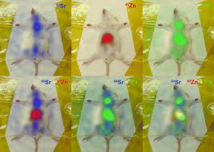
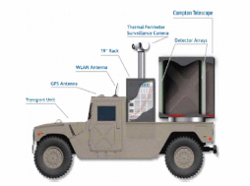
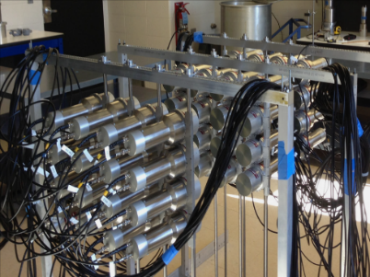
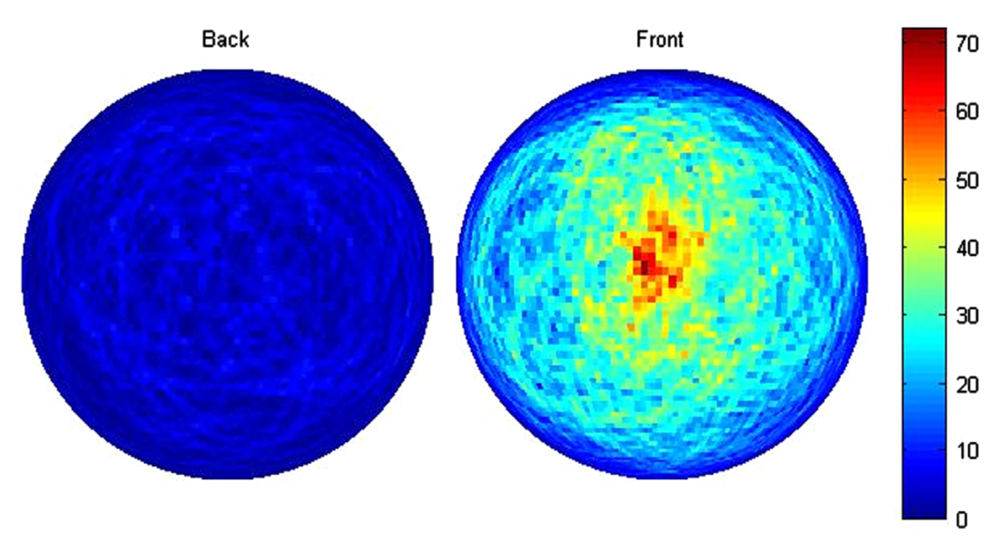
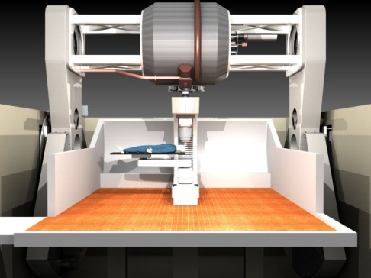
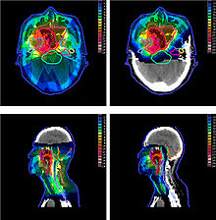
Application of Compton Camera (2/2)
Homeland security
Medical applications
Large area Compton camera for surveillance
(University of Michigan, 2012)
- Nuclear medicine and molecular imaging
- Dose verification during in particle therapy

Slide 7
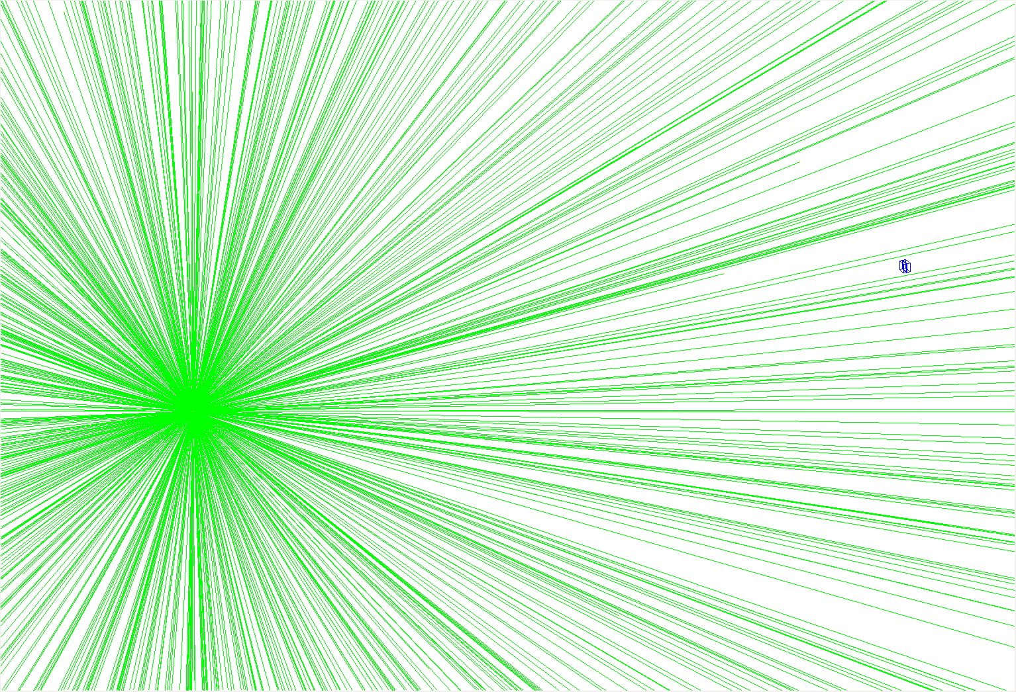
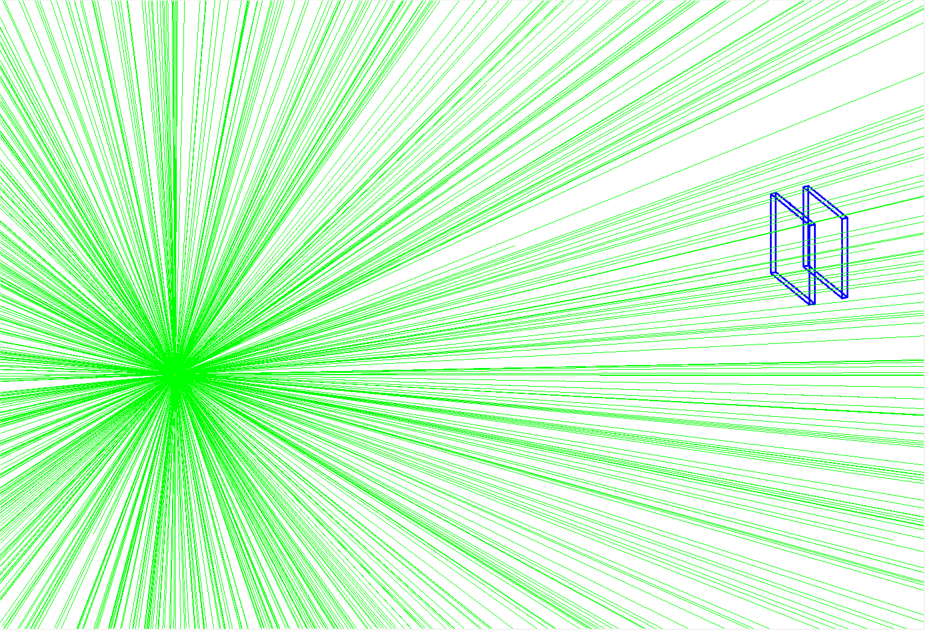
Necessity of “Large-area” Compton Camera
Existing Compton camera size:
<10 cm
Small Compton camera
Uses small detectors (<10 cm) → low interaction probability → low imaging sensitivity
Source-to-detector distance:
~a few meter
Proposed Compton camera size: ~a few tens cm
Large-Area Compton camera
Uses large detectors (a few tens cm) → high interaction probability → high imaging sensitivity (a few tens of times higher)
Notes:
There have been some Compton cameras, but most of them are very small.
Small systems have advantage of portability, but basically they suffer from low imaging sensitivity.
As you can easily imagine, the larger system size, the higher imaging sensitivity.

Slide 8
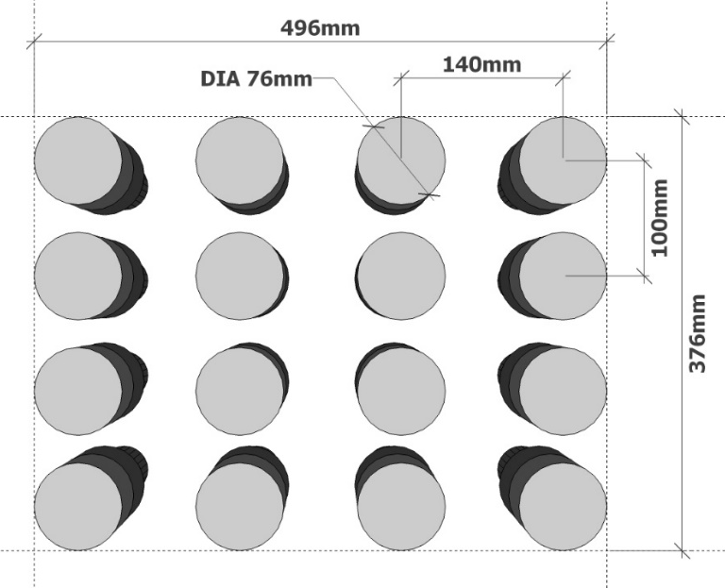
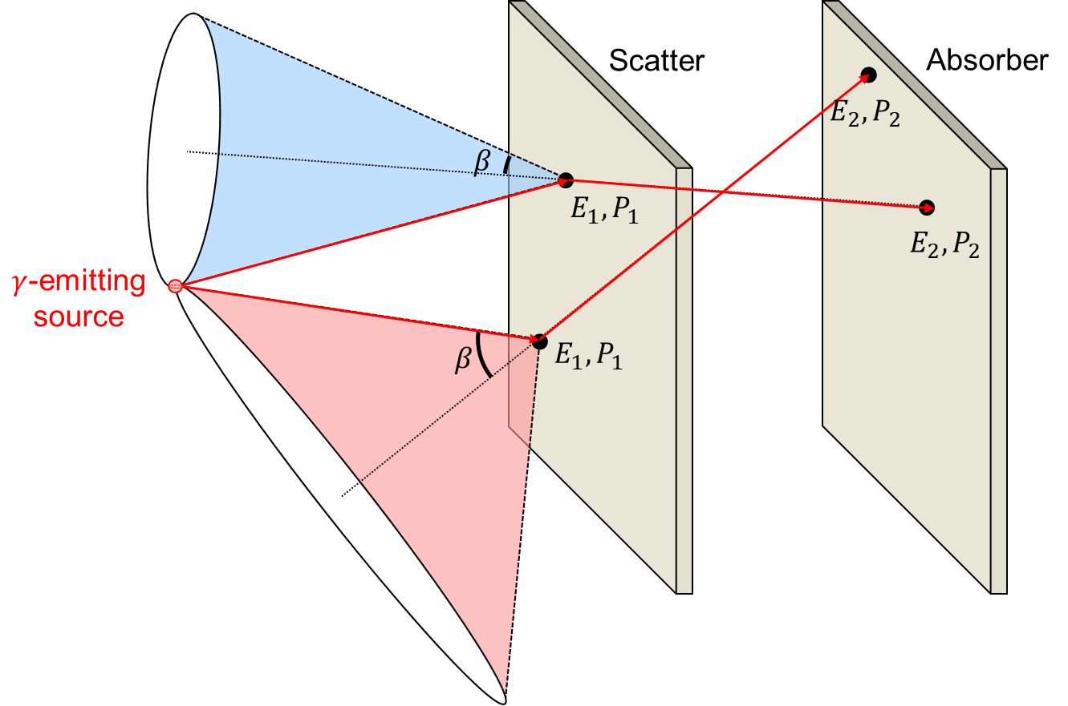
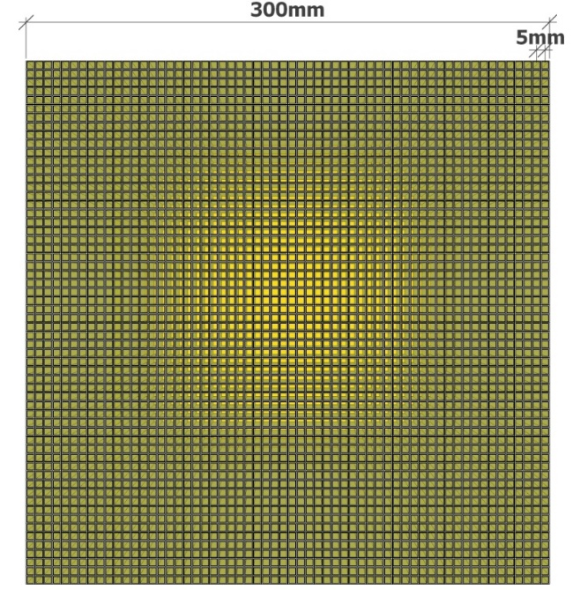
Enlarging Component Detectors
Example: Dual particle imager (University of Michigan)
Achieved large size (a few tens cm) and cost effectiveness
Low fill factor of each layer which causes loss of sensitivity
Poor spatial resolution (100–140 mm pitch) which causes deterioration of image resolution
No example
Achievable outstanding spatial resolution (a few mm pitch) and large size (a few tens cm)
High production cost for both the pixelated crystal and multiple photo-sensors
Difficult to manufacture and maintain the crystal array structure
Notes:
But enlarging component detectors is quite tricky and difficult.
Simple idea is to use of multiple detectors like this, but the fill factor is too low and the spatial resolution is also poor. Whole system size could be enlarged easily, but hard to earn a merit.
Another idea is to use pixelated detector. But this is very hard to be applicable in real world because it needs too high production cost, moreover, it is difficult to manufacture and handling.

Slide 9
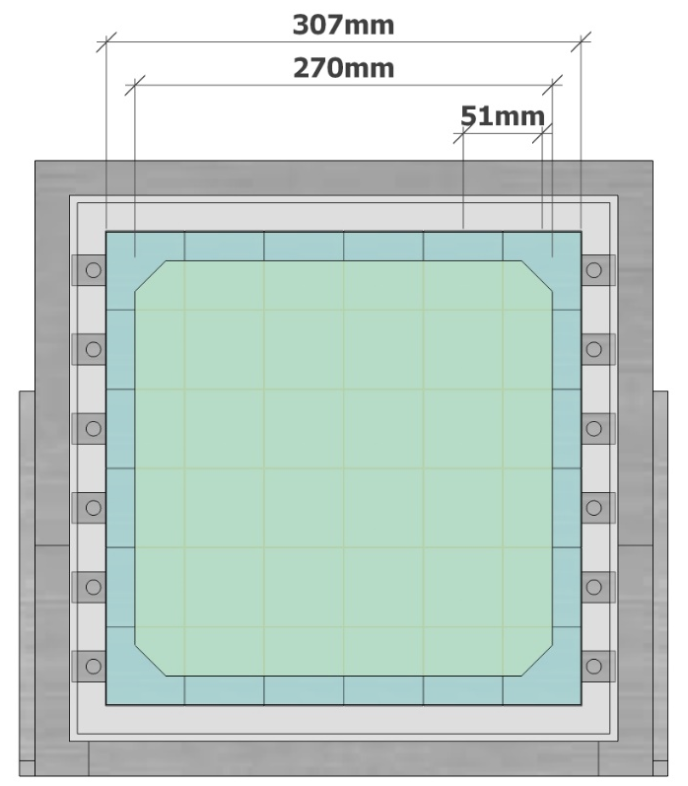
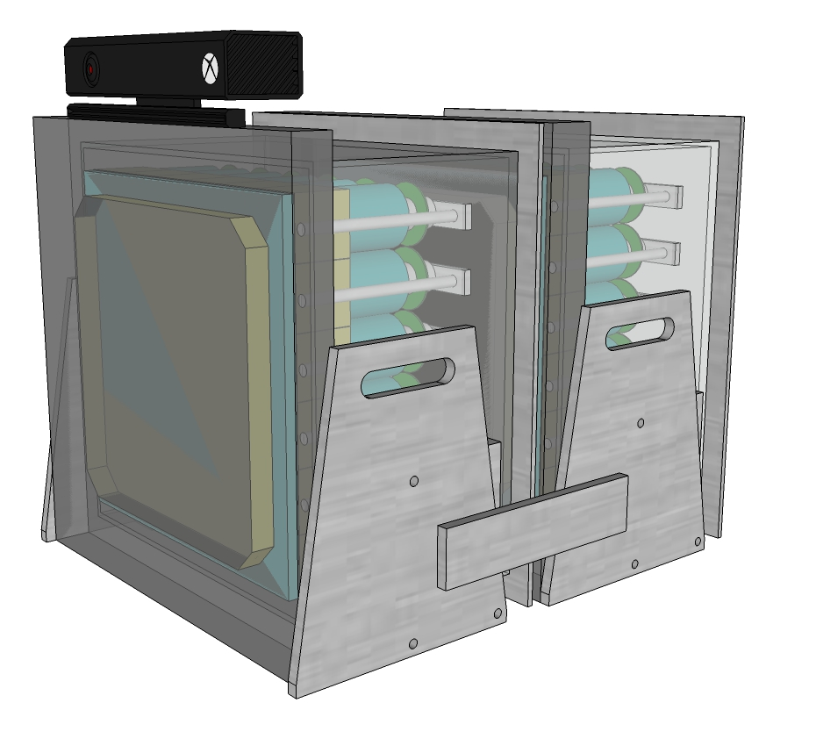
Conceptual design of Large-area Compton camera
Range scanner
27 cm
Effective area: 27×27 cm²
Large monolithic scintillation detectors crystal: NaI(Tl) (27×27 cm²) photo-sensor: 6×6 PMT array (5.1×5.1 cm²)
Achievable large size (a few tens cm) and cost effectiveness
Achievable spatial resolution as excellent as a pixelated one, by using interaction position estimating algorithm
Large monolithic scintillator with an array of photomultiplier tubes
Notes:
Here, the conceptual design of the large-area Compton camera is like this.
The large-size monolithic scintillation detector composed of NaI(Tl) crystal.
The size

Slide 10
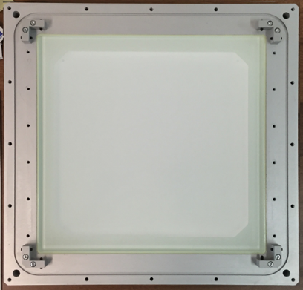
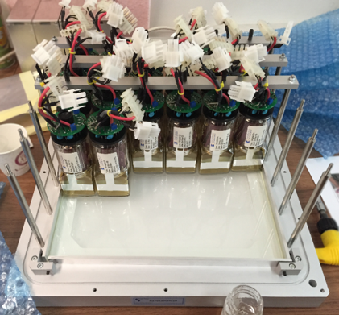
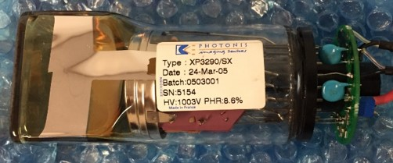
Component Detector
Monolithic crystal
Order-made. Scintitech, MA, USA
Crystal dimension 27×27×2 cm³ (for scatter) 27×27×3 cm³ (for absorber)
Material: NaI(Tl)
Optical window dimension: 30×30×1 cm³
Photomultiplier tube (PMT) array
PMT: XP3290, Photonis, MA, USA
Entrance window dimension: □ 51×51 mm²
Window material: borosilicate glass
Cathode dimension: □ 48×48 mm²
Array: □ 6×6

Slide 11
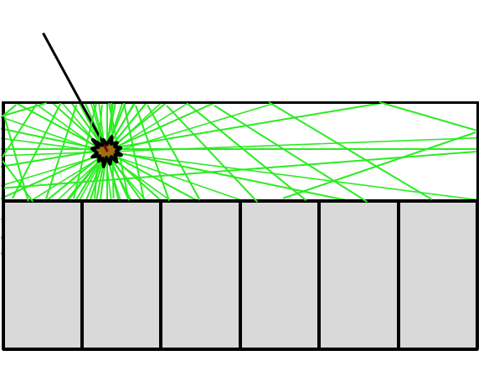

Interaction Position Estimation in Monolithic Scintillator
$γ$-ray
Monolithic crystal
Scintillation lights
PMT array
How to know where the interaction position was?
Interacted position
Can be estimated by analyzing the dispersion pattern of the scintillation lights
→
by Maximum Likelihood Position Estimation (MLPE) algorithm

Slide 12
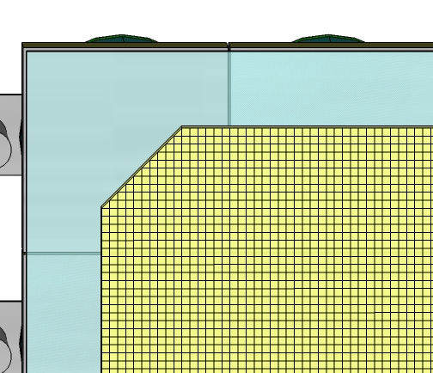
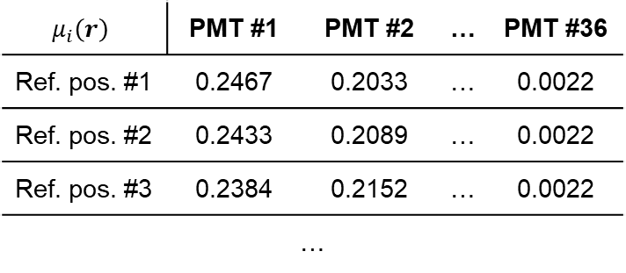
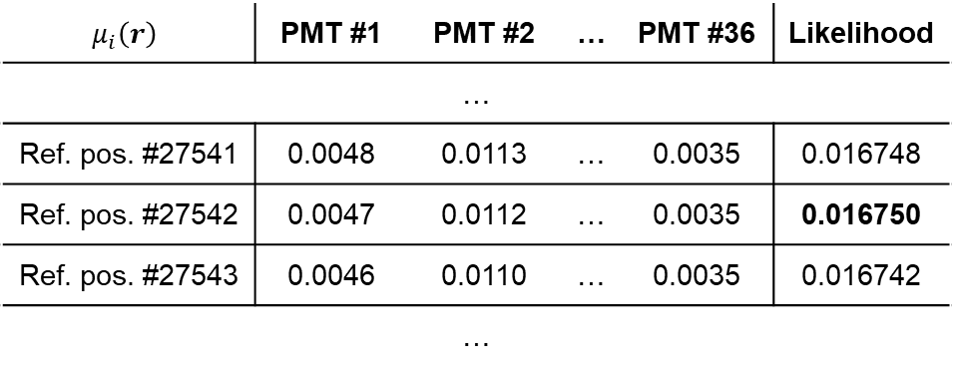

MLPE Procedure
Pre-process: look-up table generation
Estimation process
$$\hat{r}=\underset{r}{argmax}{L\left(r|g_{i}\right)}$$
Virtual grid
Measured value on $i$^{th} detector channel for unknown position
Example)
 | PMT #1 | PMT #2 | … | PMT #36
Measured | 0.0047 | 0.0112 | … | 0.0035
Look-up table
$$μ_{i}\left(r\right)$$ | PMT #1 | PMT #2 | … | PMT #36
Ref. pos. #1 | 0.2467 | 0.2033 | … | 0.0022
Ref. pos. #2 | 0.2433 | 0.2089 | … | 0.0022
Ref. pos. #3 | 0.2384 | 0.2152 | … | 0.0022
…
$$μ_{i}\left(r\right)$$ | PMT #1 | PMT #2 | … | PMT #36 | Likelihood
…
Ref. pos. #27541 | 0.0048 | 0.0113 | … | 0.0035 | 0.016748
Ref. pos. #27542 | 0.0047 | 0.0112 | … | 0.0035 | 0.016750
Ref. pos. #27543 | 0.0046 | 0.0110 | … | 0.0035 | 0.016742
…
best
estimation

Slide 13
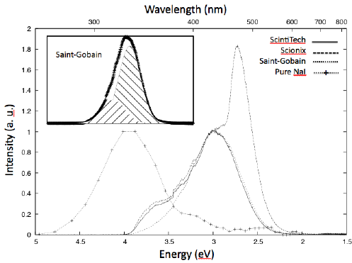
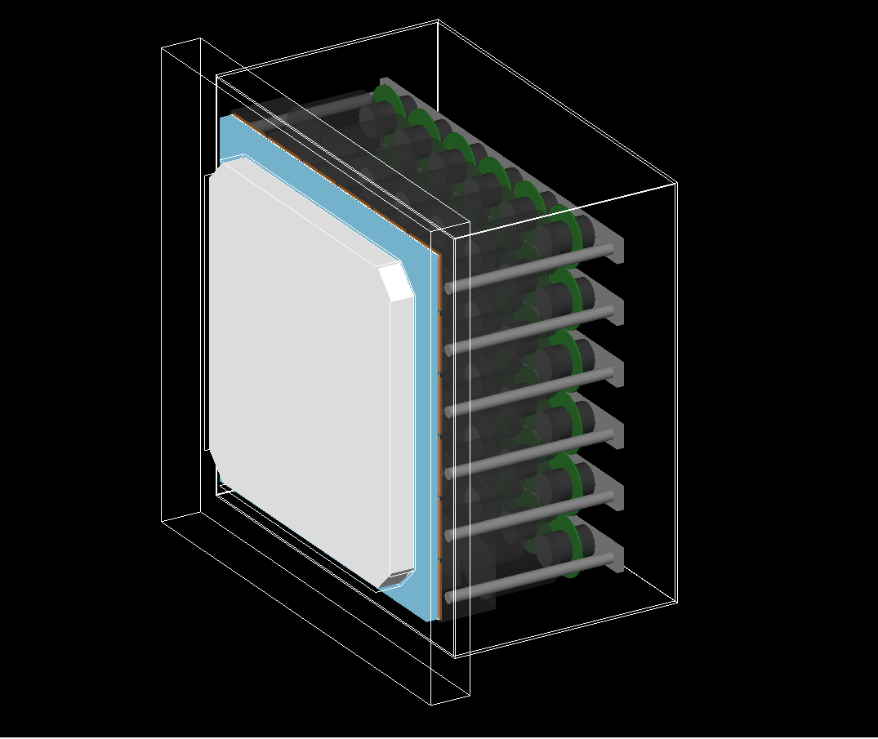
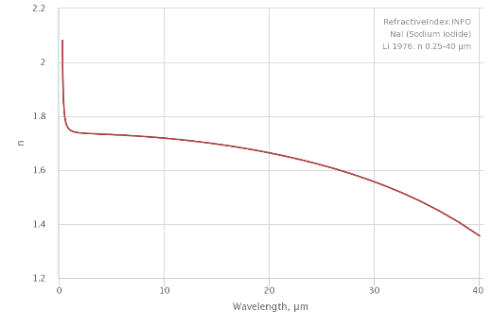
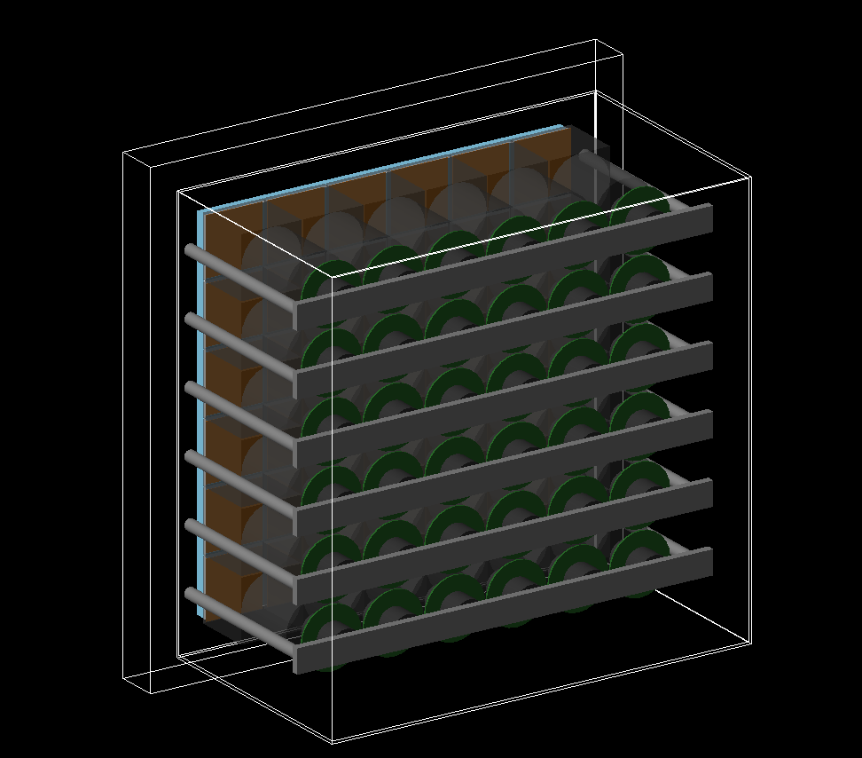
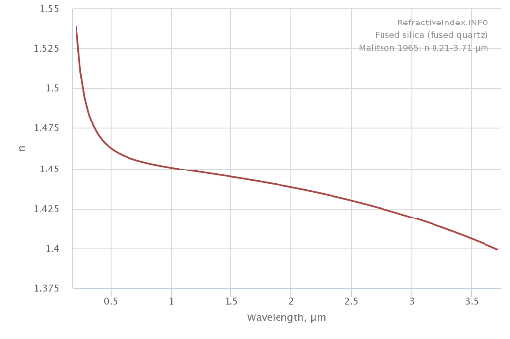
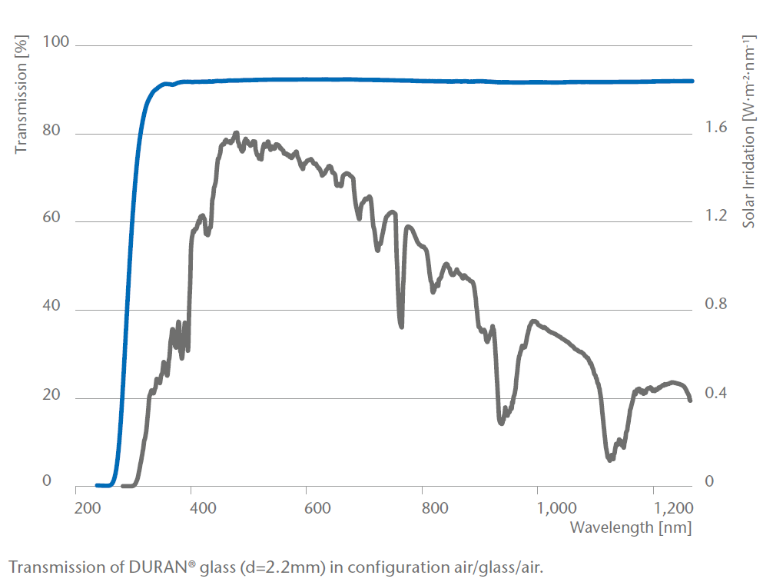
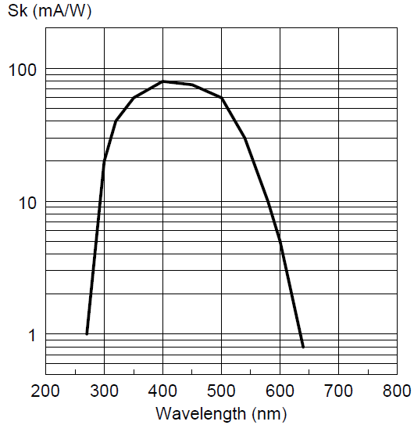
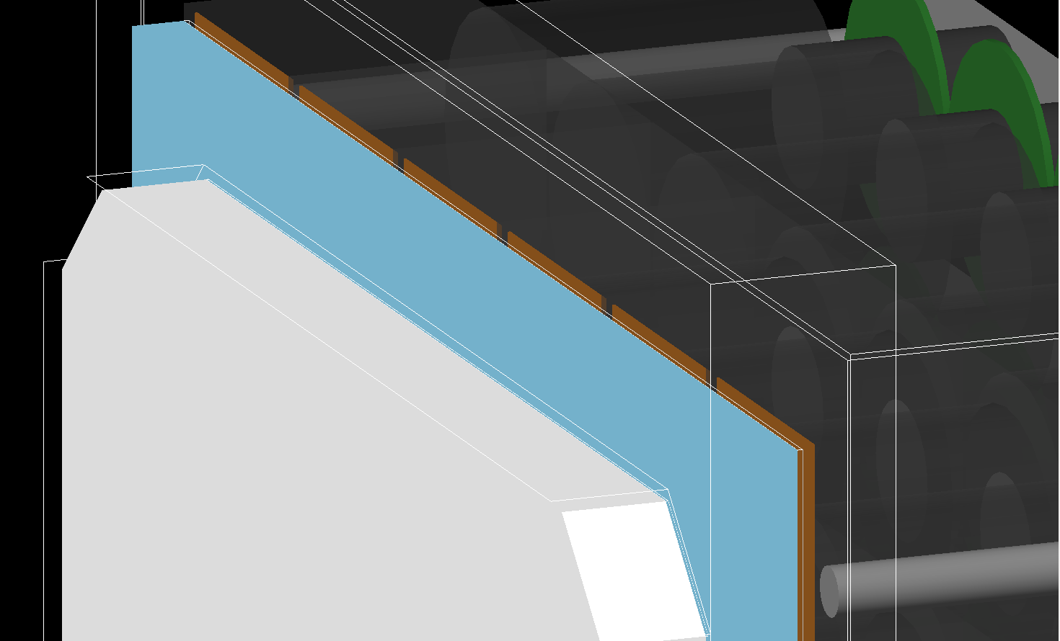
Scintillator Modeling (1/2)
Light yield
Refractive Index
Refractive Index
Transmission
Quantom Efficiency

Slide 14
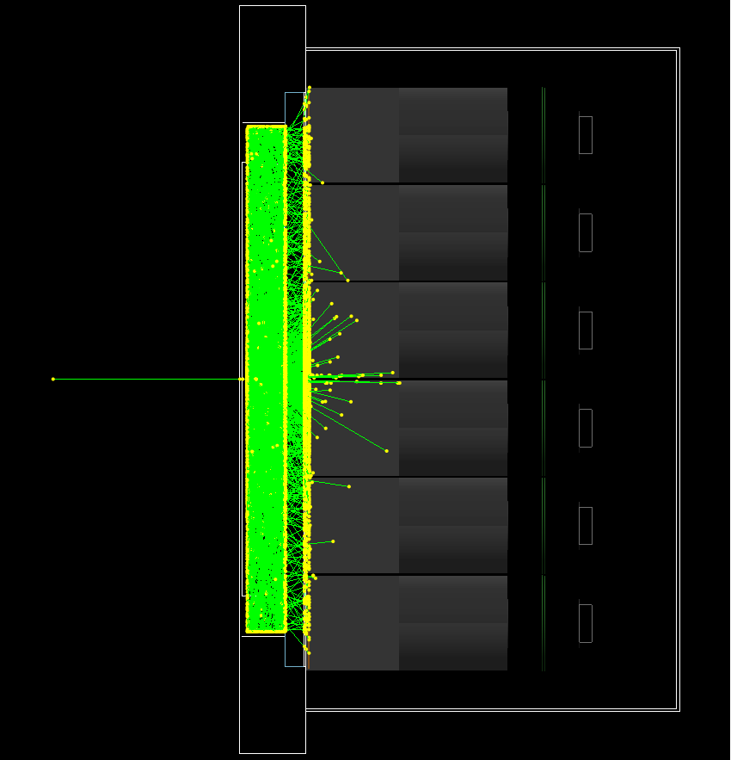
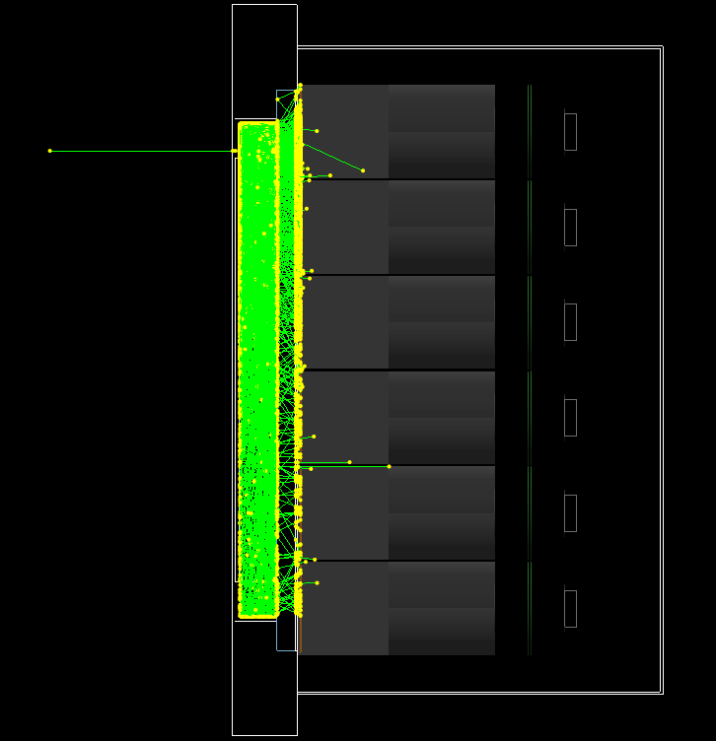
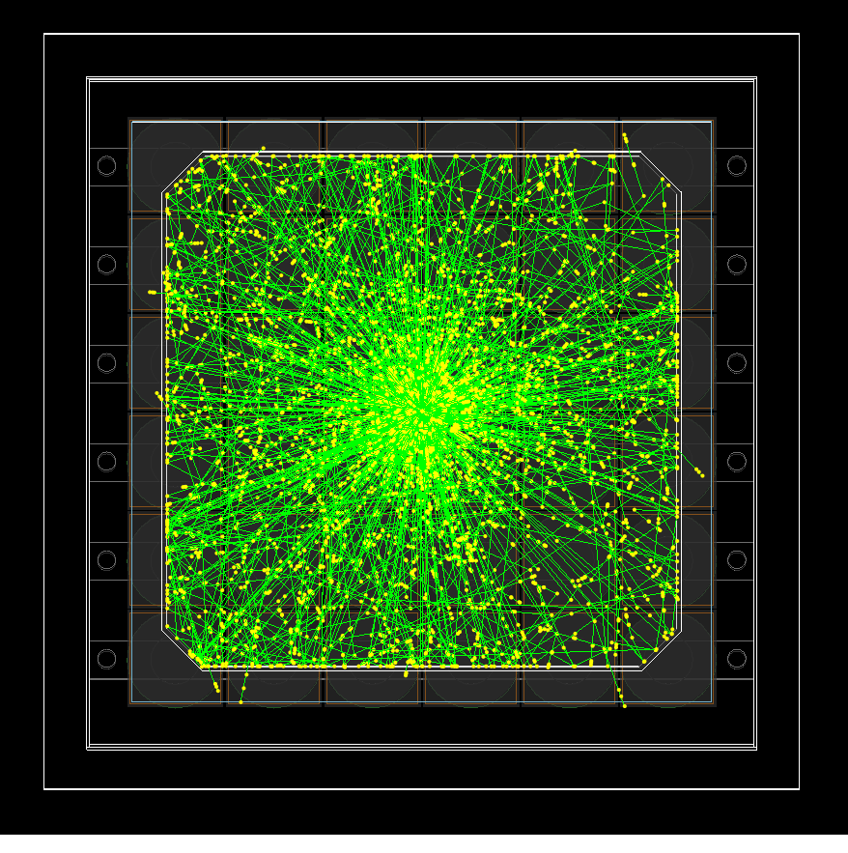
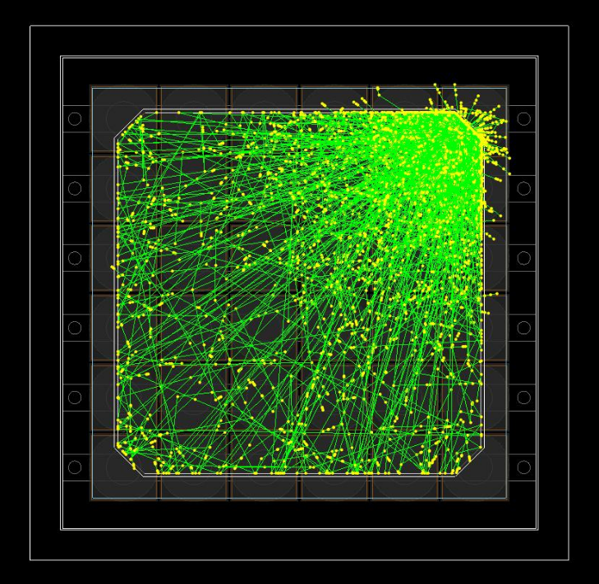
Scintillator Modeling (2/2)
*Downscaled to 1/30 light yield in these pictures

Slide 15
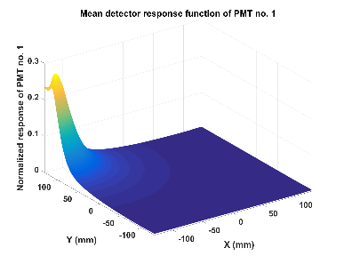
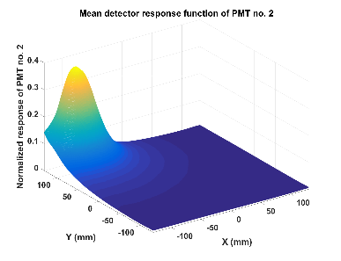
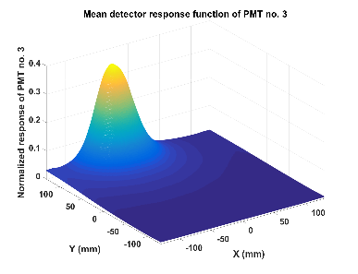
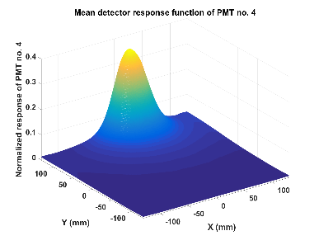
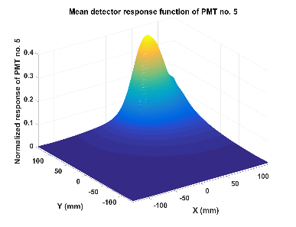
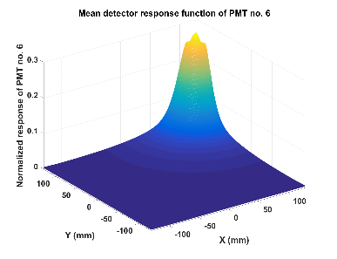
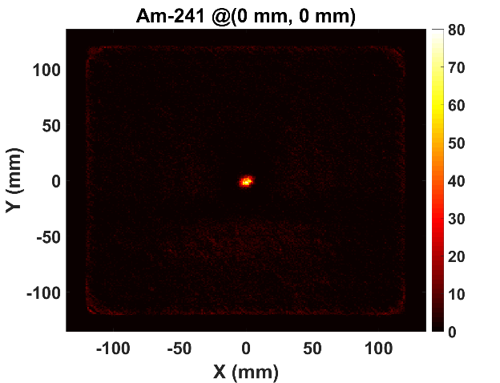
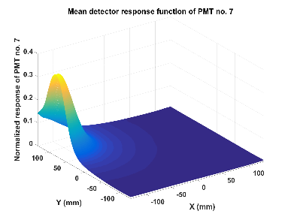
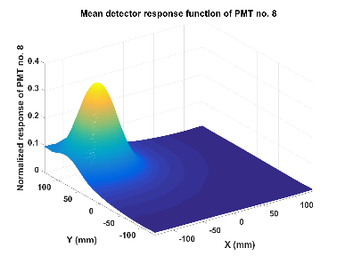






























Experimental Results

Slide 16


Imaging System Optimization
Simulation toolkit: Geant4 (version 10.3)
Physics model: G4EmLivermorePhysics
Radiation source:
0.662 MeV
isotropic gamma-ray source
1 m in front of the system
10⁸ particles (equivalent to ~10 µCi ¹³⁷Cs×5 min. measurement)
Thickness of scatter: 0.5, 1.0, 1.5, 2.0, 2.5, 3.0, 3.5, 4.0 cm
Thickness of absorber: 0.5, 1.0, 1.5, 2.0, 2.5, 3.0, 3.5, 4.0 cm
Distance between scatter & absorber: 20 cm, 25 cm, 30 cm

Slide 17

Performance Parameters
Imaging sensitivity $\left(sensitivity\right)=\frac{\left(\# of effective detection\right)}{\left(\# of primary particles\right)}$
Resolution FWHM of the point source image
To consider both sensitivity and resolution, we used FOM (figure-of-merit) calculate as $\left(FOM\right)=\frac{\left(sensitivity\right)}{{\left(resolution\right)}^{3}}$
Additionally, considering the price of the detector, FOM per crystal volume is used.

Slide 18



Optimization Results

Slide 19




Large-Area Compton Camera
Source
Source
Source

Slide 20
Gamma-ray Spectrum Generator

Slide 21

Machine Learning for Gamma Spectroscopy
Many recent studies on gamma spectroscopy have adopted machine learning techniques as increasing in accessibility of the techniques.
To develop gamma spectroscopy algorithms based on machine learning, it requires a considerable amount of gamma-ray spectrum data with known radio-isotope concentrations.

Slide 22


Data, More Data!

Slide 23



Experimental Environment
HPGe Detector
CANBERRA
Model No.: GR6022
Dimension: Φ67.3 mm × 65.1 mm
Experimental environment
5-cm-thick Pb block to shield external radiation
Point source placed in front of 7.5 cm from the detector head following main axis
Source: ¹³⁷Cs 370.3 kBq, ⁶⁰Co 212.3 kBq

Slide 24




Monte Carlo Simulation
Monte Carlo Simulation
Geant4 version 11.0
Detailed geometry modeling corresponding to the datasheet & experimental environment
G4EmLivermorePhysics
1×10⁸ primary particles

Slide 25


Limitation of Naïve Monte Carlo Simulation
Takes too long time
Do not reflect characteristics of detector
coincidence sum, dead time loss
energy resolution

Slide 26

Spectrum Generation Procedure (1/2)
Save data as list-mode format
A nuclide of radio-isotope is set to be a primary particle.
A single decay == an event number
Record (event #, deposited energy) pair, rather than counts per energy bin in general simulation
Refine data
Event number → Measured time of the detector (activity, timing resolution)
Data refining considering charge collection time & dead-time(coincidence sum, count loss)
Data refining considering energy resolution

Slide 27

Spectrum Generation Procedure (2/2)
Same process as single nuclide data
Need to sorting process as measured time when combining multiple nuclide data
The final list-mode data can be directly converted to an energy spectrum.

Slide 28

Time Comparison
A naïve Monte Carlo simulation took about a few hours per a spectrum for 1×10⁸ of primary particles. (i9-11900K @3.50GHz, single core)
The generator takes about 10–20 minutes to generate a spectrum.
The generator requires single nuclide spectra for every isotope as prerequisites.
After then, it took 10–20 min. per a spectrum.

Slide 29




Validation Results
Photopeak counts: 98.8% (662 keV; ¹³⁷Cs), 98.9% (1173 keV; ⁶⁰Co), 99.0% (1332 keV; ⁶⁰Co)
Whole range(0–3000 keV) similarity: 94.3% (¹³⁷Cs), 94.6% (⁶⁰Co) (c.f. naïve MC: ~30%)
Cs-137 only
Co-60 only
Cs-137 + Co-60

Slide 30
Closing

Slide 31
Closing

Slide 32
Thank You

