Slide 1

Introduction to TOPAS MVLinac example
Kyungdon Choi
2022. 12. 05.

Slide 2
Index
TOPAS introduction
2. Components (Siemens Oncor)
3. Treatment head simulation
4. TOPAS external code

Slide 3



TOPAS introduction
TOPAS -> GEANT 4 wrapper for proton therapy
Application: Proton therapy, conventional radiation therapy, Positron Emission Tomography and etc.
Easy to generate geometry: Support basic shapes as well as external expansions
No user fee for academic users, NIH is currently funding for TOPAS academic users

Slide 4
TOPAS introduction
How to get access to TOPAS
Register as a user at http://www.topasmc.org/home
Wait until TOPAS introduction (online) course is open
Attend the TOPAS introduction course when it is open (Usually morning in pacific time and dawn in Korea time)
Login to TOPAS page and download lastest (or proper) version for your system

Slide 5
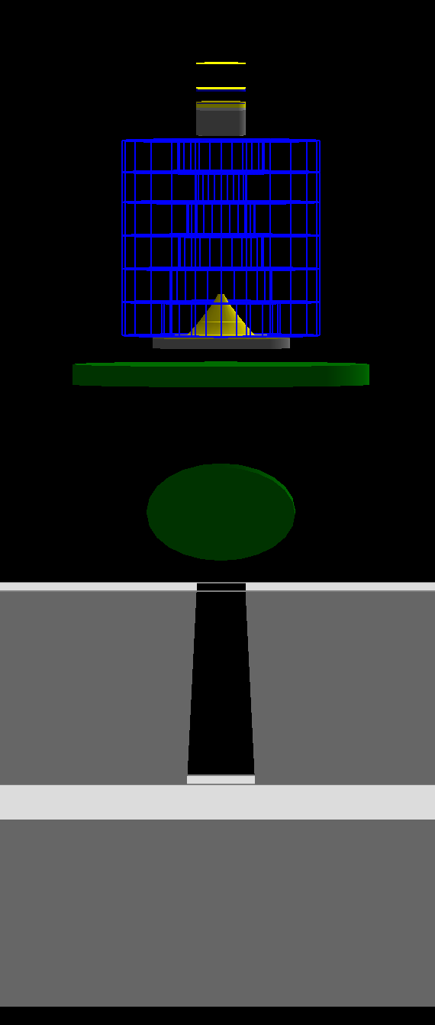
Components
Electron Beam
Target
Primary collimator
Primary collimator
Detector and mirror
Jaws
Multi leaf collimator

Slide 6
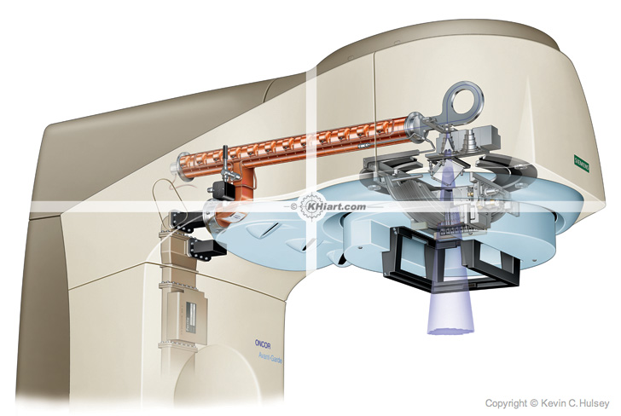
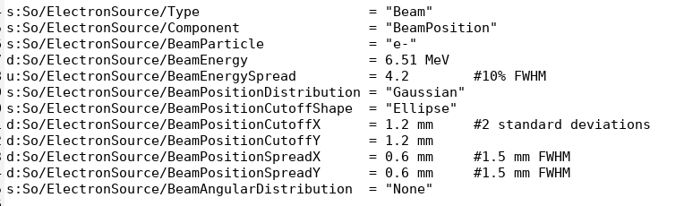
Components
Electron Beam
270 degree bending magnet
Target
LINAC: Accelerate electron

Slide 7
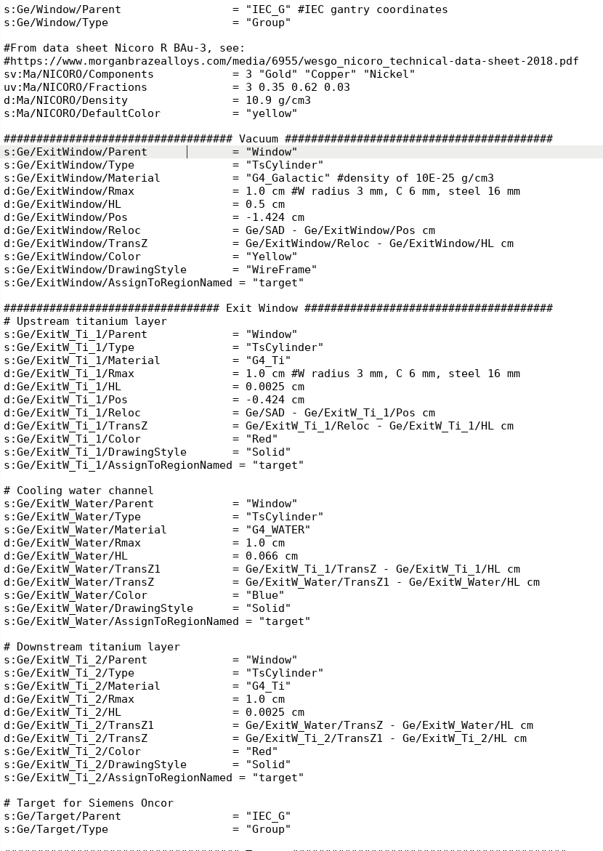
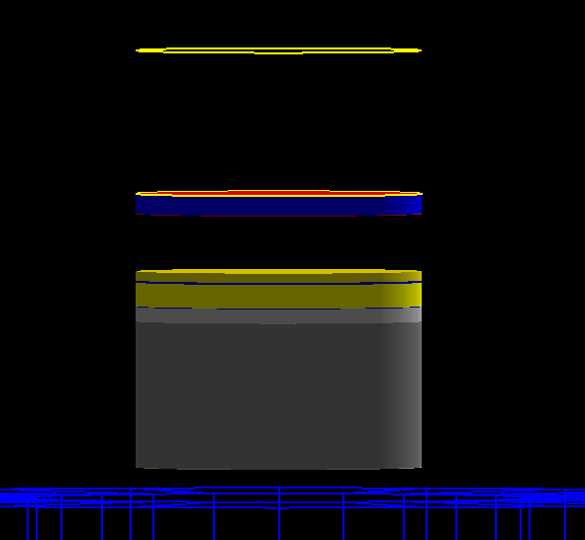
Components
Target
Vacuum
Exit window

Slide 8
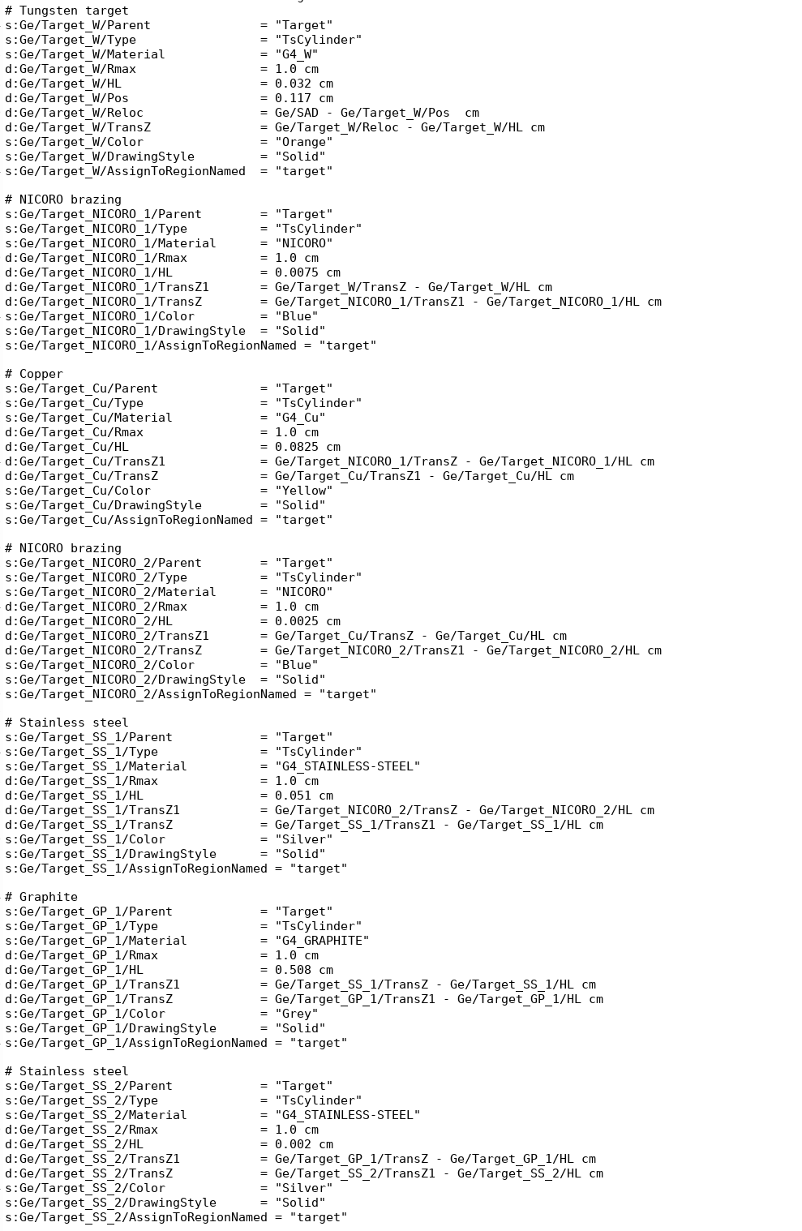
Components
Target
Target

Slide 9
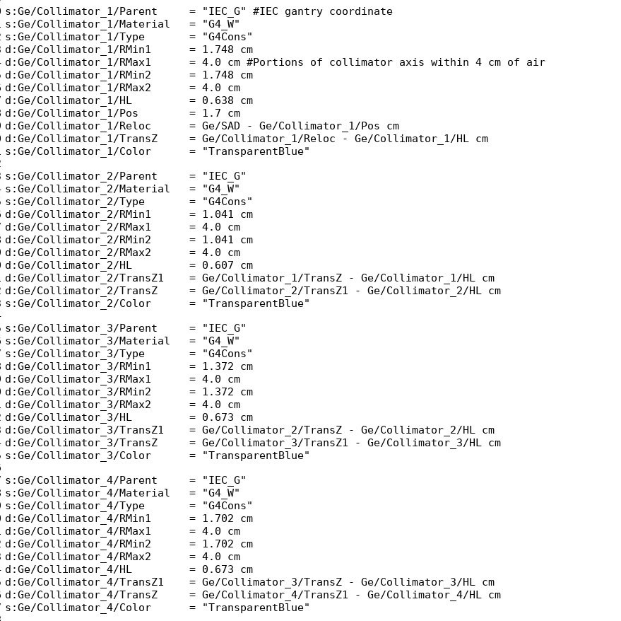
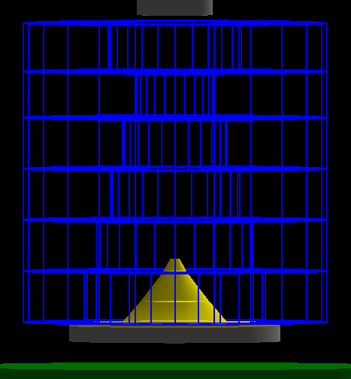
Components
Primary Collimator
Primary Collimator

Slide 10
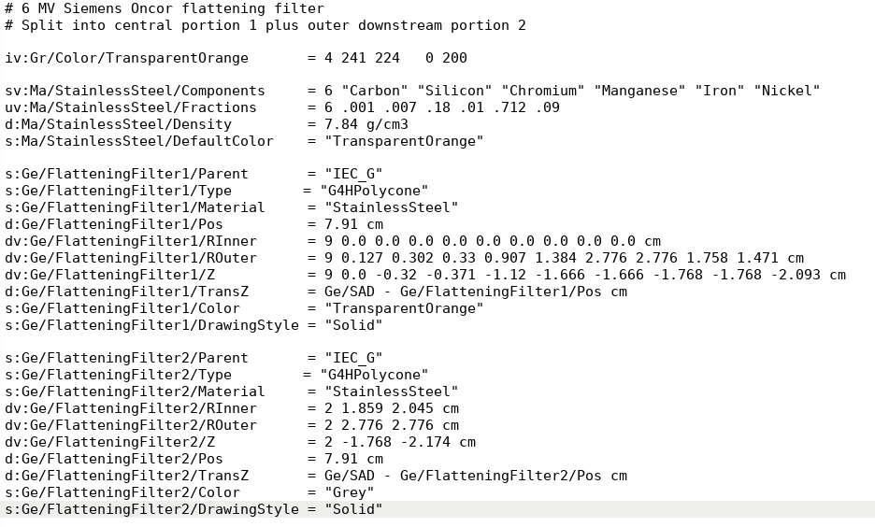
Components
Flattening Filter 6MV
Flattening Filter 6MV

Slide 11
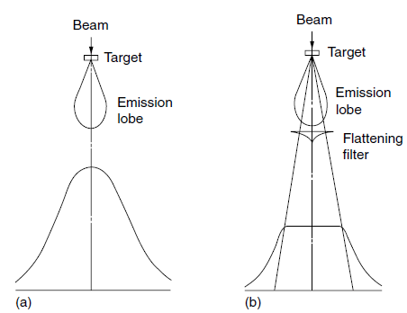
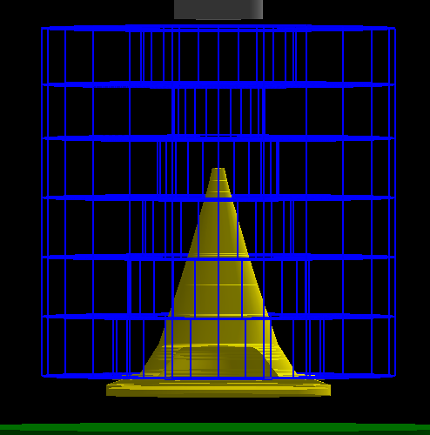
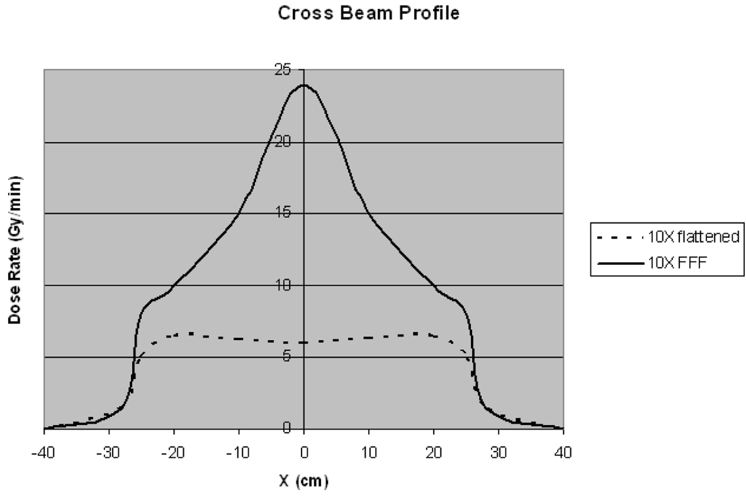
Components
Flattening Filter 18MV

Slide 12
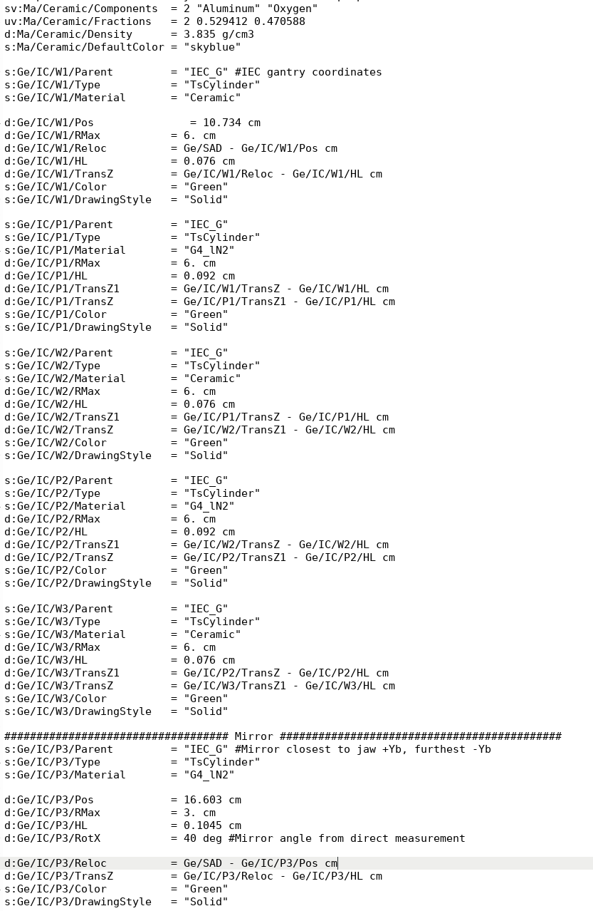
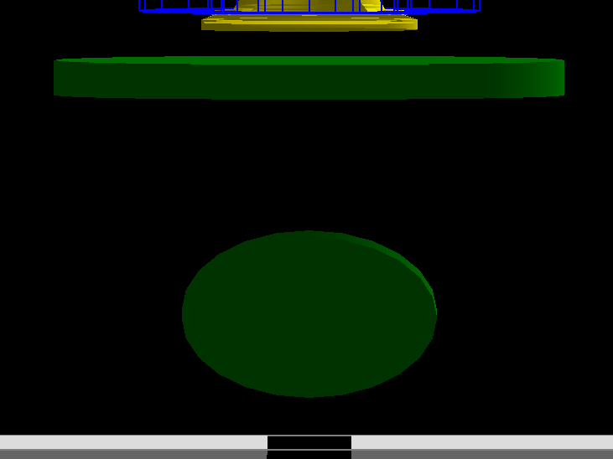
Components
Detector and Mirror

Slide 13
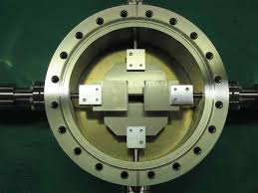
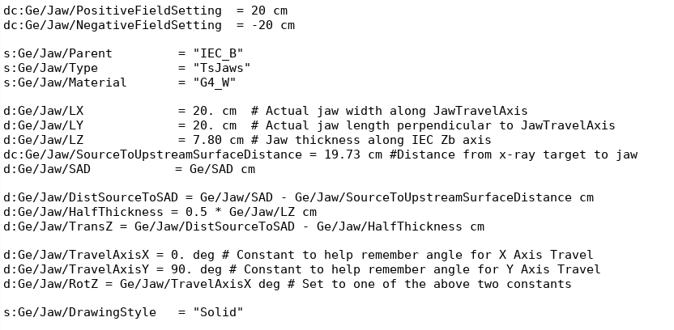
Components
Jaws
Jaws

Slide 14

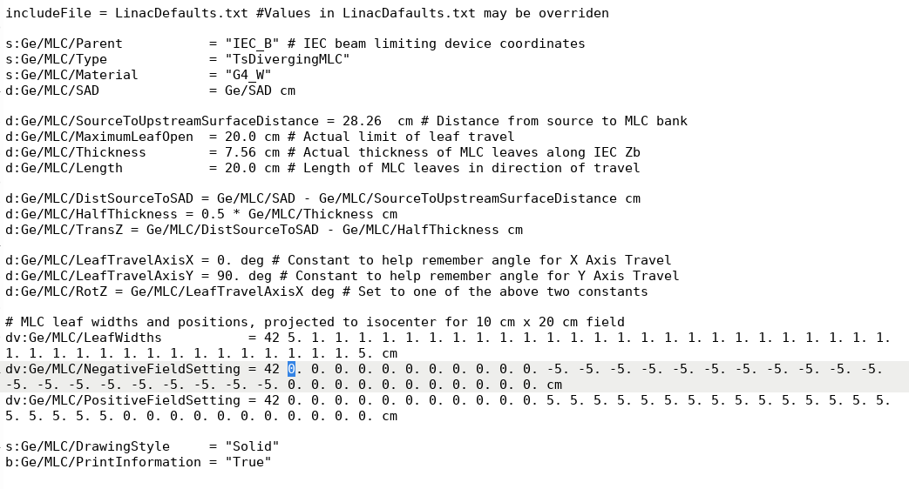
Components
MLC

Slide 15
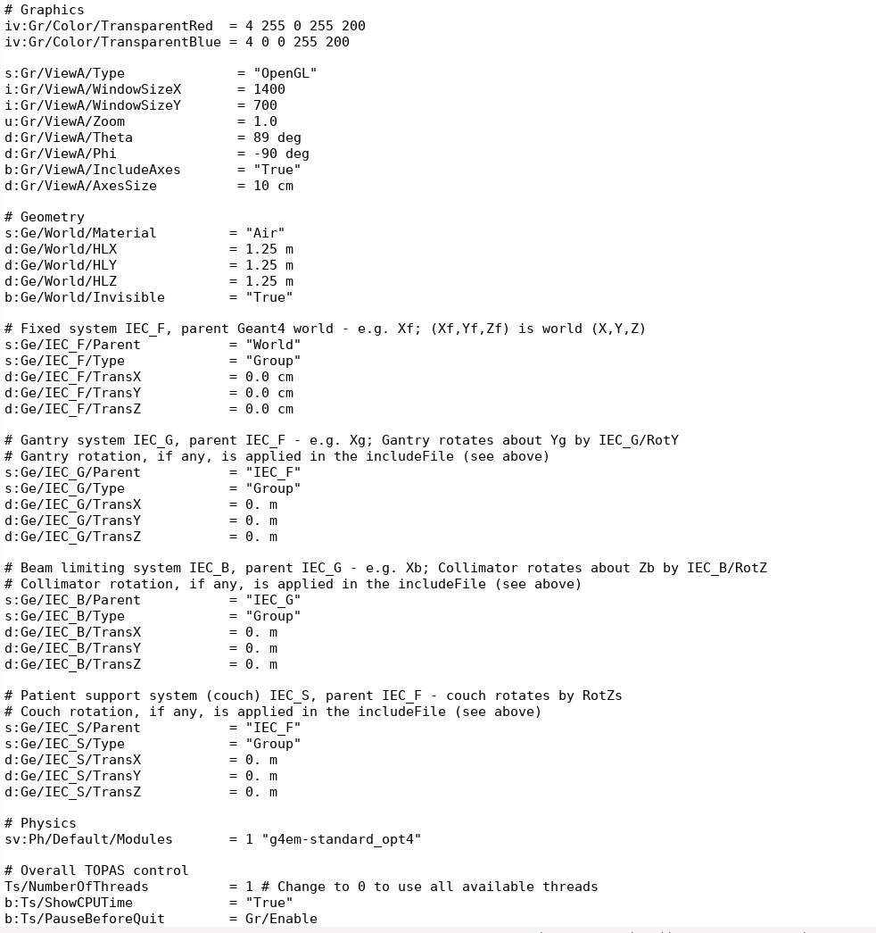
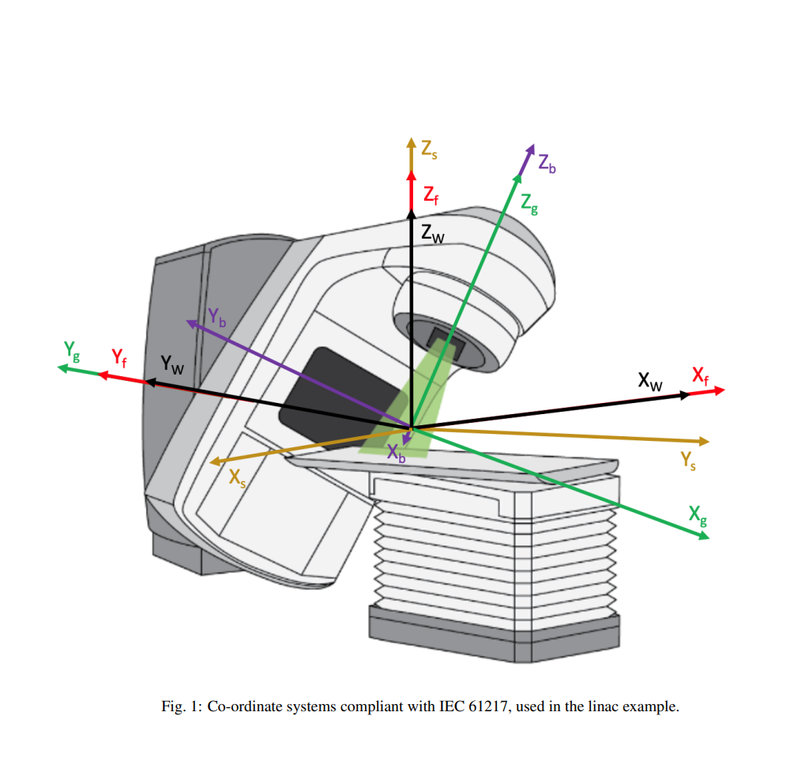
Treatment head simulation
All geometries are correspond to IEC 61217

Slide 16
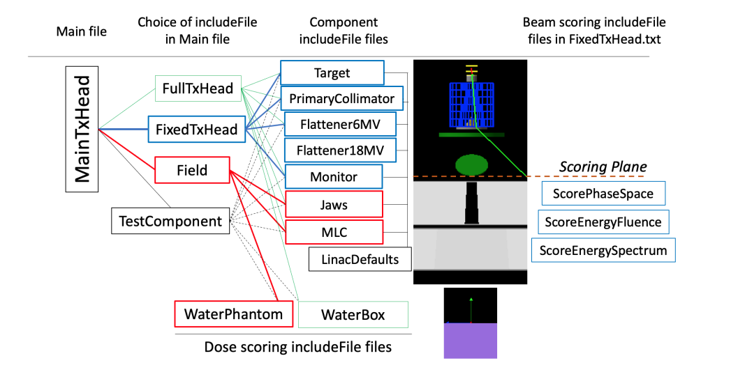
Treatment head simulation

Slide 17
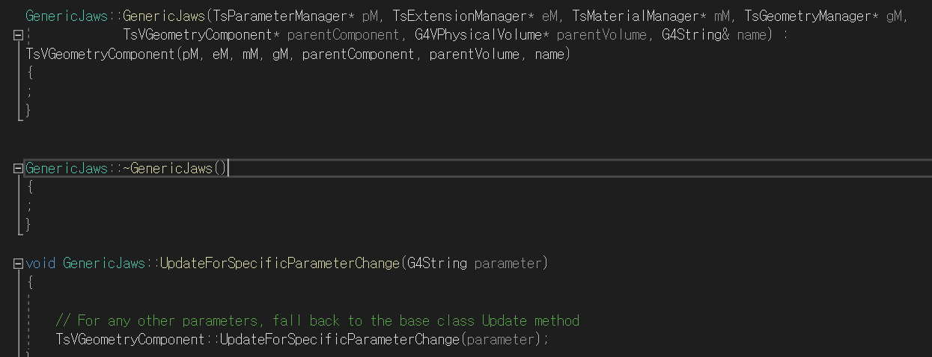
TOPAS external code
Jaws and MLC dev
Generator
Destructor
Parameter update

Slide 18
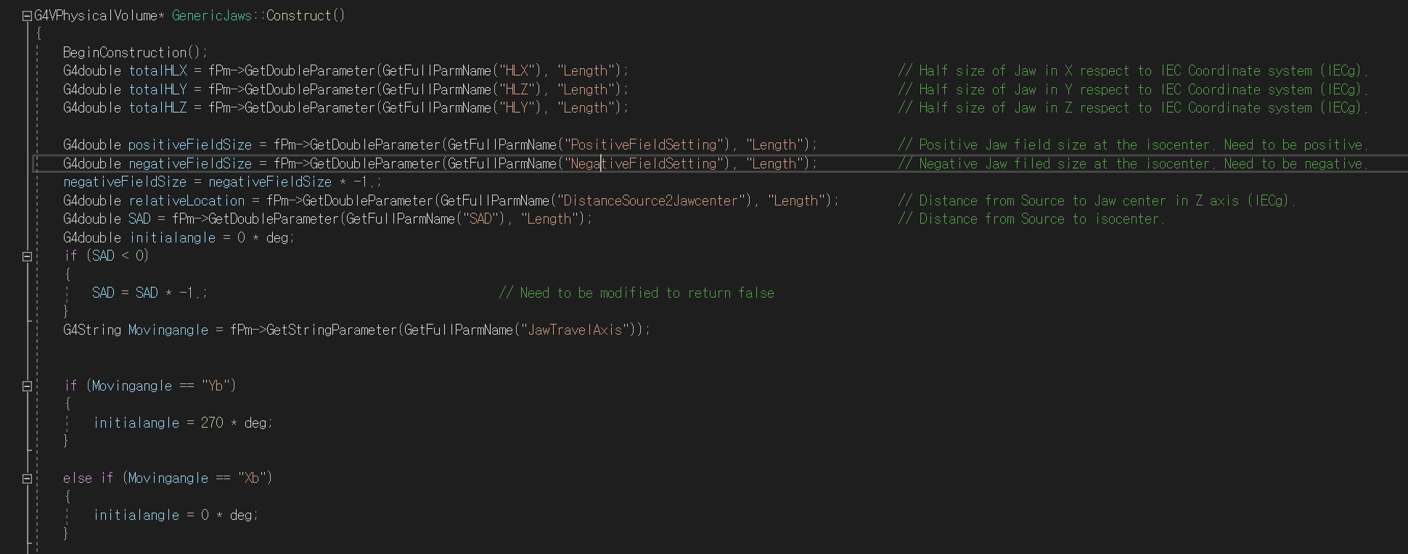
TOPAS external code
Jaws and MLC dev

Slide 19
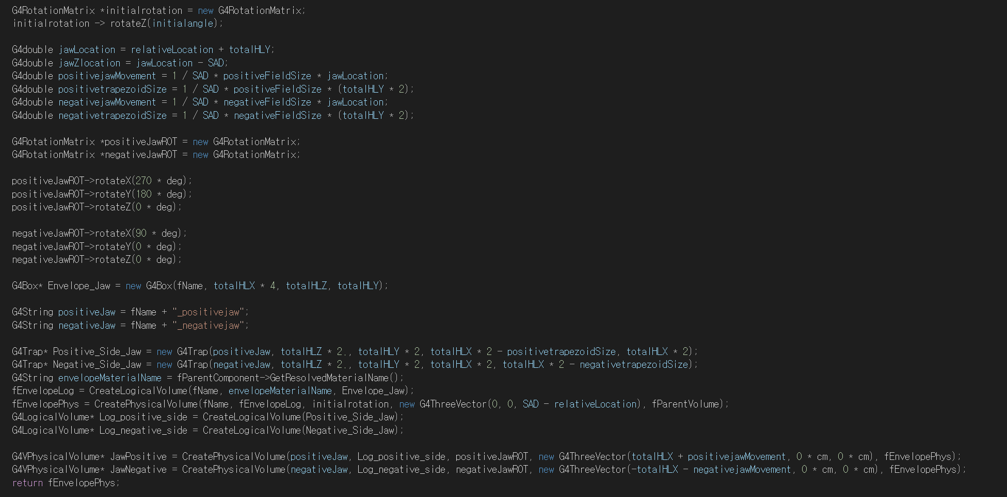
TOPAS external code
Jaws and MLC dev

Slide 20


