Slide 1
Heavy Ion Beam Simulation on Geant4
Uranium beam to liquid hydrogen target
Dec. 5th (Mon), 2022
Kihyeon CHO, Kyungho KIM

Slide 2
Contents
Validation of physics lists
  Conditions of simulation
  Result
  Finding the best physics list for heavy ion beam simulation
Production of secondary particle
  Conditions of simulation
  Result
Summary

Slide 3
Validation of physics lists

Slide 4
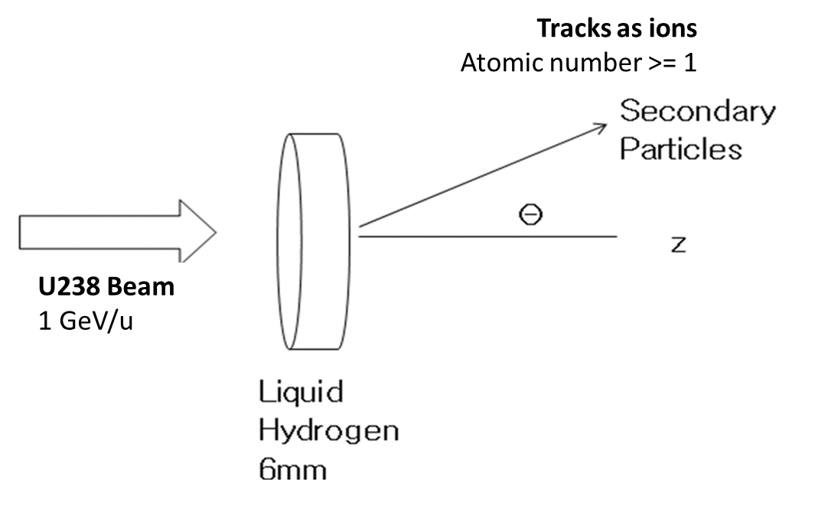
Conditions
Conditions of experiments
  Geant4 version: 11.0.2
  1 million events per each condition
Liquid hydrogen
12.5mm
Schematic of simulation
Simulation | Geant4 Beam |  | Target
 | Particle | Energy (MeV/u) | Materials | Thickness (mm)
U → Liquid Hydrogen | U | 1000 | Liquid Hydrogen | 12.5
Beam & target conditions for validation

Slide 5
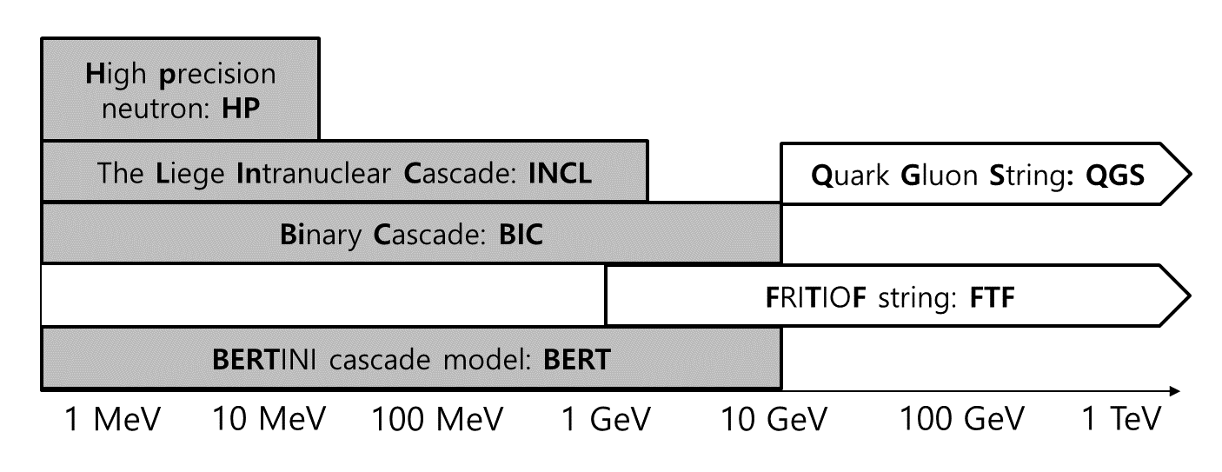
Physics List
Considered physics list in Geant4
  FTFP_BERT, FTFP_BERT_HP, FTFQGSP_BERT, QGSP_FTFP_BERT
  FTF_BIC, QGSP_BERT, QGSP_BERT_HP, QGSP_BIC
  FTFP_INCLXX, FTFP_INCLXX_HP, QGSP_INCLXX, QGSP_INCLXX_HP
  Shielding

Slide 6
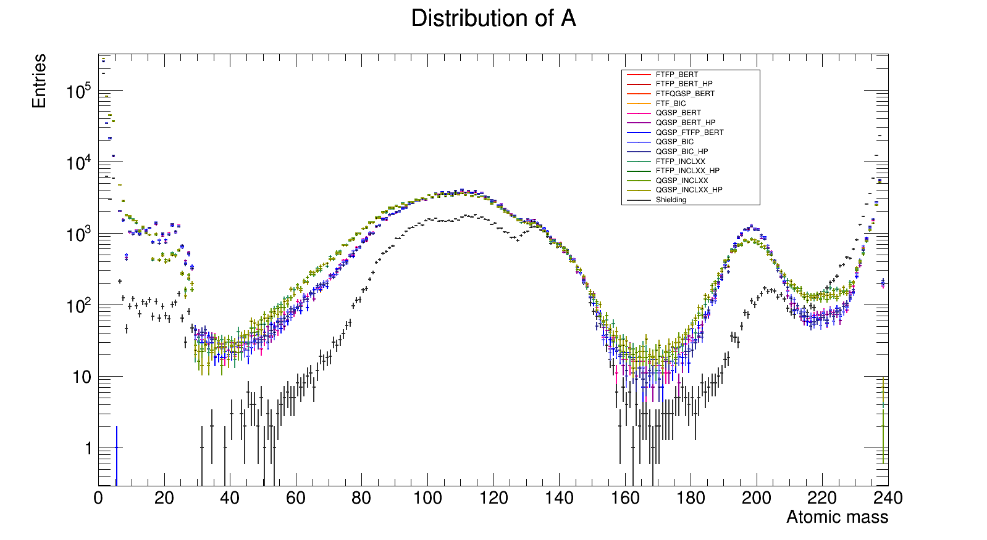
Distribution: Atomic Mass

Slide 7
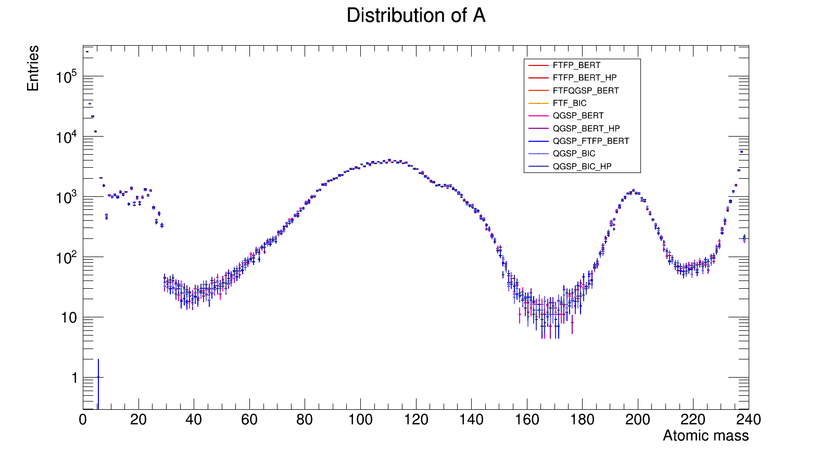
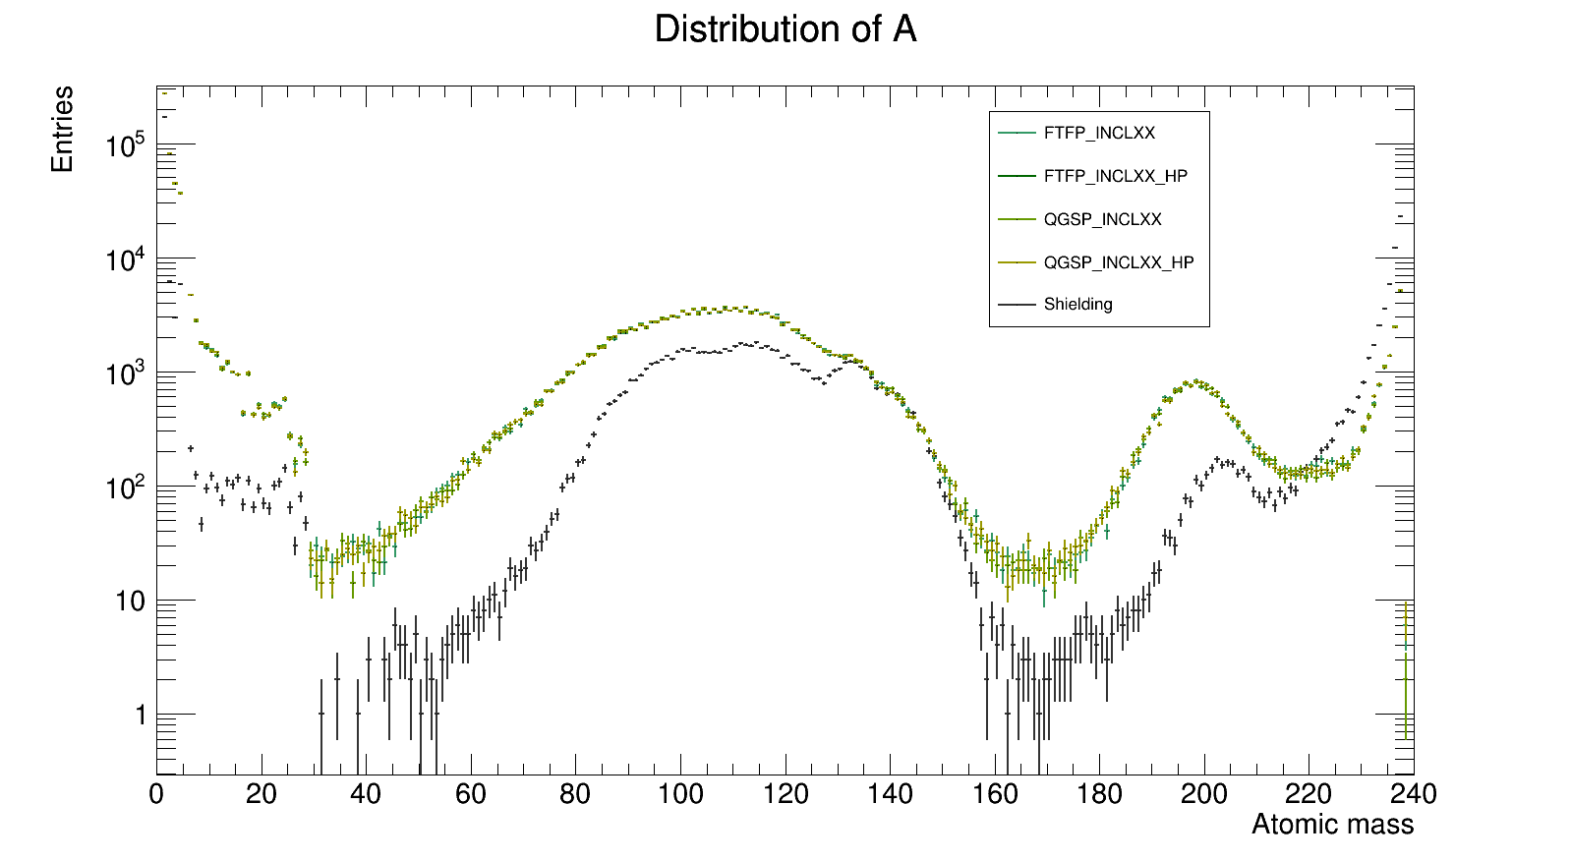
Distribution: Atomic Mass
PhysicsLists are separated to 3 groups
  Group 1: FTFP_BERT, FTFP_BERT_HP,
  FTFQGSP_BERT, FTF_BIC, QGSP_FTFP_BERT,
  QGSP_BERT, QGSP_BERT_HP,
  QGSP_BIC, QGSP_BIC_HP
  Group 2: FTFP_INCLXX, FTFP_INCLXX_HP,
  QGSP_INCLXX, QGSP_INCLXX_HP
  Shielding
Group 1
Group 2 + Shielding

Slide 8
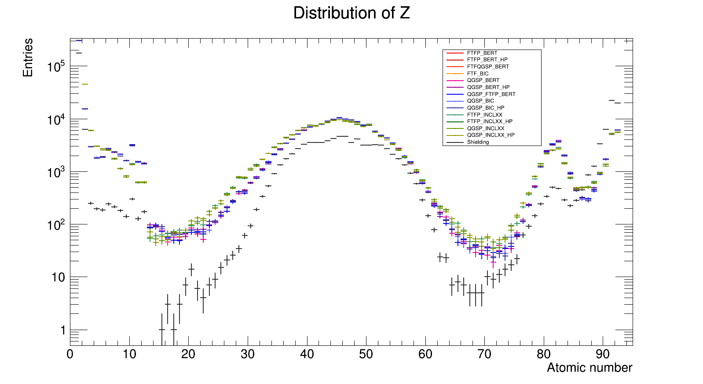
Distribution: Atomic Number

Slide 9
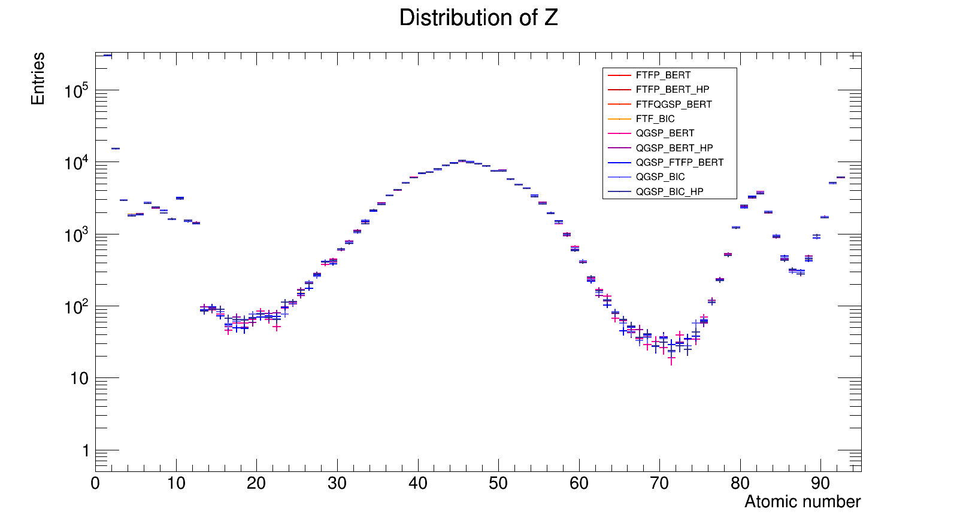
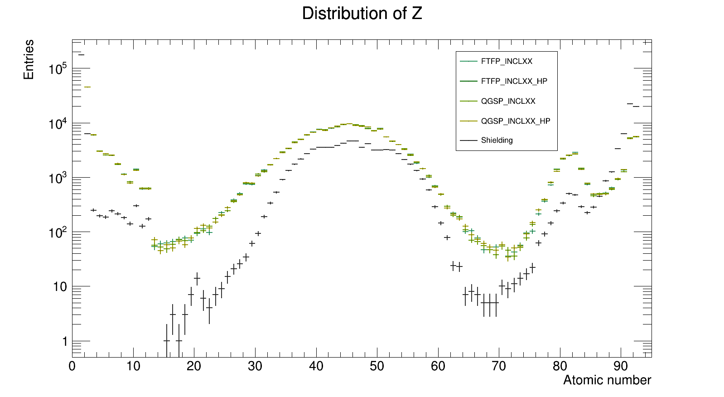
Distribution: Atomic Number
PhysicsLists are separated to 3 groups
  Group 1: FTFP_BERT, FTFP_BERT_HP,
  FTFQGSP_BERT, FTF_BIC, QGSP_FTFP_BERT,
  QGSP_BERT, QGSP_BERT_HP,
  QGSP_BIC, QGSP_BIC_HP
  Group 2: FTFP_INCLXX, FTFP_INCLXX_HP,
  QGSP_INCLXX, QGSP_INCLXX_HP
  Shielding
Group 1
Group 2 + Shielding

Slide 10
Finding the Best Physics List
The best physics list for studying heavy-ion beam simulation
- The amount of the secondary particles
- The validity compared with experiment
- Cost-effective CPU time

Slide 11
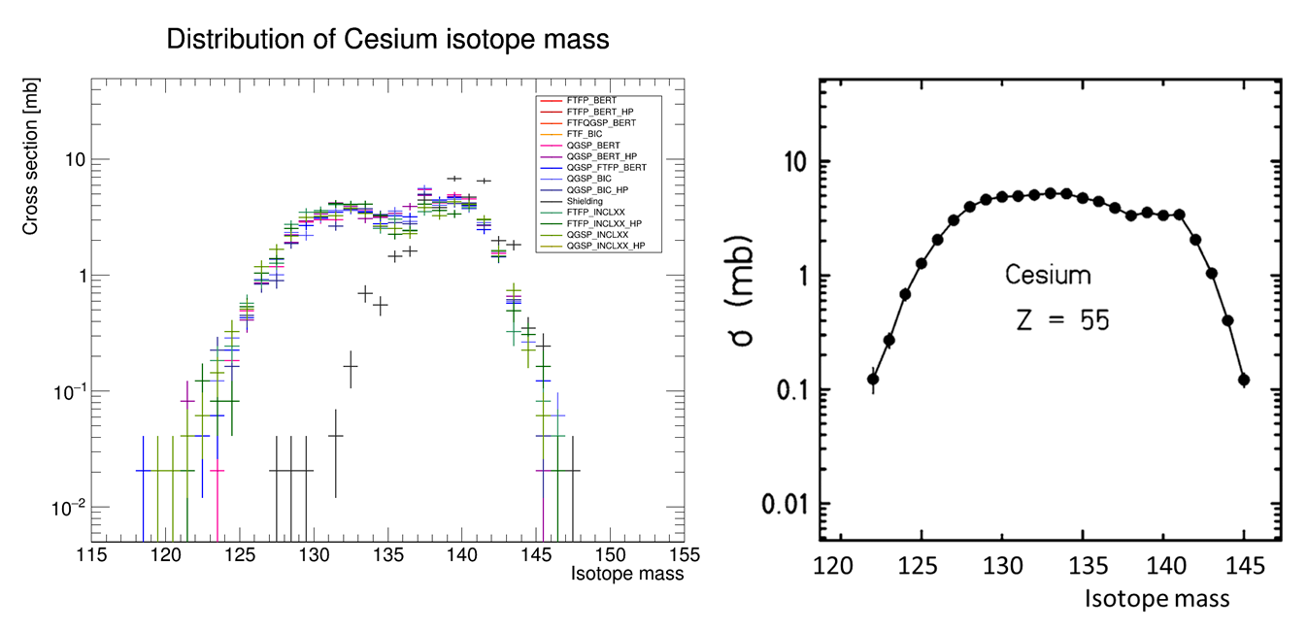
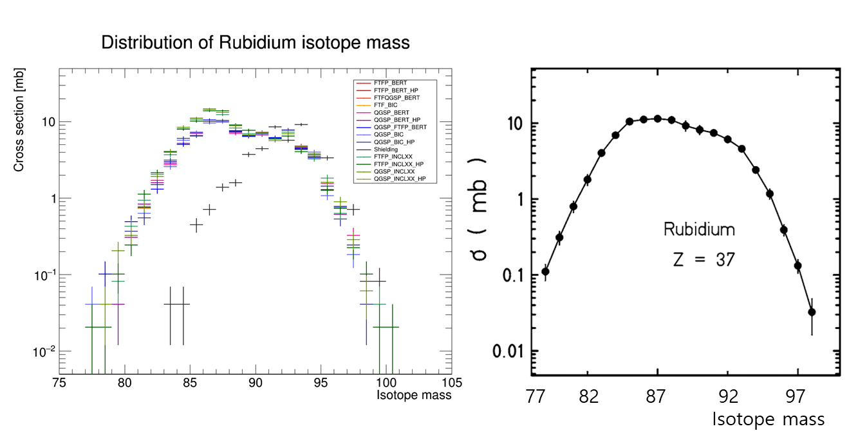
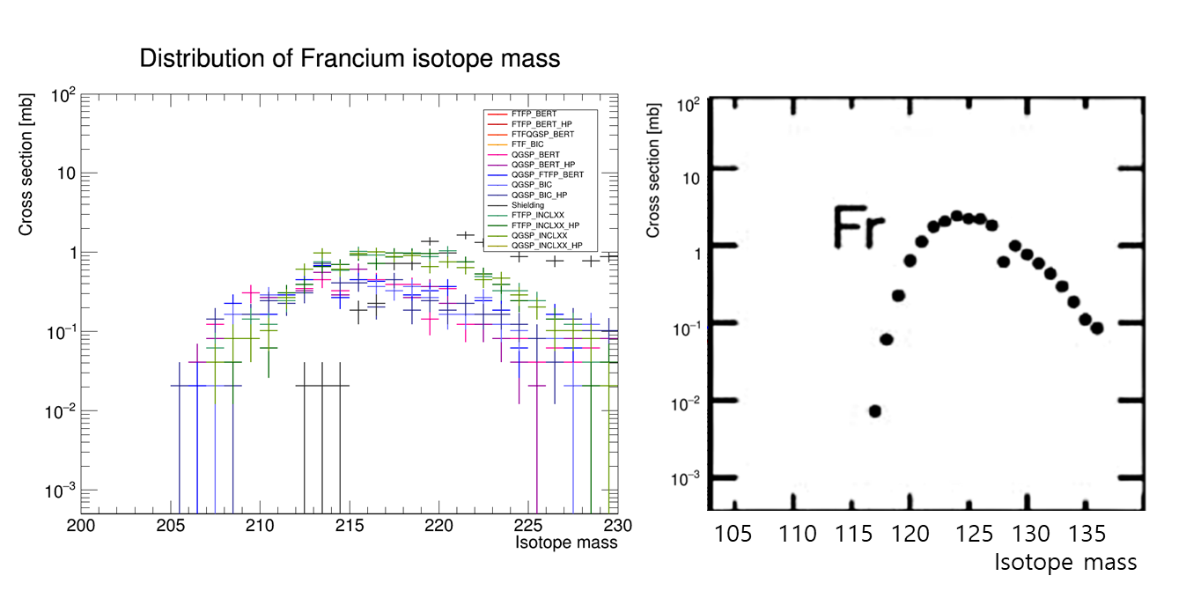
Isotope Distribution

Slide 12
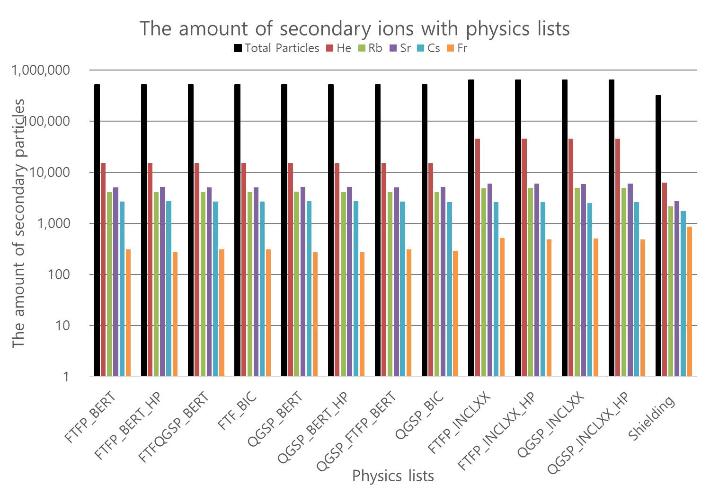
Created Secondary Ions
Group 2 physics list take more secondary ions.
  Abundant statistics for analysis
  compared with group 1 lists.
Group 1
Group 2

Slide 13
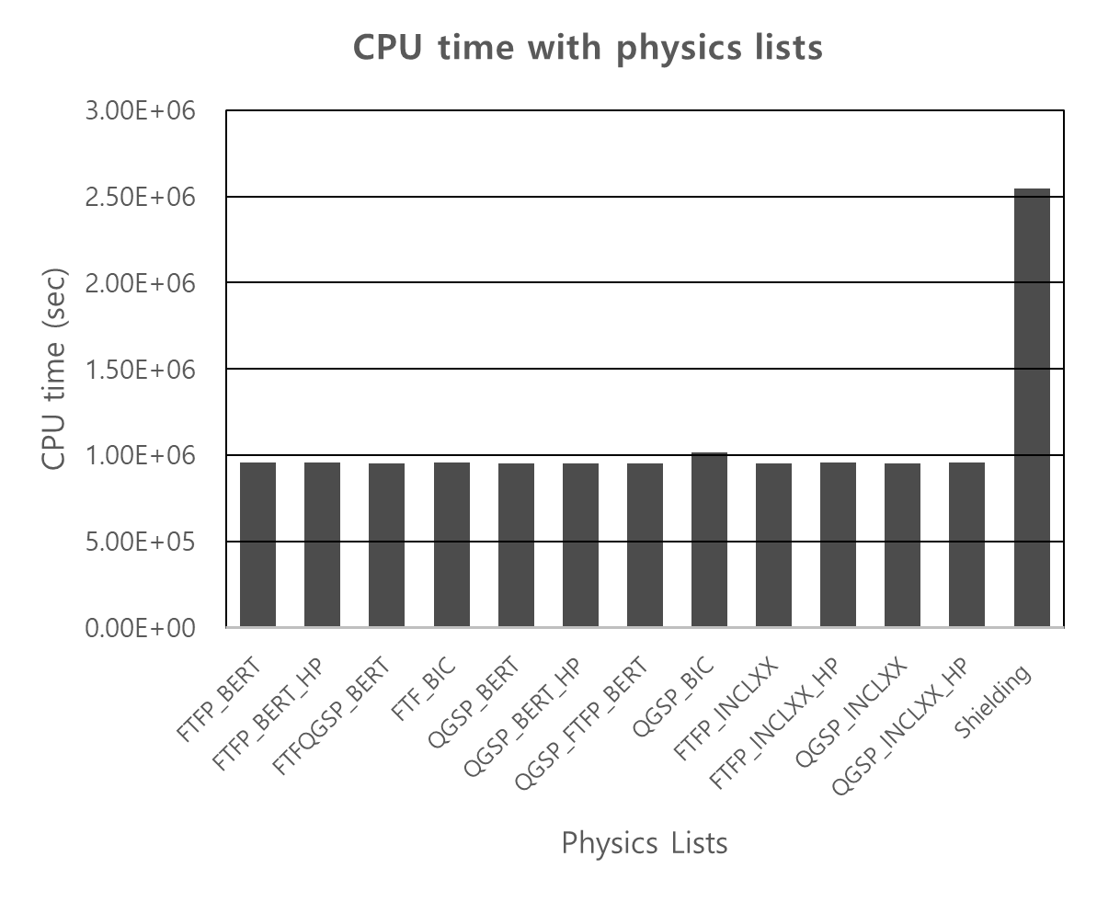
Computing Time
Excluding ‘Shielding’ for our suitable list (due to long runtime)
Others looks same.
  Any physics list (except Shielding)
  would be OK.
What would be the best?
  FTFP_INCLXX(_HP)
Group 1
Group 2

Slide 14
Prodution of secondary particles

Slide 15
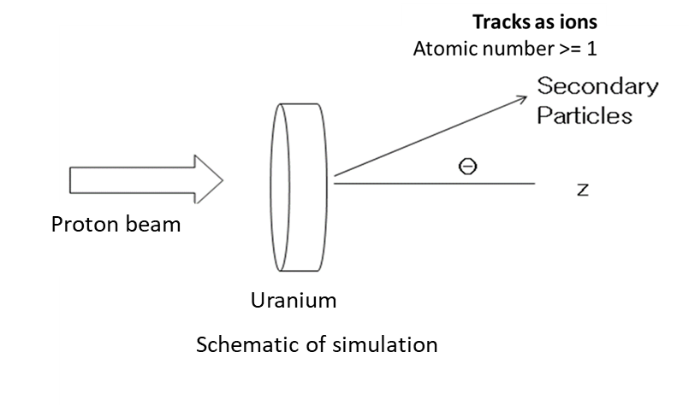
Conditions
Conditions of experiments
  Geant4 version: 11.0.2
  1 million events per each condition
Simulation | Geant4 Beam |  | Target
 | Particle | Energy (MeV/u) | Materials | Thickness (mm)
Proton → U | Proton | 100, 200, 500, 1000 | Uranium | 6
Proton → U | Proton | 100 | Uranium | 1, 2, 5, 6, 10
Beam & target conditions for validation

Slide 16
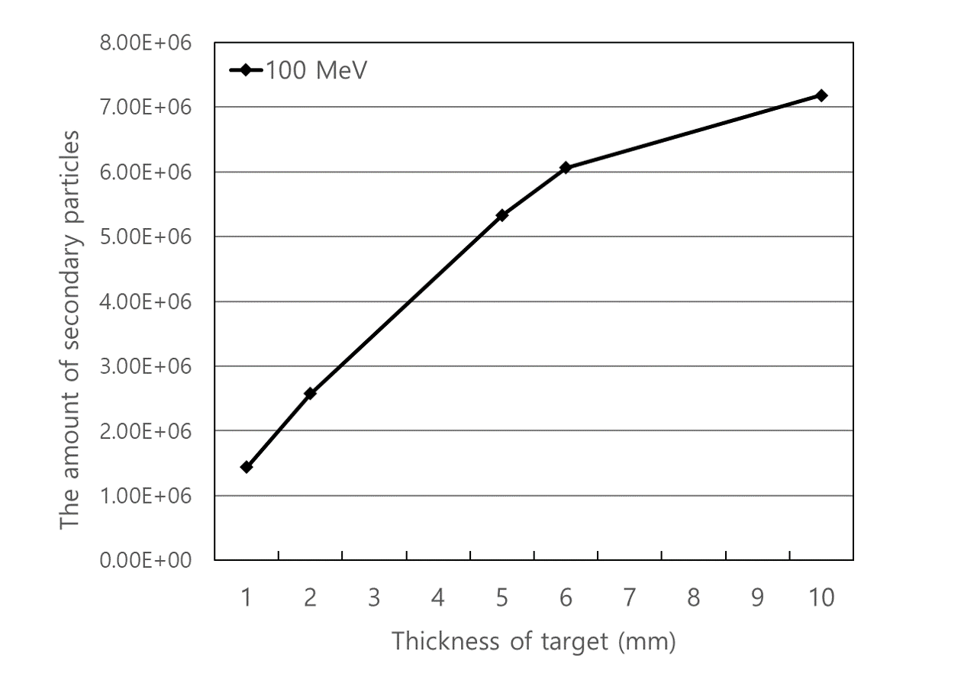
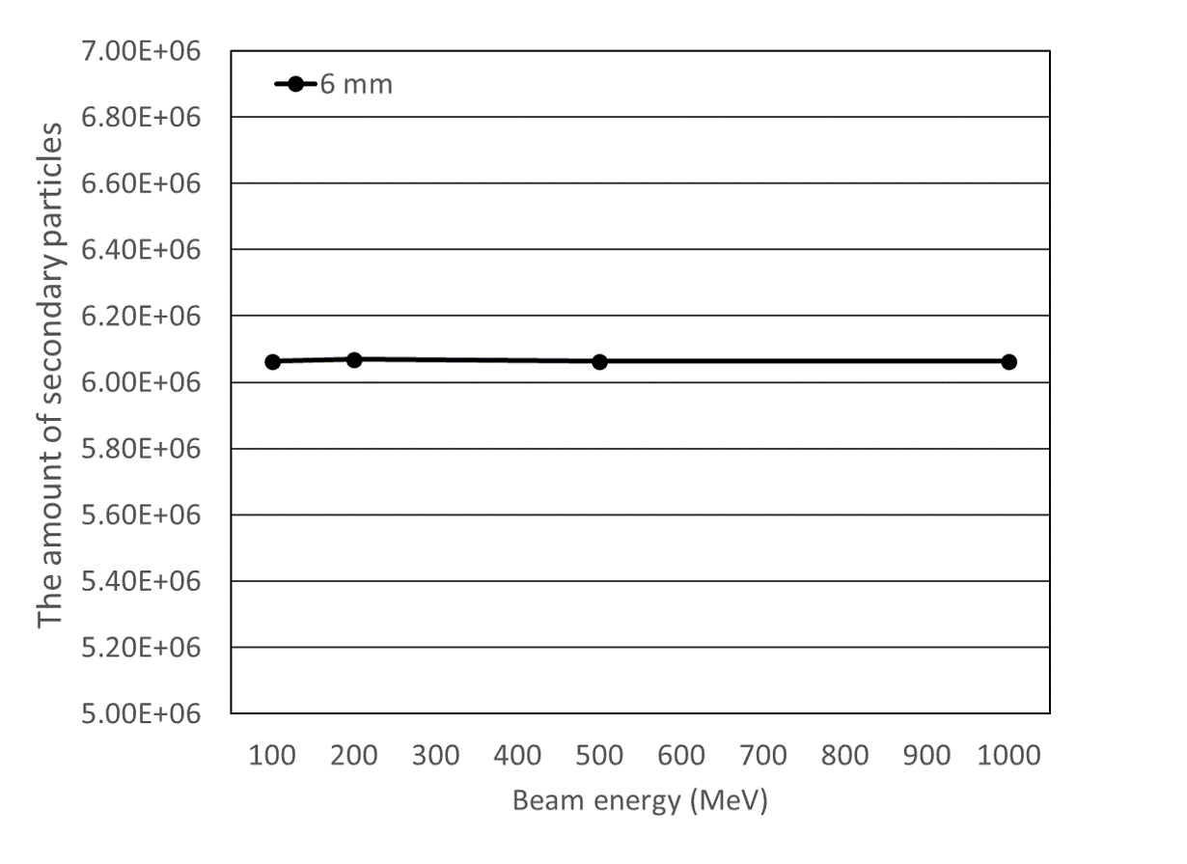
Amount of Secondary Particles
Amount per thickness of target
Amount per beam energy

Slide 17
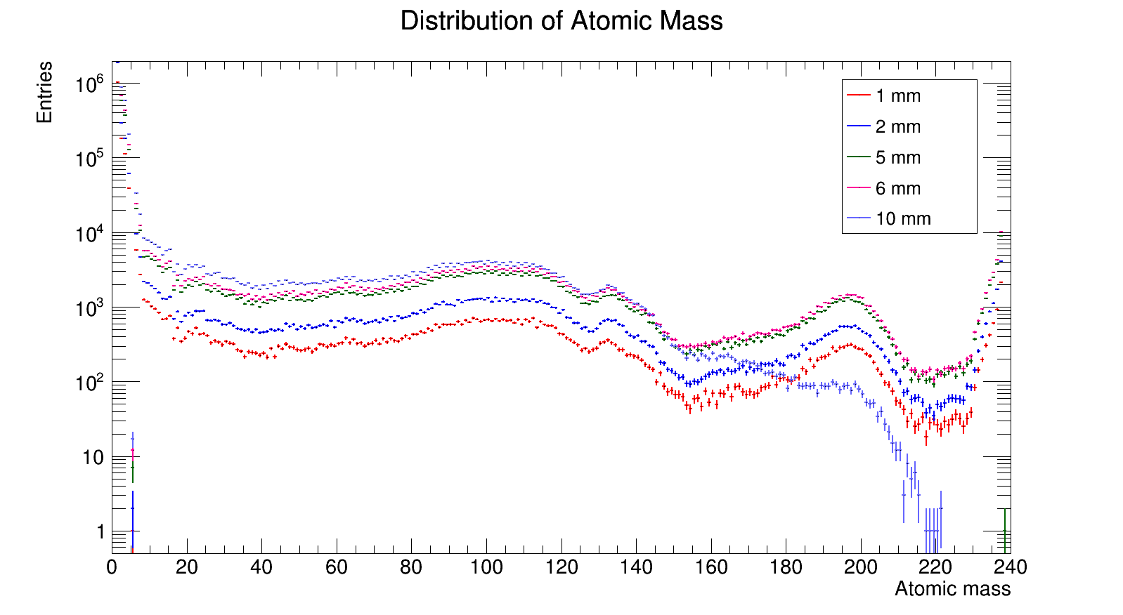
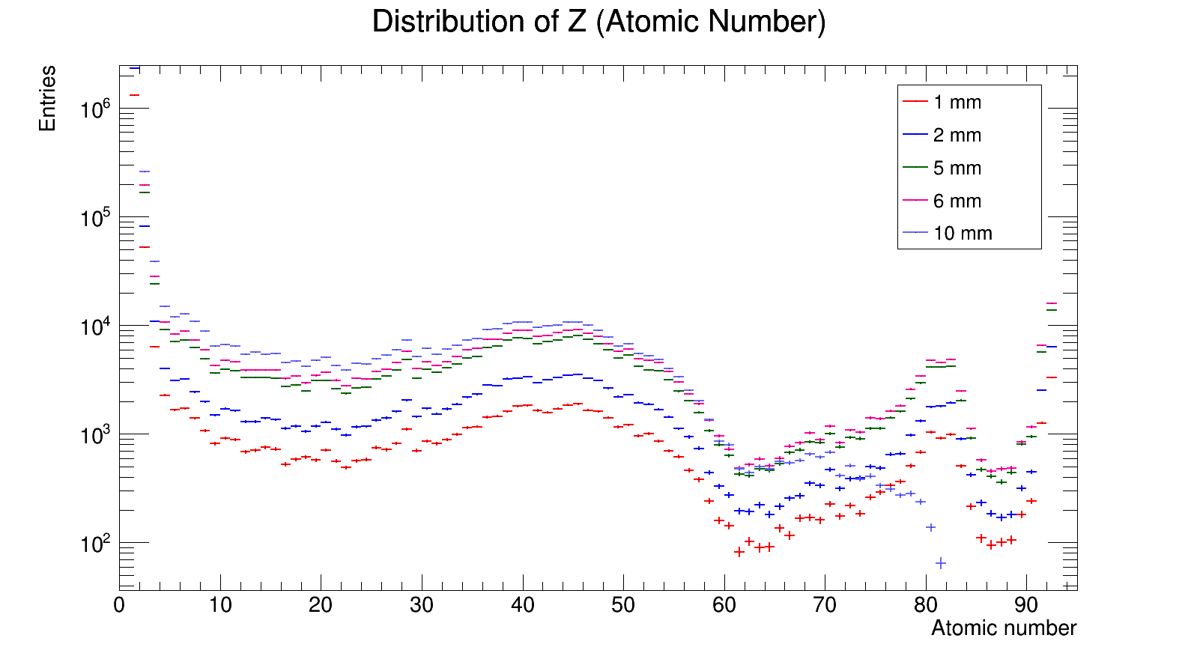
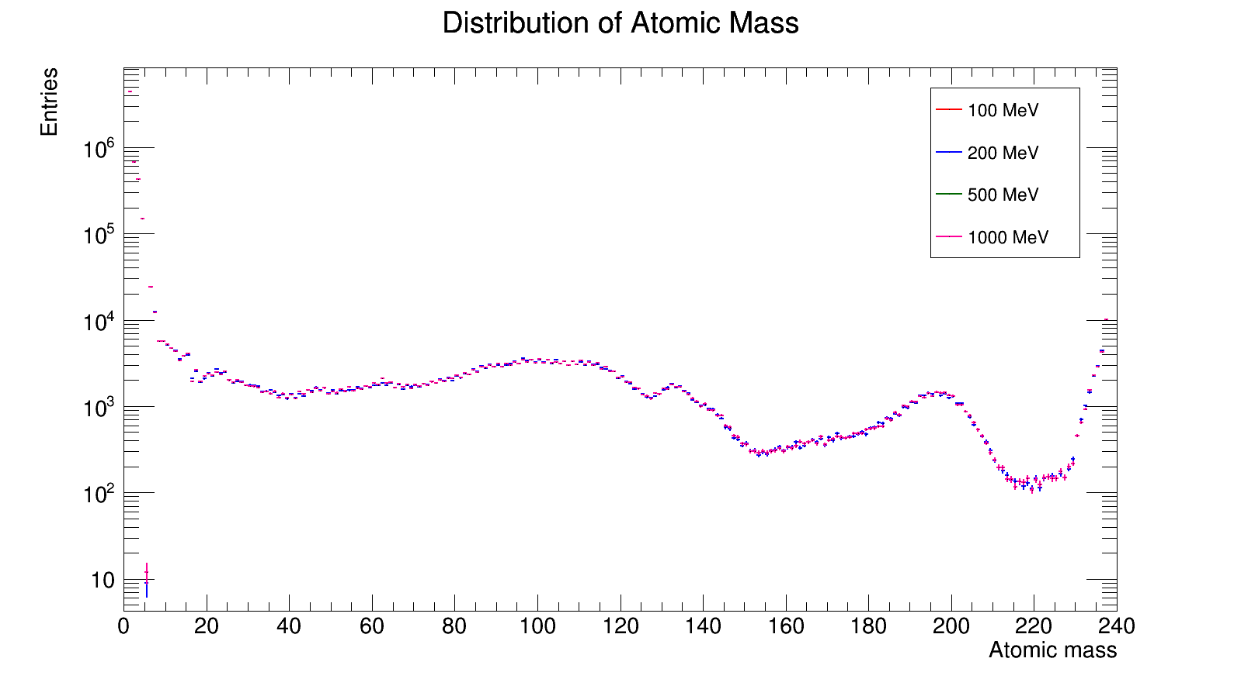
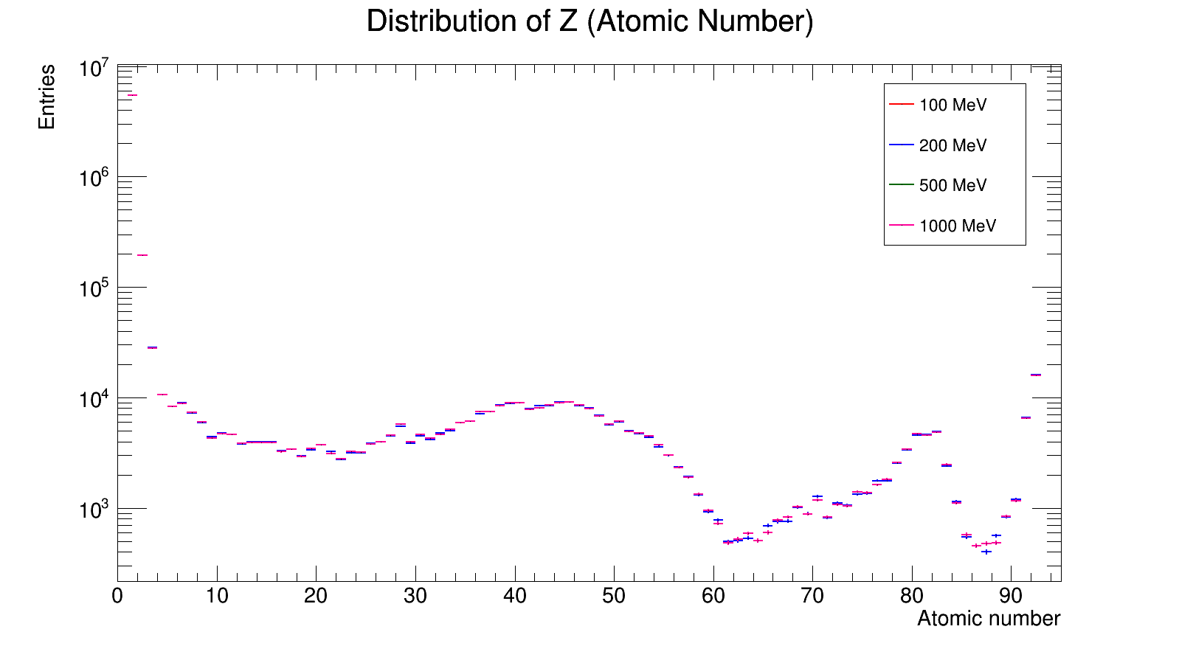
Amount of Secondary Particles

Slide 18
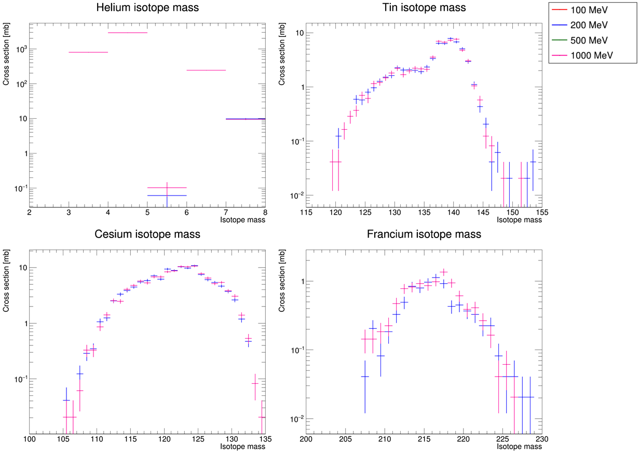
Amount of Specific Isotopes

Slide 19
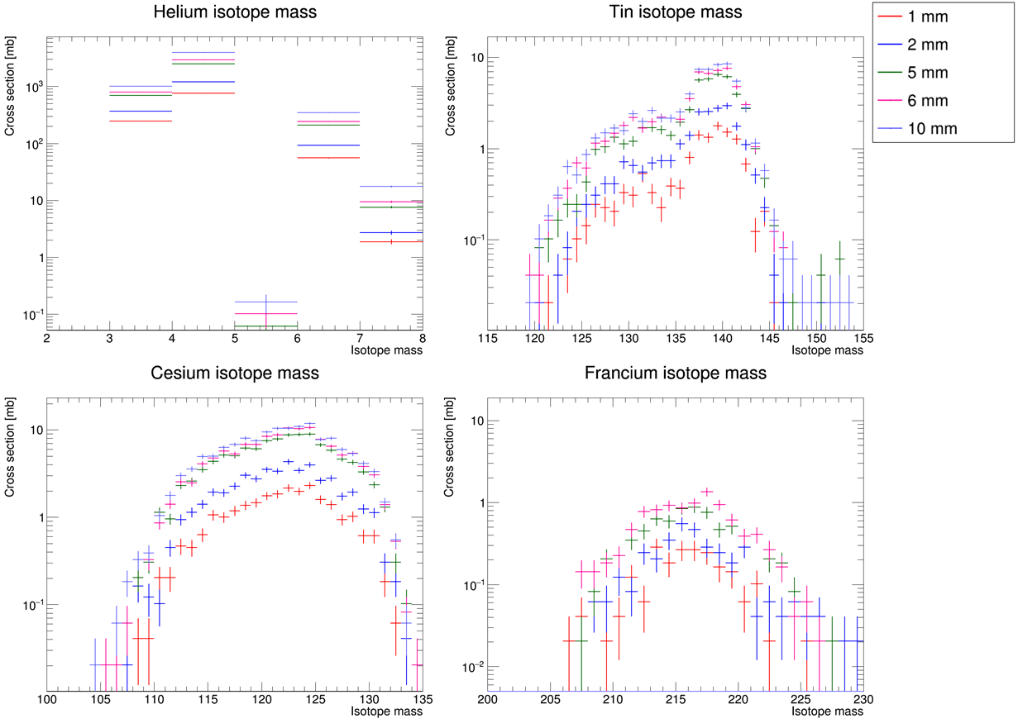
Amount of Specific Isotopes

Slide 20
Summary & Plan
We studied heavy ion beam simulation on Geant4.
  We found the optimized physics lists among Geant4 reference physics lists
  For physics list optimization, uranium beam to liquid hydrogen target simulation was done.
  The atomic mass & number distributions are separated to 3 groups.
    INCL++ group
    Non-INCL++ group
    Shielding
  Mass distribution of specific atoms (Cs, Rb, Fr) are shown.
  CPU time and the amount of secondary ions are shown.
    The most optimized physics list is FTFP_INCL++(_HP).
Next, we will test the proton beam emission to uranium target with various target thickness and beam energy.
We will improve this simulation to complicated detector condition and various beam and target condition.

Slide 21
Backup

Slide 22
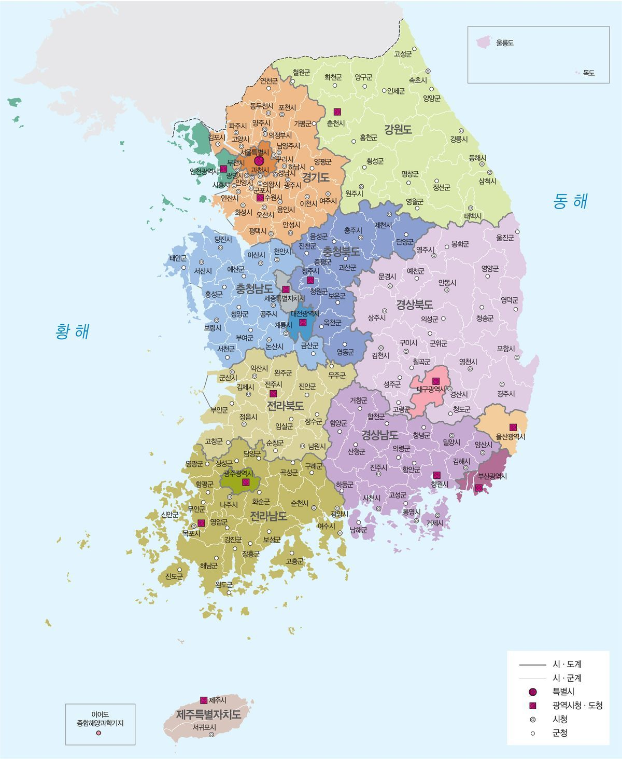

Motivation
The last few years have seen a rise in the number of particle accelerators built in Korea.
  Confirmed
    RAON, 2023 (Scientific)
    Yonsei severance hospital, 2023 (Medical)
    Seoul national university hospital, 2025 (Medical)
  Consideration
    Asan medical center (Medical)
    Sejong city (Medical)
  .. And so on.
But there has been relatively little focus on
accelerator-based study of secondary particles.
=> Planning heavy ion beam simulation
Yonsei severance hospital
Asan medical center
RAON
Sejong city
Seoul national university hospital

Slide 23
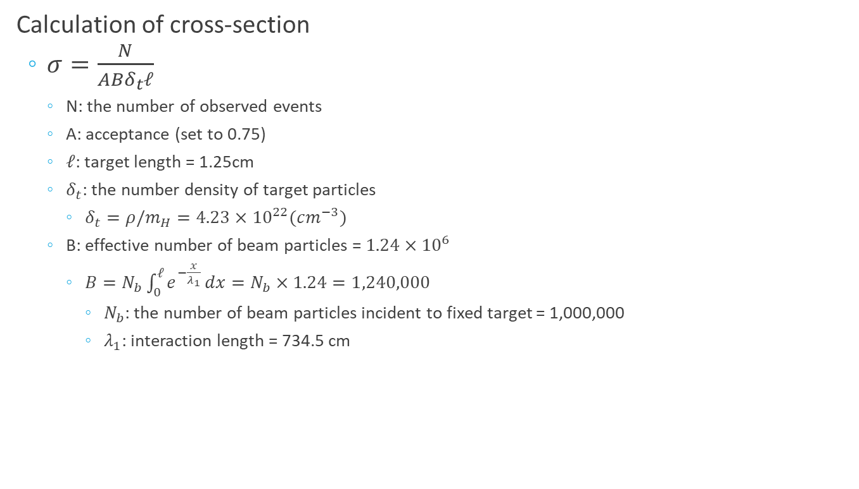
Calculation of Cross-section
Calculation of cross-section
  $σ=\frac{N}{ABδ_{t}ℓ}$
    N: the number of observed events
    A: acceptance (set to 0.75)
    $ℓ$: target length = 1.25cm
    $δ_{t}$: the number density of target particles
      $δ_{t}=ρ/m_{H}=4.23×{10}^{22}(cm^{−3})$
    B: effective number of beam particles = $1.24×{10}^{6}$
      $B=N_{b}\int_{0}^{ℓ}{e^{−\frac{x}{λ_{1}}}}dx=N_{b}×1.24=1,240,000$
        $N_{b}$: the number of beam particles incident to fixed target = 1,000,000
        $λ_{1}$: interaction length = 734.5 cm

Slide 24
Isotope Distribution: Cs

Slide 25
Isotope Distribution: Rb

Slide 26
Isotope Distribution: Fr
Notes:
Francium은 실험과 모사가 100% 일치하지는 않습니다. 다만 경향성은 매우 뚜렷하게 보여줍니다.

