Slide 1
DMAG Workshop 2026-02-11
Quantum Sensing
Sergey Uchaikin

Slide 2
QS goals
Support and update test facility based on BF4
Provide QNL amplifiers for axion experiments
Development new read-outs for future experiment
Publishing

Slide 3
JPA testing facilities update
Work on reliability of test bench based on BF4. The most loaded fridge, most often thermocycles, rearrangement of components and lines.
Fixed:
DC fridge Lines. Bad quality of soldering (outsource) of NbTi wires– fixed.
60 of 64 differential lines on the MXC - done
24 differential lines on the 4K – done
2) Cryocooler HEMT Amplifier test setup
3) New 4-channel noise source for BF4 – take small space.

Slide 4
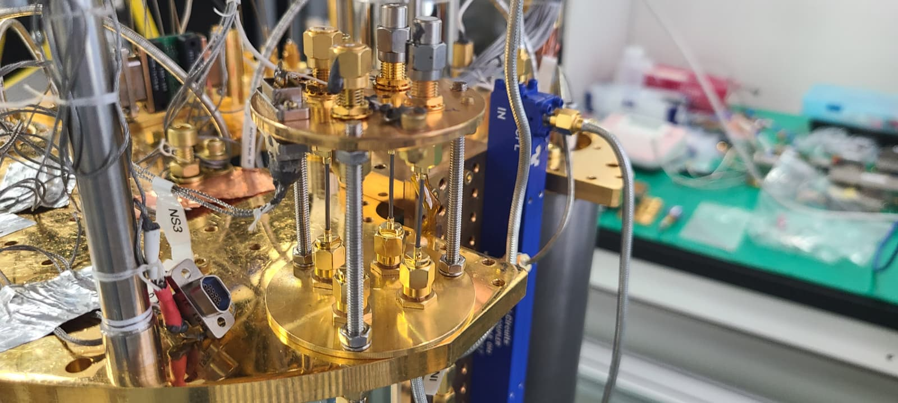
New NS

Slide 5
Testing facilities update-2
RF channels
Channel | 4K | MXC
1 | 4-8 GHz amps/components | 4-12 GHz amps/components
2 | 2.5-4 GHz amps/components | 2.5-4 GHz amps/components
3 | 1.7-2.1 GHz amps/components | 1.7-2.1 GHz amps/components

Slide 6
JPAs
FD JPA – since Arjan left Japan, new relation was established (Chih-Chiao). First run was done for the range 2-3 GHz. It repeat Arjan's design.
RIKEN works on custom documentation to send it to us.
Support:
2 JPA (for BF5 and BF3 experiment)
Fixed problem with BF5 and BF6 JPA, thermalization of Gemini and magnetic shielding.
Leo 1.2-1.5 was re-tested in BF4 and mounted in 12TB

Slide 7
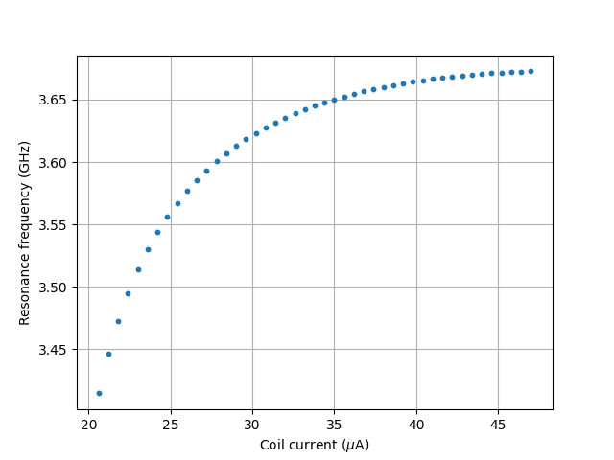
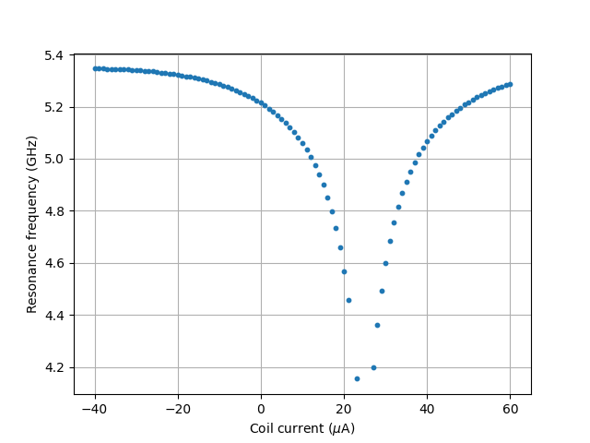
New frequency ranges were covered with FD JPA
4.3-5.3 GHz
3.42 (3.3)-3.65 GHz

Slide 8
L-JPAs
L JPA - Arjan design with bridges, very sensitive for transportation. In >100 times less sensitive to dc flux bias. Check 7 of them, only 2 is working. One of them characterized by Minsu, the second is under the test now.
New postdoc (Chih-Chiao) agreed to make new design of L JPA. Need to reduce Ibias > then 10 times (better 50). More reliable bridges (vias?).

Slide 9
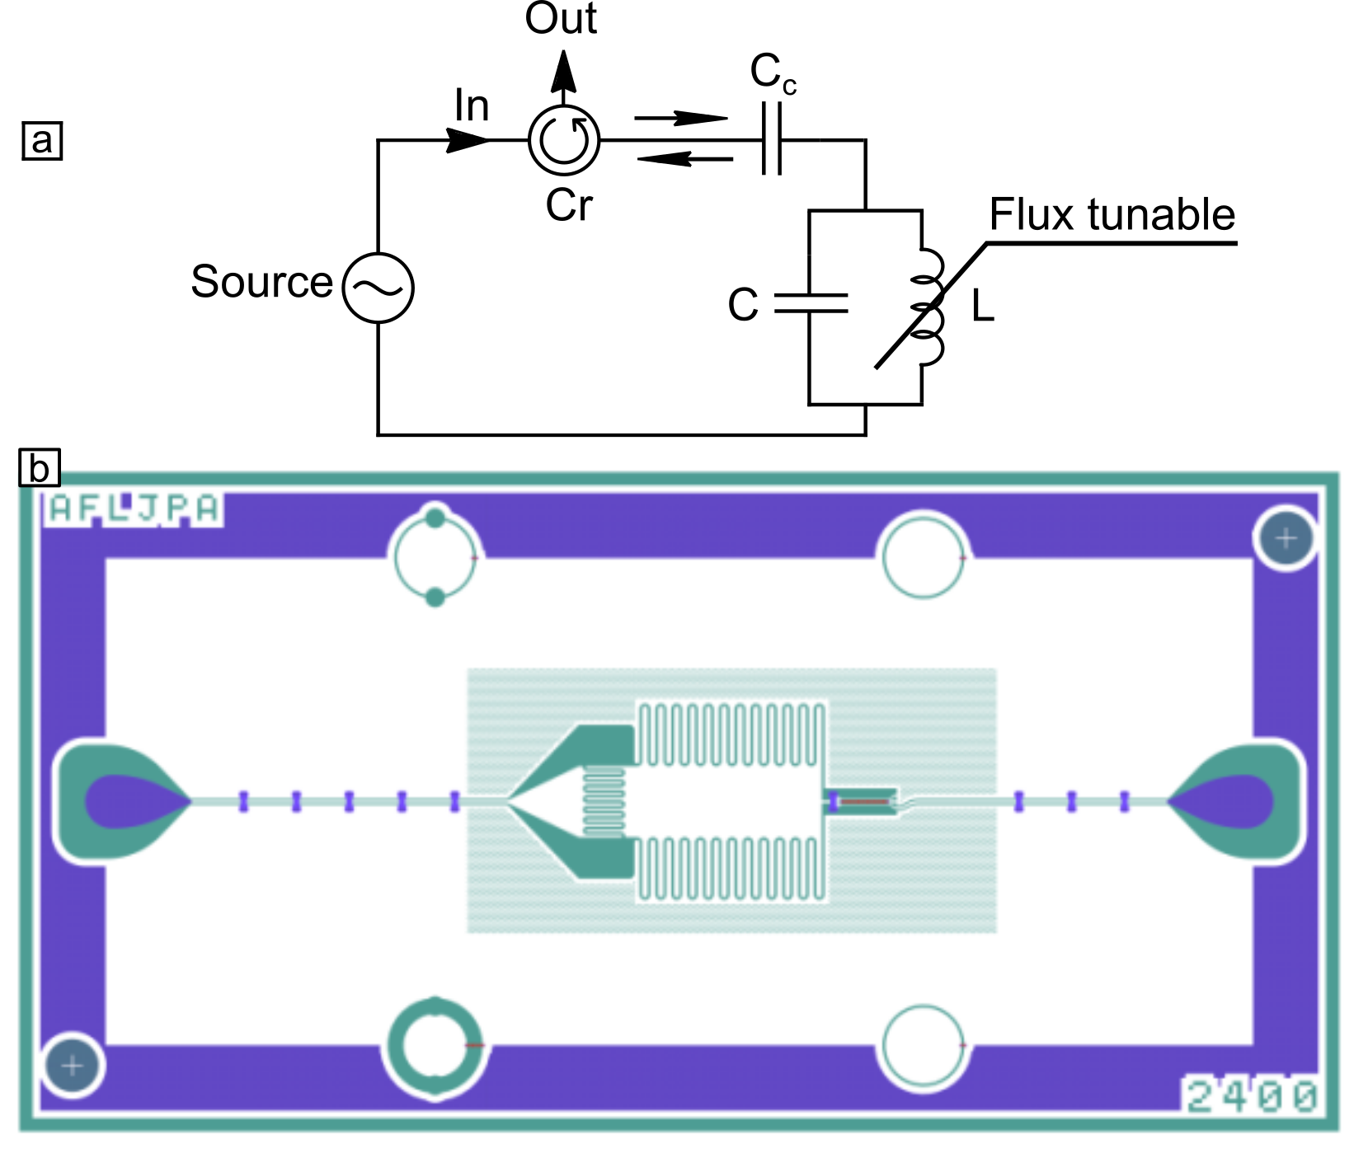
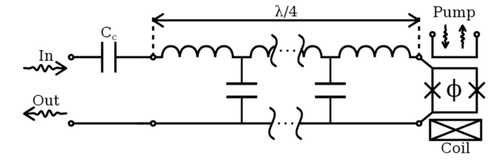
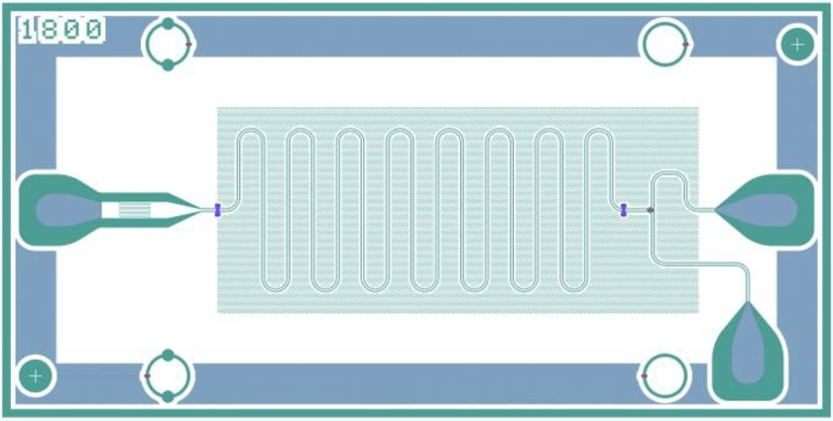
FD JPA vs L-JPA

Slide 10
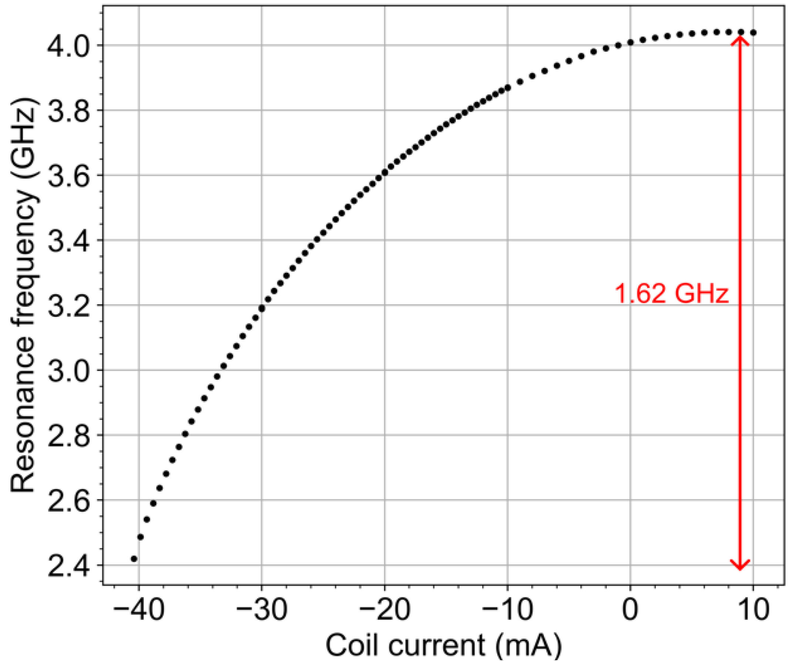
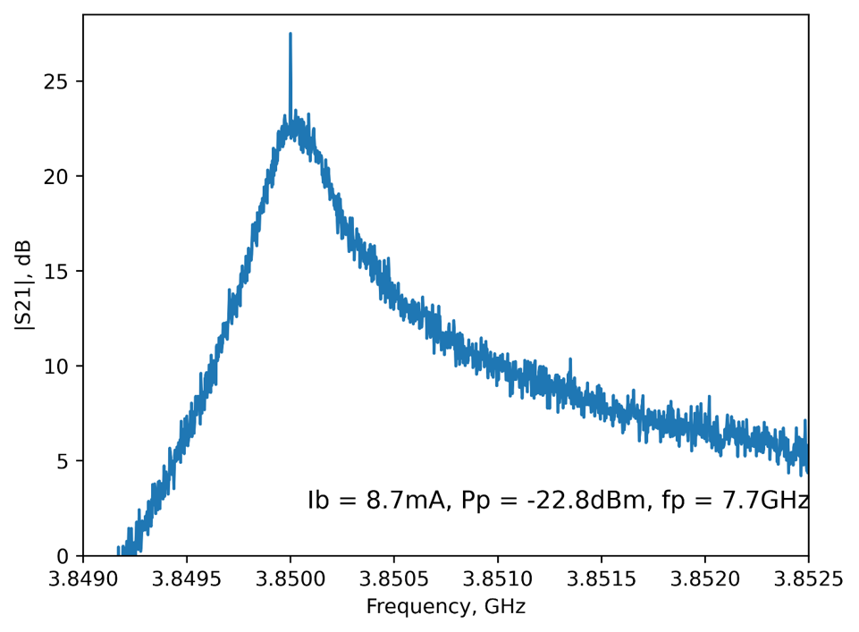
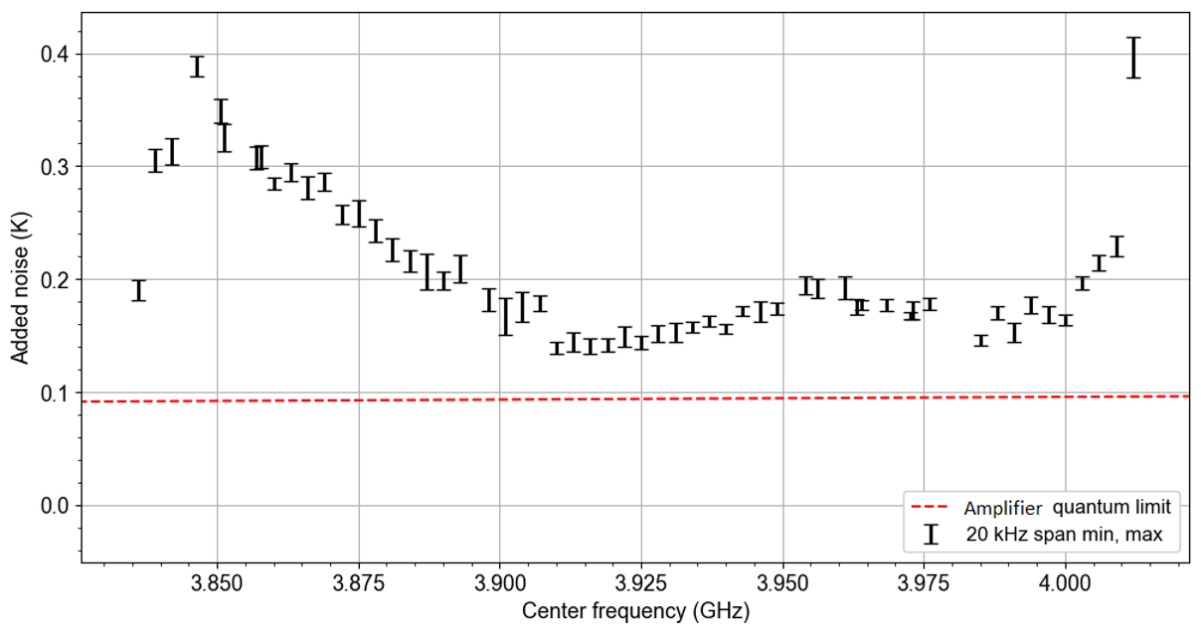
L-JPA tunable range

Slide 11
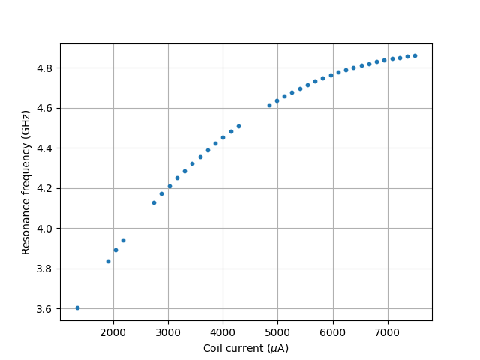
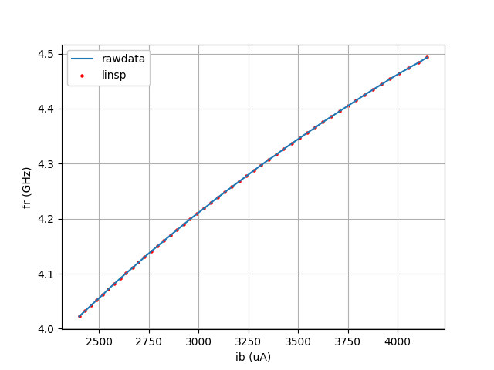
New L-JPA
3.6 -4.85 GHz
In the cavity range of 4.1-4.4 GHz

Slide 12
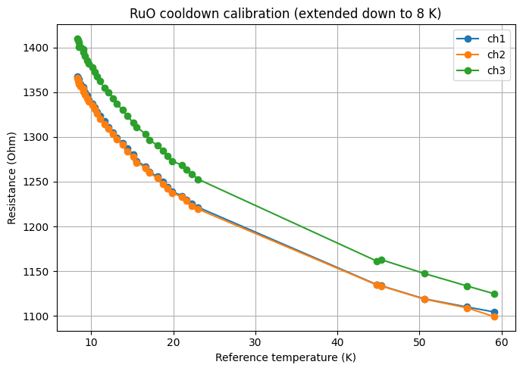
Thermometer calibration setup
A setup to calibrate up to 4 thermometers in BF4 was prepared. As a reference BF thermometer is used. The first calibration run is done, 3 thermometer tested.
Will work on set a permanent setup.

Slide 13
Plan and issues
BF4 – leak in mixture line. Afraid will be worse after moving (Still 1% probability will be better ☺)
Work on HEMT amp noise understanding
Low RF frequency line fix (1.5-2.1 GHz)
2nd RF channel recovering
Program updates
SPD setup in BF4
JPA test
Permanent thermometer calibration setup

