Slide 1
Systematic Measurements of Interaction-Cross Sections
for Nuclides around ¹³⁶Xe at the RIKEN RI Beam Factory
Tokyo City University M1
Keita Maeda
Notes:
Thank you for introducing me. I’m Keita Maeda from Tokyo City University. I’ll talk about “...”.

Slide 2
Contents
P.1
Background and Objectives
Measurement Principle
Experiment
Analysis Results and Discussion
Summary and Future Prospects
Notes:
Here is the table of contents. First, I will talk about Background and Objectives. and then Measurement Principle, experimental setup
,and Analysis Results, finally, summary and Future Prospects.

Slide 3
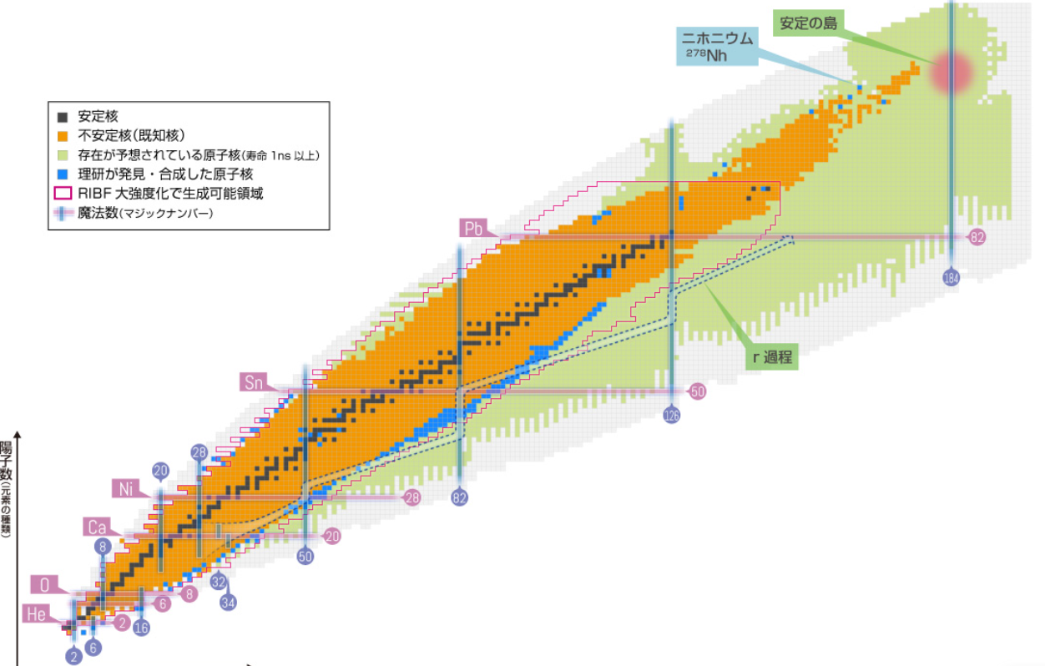

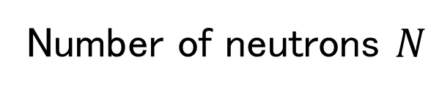
Background and Objectives
P.2
Charge radii have
already been measured
for many nuclei.^{[1]}
$$Z$$
Proton number
Proton distribution radius
Nuclides around ¹³⁶Xe
Matter radius
Number of neutrons $N$
[1] I.Angeli and K. P. Marinova, At. Data and Nucl. Data Tables 99, 69–95 (2013).
Notes:
First, I will explain the background of this study.
Previous studies have systematically measured nuclear charge radii.
In addition, matter radii can be extracted from interaction cross sections.
By comparing them with proton distribution radii, which can be obtained from charge radii, we can study the neutron distribution inside the nucleus.
However, systematic data on matter radii are limited in the region of interest in this study.
ーーーーーーーーーーーーーーーーーーーーーーーーーーーーーーーーーーーーーーーーーーーーーーーーーーーーーーーーーー
Electron scattering experiment: High-energy electrons are scattered by nuclei, and the scattering cross section is measured.

Slide 4
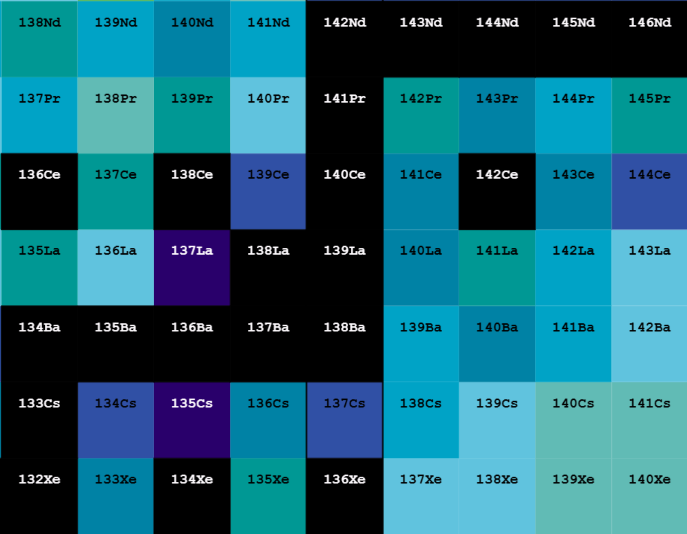

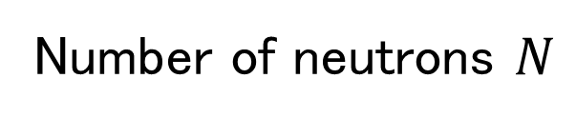
Background and Objectives
P.3
Magic Number
Neutron number 𝑁=82
Charge radii have
already been measured
for many nuclei.^{[1]}
60
$$Z$$
59
Proton number
58
Proton distribution radius
57
56
Matter radius
55
54
The aim of this study is to obtain
matter radii from interaction cross sections.
78
79
80
81
82
83
84
85
86
Number of neutrons $N$
[1] I.Angeli and K. P. Marinova, At. Data and Nucl. Data Tables 99, 69–95 (2013).
Notes:
The aim of this study is to obtain matter radii from interaction cross sections.
I compare them with proton distribution radii from previous studies to evaluate the neutron distribution of nuclides around 136Xe with the magic number N equals eighty-two (N=82).
ーーーーーーーーーーーーーーーーーーーーーーーーーーーーーーーーーーーーーーーーーーーーーーーーーーーーーーーーーー
N=82 is a magic number for neutrons, where shell effects can appear in the nuclear radius and neutron distribution.
Changes in the neutron distribution are expected near the shell closure.
Therefore, we selected nuclei around 136Xe to study these effects.

Slide 5
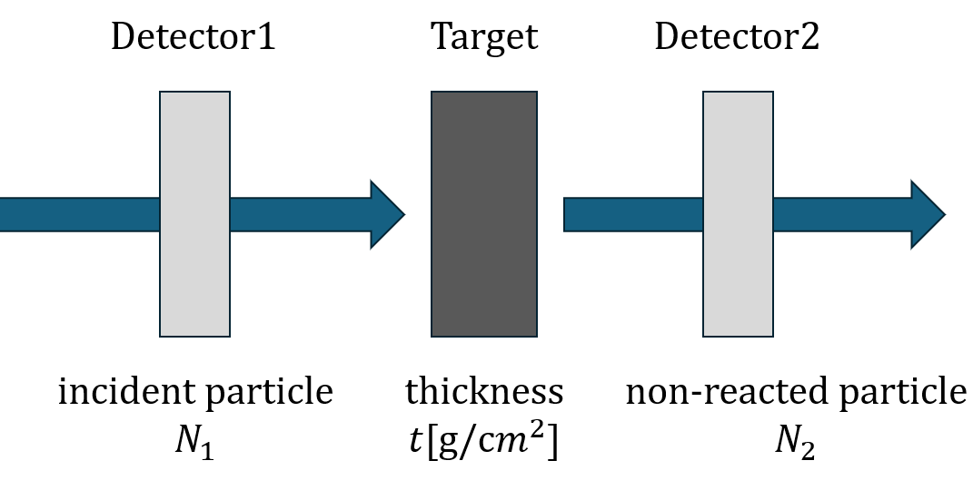
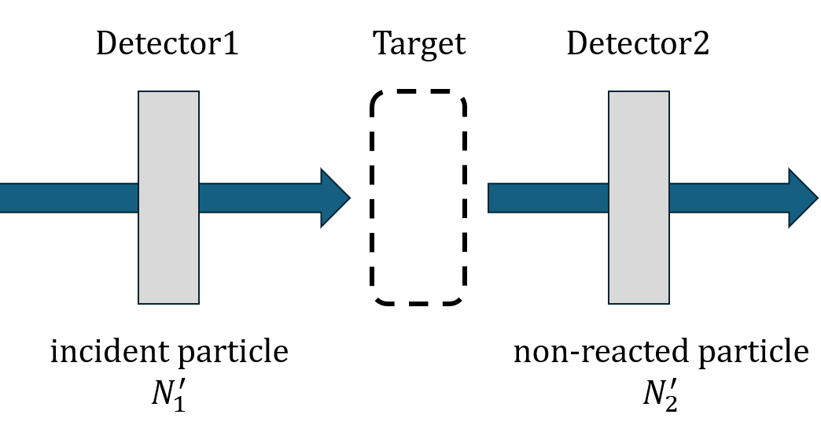
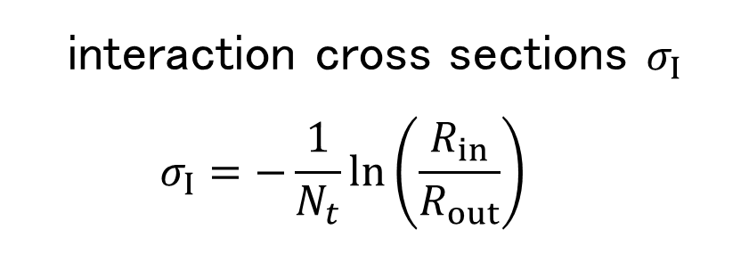



Measurement Principle
P.4
Transmission Method
$$N_{t}=\frac{ρN_{A}}{A}x$$
$$R_{in}=\frac{N_{2}}{N_{1}}$$
Transmission
$$R_{out}=\frac{N_{2}^{′}}{N_{1}^{′}}$$
interaction cross sections $σ_{I}$
$$σ_{I}=−\frac{1}{N_{t}}\ln\left(\frac{R_{in}}{R_{out}}\right)$$
Notes:
Next, I will explain the measurement method. The interaction cross section is measured using the transmission method. A primary beam is used to produce a secondary beam, which enters the reaction target. We identify the nuclides before and after the target and measure the numbers of incoming particles, N1​ and N1′​, and non-reacted particles, N2​ and N2′​. The interaction cross section can be calculated using the number of target nuclei per unit area, Nt​, and the non-reaction rates with and without the target, as shown here.

Slide 6
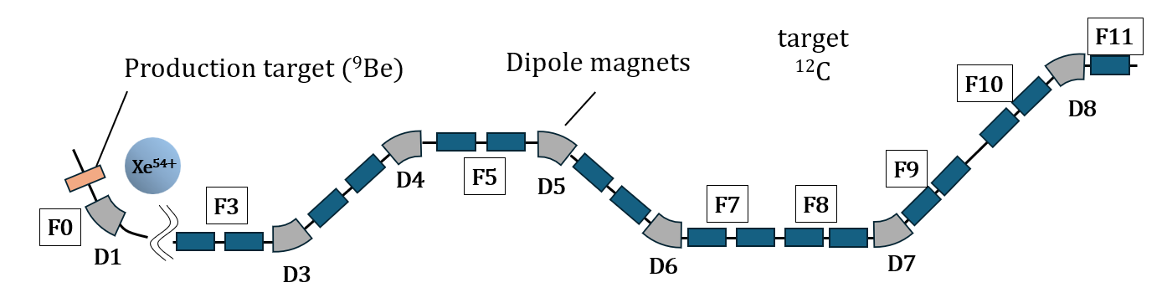

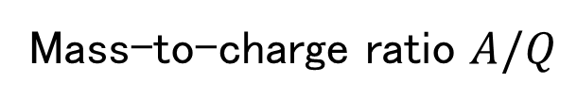
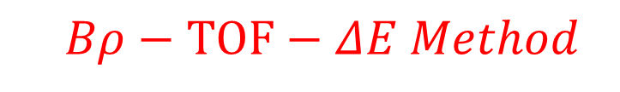






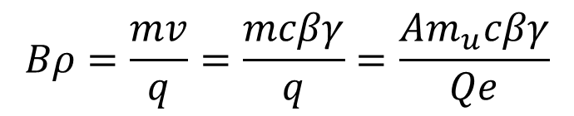
Measurement Principle
$$Bρ−TOF−ΔE Method$$
P.5
Particle
Identification
RIKEN RI beam Factory (RIBF)
Beam Path
Mass-to-charge ratio $A/Q$
Magnetic Rigidity
$$Bρ=\frac{mv}{q}=\frac{mcβγ}{q}=\frac{Am_{u}cβγ}{Qe}$$
$m_{u} :$ Atomic mass unit
Energy loss, ΔE
$γ :$ Lorentz factor
From the Bethe-Bloch equation
Particle velocity
$$γ=\frac{1}{\sqrt{1−β^{2}}}$$
$$\frac{A}{Q}∝\frac{Bρ}{βγ}$$
$$ΔE∝\frac{Z^{2}}{β^{2}}$$
$$β=\frac{L}{c∙TOF}$$
Notes:
Next, let me explain the Bρ–TOF–ΔE method for particle identification.
I measure the magnetic rigidity Bρ, time of flight (TOF), and energy loss ΔE using detectors.
I determine the atomic number Z from TOF–ΔE and the mass-to-charge ratio A/Q from TOF–Bρ, allowing us to identify the nuclides.

Slide 7
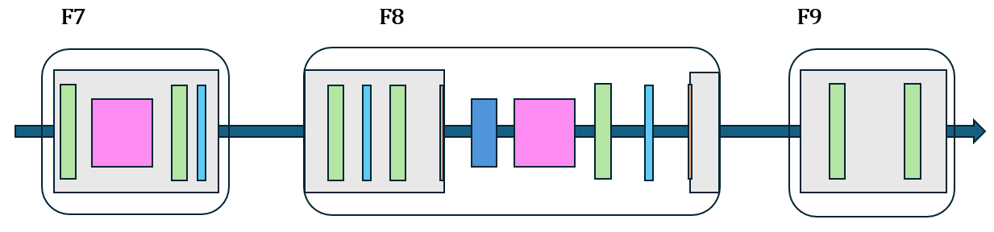
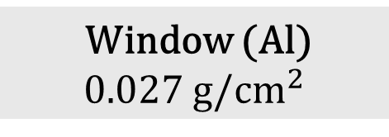
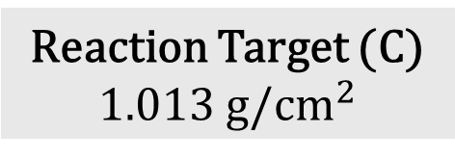
Experiment
P.6
RIKEN RI beam Factory (RIBF)
BigRIPS F7~F9
Detector
PPAC
Ionization Chamber
Reaction Target (C)
1.013 g/$cm^{2}$
Window (Al)
0.027 g/$cm^{2}$
Plastic Scintillator
Notes:
This is the experimental setup.
First, a 238U primary beam at about 345 MeV/u is sent to a 1-mm-thick Be target to produce a secondary beam.
The secondary beam is separated by mass and then sent to the carbon target.
PPACs, plastic scintillators, and Ionization chambers are placed before and after the carbon target for particle identification.
ーーーーーーーーーーーーーーーーーーーーーーーーーーーーーーーーーーーーーーーーーーーーーーーーーーーーーーーーーーーーーーーーーーーーーーーーーーーーーーー
The window separates the target area from the vacuum in the beamline.
Although we call it the thickness, what matters for the interaction cross section and energy loss is not the geometrical thickness, but the amount of material that the particles pass through.
Therefore, we express it as an areal density in g/cm².
Carbon is a relatively light nucleus, so the contribution from the Coulomb interaction is small.
This allows us to mainly measure the interaction cross section due to nuclear reactions.

Slide 8
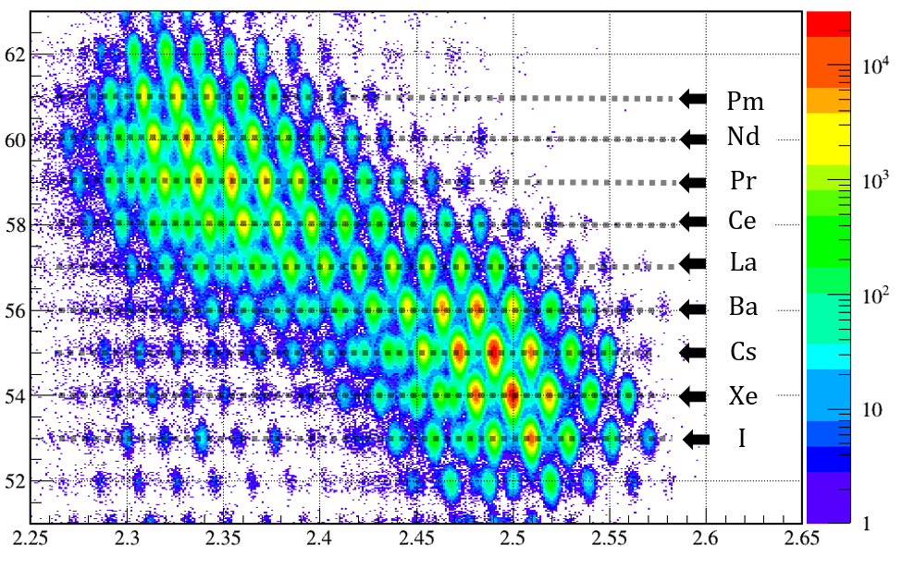
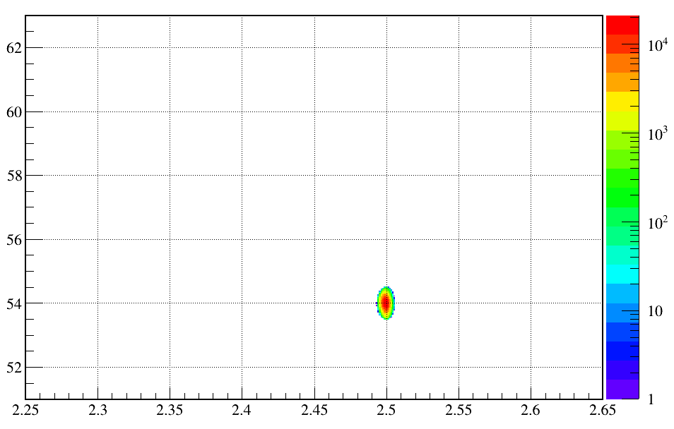

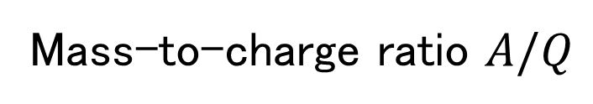


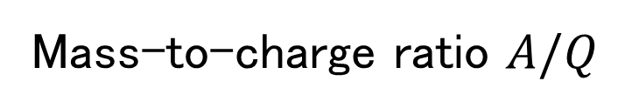
Results and Discussion
P.7
Upstream:
Particle Identification (PI) Plot
$$Z$$
$$Z$$
Proton number
Proton number
$$135Xe$$
Mass-to-charge ratio $A/Q$
Mass-to-charge ratio $A/Q$
Notes:
Next, I will show the analysis results and discussion. In this study, I analyzed the data using a carbon target.
This is the particle identification plot before the target.
Z is obtained from the TOF and ΔE, and A/Q is obtained from the TOF and Bρ.
From these values, we can identify the nuclides.
I then selected the nuclide of interest with an elliptical gate, and used the number of particles inside this gate as the incoming particle number for the transmission method.
ーーーーーーーーーーーーーーーーーーーーーーーーーー
There are relatively more σI​ data for lighter nuclei.
However, systematic data are limited in this mass region.
Therefore, we believe that this study is physically important for filling this gap in the available data.
We calculate Bρ using a distance-weighted average between F3–F5 and F5–F7.

Slide 9
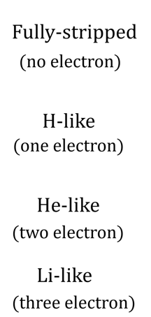
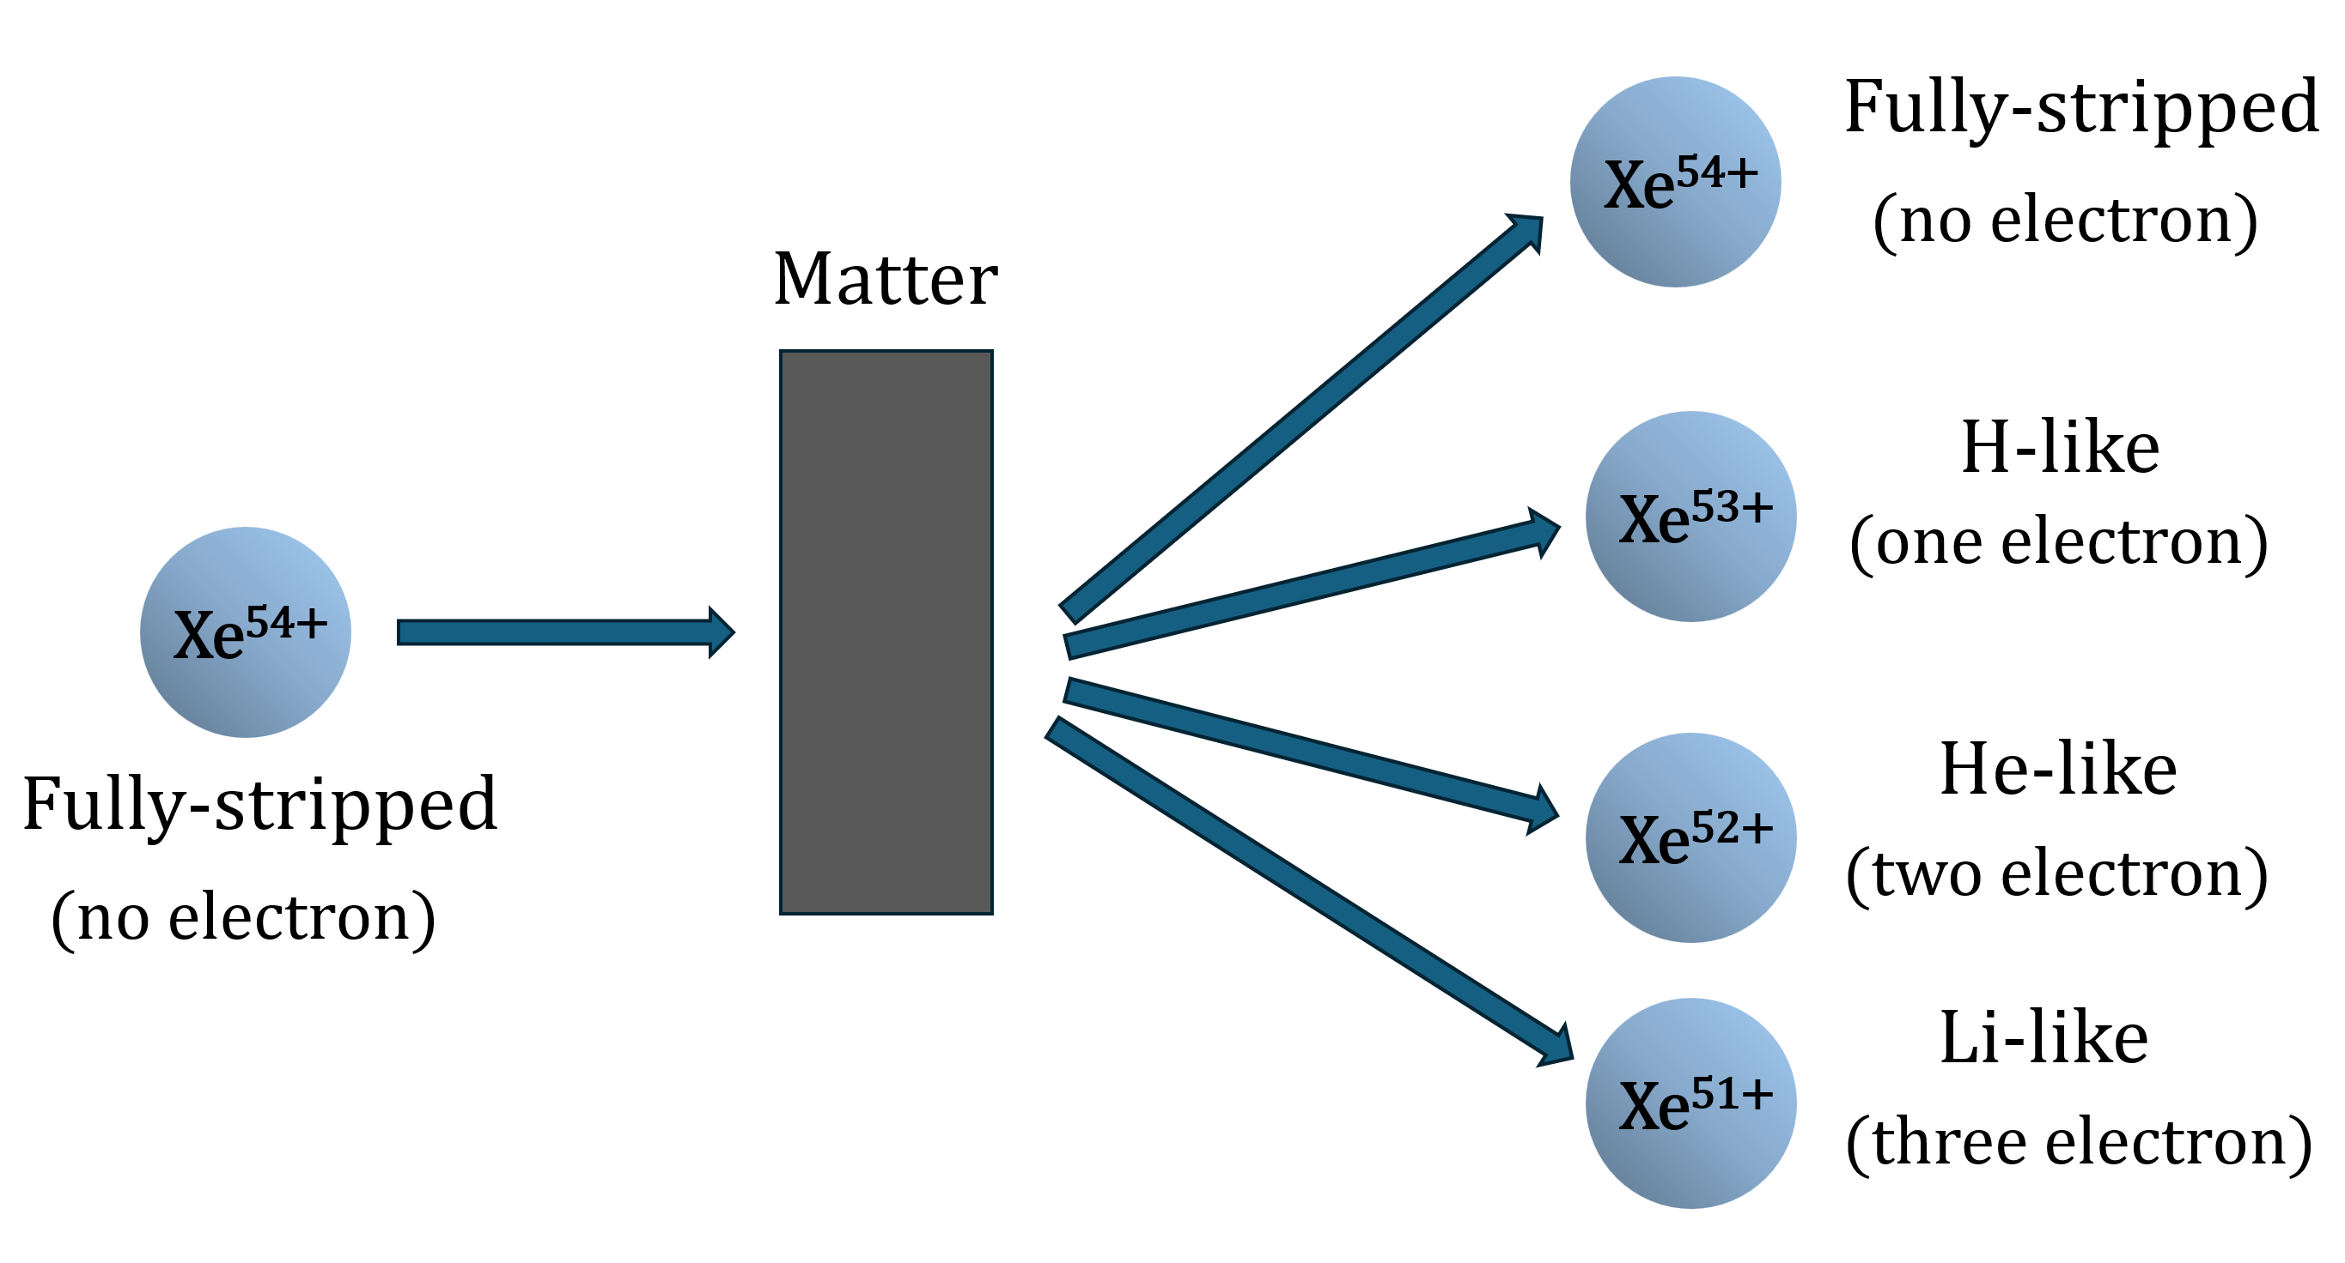
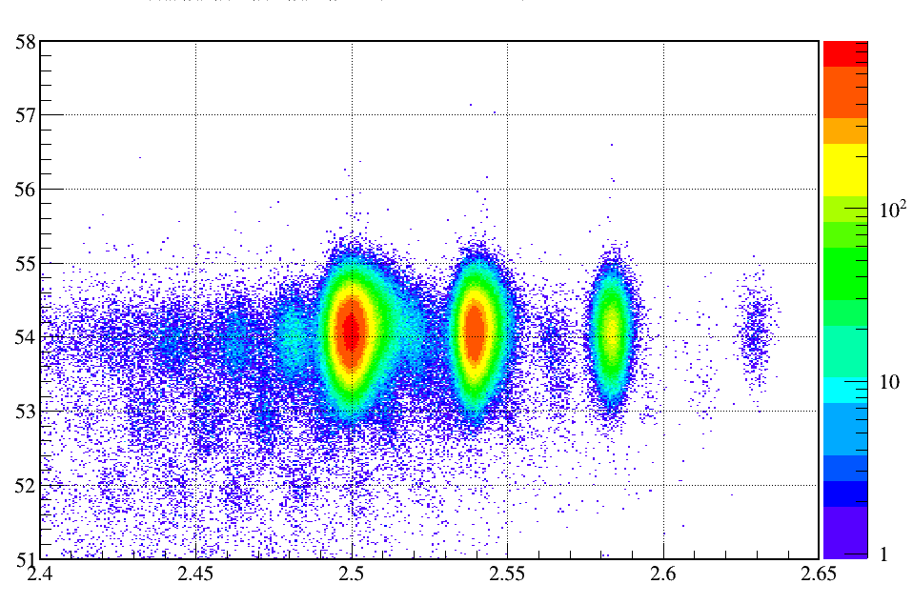


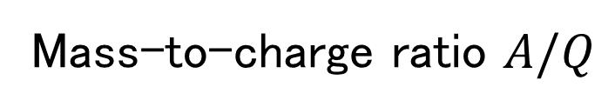
Results and Discussion
P.8
Downstream:
Particle Identification (PI) Plot
Fully-stripped
H-like
He-like
Li-like
$$Z$$
Material
Proton number
-
-
-
-
-
-
Mass-to-charge ratio $A/Q$
Notes:
This is the particle identification plot after the target. Here, Z is obtained from the TOF between F8 and F11 ． the ΔE measured by the Ionization chamber at F8.A/Q is obtained from the TOF between F8 and F11 and the Bρ measured using the dipole magnet between F10 and F11. The histogram showed different charge states, from fully stripped to H-like, He-like, and Li-like ions.
These are non-reacted particles, so we need to count them. However, these included particles with one neutron removed, so we need to subtract them.
-----------------------------------------------------------
The charge state is determined by the competition between electron stripping and electron capture in the target.
At higher beam energies, electron stripping becomes more likely, so highly charged states become dominant.

Slide 10
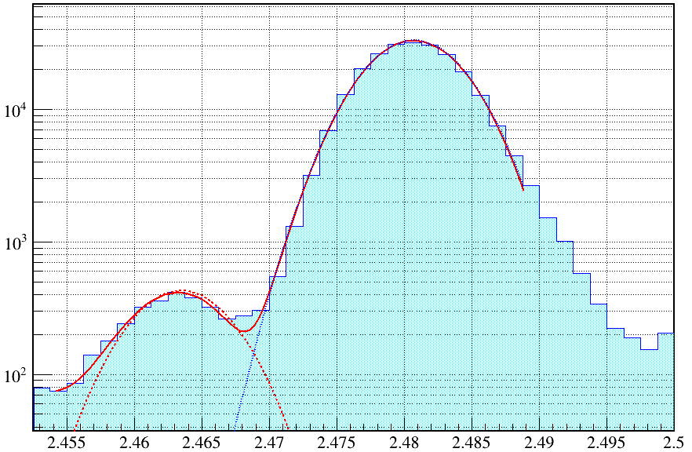

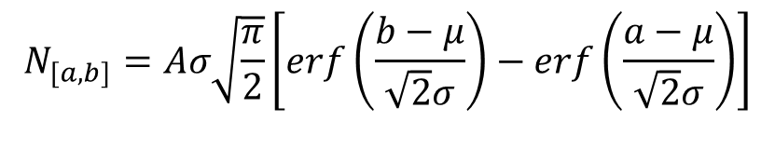

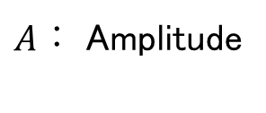
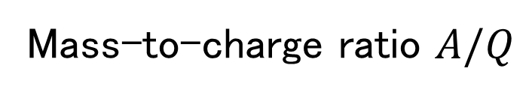
Analysis Results
P9
After the target
Estimation of Contamination
from Neutron Removal
$$N_{[a,b]}=Aσ\sqrt{\frac{π}{2}}\left[\operatorname{erf}\left(\frac{b−μ}{\sqrt{2}σ}\right)−\operatorname{erf}\left(\frac{a−μ}{\sqrt{2}σ}\right)\right]$$
neutron
removal peak
$N_{[a,b]}：$ Neutron removal contamination in the range [a,b]
$A：$ Amplitude
$σ：$ Standard deviation
$μ ：$ Mean of the Gaussian distribution
Mass-to-charge ratio $A/Q$
Exclude neutron removal events for an accurate evaluation of ${ N}_{2}$​.
Notes:
This is the one-dimensional A/Q histogram after the target.
The peak fitted by the blue line corresponds to non-reacted particles of the nuclide of interest.
The component next to this peak is considered to be from neutron removal.
I fit these components with two Gaussians and estimate the neutron removal amount by integrating the overlapping region using the error function.
ーーーーーーーーーーーーーーーーーーーーーーーーーーーーーーーーーーーーーーーーーーーーー
First, we fit the neutron removal and fully-stripped peaks with Gaussian functions. Then, we define the FS gate as ±3σ around the fully-stripped peak. We integrate the neutron-removal Gaussian within this gate to estimate the neutron-removal contamination in the FS gate.

Slide 11

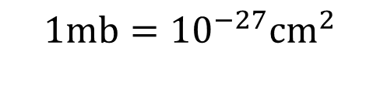
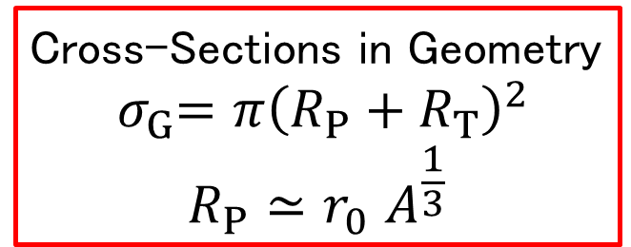
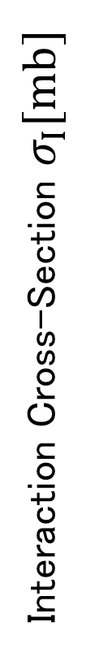
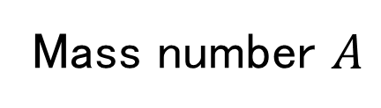
Results and Discussion
P.10
Interaction Cross-Section Measurement Results
Cross-Sections in Geometry
$${ σ}_{G}=π{\left(R_{P}+R_{T}\right)}^{2}$$
$$R_{P}{≃r}_{0}A^{\frac{1}{3}}$$
$$1mb={10}^{−27}{cm}^{2}$$
Interaction Cross-Section $σ_{I}[mb]$
Mass number $A$
The interaction cross section $σ_{I}$​ tends to increase with mass number.
Notes:
Next, let me discuss the mass-number dependence of the interaction cross section σI​.
The interaction cross section σI​ tended to increase with mass number.
I compared the measured σI​ with the geometric cross section σG​, and found a trend consistent with its mass-number dependence.
This indicates that, within the experimental uncertainty, the interaction cross section reflects the geometric size of the nuclei.
-------------------------------the black line represents the expected cross section from a simple geometrical model, with r0fitted to the experimental data.

Slide 12
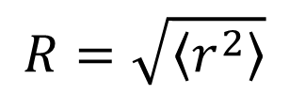
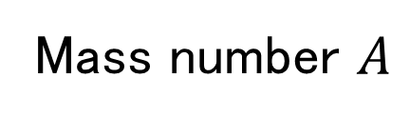
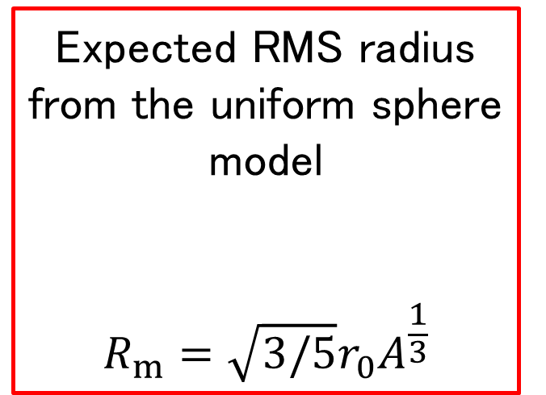
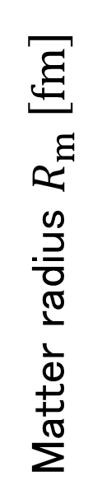
Results and Discussion
P.11
Expected RMS radius from the uniform sphere model
$$R_{m}=\sqrt{3/5}{r_{0}\text{​}A}^{\frac{1}{3}}$$
Matter radius Results
$$R=\sqrt{\left\langle r^{2}\right\rangle }$$
Matter radius $R_{m} \left[fm\right]$
Mass number $A$
Notes:
Next, I obtained the matter radii from the interaction cross sections.
The matter radii tended to increase with mass number.
The black line shows the expected RMS radius from the uniform sphere model.
Our results showed a similar trend.
This suggests that the nuclear density distribution is relatively uniform for these nuclei.
--------------------------------------------------------------------------------------------------------
RMS radius represents how spread out the nucleons are in the nucleus.
In the uniform sphere model, we assume a constant density and calculate the RMS radius.
RMS->root mean square

Slide 13

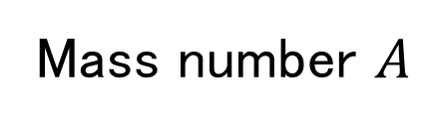
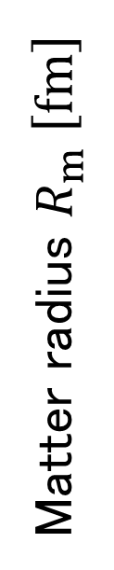
Results and Discussion
P.12
Matter radius Results
Matter radius $R_{m} \left[fm\right]$
preliminary
Mass number $A$
The neutron distribution extends
beyond the proton distribution.
Matter radius > Proton distribution radius
Notes:
Next, I compared the matter radii obtained in this study with the proton distribution radii derived from charge radii in previous studies.
The black symbols show the proton distribution radii obtained from the charge radii with corrections.
The matter radii obtained in this study are larger than the proton distribution radii for all nuclides.
This suggests that the neutron distribution extends beyond the proton distribution.

Slide 14


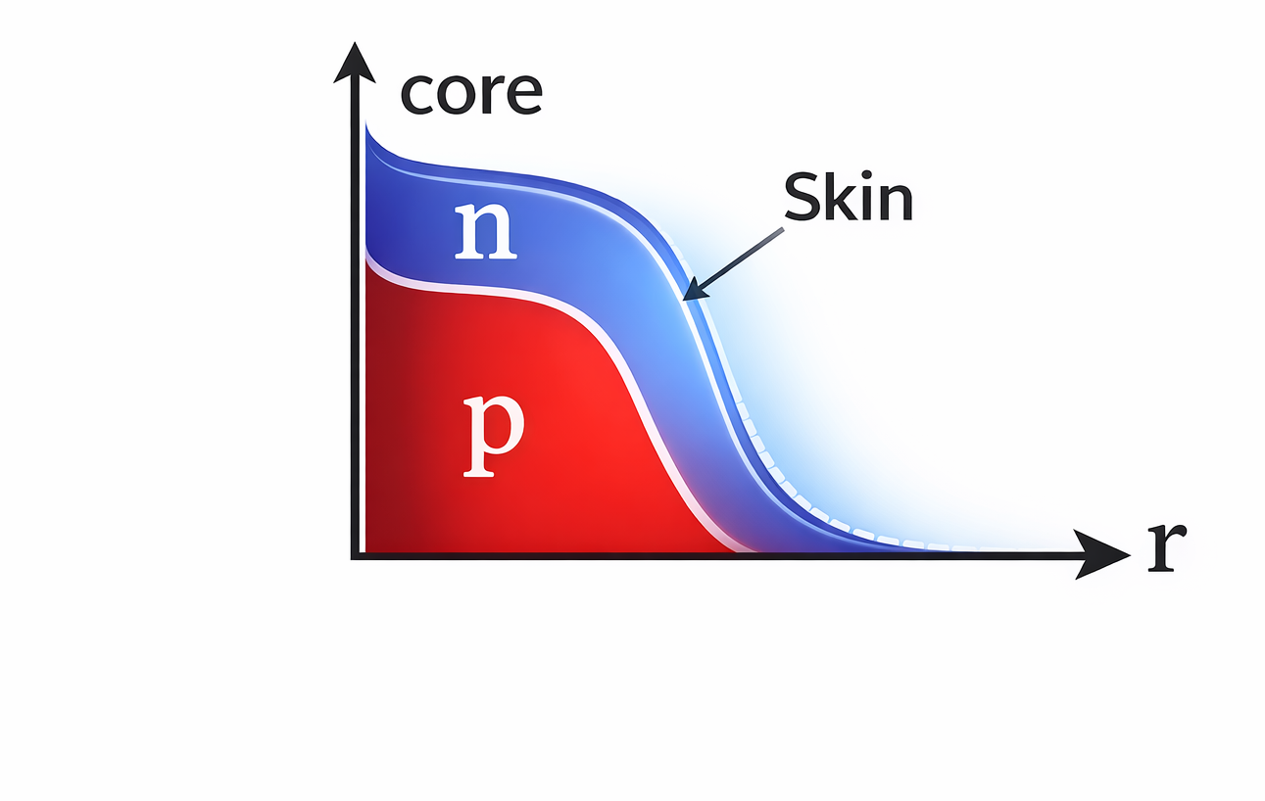
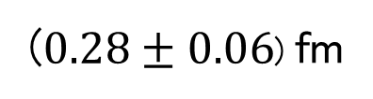
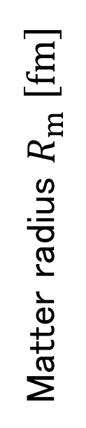


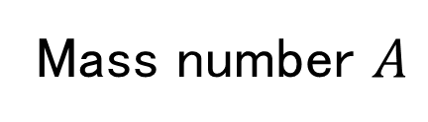

Results and Discussion
Matter radius Results
P.13
Comparison with previous studies
Neutron skin thickness
Theoretical values from previous study^{[2]}
($0.28±0.06$) fm
Experimental values
Neutron distribution radius
$$136Xe$$
$$R_{n}=\sqrt{\frac{AR_{m}^{2}−ZR_{p}^{2}}{N}}$$
$$R_{n}$$
Matter radius $R_{m} \left[fm\right]$
preliminary
Mass number $A$
[2] S. Yoshida et al., "Neutron distribution radii from magnetic rigidity of secondary beams," arXiv:2411.13622 [nucl-th] (2024).
Notes:
Here, I obtained the neutron distribution radius and neutron skin thickness of 136Xe using the matter radius and the proton distribution radius from previous studies.
There was little difference between our results and the theoretical calculations from the previous study, shown in red.
This may be due to assumptions about the density distribution and model dependence.
I would like to investigate this further with additional measurements and improved analysis methods.
ーーーーーーーーーーーーーーーーーーーーーーーーーーーーーーーーーーーーーーーーーーーーーーーーーーーーーーーーーー
The matter radius is obtained from an inverse calculation based on Glauber theory, assuming smooth proton and neutron density distributions.
Therefore, the fine structures of the density distribution and the details of the nuclear surface may depend on the model.
Theoretical predictions of the neutron skin thickness of 136Xe range from about 0.15 to 0.25 fm, depending on the model.
This may be related to differences in the surface diffuseness and the density dependence of the symmetry energy.

Slide 15
Summary and Future Prospects
P.14
Measurement of Interaction Cross Sections and Matter Radii for Isotopes
of Z=54–60 (Xe, Cs, Ba, La, Ce, Pr, Nd)
・
Comparison of the obtained interaction cross sections with geometric cross sections
The results show a trend consistent with the mass-number dependence
of the geometric cross section.
・
Derivation of matter radii
Matter radii increase with mass number, consistent with the RMS radii
expected from the uniform sphere model.
・
Comparison with previous studies
The obtained matter radii are larger than the proton distribution radii for all nuclides.
Future Prospects
・
Study of the effects of nuclear structure on interaction cross sections around N=82.
Notes:
Finally, I will summarize this study and discuss future work.In this study, I measured the interaction cross sections and matter radii of isotopes with Z=54–60.The interaction cross sections showed a trend consistent with the mass-number dependence of the geometric cross section. The obtained matter radii increase with mass number, consistent with the RMS radii expected from the uniform sphere model.For future work, I would like to study nuclear structure effects on interaction cross sections around the magic number N=82, beyond a simple geometric picture.
ーーーーーーーーーーーーーーーーーーーーーーーーーーーーーーーーーーーーーーーーーーーーーーーーーーーーーーーーーーーーーーーーーーーーーーーーーーーーーーーーーー

Slide 16
Collaborators and Affiliations
P.15
D. Nishimura¹, S. Endo¹, Y. He¹, C. Inoue¹, K. Matsuyama¹ , F. Sato¹, T. Moriguchi², T. Tanaka³, M. Fukutome⁴, S. Ishitani⁵, R. Taguchi⁵, G. Takayama⁵, A. Yano², K. Adachi⁴, H. Baba⁶, M. Fukuda⁵, N. Fukuda⁶, Y. Ichinohe⁶, R. Kageyama¹, Y. Kikuchi⁷, N. Kobayashi⁸, H. Kobayashi², K. Kusaka⁶, S. Michimasa⁶, M. Mihara⁵, M. Mikawa², M. Mitsui², D. Nagae⁷, S. Nishizawa⁷, M. Ohtake⁶, T. Ohtsubo⁴, A. Ozawa², C. Santonastaso⁶, R. Sasamori⁴, T. Shimamura,⁴, Y. Shimizu⁶, T. Suzuki⁷, H. Suzuki⁶, H. Takeda, S. Takeshige⁹, K. Tezuka⁴, Y. Togano⁶, K. Watanabe⁷, Y. Wei⁷, T. Yamaguchi⁷, Y. Yanagisawa⁶, I. Yasuda⁷, K. Yasuda⁵, M. Yoshimoto⁶
Affiliations
Tokyo City University 2. University of Tsukuba 3. Kyushu University
4. Niigata University 5. Osaka University 6. RIKEN Nishina Center
7. Saitama University 8. Rikkyo University 9. RCNP, The University of Osaka
Notes:
Here are the collaborators and their affiliations.
Thank you for your kind attention

Slide 17
Backup slides

Slide 18
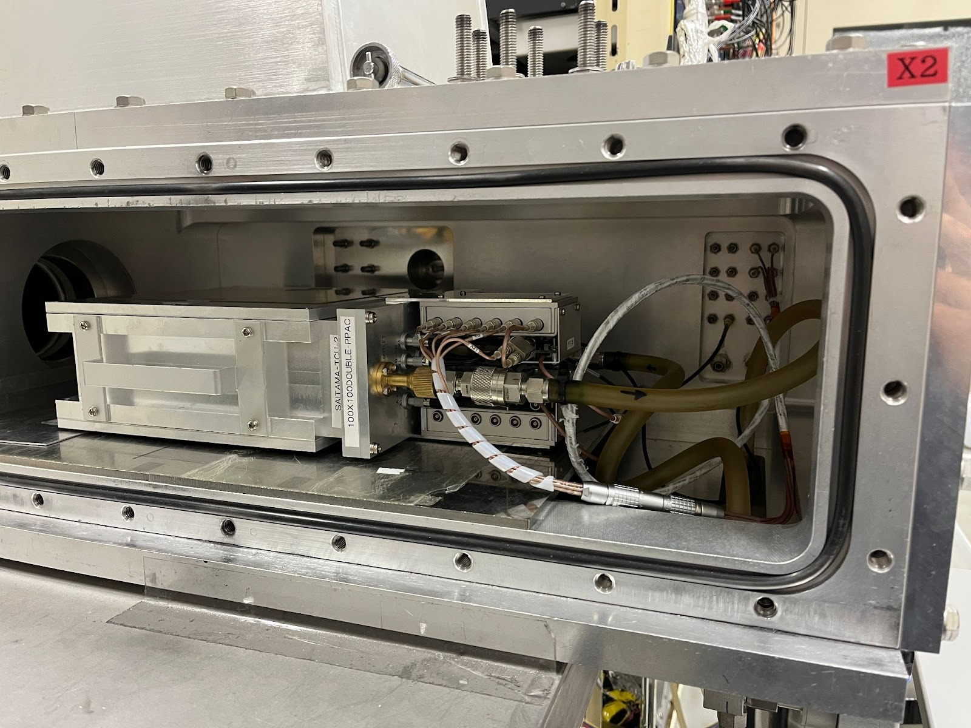
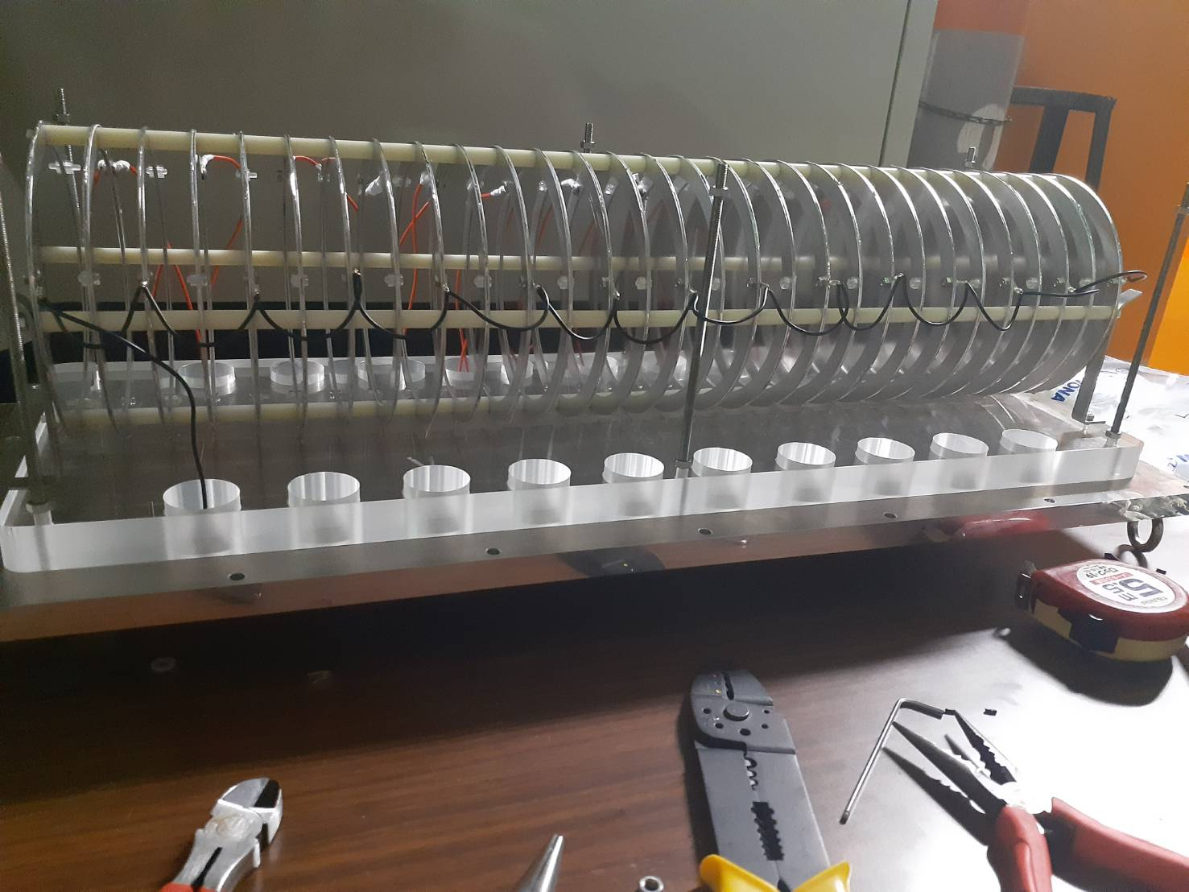


Detector List
PPAC
ion chambers
plastic scintillator
plastic scintillator
Notes:
●plastic scintillator
A plastic scintillator emits light when a charged particle passes through it.
Its fast response makes it suitable for TOF measurements.
PMTs are placed on both sides, allowing us to determine the particle position from the time and pulse-height differences.
●イオンチェンバー (ΔE)
The ion chamber has 29 aluminized Mylar electrodes.
A charged particle ionizes the gas and produces electron-ion pairs.
The resulting signal is proportional to the energy loss.
●PPAC
PPAC is a detector used to measure the beam position and angle.
The position is determined from signals from the X- and Y-direction strip electrodes.
It uses electron-ion pairs, similar to an ion chamber, and has good time resolution.
The X plane is at the top, followed by the anode and the Y plane.
These three parts form the B side, and there is also an A side on the other side.

Slide 19

Cyclotron
About 70% of the
speed of light
Linear accelerator
Cyclotron
RILAC
AVF
RRC
fRC
IRC
SRC
ＢｉｇＲＩＰＳ
Electron stripper
Electrons are stripped off
Notes:
The beam is first accelerated by RILAC and then by several ring cyclotrons. Finally, the SRC accelerates the beam to about 70% of the speed of light.
During the acceleration, electron strippers remove electrons from the ions using a thin carbon foil. This produces highly charged ions and allows more efficient acceleration to higher energies.

Slide 20

About the Experiment
RIKEN RI Beam Factory (RIBF)
The primary beam (²³⁸U) is accelerated
to about 70% of the speed of light by
the Superconducting Ring Cyclotron (SRC).
Incident
About 126m long from F0 to F11
SRC
RI beams are produced, separated,
and identified by the BigRIPS separator.
Source: RIKEN
Notes:
The experiment was performed at the RIKEN RI Beam Factory (RIBF).
We used the BigRIPS separator with a primary beam accelerated to about 70% of the speed of light by the SRC.

Slide 21

Red: User-defined equipment
Red: User-defined equipment
Notes:
The upstream TOF is measured between F3 and F7, over a distance of 46.976 m.
The downstream TOF is measured between F8 and F10, over a distance of 25.434 m.
For the upstream Bρ, we use the average of the values between F3–F5 and F5–F7.
The two distances are almost the same, so we use a simple average.

Slide 22


Interaction cross sections for each nuclide
Xe
Cs
$$\text{Interaction cross sections} σ_{I}$$
Ba
La
mass number $A$

Slide 23

Interaction cross sections for each nuclide
Pr
Nd
$$\text{Interaction cross sections} σ_{I}$$
mass number $A$

Slide 24





Interaction cross sections
The following differential equation describes
the number of particles N passing through the target.
$$\frac{dN}{dx}=−σ_{I}\left(\frac{ρN_{A}}{A}\right)N$$
Solving this equation gives
$$N_{t}[1/{cm}^{2}]=\frac{ρN_{A}}{A}x$$
$$N_{2}=N_{1}exp⁡(−σ_{I}N_{t})$$
The interaction cross section is
Solving this equation gives
$$σ_{I}=\frac{1}{N_{t}}\sqrt{\left(\frac{1−R_{in}}{N_{1}^{in}R_{in}}+\frac{1−R_{out}}{N_{1}^{out}R_{out}}\right)}$$
$$σ_{I}=−\frac{1}{N_{t}}ln\left(\frac{N_{2}}{N_{1}}\right)$$
Notes:
The interaction cross section is obtained from the decrease in the number of beam particles in the target.
We assume that particles are lost with a constant probability, which gives the following differential equation.
Solving this equation gives an exponential decrease, and we obtain the interaction cross section from the relation between N1​ and N2​.
Here, Nt​ is the target areal density, or the number of target atoms per unit area.
For the uncertainty, we consider only the statistical fluctuations of the particle counts.
The events are assumed to follow a binomial distribution, which is approximated by a Gaussian distribution for a large number of events.
We use the 1σ, or about 68%, range as the uncertainty. Systematic uncertainties are not included.

Slide 25






Derivation of the Matter Radius
Nucleon Density (Fermi Distribution)
$$ρ\left(r\right)=\frac{ρ_{0}}{1+\exp\left(\frac{r−r_{0}}{c}\right)}$$
Measured Interaction Cross Section
Assuming a Fermi-type
Nuclear Density Distribution
$$r ：\text{Distance from the Nuclear Center}$$
$$ρ_{0}：\text{Central Density}$$
$$r_{0} ：\text{Nuclear Radius where} ρ\left(r\right)=\frac{ρ_{0}}{2}$$
The Glauber calculation uses this
distribution to obtain the matter radius.
$$c ：\text{Surface Diffuseness}$$
$（c=0.56$）
$r_{0}$ was chosen to reproduce
the measured interaction cross section.
Notes:
here, I will explain how we obtained the matter radius from the interaction cross section.
We assume a Fermi-type nuclear density distribution, as shown here.
Here, r0​ represents the nuclear radius, and c represents the surface diffuseness.
Using this density distribution, the Glauber calculation gives the interaction cross section.
We vary r0​ to reproduce the measured cross section, and then obtain the matter radius.

Slide 26
















Transmission
Transmission: Selection of stably transported beam components
Transmission $= \frac{\text{Number of non−reacted particles}}{\text{Number of incoming particles}}$
$$μ±2σ$$
$$μ±2σ$$
$$μ±2σ$$
$$μ±2σ$$
$F3a$[mrad]
$F3b$[mrad]
$$μ±2σ$$
$F5Y$[mm]
$$μ±2σ$$
$F3$X[mm]
$F3Y$[mm]
$F5X$[mm]

Slide 27







emittance cut
$$F3$$
$$F3$$
$F3X$：
Horizontal beam position
$$F3Y：$$
Vertical beam position
$$F3a：$$
Horizontal beam angle
$$F3b：$$
Vertical beam angle
Notes:
The emittance cut removes particles that are far from the main beam orbit and selects particles with stable trajectories.
This helps to improve the accuracy of the interaction cross section.
At F3, particles with large divergence angles can affect the downstream optics.
Therefore, we apply the emittance cut in phase space using the X and Y positions and the divergence angles a and b.
We select particles within the beam acceptance.

Slide 28





emittance cut
$$F5$$
$F$5
$F5X$：
Horizontal beam position
$$F5Y：$$
Vertical beam position
Notes:
At F5, we apply the emittance cut only in the X direction, which is related to the momentum.
Since the momentum is related to Bρ, we remove particles with different momenta to make the incoming beam conditions uniform.

Slide 29









Expected RMS radius from the uniform sphere model
$$\int_{0}^{R}{r^{2}∙\text{4}πr^{2}dr}=\int_{0}^{R}{\text{4}πr^{4}dr}$$
Numerator
$$\int_{0}^{R}{{\text{4}πr}^{4}dr}=\text{4}π∙\frac{1}{5}R^{5}$$
$$R_{m}=\sqrt{\left\langle r^{2}\right\rangle }$$
$$\int_{0}^{R}{\text{4}πr^{2}dr}$$
Denominator
$$\left\langle r^{2}\right\rangle =\frac{\int{r^{3}ρ\left(\vec{r}\right)ⅆ^{3}r}}{\int{ρ\left(\vec{r}\right)ⅆ^{3}r}}$$
$$\int_{0}^{R}{\text{4}πr^{2}dr}=\text{4}π∙\frac{1}{3}R^{3}$$
For a spherical object
$$ⅆ^{3}r=\text{4}πr^{2}ⅆr$$
$$R_{rms}=\sqrt{\frac{3}{5}}R$$
$$R=r_{0}A^{\frac{1}{3}}$$
Notes:
We assume the nucleus is a uniform-density sphere with a radius of R=r0​A1/3.
The RMS radius is defined as the square root of the mean square radius.
Assuming spherical symmetry, the volume element is dV=4πr2dr.
Since the density is uniform, it cancels in the numerator and denominator.
After integration, we obtain ⟨r2⟩=3R2/5.
Therefore, the RMS radius is 3/5​r0​A1/3.

Slide 30




Proton distribution radius
$${\left\langle r^{2}\right\rangle }_{ch}={\left\langle r^{2}\right\rangle }_{P}+\left\langle R_{P}^{2}\right\rangle +\frac{N}{Z}\left\langle R_{N}^{2}\right\rangle +\frac{3ℏ^{2}}{4m^{2}pc^{2}}$$
${\left\langle r^{2}\right\rangle }_{P}$：Point-proton distribution radius
${\left\langle r^{2}\right\rangle }_{ch}$：Squared charge radius
$\left\langle R_{P}^{2}\right\rangle$：Squared proton charge radius
$\left\langle R_{N}^{2}\right\rangle$：Squared neutron charge radius
$\frac{3ℏ^{2}}{4m^{2}pc^{2}}$：Foldy term
(relativistic correction)
・・・（１）
$${\left\langle r^{2}\right\rangle }_{P}={\left\langle r^{2}\right\rangle }_{ch}−\left\langle R_{P}^{2}\right\rangle −\frac{N}{Z}\left\langle R_{N}^{2}\right\rangle −\frac{3ℏ^{2}}{4m^{2}pc^{2}}$$
・・・（２）
$$r_{p}=\sqrt{{\left\langle r^{2}\right\rangle }_{P}}$$
・・・（３）
Notes:
From the charge radii obtained from previous studies, we can derive the proton distribution radius by assuming that the protons are point charges.
The square of the charge radius can be separated into several terms.
The first term represents the spatial distribution of the point-like protons.
The second term comes from the finite size of the proton.
The neutron has no electric charge, but it has an internal charge distribution.
Therefore, the neutron contribution is included with a factor of N/Z.

Slide 31









Neutron distribution radius
： Matter radius [$fm$]
$$R_{m}$$
： Proton distribution radius [$fm$]
$$R_{p}$$
$$Δr_{np}=R_{n}−R_{p}$$
$$R_{n}$$
： Neutron distribution radius [$fm$]
$$R_{m}=\frac{Z}{A}R_{p}^{2}+\frac{N}{A}R_{n}^{2}$$
$$σ_{R_{m}}$$
： Statistical uncertainty of the matter radius [$fm$]
$$σ_{R_{p}}$$
： Statistical uncertainty of the proton distribution radius [$fm$]
$$R_{n}=\sqrt{\frac{AR_{m}^{2}−ZR_{p}^{2}}{N}}$$
Uncertainty of the neutron
distribution radius
$$σ_{R_{n}} =\sqrt{(\frac{AR_{rms}}{NR_{n}}σ_{R_{rms}})^{2}+(\frac{ZR_{p}}{NR_{n}}σ_{R_{p}})^{2}}$$
Notes:
The matter radius is the particle-number-weighted mean square of the proton and neutron distribution radii.
Therefore, we can determine the neutron distribution radius from the matter radius and proton distribution radius.
Its uncertainty was evaluated by error propagation using the uncertainties of the two radii.

Slide 32



Neutron distribution radius
Neutron distribution radius
$$R_{n}=\sqrt{\left\langle r^{2}\right\rangle }$$
$$R_{n}=\sqrt{\frac{AR_{m}^{2}−ZR_{p}^{2}}{N}}$$
The neutron distribution radius
does not represent a specific boundary.
It is the weighted average distance of the
neutron distribution from the nuclear center.
$$r_{0}=\sqrt{\frac{3}{5}}R=0.77R$$
No large difference from the uniform sphere model
Notes:
The neutron distribution radius is a weighted average over the whole neutron distribution, based on the neutron density and the square of the distance from the center.
So, it does not represent a specific position in this figure. It represents the overall size of the neutron distribution.

Slide 33

Notes:
While nuclear charge radii have been systematically measured, as shown in the left figure, the nuclei with known interaction cross sections are much more limited, as shown in the right figure. Since there are still very few systematic data on interaction cross sections and nuclear matter radii in the region studied in this work, we aimed to systematically measure the interaction cross sections in this region.

Slide 34


Full measurement range of this experiment
$$Z$$
Proton number
¹³⁶Xe 近傍核
Number of neutrons $N$
Source: RIKEN

Slide 35
Future Work
Extend the measurements to nuclides around the magic number N=82 and study
changes in interaction cross sections due to nuclear structure effects.
Nuclear Structure Effects
・Shell structure (shell effects)
・Nuclear deformation (spherical, ellipsoidal, etc.)
・Neutron skin / halo structure
・Non-uniform density distributions and other nuclear structures
Notes:
There are several possible nuclear structure effects, such as shell effects, nuclear deformation, and neutron skin or halo structures. These effects can modify the nuclear density distribution and consequently affect the interaction cross section. So, we want to measure nuclides around N equals 82 and investigate how these structural changes are reflected in the interaction cross sections.

