Slide 1


Probing Neutron–Neutron
Short-Range Correlations in ¹⁶O
The ¹⁶O(p,nd)¹⁴O Reaction at RCNP
Zixu Ma
Institute of Modern Physics, Chinese Academy of Sciences

Slide 2
Outline
1
Introduction
2
Experimental procedure
3
Data analysis
4
Preliminary results

Slide 3
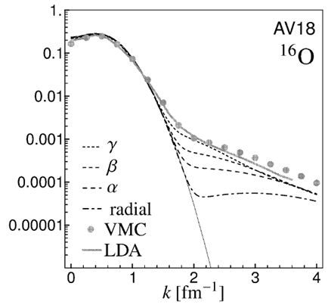
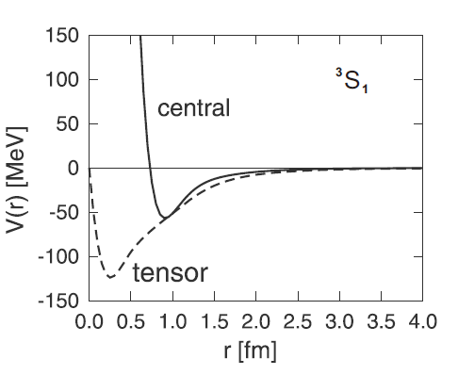
Introduction: Short Range Correlations
Fermi motion
High-momentum components above k_{F} arise from nucleon-nucleon correlations.
ρ_{NN} (fm)
Tensor
Repulsive core
Short-range central interaction
Tensor interaction
T. Neff and H. Feldmeier, NPA713, 311(2003)
Originate from π exchange
Non-central, 70–80% of NN attraction
Contribute mainly to the (S,T)=(1,0) channel
2p–2h excitation to higher orbitals with ΔS=ΔL=2
Central and repulsive
Approximately symmetric among different ST channels
Gives rise to a high-momentum tail through hard collisions at short distances
K.Ikeda and H.Toki, Lecture Notes in Physics, Springer, 165 (2010)

Slide 4
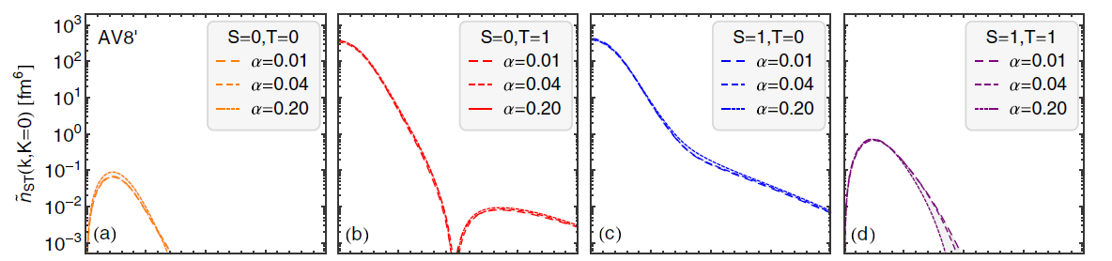
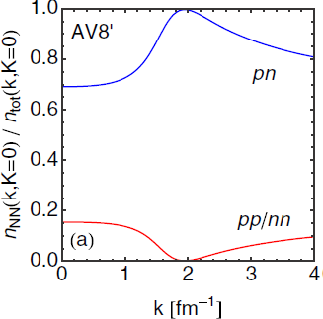
Theoretical predictions of momentum distribution
At around 2 fm⁻¹ , np (S,T)=(1,0) pairs dominate due to the strong tensor interaction.
Short-range repulsion generates a high-momentum tail extending to very high k.
Relative probability to find pn or pp/nn pairs is a function of relative momentum.
Provides an opportunity to investigate the short range correlations
T.Neff et al., PRC 92(2015)024003
Notes:
The right figure shows the relative momentum distribution of different (ST) channels for pairs with zero CM momentum

Slide 5
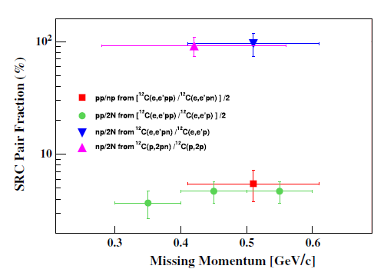
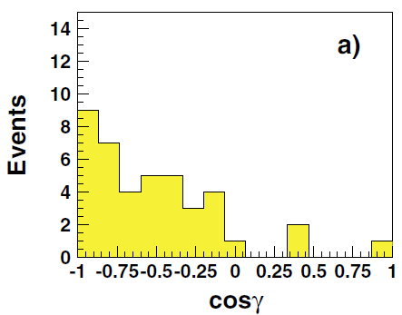
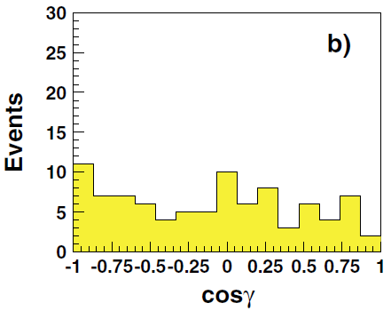
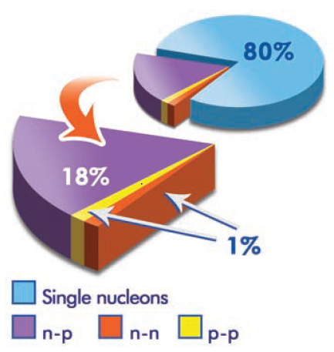
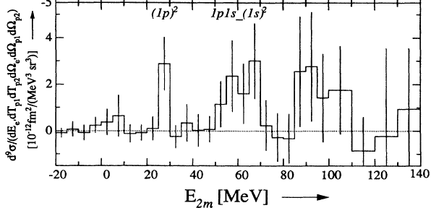
Previous experimental studies
Two-nucleon knockout reaction
12C(p,2p+n) @ BNL
A.Tang et al., PRL 90 (2003) 042301
¹²C(e,e’pN) @ JLab
R.Subedi et al., Science 320 (2008) 1476
np/2N
P_{n}>k_{F}
P_{n}<k_{F}
pp/np
pp/2N
¹²C(e,e’pp) @ NIKHEF
L.J.H.M.Kester et al., PRL 74(1995) 1712
Strong suppression of pp pairs is observed compared with np pairs, with an np/pp ratio of about 18.
These measurements provide limited information on the spin–isospin dependence of the correlated pairs.
More statistics and moderate resolution are needed for further investigation.
(p,Nd) reaction is a possible method

Slide 6
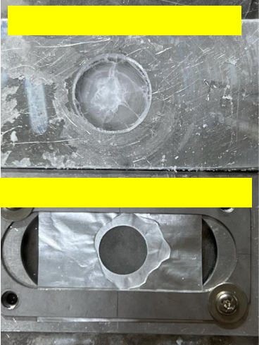
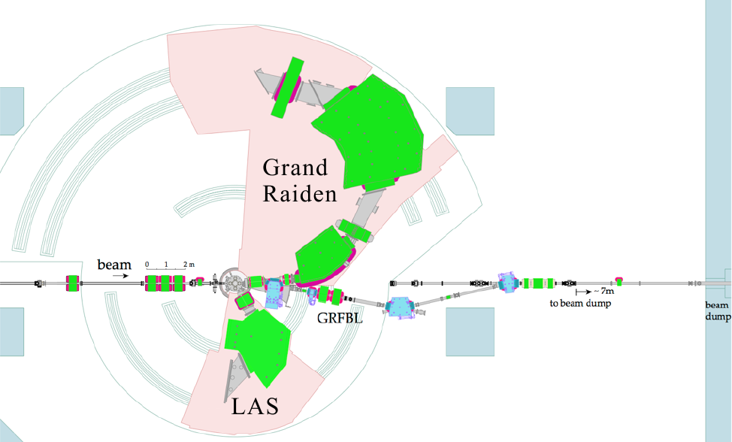
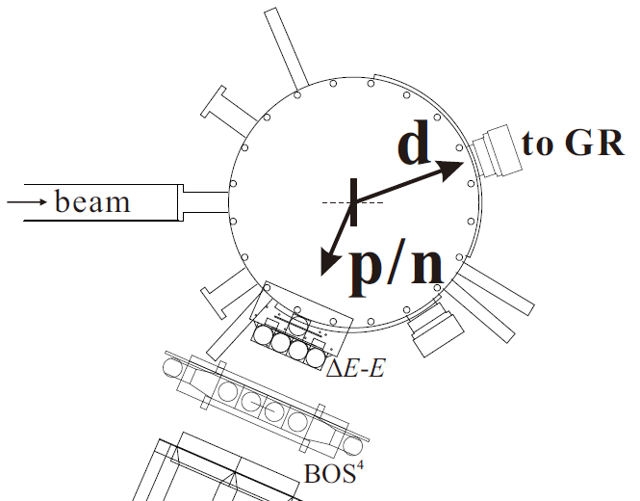

Experimental procedures: setup
E552@WS course, RCNP
Thin ice: ~20 mg/cm²
Focal plane detectors:
two VDCs: tracking
two plastic scintillators: PID and trigger
d
Beam: 392, 230 MeV
Target:
thin ice: ¹⁶O(p,pd)¹⁴O
thick ice: ¹⁶O(p,nd)¹⁴O
Thick ice: ~200 mg/cm²
GRAF beam line
BAckward Nucleon Detectors (BAND)
d
p
ΔE-E: proton detector
BOS⁴: neutron detector
BAND
Recoil-less
p or n
Denoted as N
Low-background coincidence measurement

Slide 7
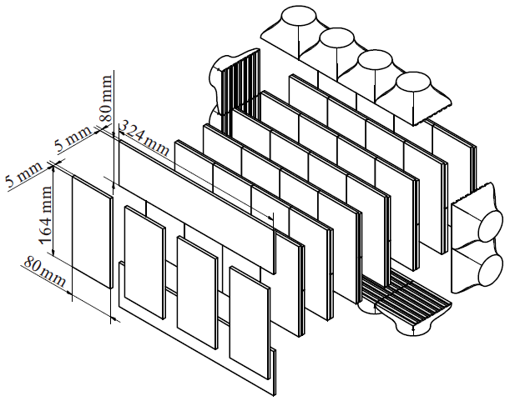
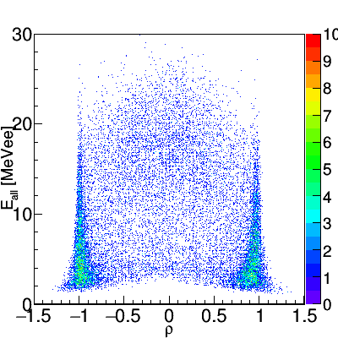
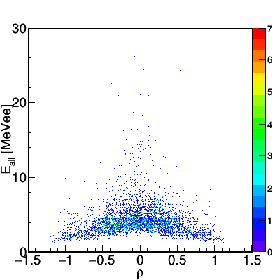
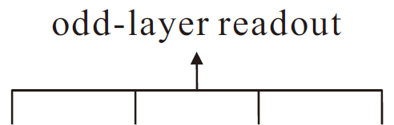
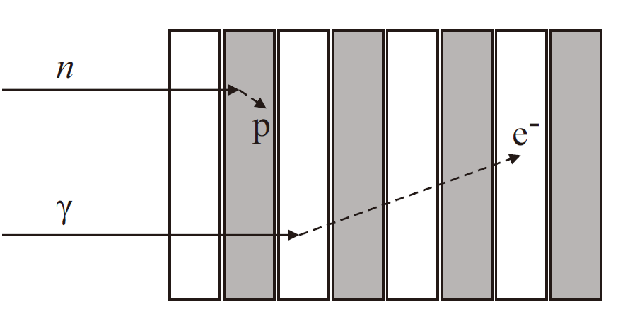
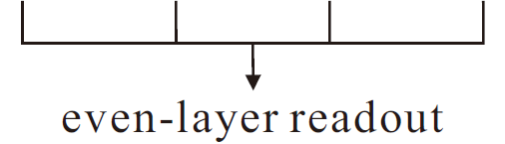


Experimental procedures: BOS⁴ detector
Structure and Discrimination Principle
n-γ discrimination under a high counting rate
Experimental results
Monoenergetic neutrons at 31 MeV produced by the d+d→n+³He reaction
Beihang-Osaka university
Stack Structure Solid Organic Scintillator
(BOS4)
monoenergetic n
prompt γ
$$E_{all}=E_{odd}+E_{even}$$
$$ρ=\frac{E_{even}−E_{odd}}{E_{even}+E_{odd}}$$
neutron: ρ ~±1 γ ray: ρ~0
Clear n-γ separation in Eall-ρ plot
L. Yu et al, NIM A 866(2017)118

Slide 8
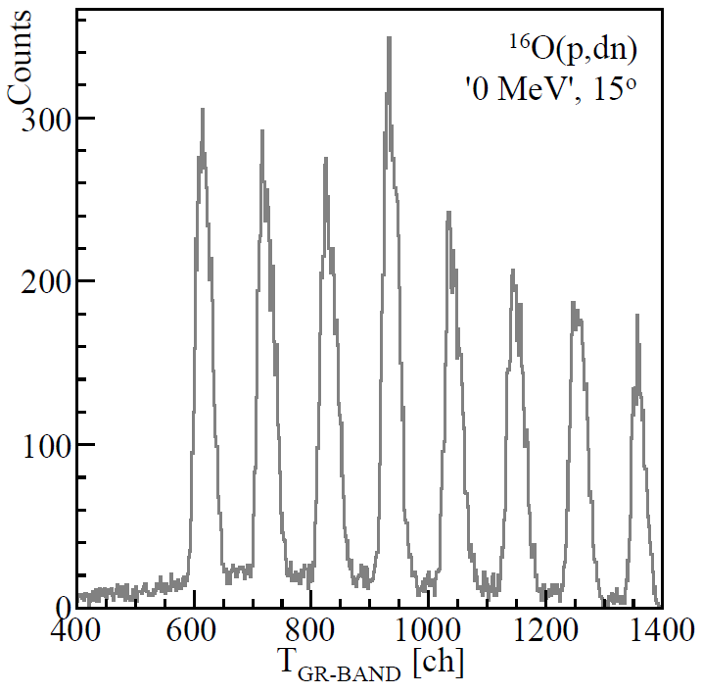
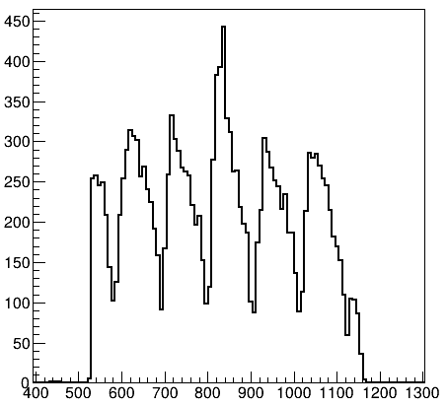
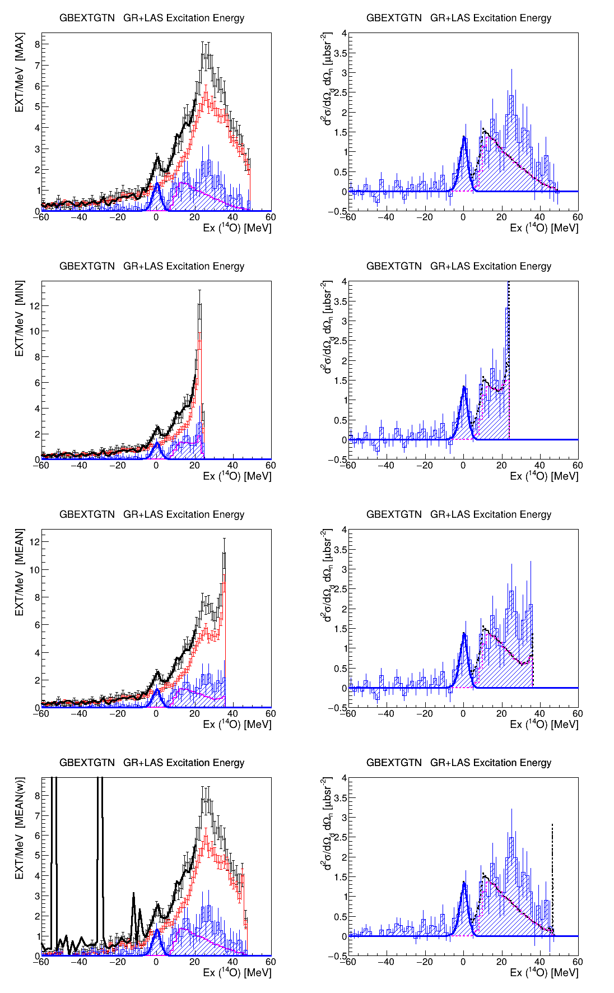

Data analysis: coincidence measurement of (p,nd) reaction
Time difference between deuteron and neutron triggers
Missing mass spectrum
Prompt peak: true + accidental coincidence
Other 4 peaks: accidental coincidence between different beam bunches
¹⁶O(p,nd)¹⁴O excitation spectrum at 6.4°
True: Acc. coin: ~ 1:5
Black/red: total spectrum and accidental backgrounds.
Blue hatched: true event after background subtraction.
Blue solid line: ground-state fit.
Magenta solid line: ¹³N contribution.
After subtracting accidental coincidence, G.S. (0⁺,1) can be clearly observed.

Slide 9
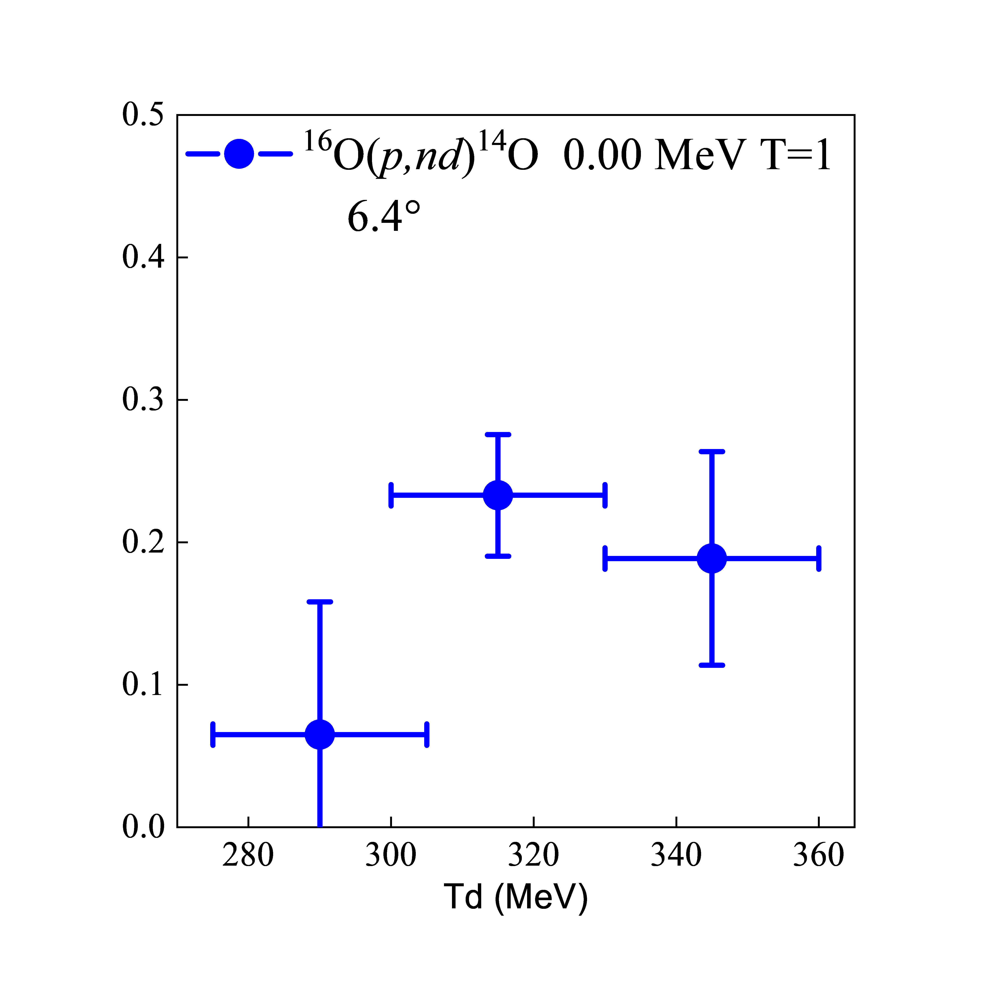
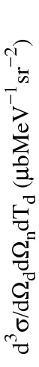
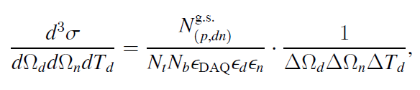
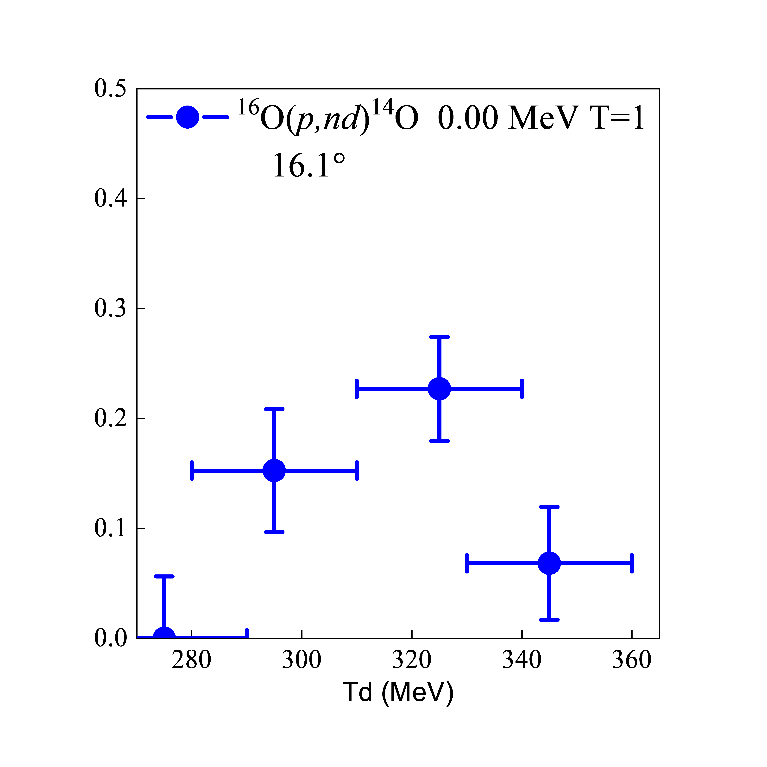
Data analysis: (p,nd) triple differential cross section
The (p,nd) triple differential cross section along the Ex axis is given by:
2.4 MeV in σ
¹⁶O(p,nd)¹⁴O excitation spectrum at 6.4°, Bρ ratio = 1.21

Slide 10
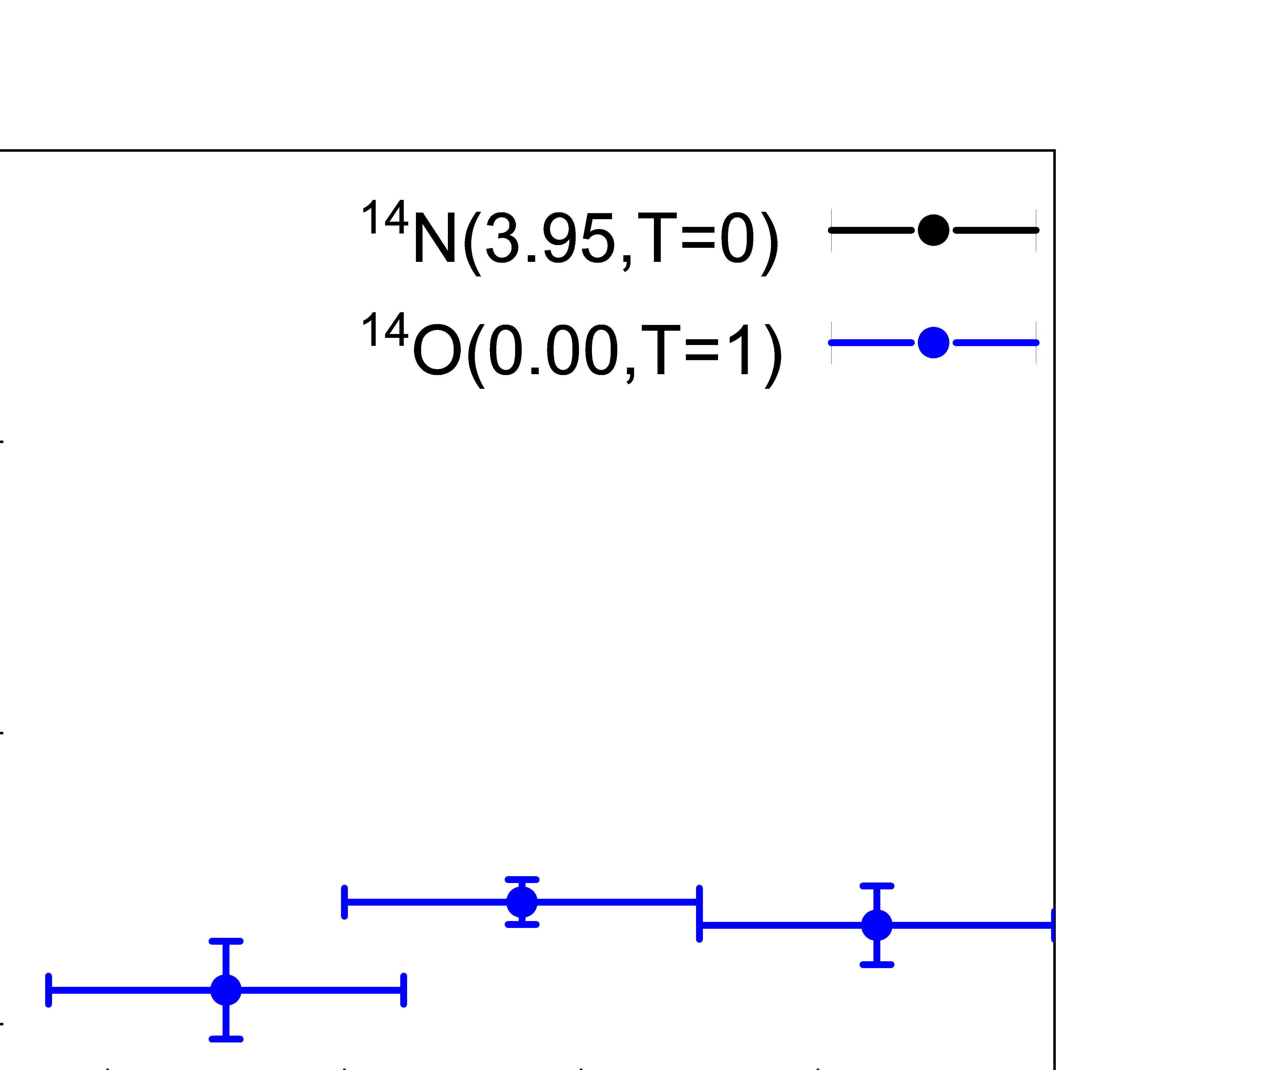
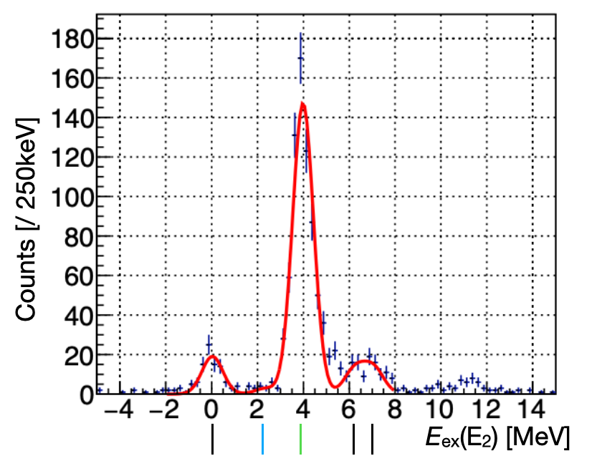
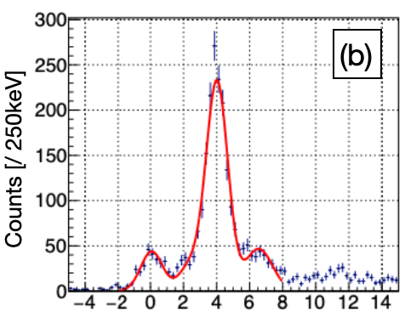
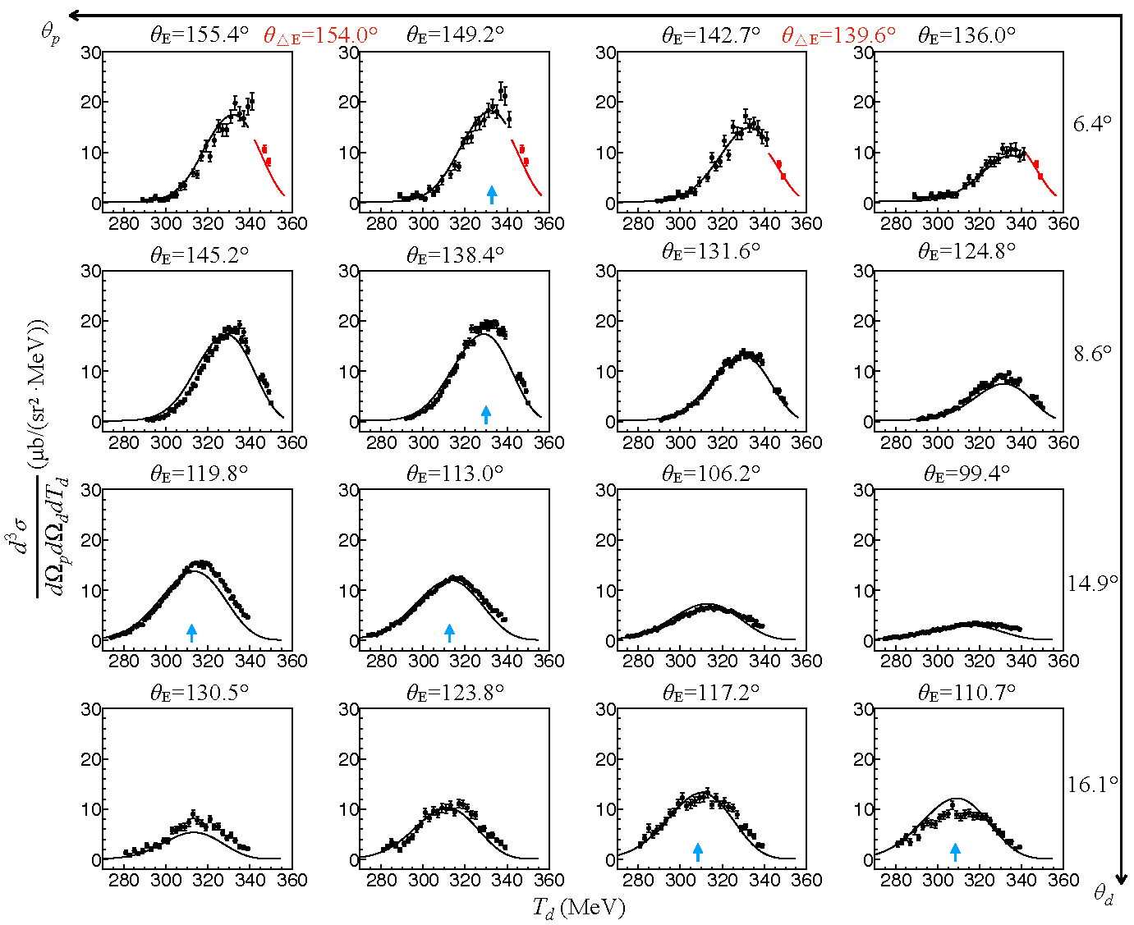
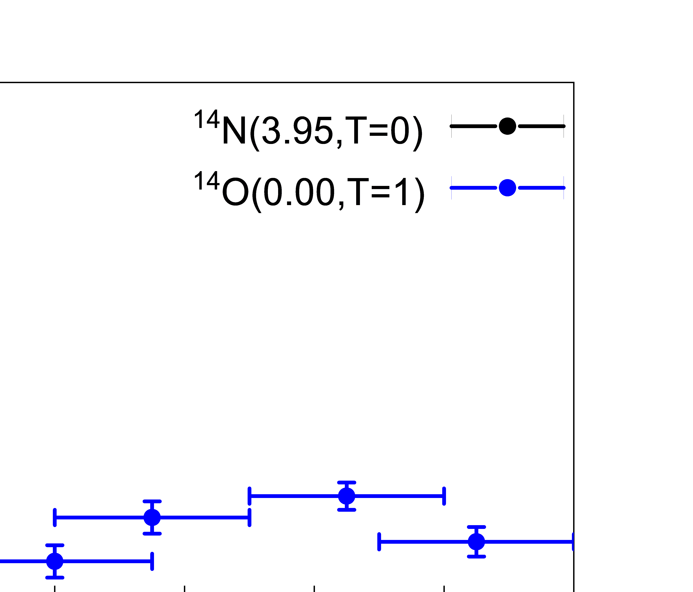
Preliminary Results: compare with (p,pd) channel
6.4°
¹⁶O(p,pd)¹⁴N
16.1°
¹⁶O(p,pd)¹⁴N
6.4°
3.95 MeV
(1⁺,0)
3.95 MeV
(1⁺,0)
×18
¹⁴N excitation spectrum(measured by ΔE-E)
X. Wang, Ph.D. thesis, 2025.
¹⁶O(p,pd)¹⁴N 3.95 MeV (1+, L=0)
¹⁶O(p,nd)¹⁴O 0.00 MeV (0+, L=0)
16.1°
×18
The np/nn ratio of the triple differential cross section is about 18.
Dominance of np (ST10) pair over nn (ST01) pair.
Direct evidence of tensor effect!

Slide 11
Summary
The n-n pair is observed at around 2 fm⁻¹ via ¹⁶O(p,nd)¹⁴O reaction
The ground state of ¹⁴O was identified, and the triple differential cross section for the ground-state transition was extracted.
The nn yield is found to be strongly suppressed compared with the pn case, suggesting a possible signature of the dominant tensor force effect at ~ 2 fm⁻¹
The (p,Nd) reaction proves to be a promising probe of high‑momentum components in nuclei and can be extended to other nuclei beyond ¹⁶O

Slide 12
Thank you for your attention!

Slide 13
Backup

Slide 14

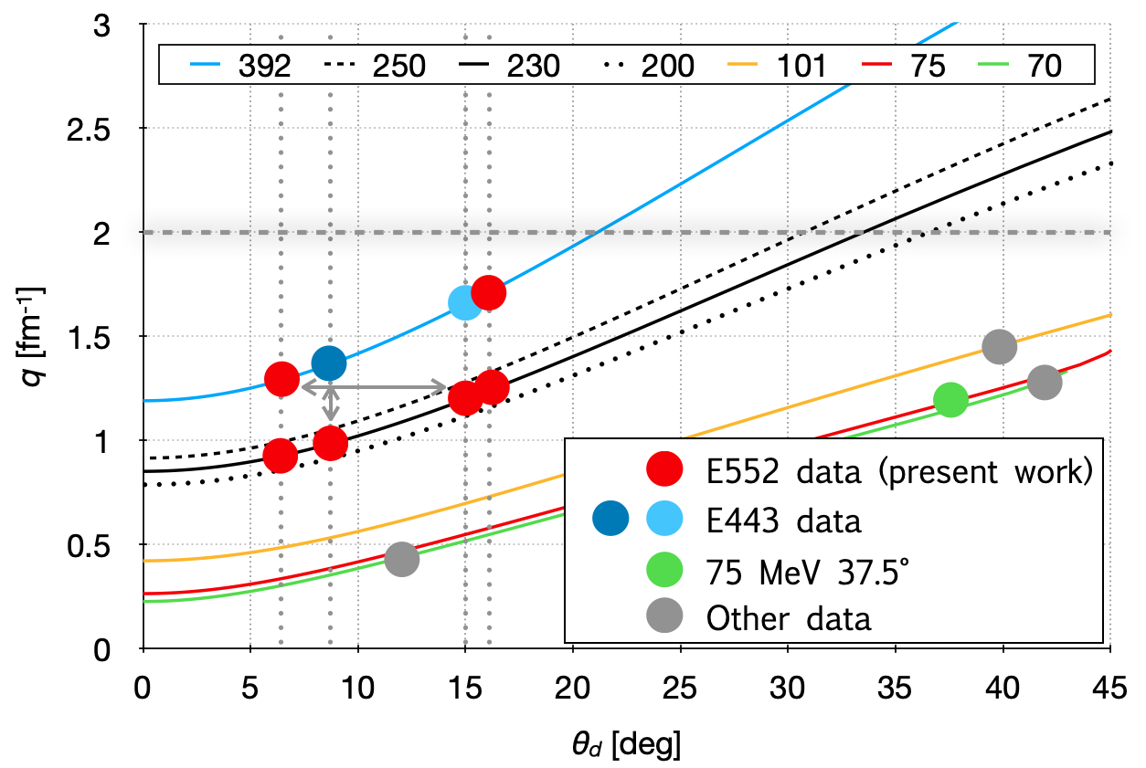
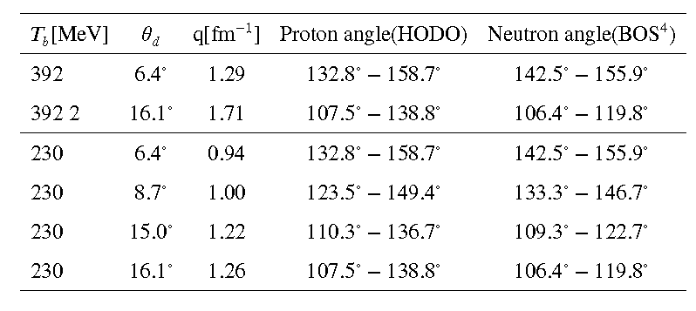
kinematics settings
Measurements were performed at beam energies of 392 MeV (two angles) and 230 MeV (four angles), with several momentum settings
covering 0.9–1.8 fm⁻¹ of momentum between pickup neutron and eject neutron/proton
p
Recoil-less
p or n
Denoted as N
Momentum transfer of 16O(p,Nd) reaction
Kinematics summary

Slide 15
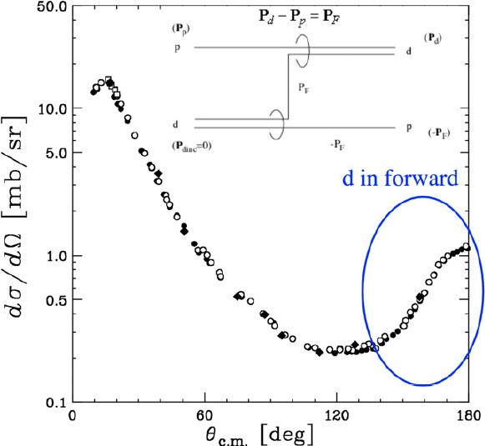

(p,d) Reaction at high momentum transfer
Forward d in (p,d) reaction is equivalent to backward elastic scattering of p+d, which is dominated by a neutron pick-up
Reaction at “backward” occurs via the pick-up of high-momentum neutrons.
K.Sekiguchi et al.,PRL 95 (2005)
162301
Momentum selectivity of neutron pickup reaction: momentum transferred to the deuteron = initial momentum of picked-up neutron.
High-momentum n-N pairs can be probed by the (p, Nd) reaction!

Slide 16
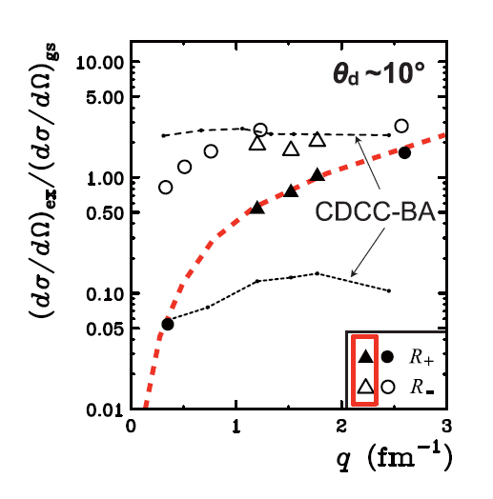
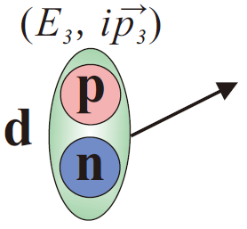
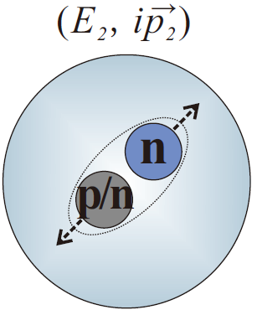
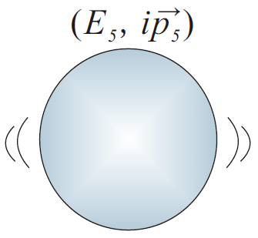
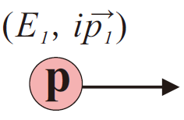
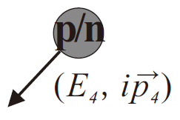
(p,d) Reaction at high momentum transfer
?
What kind of correlation induces the high-momentum neutrons in (p,d) pickup reaction?
¹⁶O(p,d) at 198, 295, 392 MeV @RCNP
open
3/2- to 1/2-
solid
5/2+ to 1/2-
1/2+
TOSM
H.J.Ong et al, PLB 725(2013)277
(1⁺,0) state of ¹⁴N
(0⁺,1) state of ¹⁴N
(0⁺,1) state of ¹⁴O
n-p (ST10)
n-p (ST01)
n-n (ST01)
residual nucleus and spin-isospin state:
The (p,d) reaction is sensitive to tensor interactions and high-momentum components, particularly at large momentum transfer

Slide 17
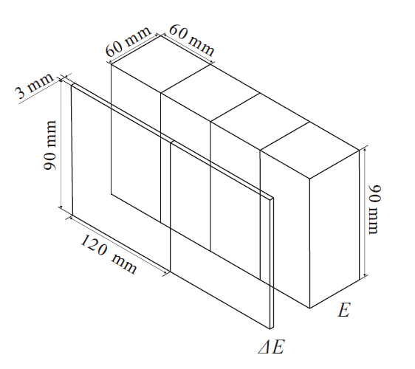
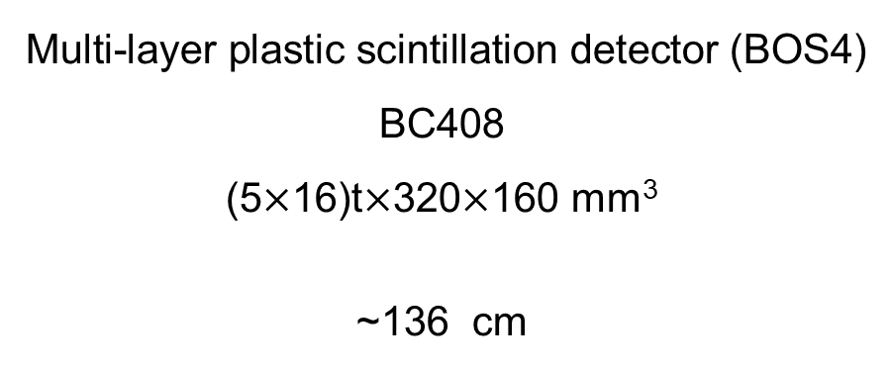
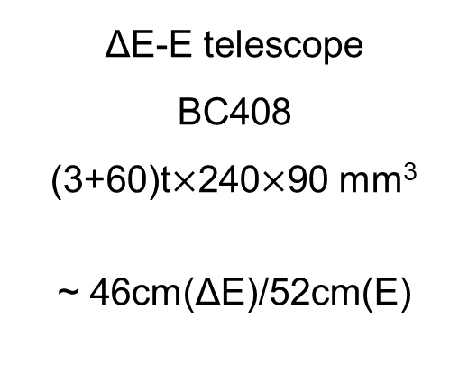
BAckward Nucleon Detectors (BAND)
ΔE-E + BOS⁴
proton detection
neutron detection
Name:
Type:
Volume:
Flight path (middle):
ΔE-E telescope
BC408
(3+60)t$×$240$×$90 mm³
~ 46cm(ΔE)/52cm(E)
Multi-layer plastic scintillation detector (BOS4)
BC408
(5$×$16)t$×$320$×$160 mm³
~136 cm

Slide 18
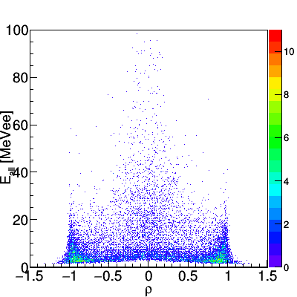
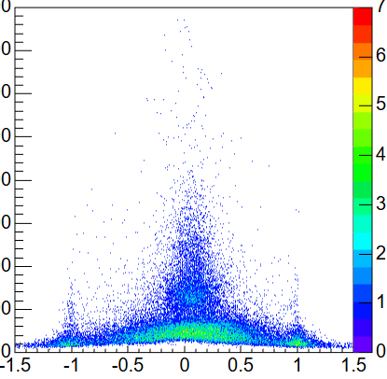
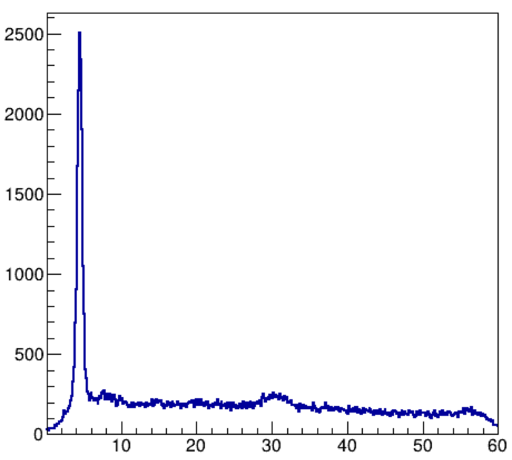
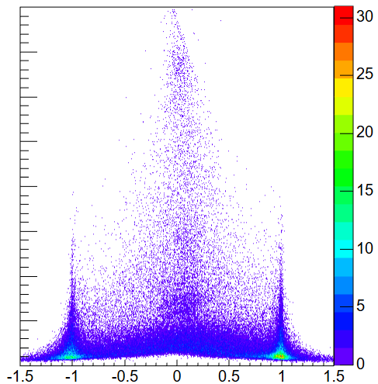
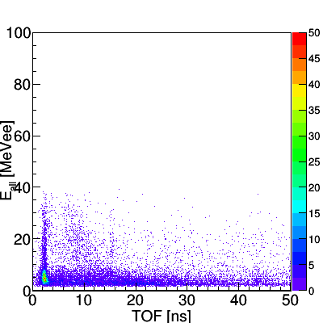
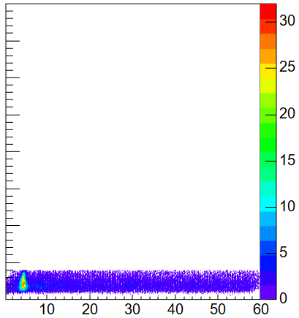
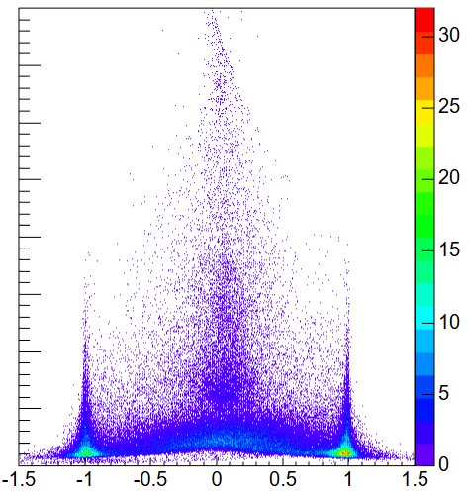
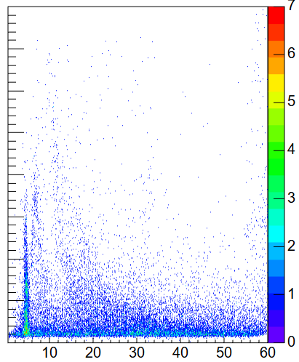
Data analysis: Neutron analysis
Neutron identification
  Charge veto + TOF gate + E-ρ gate
TOF-gate γ (TOF<9 ns)
TOF-gated n (TOF>9 ns)
Neutrons are clearly identified using Eρ+TOF information.
TOF and position on BOS4 reconstruct the momentum of neutrons.
prompt and non-prompt γ
Eρ-gated clean neutron

Slide 19






Structure of BOS⁴ Detector
--Configuration
Area: 320x160mm², total thickness: 80mm
16 layers of plastic scintillator (BC-408) even(H): 5^{t}x320x80mm³ x2 x8 layers
odd(V): 5^{t}x160x80mm³ x4 x8 layers
--Reflector
All plates are wrapped by 12-μm Aluminized Mylar film
--Light guide x 12
Sawtooth shape to connect odd or even layers only
--Photomultiplier x 12 H7195/H6410
--Performance
Counting rate: >50 kHz@20 nA
Position resolution: 2.4 cm in σ Timing resolution: 0.28 ns in σ
Light output resolution: σ(L)/L=0.33/√L

Slide 20





Test of BOS⁴ Detector
Capability of n-γ discrimination using range + TOF under high-counting rate
Discrimination principle:
Detector configuration
Simulation by Geant4
20~60 MeV n 0~10 MeV γ
5-mm-thick normal plastic scintillator (BC-408) x 16 layer
Total area: 320 x 160mm²
Odd and even layers are read out separately.
Test by ²⁴¹Am-⁹Be
$$E_{all}=E_{odd}+E_{even}$$
$$ρ=\frac{E_{even}−E_{odd}}{E_{even}+E_{odd}}$$
L. Yu et al, NIM A 866(2017)118-128

Slide 21









Data analysis: (p,nd) triple differential cross section
¹⁶O(p,nd)¹⁴O excitation spectrum at 6.4°(upper),16.1°(lower)

Slide 22



Preliminary Results: compare with (p,pd) channel
$$θ_{E}=142.7°{ θ}_{∆E}=139.6°$$

Slide 23



Triple differential cross sections of ¹⁶O(p,nd) E443
E443 392 MeV @RCNP
¹⁶O, 8.7° ¹⁶O, 15.0°
Averaged cross-section of G.S. in four settings
(extracted from fitting)
Comparison with ¹⁶O(p,pd) channel
(measured by ΔE-E)
¹⁶O(p,pd)¹⁴N 3.95 MeV (1+, L=0)
¹⁶O(p,nd)¹⁴O 0.00 MeV (0+, L=0)
x20
x20
ratio: 18.1±6.4 at 8.7°
16.9±2.7 at 15.0
→ strong suppression of nn pair

