Slide 1
Exploring the Island of Stability through Deformed Shell Structure at N = 118
TOPTIER CNS Summer School 2026, August 23-28, 2026
Misaki Mikawa¹, Nobuo Hinohara²
¹Grad. Sch. of Sci. Technol., Univ. of Tsukuba
²CCS, Univ. of Tsukuba
Notes:
メインの主張：換算質量を振って計算した、204RnのバリアとN=184ギャップには相関があるので、204Rnのバリアを測定できれば換算質量を決定し、N=184のギャップを予想できる。

Slide 2
Island of Stability
Superheavy nuclei generally have short lifetimes.
Shell effect
h_{11/2}
184
s_{1/2}
d_{3/2}
N~184
Z~114
d_{5/2}
8
By Lasunncty - Own work, CC BY-SA 4.0, https://commons.wikimedia.org/w/index.php?curid=88475330
p_{1/2}
Nuclei around the island of stability are difficult to produce experimentally.
p_{3/2}
2
To understand the island of stability, we need to consider methods other than direct measurement.
s_{1/2}
Notes:
First, I will introduce the island of stability.
Generally, superheavy nuclei have short lifetimes.
However, the shell effect stabilizes the nuclei from nuclear fission.
These numbers are thought to be magic numbers; this is the island of stability.
We will focus on the this neutron magic number.
書いてある文
1:06

Slide 3
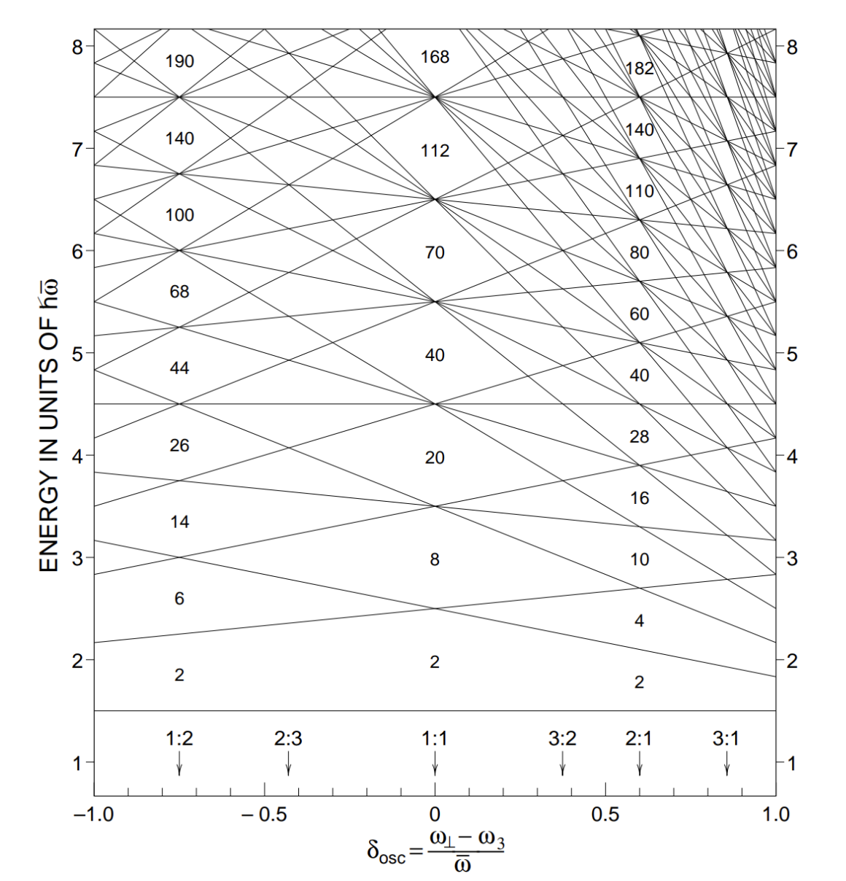
Superdeformed state
Quadrupole deformation: β
Oblate
Spherical
Prolate
β~0.6
Long axis: Short axis= 2:1
Magic number changes.
→Superdeformd (SD) state
N=118 is one of the numbers predicted to be magic in the SD region.
Nilsson and Ragnarsson
Notes:
I will introduce superdeformed states.
Quadrupole deformation, an axially symmetric deformation is represented by a character β.
This is the degree of deformation, similar to beta.
This is the single-particle orbital.
This is the spherical magic number.
When the degree of deformation increases, the degeneracy is resolved, and the single orbital splits.
Then, in this area, beta is around 0.6, they degenerate again, and gaps appear. These are the deformed magic numbers.
Nuclides with these numbers have metastable states when they deform.
These states are called superdeformed states.
I will focus on the number N=118, and this is one of the numbers predicted to be magic.
1:36

Slide 4
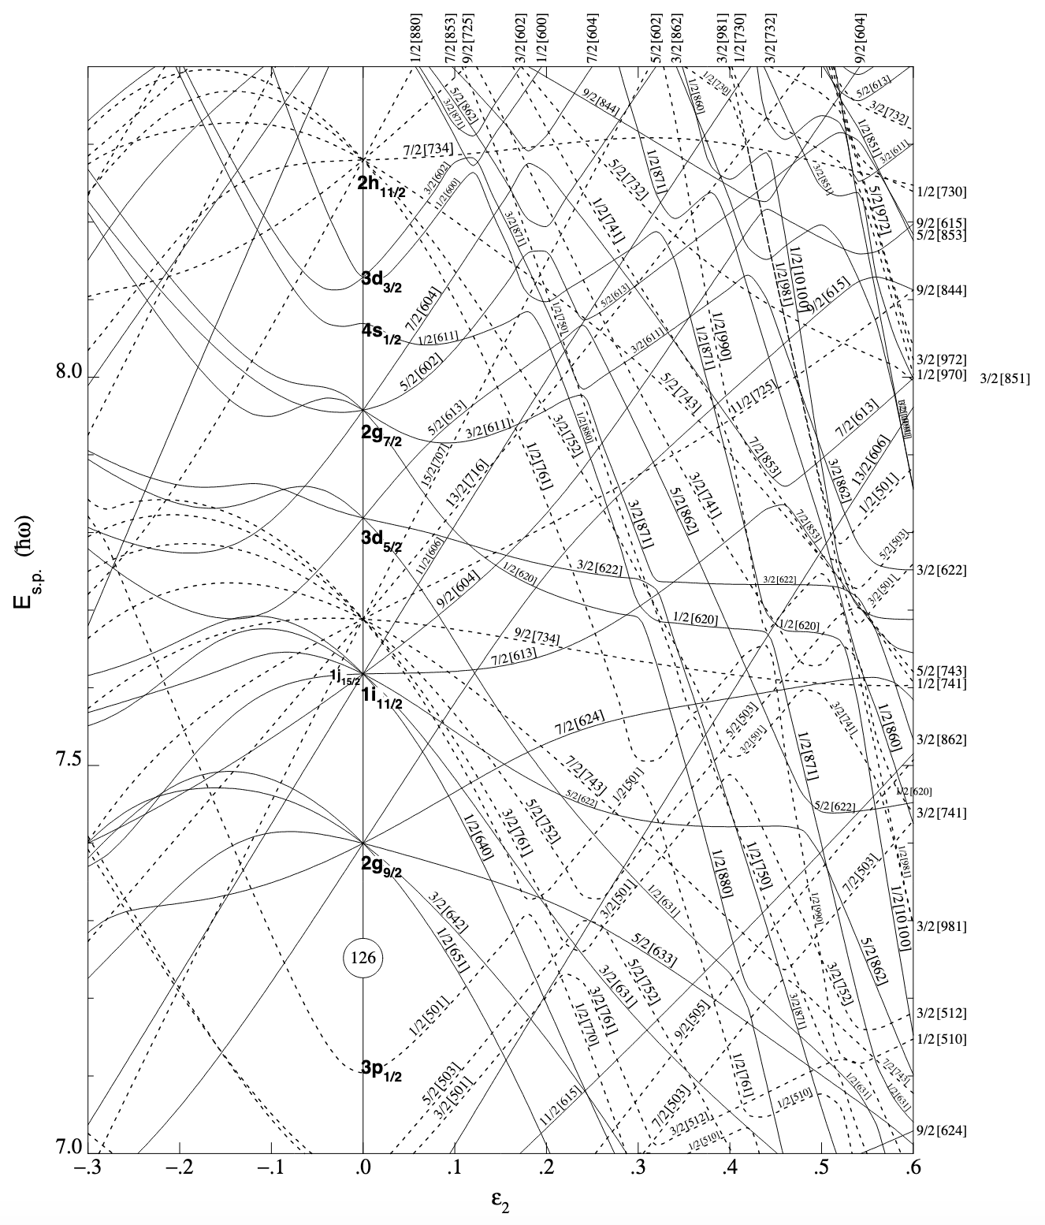
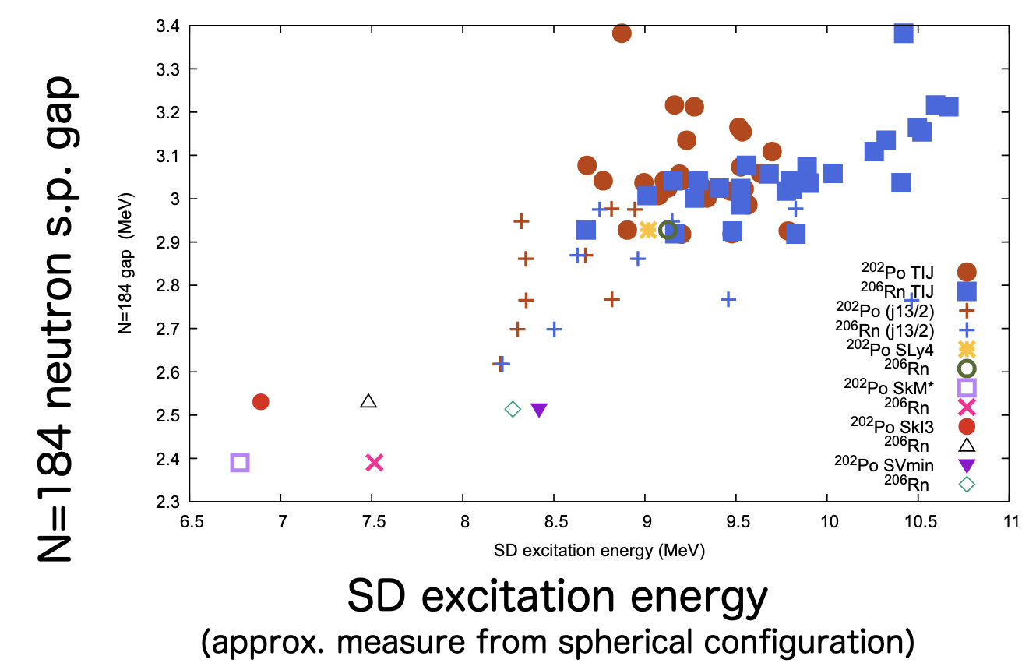
There is a correlation between N=184 and N=118.
One of the Nilsson orbitals responsible for the N = 184 shell gap is also involved in the N = 118 shell gap.
184
Correlated
Observable of N=118
Although an experiment with N=184 is difficult to conduct, we should be able to understand the results from N=118.
Table of Superdeformed Nuclear Bands and Fission Isomers
Notes:
There is a correlation between them. I will explain this in this slide.
This graph is similar to the graph I have shown in the previous slide.
Here is the 184 spherical magic number.
When the degree of deformation increases, this orbital descends.
This orbital is also involved in the 118 shell gap.
Also, this graph indicates the correlation between them.
This is an observable of 118, and this is 184 single-particle gap, so they are correlated.
文を読む
1:35

Slide 5
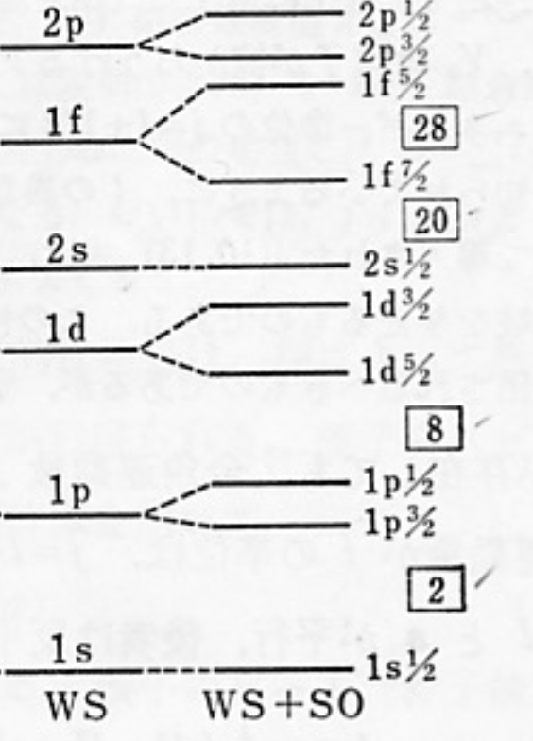
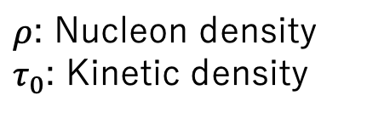
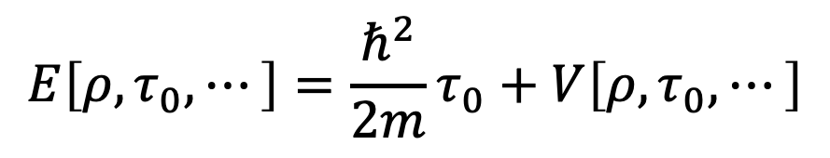
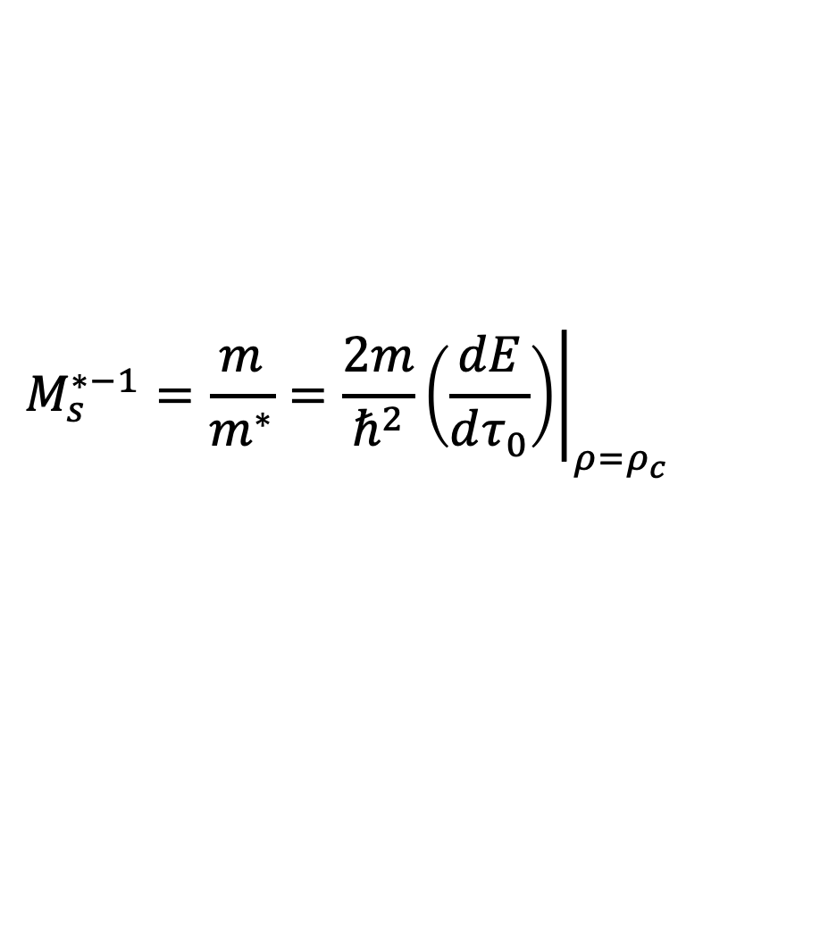
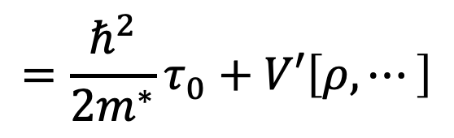
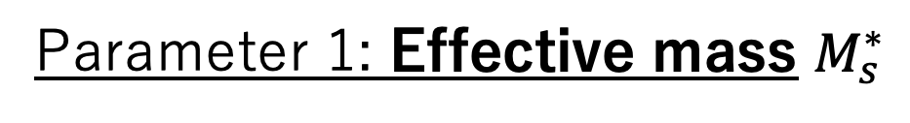
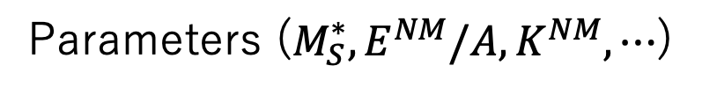
Parameters to be varied: Effective mass, SO interaction
Energy density functional
Parameter 2: Spin-orbit (SO) interaction strength
$$E\left[ρ,τ_{0},⋯\right]=\frac{ℏ^{2}}{2m}τ_{0}+V\left[ρ,τ_{0},⋯\right]$$
Interaction term
Magic numbers greater than 28 can only be reproduced by taking the spin-orbit interaction into account.
Kinetic term
$ρ$: Nucleon density
$τ_{0}$: Kinetic density
Parameters ($M_{S}^{∗},E^{NM}/A,K^{NM},⋯$)
Parameter 1: Effective mass $M_{s}^{∗}$
$$=\frac{ℏ^{2}}{2m^{∗}}τ_{0}+V′\left[ρ,⋯\right]$$
$$M_{s}^{∗−1}=\frac{m}{m^{∗}}=\frac{2m}{ℏ^{2}}{\left.\left(\frac{dE}{dτ_{0}}\right)\right|}_{ρ=ρ_{c}}$$
K. Yagi, Genshikaku Butsurigaku [Nuclear Physics], Asakura Shoten, 1971.
In this presentation, we will focus on
effective mass and SO interaction.
These are correlated with the shell gap.
Notes:
In the mean-field method, the energy density functional is expressed by this.
It is divided into a kinetic term and an interaction term.
In the interaction term, there are parameters that should be determined by fitting with experiments.
We will focus on two parameters.
The first is the effective mass, defined by this equation.
What it means is:
The kinetic density involved in the interaction term is absorbed into the kinetic term through the effective mass.
The second is the spin-orbit interaction.
This is known by the fact that 文を読む
These two are correlated with the shell gap, so we will focus on them.
1:12

Slide 6
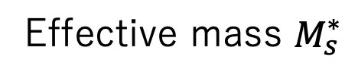
Purpose
Long-term:
N = 184 is experimentally difficult to access, but N = 184 and N = 118 (experimentally accessible) are correlated.
h_{11/2}
184
?
s_{1/2}
To explore the island of stability at N=184 using observables at N=118 through their correlation.
d_{3/2}
Short-term:
Which parameter links N = 184 and N = 118?
Which parameter should be constrained by experiments?
This presentation:
Are the effective mass and SO interaction the factors linking the gap in N=184 to the SD excitation energy of N=118 nuclei?
Correlated
Correlated?
Effective mass $M_{s}^{∗}$
SD originated from N=118 gap
N=184 shell gap
SO interaction strength
Correlated
Correlated?
Notes:
Our purpose is to understand the island of stability at N=184.
For example, we want to know this shell gap.
This is experimentally difficult to access, but these two are correlated.
So our long-term purpose is ~
文を読む
In this presentation, we will focus on the effective mass and spin-orbit interaction because they are correlated with the N=184 shell gap.
Then, we will investigate whether they are correlated with observables of superdeformation originated from N=118 gap.
1:40

Slide 7
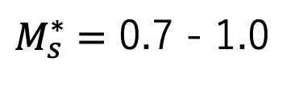
Method
Hartree-Fock-Bogoliubov method
Code: HFBTHO
Marvic et al., Comp. Phys. Commun.276, 108367 (2022)
Parameter sets: Skyrme type
1. SVmas series
This series uses different parameter sets with different isoscalar effective masses, while fitting other parameters to reproduce the properties of the various nuclides.
P. Klüpfel et al., Phys. Rev. C 79, 034310 (2009)
$M_{s}^{∗}=$ 0.7 - 1.0
SVmas07, SVmas08, SVbas, SVmas10
2. Based on SVbas, the spin-orbit force parameters were varied by -10 to +10%.
Nuclide: ²⁰⁴Rn (Z=86, N=118), ²⁹⁸Fl (Z=114, N=184)
Superdeformation
Shell gap
Notes:
We used HFB method and HFBTHO code.
The point is the parameter sets we used.
We used two series of parameter sets.
The first series is Svmas series, from a previous study.
文を読む
The effective mass was varied from 0.7 to 1.0, and Svbas corresponds to 0.9.
The second series is this, 文を読む
We calculated 204Rn, which has a neutron number of 118, for superdeformation, and 298Fl, which has a neutron number of 184, for shell gap.
1:10

Slide 8
Physical quantities for N=118 compared to the N=184 shell gap
Potential Energy Surfaces of ²⁰⁴Rn
For different effective masses
For different SO interaction strengths
Increasing effective mass
Decreasing SO interaction
②
①
②
①
Ground
states
Barrier
top
SD
state
Ground
states
Barrier
top
SD
state
① SD excitation energy
② Inner barrier
Notes:
The followings are the results.
These are the potential energy surface of 204Rn. The horizontal axis is quadrupole deformation beta.
The left is for different effective mass series, and the right is for different spin-orbit interactions.
These are the ground states, barrier top, and superdeformed state, and the same on the right.
When the effective mass increases, these values shift like this.
When the spin-orbit interactions decrease, these lines shift like this.
We compared this value, superdeformation excitation energy, and this value, inner barrier, with N=184 gap.
1:19

Slide 9
N=184 shell gap vs SD excitation energy (①)
For different effective masses
For different SO interaction strengths
N=118
N=118
j_{13/2}
+10%
±0%
-5%
-10%
Correlated
Slope is large
h_{11/2}
184
s_{1/2}
Notes:
タイトルをいう
For different effective masses, there is a correlation, and it has a large slope.
For different spin-orbit interactions, I plotted two points for -10%.
The single-particle orbits near the 184 gap are like this.
For these percentages, the lowest empty orbital is h11/2, but for -10%, the lowest empty orbital is j13/2.
When we see this orange gap, the point isn’t on this correlation line, but when we see this red gap, the point is on this line.
1:16

Slide 10
N=184 shell gap vs Inner barrier (②)
For different effective masses
For different SO interaction strengths
N=118
N=118
j_{13/2}
+10%
±0%
-5%
-10%
h_{11/2}
Weakly correlated
184
s_{1/2}
Notes:
タイトルをいう
For different effective masses, there is a weak correlation.
For different spin-orbit interactions, same as the previous slide.
When we see orange gap, the point isn’t on this correlation line, but when we see red gap, the point is on this line.
30s

Slide 11
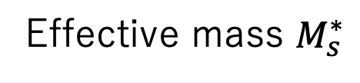
Summary & Future works
We want to explore the island of stability at N=184 using observables at N=118 through their correlation.
N=184 neutron shell gap correlates with the N=118 SD excitation energy and inner barrier through effective mass and SO interactions.
So far, the change in the SD excitation energy when the effective mass is varied has been found to be most sensitive to the shell gap.
Correlated
Correlated
Effective mass $M_{s}^{∗}$
SD originated from N=118 gap
N=184 shell gap
SO interaction strength
Correlated
Correlated
In the future, we will calculate other parameters.
We will verify whether a similar correlation between superdeformed states and spherical magic numbers can be observed in other experimentally accessible nuclei.
Notes:
まとめです。N=118の超変形励起エネルギーという物理量は、有効質量との相関は弱く、N=184との相関も弱いものでした。
一方でN=118の内部バリアという物理量を見ると、有効質量N=184ギャップと有効質量を通じて相関していました。
ここが相関しているということがわかったということです。
今後は、汎関数のパラメータは他にもあるので、例えばスピン軌道力というパラメータがこれらの相関に関与しているかを調べようと思っています。
45s

Slide 12
Backup

Slide 13
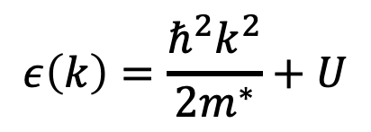
There is a correlation between effective mass and shell gaps.
有効質量とシェルギャップには相関がある
$$ε\left(k\right)=\frac{ℏ^{2}k^{2}}{2m^{∗}}+U$$
単一粒子エネルギー:
$M_{s}^{∗}$が大きい
$M_{s}^{∗}$が小さい

Slide 14
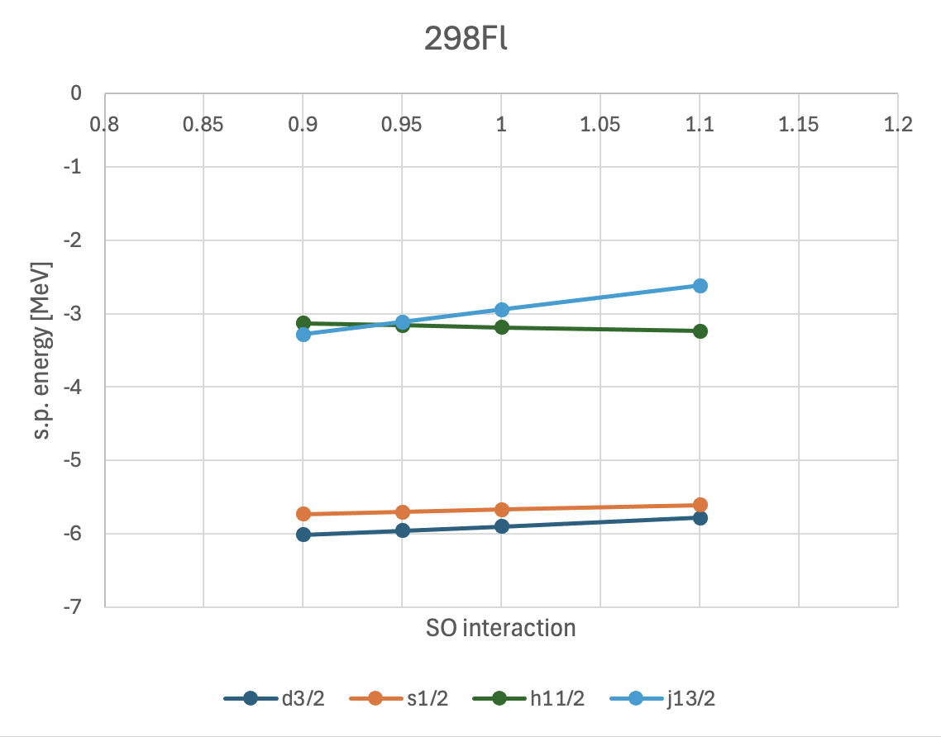

Slide 15
N=184 shell gap vs SD excitation energy (①)
For different effective masses
For different SO interactions
N=118
N=118
相関が弱い
N=118
N=118
Notes:
これが右の部分で、有効質量と超変形励起エネルギー、ここですね、をプロットしたものです。
こちらは204Rnで、ぱっと見相関しているように見えますが、縦軸の値が小さいので相関が弱いです。
202Poは、ぱっと見てもわかるように、相関していません。
これはN=184とN=118の超変形励起エネルギーをプロットしたものですが、これもあまり相関していません。
1:19

Slide 16
N=184 shell gap vs Inner barrier (②)
For different effective masses
For different SO interactions
N=118
N=118
相関している
N=118
N=118
Notes:
これは
内部バリア、この部分と有効質量を比べたものです。204Rnは相関していて、202Poも弱く相関しています。
そのため、N=184とN=118の内部バリアも相関しています。
18s

Slide 17
N=184ギャップと比較するN=118の物理量
²⁰⁴Rnのポテンシャルエネルギー曲面
²⁰²Poのポテンシャルエネルギー曲面
①
②
①
②
基底
状態
バリア
トップ
超変形
状態
基底
状態
バリア
トップ
超変形
状態
①内部バリア
※オレンジがSVmas系列
②超変形励起エネルギー
Notes:
これは横軸を四重極変形度べーたとしたポテンシャルenergy曲面です。オレンジがSvmas系列なので、それに注目して下さい。
ここが基底状態、ここが超変形状態です。超変形に移行するには、この内部バリアを超えなければなりません。
今回は、N=184ギャップと、N=118のこの値、N=184ギャップとこの値をそれぞれ比較しました。
37s

Slide 18
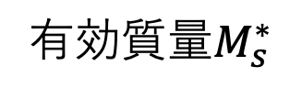
N=184ギャップの計算結果
N=184 ギャップ vs 有効質量
※オレンジがSVmas系列
N=184ギャップと有効質量には相関がある(自明)
N=118ギャップに起因する超変形
N=184 ギャップ
有効質量$M_{s}^{∗}$
相関
相関?
Notes:
これは、N=184ギャップの計算結果です。
このように、N=184ギャップと有効質量は相関しています。これは自明な結果です。
次の２ページが、この部分とこの部分を調べた結果です。
22s

Slide 19
N=184ギャップ vs 超変形励起エネルギー(①)
²⁰⁴Rn
²⁰²Po
N=118
N=118
相関が弱い
N=118
N=118
Notes:
これが右の部分で、有効質量と超変形励起エネルギー、ここですね、をプロットしたものです。
こちらは204Rnで、ぱっと見相関しているように見えますが、縦軸の値が小さいので相関が弱いです。
202Poは、ぱっと見てもわかるように、相関していません。
これはN=184とN=118の超変形励起エネルギーをプロットしたものですが、これもあまり相関していません。
1:19

Slide 20
N=184ギャップ vs 内部バリア(②)
²⁰⁴Rn
²⁰²Po
N=118
N=118
相関している
N=118
N=118
Notes:
これは
内部バリア、この部分と有効質量を比べたものです。204Rnは相関していて、202Poも弱く相関しています。
そのため、N=184とN=118の内部バリアも相関しています。
18s

Slide 21
質問
他の原子核で実際に同じ軌道を共有しているために同じ核構造を持つというのはあるのか
204Rnと202Po以外に調べられるものはあるのか
パラメータを振るという考え。今後はこれは予想なのか事実なのか明らかにするといいかも

