Slide 1
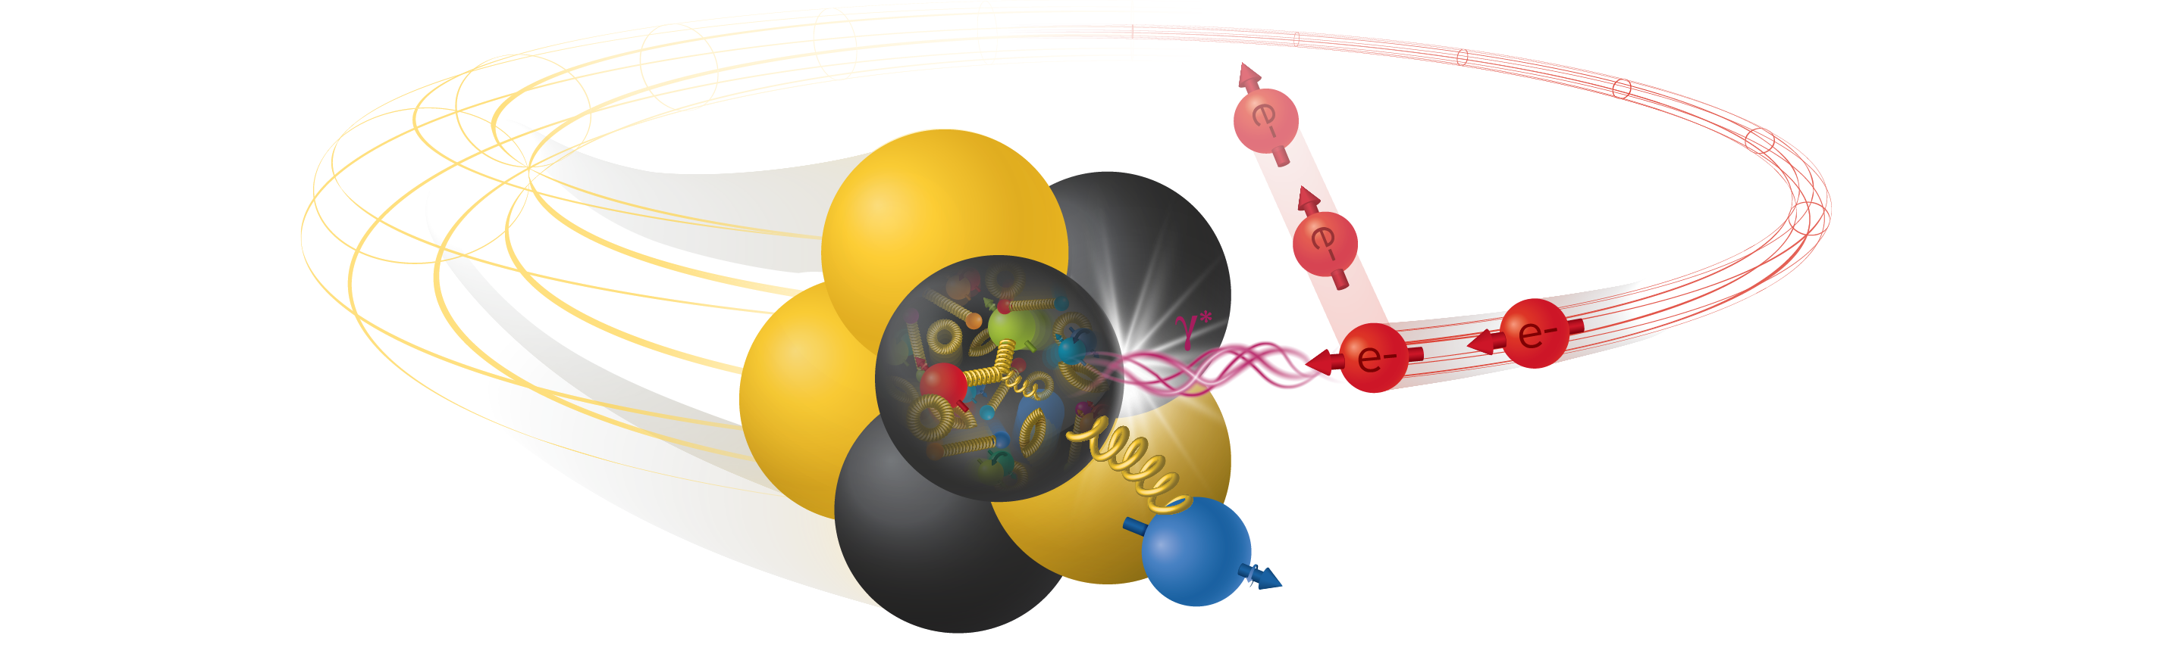


Phenomenology at the EIC
Daekyoung Kang (Fudan U -> Sejong U)
On behalf of EIC$φ$ collaboration

Slide 2

감사의 인사
총 참여자 81명 중 한국 학생이 30명

Slide 3
10일된 (중고) 신임교수의 질문
이걸 왜 하지?
내 강의/연구하기도 바쁜데
10년 전 나는 어디서 무엇을?
2016년 포스닥 5년차: 미래에 대한 두려움/불안
장기계획은 나/우리에게 무엇을 해줄 수 있을까?

Slide 4
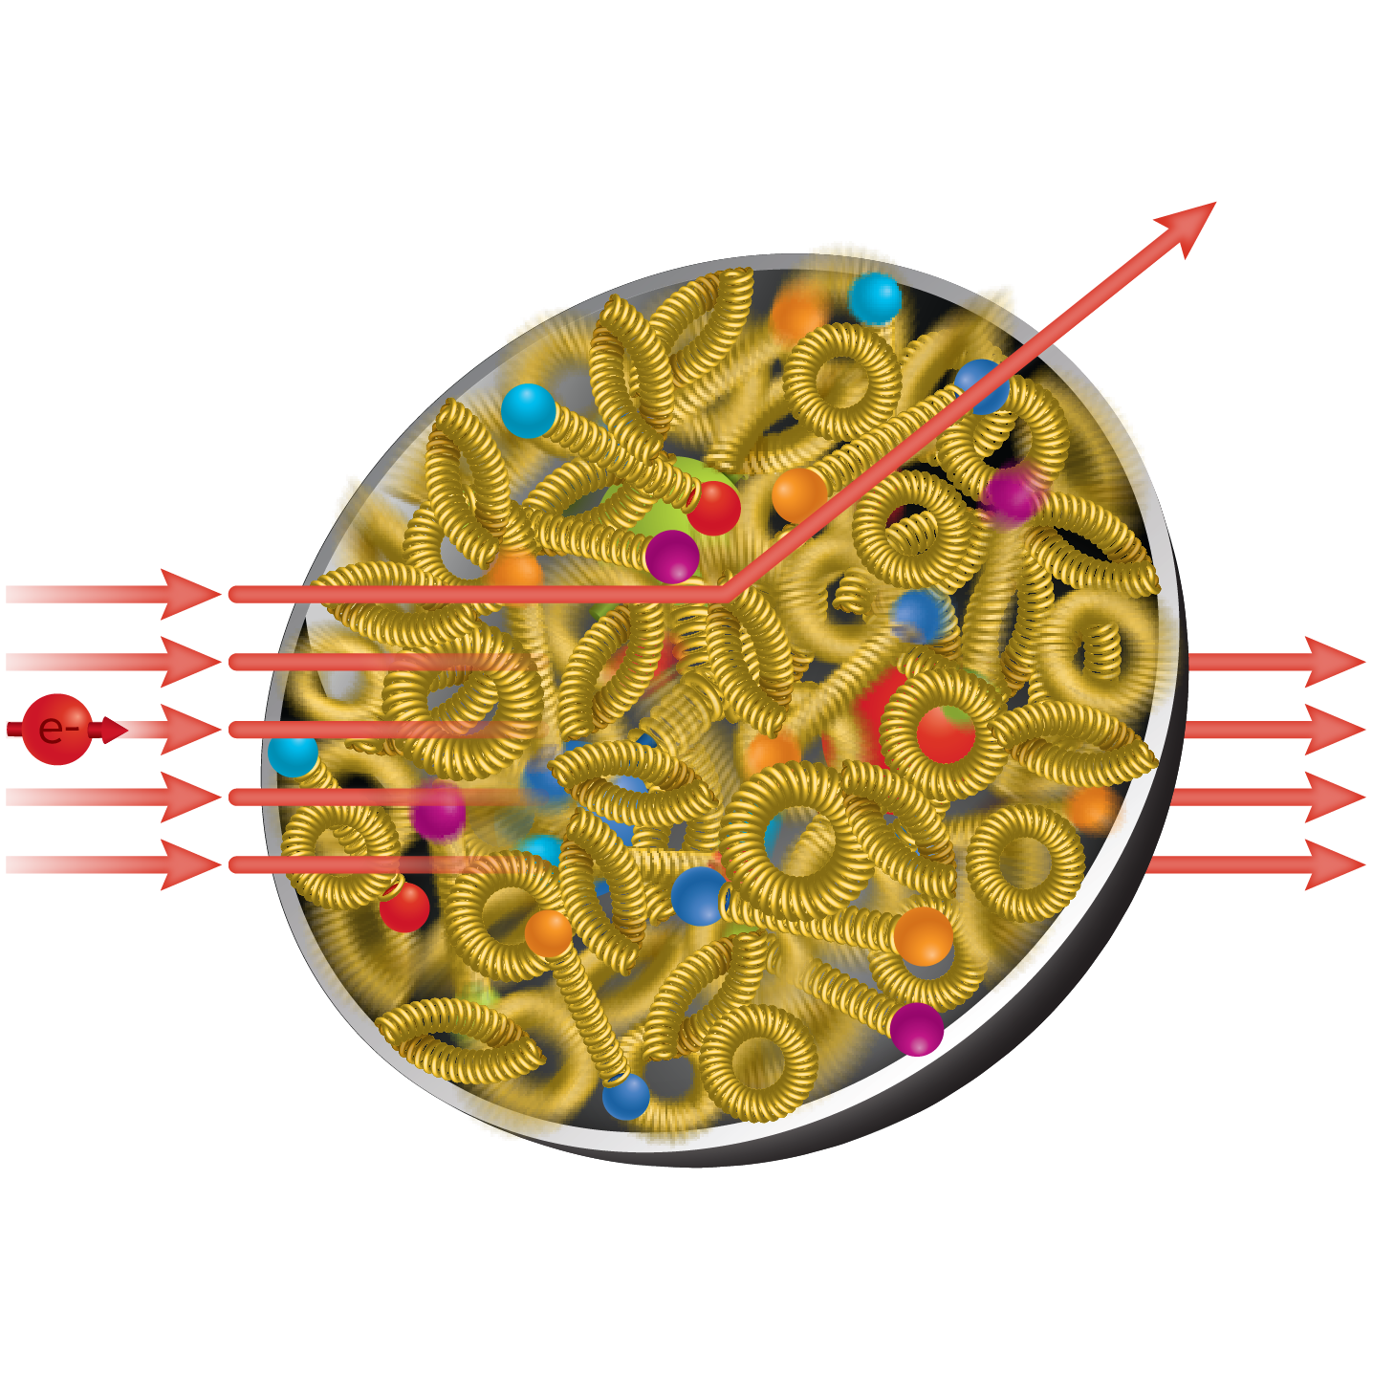
Electron-Ion Collider
probing nuclear structure

Slide 5
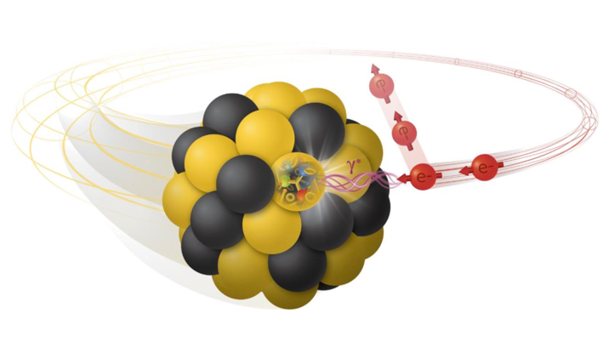
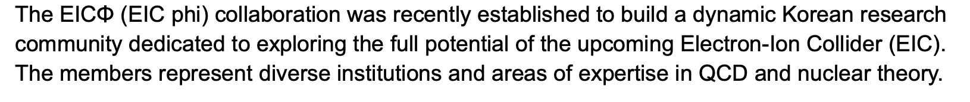
Related talks
EIC𝜙 collaboration (theory)
one-year old: newly formed in 2025 by Sejong, Korea, PKNU, GWNU, Seoul Tech, IBS-CTPU + overseas (Fudan, LLNL, MIT)

Slide 6
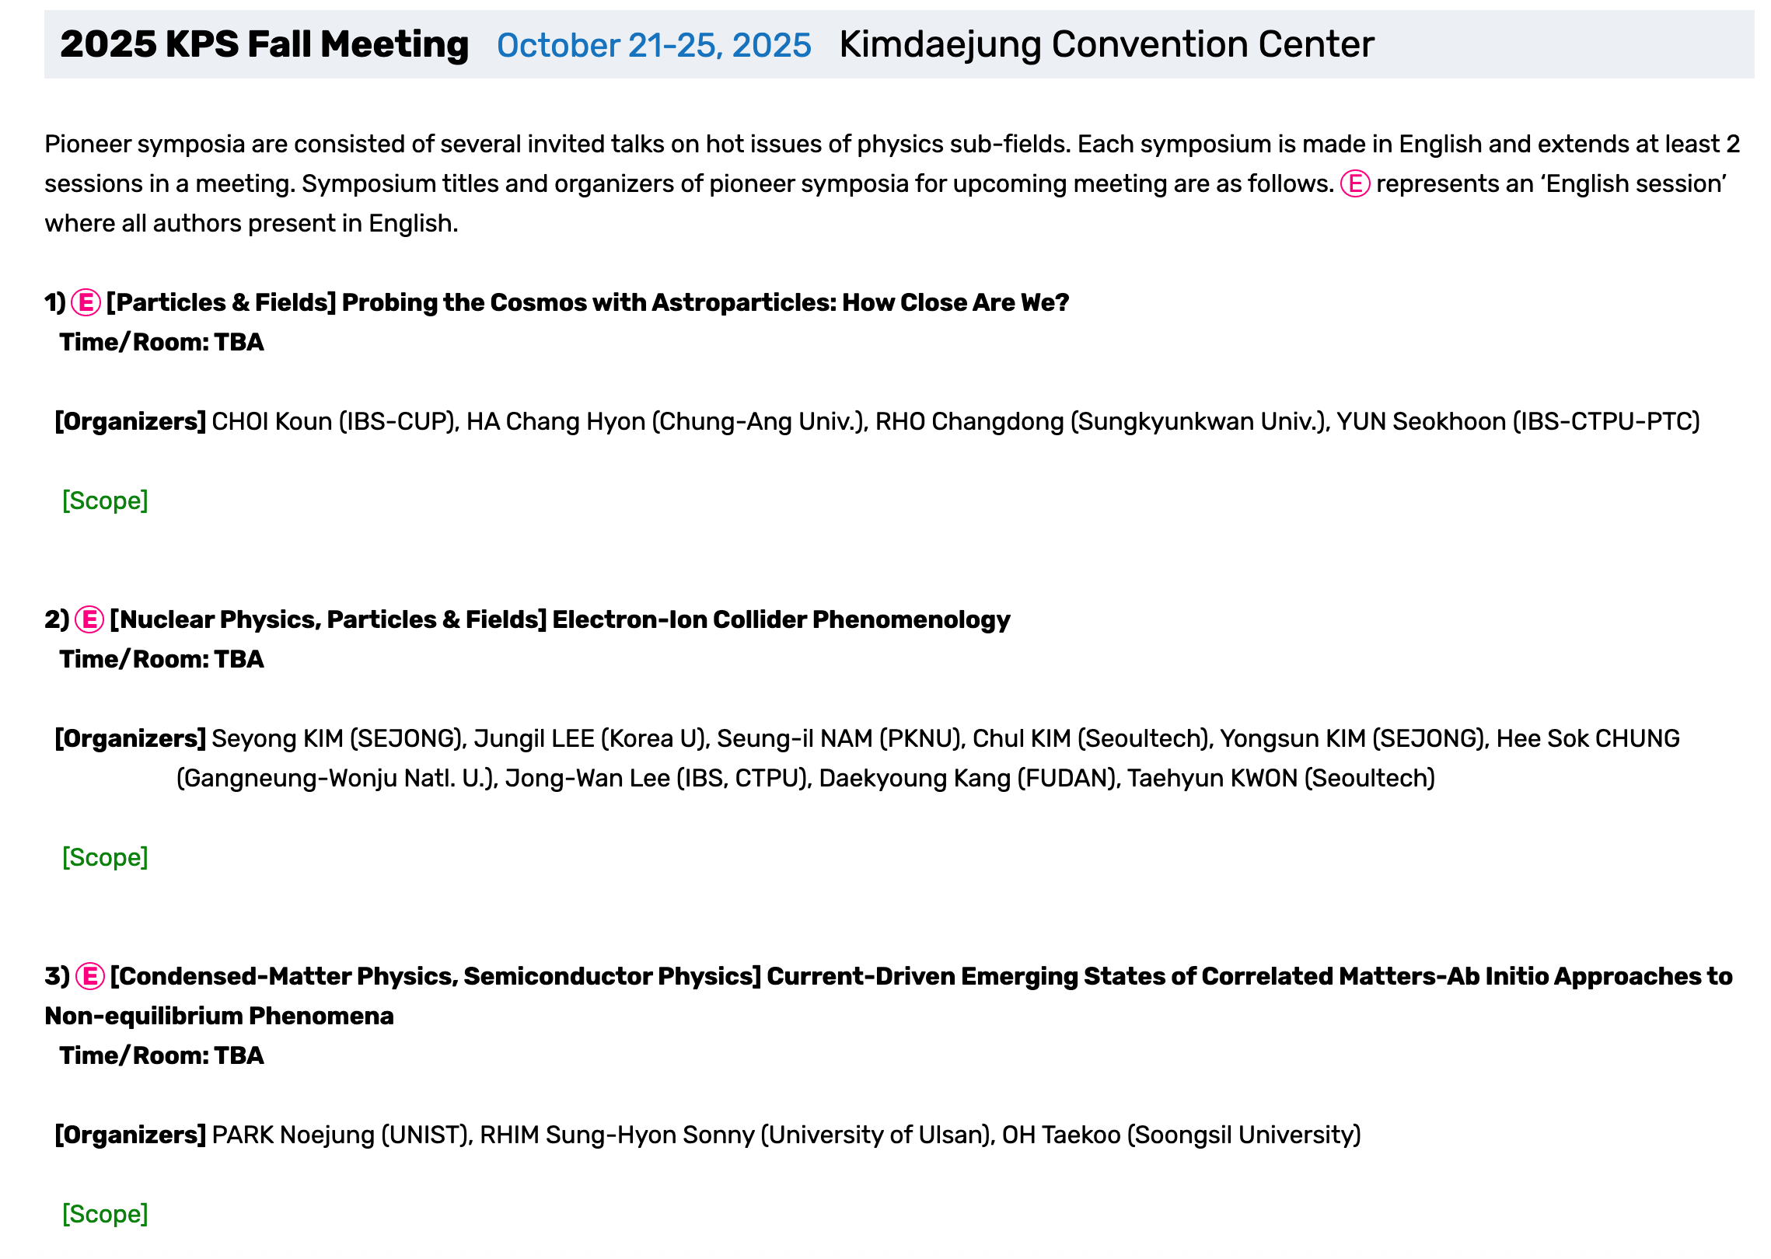
EIC𝜙 activity: Pioneer Symposium in KPS 2025

Slide 7
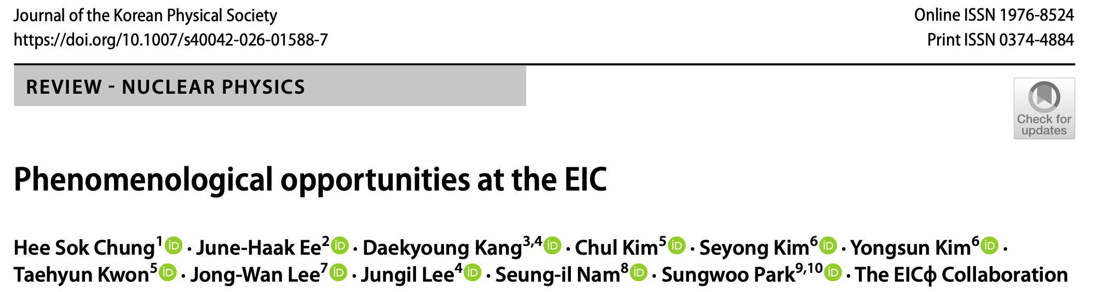


EIC𝜙 activity: collaboration’s long-range plan
Academic activities (tentative): EIC school, Workshops, international exchange and collaboration program
Need support from Nuc community!

Slide 8

작동 ~10년 남았어요!

Slide 11

Synergy with ongoing experiments

Slide 12
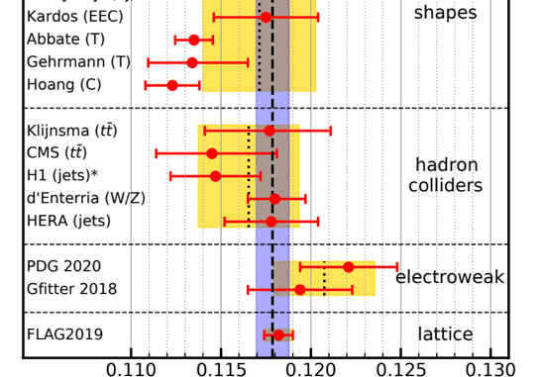
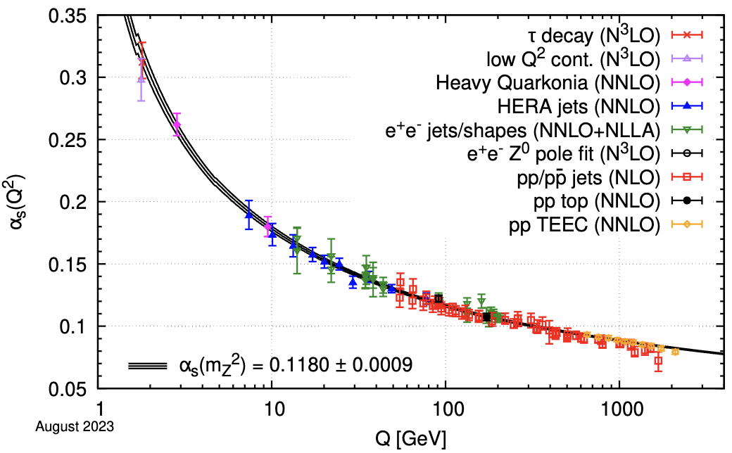

Jets in collider
A puzzle in the e+e- strong coupling
α_{s} values are different (3 sigma level). What’s wrong?
A long-lasting discrepancy remains unresolved for 15 years
future EIC experiment provides independent data
Notes:
cross lines looking good? better

Slide 13
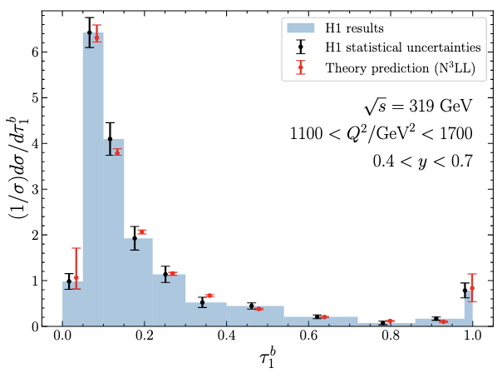
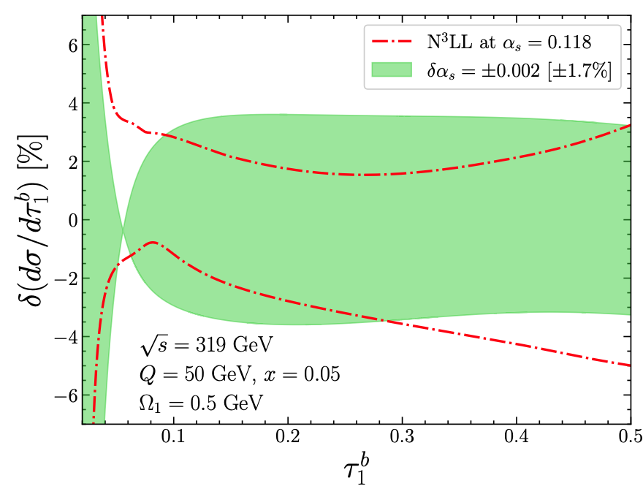
Up-to-date progress for HERA
World–leading precision improved with
higher-order O(α_{s}²) correction, non-perturbative correction, renormalon subtraction
The determination of the strong coupling is underway.
[JHEP2025 Ee, DK, Lee, Stewart]
Theory vs. Exp (H1 coll., 1st EPJC ‘24)
(Not a fit)

Slide 14
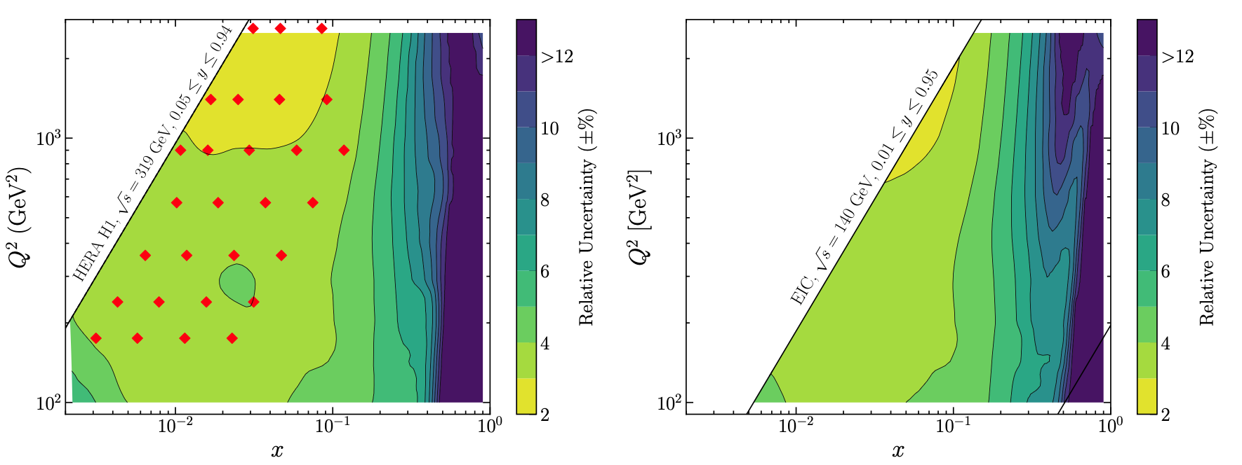
Uncertainty budget in x-Q² plane
[JHEP2025 Ee, DK, Lee, Stewart]
HERA
EIC
Notes:
Our preliminary results shows excellent convergence of perturbative uncertainty as we go from NLL to N3LL.
The width of band, which is perturbative uncertainty, reduces dramatically as we go from NLL to N3LL.
Final perturbative uncertainty is 1-3% at N3LL accuracy.
(more explain about the curve and spend more time here)

Slide 15
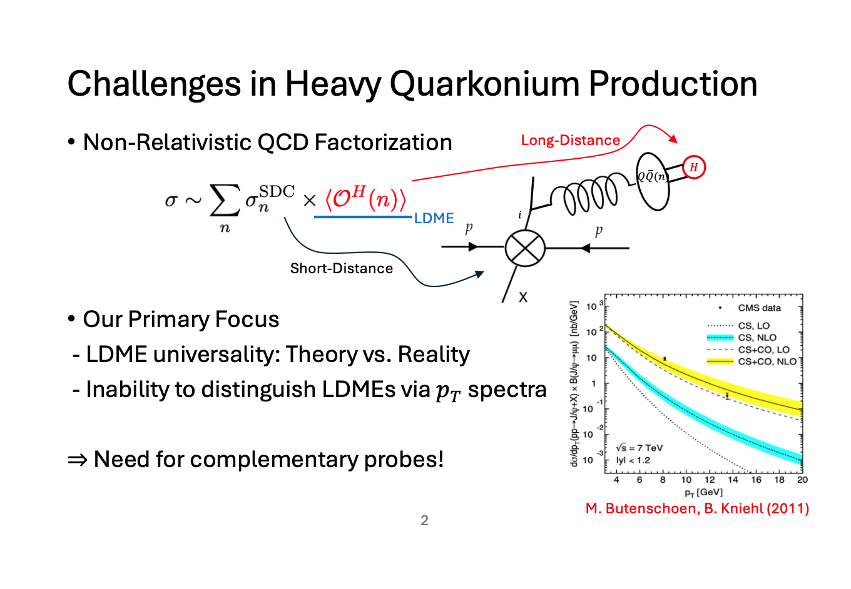

Slide 16
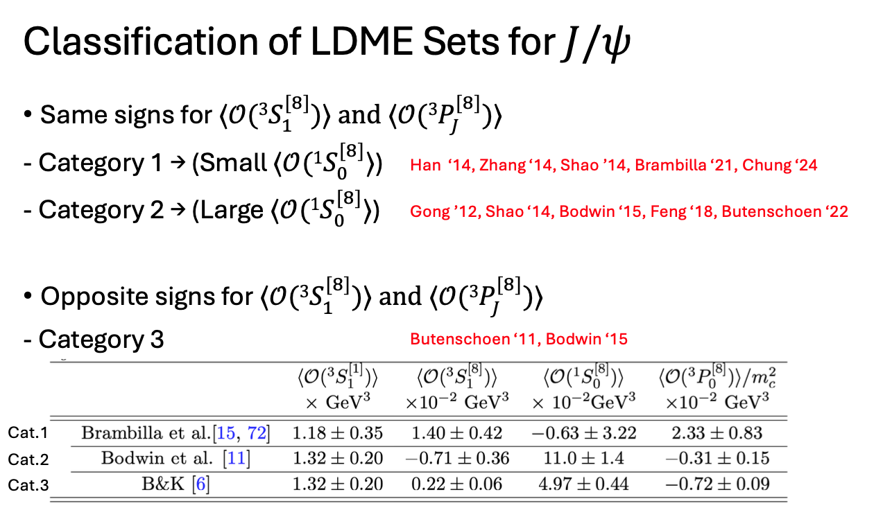

Slide 17
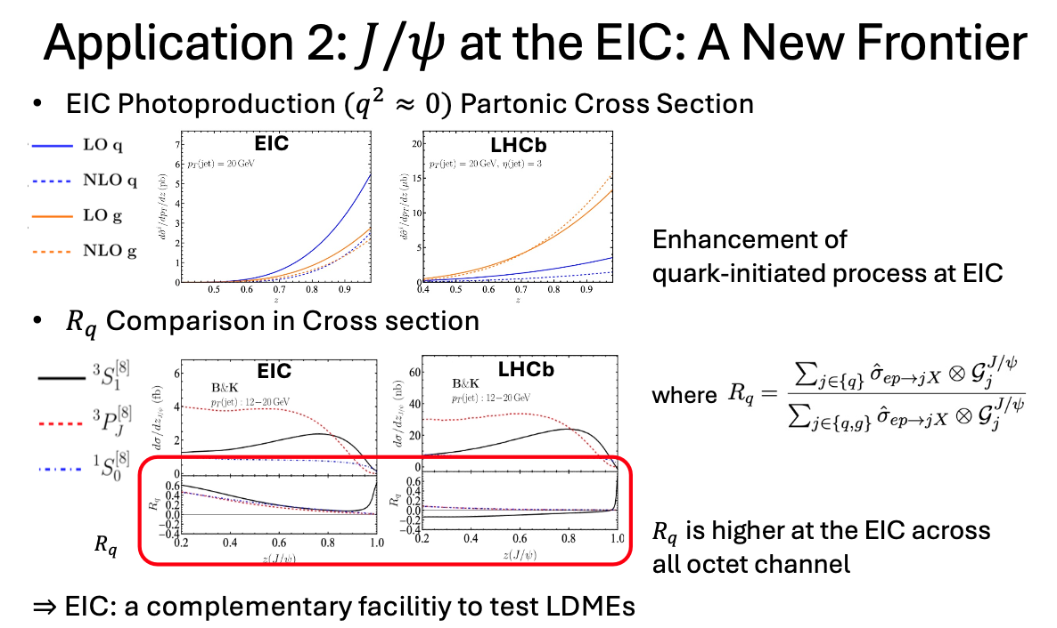

Slide 19
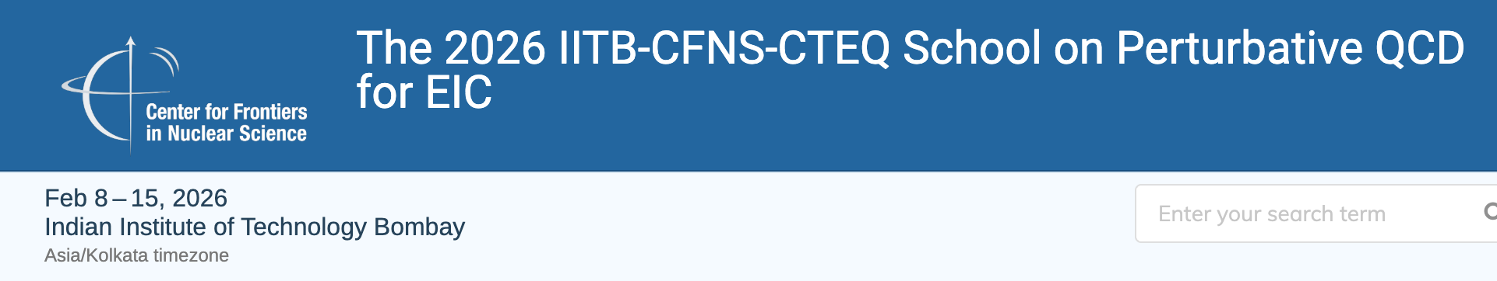
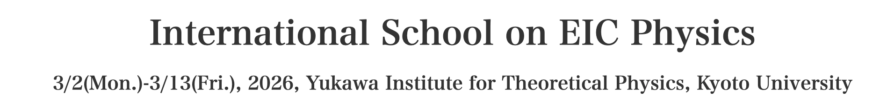
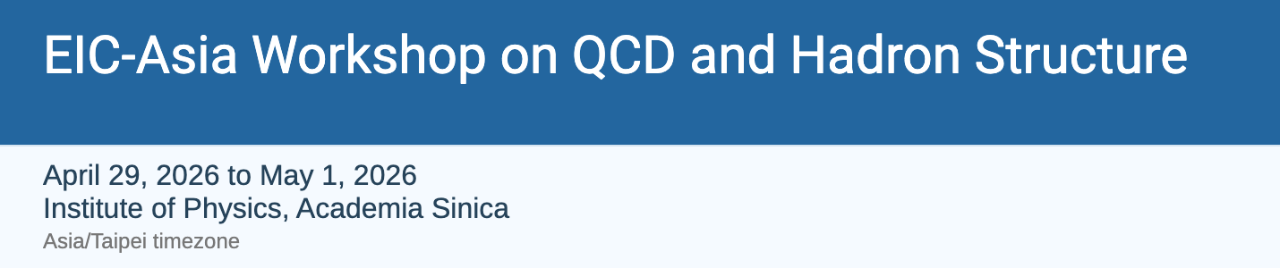
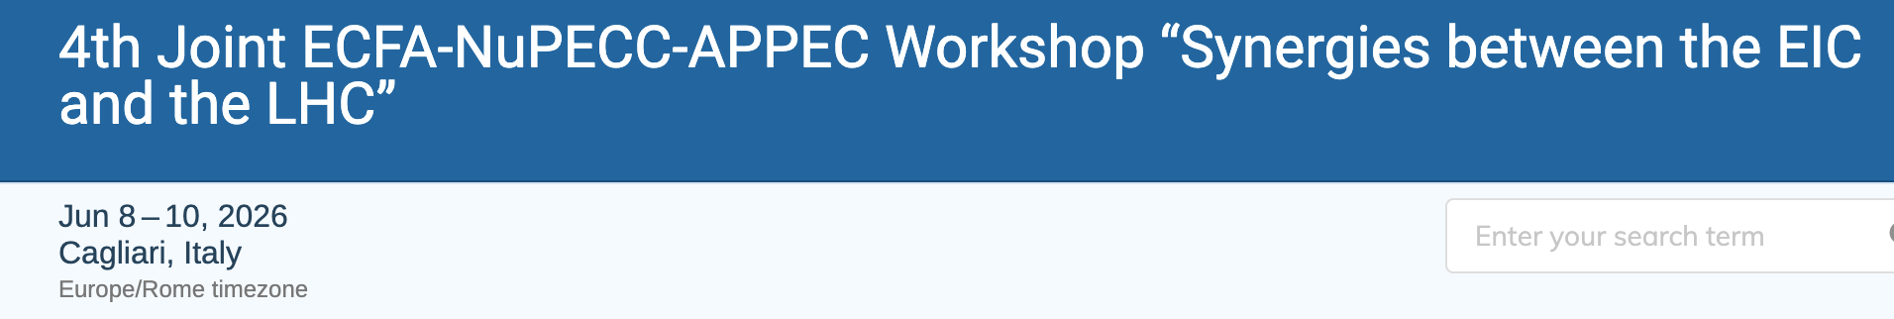
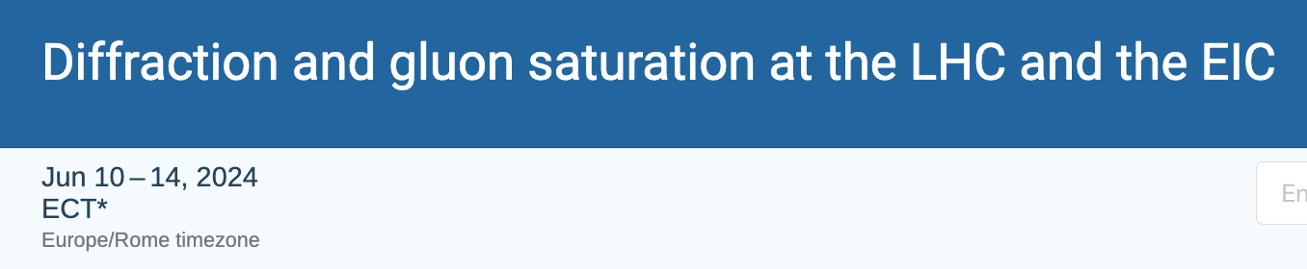
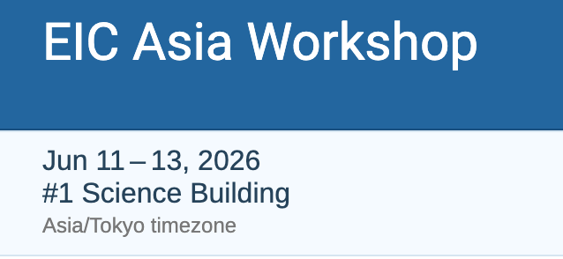
맺음말
핵물리 장기계획이 우리에게 무엇을 줄 것인가?
Request for an EIC theory alliance in Korea
작년 EIC𝜙 collaboration의 활동 소개
EIC의 기회
Main pillars: mass, spin, 3D structure, gluon saturation, …
기존의 실험과 시너지
예: 강력상수 퍼즐, 쿼코늄의 LDME

Slide 20
Thank you!
[PRD `19, Chien, Lee, DK, Makris]

