Slide 1
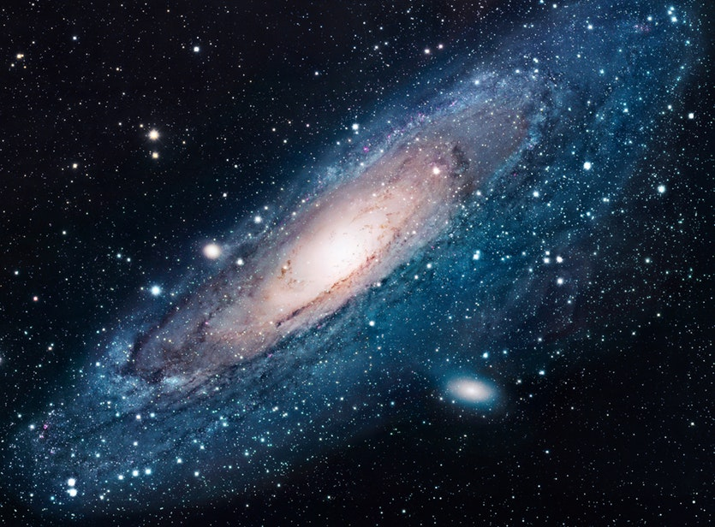
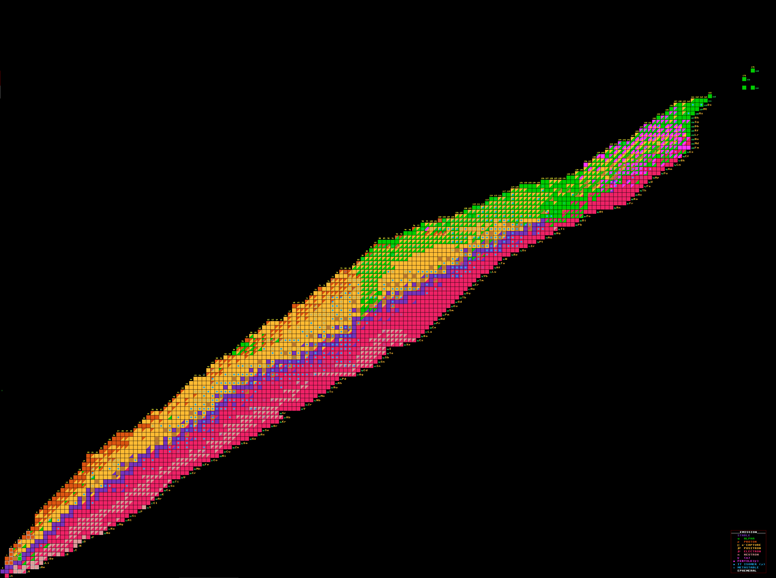
The 2nd IBS Conference on Exotic Nuclei (ISEN2026)
July 22-24, 2026, Science Culture Center at IBS, Daejeon
CENS research activities on excited- state lifetime measurements
Hiroshi Watanabe
CENS, IBS

Slide 2
Contents
Introduction of CENS Nuclear Structure group
Commissioning experiments for excited-state lifetime measurement
  IDATEN project at RIBF
    Electronic fast-timing method using a large LaBr₃(Ce) array
  ASGARD campaign at RAON
    Development of plunger
    Low-energy Coulomb excitation
Summary

Slide 3
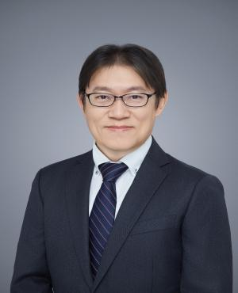
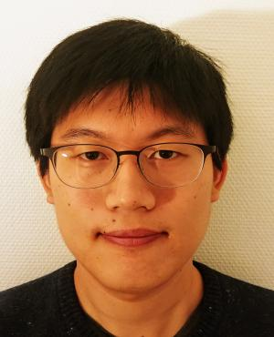
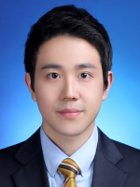
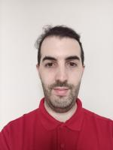
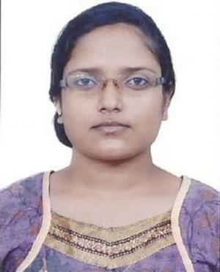
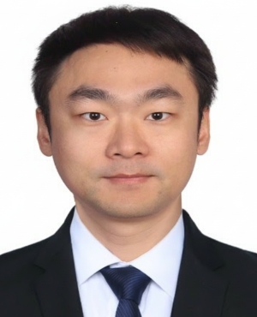
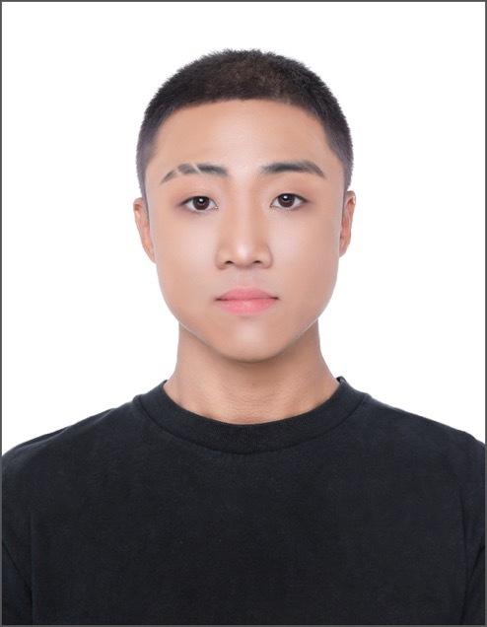
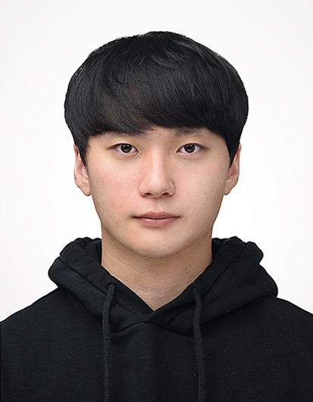

Research interest of Nuclear Structure group at CENS
Probing the mechanism of a quantum many-body system:
  Magicity loss and new magic numbers (shell evolution)
  Shape co-existence and higher-order deformation
  Isospin breaking, seniority (non-)conservation
  Proton-neutron pairing
Filtering/enhancing specific interactions relevant to fundamental symmetries:
  β/γ asymmetry and correlations from polarized nuclei
  γ-ray circular polarization from parity-mixed nuclear levels
Exploring exotic nuclei and their sensitivity to nucleosynthesis:
  Decay properties (β-T_{1/2}, P_{n}, etc.) and masses
  Isomers on s/i/r-process pathways
Hiroshi WATANABE
Yung Hee KIM
Byul MOON
Xesus PEREIRA-LOPEZ
Arunita MUKHERJEE
Zhiqiang CHEN
Youngseub JANG
Jaehwan LEE
Minju KIM

Slide 4
Gamma-ray spectroscopy in nuclear physics
Powerful experimental means to investigate (bound) excited states
Observables/techniques Physics outputs
Full-energy (photo) peak ⇒ Level and transition energy
Time distribution, Doppler shift ⇒ Lifetime of excited states
Coincidence relationship ⇒ Level scheme
Angular distribution and correlation ⇒ Spin, multipolarity (λ)
Linear polarization ⇒ Parity (Eλ or Mλ)
High resolution γ-ray spectroscopy with large detector arrays has been a cornerstone in nuclear structure studies

Slide 5
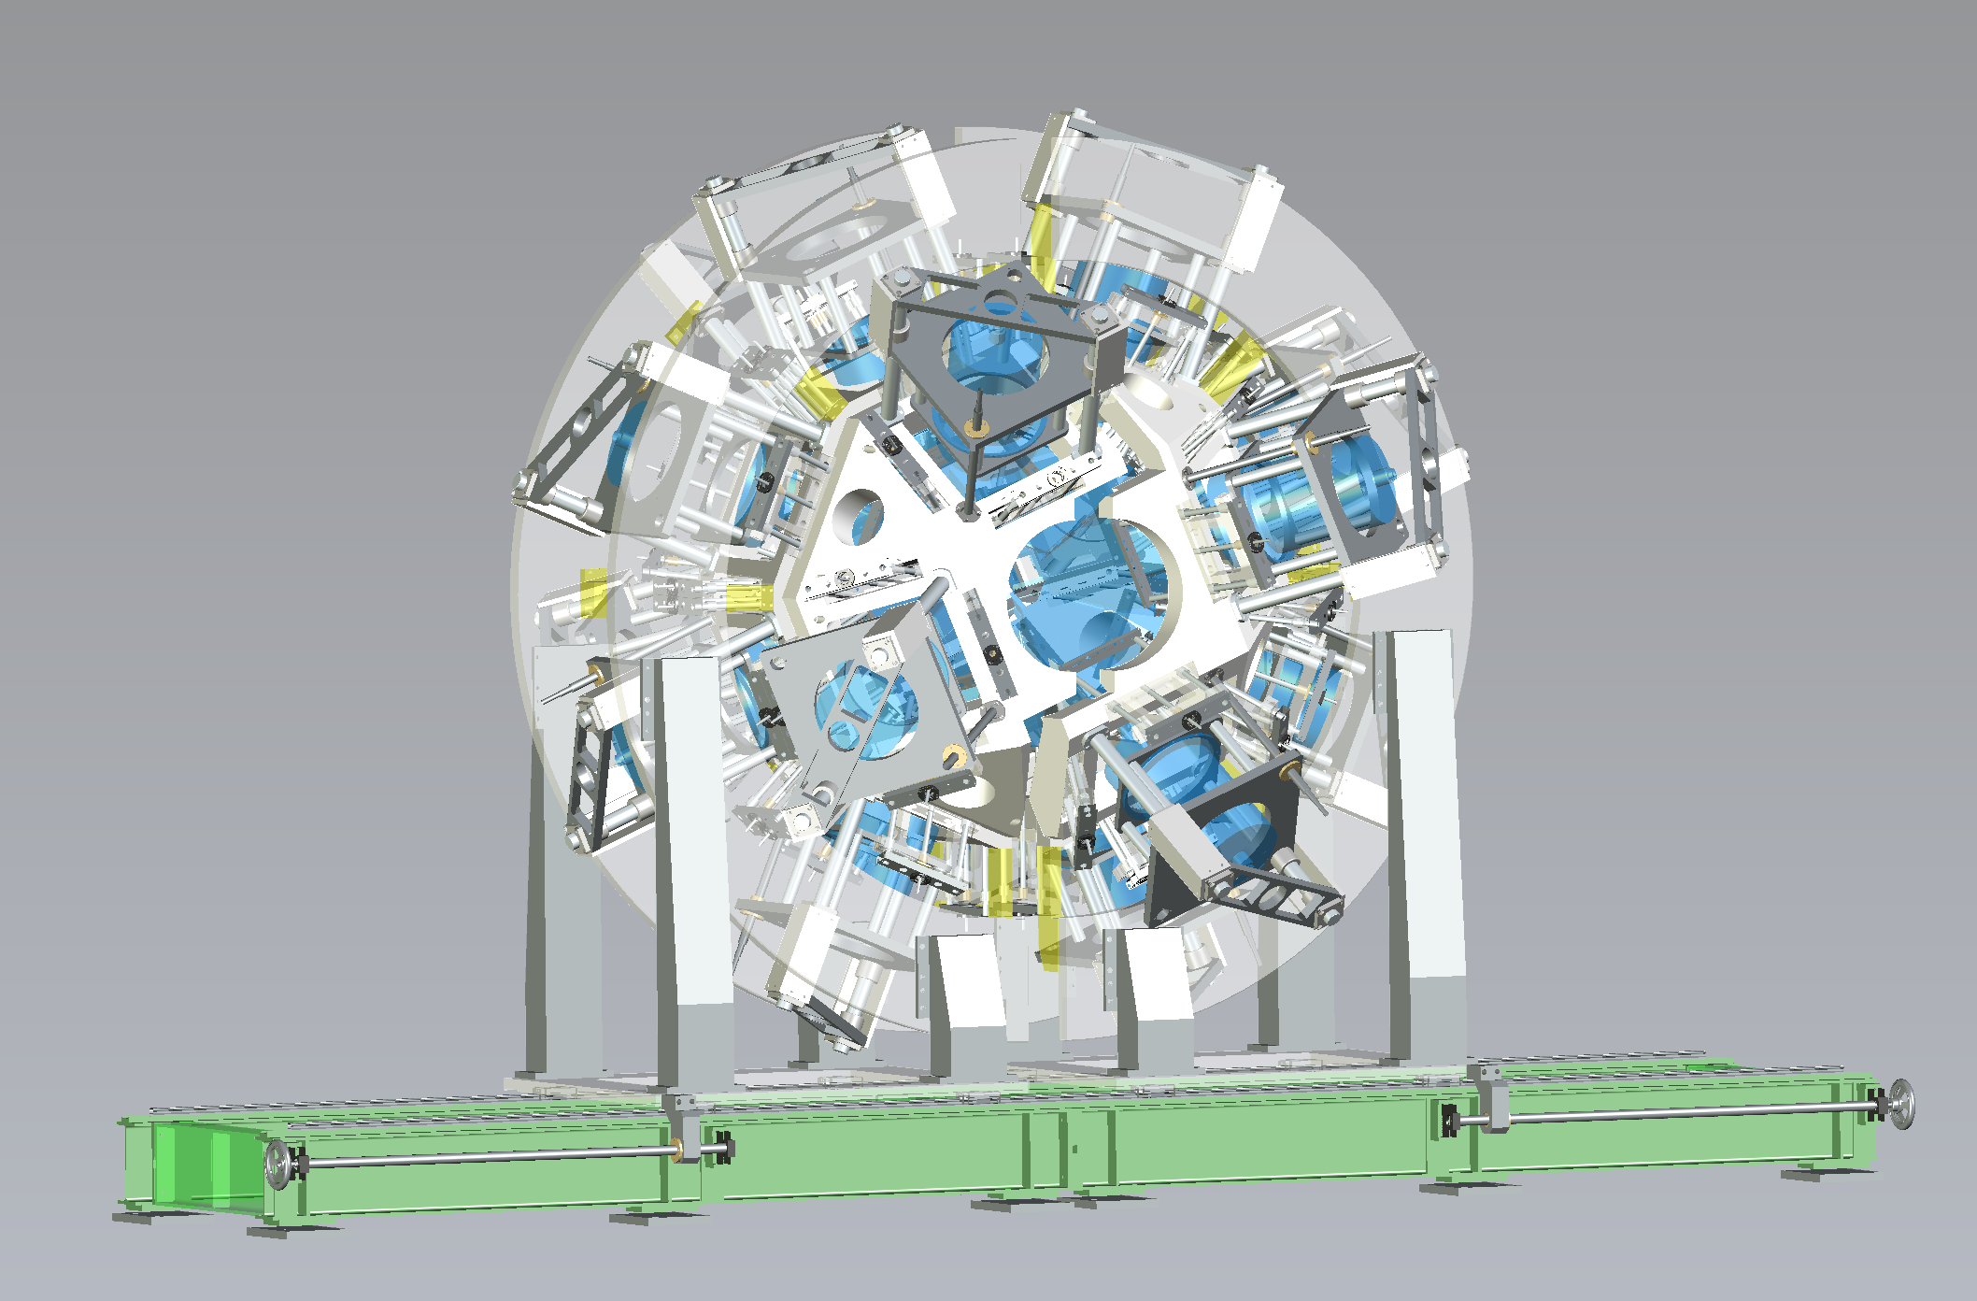
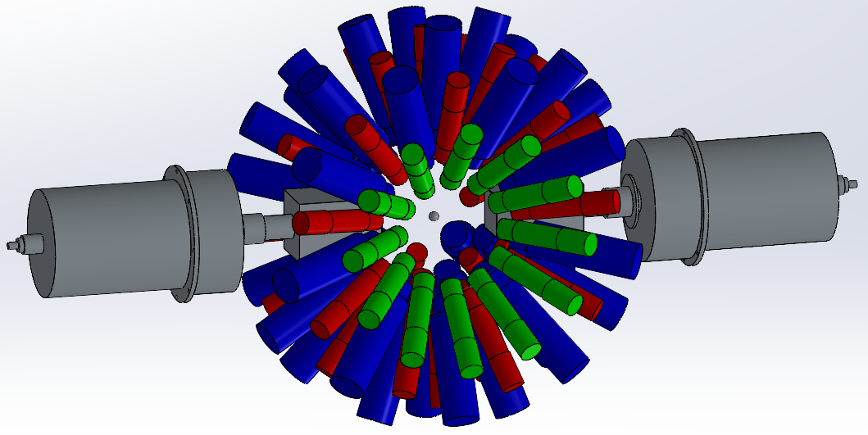
Two main research gears for γ-ray spectroscopy at CENS
IDATEN
(International Detector Assembly for fast-Timing
measurements of Exotic Nuclei)
ASGARD
(Array of Super clover GAmma-Ray Detectors)
LaBr₃(Ce)-based array
⇓
Fast time response
Hyper-pure Ge detectors
⇓
High energy resolution
5 proposals from CENS (spokesperson/co-spokesperson) approved by RIBF PAC in 2022/2023
4 experiments proposed by the CENS members scheduled at RAON in Oct-Nov 2025

Slide 6
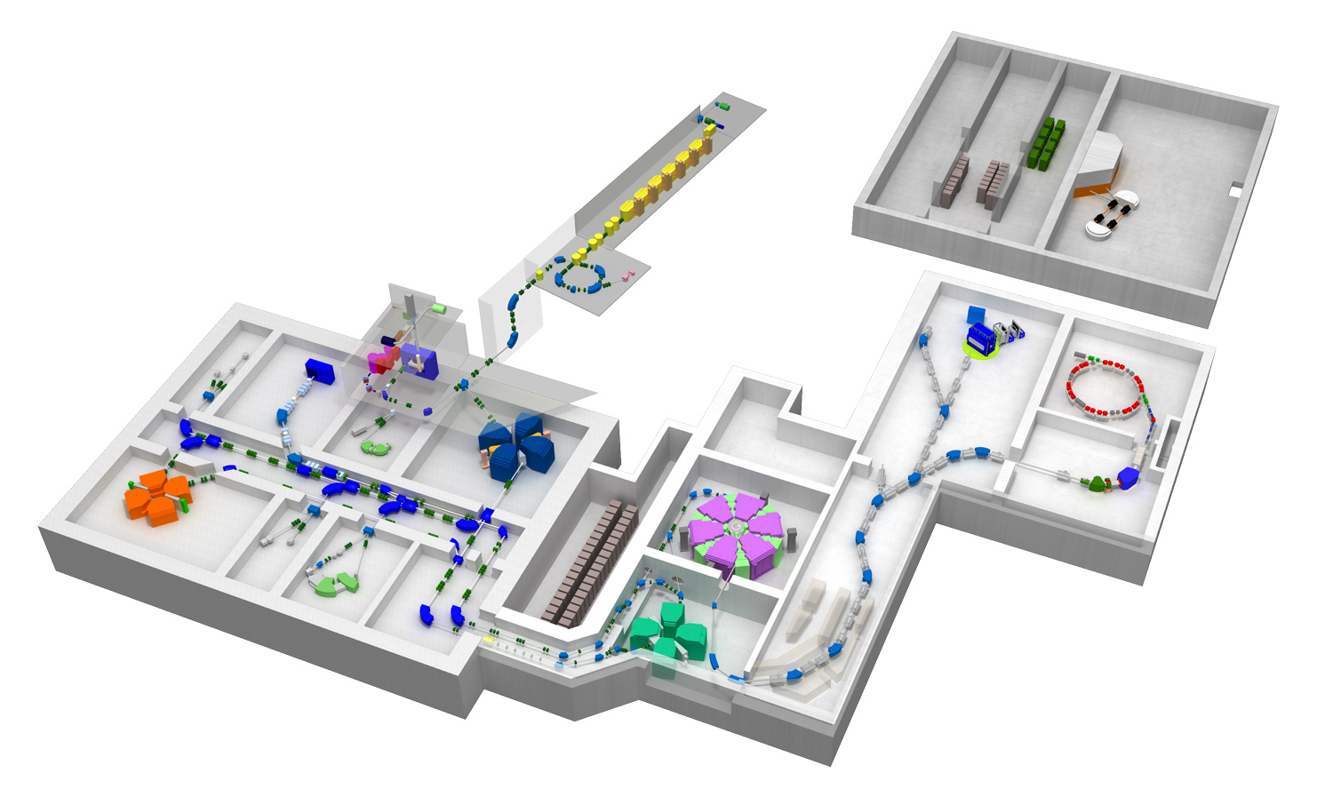
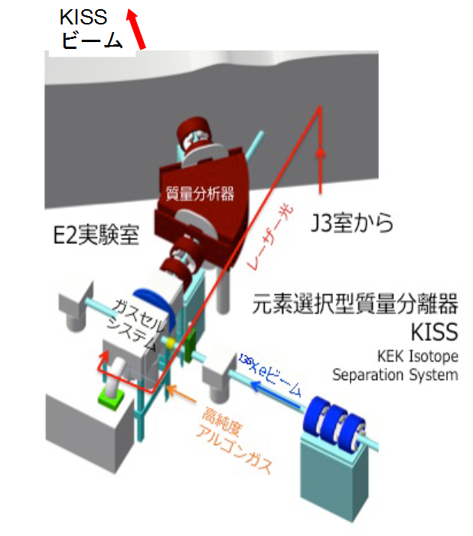
Radioactive Isotope-Beam Factory (RIBF) at RIKEN
IDATEN
New generation in-flight facility that came online in 2007
RILAC
AVF
RILACⅡ
RRC
SRC
fRC
IRC
Maximum beam intensities in pnA (as of June 2022)
²³⁸U | 117 | ¹²⁴Xe | 178
⁷⁸Kr | ~600 | ⁷⁰Zn | ~600
⁴⁸Ca | 730
KISS
BigRIPS

Slide 7
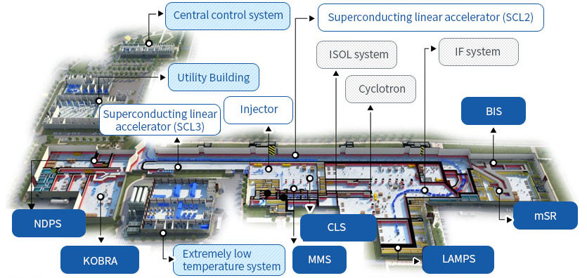
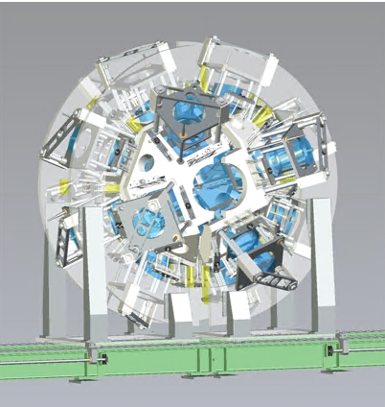

Rare isotope Accelerator complex for ON-line experiments: RAON
Commissioning of SCL3, ISOL, KoBRA performed in 2023 and 2024
ISOL RIBs produced from SiC/LaC₂ targets (planed with an UC_{x} target in 2026)
KoBRA spectrometer separated/identified secondary RIBs from 18.5 MeV/u ⁴⁰Ar⁸⁺
Post-accelerated (16.4 MeV/u) ²⁵Na⁵⁺ RIB provided through ISOL-SCL3-KoBRA
CENS managing device for in-beam γ experiments in Oct-Nov 2025

Slide 8
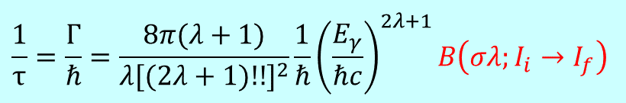
Scientific motivation for measuring excited-state lifetime
Lifetime of an excited state is one of the most important observables in nuclear structure studies
$$\frac{1}{τ}=\frac{Γ}{ℏ}=\frac{8π(λ+1)}{λ[(2λ+1)!!]^{2}}\frac{1}{ℏ}{\left(\frac{E_{γ}}{ℏc}\right)}^{2λ+1}B\left(σλ;I_{i}→I_{f}\right)$$
B(σλ) contains information of the wave functions of the initial and final states
More sensitive to the intrinsic structure than level energies
In-depth study of the underlying nuclear structure aspects, such as single-particle and collective motion
Probe for the “hidden” mechanism of structural change (e.g., shell/shape evolution)
Good testing ground for theoretical nuclear structure models

Slide 9
Scientific motivation for measuring excited-state lifetime
Lifetime of an excited state is one of the most important observables in nuclear structure studies
$$\frac{1}{τ}=\frac{Γ}{ℏ}=\frac{8π(λ+1)}{λ[(2λ+1)!!]^{2}}\frac{1}{ℏ}{\left(\frac{E_{γ}}{ℏc}\right)}^{2λ+1}B\left(σλ;I_{i}→I_{f}\right)$$
B(σλ) contains information of the wave functions of the initial and final states
More sensitive to the intrinsic structure than level energies
In-depth study of the underlying nuclear structure aspects, such as single-particle and collective motion
Probe for the “hidden” mechanism of structural change (e.g., shell/shape evolution)
Good testing ground for theoretical nuclear structure models
P.J. Nolan and J. F. Sharpey-Schafer, Rep. Prog. Phys. 42, 1 (1979)
Beam pulse, particle, radiation (β, γ, etc.)
Start
I_{i}
τ
E_{γ}, λ
Deexcitation γ ray
Stop
I_{f}
Time difference
The mean lifetime can be determined directly from the slope or the shift of centroids of the time differential spectrum.

Slide 10
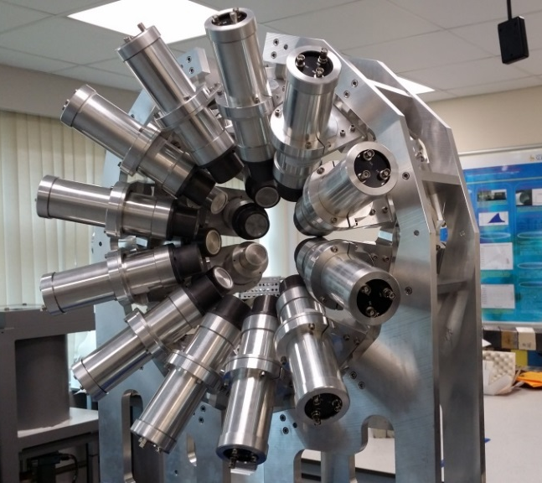


International Detector Assembly for fast-Timing measurements of Exotic Nuclei: IDATEN
FATIMA
FAst-TIMing Array
KHALA
Korea High-resolution Array of LABr₃(Ce)
IDATEN
82 LaBr₃(Ce) + 2 Clover HPGe detectors
+
Simulated γ-ray FEP efficiency with
82 LaBr₃(Ce) at 17cm from the center
Quantity | 36 units | 48 units
Crystal size | 𝜙1.5” × 2”-length | 𝜙1.5” × 1.5”-length
PMT | R9779 | R13408
δE_{γ}/E_{γ} | 3.4 % @779 keV | 3.3 % @662 keV
δT_{γ} in FWHM (γ-γ coin.) | 334.3(4) ps (1332-1173 keV) | 335(1) ps (511-511 keV)
Owners | U. of Surrey U. of Brighton | Korea U. Seoul National U.
~9 % @500 keV
The world’s most efficient fast-timing LaBr₃(Ce) array

Slide 11
International Detector Assembly for fast-Timing measurements of Exotic Nuclei: IDATEN
FATIMA
FAst-TIMing Array
KHALA
Korea High-resolution Array of LABr₃(Ce)
IDATEN
82 LaBr₃(Ce) + 2 Clover HPGe detectors
+
Quantity | 36 units | 48 units
Crystal size | 𝜙1.5” × 2”-length | 𝜙1.5” × 1.5”-length
PMT | R9779 | R13408
δE_{γ}/E_{γ} | 3.4 % @779 keV | 3.3 % @662 keV
δT_{γ} in FWHM (γ-γ coin.) | 334.3(4) ps (1332-1173 keV) | 335(1) ps (511-511 keV)
Owners | U. of Surrey U. of Brighton | Korea U. Seoul National U.
Scope of IDATEN
Measurement of 10 ps - 10 ns lifetimes using the electronic fast-timing methods
Study of new levels and γ rays by β-γ spectroscopy
Search for previously unexplored isomers

Slide 12
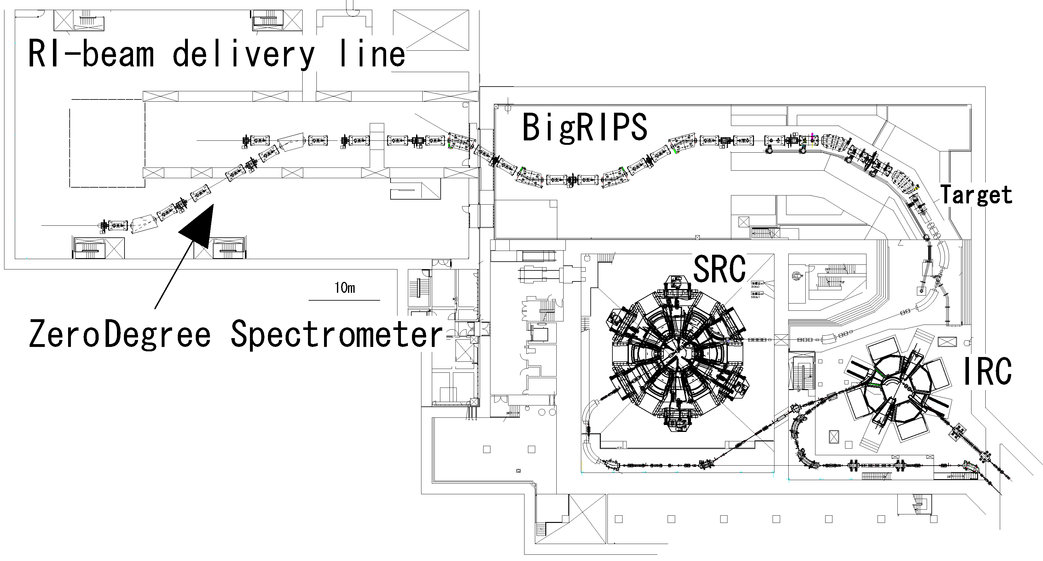

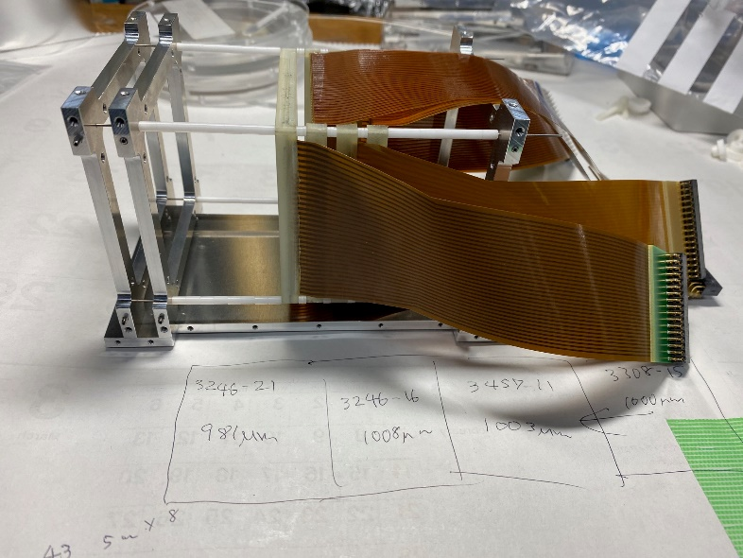
Experimental setup: SRC → BigRIPS/ZeroDegree → IDATEN
²³⁸U beam
345 MeV/u
70 pnA
Scope of IDATEN
Active stopper system
DSSSD (Micron BB-7)
Segmented plastic
Measurement of 10 ps - 10 ns lifetimes using the electronic fast-timing methods
Study of new levels and γ rays by β-γ spectroscopy
Search for previously unexplored isomers

Slide 13
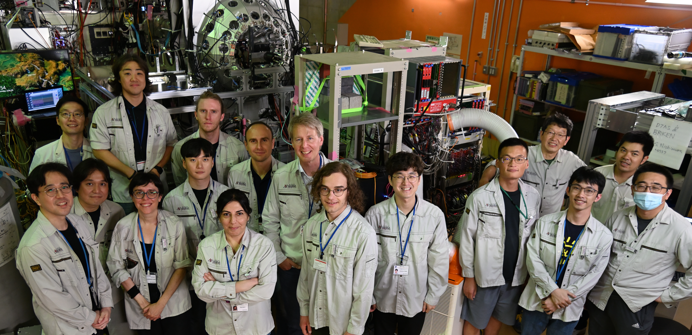
IDATEN commissioning experiment (26-27 June 2024)
Spokespersons: HW, P.H. Regan, B. Moon
26 on-site participants from Korea, Japan, China, UK, Spain, Norway, Germany, France
Primary beam: ¹²⁴Xe, 345 MeV/u, 140 pnA
29.5 hours for user beam time

Slide 14
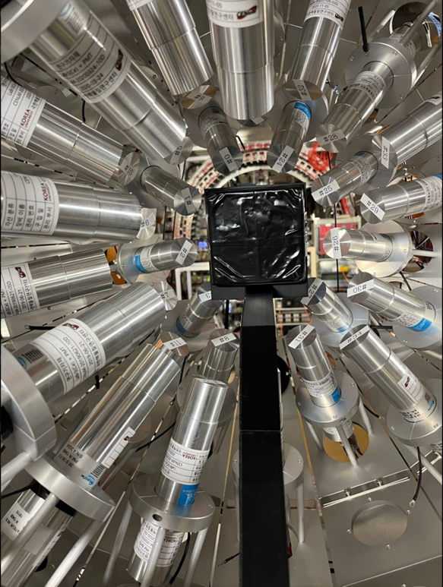
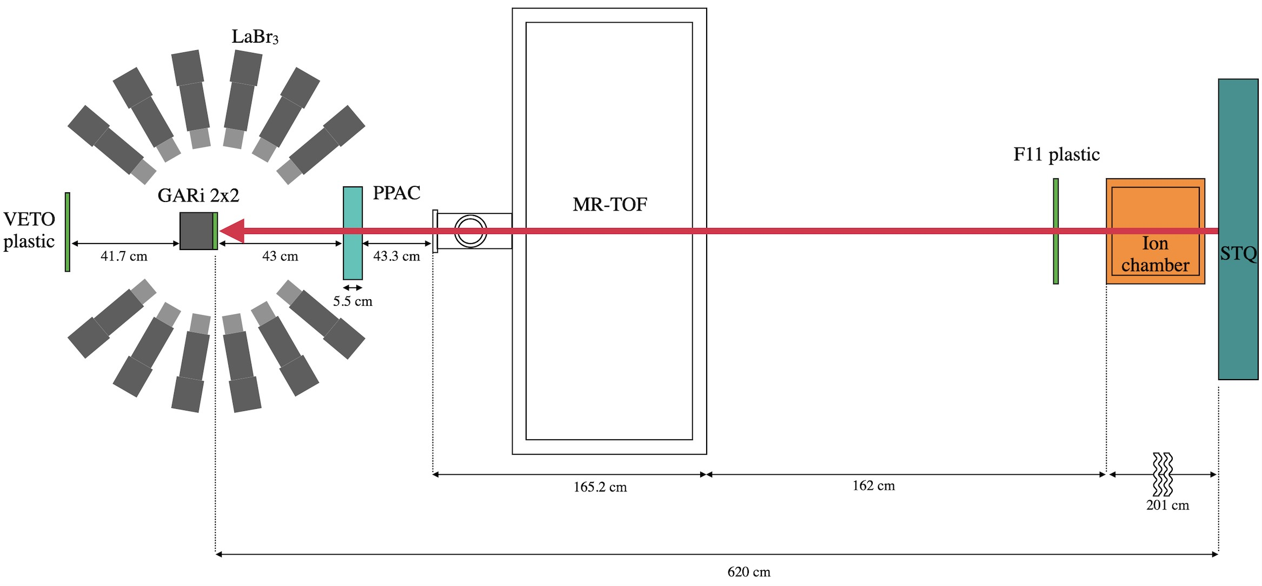
Experimental setup in the IDATEN commissioning experiment
Courtesy of Y. Jang
48 LaBr₃(Ce) detectors (KHALA: 36 units from Korea U, 12 units from SNU)
Segmented plastic (GARi 2×2) as an active stopper for heavy ions and decay particles
PPAC and VETO plastic to monitor the beam profile
~2 m downstream from the original position at F11

Slide 15
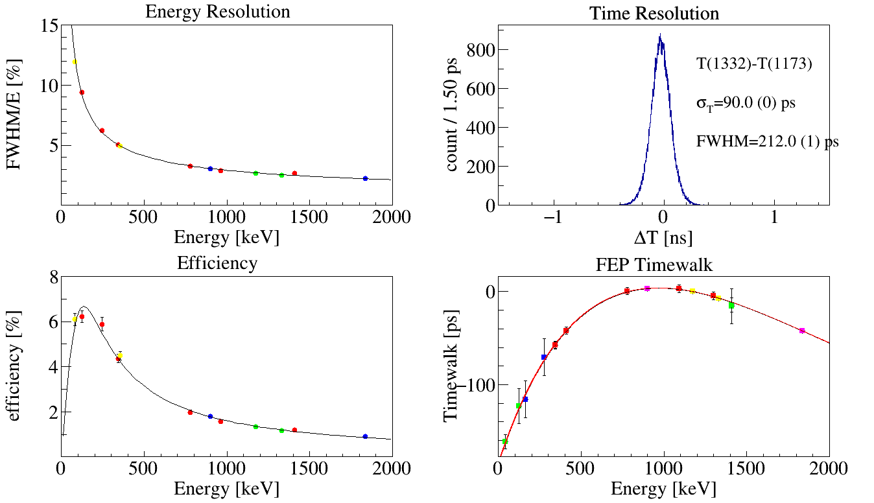
LaBr₃(Ce) detectors
KHALA: Korea High-resolution Array of LABr₃(Ce)
B. Moon et al., NIMB 541 (2023) 253
𝜙1.5”×1.5” crystal (BrilLanCe380) from Saint-Gobain
HAMAMATSU R13408 PMT assembly
36 units from Korea U., 12 units from SNU
Courtesy of J. Lee

Slide 16
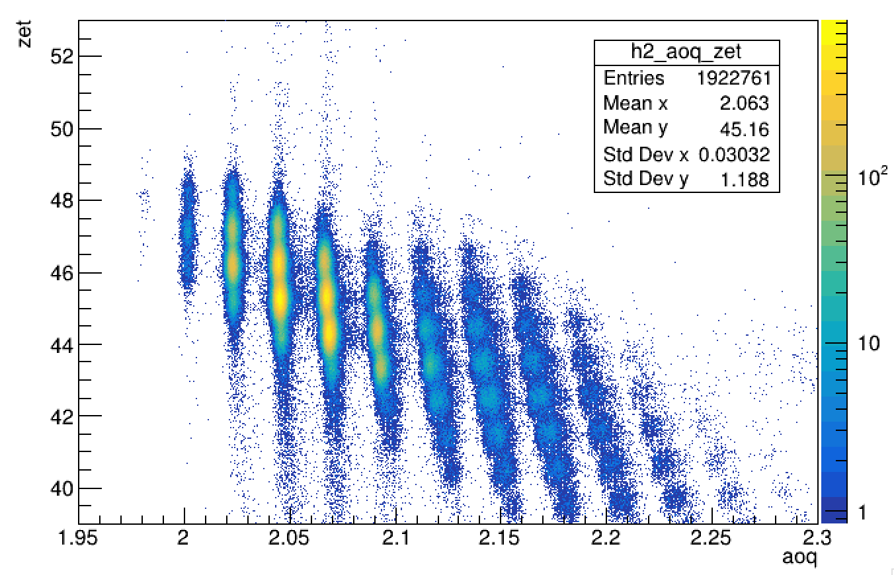
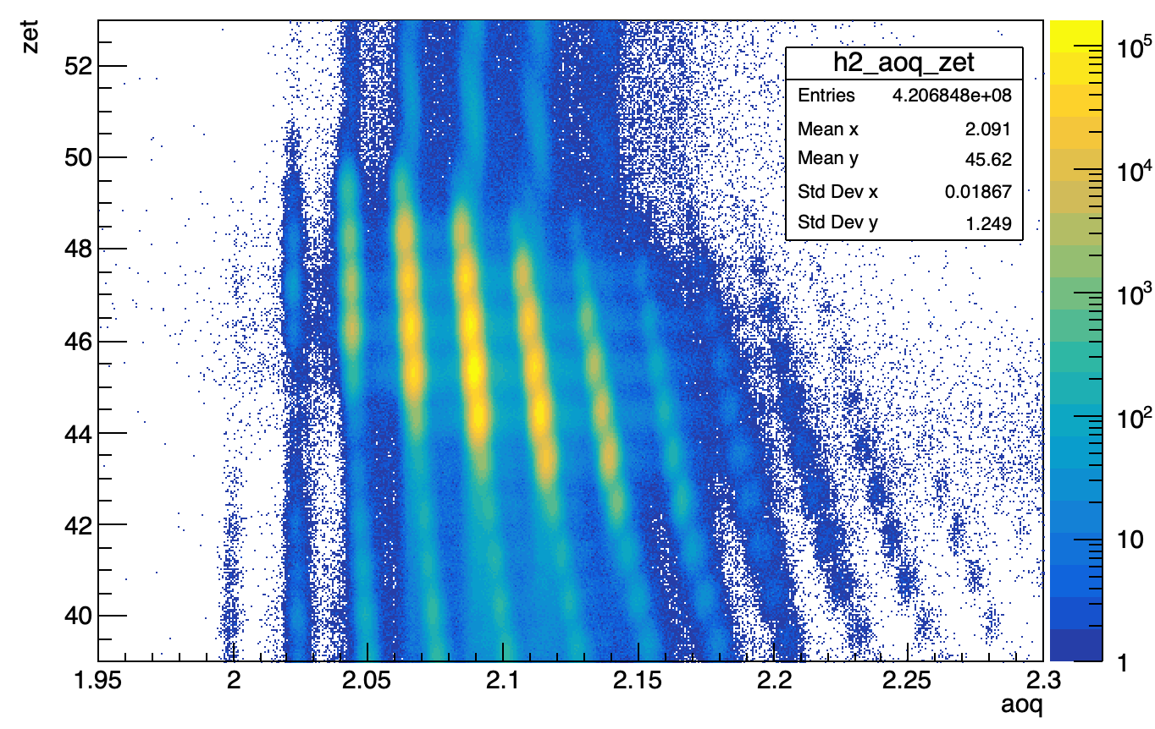
Beam settings in the commissioning experiment
Courtesy of B. Moon
Low-rate setting: ~120 cps at F11
High-rate setting: ~12 kcps at F11
⁹³Pd
⁹⁴Pd
⁹⁴Pd
⁹⁶Pd
⁹²Ru
⁹³Ru
⁹⁴Ru
Test for β-γ fast timing measurement with β-delayed proton emitter ⁹³Pd (T_{1/2} = 1.17 s, εp = 7.5 %)
Feasibility study for ion-β position correlation
Test for isomer-γ-γ fast-timing measurement with μs isomers in ^{94,96}Pd and ⁹⁴Ru that feed the lower-lying levels with ps-ns lifetimes
Performance check at high-beam intensity

Slide 17

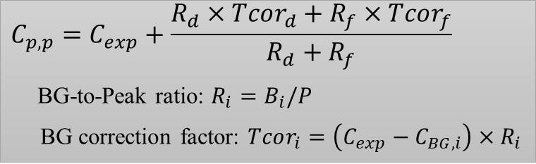
Analysis technique: Generalized Centroid Difference (GCD)
Lifetimes comparable with time resolution (10 – 100 ps) can be determined by means of the GCD method using fast-response γ-ray detectors such as LaBr₃(Ce).
$$C_{exp}\left(756−311\right)$$
$$C_{p,p}=C_{exp}+\frac{R_{d}×Tcor_{d}+R_{f}×Tcor_{f}}{R_{d}+R_{f}}$$
BG-to-Peak ratio: $R_{i}=B_{i}/P$
BG correction factor: $Tcor_{i}=\left(C_{exp}−C_{BG,i}\right)×R_{i}$
H. Mach et al., PRC95, 014313 (2017)

Slide 18
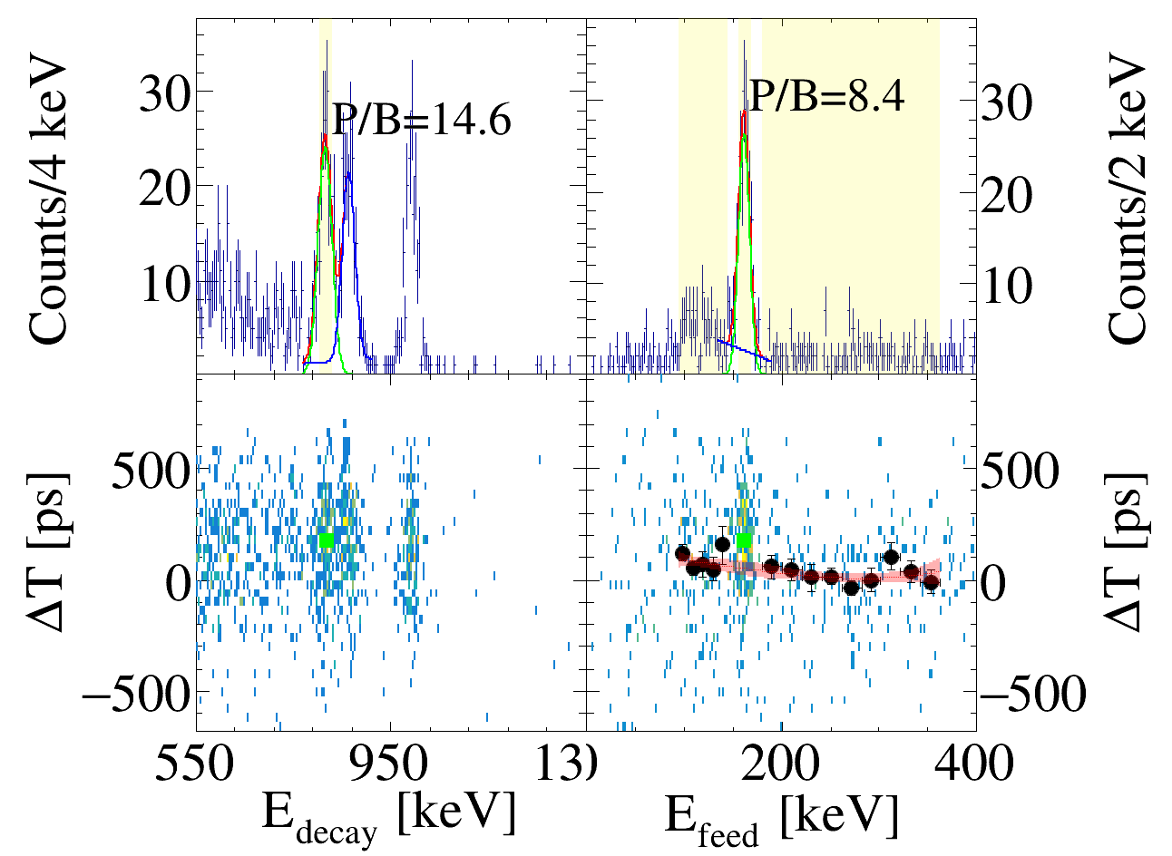
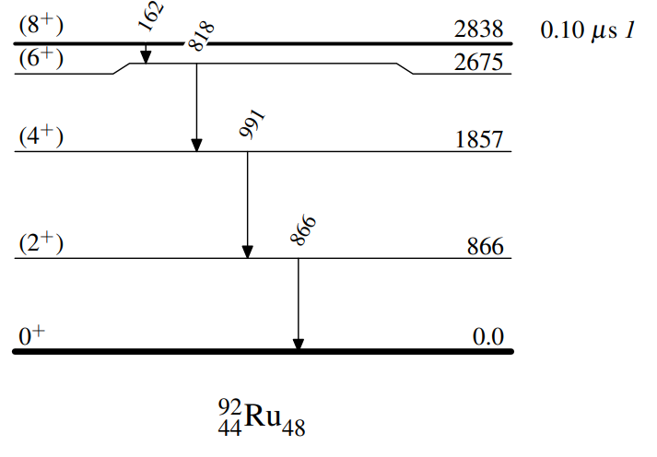
⁹²Ru results
Physics discussion underway
Jaehwan Lee
Korea University
162-keV gate
818-keV gate
Reference
Present work
97.0(12) ns
50(17) ps
< 35 ps
< 35 ps
Lifetime of the (8⁺) isomer consistent with the reference value
Lifetime of the (6⁺) level measured for the first time
Upper limit of lifetime defined for the (2⁺) and (4⁺) levels

Slide 19
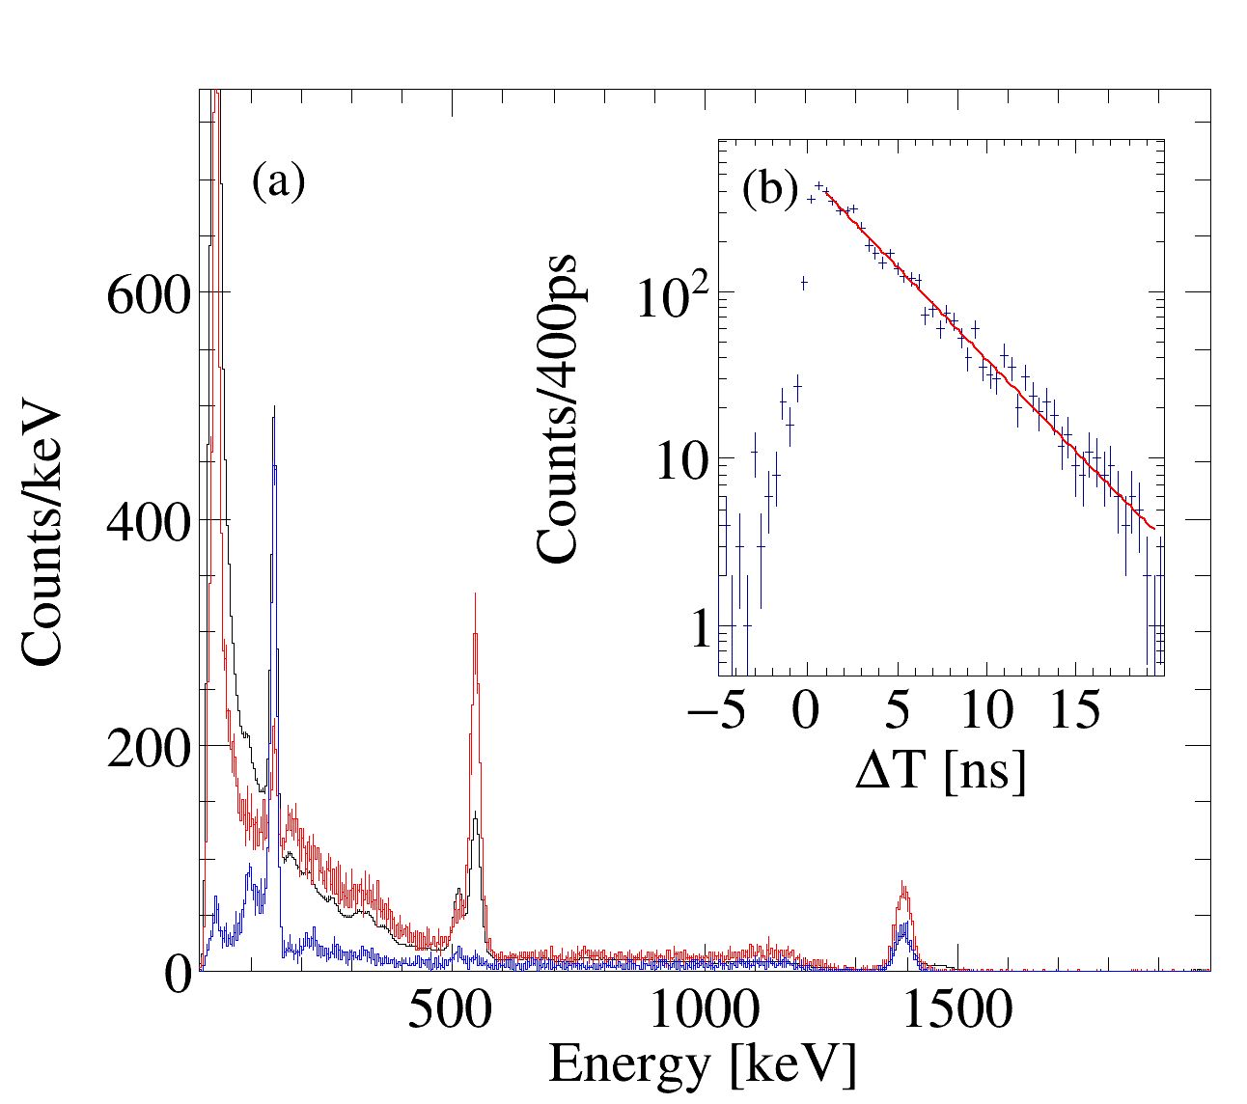
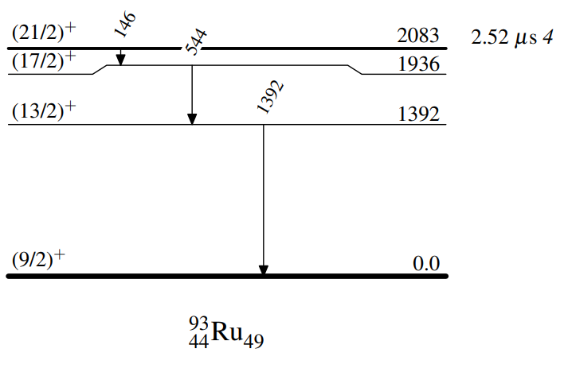
⁹³Ru results
Physics discussion underway
Jaehwan Lee
Korea University
Reference
Present work
146
2.48(6) μs
2.71(6) ns
544
Time difference between the 146 and 544 keV γ rays
< 6 ps
1392
Lifetime of the (21/2)⁺ isomer consistent with the reference value
Lifetime of the (17/2)⁺ level measured for the first time
Upper limit of lifetime defined for the (13/2)⁺ level

Slide 20
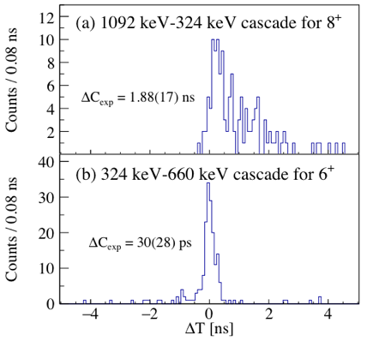
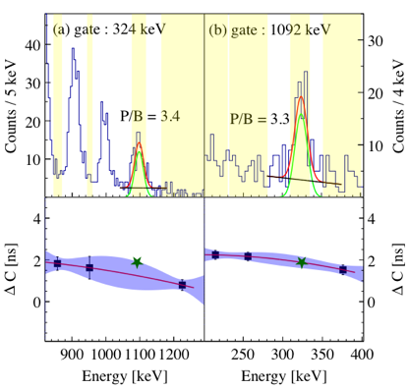
⁹⁴Pd results
Talked by
Youngseub
Youngseub Jang
Korea University
Reference
Present work
560(10) ns
< 19 ps
693(72) ps
< 13 ps
13(11) ps
< 15 ps
Lifetime of the (8⁺) level measured in better precision
Lifetime of the (4⁺) level measured for the first time
Upper limit of lifetime defined for the (2⁺), (6⁺), and (10⁺) levels

Slide 21
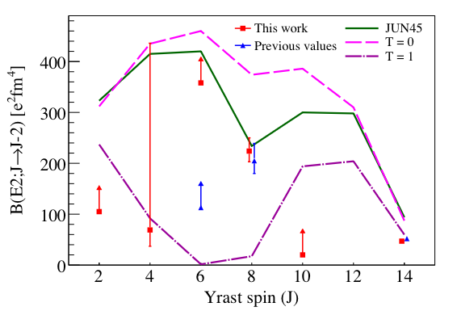
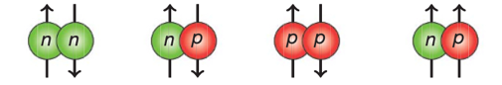
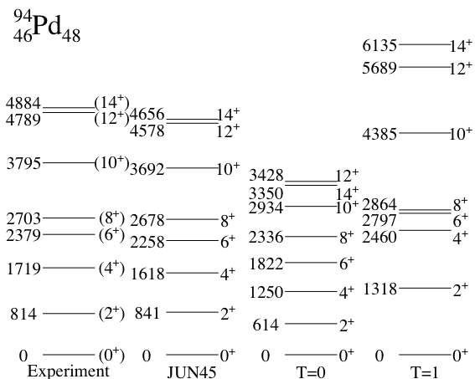
⁹⁴Pd results: compared to shell-model calculations
Talked by
Youngseub
Model space: p_{3/2}, f_{5/2}, p_{1/2}, g_{9/2} for protons and neutrons
Interactions: JUN45 (optimized using experimental data)
Effective charges: 1.5e for protons, 1.1e for neutrons
Three types of calculation using the KSHELL code:
JUN45 full
T=0 (V^{pn}_{T=1} off)
off
T=1 (V^{pn}_{T=0} off)
off
T = 1
T = 0
Newly measured B(E2) values can put a stricter constraint on the p-n interactions
T = 0 component plays a dominant role in the 6⁺ state
Both T = 0 and T = 1 components contribute to the 8⁺ state
Submitted for publication in PRC

Slide 22
Approved IDATEN proposals (43 days BT granted)
Grade | Proposal # | Title of proposal | Spokesperson | Primary beam | BT [days] | BigRIPS setting(s) | Stopper
A | RIBF212 | Fast-timing γ-ray spectroscopy of exotic nuclei at RIBF | Hiroshi Watanabe | 124Xe | 1.5 | 94Pd | Segmented plastic
A | RIBF229 | Study of shell structure, core-breaking and seniority-breaking effects close to 100Sn with IDATEN | Andrey Blazhev | 124Xe | 3.5 | 105Te | Segmented plastic
A | RIBF230 | Nuclear structure study of Pd, Ag, and Cd isotopes towards N=82 with fast-timing lifetime measurement | Hiroshi Watanabe | 238U | 7 | 128Pd | Passive
A | RIBF232 | Locating the center of the N = 40 Island of Inversion | Bruno Olaizola | 238U | 3 | 64V | Active
A | RIBF215R1 | Seniority and collectivity beyond 132Sn | Radomira Lozeva | 238U | 3.5 | 136,138Sn | Passive
A | RIBF218R1 | Exploring quantum shape phase transition around Z = 40 and N = 60 with gamma-gamma fast timing | Tumpa Bhattacharjee | 238U | 4.5 | 100,102Rb,Sr | Active
A | RBF219R1 | Nuclear structure beyond N=126 and the nucleosynthesis of actinide elements | Ana Isabel Morales López | 238U | 5.5 | 218Hg | Active
A | RIBF220R1 | Shape coexistence and collectivity in the doubly magic 78Ni region | Eda Sahin | 238U | 4.5 | 77Ni | Active
A | RIBF222R1 | Fast-timing spectroscopy of excited states in N ~ Z nuclei below 100Sn | Joochun Park | 124Xe | 5.5 | 95Cd, 99Sn | Active
A | RIBF239 | Collectivity and isoscalar interaction in 82Nb and 86Tc | Byul Moon | 124Xe | 4.5 | 82Nb, 86Tc | Passive

Slide 23
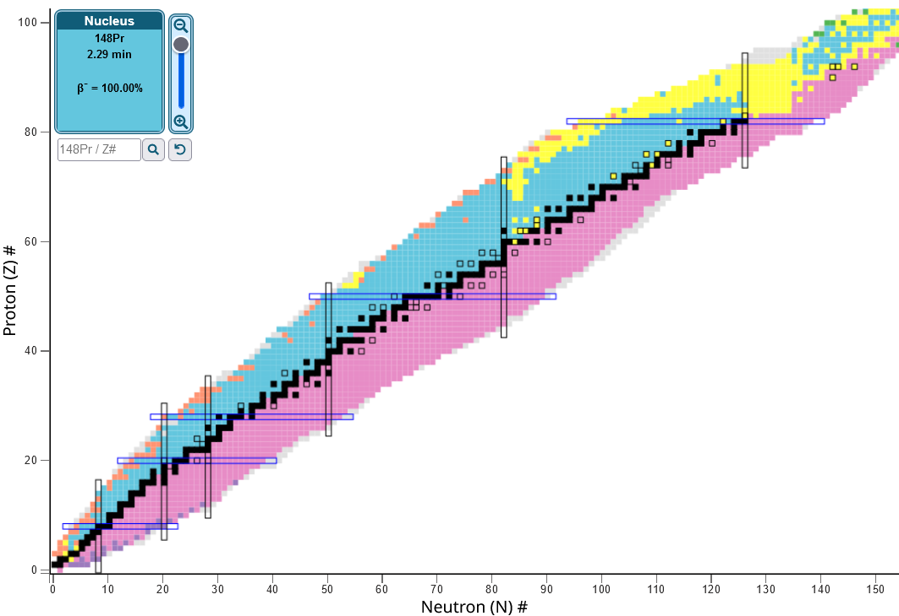
Physics interest with IDATEN
Shell evolution, seniority breaking
Collectivity and shape transition/coexistence
Pairing, IS/IV interactions
N=126
Z=82
Core/seniority breaking close to ¹⁰⁰Sn;
^{101,102,103}Sn
N=82
Structure beyond N=126;
²¹⁶⁻²²²Pb, ²¹²⁻²¹⁶Hg
N~Z nuclei towards ¹⁰⁰Sn;
^{95,96}Cd, ⁹⁵Ag, ⁹⁷Pd, ⁹⁹Cd
N=50
Collectivity at N=Z;
⁸²Nb, ⁸⁶Tc
Z=50
Collectivity beyond ¹³²Sn; ^{136,138}Sn
N=28
N=20
N=82 shell quenching; ¹²⁵⁻¹²⁸Pd, ¹²⁵⁻¹²⁸Ag, ¹²⁶⁻¹³⁰Cd, In
Z=28
Shape/phase transition around A=100; ^{100,102}Sr,Zr
N=8
Z=20
Collectivity in the ⁷⁸Ni region; ^{75,77}Cu, ⁷⁶Ni
Z=8
Waiting for
BT allocation
at RIBF
N=40 Island of Inversion; ⁶⁴Cr

Slide 24
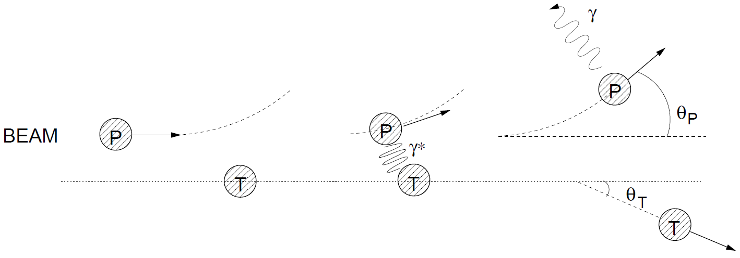
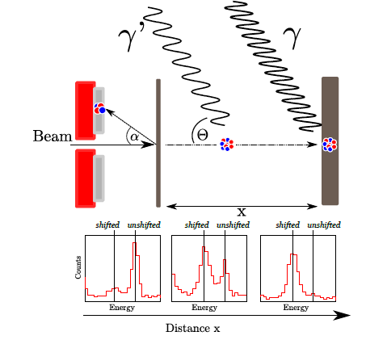

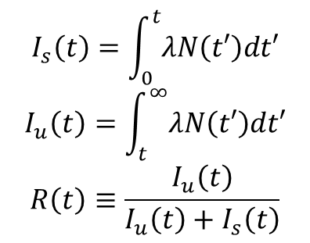
Scientific motivation for measuring excited-state lifetime
Lifetime of an excited state is one of the most important observables in nuclear structure studies
$$\frac{1}{τ}=\frac{Γ}{ℏ}=\frac{8π(λ+1)}{λ[(2λ+1)!!]^{2}}\frac{1}{ℏ}{\left(\frac{E_{γ}}{ℏc}\right)}^{2λ+1}B\left(σλ;I_{i}→I_{f}\right)$$
Coulomb excitation
EM excitation induced by the impinging charged particle
P.J. Nolan and J. F. Sharpey-Schafer, Rep. Prog. Phys. 42, 1 (1979)
$$σ∝B\left(Eλ↑\right)$$
Recoil distance method
$$I_{s}\left(t\right)=\int_{0}^{t}{λN\left(t′\right)dt′}$$
$$I_{u}\left(t\right)=\int_{t}^{∞}{λN\left(t′\right)dt′}$$
$$R\left(t\right)≡\frac{I_{u}\left(t\right)}{I_{u}\left(t\right)+I_{s}\left(t\right)}$$

Slide 25
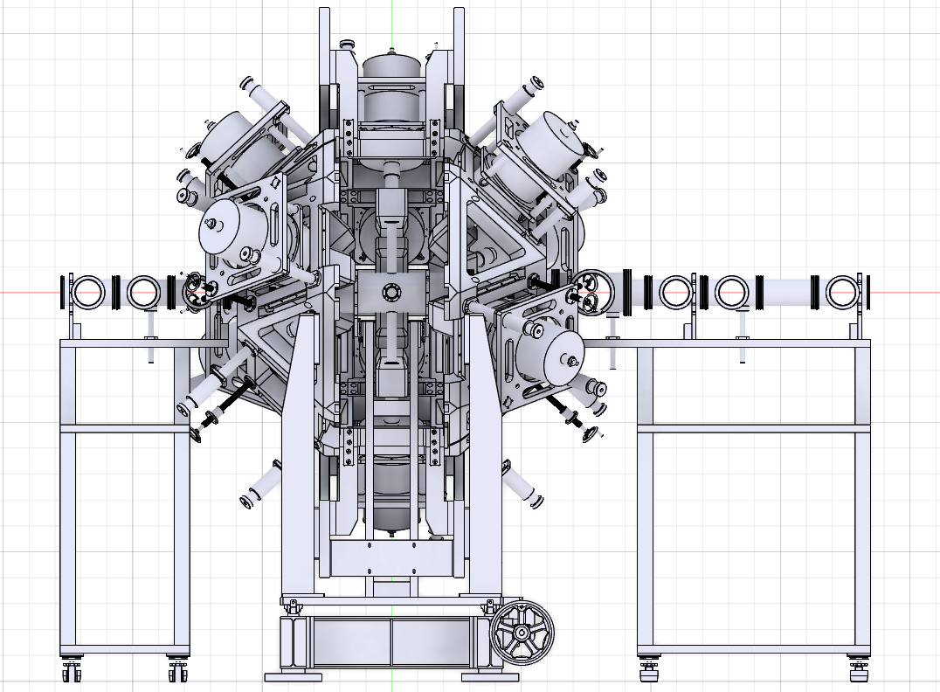
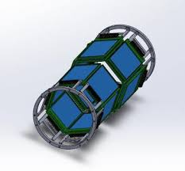
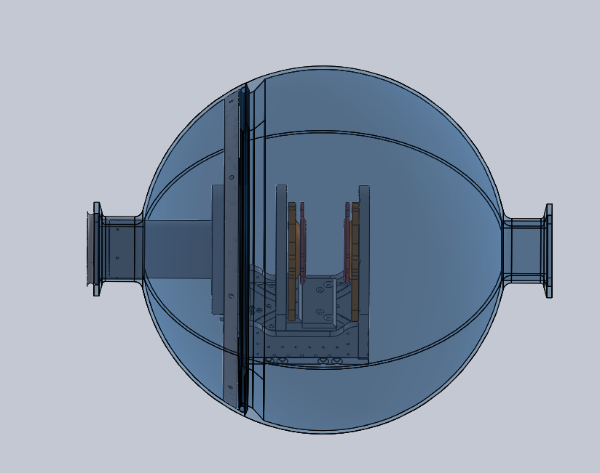
Experimental setup for Fall 2025 Exp. at KoBRA
Si
Plastic
FC
BD
First beam experiment with ASGARD
10 Clover HPGe detectors on the ASGARD frame
Target position ~2 m downstream from the original F3 focal point
STARK Jr. or Plunger installed at the array center
2 PPACs in the F3 chamber
Degrader, 2 collimators, beam viewer (MCP) installed in the upstream of the target
Si detectors, plastic, FC, beam dump located in the downstream of the target
Contact person: H. Watanabe
MCP
Degrader
Collimators
Pb shield
F3
focus
Beam
STARK Jr.
Plunger

Slide 26
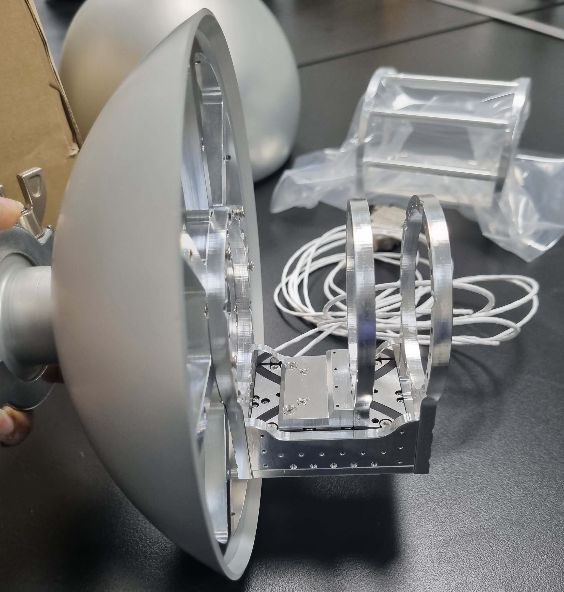
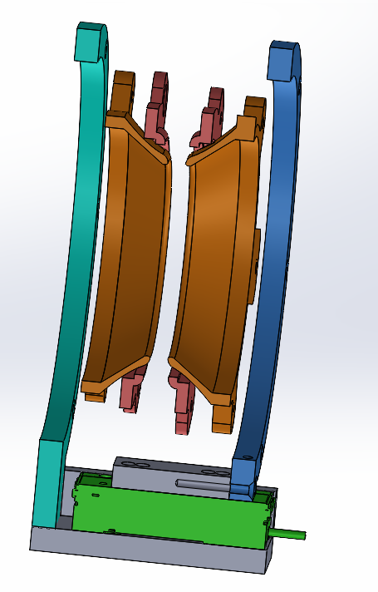
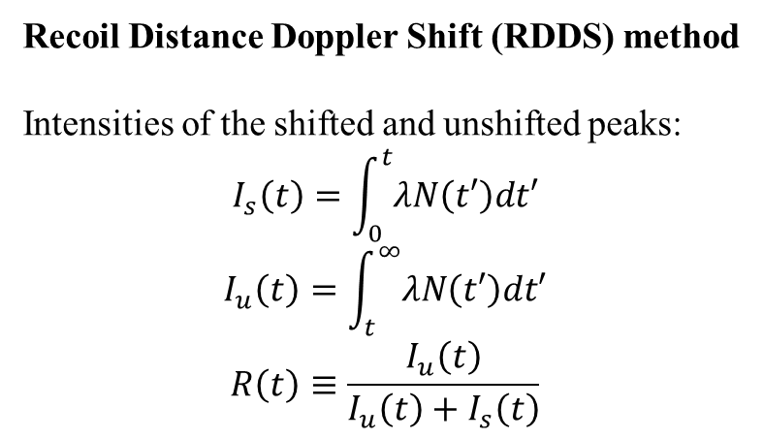
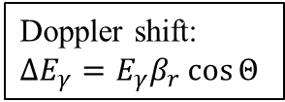
Development of Plunger for ~1 ps lifetime measurement of excited states
Courtesy of
Arunita Mukherjee
Talked by
Arunita
HPGe
Doppler shift:
$$∆E_{γ}=E_{γ}β_{r}\cos{Θ}$$
Arunita Mukherjee
Yung Hee Kim
Precision linear stage (Q-545K048) + Controller (E-873.1 AT)
  Resolution: 1 nm
  Travel range: 26 mm
Target-stopper distance measured by means of the capacitance
Feedback system to monitor/correct the slow changes of the distance caused by heating of the mechanics
Target to Clover distance:
  ~11 cm at 90° (4 units)
  ~13.3 cm at 45°, 135° (3 units each)
Target/degrader holder
Recoil Distance Doppler Shift (RDDS) method
Intensities of the shifted and unshifted peaks:
$$I_{s}\left(t\right)=\int_{0}^{t}{λN\left(t′\right)dt′}$$
$$I_{u}\left(t\right)=\int_{t}^{∞}{λN\left(t′\right)dt′}$$
$$R\left(t\right)≡\frac{I_{u}\left(t\right)}{I_{u}\left(t\right)+I_{s}\left(t\right)}$$
98 mm
64 mm
Stretcher
Precision linear stage

Slide 27
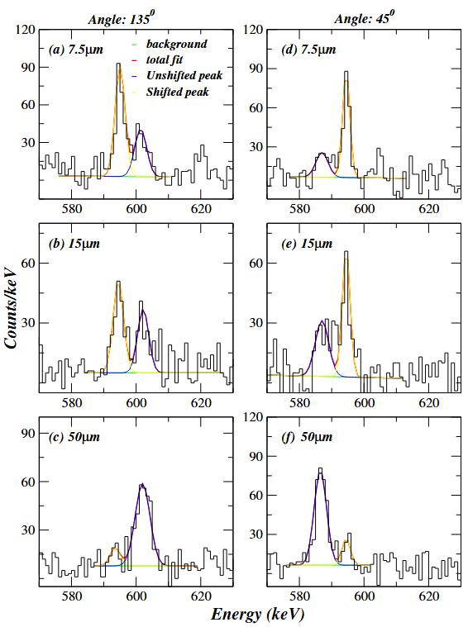
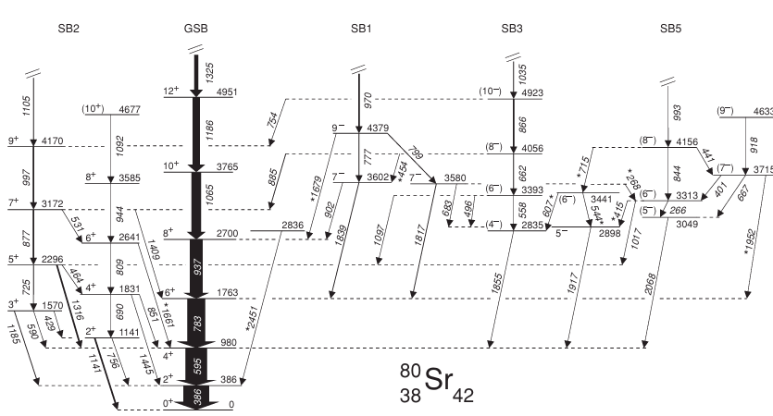
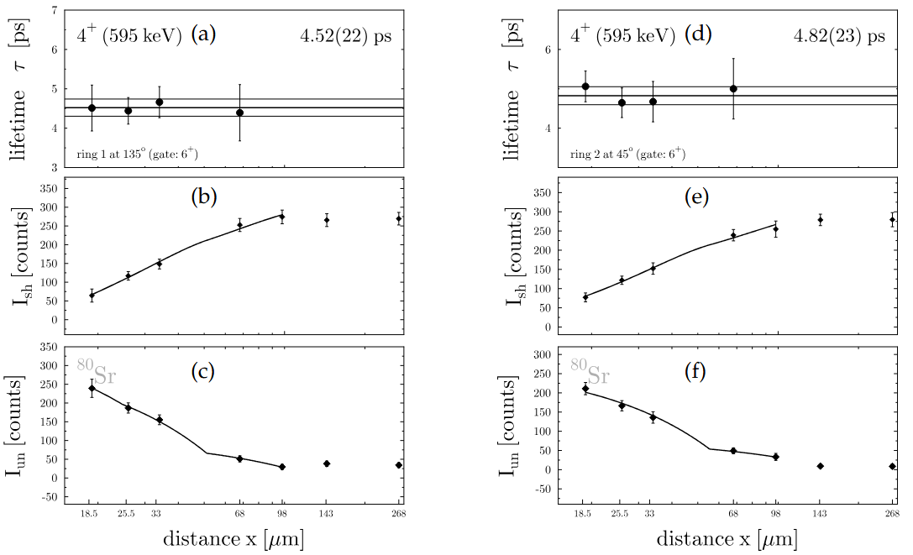
Commissioning experiment for the Plunger system at RAON
KO-25-08 carried out in Oct. 20-28, 2025
Beam: ²⁰Ne at 90 MeV
Target: ⁶⁴Zn 1.4 μm (~1 mg/cm²)
Stopper: ¹⁸¹Ta 7 μm (~12 mg/cm²)
Reaction: ⁶⁴Zn(²⁰Ne, αγ)⁸⁰Sr
Talked by
Arunita
Gate on 6⁺ → 4⁺ (783 keV, shifted)
Arunita Mukherjee
Yung Hee Kim
Angle: 45°
Angle: 135°
τ (reference)
0.49(2) ps
0.47(6) ps
0.82(8) ps
4.2 (2) ps
49.4 (18) ps
⁸⁰Sr
τ = 4.67(43) ps (velocity β ~ 0.021(3))

Slide 28


Low-energy Coulomb excitation: a powerful tool for shapes and collectivity
EM excitation of a nucleus induced by the impinging charged particle (i.e. emission/absorption of virtual photons)
Very clean process: “Safe-energy” criterion for bombarding energy to avoid nuclear interactions
Jason Park
Hope College
A. Ekström, PhD thesis (2009)
1st order process
Electric multipole (Eλ) transition probabilities connecting the ground state to the excited states
2nd (and higher) order process
Multiple excitation → Transition probabilities up to higher-spin states
Change in the magnetic substate population (Reorientation effect)
  → Static/spectroscopic quadrupole moment Q_{s} deduced from σ_{coul}
    ⇒ Nuclear shape: Spherical (≈ 0): Prolate (< 0): Oblate (> 0)
Courtesy of
Jason Park

Slide 29


Commissioning experiment for Coulomb excitation at RAON
KO-24-26 carried out in Nov. 24-28, 2025
Beam: ⁴⁰Ar at 4.42 MeV/u
Target: ¹⁸¹Ta and ¹⁹⁷Au with 1 μm
  High-Z monoisotopic elements preferred for safe-energy Coulex studies due to high E_{safe} and P_{Coul}
  Event (angle) selection for “safe-energy” Coulomb excitation
Purpose
Precision improvements in B(E2↑) of ⁴⁰Ar, ¹⁸¹Ta, ¹⁹⁷Au
First Q_{s} measurements of excited states in ¹⁸¹Ta and ¹⁹⁷Au
1461 keV γ ray in ⁴⁰Ar
Before Doppler corr.
Jason Park
Hope College
⁴⁰K E.C. decay
(Background)
⁴⁰Ar Coulex
After Doppler corr.
⁴⁰Ar Coulex
Minju Kim
Ewha W.Univ.
Successful Doppler correction of the 1461-keV γ-ray from ⁴⁰Ar using STARK Jr. and ASGARD data
This transition is important for normalization of target γ-ray yields in GOSIA analysis: absolute I_{beam} not needed
⁴⁰K E.C. decay
Angle difference between particle and γ

Slide 30
Summary
CENS Nuclear Structure group is promoting lifetime measurements of excited states
IDATEN (International Detector Assembly for fast-Timing measurements of Exotic Nuclei) for fast-timing method ⇒ τ = 10 ps – 10 ns
  Commissioning experiment performed at RIBF in June 2024
  Lifetimes in ^{92,93}Ru → Physics discussion is underway
  Lifetimes in ⁹⁴Pd → Role of the T = 0 and T = 1 components in p-n interactions
Plunger device for doppler-shift recoil-distance method ⇒ τ = 1 ps – 10 ps
  Commissioning experiment performed at RAON in Oct. 2025
  Lifetime of the 4⁺ state in ⁸⁰Sr measured, consistent with the reference value
Safe-energy Coulomb excitation ⇒ τ < 1 ps
  Commissioning experiment performed at RAON in Nov. 2025
  Successful Doppler correction of the 2⁺→0⁺ γ-ray in ⁴⁰Ar

Slide 31

Acknowledgements for IDATEN commissioning experiment

Slide 32
Acknowledgements for ASGARD in-beam γ campaign
CENS
S. Ahn, C. Anastasiia, Y. Cho, J. Ha, K.I. Hahn, J. Huh, J. Hwang, Y. Jang, S. Kim, Y.H. Kim, J. Lee, X. Pereira-Lopez, B. Moon, A. Mukherjee, J. Park, H. Watanabe
KoBRA team
Accelerator team

