Slide 1
Uncovering Hidden Leptonic Correlations with Flow Matching and Autoencoders
arXiv:2608.15042
Haruto Kitagawa¹, Satsuki Nishimura², Hajime Otsuka¹
Kyushu University
Kyoto University

Slide 2
Motivation

Slide 3
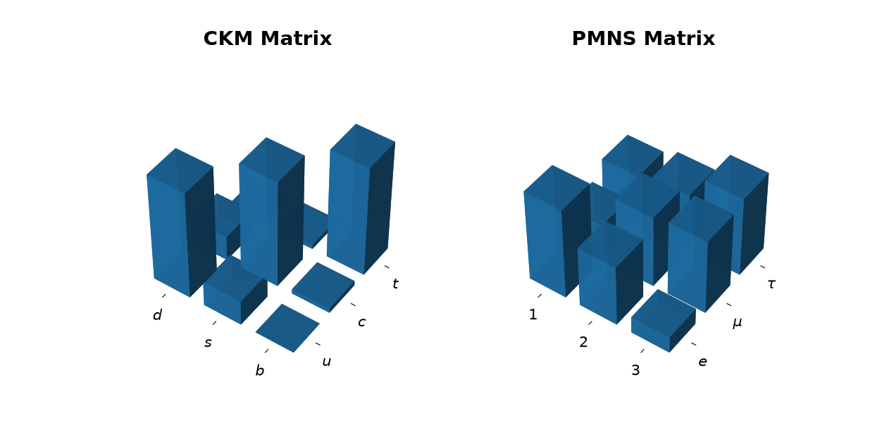
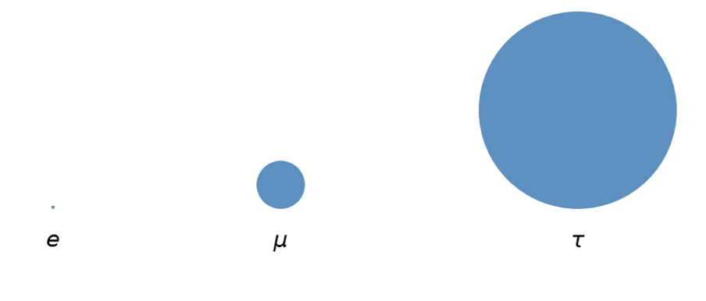
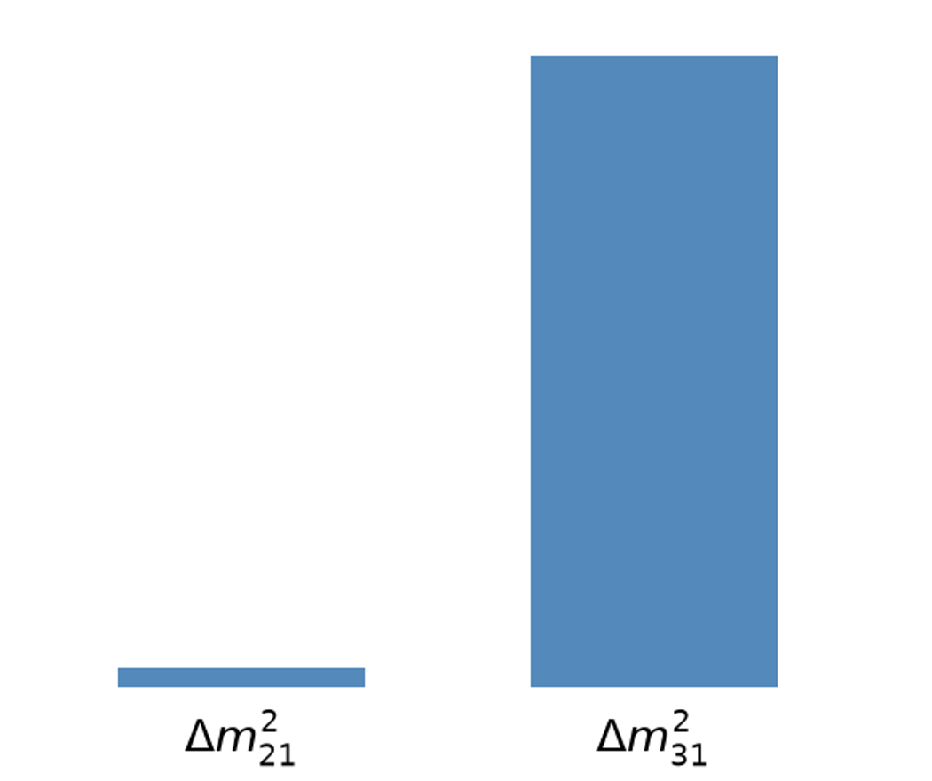
A Shift in Perspective
Lepton flavor puzzles beyond the Standard Model
Large mixing angles
Mass hierarchy
How to explain the observed flavor structure?
What the observed flavor structure implies for the theory.
Experimental observations
Constraints on theory
Correlations among observables

Slide 4
A data-driven approach to correlations among observables?
Conventional
Data-driven (This work)
Parameter Search
Parameter Search
Parameter space
Parameter space
Data-consistent region
Impose symmetries or assumptions to
narrow the search region
Explore the region with machine learning, without restricting the search space
Correlation Analysis
Correlation Analysis
Limited Information
Efficient use of information
Keep 2–3 observables and project out the rest.
ML compresses the multi-dimensional distribution to low dimensions
$$\left\{m_{1},m_{2},m_{3},\sin^{2}{θ_{12}},\sin^{2}{θ_{13}},\sin^{2}{θ_{23}},δ_{\text{CP}},α_{21},α_{31}\right\}$$

Slide 5
Overview

Slide 6
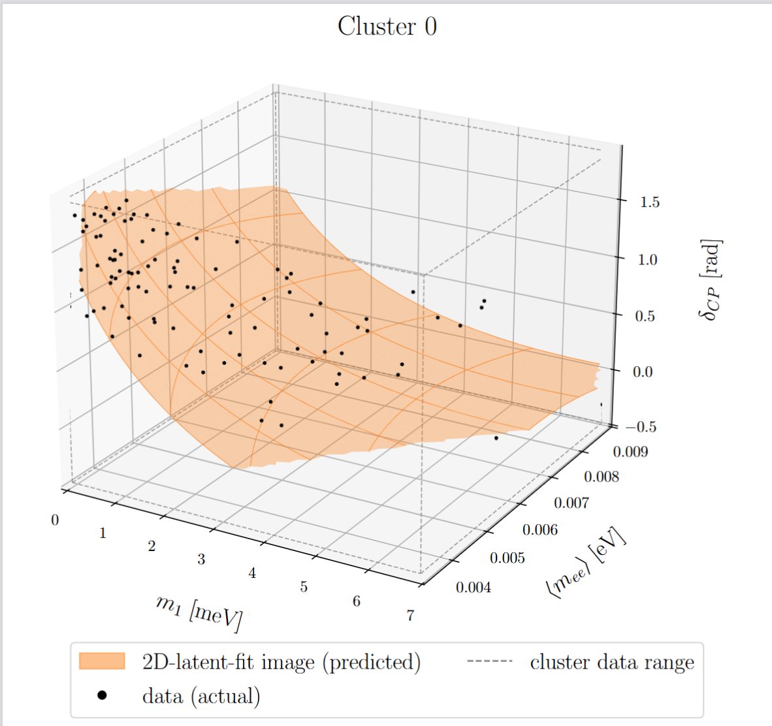
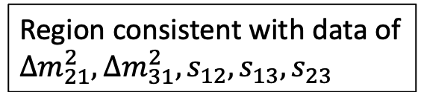
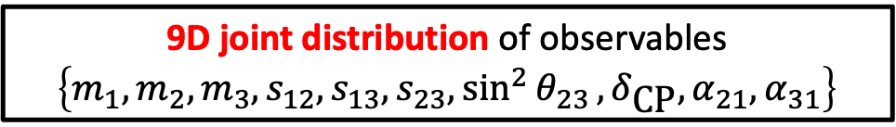
Full space of (Y, M)
Type I Seesaw
9D joint distribution of observables
$$\left\{m_{1},m_{2},m_{3},s_{12},s_{13},s_{23},\sin^{2}{θ_{23}},δ_{\text{CP}},α_{21},α_{31}\right\}$$
①
②
Region consistent with data of
$∆m_{21}^{2}, ∆m_{31}^{2},s_{12},s_{13},s_{23}$
This work proposes machine-learning methods for
①Exploring the data-consistent region
②Uncovering nonlinear correlations among observables

Slide 7
Outline
① Exploring the data-consistent region
Parameter search using Flow Matching
② Uncovering nonlinear correlations among observables
Finding relations via an Autoencoder

Slide 8
Parameter Search Using
Flow Matching

Slide 9

Problem Setup
Type-I seesaw mechanism (no symmetry imposed)
$$ℒ=Y_{iα}^{ν}{\overline{N}}_{i} l_{α} H − \frac{1}{2}M_{ij}{\overline{N}}_{i}{\overline{N}}_{j}+h.c.,$$
$$m_{ν}={\left\langle H\right\rangle }^{2}Y^{T}M^{−1}Y$$
$$U_{PMNS}^{T}m_{ν}U_{PMNS}=diag(m_{1}, m_{2}, m_{3})$$
$$U_{PMNS}=\left(\begin{matrix}c_{12}c_{13} & s_{12}c_{13} & s_{12}e^{−iδ_{CP}} \\ −s_{12}c_{23}−c_{12}s_{23}s_{13}e^{iδ_{CP}} & c_{12}c_{23}−s_{12}s_{23}s_{13}e^{iδ_{CP}} & s_{23}c_{13} \\ s_{12}s_{23}−c_{12}c_{23}s_{13}e^{iδ_{CP}} & c_{12}s_{23}−s_{12}c_{23}s_{13}e^{iδ_{CP}} & c_{23}c_{13}\end{matrix}\right)∙\left(\begin{matrix}1 & 0 & 0 \\ 0 & e^{iα_{21}} & 0 \\ 0 & 0 & e^{iα_{31}}\end{matrix}\right)$$
Parameters G (23 components): Re/Im parts of Y (18), M absolute values (3), M phases (2)
Observables L (5 components) :
$∆m_{21}^{2}, ∆m_{31}^{2},, \sin^{2}{θ_{12}},\sin^{2}{θ_{13}}$, $\sin^{2}{θ_{23}}$
Problem: given L, find the G region consistent with it
* We consider Normal Order only

Slide 10
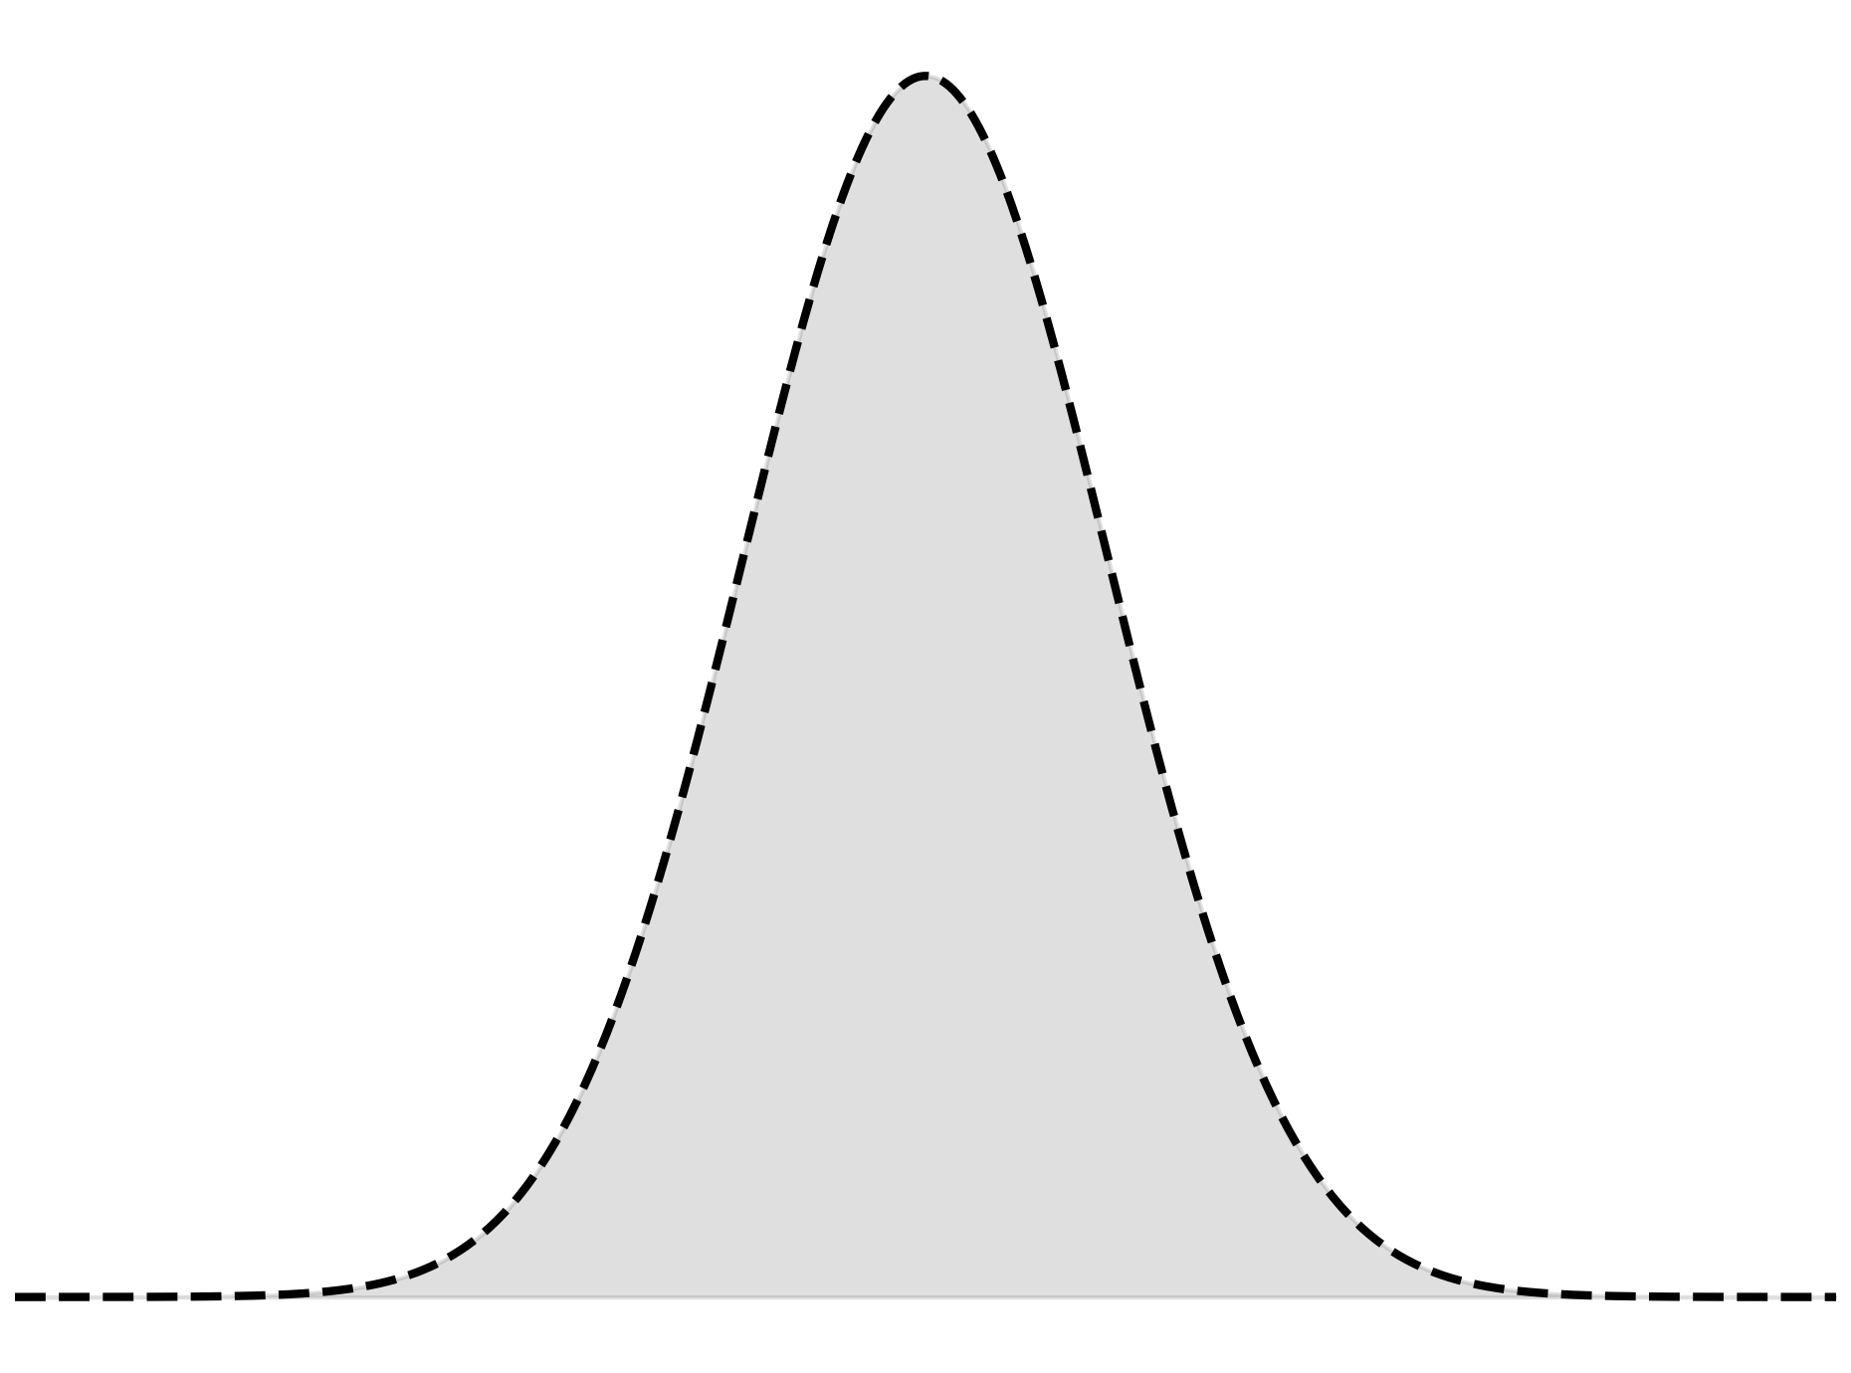

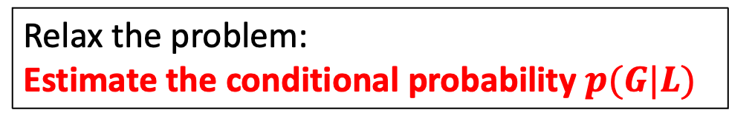


From Inversion to Estimating Conditional Probability
Original Problem:
given L, find the G region consistent with it
Relax the problem:
Estimate the conditional probability $p(G|L)$
Parameter search
$$p(G|L)$$
Region likely to yield L
Sample from $p(G|L)$ + Check consistency
×
○
L data
○
×
Full space of G
L range
① Sample G from $p(G|L)$
② Calculate L
③ Check consistency

Slide 11
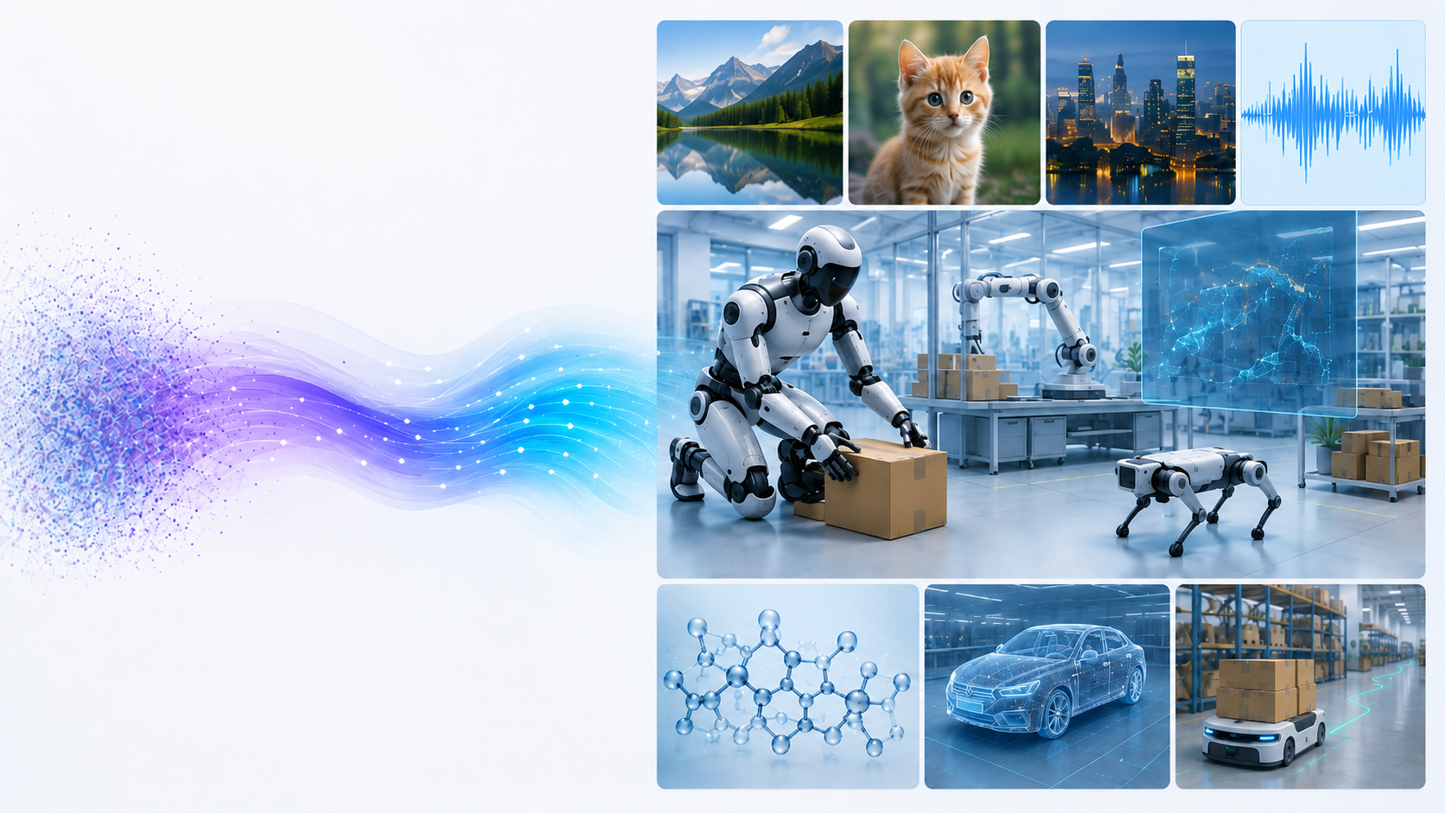
Flow Matching
Around 2020:
  Diffusion models: High-quality image generation
  Applications expand to video and audio
Around 2023:
  Flow Matching: faster, more stable generation
  Attracting attention for Physical AI

Slide 12
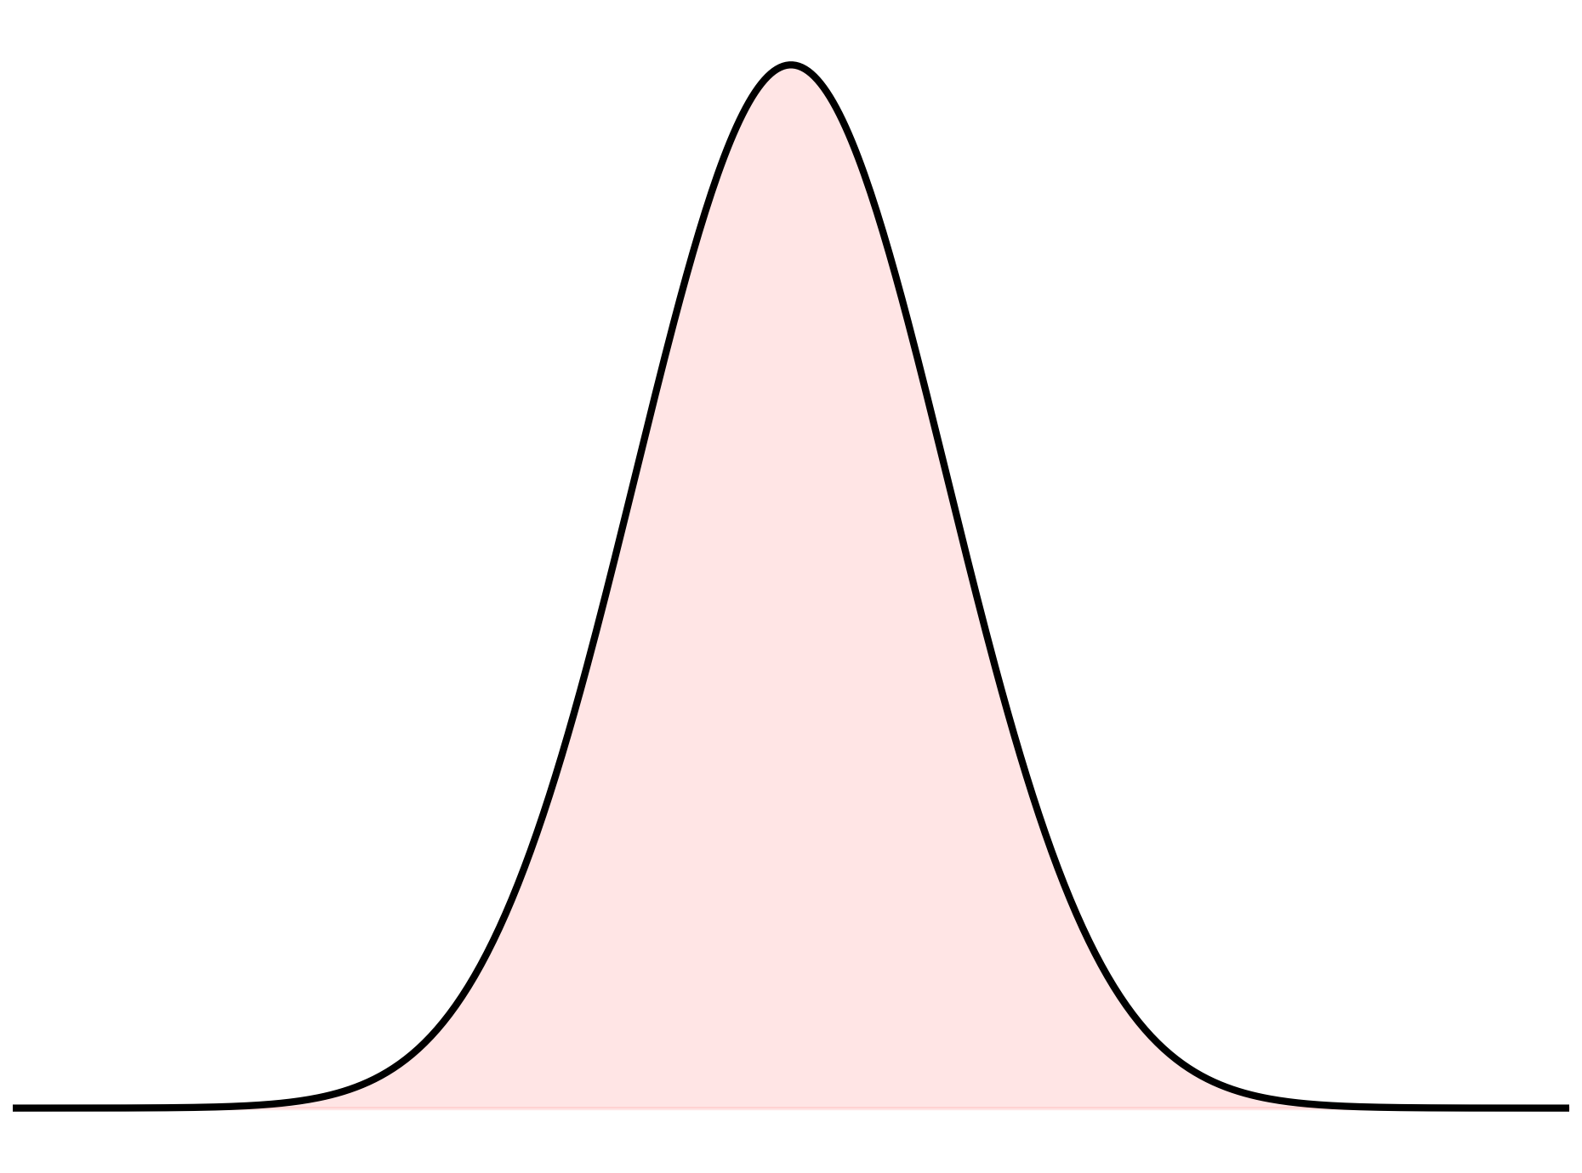
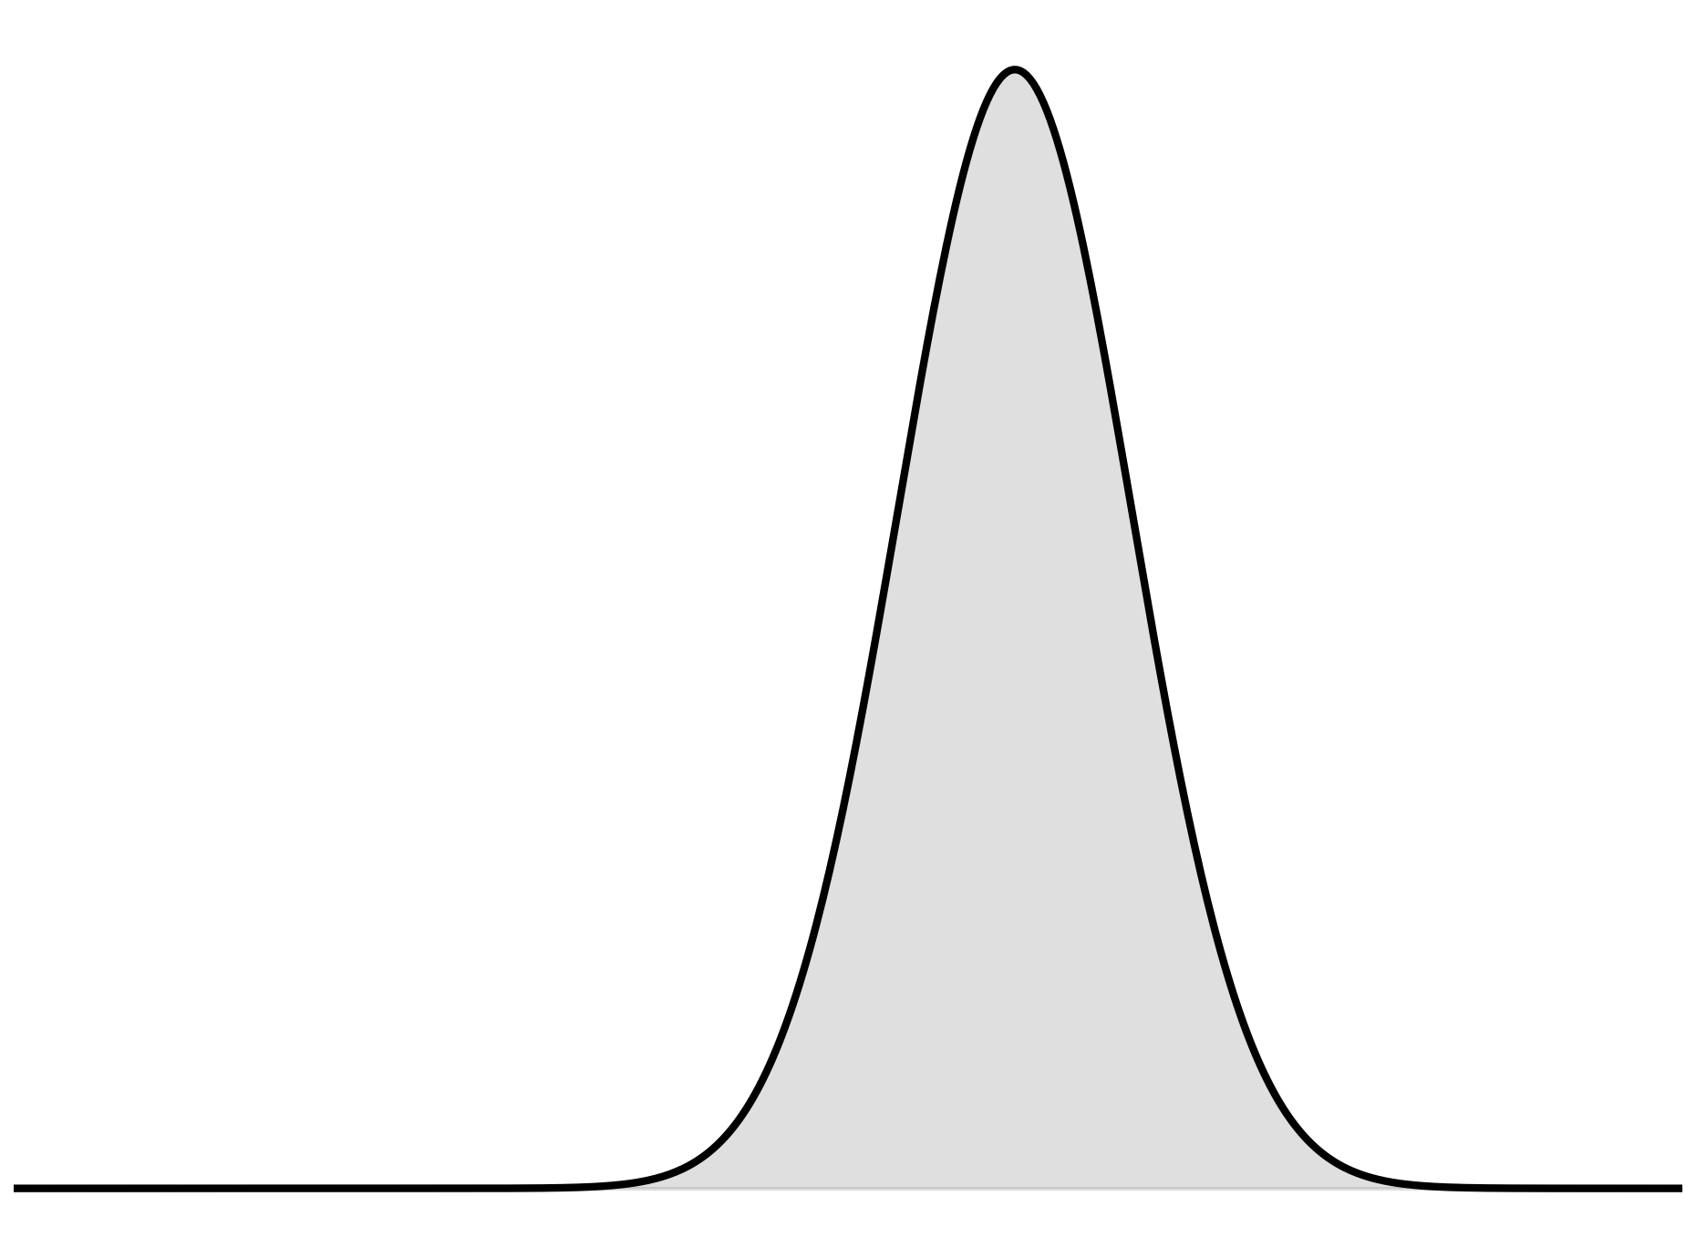
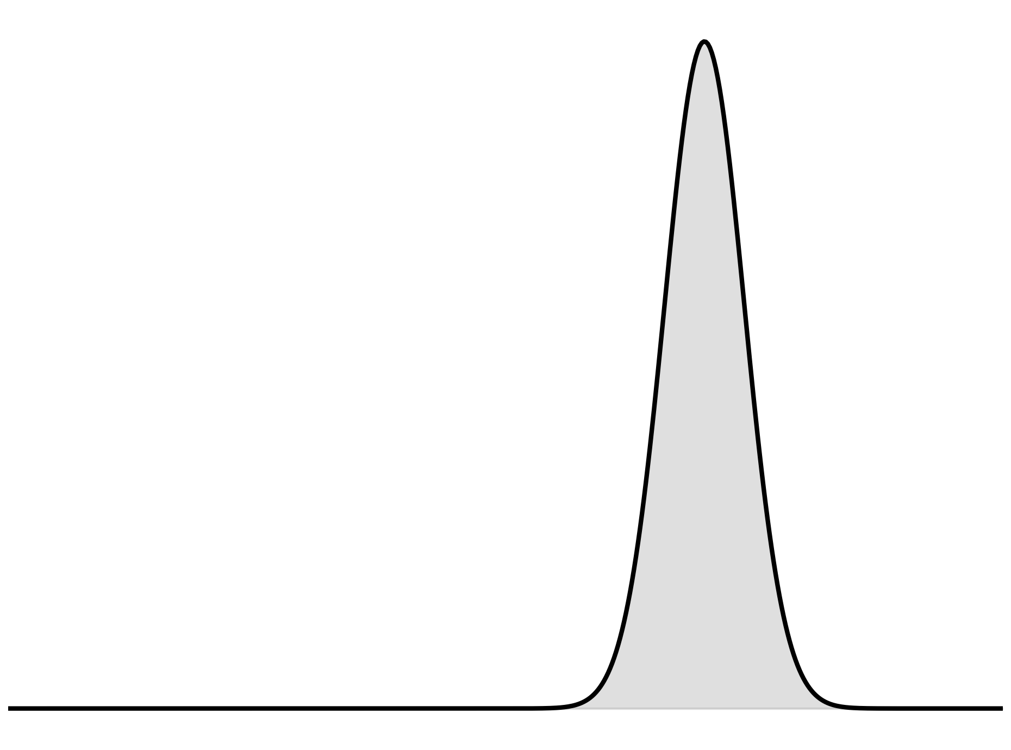
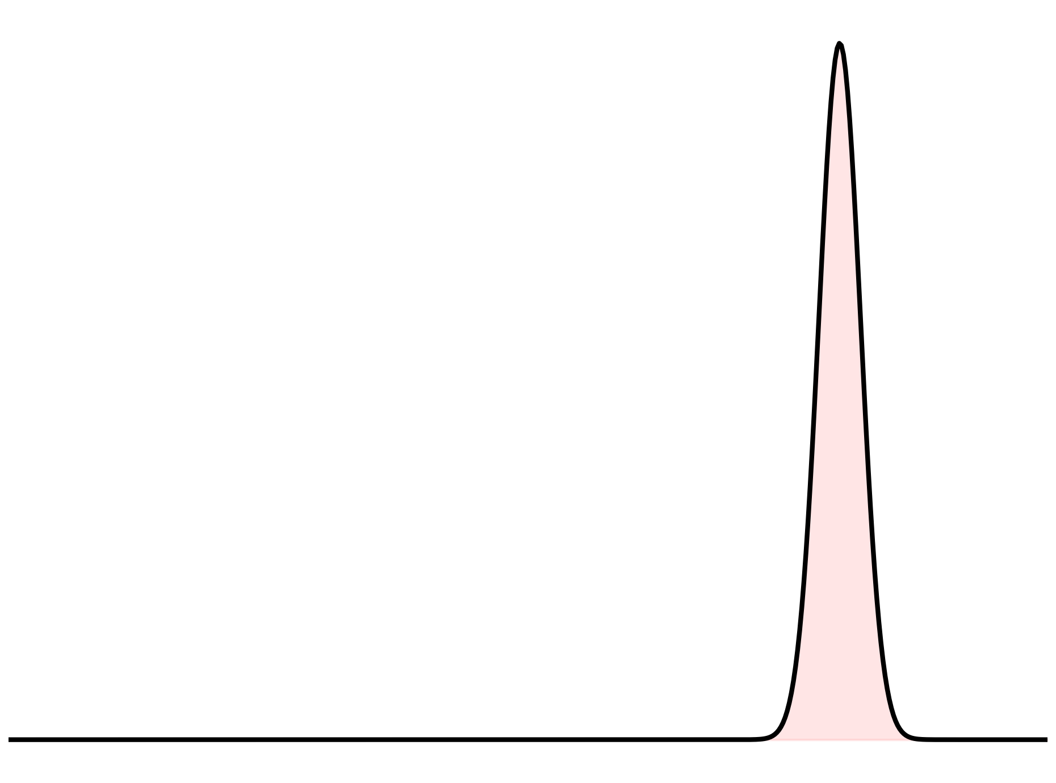






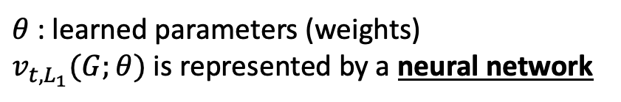

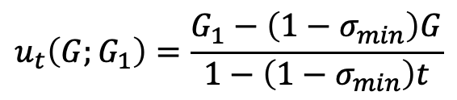


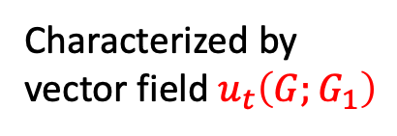
How to estimate $p(G|L)$ ?
Idea: Start from N(0, 1), and learn how to transform N(0, 1) to p(G|L)
Giving $\left(G_{1}, L_{1}\right)$, let’s define
$$u_{t}\left(G;G_{1}\right)=\frac{G_{1}−\left(1−σ_{min}\right)G}{1−\left(1−σ_{min}\right)t}$$
Characterized by
vector field $u_{t}\left(G;G_{1}\right)$
$$t=0$$
* Based on optimal transport theory
$$0$$
we learn a vector field $v_{t,L_{1}}\left(G;θ\right)$, approximating $u_{{t, L}_{1}}$
…
$$v_{t,L_{1}}(G;θ)$$
$${\sim u}_{t}\left(G;G_{1}\right)$$
$$t, G_{1}, L_{1}$$
…
…
$$σ_{min}$$
$$t=1$$
$θ$ : learned parameters (weights)
$v_{t,L_{1}}(G;θ)$ is represented by a neural network
$$G_{1}$$

Slide 13
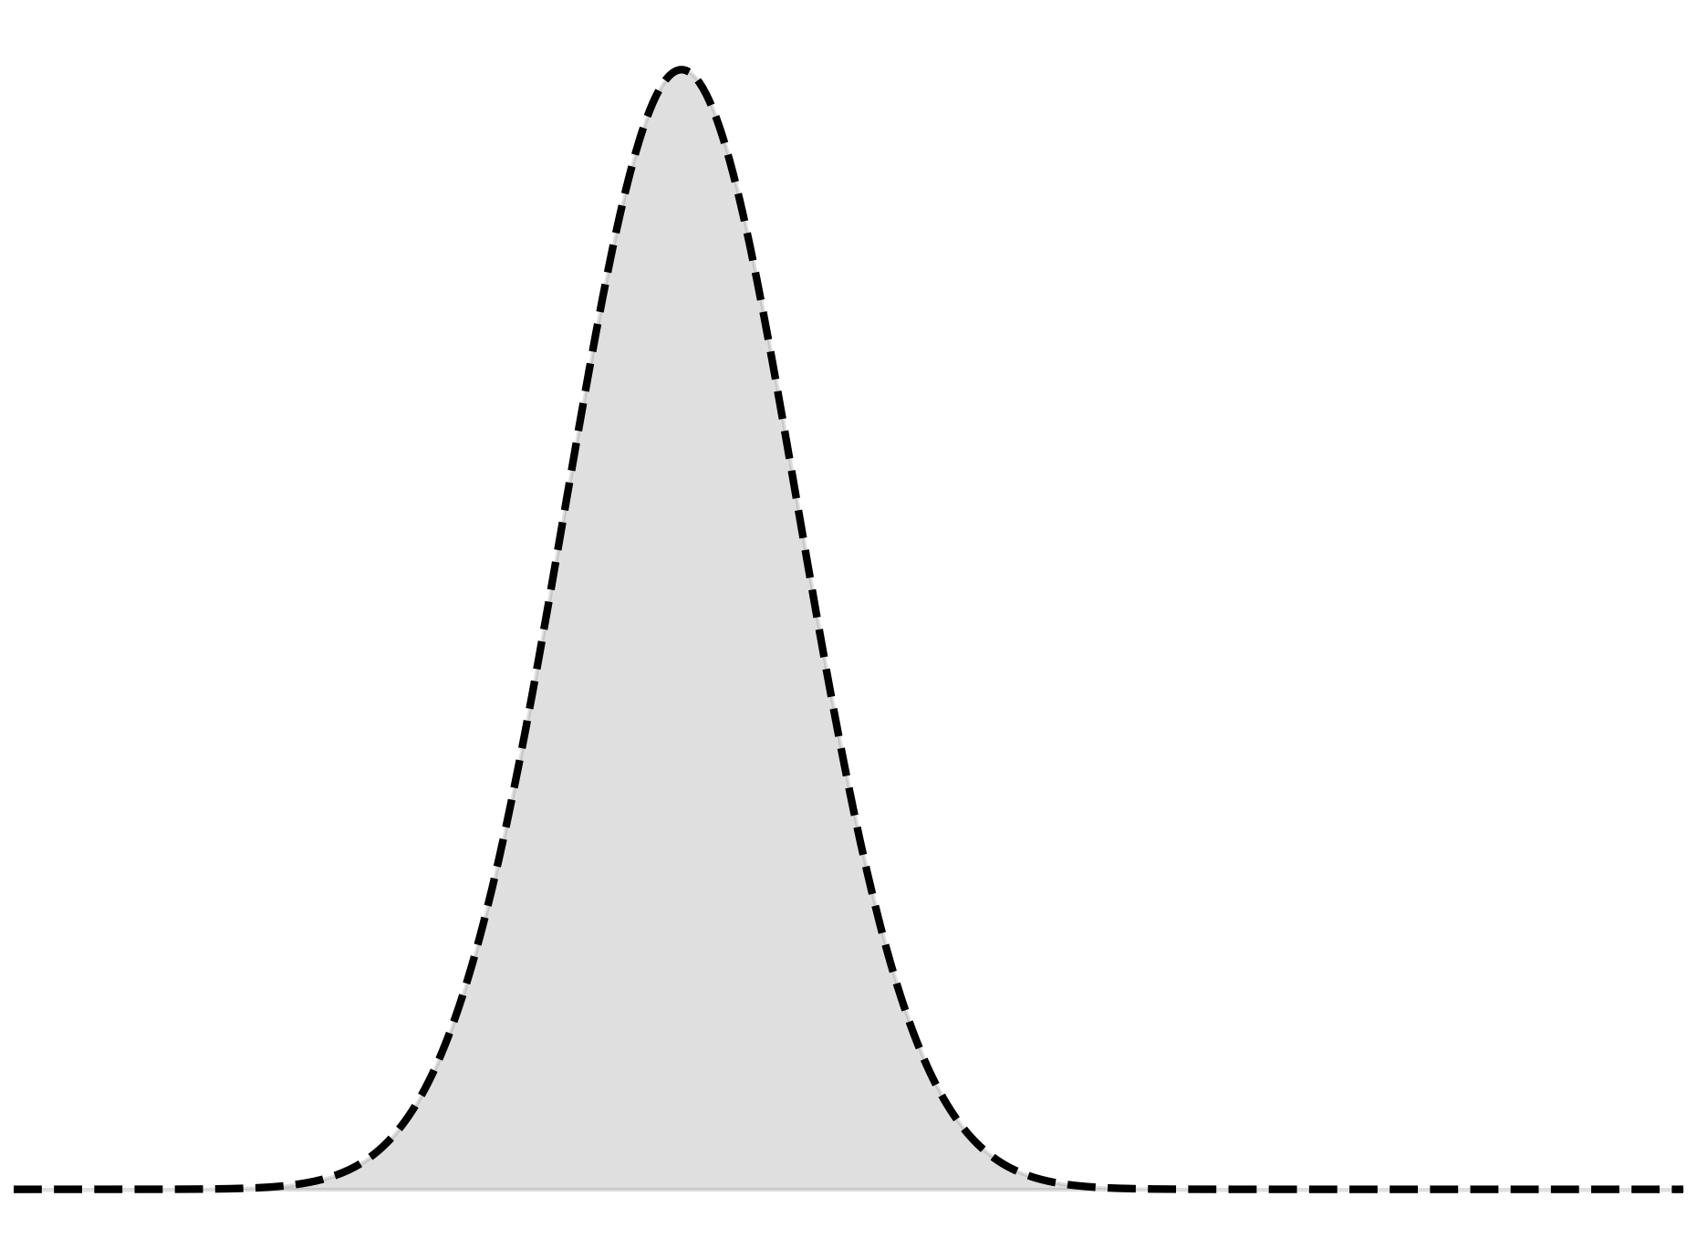
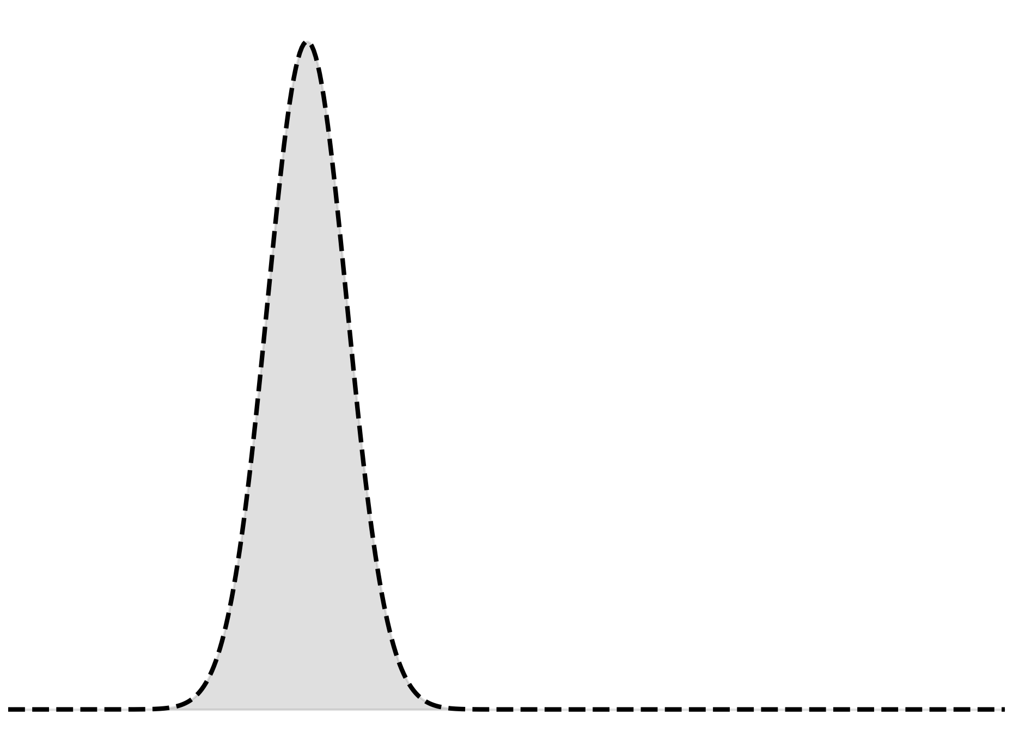
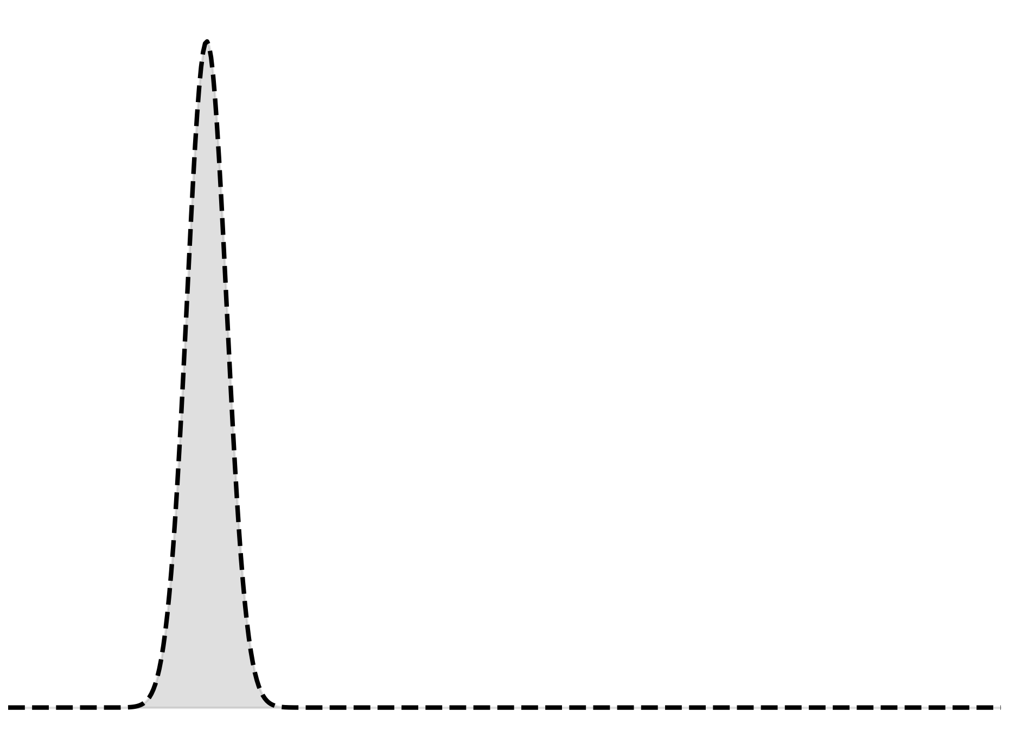


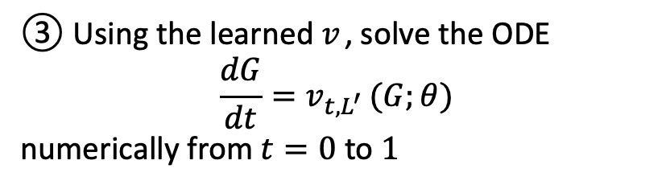






Sampling from $p(G|L)$
① Give the experimental value $L^{′}$
② Sample $G_{t=0}$from N(0, 1)
$$t=0$$
$$0$$
③ Using the learned $v_{ }$, solve the ODE
$$\frac{dG}{dt}=v_{t,L^{′} }(G;θ)$$
numerically from $t=0$ to $1$
$$G_{t=0}$$
④ The solution at $t=1$ is the estimate of $G^{′}$
$$t=1$$
Consistency check with L’
$G^{′}$?

Slide 14
Setup
Type-I seesaw mechanism (no symmetry imposed)
$$ℒ=Y_{iα}^{ν}{\overline{N}}_{i} l_{α} H − \frac{1}{2}M_{ij}{\overline{N}}_{i}{\overline{N}}_{j}+h.c.$$
Parameters G: Re/Im parts of Y (18), M absolute values (3), M phases (2)
Observables L :
$∆m_{21}^{2}, ∆m_{31}^{2},, \sin^{2}{θ_{12}},\sin^{2}{θ_{13}}$, $\sin^{2}{θ_{23}}$
Training
G: generate 10⁷ random samples, compute L → (G, L) dataset
Generation
L: specify the data, generate $3×{10}^{6}$ model parameters

Slide 15
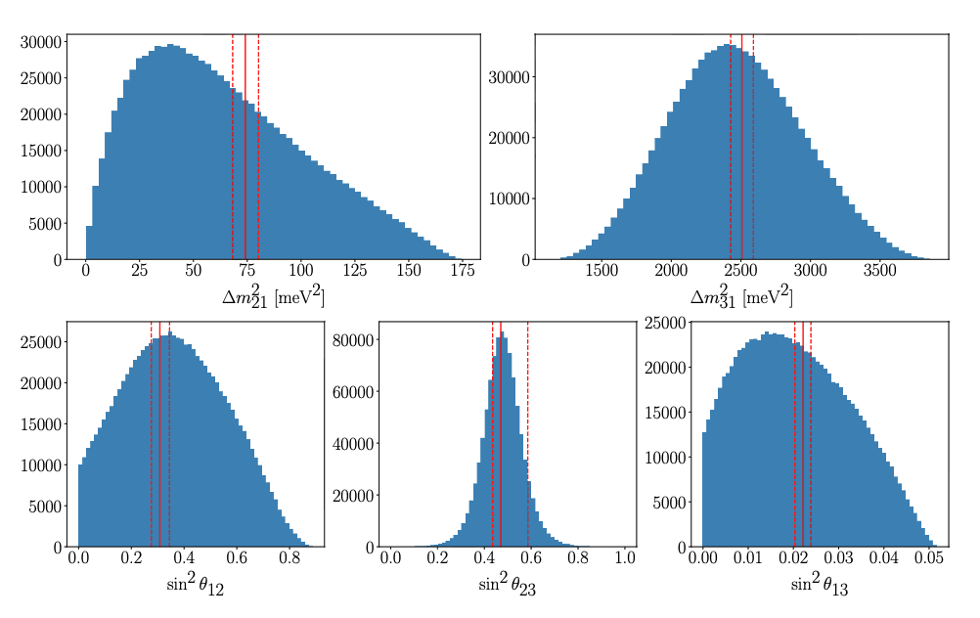
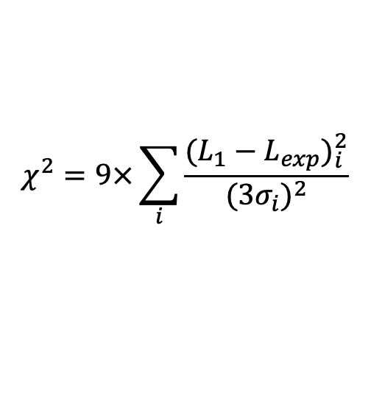


Results
Accuracy of generated $G_{1}$ is evaluated by
$$χ^{2}=9×\sum_{i}{\frac{{(L_{1}−L_{exp})}_{i}^{2}}{{(3σ_{i})}^{2}}}$$
$L=(∆m_{21}^{2}, ∆m_{31}^{2}, \sin^{2}{θ_{12}},\sin^{2}{θ_{13}}$, $\sin^{2}{θ_{23}})$
$χ^{2}<2500:956607$ samples
$χ^{2}<45:640$ samples

Slide 16

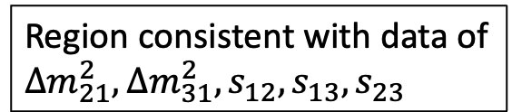
Recap
Full space of (Y, M)
①How to explore the parameter region consistent with data
Parameter search using Flow Matching
Region consistent with data of
$∆m_{21}^{2}, ∆m_{31}^{2},s_{12},s_{13},s_{23}$
②Finding nonlinear correlations among observables
Finding relations via an Autoencoder

Slide 17
Finding Relations with an Autoencoder

Slide 18
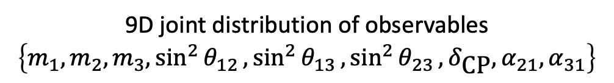




9D joint distribution of observables
$$\left\{m_{1},m_{2},m_{3},\sin^{2}{θ_{12}},\sin^{2}{θ_{13}},\sin^{2}{θ_{23}},δ_{\text{CP}},α_{21},α_{31}\right\}$$
Generated (Y, M)
$$χ^{2}<2500$$
$$χ^{2}<2500$$
$$χ^{2}<45$$
$$χ^{2}<45$$
Type I Seesaw
How can we uncover the correlations hidden in a 9-dimensional joint distribution?
Conventional
This work
Keep 2–3 observables and project out the rest.
Compress a 9D distribution to 2D
$$\left\{m_{1},m_{2},m_{3},\sin^{2}{θ_{12}},\sin^{2}{θ_{13}},\sin^{2}{θ_{23}},δ_{\text{CP}},α_{21},α_{31}\right\}$$
9D
2D

Slide 19

Compressing the 9D Distribution with an Autoencoder
9D joint distribution of observables
Input Data
$$χ^{2}<2500$$
Encoder
Decoder
Reconstruction
Latent space
(2D in this work)
Reconstruction forces the latent space to retain the essential structure

Slide 20
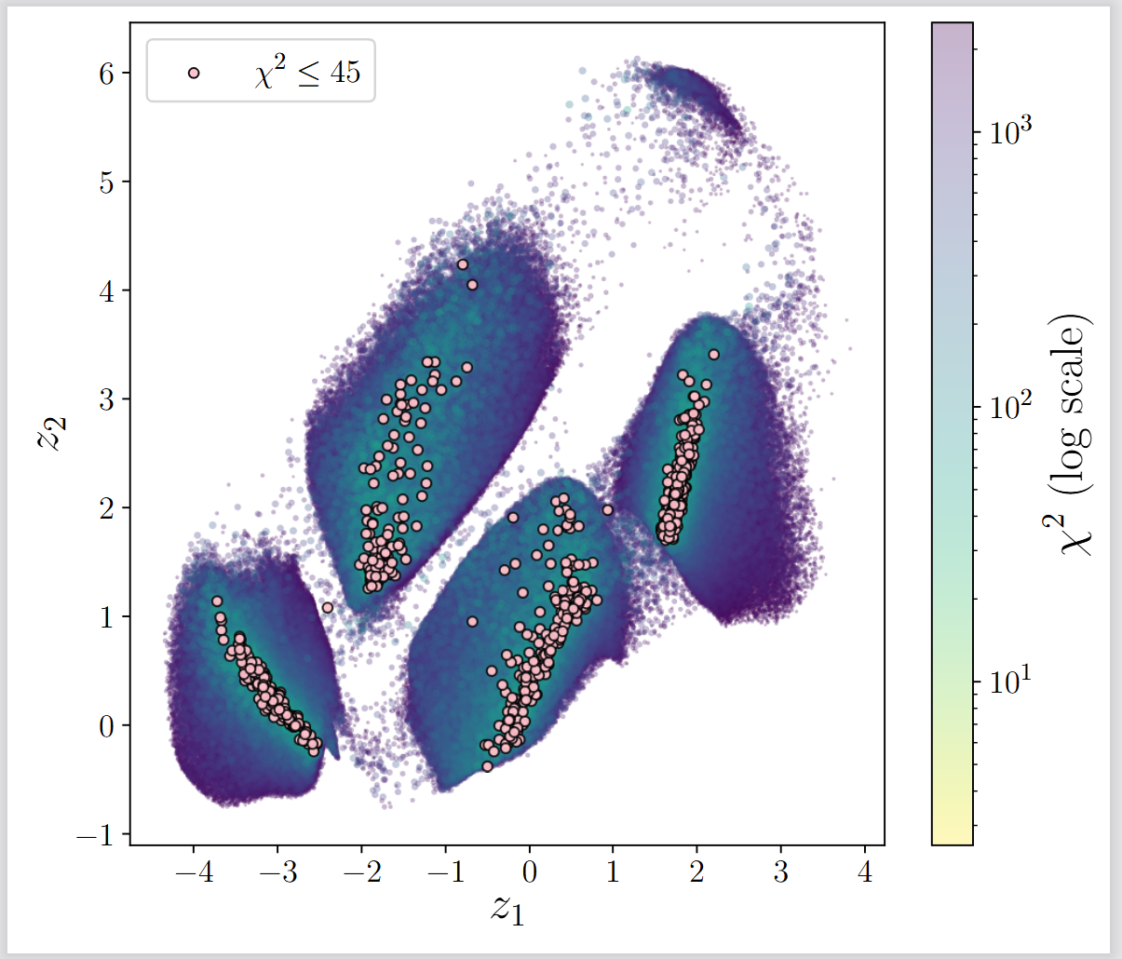

Latent space includes non-trivial features of observables data
9D distribution
$$χ^{2}<2500$$
Encoder
What separates the clusters?
Does the shape mean anything?

Slide 21
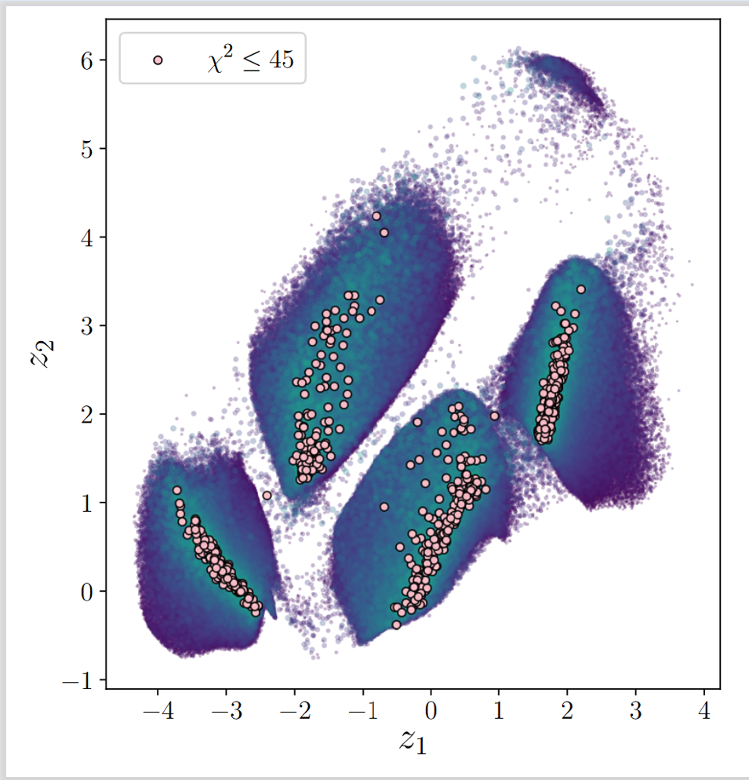
Goal: interpret latent space via observables
Pink and black points correspond
Orange surface approximates the black points

Slide 22
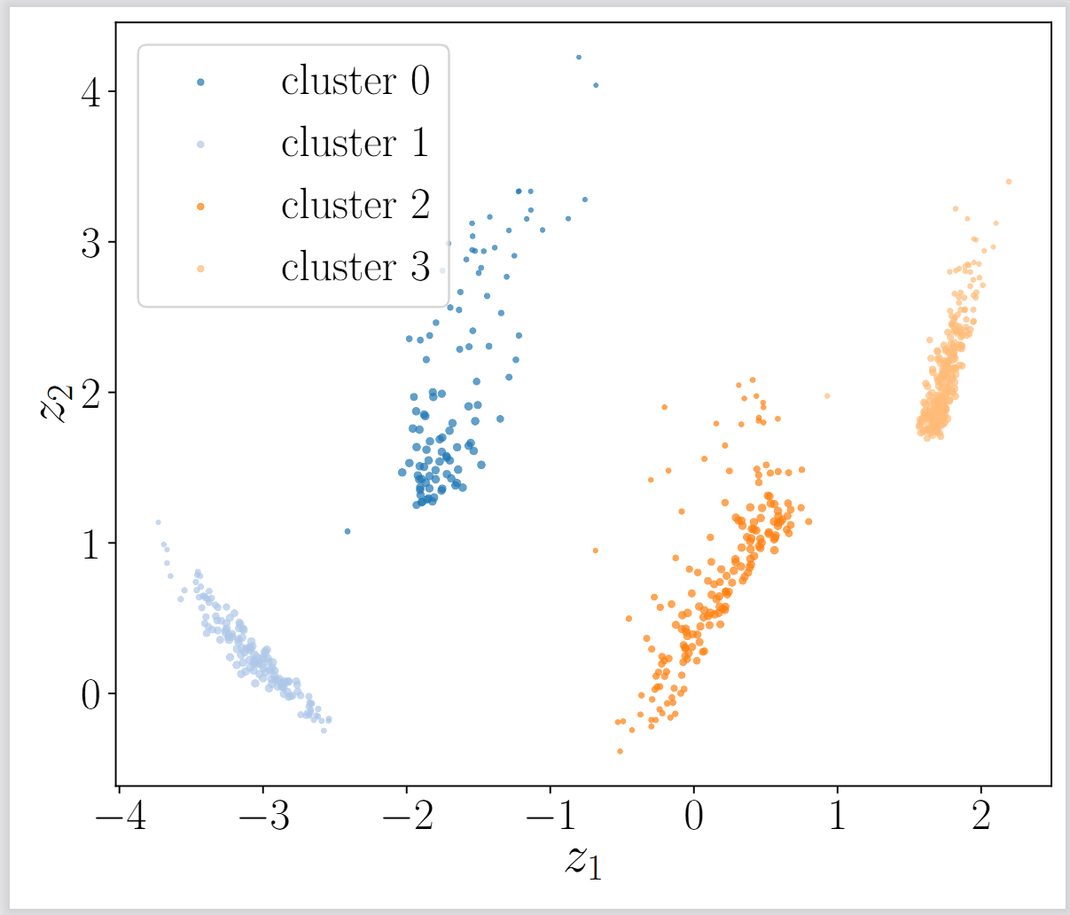
Clustering
Cluster the accurate points (pink) with HDBSCAN
What separates the clusters?

Slide 23
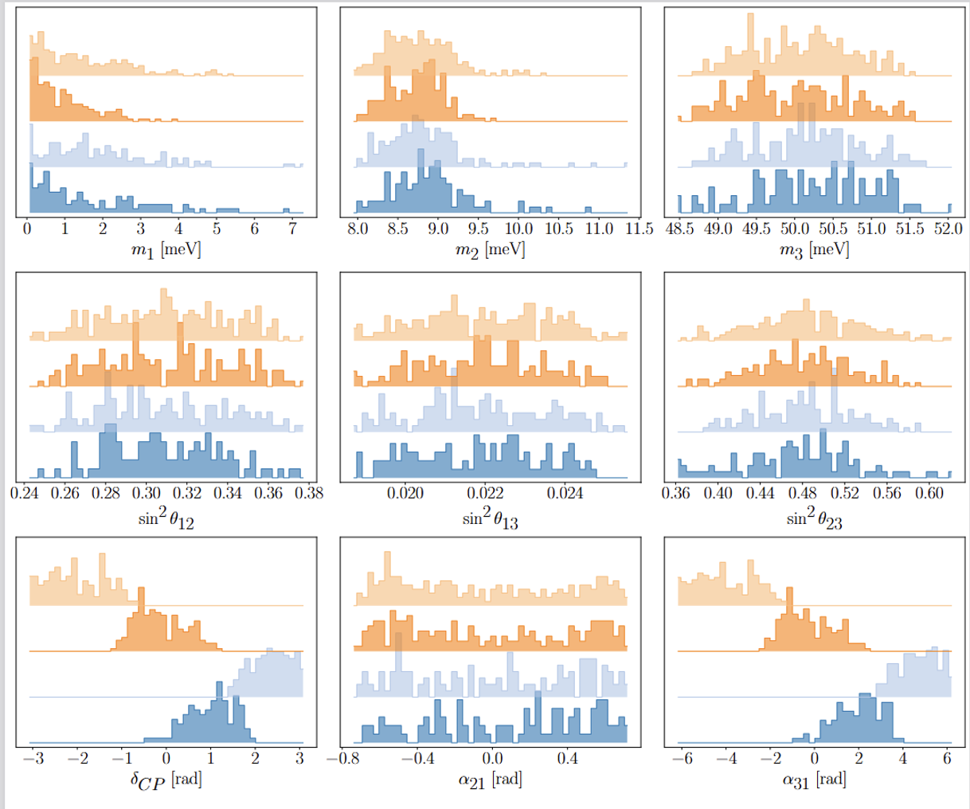

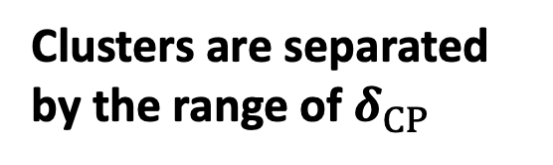
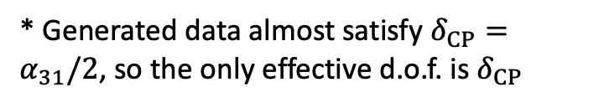
9D distribution
$$χ^{2}<45$$
Color the input distribution according to which cluster each point belongs to.
Clusters are separated by the range of $δ_{CP}$
* Generated data almost satisfy $δ_{CP}=α_{31}/2$, so the only effective d.o.f. is $δ_{CP}$

Slide 24
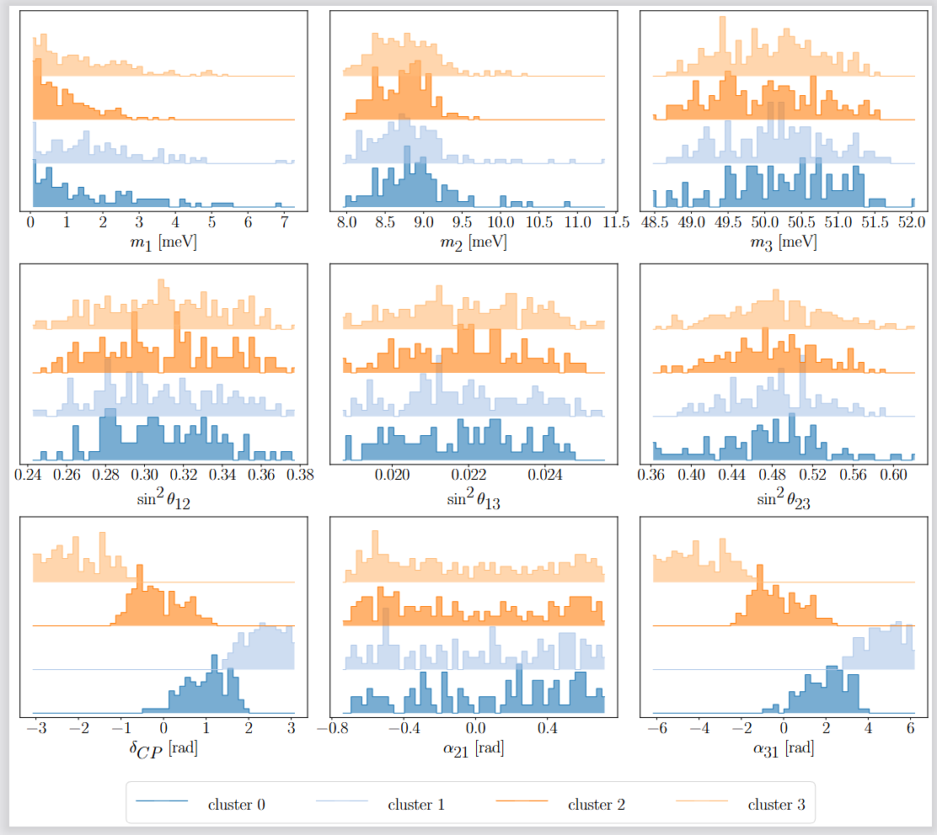
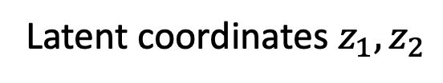
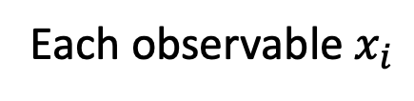
Which Observables Are Encoded in the Latent Space?
9D→2D
Compression
Regression
Each observable $x_{i}$
Latent coordinates $z_{1}, z_{2}$
Accurate prediction ⇒ $x_{i}$​ is well encoded in the latent space

Slide 25
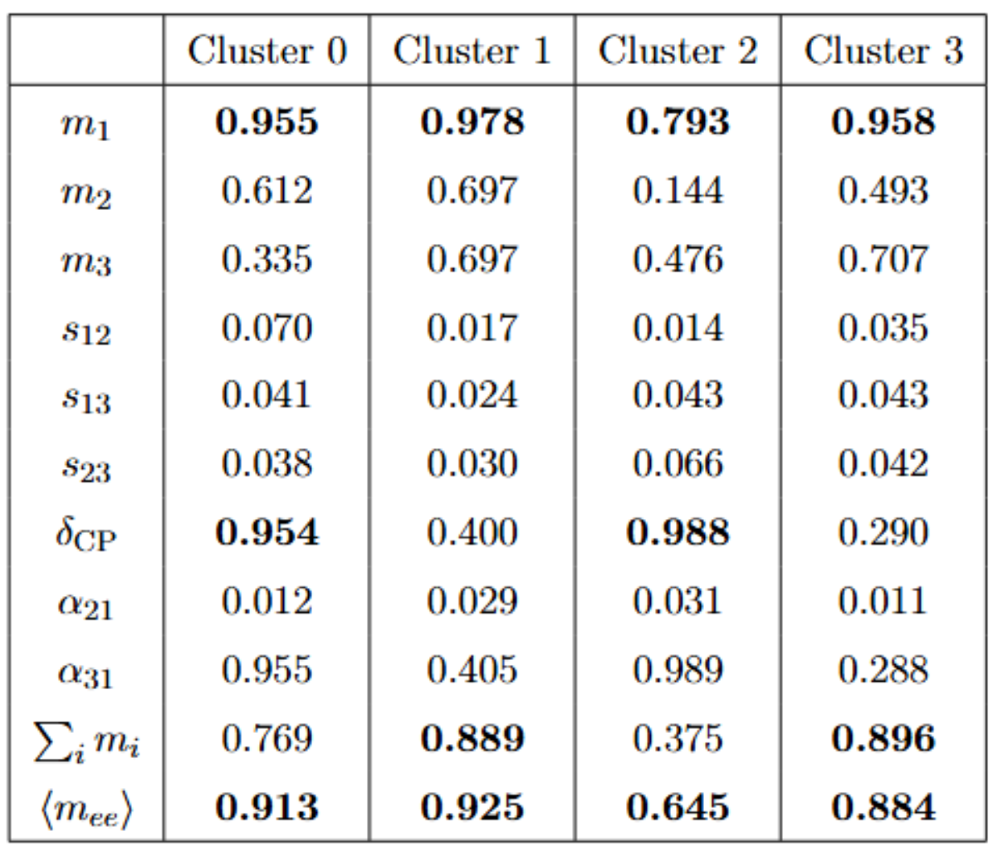
Information from regression on latent variables
Accurate prediction
Observable​ is well encoded in the latent space

Slide 26

Results
Cluster0: ${−0.47≤δ}_{CP}≤1.92$
$$m_{1}=2.72z_{1}^{2}+1.00z_{2}^{2}+0.77z_{1}z_{2}−2.36z_{1}+1.57z_{2}−0.02$$
$$\left\langle m_{ee}\right\rangle =4.58z_{1}^{2}+0.73z_{2}^{2}−1.38z_{1}z_{2}+4.58z_{1}−3.54z_{2}+8.79$$
$$δ_{CP}=−0.74z_{1}^{2}−0.02z_{2}^{2}−1.38z_{1}z_{2}+4.58z_{1}−3.54z_{2}+8.79$$
  Three observables can be described by two latent parameters
Sum rule $F\left(m_{1},\left\langle m_{ee}\right\rangle ,δ_{CP}\right)=0$

Slide 27
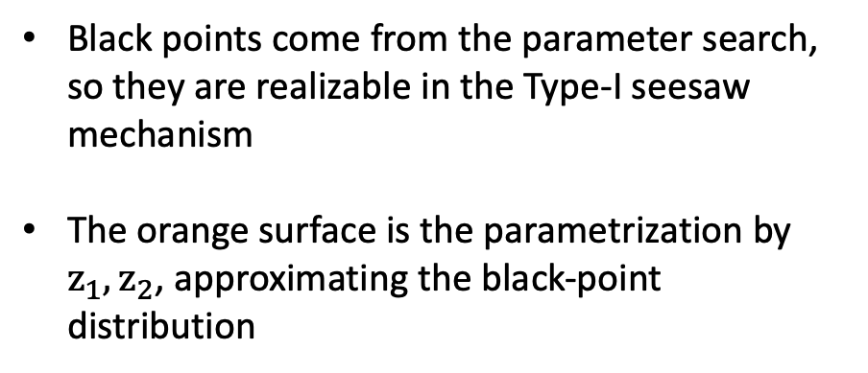
Results
  Three observables lie on a 2D surface
Black points come from the parameter search, so they are realizable in the Type-I seesaw mechanism
The orange surface is the parametrization by $z_{1},z_{2}$, approximating the black-point distribution

Slide 28
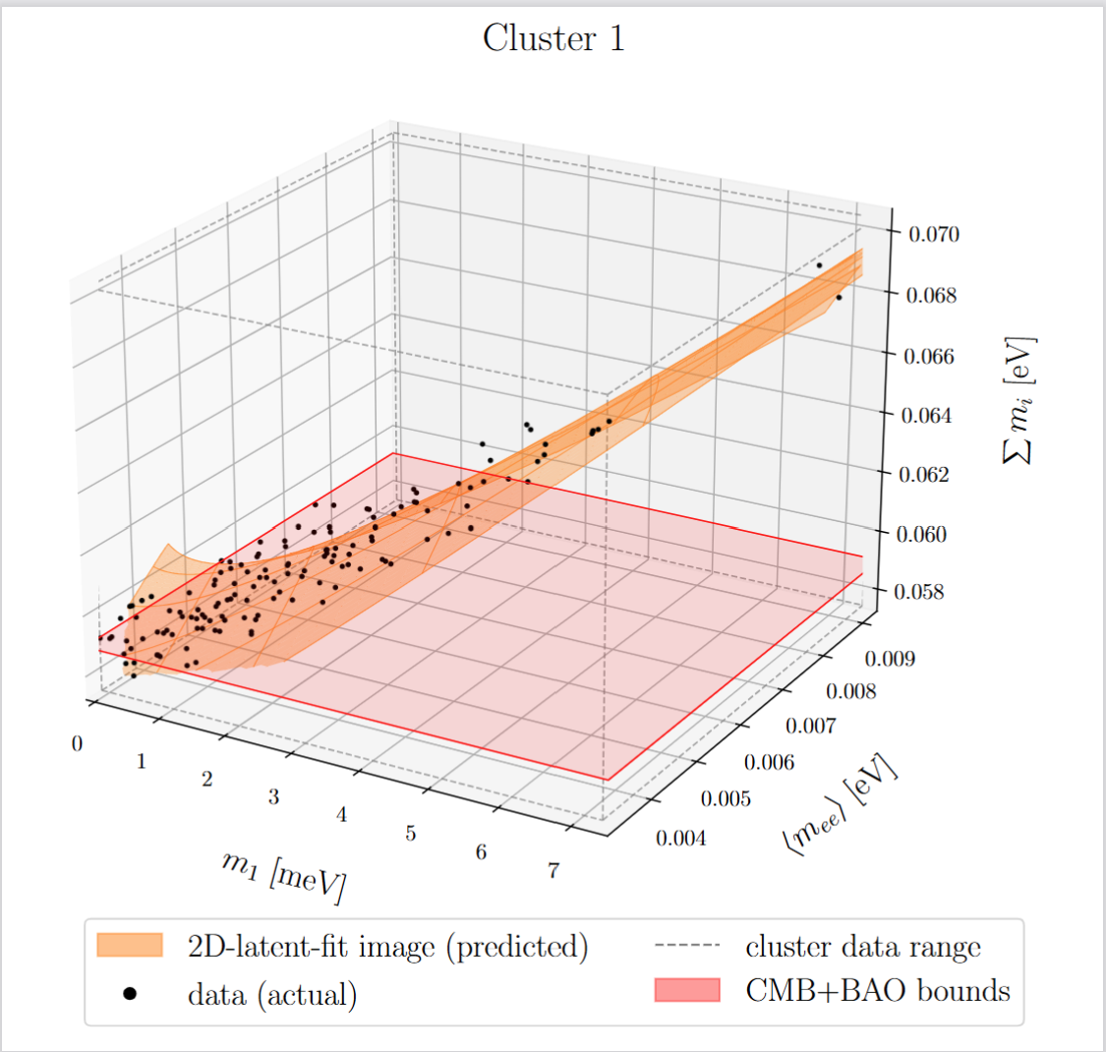
Results
Cluster1: ${1.43≤δ}_{CP}≤3.14$
$$m_{1}=2.72z_{1}^{2}+1.00z_{2}^{2}+0.77z_{1}z_{2}−2.36z_{1}+1.57z_{2}−0.02$$
$$\left\langle m_{ee}\right\rangle =4.58z_{1}^{2}+0.73z_{2}^{2}−1.38z_{1}z_{2}+4.58z_{1}−3.54z_{2}+8.79$$
$$\sum_{i}{m_{i}}=−0.74z_{1}^{2}−0.02z_{2}^{2}−1.38z_{1}z_{2}+4.58z_{1}−3.54z_{2}+8.79$$

Slide 29
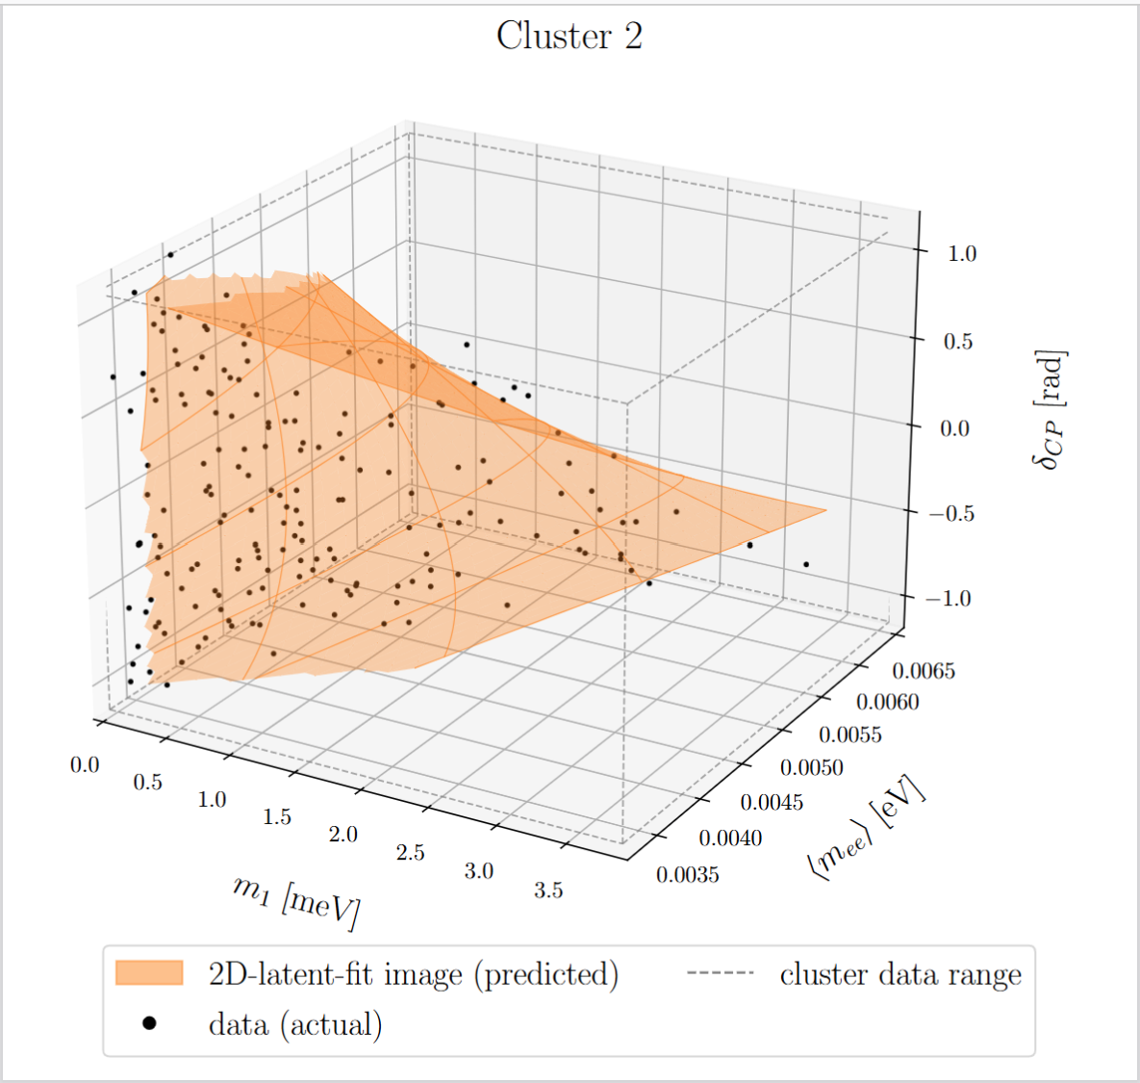
Results
Cluster2: $−1.14{≤δ}_{CP}≤1.17$
$$m_{1}=2.72z_{1}^{2}+1.00z_{2}^{2}+0.77z_{1}z_{2}−2.36z_{1}+1.57z_{2}−0.02$$
$$\left\langle m_{ee}\right\rangle =4.58z_{1}^{2}+0.73z_{2}^{2}−1.38z_{1}z_{2}+4.58z_{1}−3.54z_{2}+8.79$$
$$δ_{CP}=−0.74z_{1}^{2}−0.02z_{2}^{2}−1.38z_{1}z_{2}+4.58z_{1}−3.54z_{2}+8.79$$

Slide 30
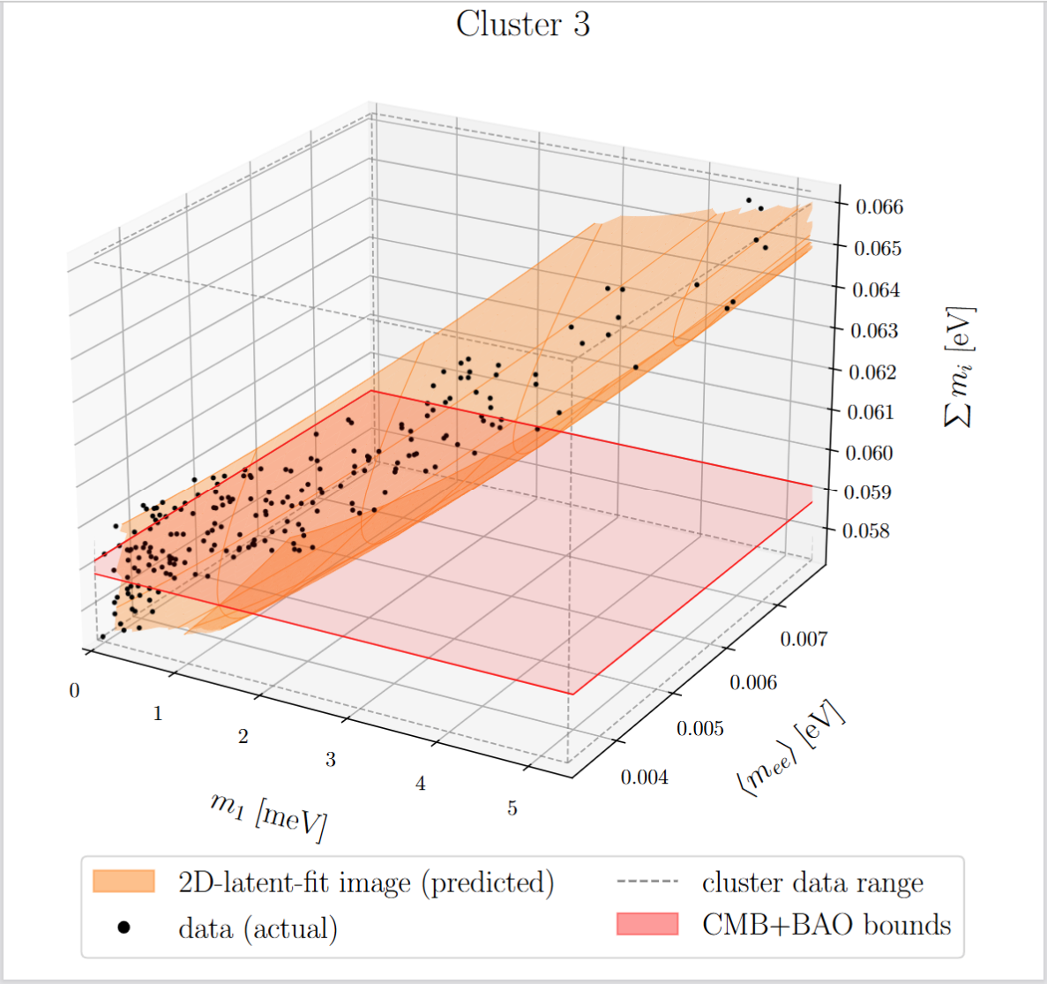
Results
Cluster3: $−3.13{≤δ}_{CP}≤−0.642$
$$m_{1}=2.72z_{1}^{2}+1.00z_{2}^{2}+0.77z_{1}z_{2}−2.36z_{1}+1.57z_{2}−0.02$$
$$\left\langle m_{ee}\right\rangle =4.58z_{1}^{2}+0.73z_{2}^{2}−1.38z_{1}z_{2}+4.58z_{1}−3.54z_{2}+8.79$$
$$\sum_{i}{m_{i}}=−0.74z_{1}^{2}−0.02z_{2}^{2}−1.38z_{1}z_{2}+4.58z_{1}−3.54z_{2}+8.79$$

Slide 31
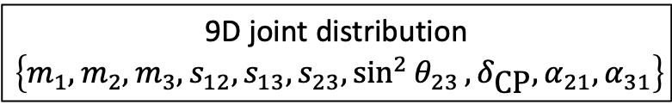
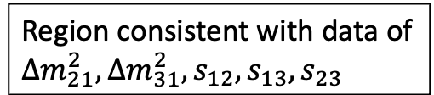
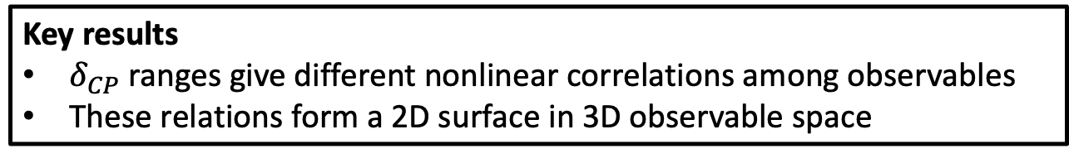
Summary
Full space of (Y, M)
①How to explore the parameter region consistent with data
Parameter search using Flow Matching
Region consistent with data of
$∆m_{21}^{2}, ∆m_{31}^{2},s_{12},s_{13},s_{23}$
9D joint distribution
$$\left\{m_{1},m_{2},m_{3},s_{12},s_{13},s_{23},\sin^{2}{θ_{23}},δ_{\text{CP}},α_{21},α_{31}\right\}$$
②Finding nonlinear correlations among observables
Finding relations via an Autoencoder
Key results
$δ_{CP}$ ranges give different nonlinear correlations among observables
These relations form a 2D surface in 3D observable space

