Slide 1

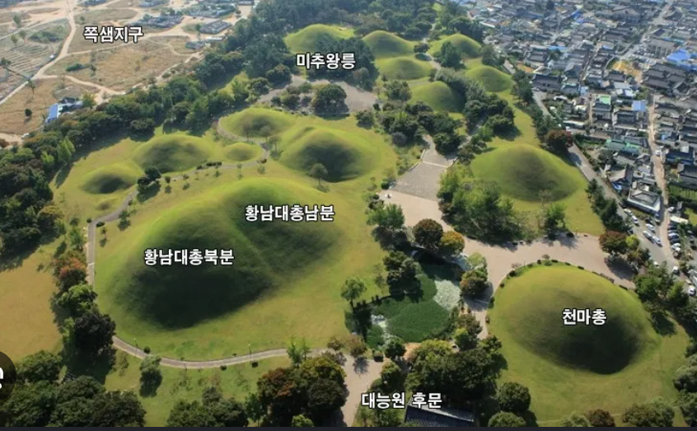

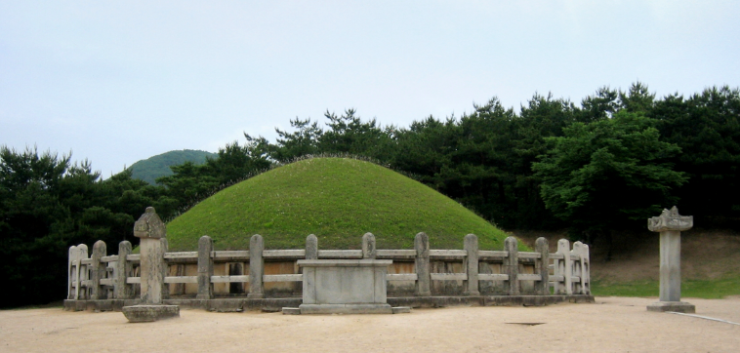
Beyond the Beam-Dump Ceiling:
Probing Light Dark Photons at the LHC
Doojin Kim
(doojin.kim@usd.edu)
Flavor Symmetries and Consequences in Accelerators and Cosmology
Gyeongju, Korea
August 19th, 2026
Based on the work done by Dutta, DK, Kim, PLB 861 (2025) 139246;
Dutta, Karthikeyan, DK, Kim, Kim, to appear soon

Slide 2
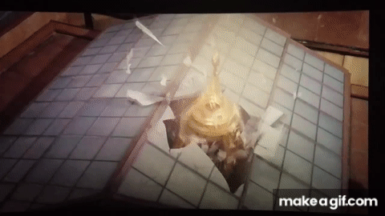
Let’s Break the Ceiling!
[Willy Wonka & the Chocolate Factory – “Glass Elevator Scene”]

Slide 3
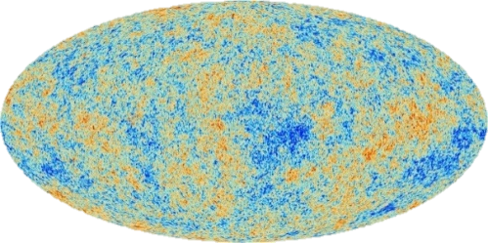
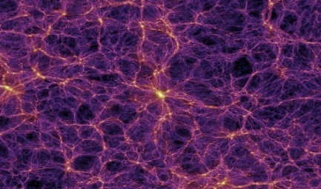
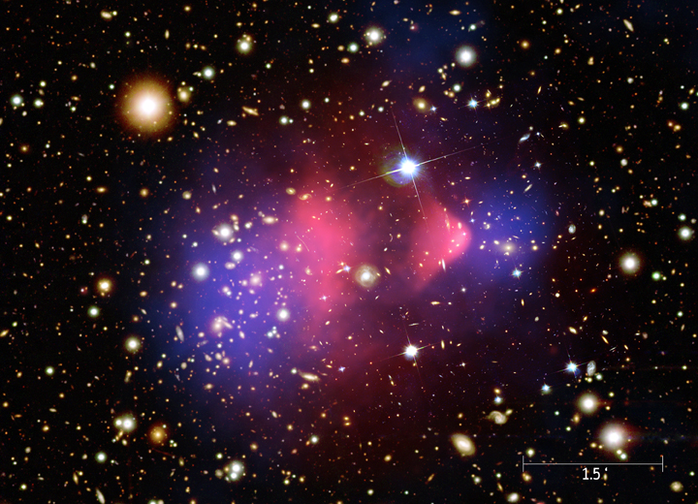
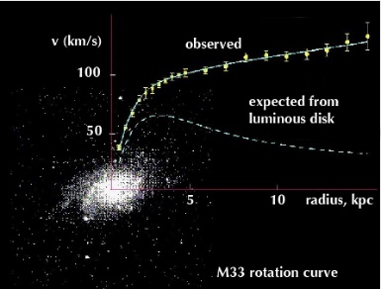
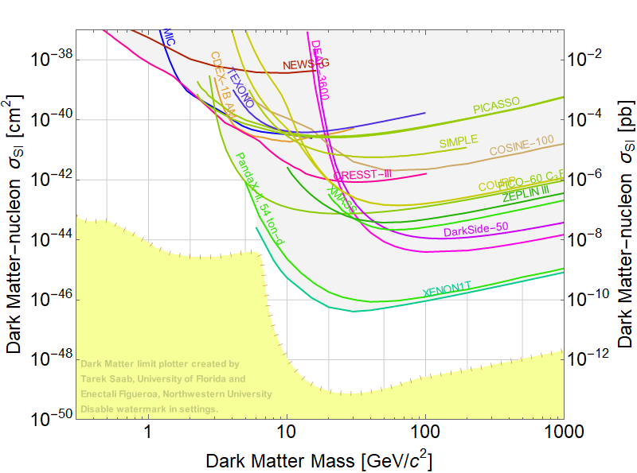
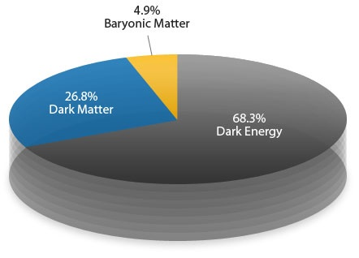
Why Look for Light New Mediators?
Larger scale
Earlier universe
Smaller scale
Later universe
No compelling evidence for weak-scale new physics so far
New physics may live at much lower scales
Various anomalies that could be explained by light mediators

Slide 4

Portal Scenario and Emergence of MeV-Range BSM Physics
SM (Visible)
Sector
Dark
Sector
Portal
(mediator or dark-force carrier)
Scalar portal (e.g., Higgs portal)
Pseudoscalar portal (e.g., ALP portal)
Neutrino portal (e.g., heavy neutral lepton)
Vector portal (e.g., dark photon)
Theoretically, feebly-interacting MeV – (sub)GeV scale (≪ TeV) mediators (new force carries) and dark matter are well motivated.

Slide 5

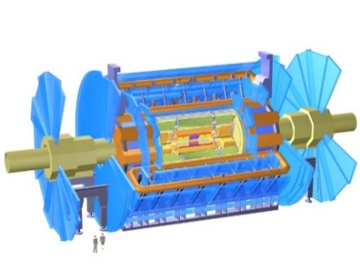

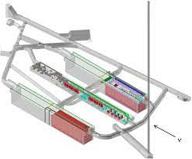
MeV-Scale Physics at Intensity Facilities
Energy-frontier facilities are not essential for exploring MeV-scale physics.
Intensity-frontier facilities are better motivated as they provide large enough intensity and large enough beam energy to produce feebly-interacting MeV-range particles. (e.g., DUNE, SHiP, NA64, SeaQuest, CCM, etc)

Slide 6
Beam-Dump Ceiling

Slide 7







Visibly Decaying Light Mediators in Beam-Dump Exp.: ALP Case Study
$$π^{0}/η$$
$$γ$$
Target/Dump
Detector
Beam
$$γ$$
$$γ$$
$$e$$
$$γ$$
$$a$$
$$γ$$
$$N$$
$$N$$
…
Meson decays
E&M showers
…
ALP production by
Primakoff process
ALP detection by
its decay to two photons
Production of photons

Slide 8
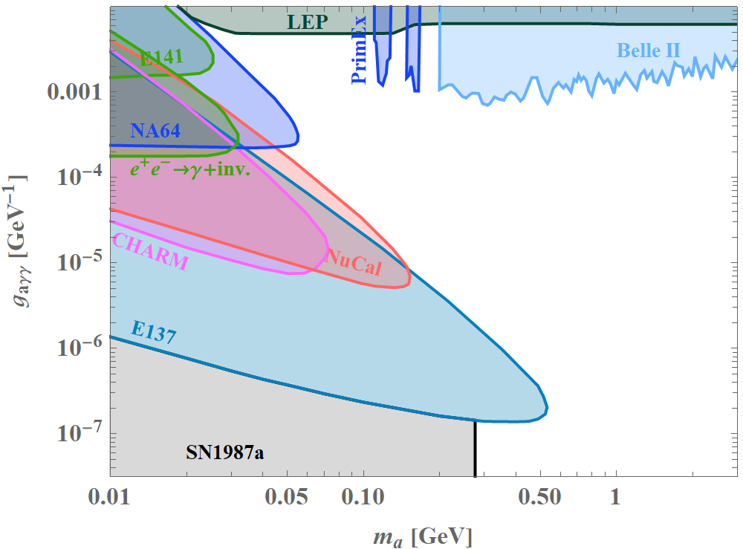
Existing Efforts in the Search for ALPs
We want to go further toward the upper-right region.
Large coupling & large mass ⇒ promptly decaying ALP
[E.g., A review on axions/ALPs, Fortin, Guo, Harris, DK, Sinha, Sun, arXiv:2102.12503]

Slide 9
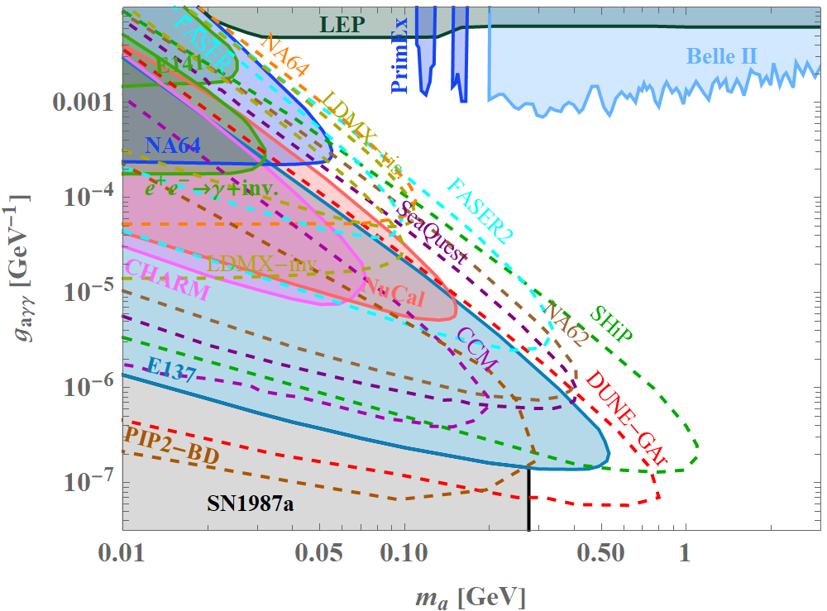
Planned Other (Beam-Dump-Type) Experiments
Can we go even further?
[E.g., A review on axions/ALPs, Fortin, Guo, Harris, DK, Sinha, Sun, arXiv:2102.12503]

Slide 10
Increasing Statistics?
Any barrier?
scattering
decay
Expanding in increasing statistics!
[Brdar, Dutta, Jang, DK, Shoemaker, Tabrizi, Thompson, Yu, PRL (2021)]

Slide 11
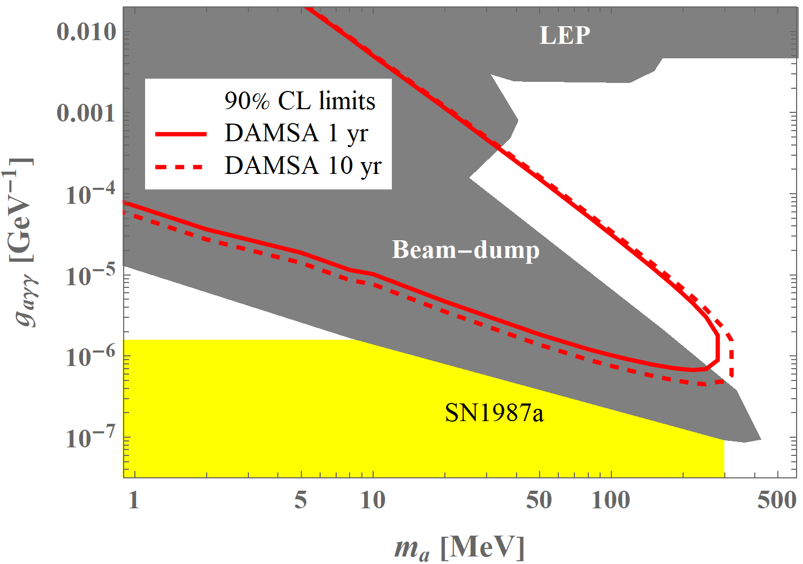
Placing a Detector Closer to the Target?
Still barrier!
[Jang, DK, Kong, Kwon, Park, Ryu, Shin, Van de Water, Yang, Yu, PRD (2023)]

Slide 12


Detection Probability
Target/Dump
Detector
$$L$$
$$∆L$$
$\tilde{l}$: lab-frame mean decay length of the mediator of interest

Slide 13


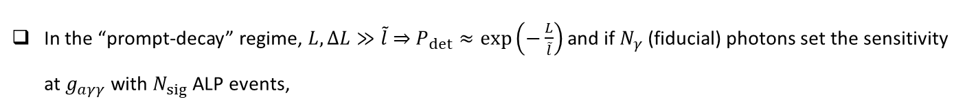
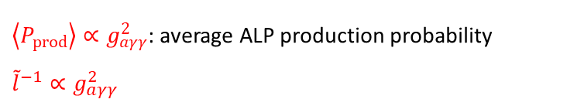
Beam-Dump “Ceiling”
In the “prompt-decay” regime, $L, ∆L≫\tilde{l}$ ⇒ $P_{det}≈\exp\left(−\frac{L}{\tilde{l}}\right)$ and if $N_{γ}$ (fiducial) photons set the sensitivity at $g_{aγγ}$ with $N_{sig}$ ALP events,
$$N_{sig}=N_{γ}\left\langle P_{prod}\right\rangle \exp\left(−\frac{L}{\tilde{l}}\right)$$
$\left\langle P_{prod}\right\rangle ∝g_{aγγ}^{2}$: average ALP production probability
${\tilde{l}}^{−1}∝g_{aγγ}^{2}$
If new reach $g_{aγγ}^{′}$ is achieved with $x$ times more statistics,
[Dutta, DK, Kim, PLB (2025)]
For large background scenarios, $\log{x}→\log{\sqrt{x}}$

Slide 14
Implications
Good News:
  Sensitivity reaches quickly saturate in the prompt-decay regime.
  Long-time data collection is not necessary.
Bad News:
  Accessing the parameter space beyond the beam-dump “ceiling” is not possible without an impractical increase of data acquisition.

Slide 15

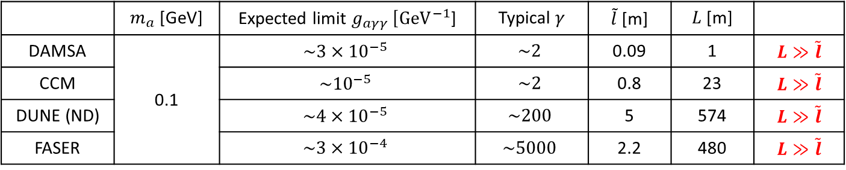
Breaking the “Ceiling”
 | $m_{a}$ [GeV] | Expected limit $g_{aγγ}$ [${GeV}^{−1}$] | Typical $γ$ | $\tilde{l}$ [m] | $L$ [m]
DAMSA | 0.1 | $${\sim 3×10}^{−5}$$ | $$\sim 2$$ | 0.09 | 1 | $L≫\tilde{l}$
CCM | 0.1 | $$\sim {10}^{−5}$$ | $$\sim 2$$ | 0.8 | 23 | $L≫\tilde{l}$
DUNE (ND) |  | $${\sim 4×10}^{−5}$$ | $$\sim 200$$ | 5 | 574 | $L≫\tilde{l}$
FASER |  | $${\sim 3×10}^{−4}$$ | $$\sim 5000$$ | 2.2 | 480 | $L≫\tilde{l}$
⇒ Planned experiments will quickly hit their beam-dump ceiling!
Breaking the “ceiling”? $\tilde{l}/L$ is not too small!
  1) Detector is extremely close.
  2) Boost factor is extremely large.
and/or

Slide 16
LHC “Beam-Dump”

Slide 17
Beam-Dump Measurement at LHC Detectors
$$π^{0}/η$$
$$γ$$
Target/Dump
Detector
Beam
$$γ$$
$$γ$$
$$e$$
$$γ$$
$$a$$
$$γ$$
$$N$$
$$N$$
…
Meson decays
E&M showers
…
ALP production by
Primakoff process
ALP detection by
its decay to two photons
Production of photons
Hadrons from jets
Calorimeters
Muon system

Slide 18
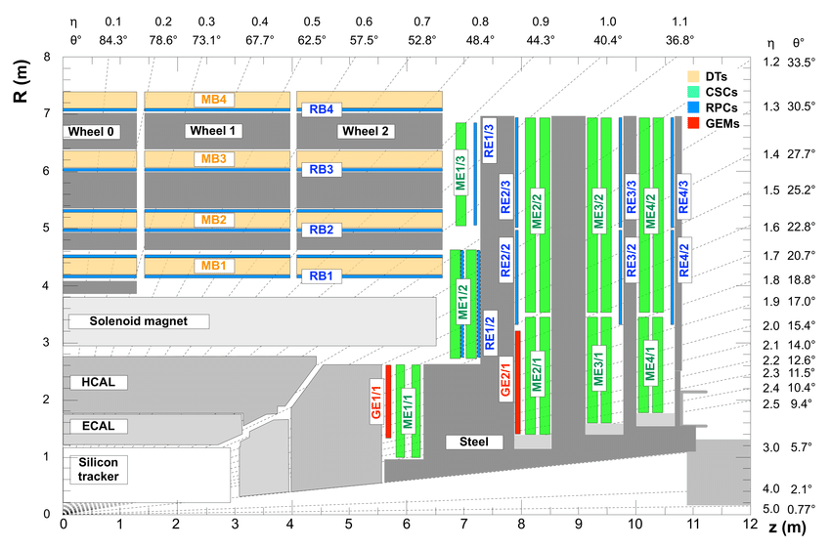
Beam-Dump Measurement at CMS

Slide 19
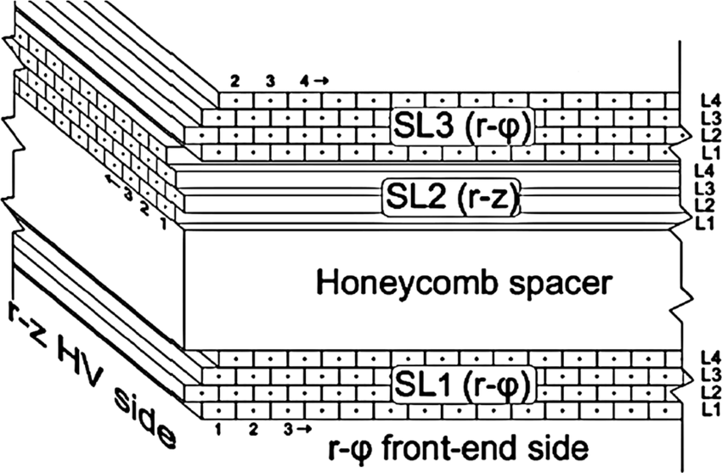
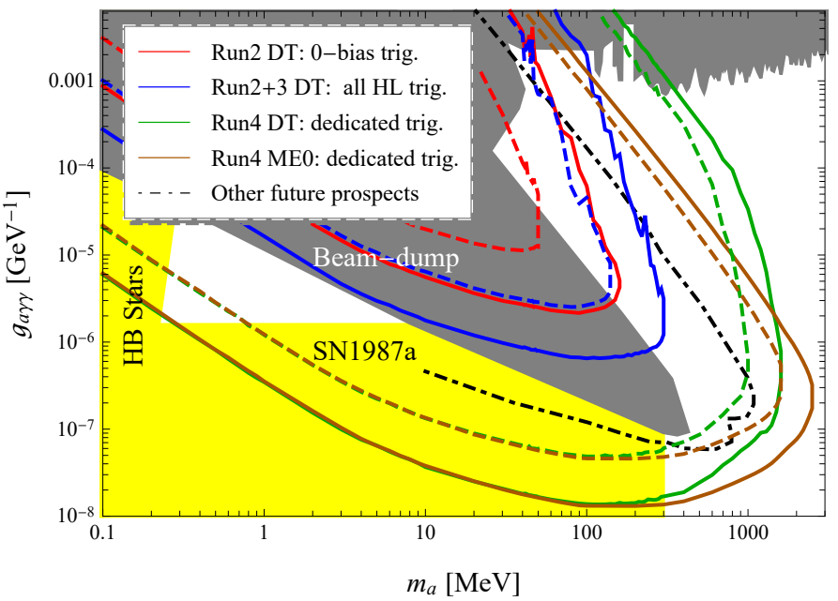
Signal Detection at Drift Tube Chambers and Sensitivity Prospect
[Dutta, DK, Kim, PLB (2025)]

Slide 20
Turning the Concept into a Realistic Search
What is the most realistic first target?
sizable production rate
experimentally recognizable final state
controllable backgrounds with existing CMS capabilities
Any low-hanging fruits (with dark-photon mediator)?

Slide 21
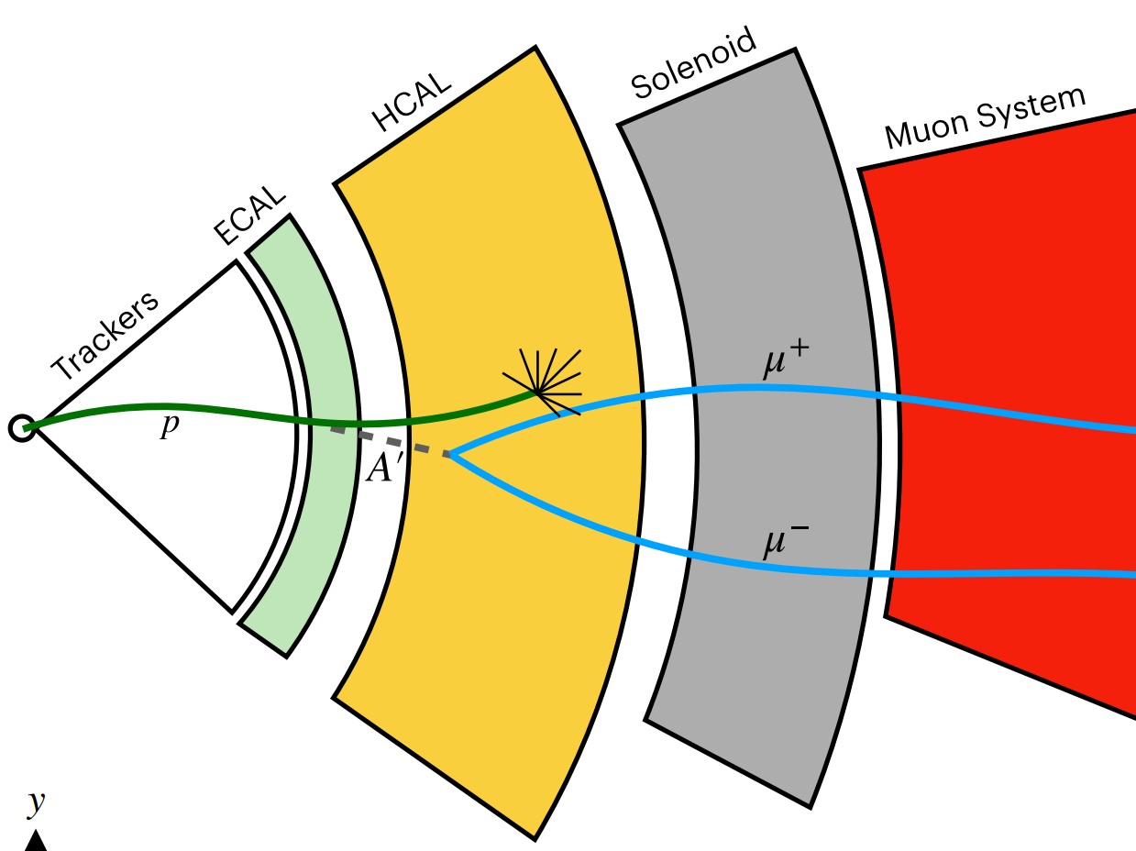
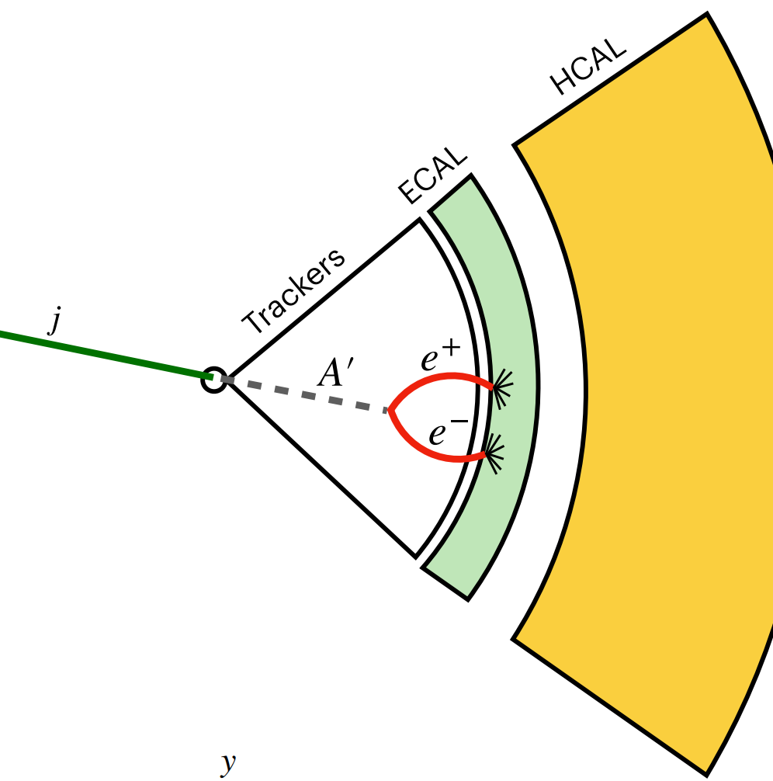
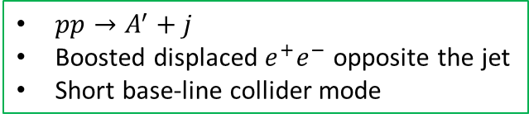
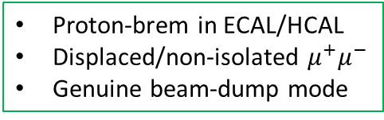
Two Ways to Exploit the LHC Geometry
Channel 1: proton brem
Channel 2: Associated prod.
Proton-brem in ECAL/HCAL
Displaced/non-isolated $μ^{+}μ^{−}$
Genuine beam-dump mode
$pp→A^{′}+j$
Boosted displaced $e^{+}e^{−}$ opposite the jet
Short base-line collider mode
Short source-to-detector distance
Displaced visible decays
Existing CMS trigger/reco. handles
[Image courtesy of Deepak Sathyan]

Slide 22
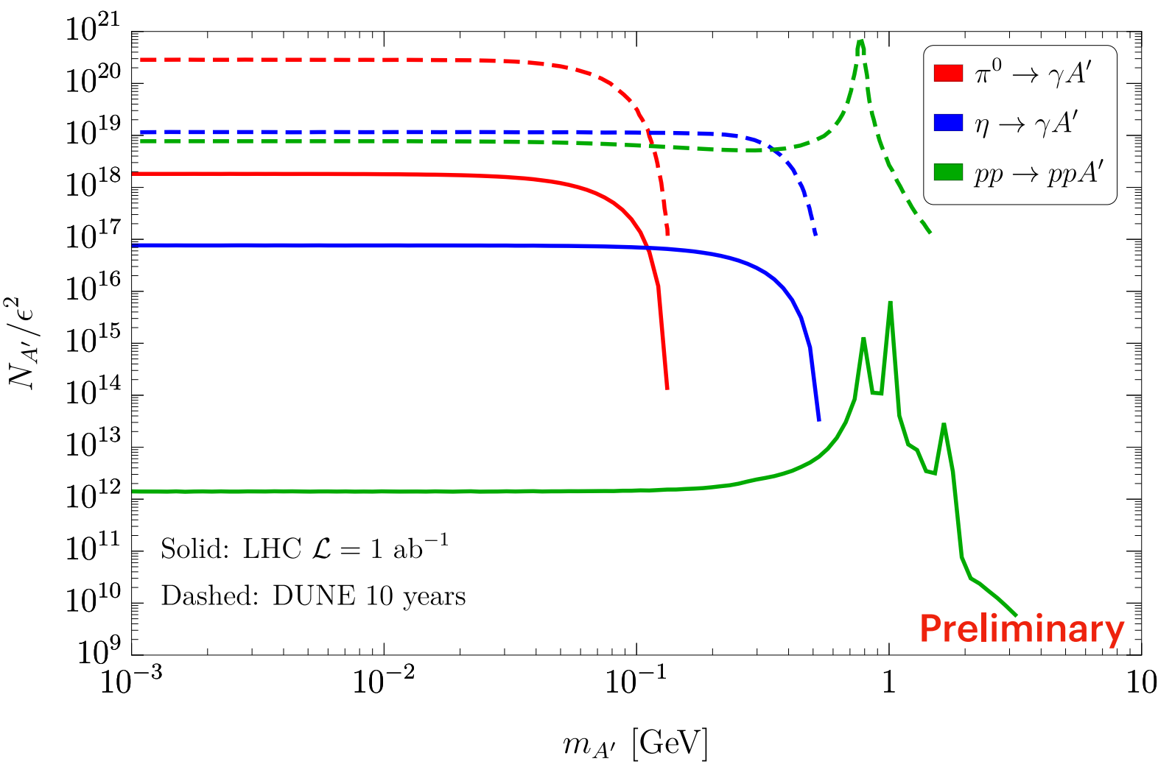
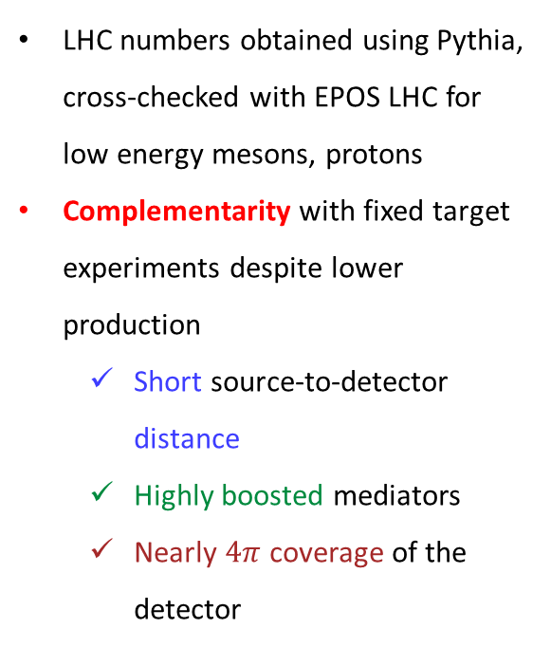
Channel I: Proton Bremsstrahlung
LHC numbers obtained using Pythia, cross-checked with EPOS LHC for low energy mesons, protons
Complementarity with fixed target experiments despite lower production
  Short source-to-detector distance
  Highly boosted mediators
  Nearly $4π$ coverage of the detector
Proton-brem calculation based on
[Foroughi-Abari, Reimitz, Ritz, PRD (2025)]

Slide 23
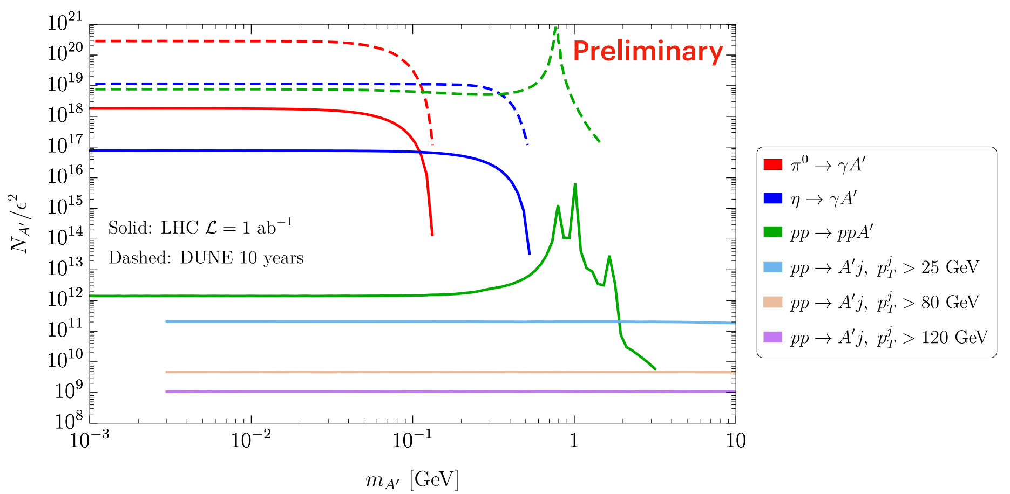

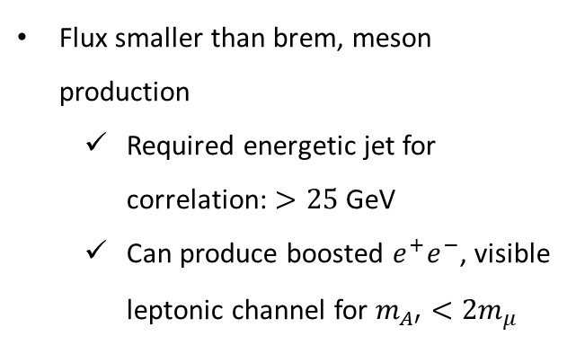
Channel II: Associated Production
LHC can produce MeV-GeV scale $A’$ with ISR jet
Flux smaller than brem, meson production
  Required energetic jet for correlation: $>25$GeV
  Can produce boosted $e^{+}e^{−}$, visible leptonic channel for $m_{A′}<2m_{μ}$
[Estimates produced with MadGraph5]

Slide 24
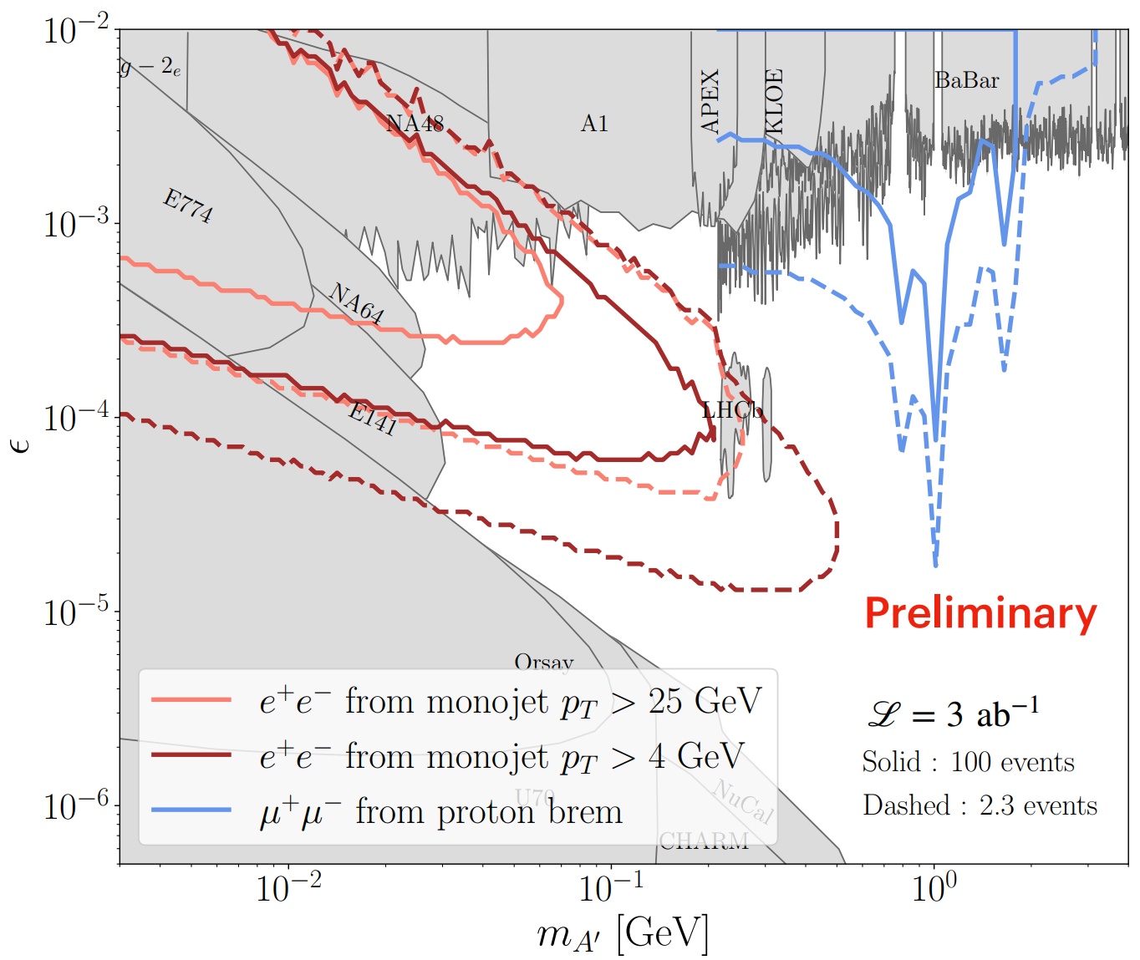
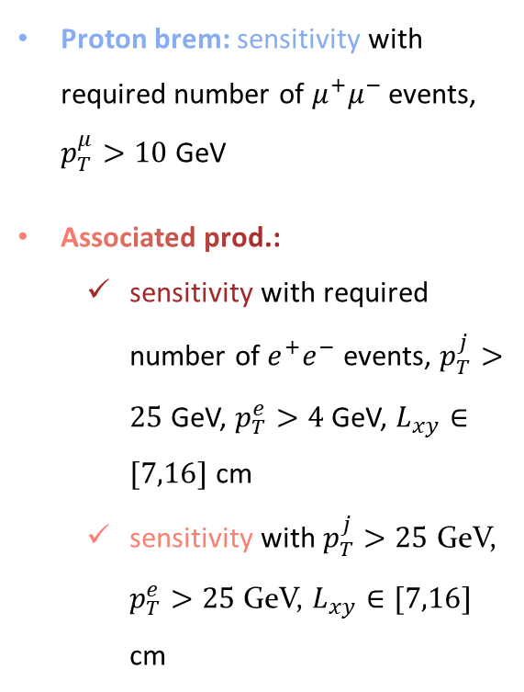
Projected Sensitivity
Proton brem: sensitivity with required number of $μ^{+}μ^{−}$ events, $p_{T}^{μ}>10$ GeV
Associated prod.:
  sensitivity with required number of $e^{+}e^{−}$ events, $p_{T}^{j}>25$ GeV, $p_{T}^{e}>4$ GeV, $L_{xy}∈[7,16]$ cm
  sensitivity with $p_{T}^{j}>25$ GeV, $p_{T}^{e}>25$ GeV, $L_{xy}∈[7,16]$ cm

Slide 25
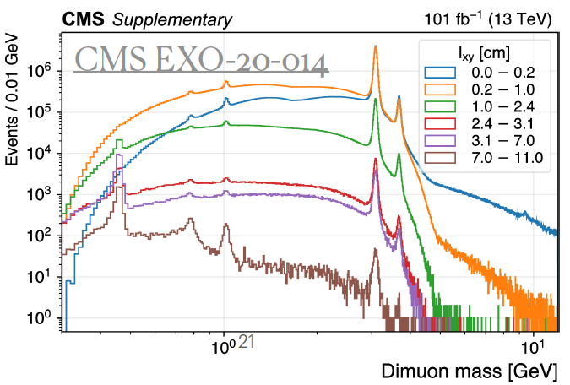
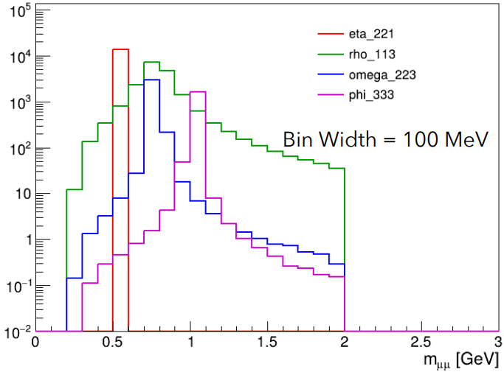
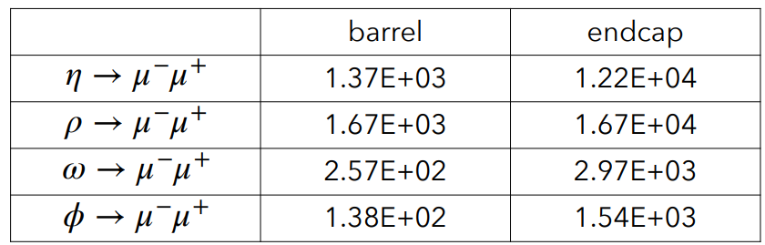


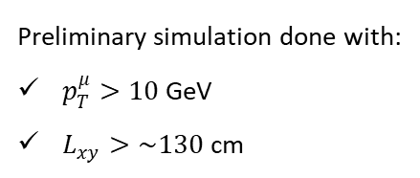
Preliminary Background Estimates
(1 ${ab}^{−1}$)
Preliminary simulation done with:
$p_{T}^{μ}>10$ GeV
$L_{xy}>\sim 130$ cm
Additional handles under investigation:
  Dimuon angle from the jet direction
  Number of protons inside a jet (upon dedicated proton ID in a jet)
$𝒪(10)$ to a few hundreds background events would be achievable.

Slide 26
Can the LHC Be Sensitive to Light Mediator Signals?
Short answer: We think so!
  Requiring dedicated experimental analyses
A novel method to probe yet unexplored parameter space for dark photons (+ other mediators)
LHC can produce lots of light dark mediators like a beam dump experiment.
  Proton bremsstrahlung
  Associated production
Visible decays of light dark mediators can be observed in CMS (+ ATLAS) detectors.
  backgrounds controlled by requiring displaced vertex, similar to LLPs
  correlated signals depending on production mechanism
Thank you!

