Slide 1


Establishing higher-order cavity modes
in axion haloscopes
04/22/2026
Jinsu Kim on behalf of high-frequency team
IBS-DMAG

Slide 2
Outline
Axion cavity haloscope
Using higher-order modes
Experiments & analysis
Summary

Slide 3

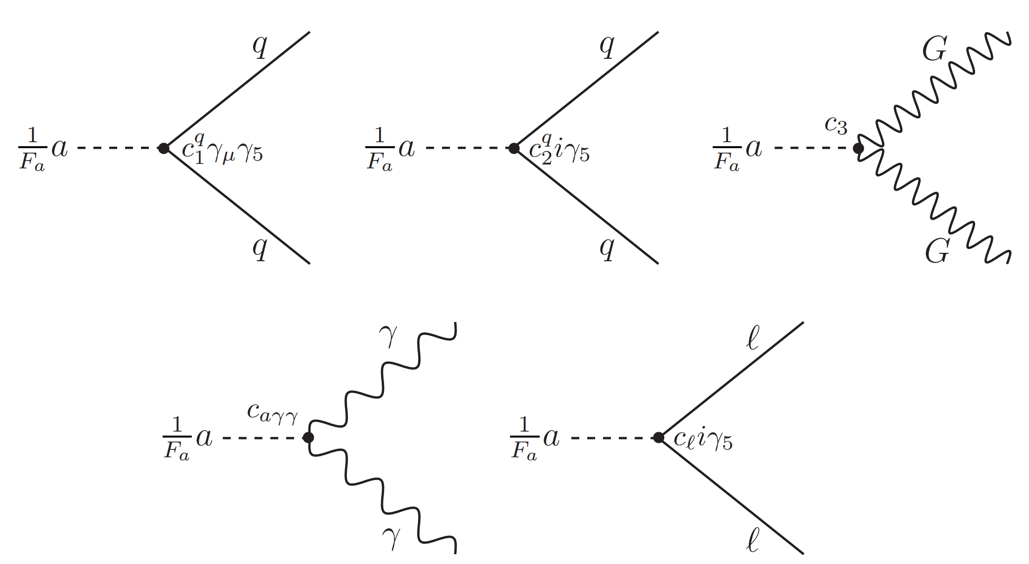
Introduction
Axion is a pseudo-scalar particle, originally introduced as a result of solving the strong CP problem
Because axions are invisible to SM particles, they are promising dark matter candidate
[1] Kim, Jihn E., and Gianpaolo Carosi. "Axions and the strong C P problem." Reviews of Modern Physics 82.1 (2010): 557.

Slide 4
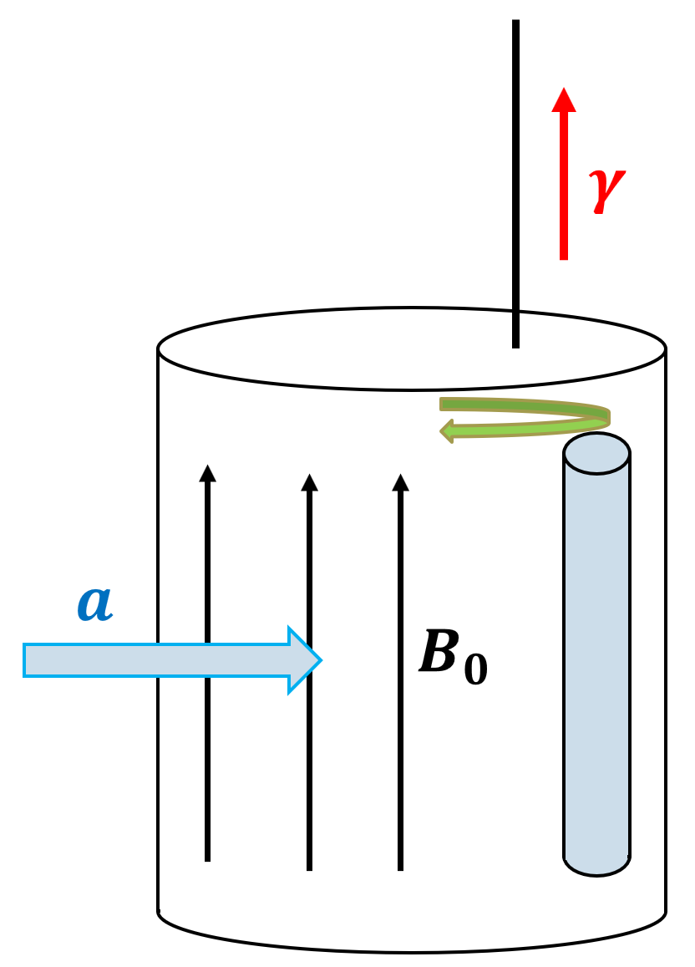
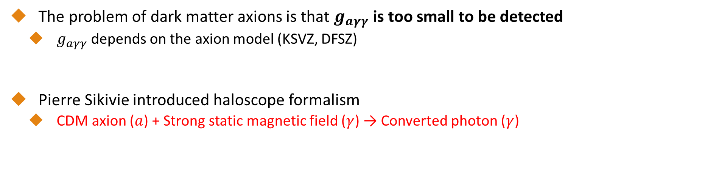
Cavity haloscope formalism
The problem of dark matter axions is that $g_{aγγ}$ is too small to be detected
  $g_{aγγ}$ depends on the axion model (KSVZ, DFSZ)
Pierre Sikivie introduced haloscope formalism
  CDM axion ($a$) + Strong static magnetic field ($γ$) → Converted photon ($γ$)
[1] Stern, Ian P., ADMX, and ADMX-HF collaborations. "Axion dark matter searches." AIP Conference Proceedings. Vol. 1604. No. 1. American Institute of Physics, 2014.
[2] Sikivie, Pierre. "Experimental tests of the" invisible" axion." Physical Review Letters 51.16 (1983): 1415.

Slide 5
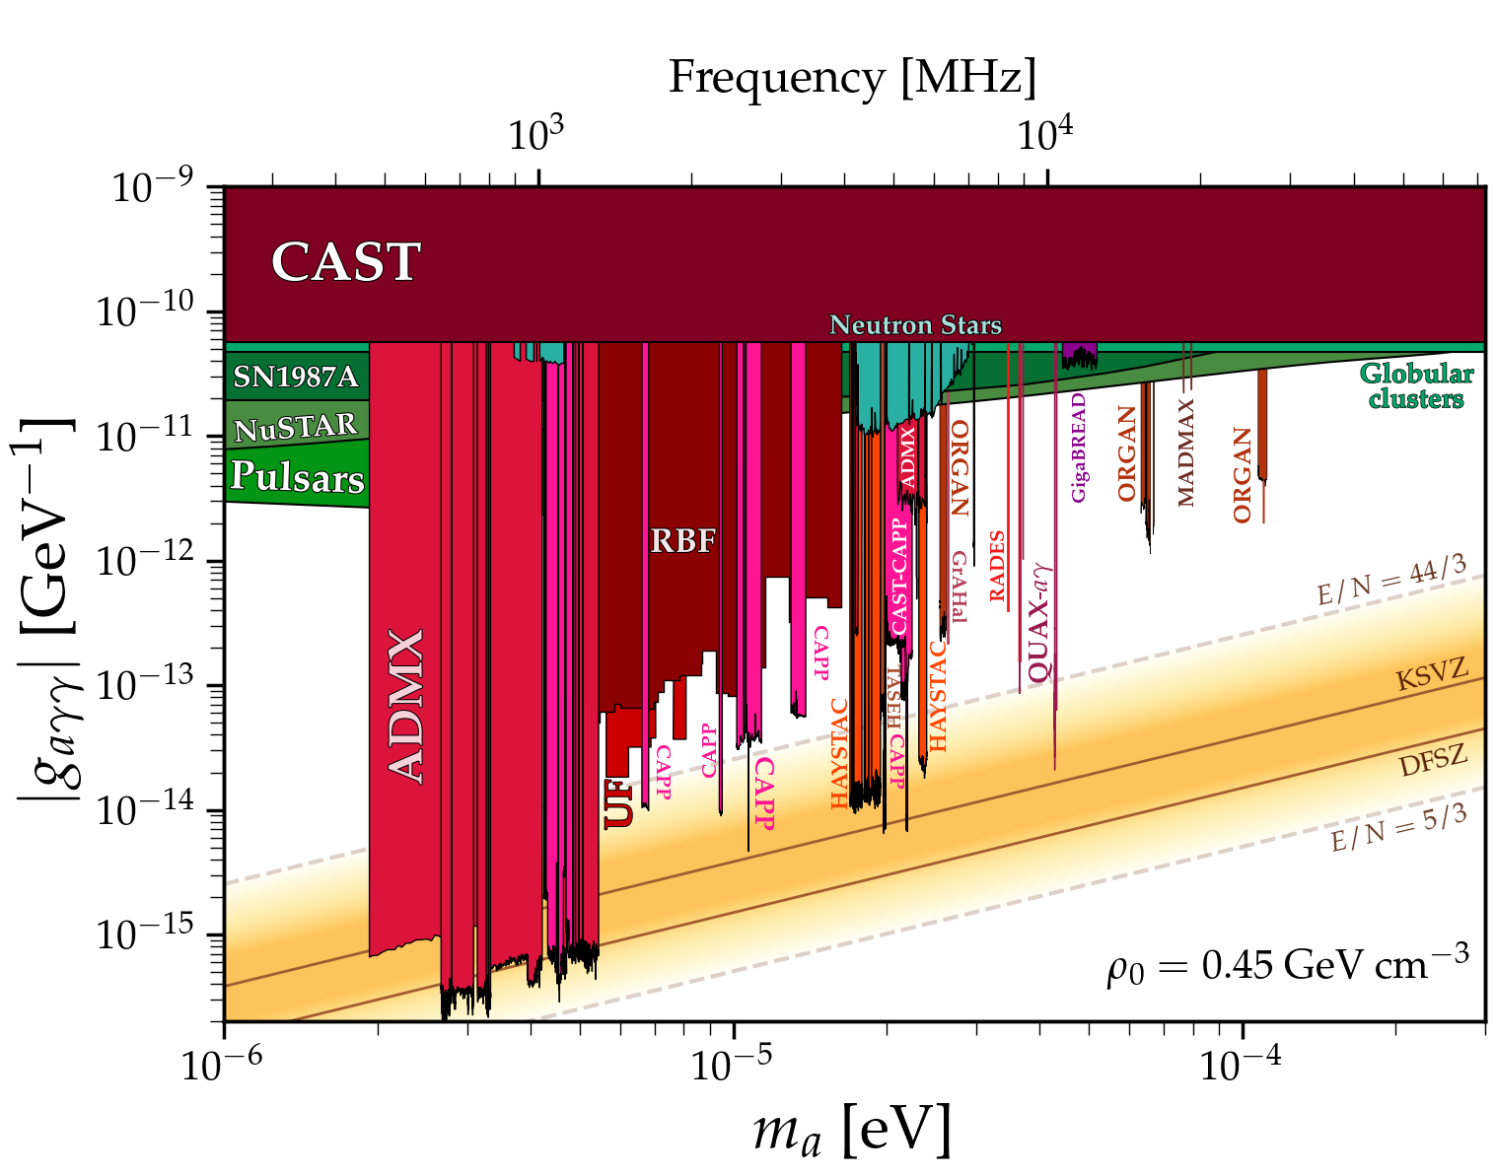





Going high-frequency
Using conventional haloscope with a cylindrical cavity,
Higher-order mode (TM020, TM030, …): Less form factor
$$C=\frac{{\left|∫E_{z}dV\right|}^{2}}{V∫E^{2}dV}$$
$$B_{0}$$
$$B_{0}$$
$$B_{0}$$
Mode | f | Q | C
TM010 | $$f_{010}$$ | $$Q_{010}$$ | 0.69
TM020 | $$2.3×f_{010}$$ | $$1.5×Q_{010}$$ | 0.13
TM030 | $${3.6×f}_{010}$$ | $${1.9×Q}_{010}$$ | 0.05

Slide 6
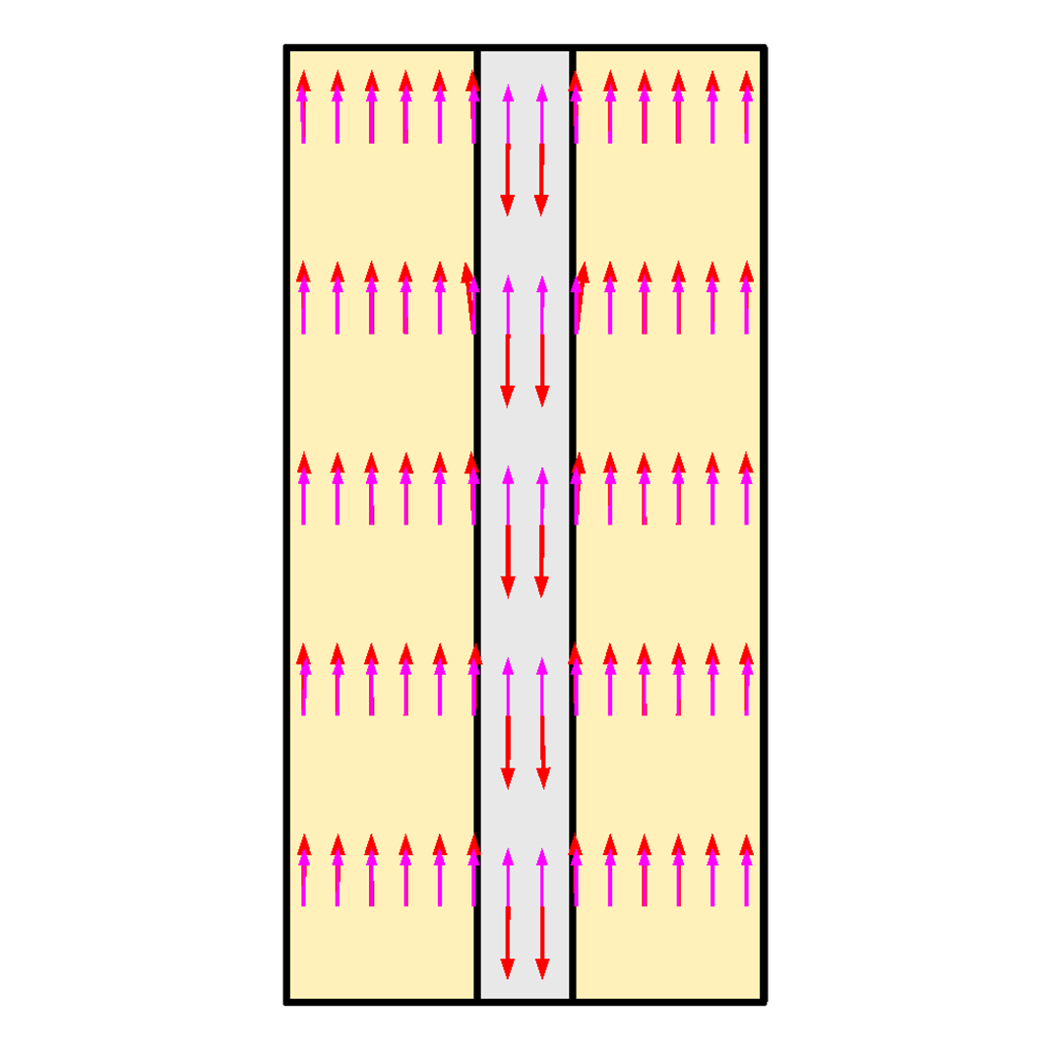
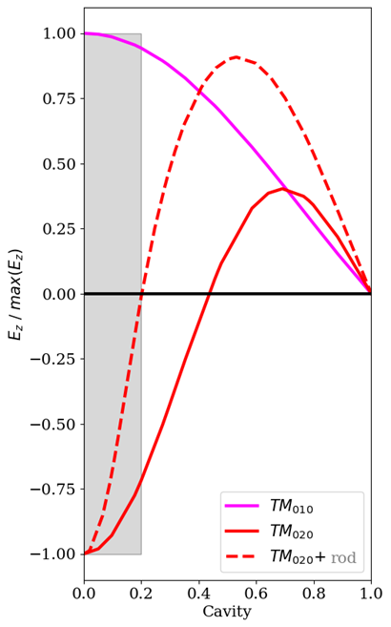
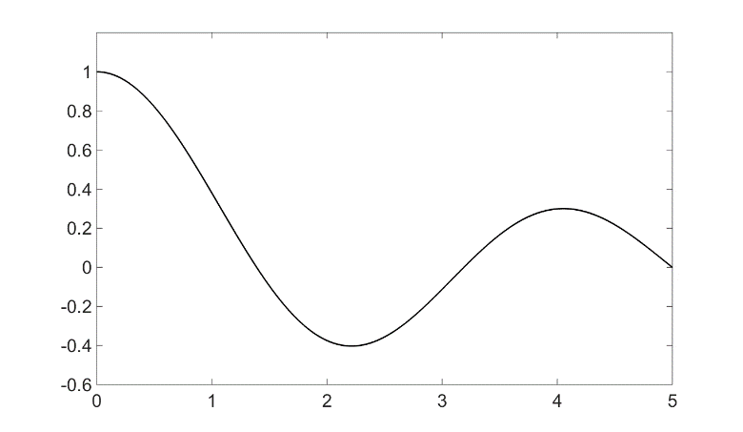
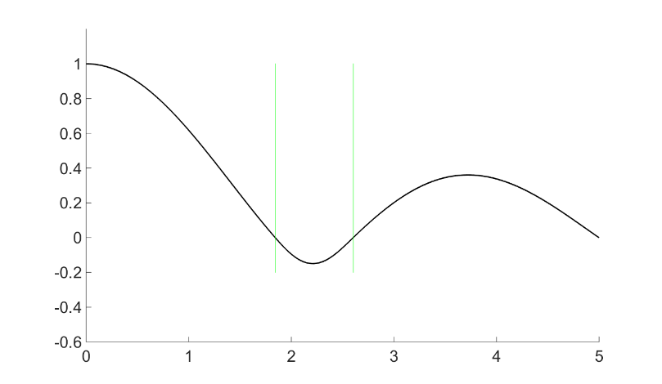
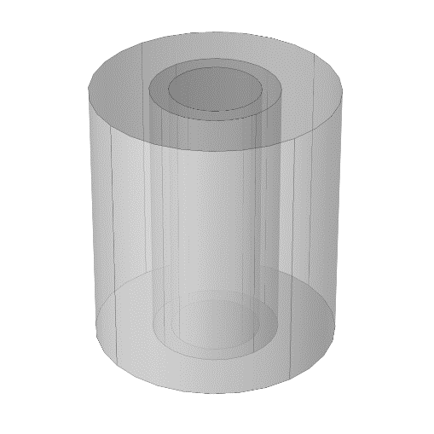
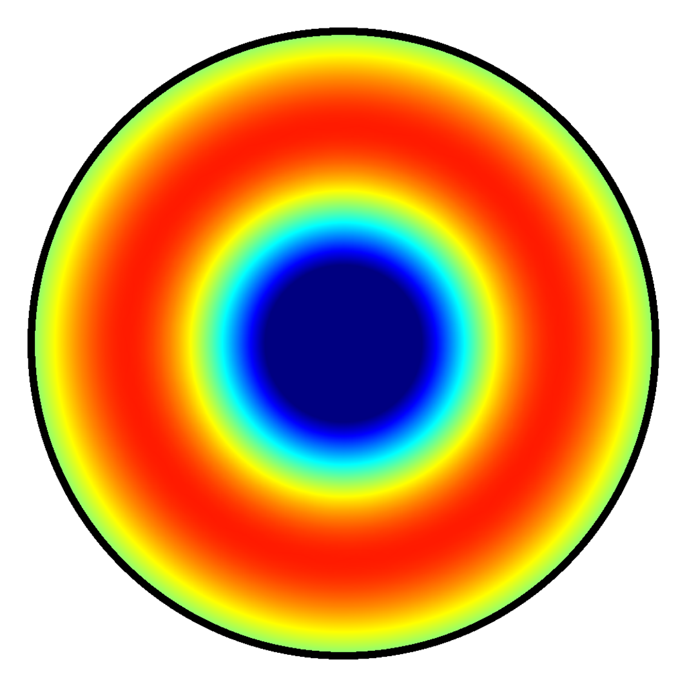
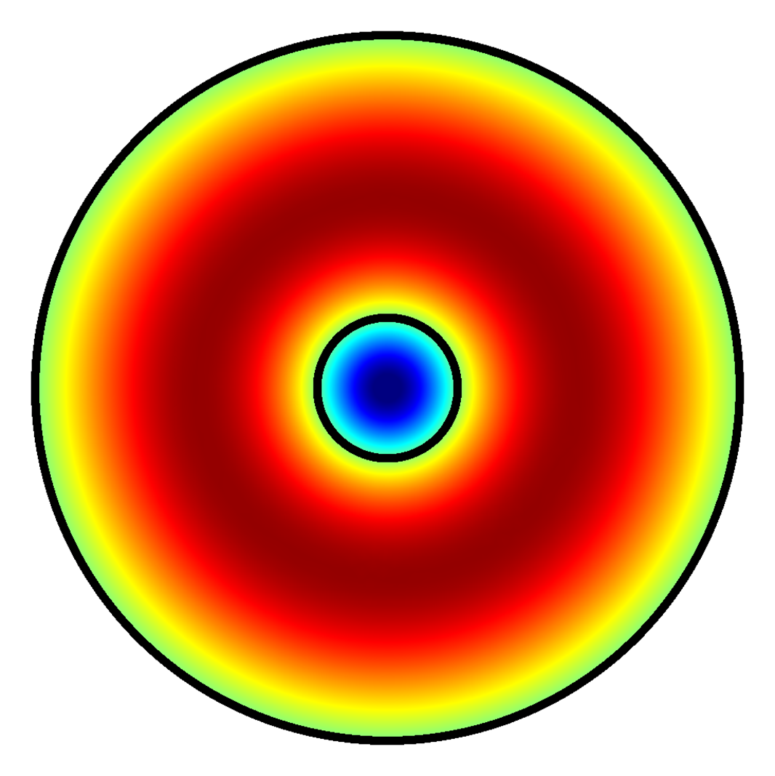
Establishing higher-order modes
To enhance form factor, dielectric geometry is introduced to suppress the negative region
TM030 mode
Ez
Ez
TM020 mode
r
r

Slide 7
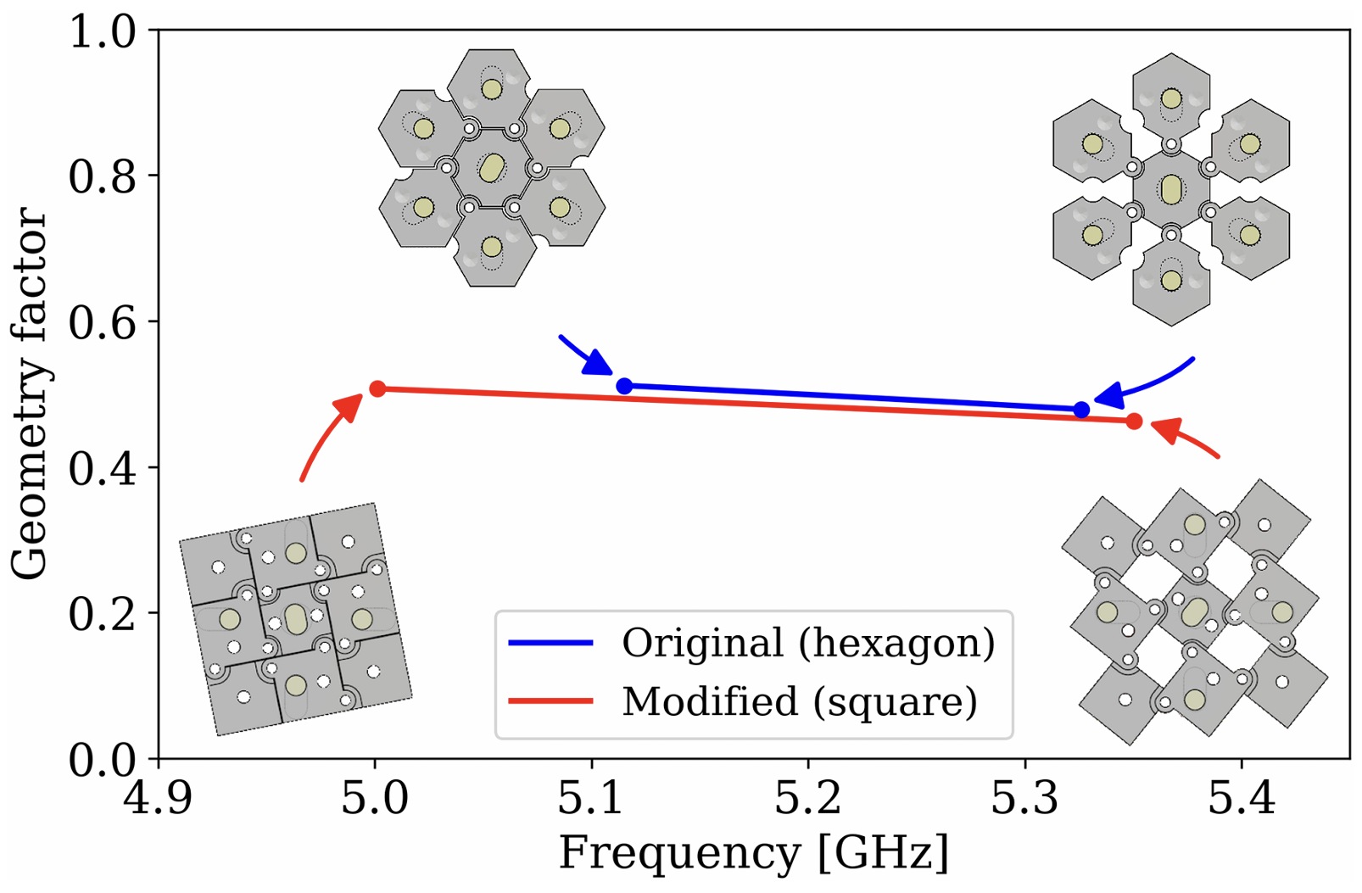
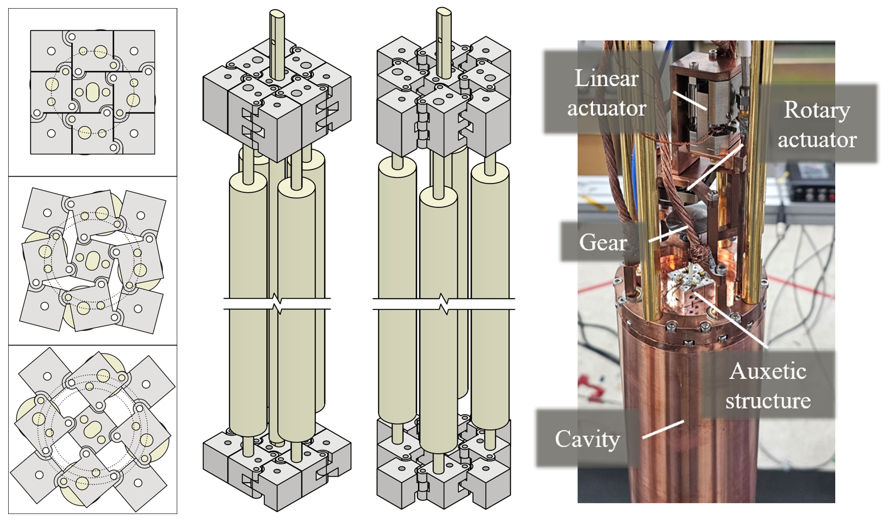
A smart way to tune TM020 mode
The dielectric geometry was designed to enable the frequency tuning
To uniformly adjust the spacings between the rods, an auxetic structure was implemented
6.5 mm spacing
Cavity: Φ78 mm
Center: Φ3 mm
Side: Φ7 mm
9.2 mm spacing

Slide 8
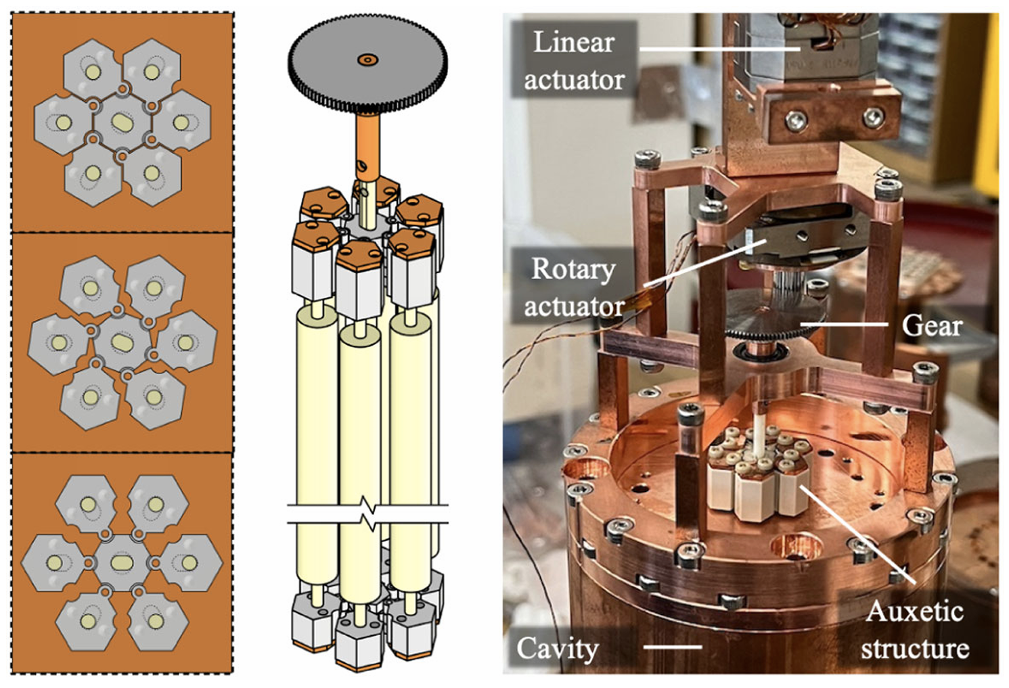
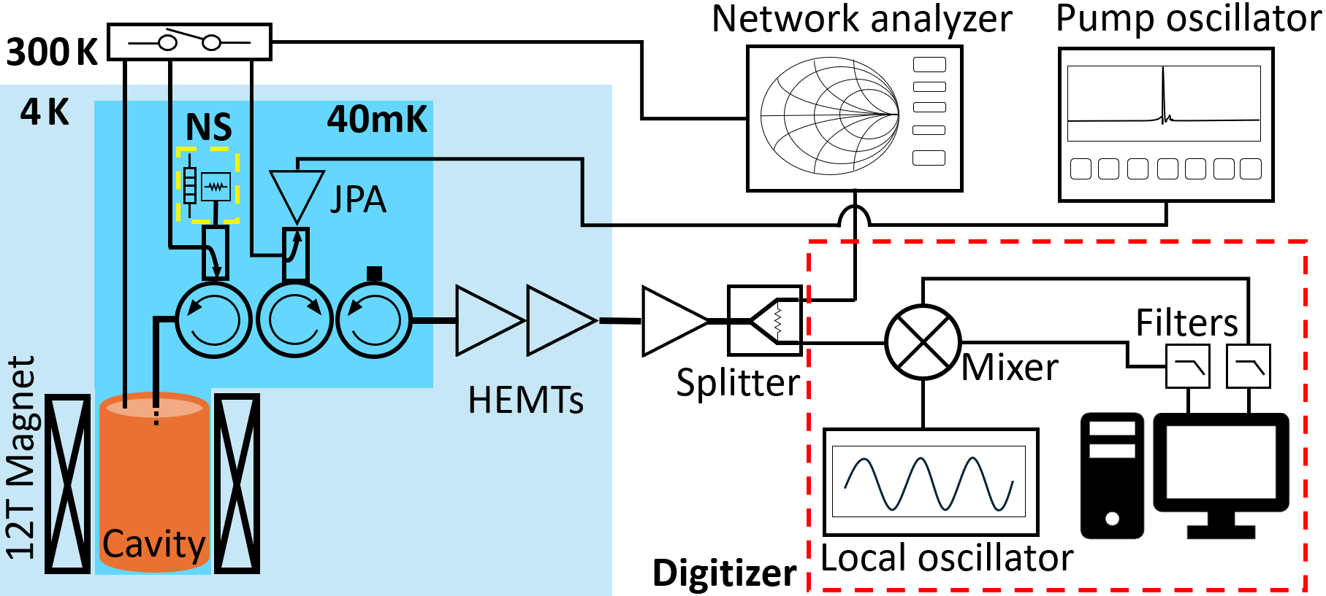
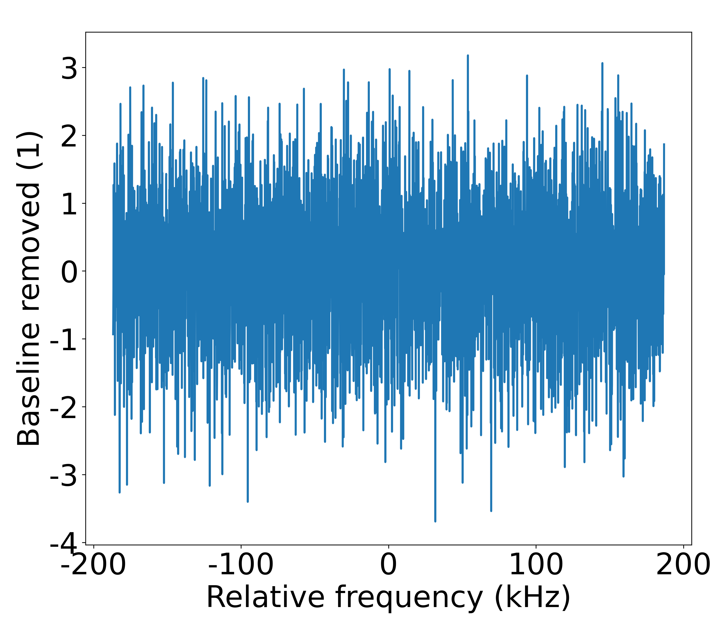
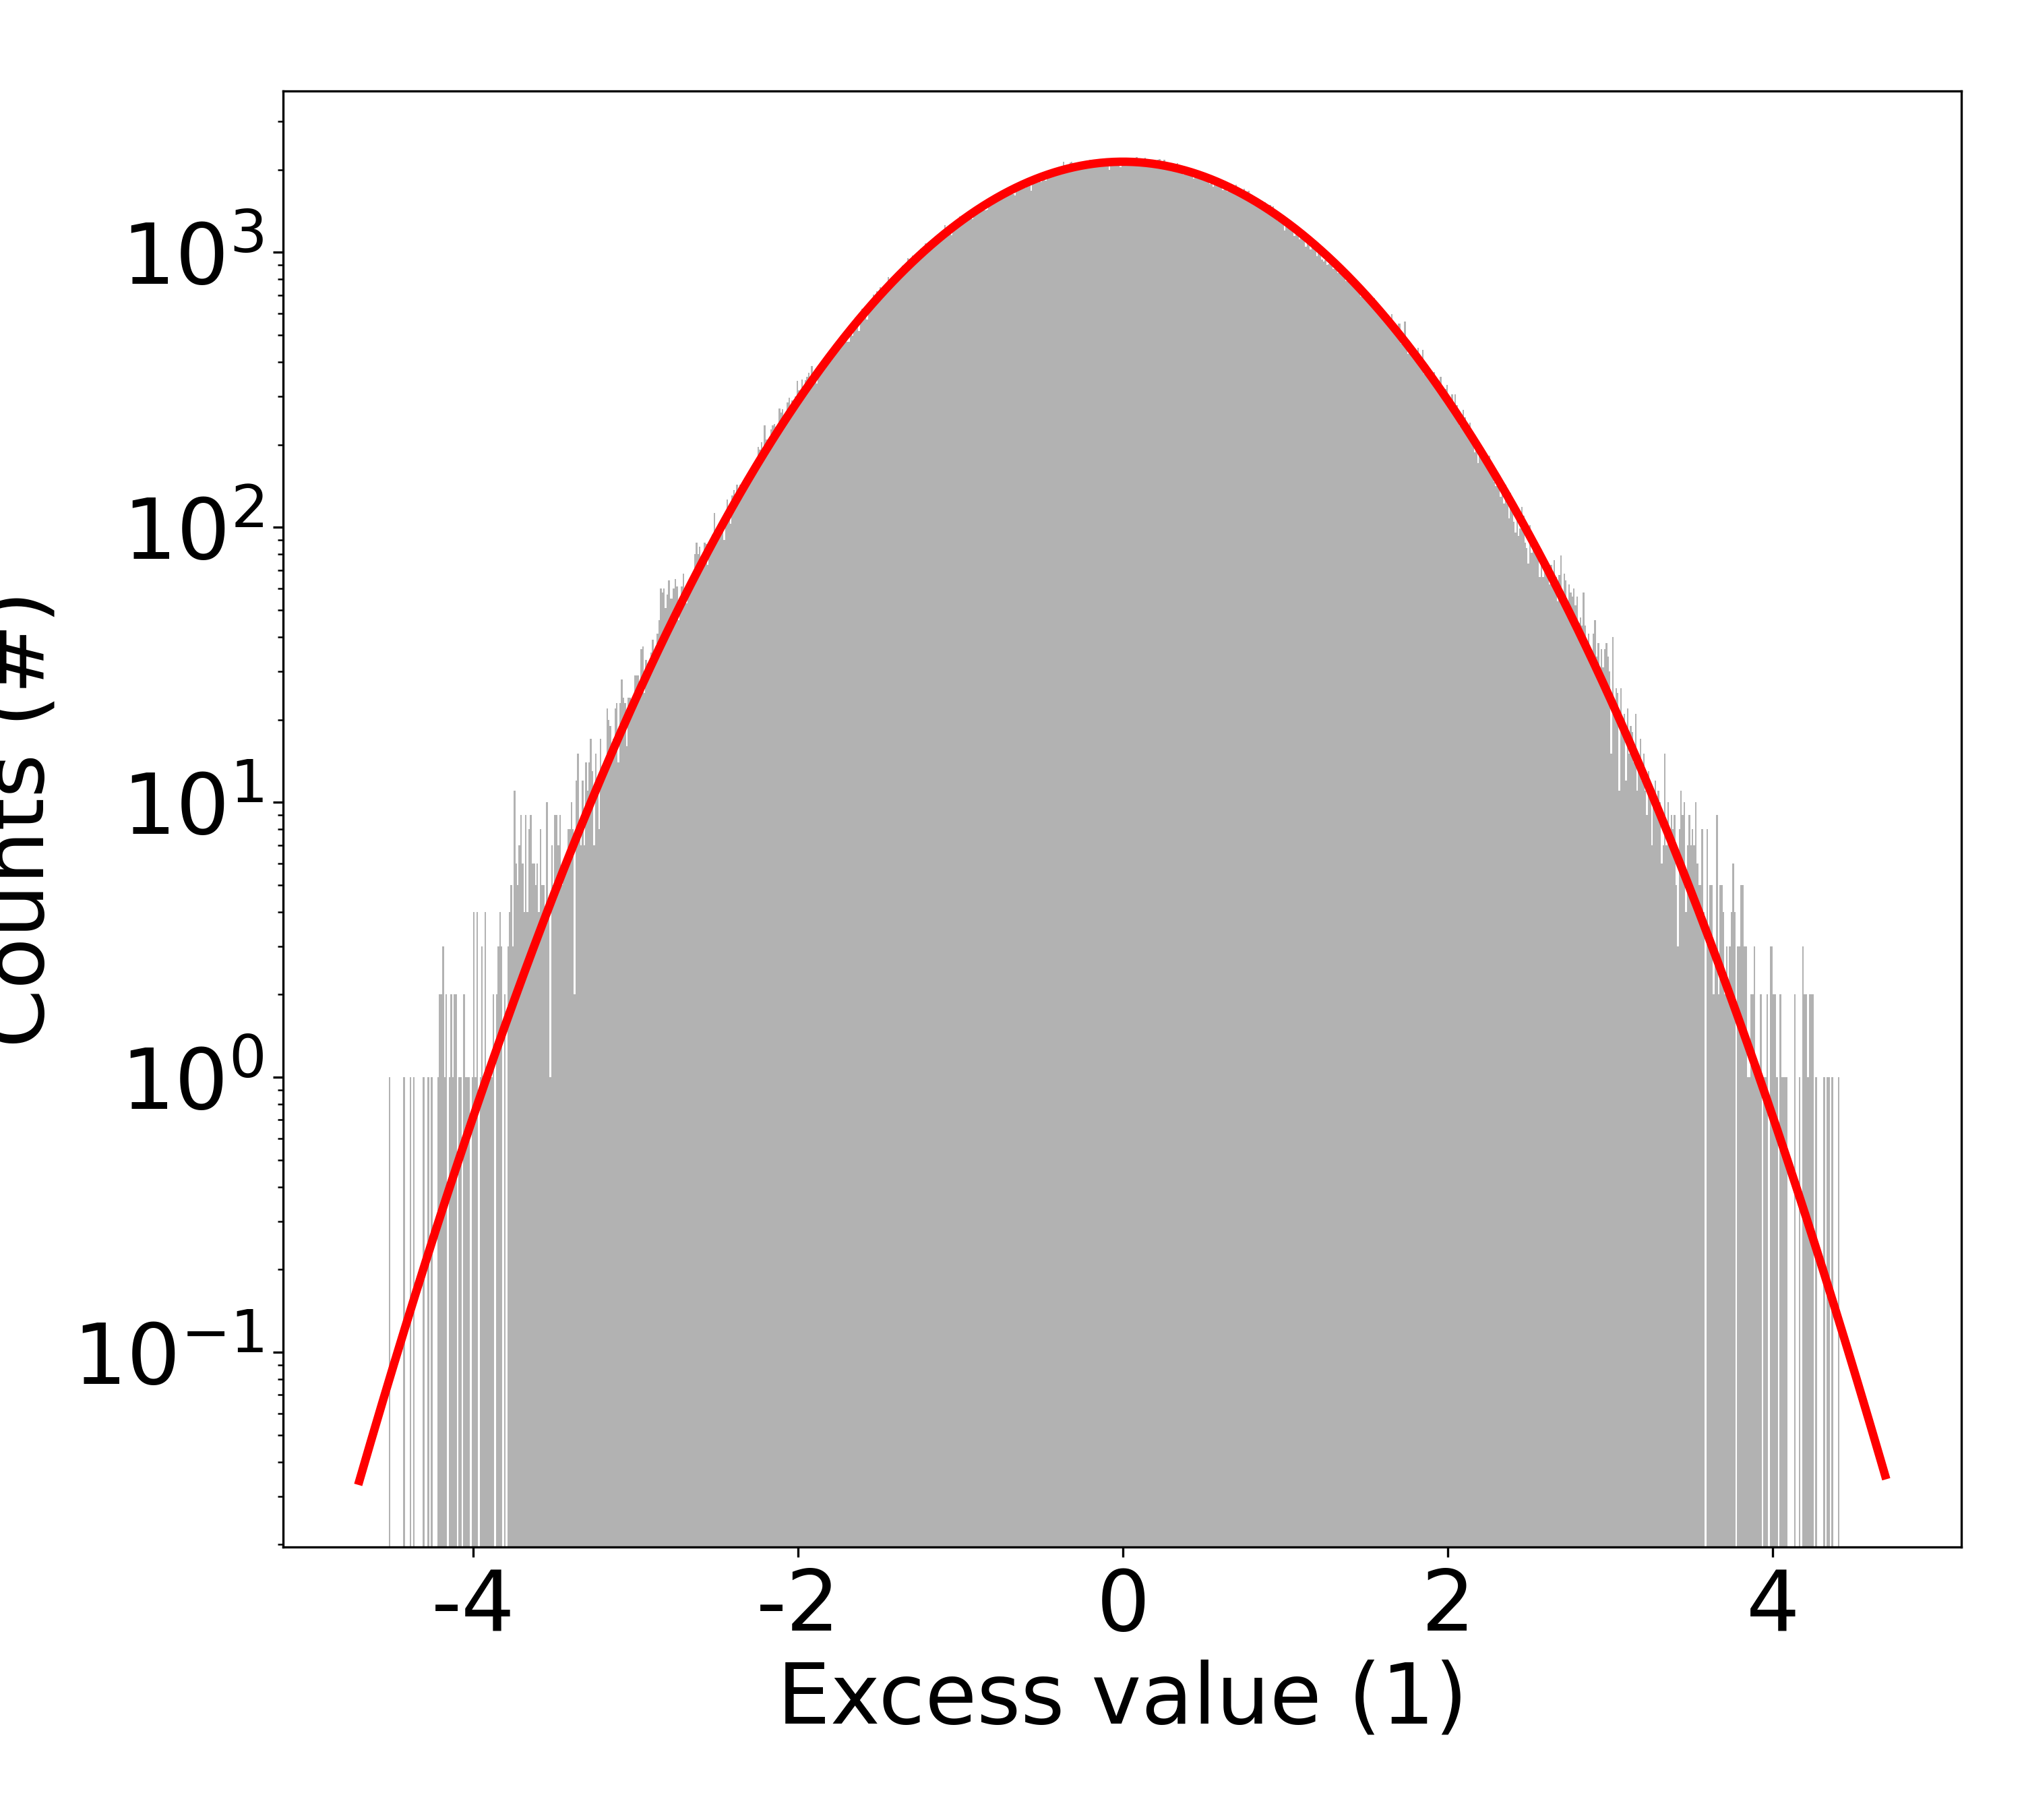
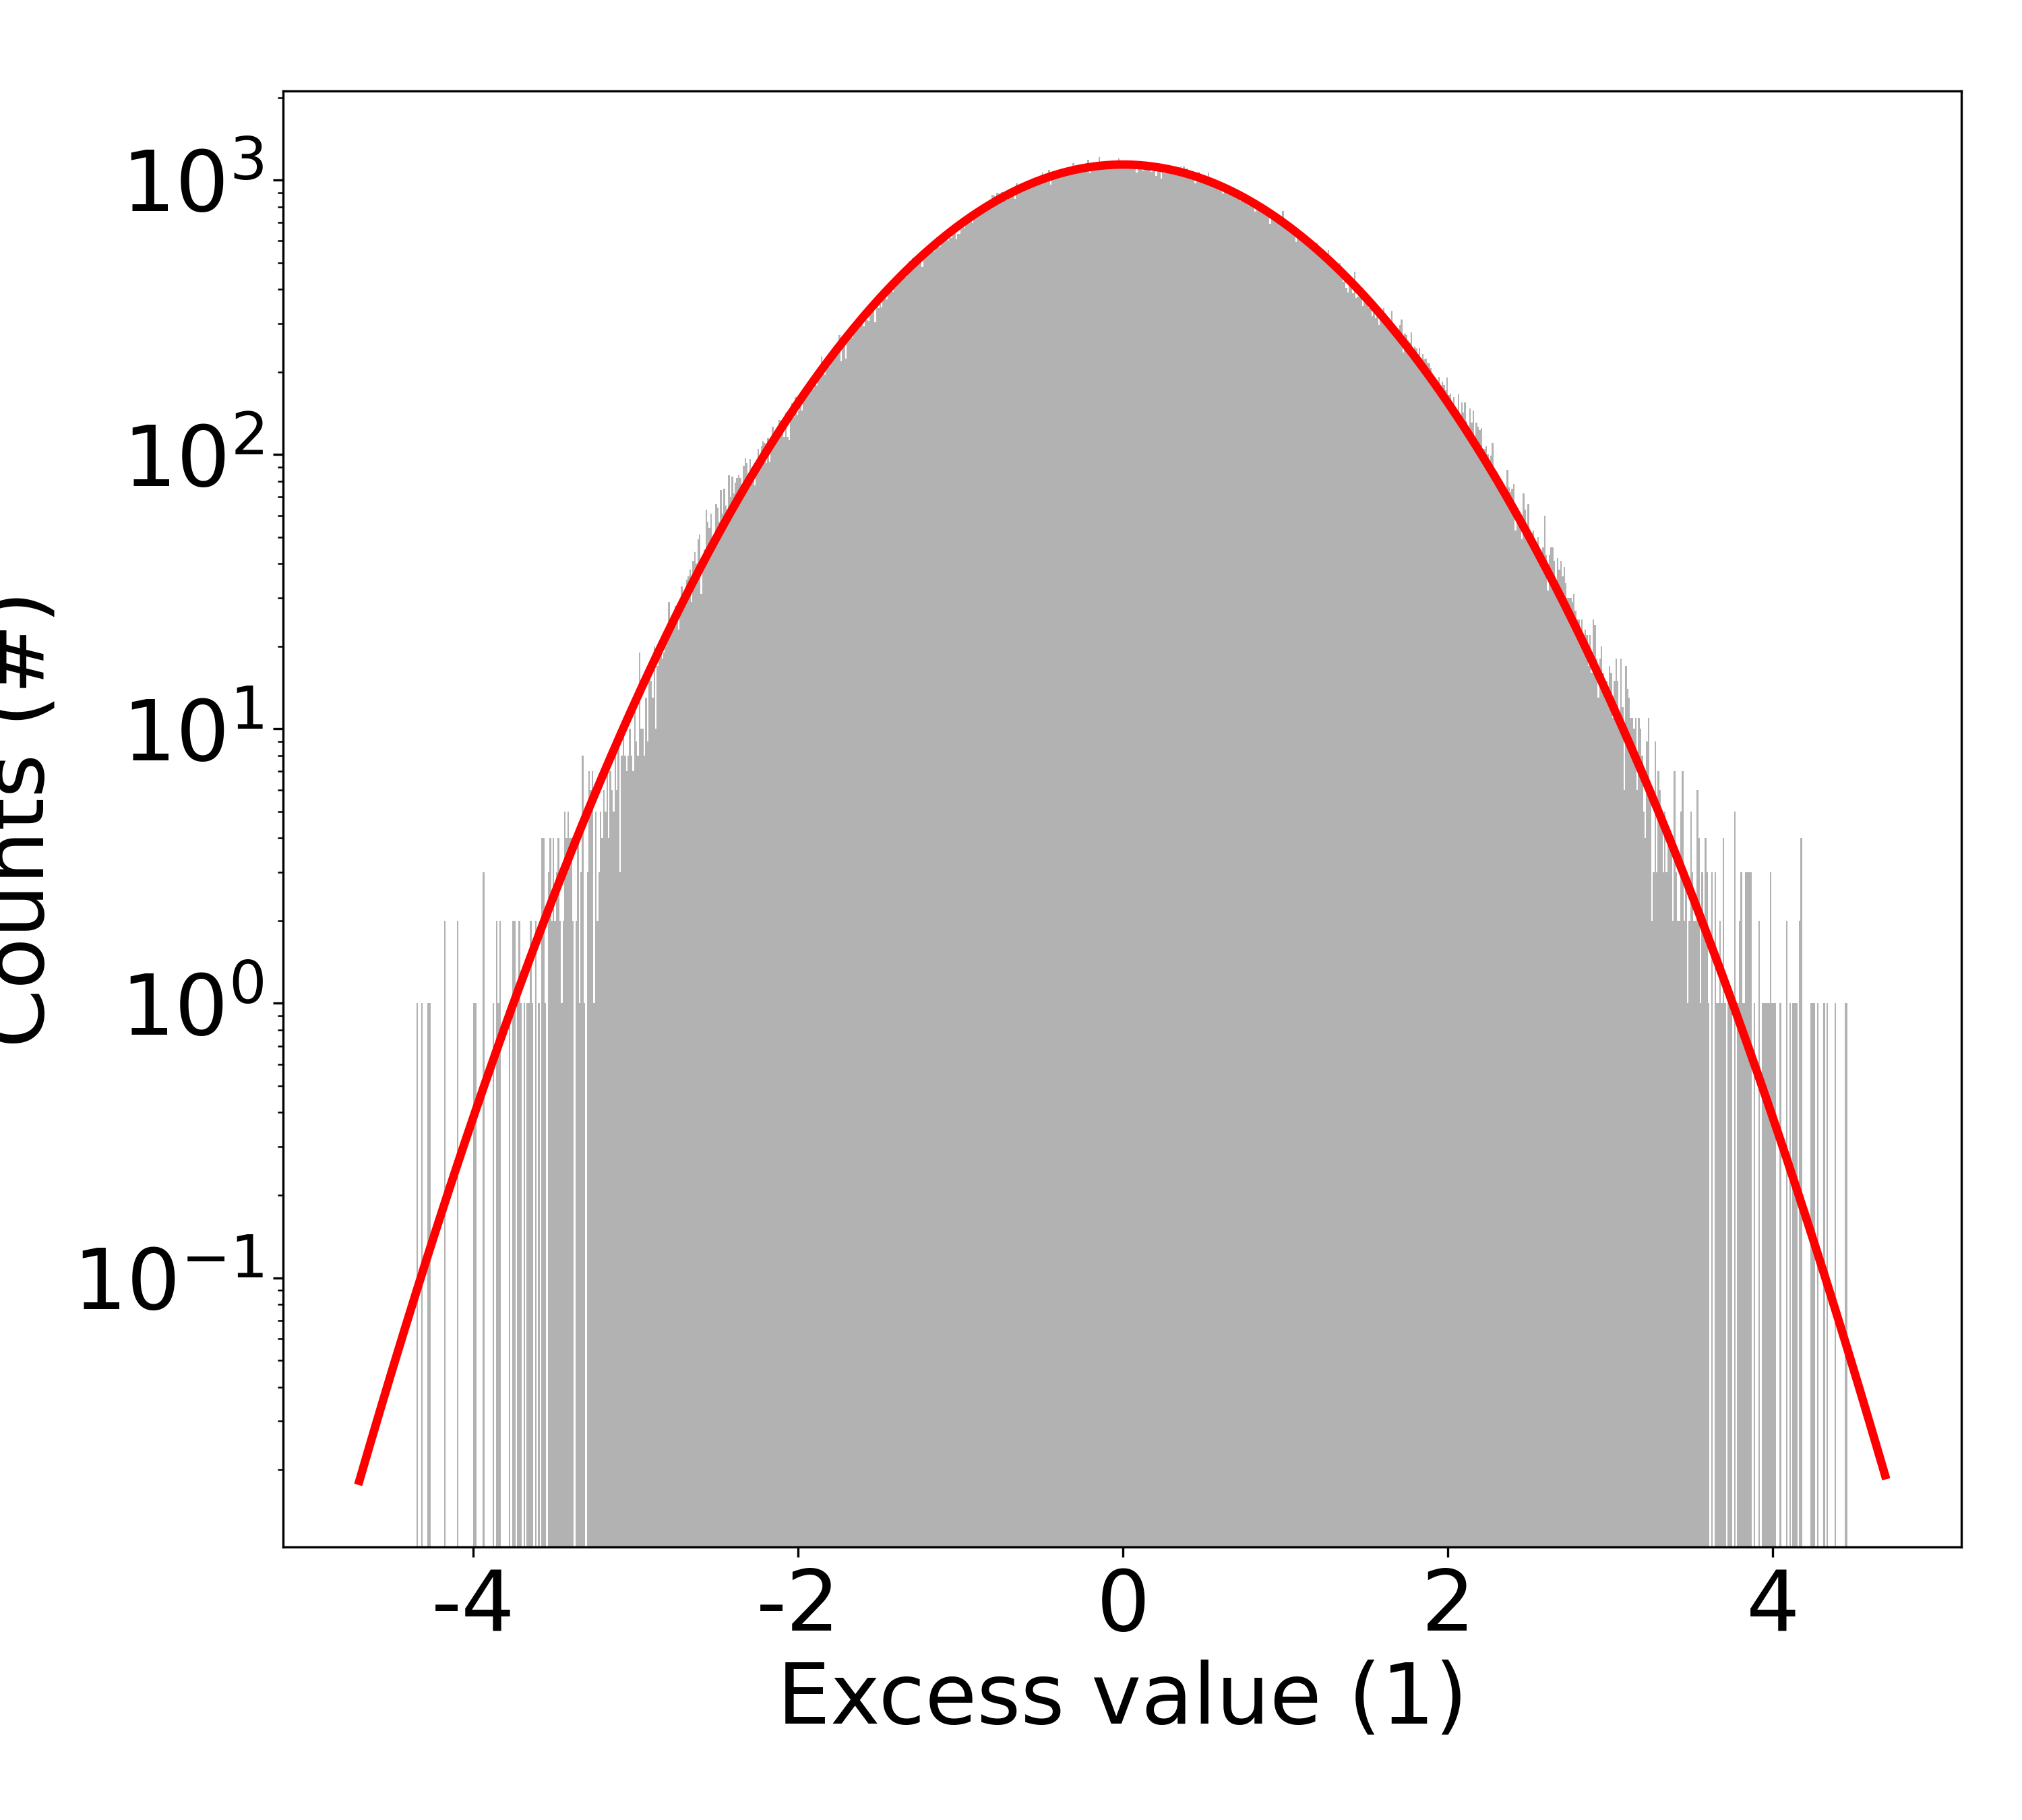
TM020 Experiments
As an extension of
[1] Bae, Sungjae, et al. "Search for dark matter axions with tunable tm 020 mode." Physical Review Letters 133.21 (2024): 211803.
[2] Bae, Sungjae, et al. "Axion dark matter search with sensitivity near the Kim-Shifman-Vainshtein-Zakharov benchmark using the TM 020 mode." Physical Review Letters 135.9 (2025): 091804.
Using two cavities, we conducted 1.85 KSVZ experiments (90% C.L.)
Period 1: 20 Feb – 06 May (2025); Scan range: 5.066 – 5.012 GHz
Period 2: 02 Sep – 28 Jan (2026); Scan range: 4.983 – 5.013 GHz
Q0 | Beta | Tcav | Tsys | Sweep time | Volume | B-field | Form factor | Tuning step | DAQ time efficiency
110k | 2.3 | 160 mK | 620 mK | 30 min. | 1.4 L | 12 T | 0.49 | 30 kHz | 87%
120k |  |  | 838 mK | 90 min. |  |  | 0.34 |  | 82%

Slide 9
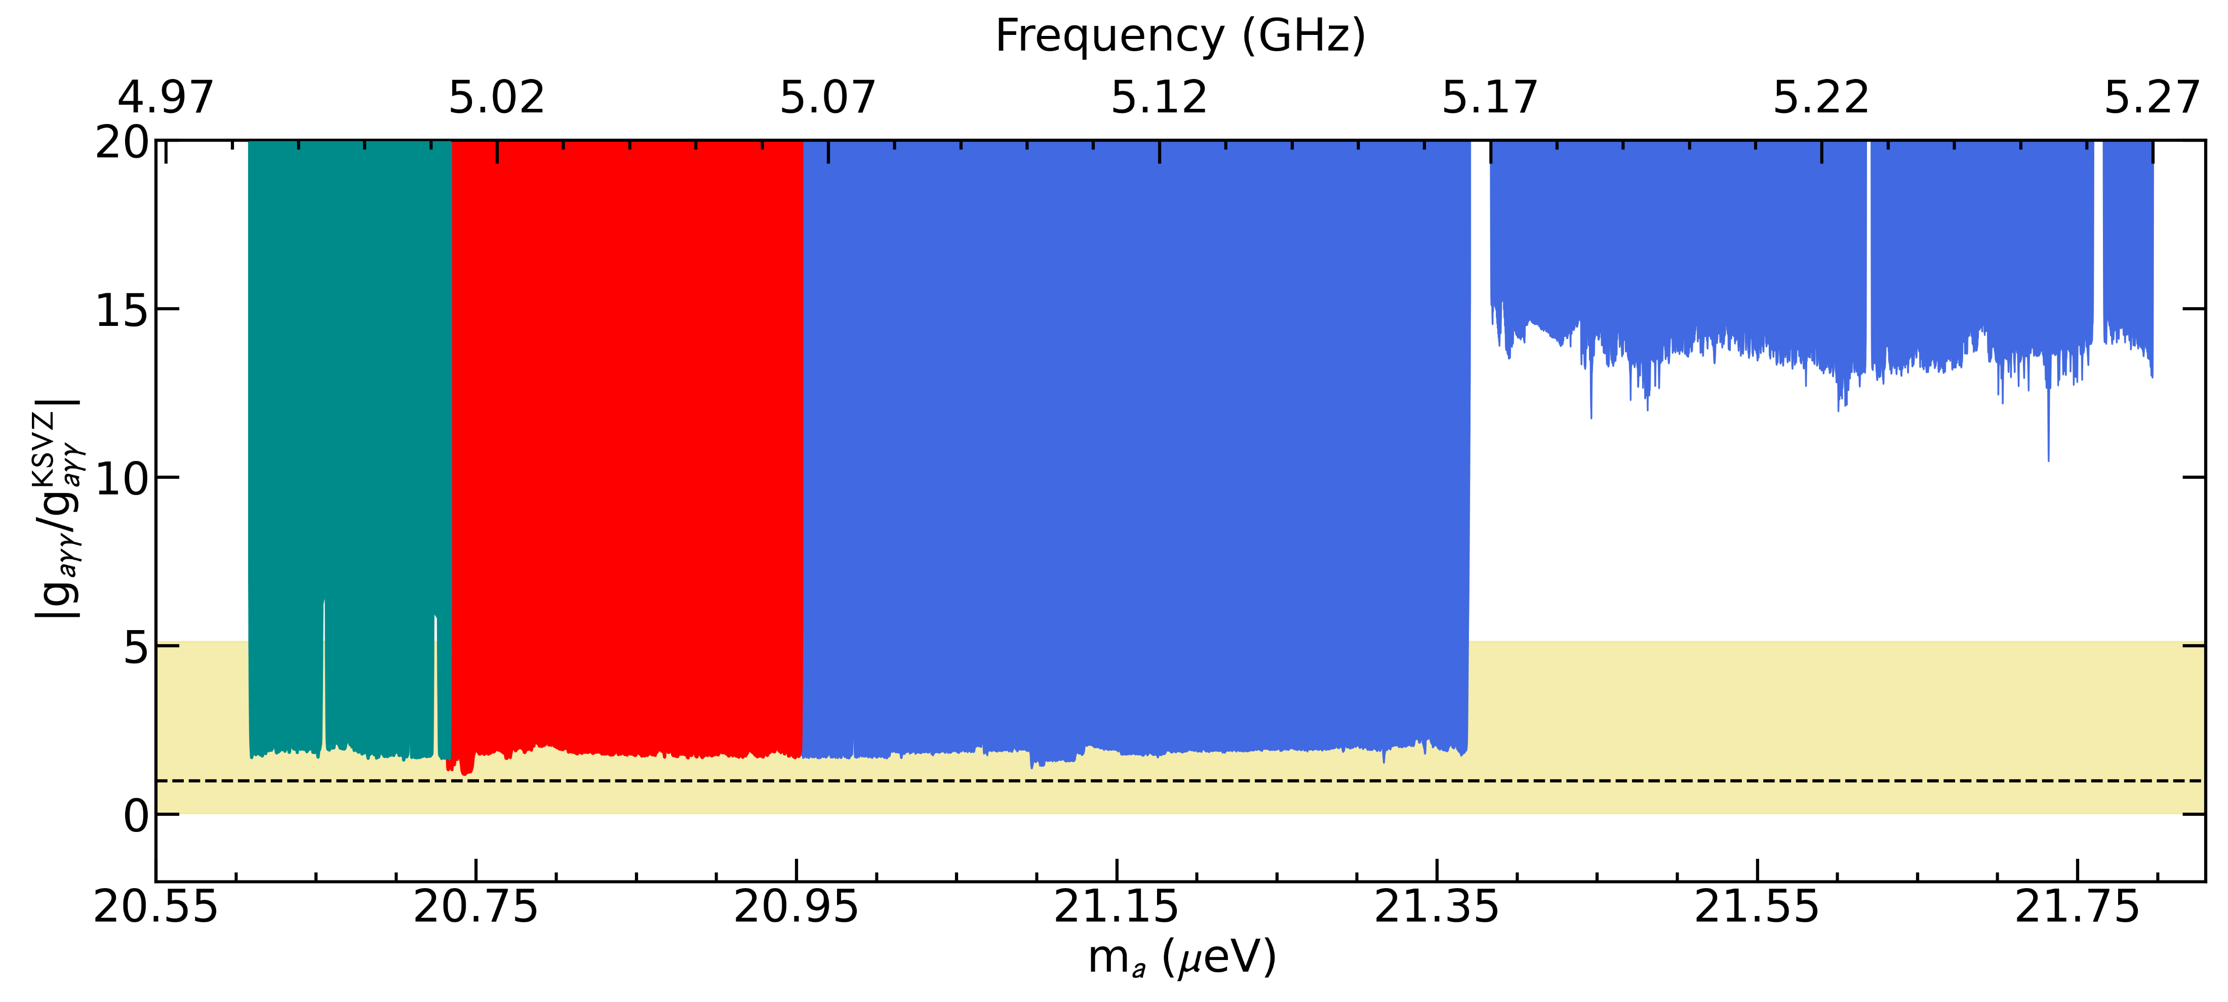
Excluded regions using TM020 mode cavities
Combined with the previous experiments, the total investigated range is about 300 MHz
Previous
Hexa-TM020
This work
Square-TM020
Previous
Square-TM020
This work
Hexa-TM020
QCD Axion band
KSVZ

Slide 10
Summary
Axion is a DM candidate originally introduced to solve Strong CP problem
Axion haloscope is the powerful device for detecting DM axions in RF range
To access to the higher frequencies, higher-order modes were explored
TM020 experiments were conducted at near-KSVZ sensitivity level
The manuscript is almost ready
Thank You!

