Slide 1
Heterodyne signal detection with bolometers in DMAG
Saebyeok Ahn
Postdoctoral researcher at IBS-DMAG
2026 KPS spring meeting, Daejeon Convention Center

Slide 2
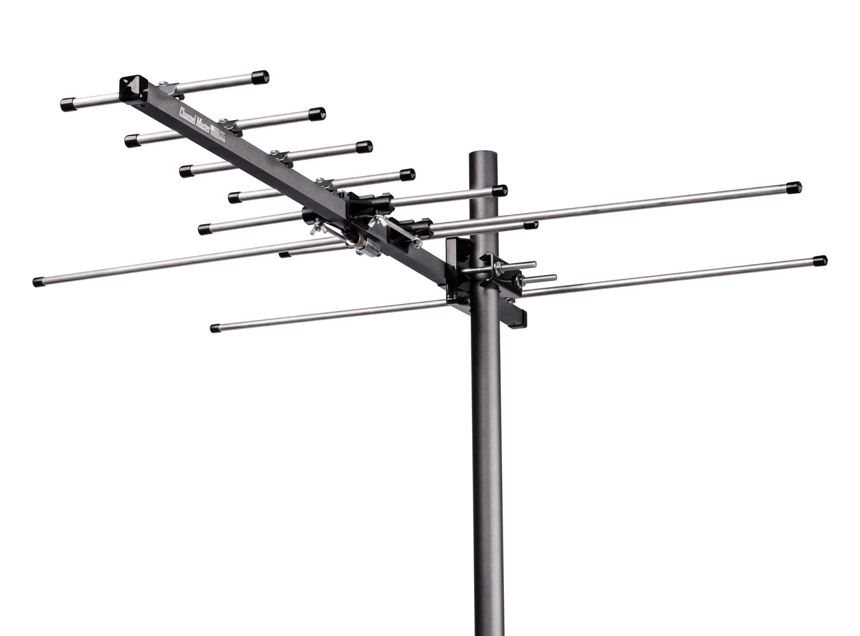

Axion Haloscopes
$$ℒ_{aγγ}=g_{aγγ}aE⋅B$$
Axion induced electric field
Antenna
Axion field from
galactic dark matter halo
Laboratory magnetic field
Analog-digital conversion

Slide 3
Axion Haloscopes
Axion induced electric field
Axion field from
galactic dark matter halo
Laboratory magnetic field
Microwave cavity

Slide 4
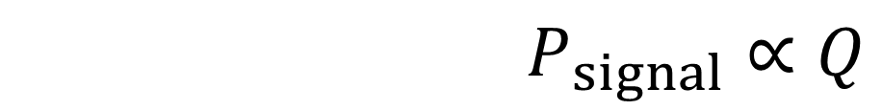
Axion Haloscopes
Resonant mode electric field
(Thermal noise + signal)
Matched antenna
RF amplifier
$$At ω_{cavity}\sim ω_{a},$$
$$P_{signal}∝Q$$
Microwave cavity
Signal boosted by the quality factor

Slide 5
Bolometers and heterodyne signal detection

Slide 6
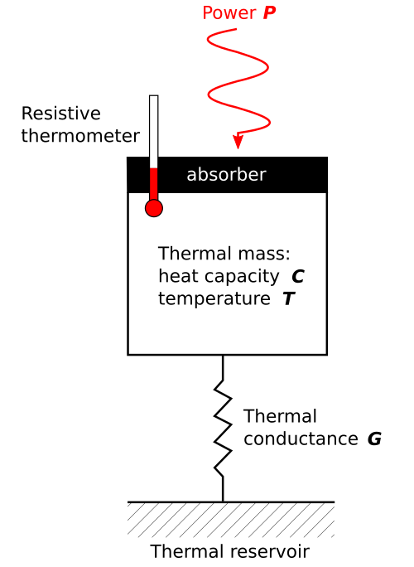
Bolometer
(Signal + noise photons)
Phase-insensitive power detector

Slide 7
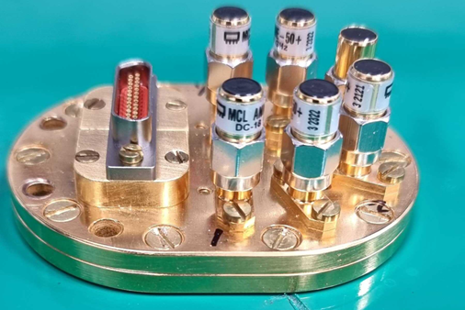
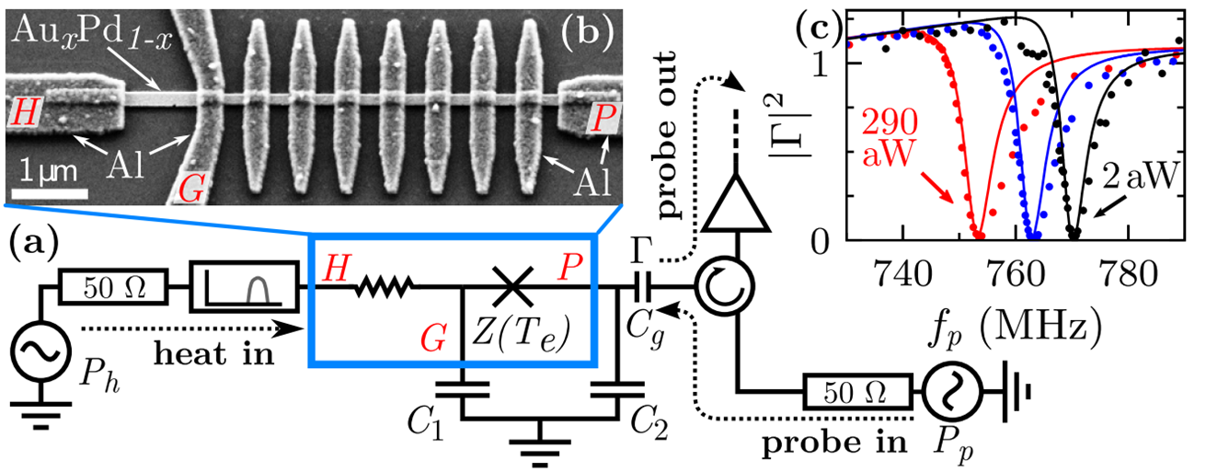
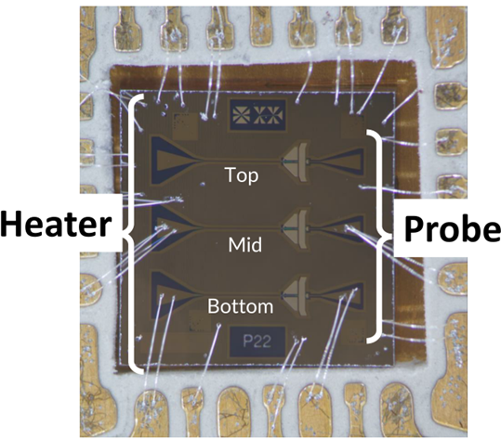
Bolometer
Zeptojoule nanobolometer (Aalto university)
Non-linear power detector
Detecting heat dissipation on the film
With Josephson-junction terminated resonator

Slide 8
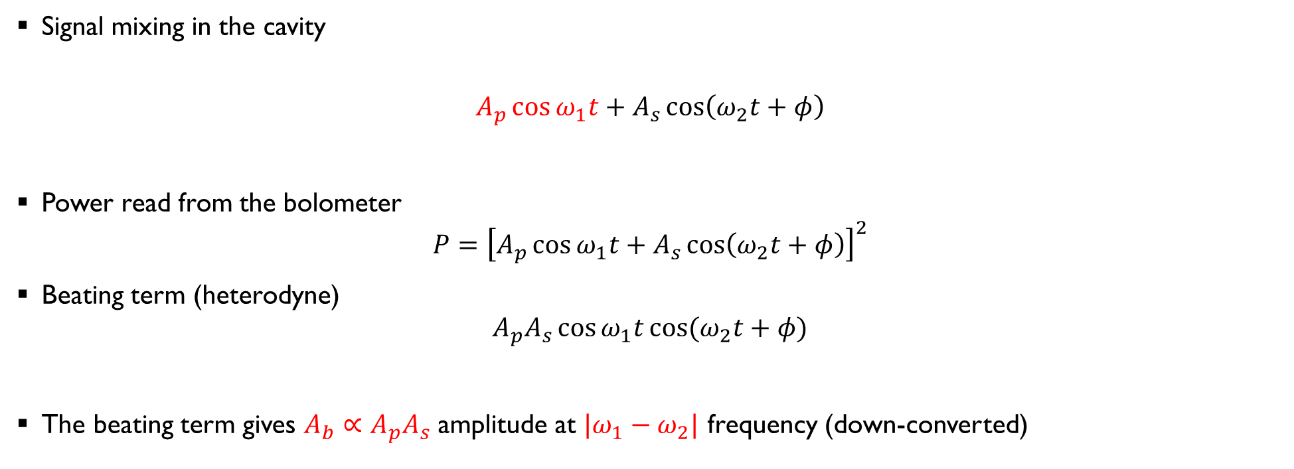
Heterodyne signal detection
Signal mixing in the cavity
$$A_{p}\cos{ω_{1}t}+A_{s}\cos\left(ω_{2}t+φ\right)$$
Power read from the bolometer
$$P={\left[A_{p}\cos{ω_{1}t}+A_{s}\cos\left(ω_{2}t+φ\right)\right]}^{2}$$
Beating term (heterodyne)
$$A_{p}A_{s}\cos{ω_{1}t}\cos{(ω_{2}t+φ)}$$
The beating term gives $A_{b}∝A_{p}A_{s}$ amplitude at $|ω_{1}−ω_{2}|$ frequency (down-converted)

Slide 9
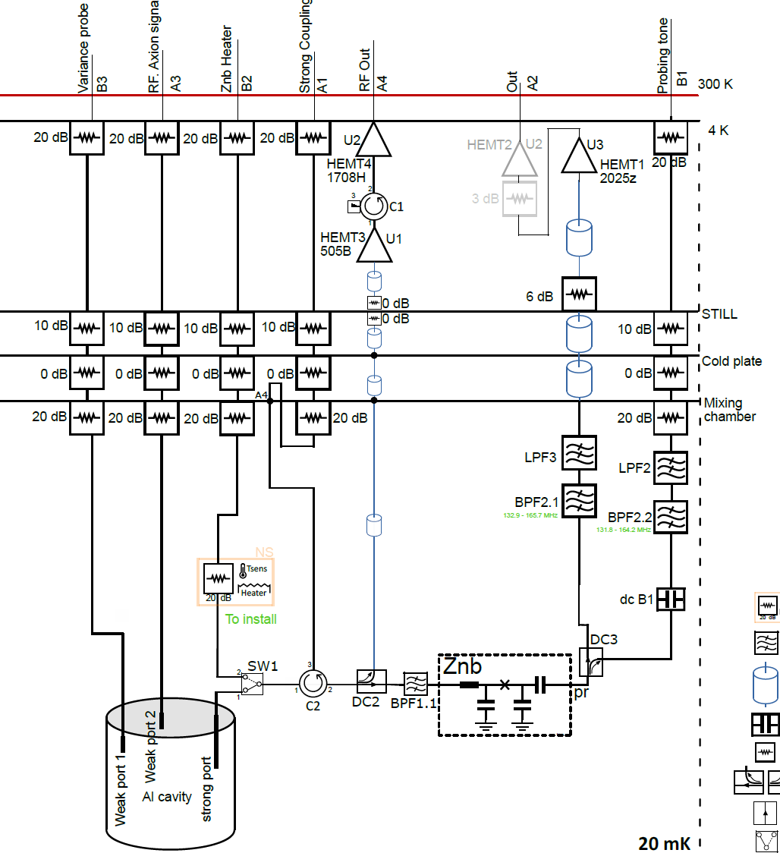
Bolometer measurements
Bolometer resonance-frequency measurement
Signal to detect
Probe tone
Power measurement

Slide 10
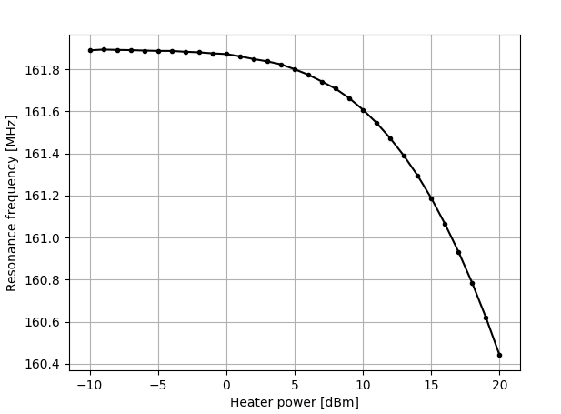
Input power dependence
Heater power
Resonance probe
Bolometer
Heater tone at 5.5 GHz
Sweeping amplitude ([-10, 20] dBm)
Map the resonance curve
Calibration curve

Slide 11
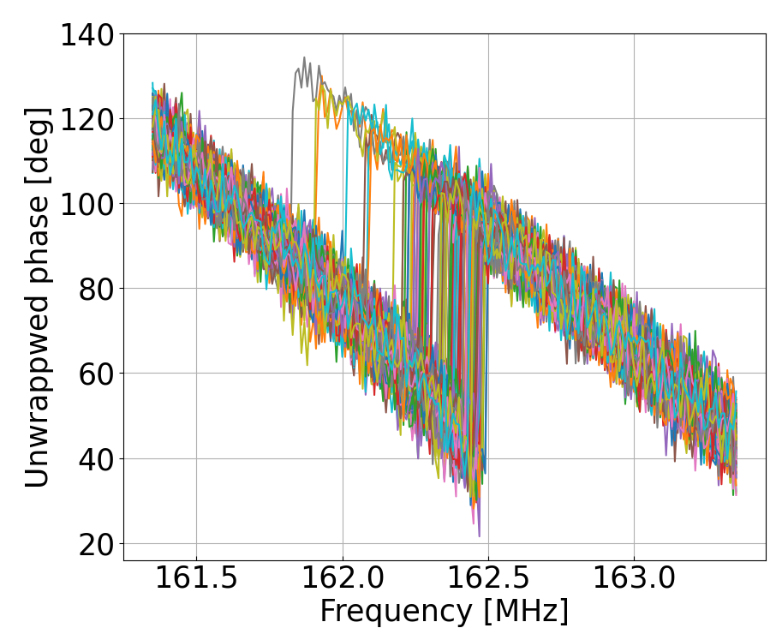
Bolometer measurements

Slide 12
Bolometer measurements
Noise jitter + signal

Slide 13
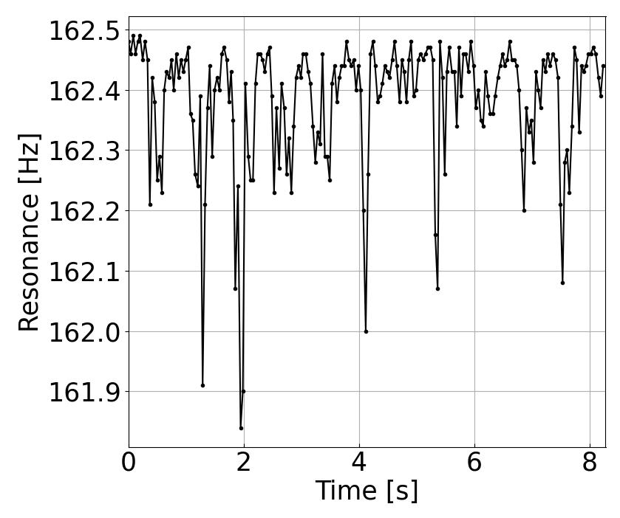
Bolometer measurements
Noise jitter + signal
Resonance analysis, plotting with time

Slide 14
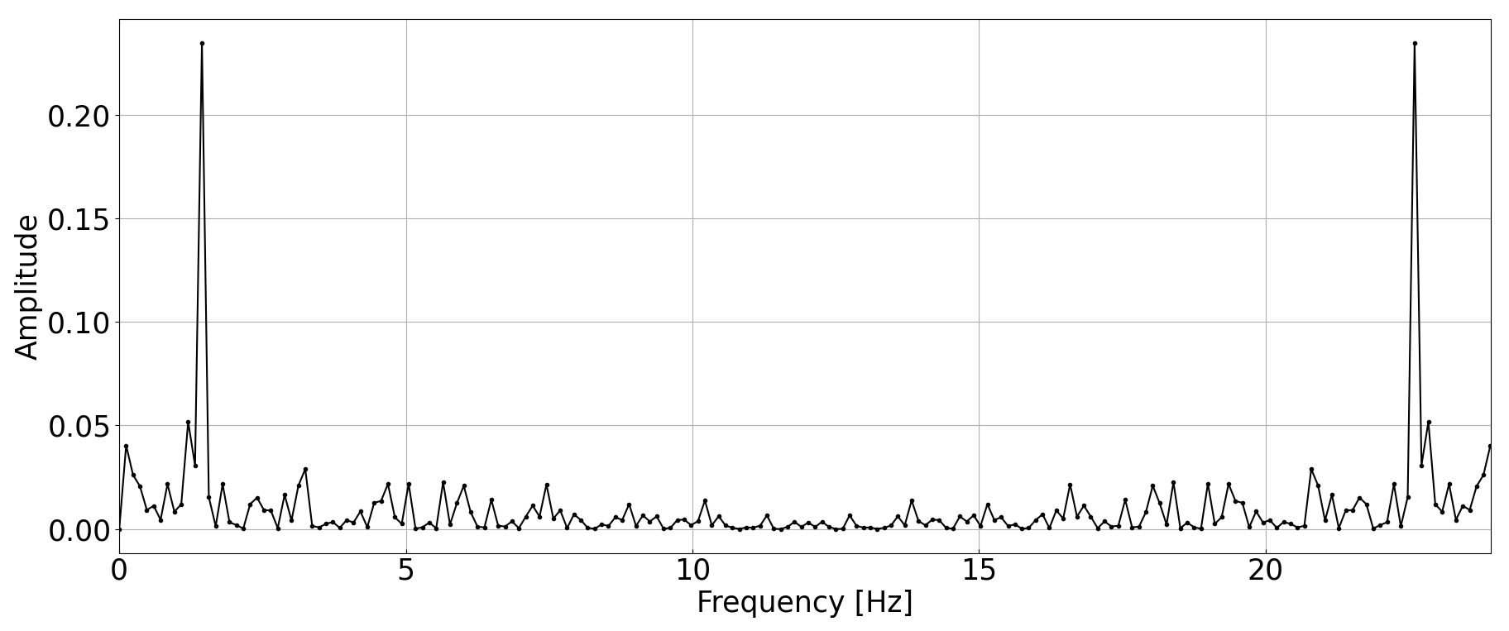
Bolometer measurements
Fourier-analyzed bolometer resonance samples
Nyquist frequency
Pulse-tube (4 K cooler) induced

Slide 15
Bolometer measurements
Fourier-analyzed bolometer resonance samples
Bandwidth limit: 1/τ (bolomter time-const.)
Higher frequencies will be dissipated as DC offset
Reduced amplitude
Problem: high dark count in bolometer (bandwidth, thermal input)
Nyquist frequency
Pulse-tube (4 K cooler) induced

Slide 16
Bolometer measurements
Resonance probe
Coherent pump
f_{p}
Test
Signal
f_{s} = f_{p} + Δ
Bolometer
+

Slide 17
Bolometer measurements
Resonance probe
Coherent pump
f_{p}
Test
Signal
f_{s} = f_{p} + Δ
Bolometer
+
Mixed together (power-conversion)
- Beating term created, heterodyne detection

Slide 18
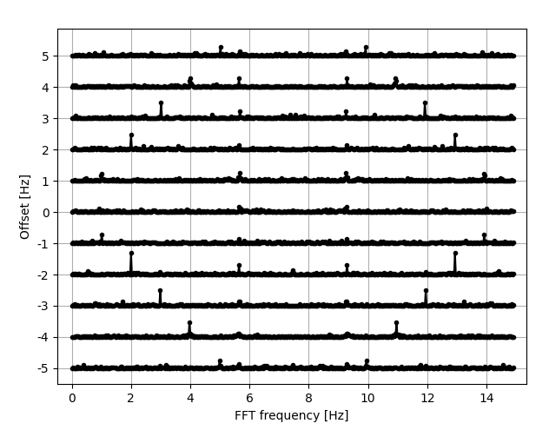
Bolometer measurements
Test signals
Signal offset [-5, 5] Hz with 1 Hz step
Downmixing happens at the bolometer
Beating signal detected at higher amplitudes
Test signals

Slide 19
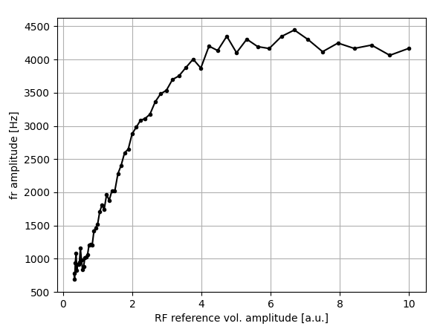
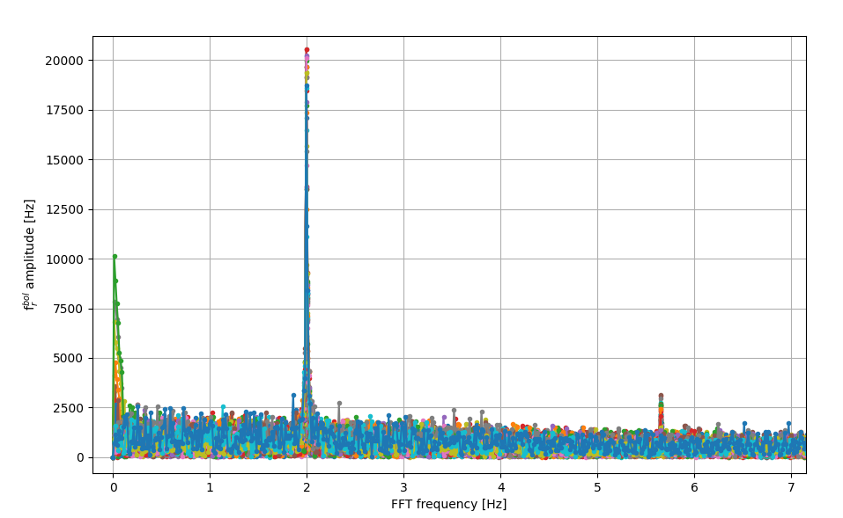
Bolometer measurements
Heater at 5.5 GHz
Test tone at 5.5 GHz + 2 Hz
Sweeping the heater power
Noise limit
Signal amplified relative to system noise
With different reference tone power
Test signal amplitude vs. pump amplitude
Relative to noise amplitude
SNR gets enhanced, plateaued at high pump amplitude
Thermal noise dominates (input)

Slide 20
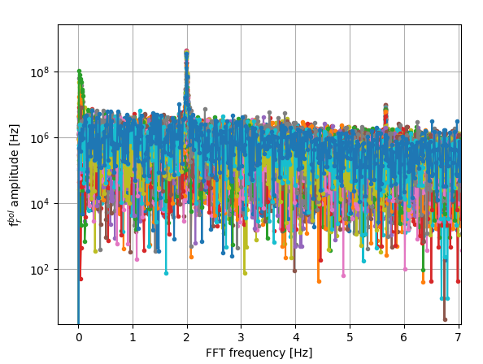
Bolometer measurements
Same plot, log scale
Heater at 5.5 GHz
Test tone at 5.5 GHz + 2 Hz
Sweeping the heater power
Noise limit
Test signal
Thermal constant
Signal amplified relative to system noise
With different reference tone power
Test signal amplitude vs. pump amplitude
Relative to noise amplitude
SNR gets enhanced, plateaued at high pump amplitude
Thermal noise dominates (input)

Slide 21
Challenges and solutions
Bolometer’s time constant: fundamental band-limit in intermediate frequency
More samples to be tested; more samples to be delivered
Double-sideband noise
3 dB SNR loss from image noise
I/Q demodulation with two bolometers / 90 degrees hybrid pumps
Gorynich JPA holders at CAPP → good synergy with the proposed design
Systematic bolometer resonance readout
Frequency-comb probe + fast digitizer

Slide 22
Thank you very much!

