Slide 1
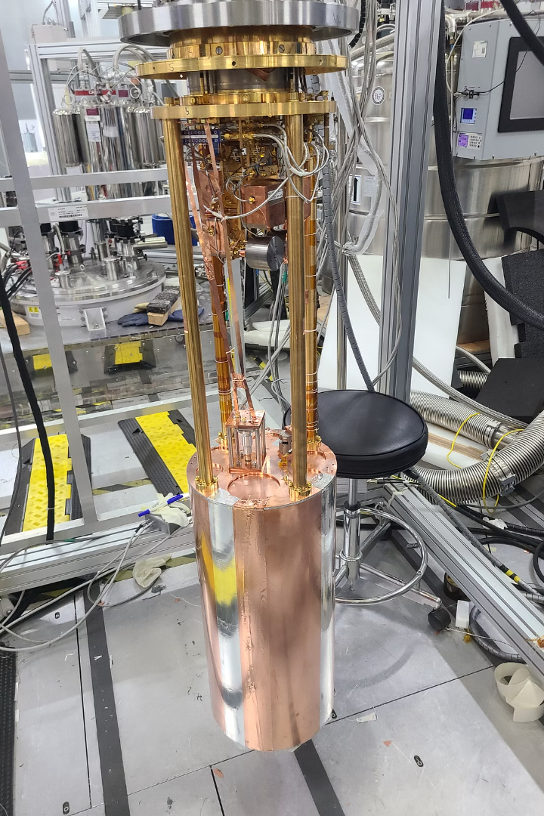
Broadband Lumped-Element Josephson Parametric Amplifier for Axion Search
Uchaikin Sergey for Quantum Sensing Team
IBS/Dark Matter Axion Group
2026-04-23
Notes:
Introduction to axion dark matter and the challenges of detection. Emphasize the importance of GHz-range haloscope and noise requirements.

Slide 2
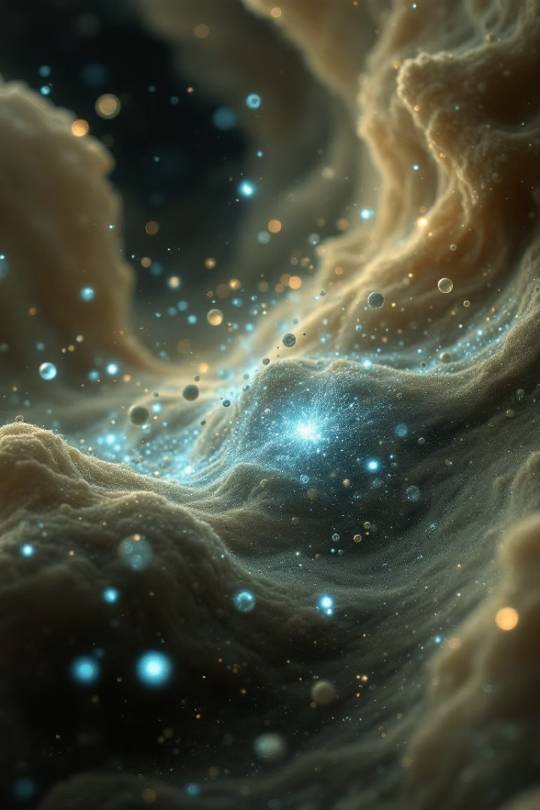


Introduction
Axion Dark Matter
A promising candidate to explain the universe's missing mass and CP violation.
DMAG’s Challenge
Detecting extremely weak signals across a vast frequency range (our goal: 1-6 GHz).
Notes:
Explain the challenge: our FD-JPA in 2020 only covered 30 MHz. Need to match cavity range with amplifier range.

Slide 3

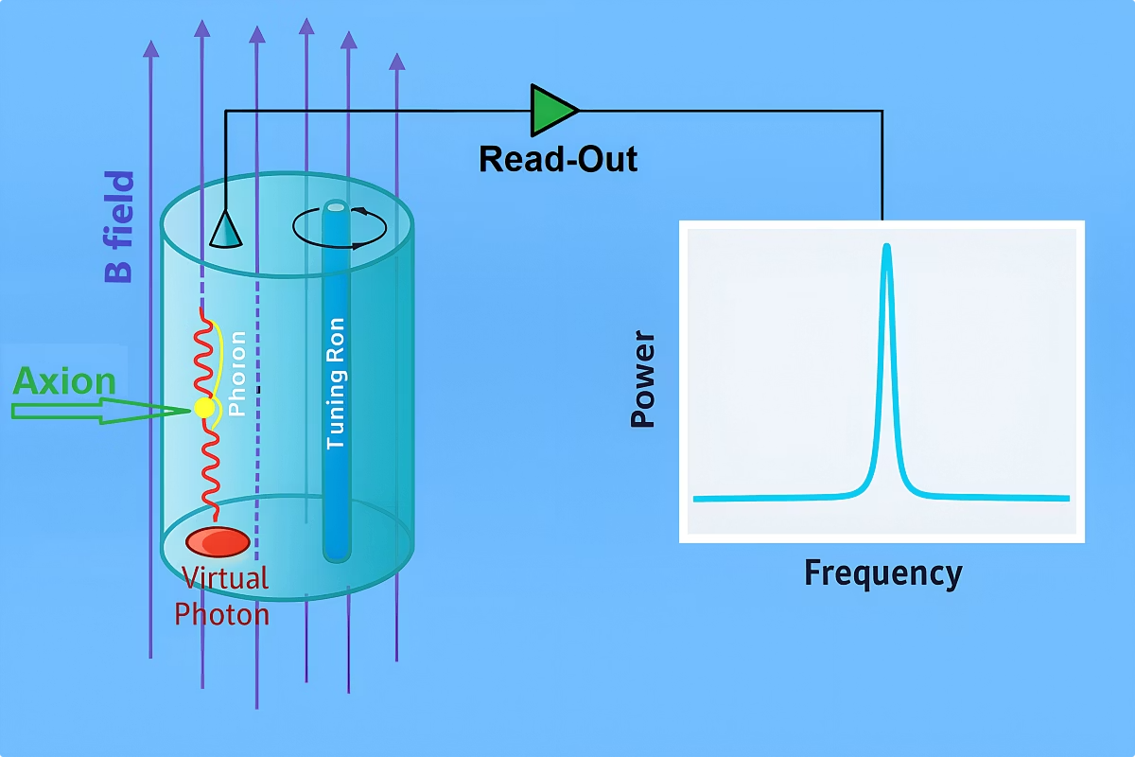



Axion Haloscope Detection Principle
Magnetic Field
Strong field creates conversion environment (in DMAG 8, 8, 12 and 12 Tesla) .
Axion Conversion
Axions convert to photons in cavity (Q is in the range of 30000_300000).
Signal Detection
Low-noise systems capture faint photon signals (noise is a few unit of the QNL).
Frequency range dictated by axion mass uncertainty.
DMAG/IBS
Notes:
Overview of axion haloscope principle: magnetic field, photon conversion in the cavity, quantum-limited detection.

Slide 4
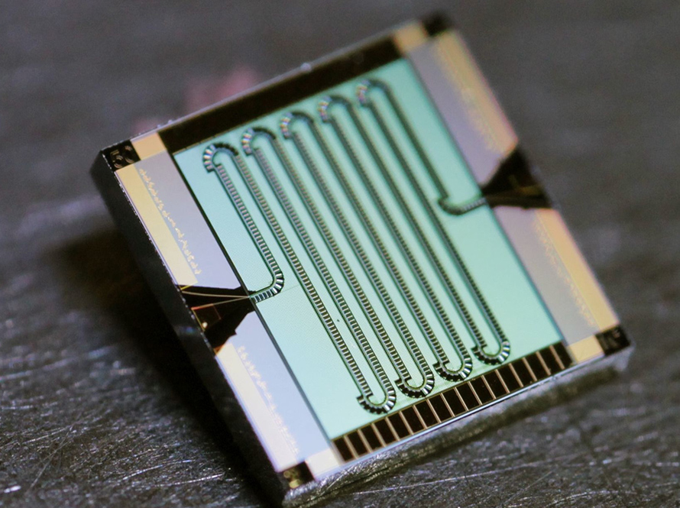
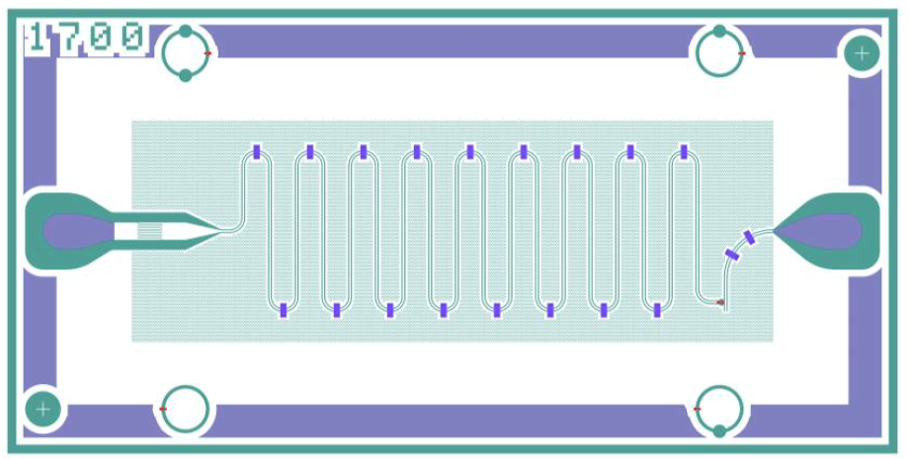

Optimal read-out:
TWJPA or Flux-Driven JPA?
Cavity for 1-6 GHz range
Tuning cavity range up to 300 MHz
Wideband Detection Challenge
Need to fit amplifier band or tuning range with cavity range >300 MHz
DMAG/IBS

Slide 5
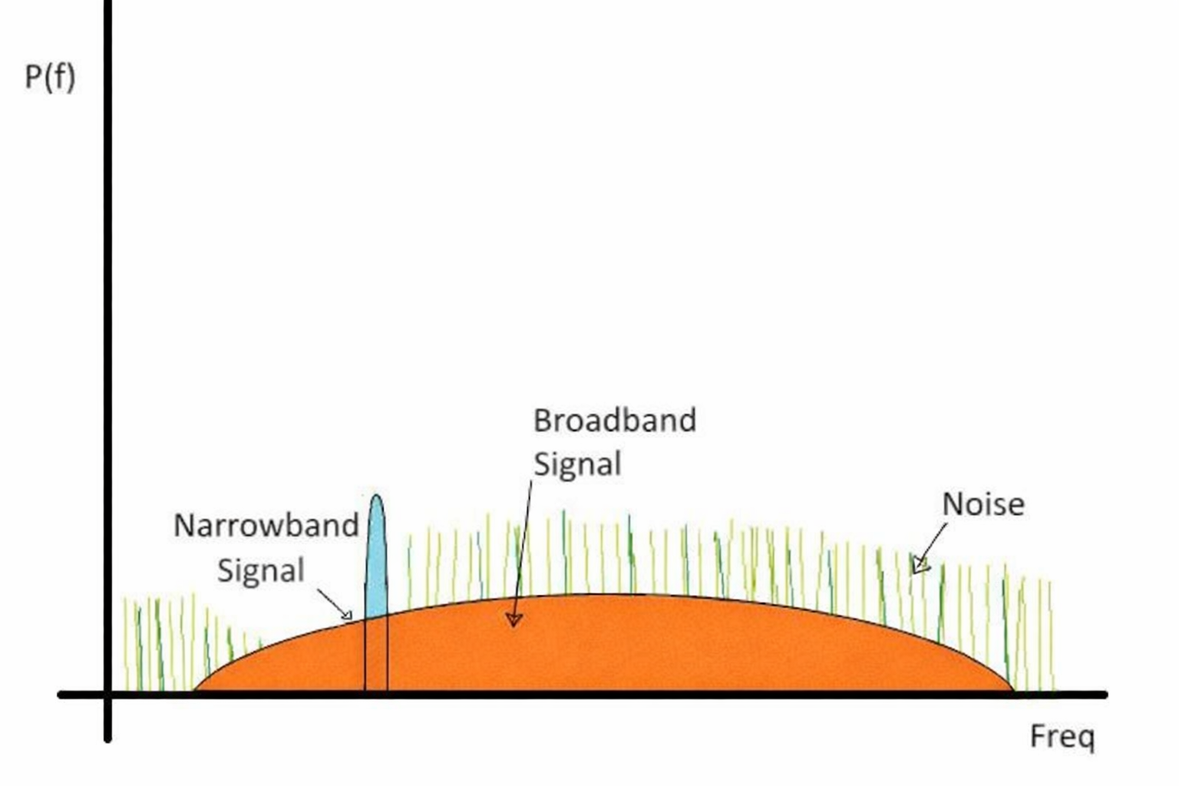
Broadband Amplification vs Narrowband Axion Signal
Mismatch of bandwidth
Axion signal: ultra-narrowband
TWPA: broadband amplification =>
Excess noise integration
Noise ∝ Δf
Signal occupies tiny fraction of band👉 SNR degrades
Dynamic range problem
Weak signal + large broadband noise
Requires:
high linearity
large dynamic range👉 Risk of gain compression
Impact
Reduced sensitivity 👉 Inefficient scanning
Broadband amplifiers are not optimal for👉 detecting narrowband axion signals

Slide 6
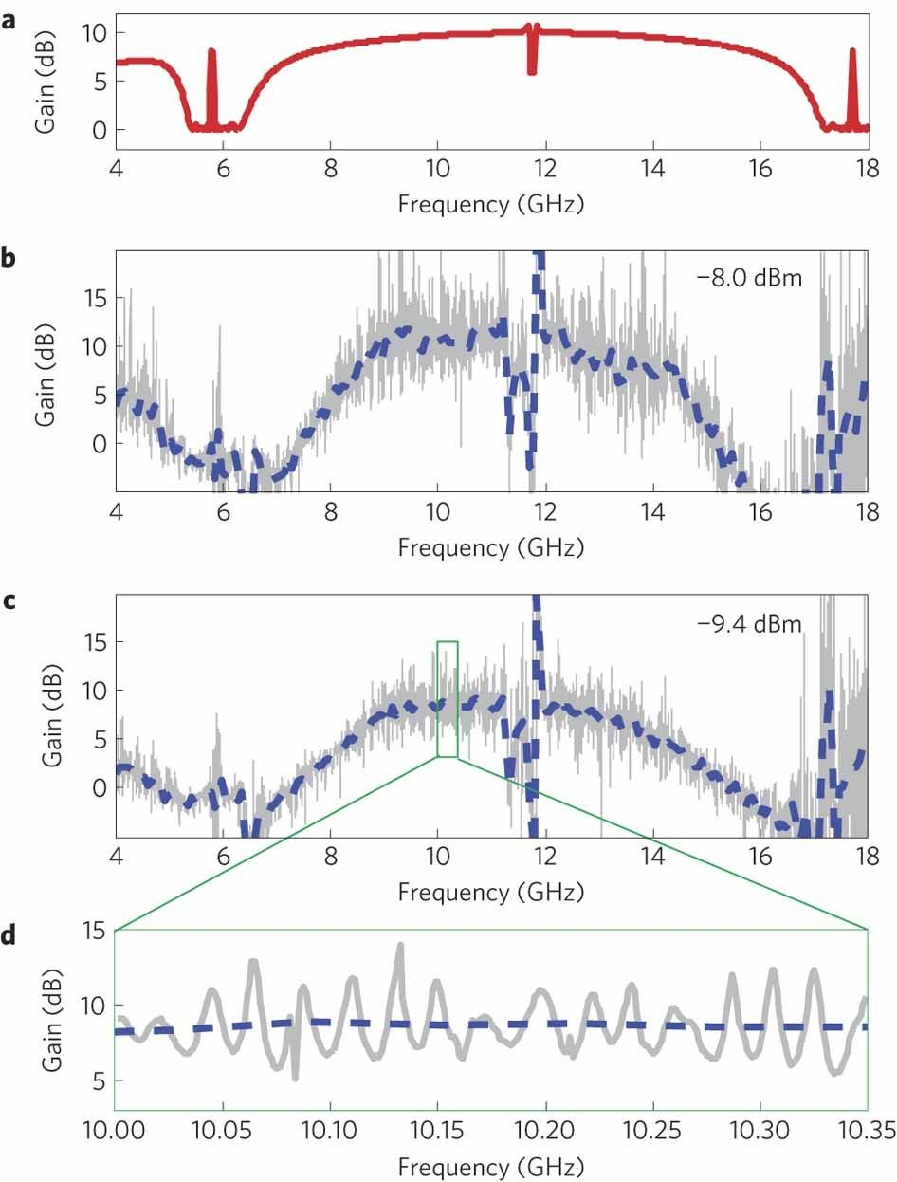
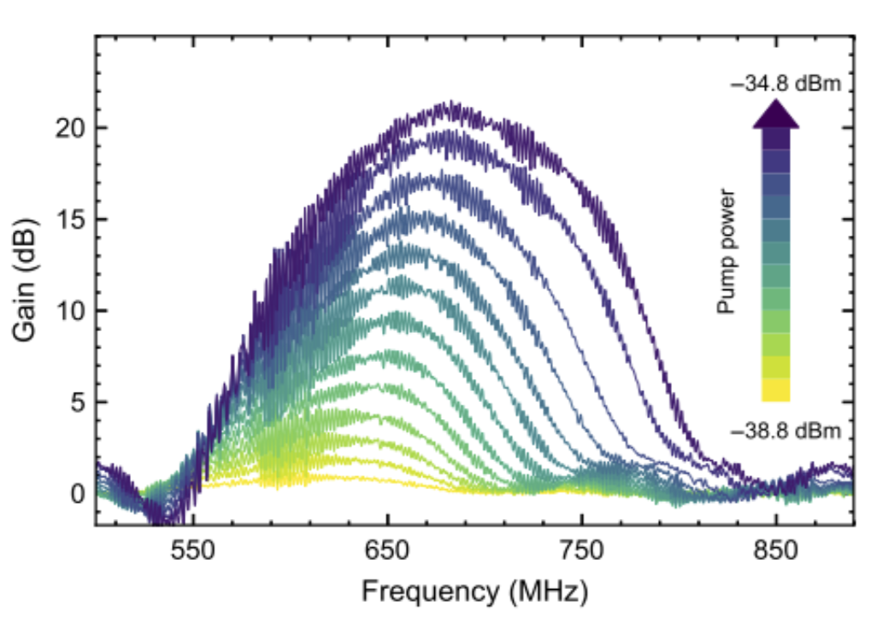
TWJPA: Gain Non‑Uniformity Problem
1) Gain strongly varies across frequency (ripple due to multi‑cell line & mismatch)
2) Response depends on pump power
Axion scan requires ultra‑flat response with ~5–10 kHz step
⇒ Gain ripple → non‑uniform sensitivity across scan
DMAG/IBS
https://doi.org/10.1038/nphys2356
https://doi.org/10.1103/PhysRevApplied.23.024063

Slide 7
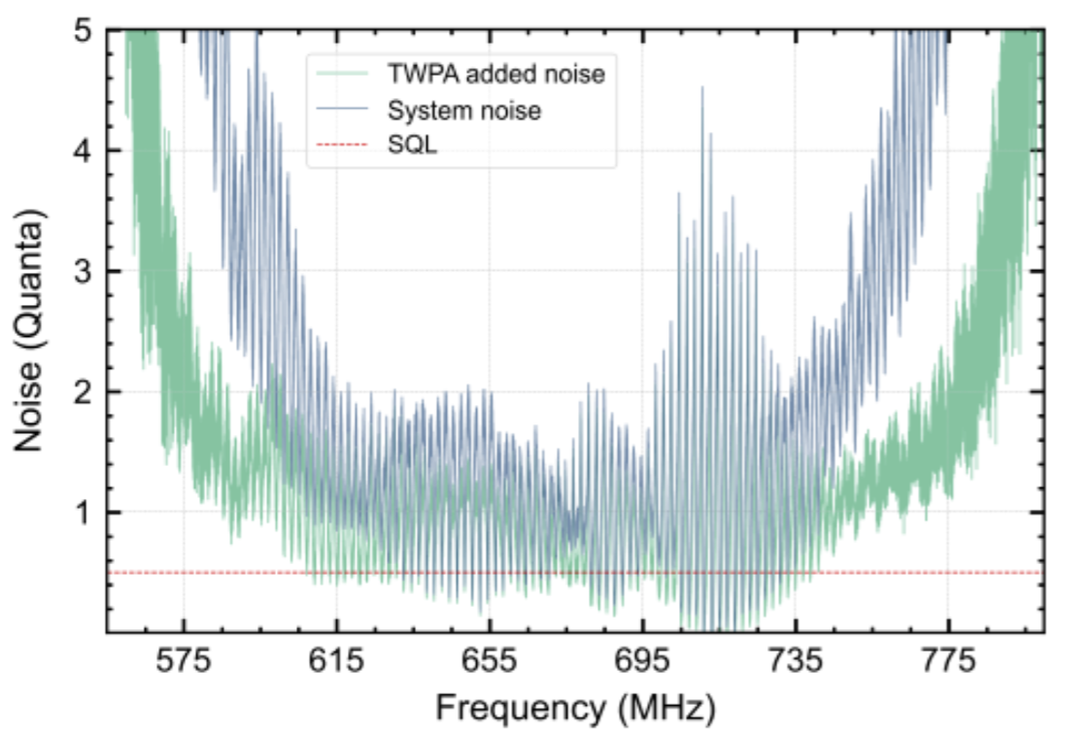
TWJPA: Noise Fluctuations Limit
Added noise fluctuates across band; deviates from quantum limit
Origin:
long transmission line
impedance mismatch
System noise inherits this structure
⇒
Frequency‑dependent sensitivity,
slower and less reliable axion scan
DMAG/IBS
https://doi.org/10.1103/PhysRevApplied.23.024063

Slide 8
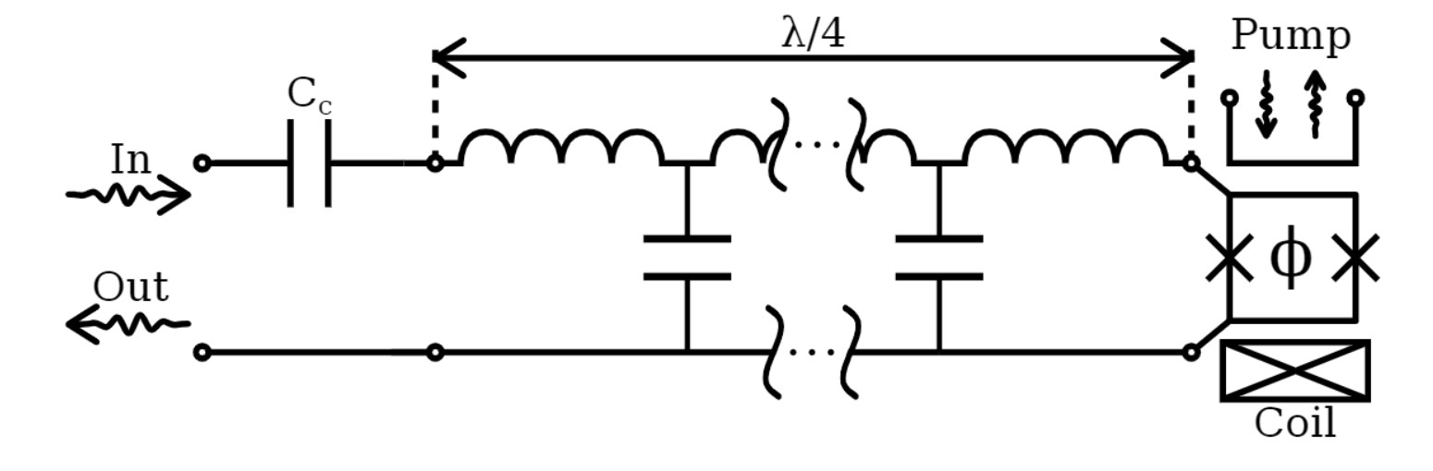
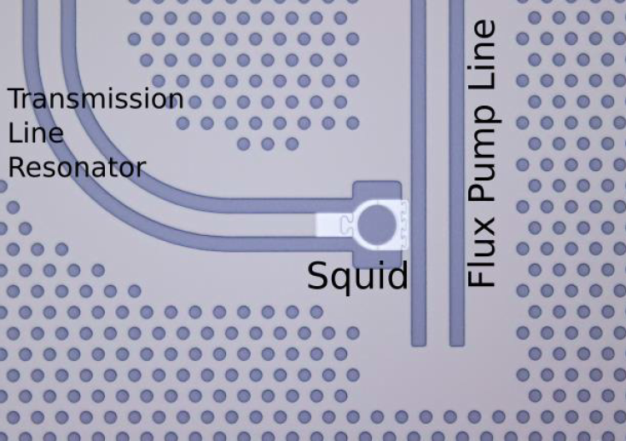
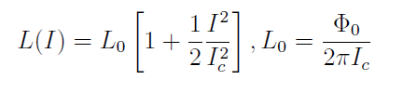

Flux-driven Josephson Parametric Amplifiers (JPA)
1) To get parametric amplifier a nonlinear element:
The nonlinear current-dependent inductance of a Josephson junction
2) To tune frequency:
Average inductance of a SQUID depends from flux bias Φ
Ic –critical current of the SQUID,
Φ0 – flux quantum, 2.069*10^(-15) Wb
I – persistent current, created by dc flux
DMAG/IBS
Notes:
How FD-JPA works: non-linear inductance, tuning via flux bias. Show equation and mention limitations.

Slide 9
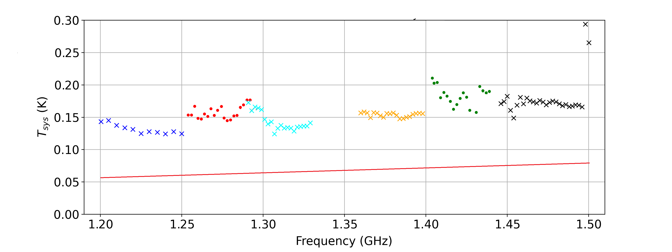
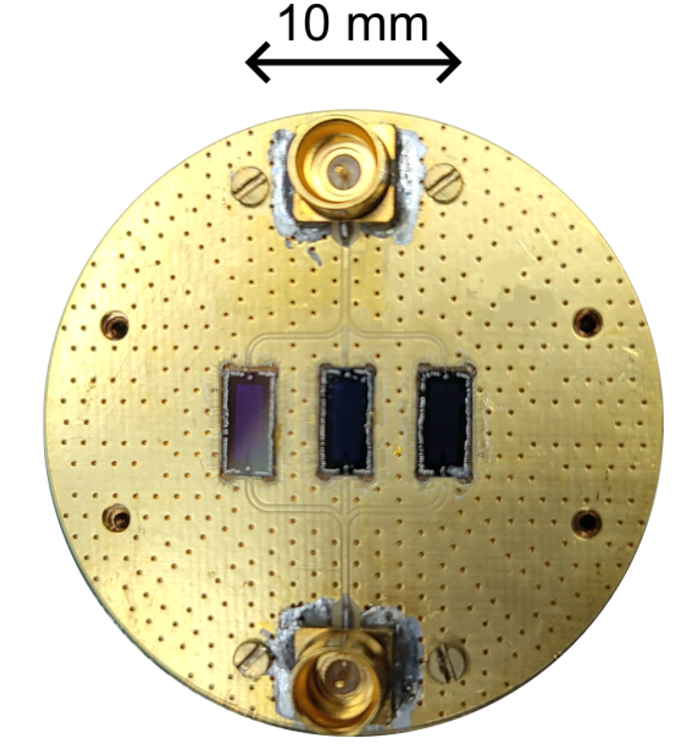
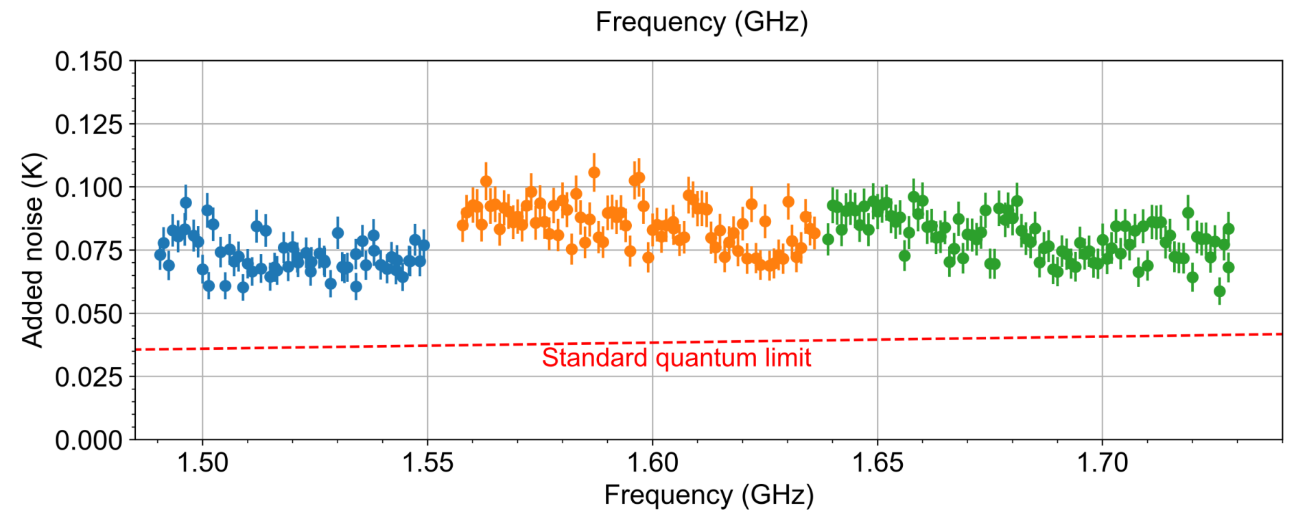
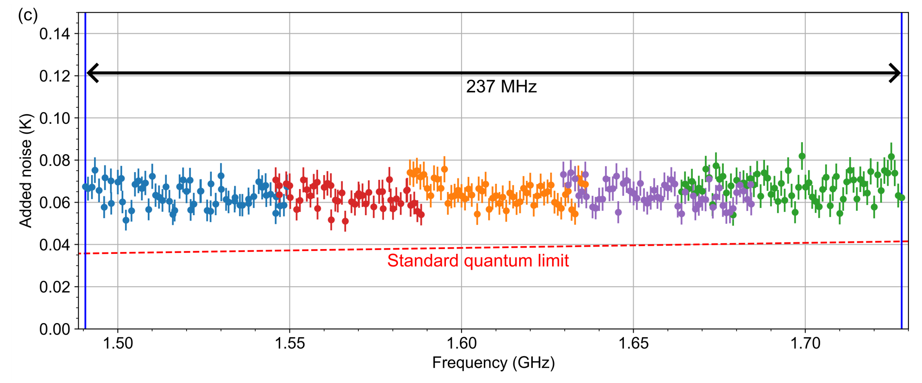
Multi-JPA Systems – Gorynych Set
Three JPAs
Frequency multiplexing
Combined in parallel in single read-out line.
JPA is selected by chose of pump frequency f_{PUMP},
f_{PUMP}~ f_{SIGNAL}.
300 MHz
Six JPAs
Parallel/series arrangements for optimal performance.
Performance
300 MHz bandwidth without noise penalty.
237 MHz
DMAG/IBS
Notes:
Gorynych set: 3 JPAs in parallel. 6 JPA combination with parallel/series config. Achieved ~300 MHz bandwidth.

Slide 10

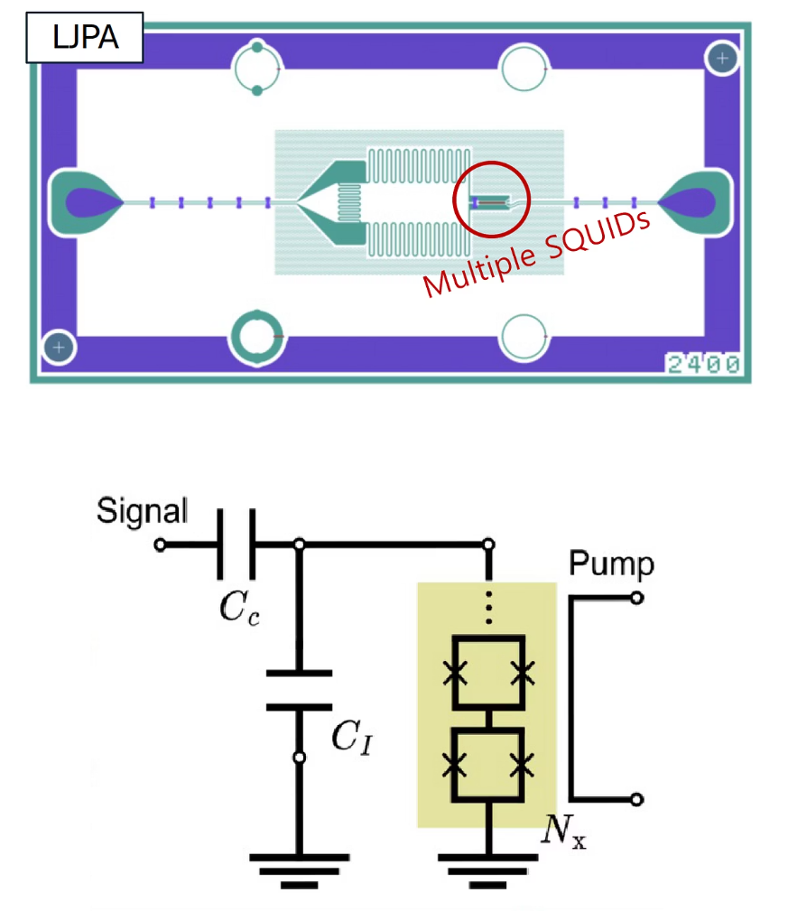
Lumped Element JPA (Lump JPA)
Design
Discrete components replace distributed elements.
No transmiting line is necessary
Need big interdigital capacitance.
Need higher inductance - a 5-10 SQUIDs in Series
Enhanced Tunability
No transmition line → Wider frequency range accessible with single device.
Reduced need for multiple amplifiers.
Integration
No change in TF line is necessary
DC flux bias need higher current → need some change in next design
DMAG/IBS
Notes:
Lumped-element JPA concept: no transmission line. Requires high inductance and interdigital capacitor. Better tunability.

Slide 11
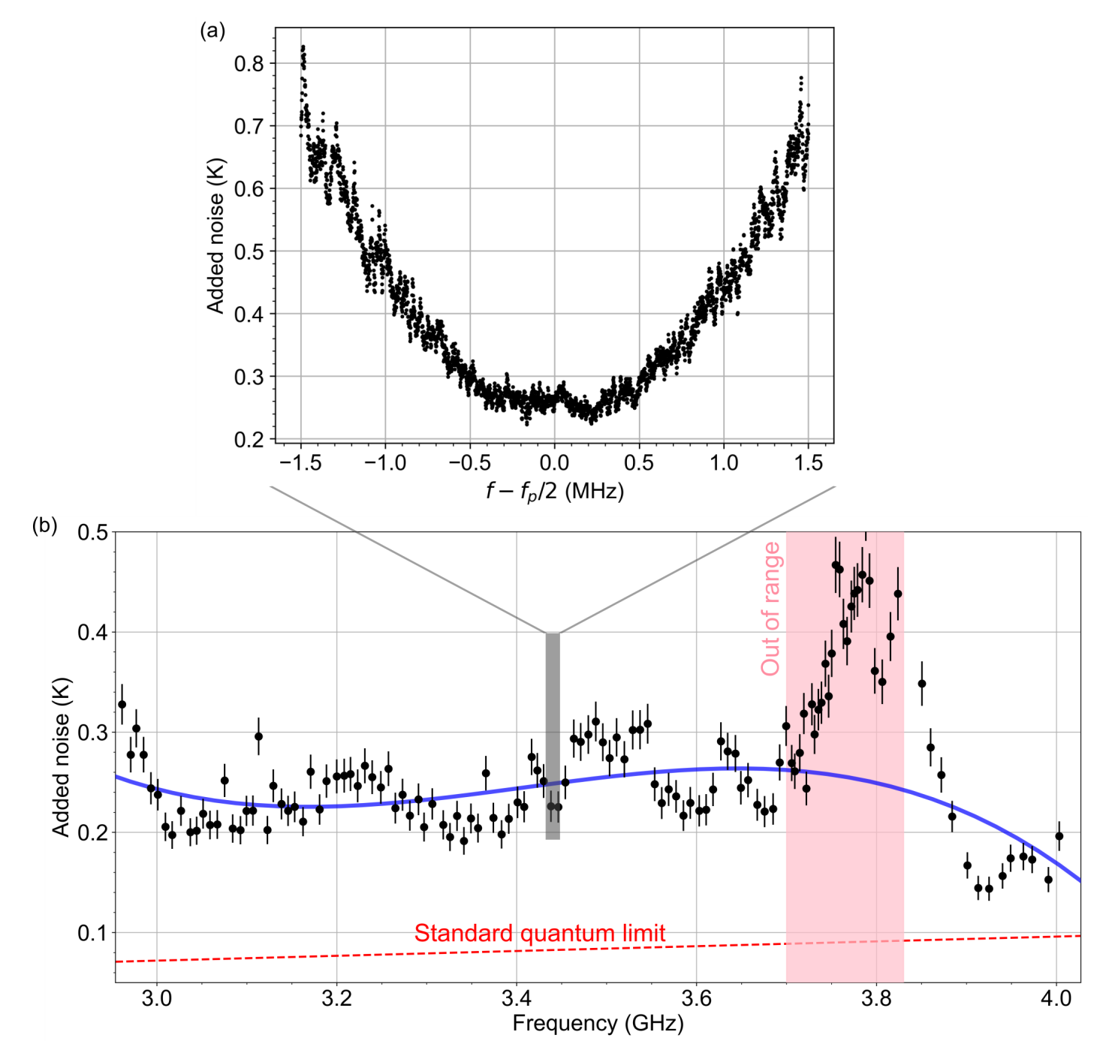
LJPA Noise Measurements
One frequency point noise
JPA Gain ~20 dB
In 3-4 GHz range
Noise compare with Quantum Noise Limit (QNL)
DMAG/IBS
Notes:
Noise measurement of Lump JPA: compares well with QNL. Bias heating issues below 2 GHz.

Slide 12
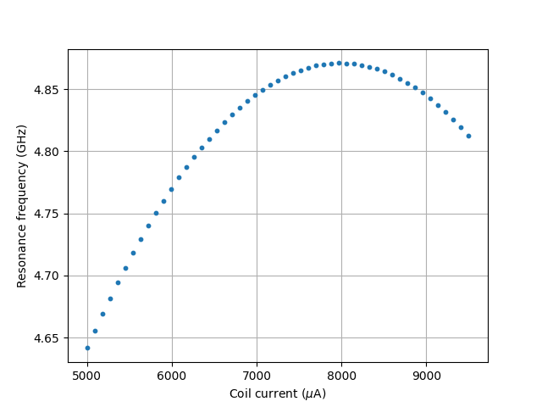
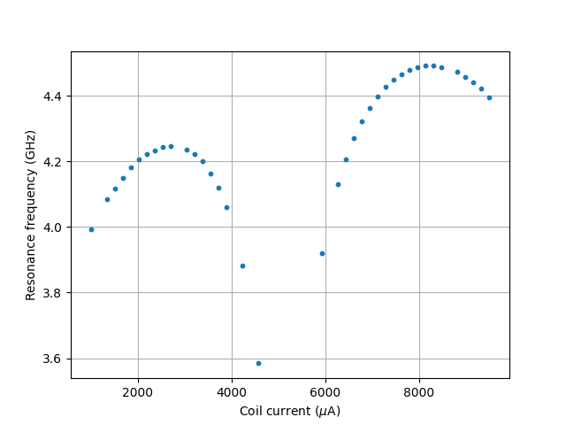
Resonance shift because of Flux trapping
ZFC
FC
ZFC method allows extending tuning range of L-JPA
DMAG/IBS

Slide 13

Flux trapping => Persistent current
ZFC
DMAG/IBS

Slide 14
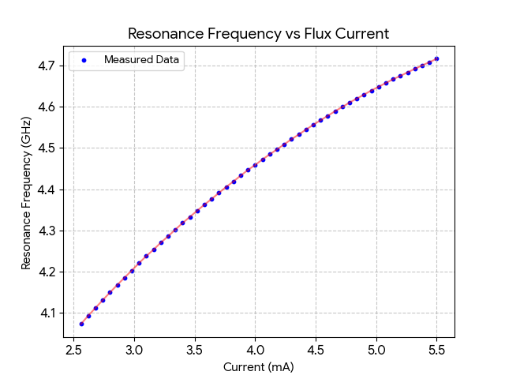
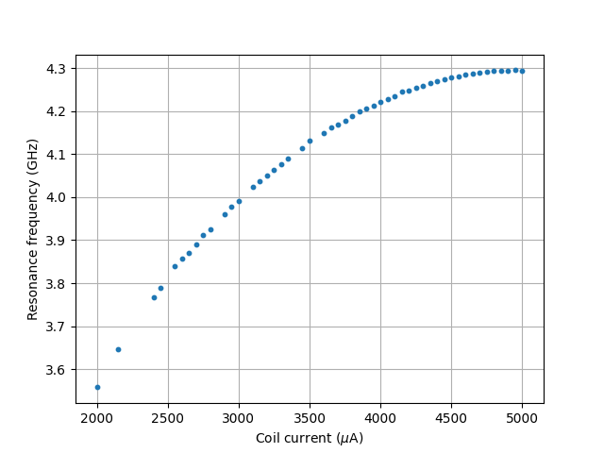
Further Tunable Range Enhance by Flux trapping
1 old JPA 30 MHz
1 modified JPA 60 MHz
3 JPA assembly 150 MHz
6 JPA assembly 300 MHz
Zero Field Cooling (ZFC)
4.1-4.7 GHz
Field Cooling (FC)
3.5-4.2 GHz
ZFC method allow increasing useful tuning range from 0.6 to 1.2 GHz
DMAG/IBS
Notes:
Characterization of Lump JPA: 1.6 GHz tuning, to compare I show band of our previous read-out. On the right picture is the gain paramap, a dependence of the gain from pump power and pump frequency. Within this border the gain exceed 20 dB.

Slide 15
Summary
For axion search flux-driven JPA are preferable for read-out because provide more smooth gain and noise characteristics in the frequency band
We can enlarge tuning range of the JPA using field cooling
DMAG/IBS

Slide 16
Quantum Sensing Team
Sergey Uchaykin
Boris Ivanov
Saebyeok Ahn
Minsu Ko
Seonjeong Oh
Pallavi Parashar
In collaboration with Riken, U. of Tokyo
Yasunobu Nakamura
Chih-Chiao Hung
Arjan F. van Loo
CI – SungWoo Youn
DMAG/IBS

Slide 17

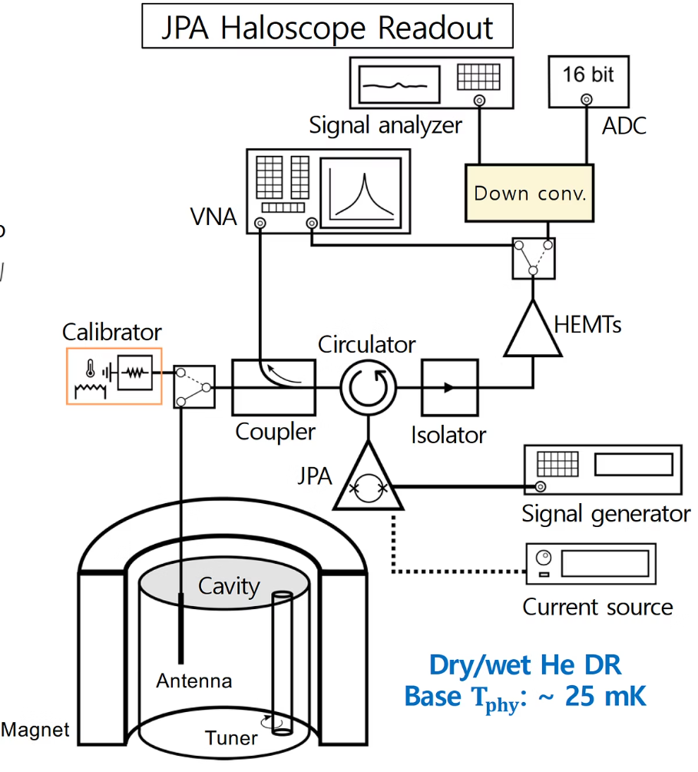




Read-out Chain Overview
Cavity
Resonant structure where axion-photon conversion occurs.
Amplifier (JPA)
Quantum-limited signal boosting.
Heterodyne Receiver
Frequency conversion and filtering.
DAQ
Data acquisition and analysis.
DMAG/IBS
Notes:
Describe the read-out chain: cavity, JPA, heterodyne receiver, DAQ. Emphasize noise and matching importance.

Slide 18
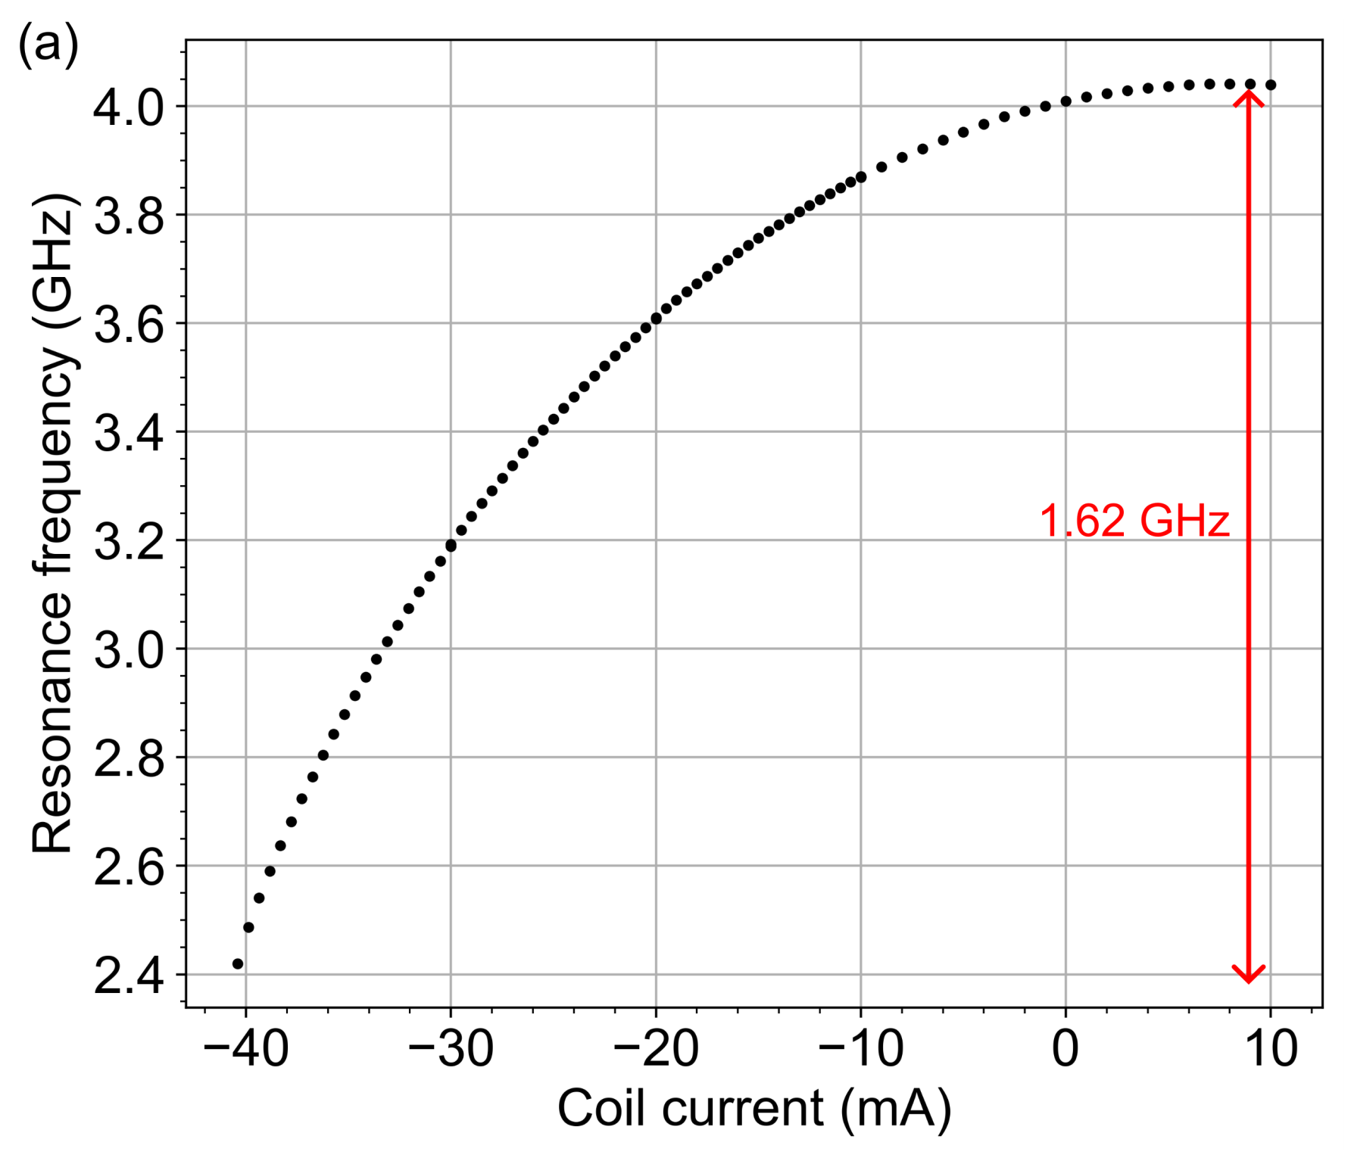
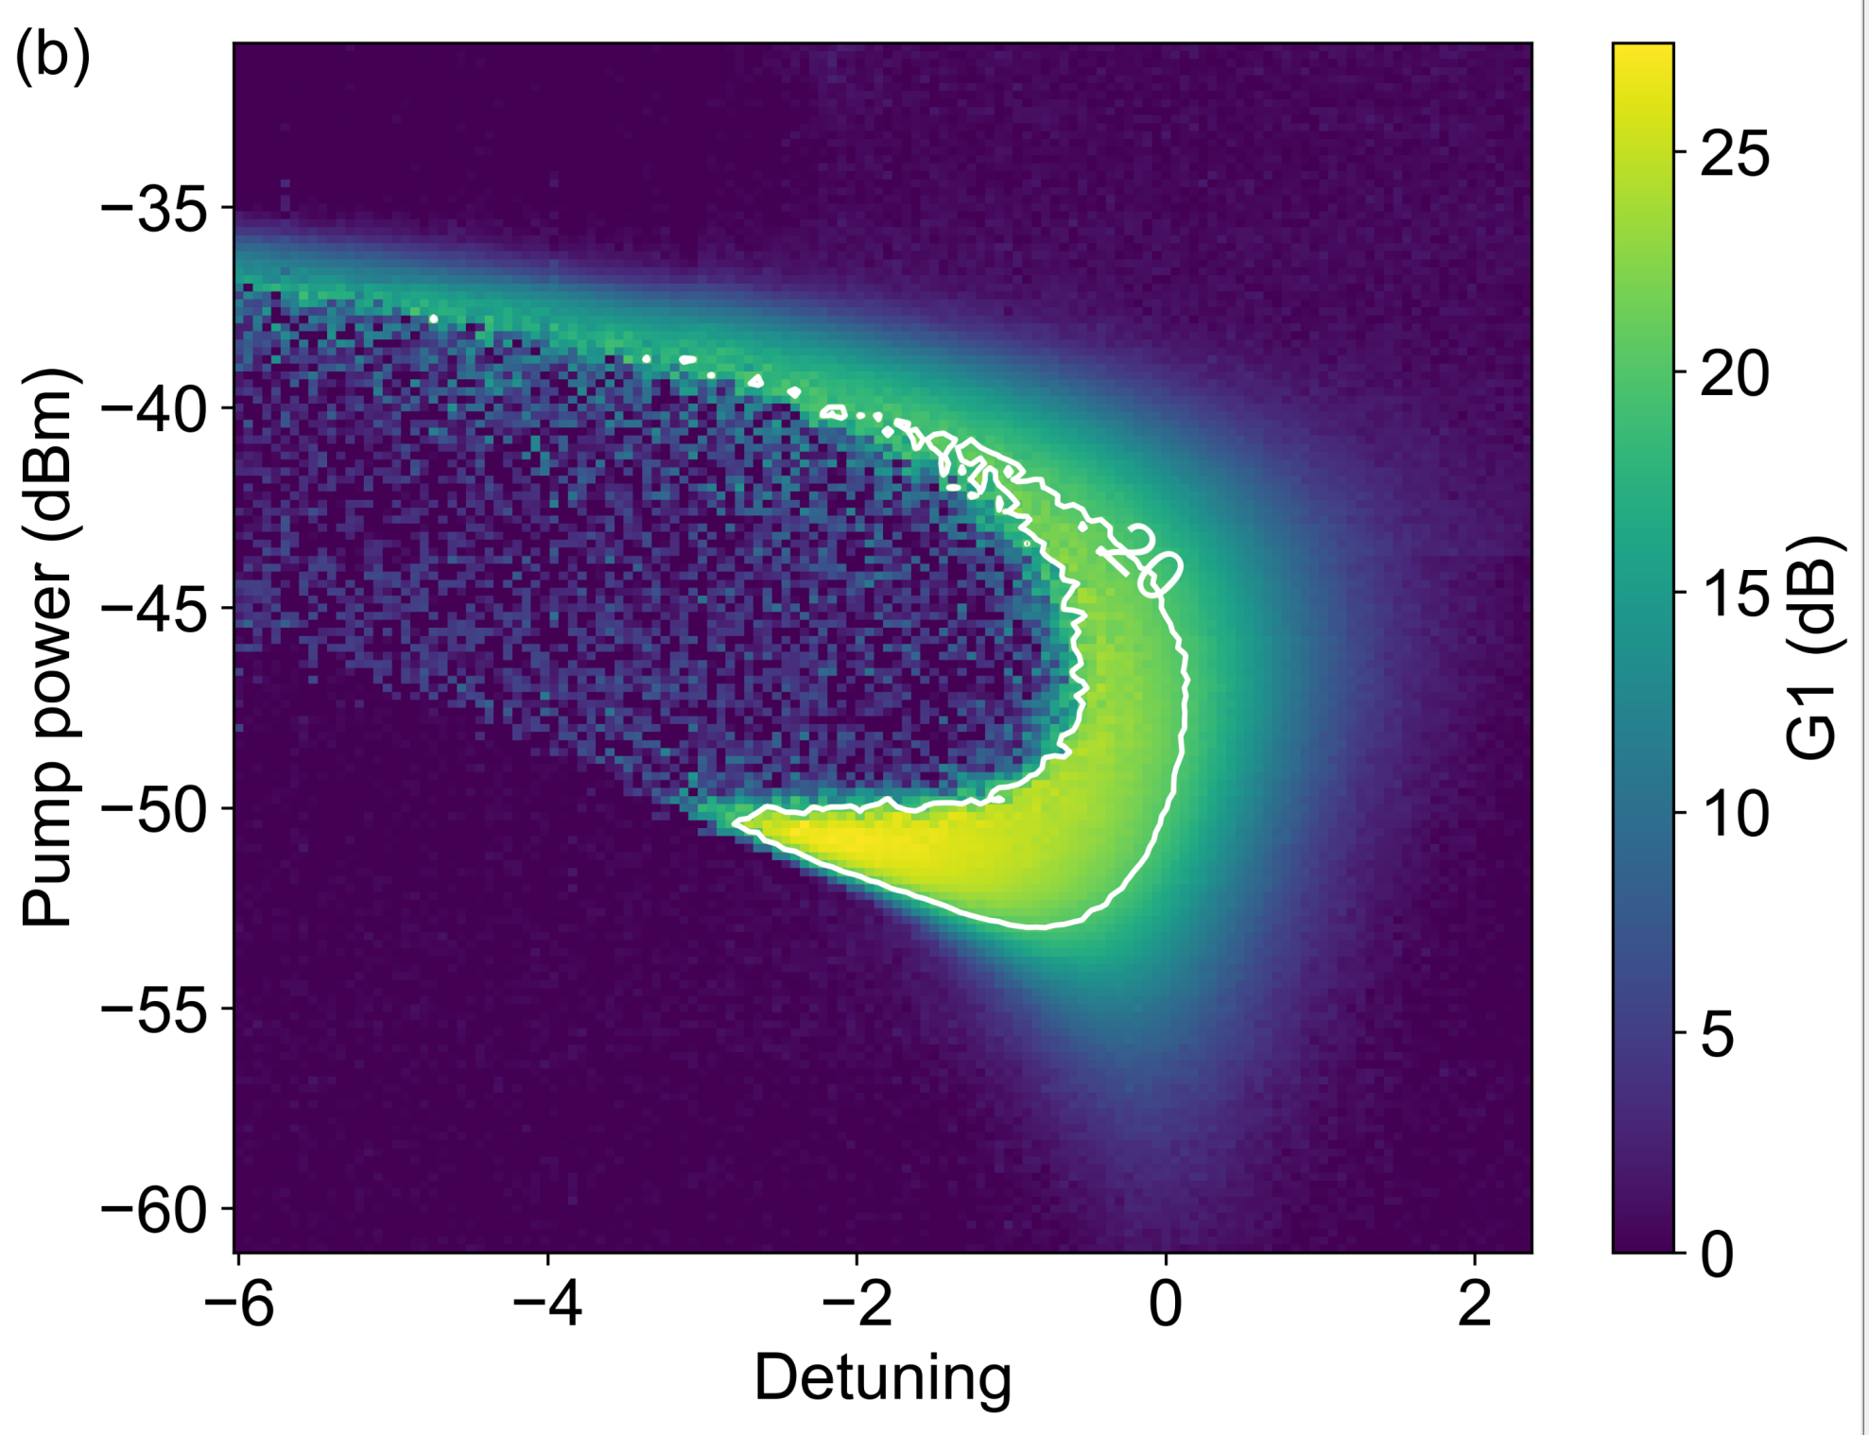
LJPA Characterization
Tuning with dc flux bias
~1620 MHz,
Gain Paramap
Gain vs (f_{PUMP},f_{DETUNING})
DMAG/IBS
Notes:
Characterization of Lump JPA: 1.6 GHz tuning, to compare I show band of our previous read-out. On the right picture is the gain paramap, a dependence of the gain from pump power and pump frequency. Within this border the gain exceed 20 dB.

