Slide 1
Continued Effort Towards Ultimate Performance for Accelerator Cavities
French Group |  |  | Japanese Group
Yasmine KALBOUSSI | Dr. | Irfu | Takayuki KUBO | Dr. | KEK
Claire ANTOINE | Dr.. | Irfu | Ryo KATAYAMA | Dr. | KEK
Thomas PROSLIER | Dr. | Irfu | Takeyoshi GOTO | Dr. | KEK
Enrico CENNI | Dr. | Irfu | Hayato ITO | Dr. | KEK
Grégoire JULLIEN |  | Irfu | Hitoshi HAYANO | Dr. | KEK
Fabien EOZENOU |  | Irfu | Takayuki SAEKI | Dr. | KEK
 |  |  | Yoshihisa IWASHITA | Dr. | Kyoto Univ.
^{[1]} e.g. LAPP/IN2P3, Irfu/CEA, IPNS/KEK, etc.
³ IN2P3, Irfu or KEK
⁴ e.g. French Embassy, other CNRS or CEA programs, PICS, European grants, JSPS, RIKEN, Universities ….;

Slide 2
Continued Effort Towards Ultimate Performance for Accelerator Cavities
Japan Part
Review of Thin Film Theory T. Kubo
Experimental Effort for TF R. Katayama
3GHz cavity H. Hayano
Vertical & HF free EP T. Goto
Penetration Depth Meas. Y. Iwashita

Slide 3
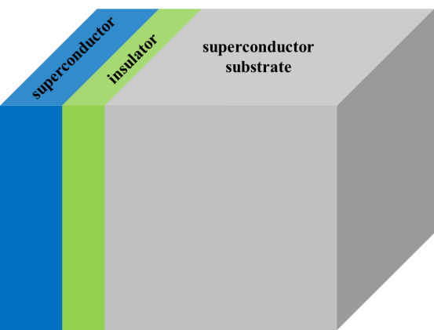
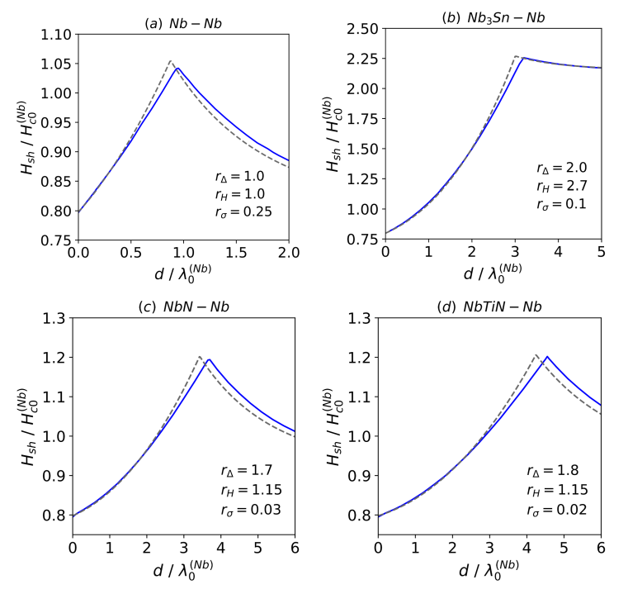
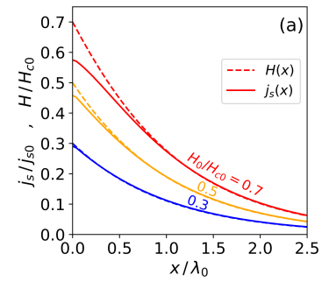
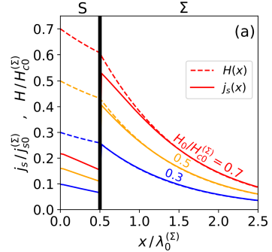
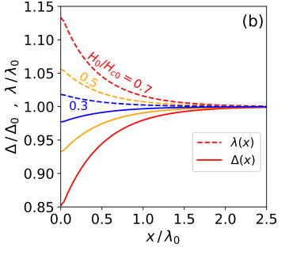
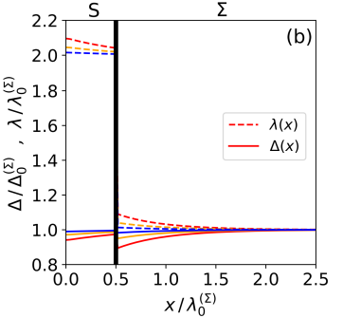

Engineer the Meissner Effect
Enhance the accelerating gradient
Dirty Nb or a large $λ$ material
Nb
There is the optimum thickness, where the achievable field is significantly enhanced.
Bulk Nb
Multilayer
structure
450mT (105MV/m)
210mT (50MV/m)
x
Using the multilayer structure, we can engineer the screening current distribution.
240mT (56MV/m)
240mT (56MV/m)
We can suppress the pair breaking in the top layer.
T. Kubo, Y. Iwashita, and T. Saeki, Appl. Phys. Lett. 104, 032603 (2014).
A. Gurevich, AIP Adv. 5, 017112 (2015).
T. Kubo, Supercond. Sci. Technol. 30, 023001 (2017).
T. Kubo, Supercond. Sci. Technol. 34 045006 (2021).
T. Kubo,
SUST 34 045006 (2021).

Slide 4
Continued Effort Towards Ultimate Performance for Accelerator Cavities
Japan Part
Review of Thin Film Theory T. Kubo
Experimental Effort for TF R. Katayama
3GHz cavity H. Hayano
Vertical & HF free EP T. Goto
Penetration Depth Meas. Y. Iwashita

Slide 5
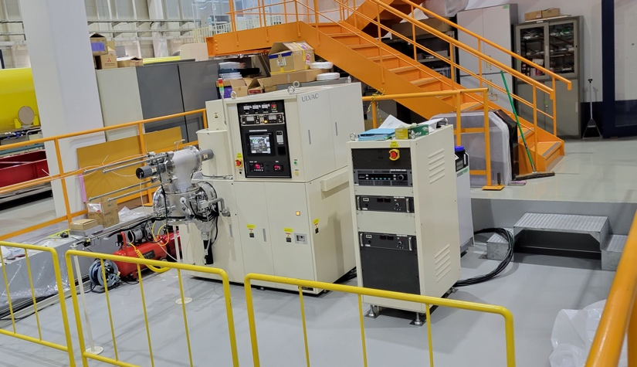
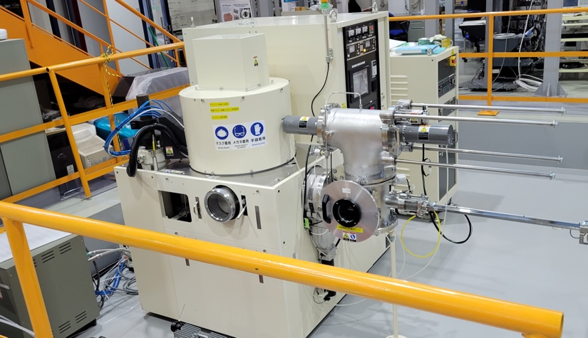
DC magnetron sputtering apparatus
Front View
DC magnetron sputtering apparatus was introduced to KEK COI on 20240319.
This apparatus enable to do DC magnetron sputtering to two different objects:
  Flat substrate (up to φ2-inch)
  3 GHz cavity
DC power sources of 4 kW × 2 and 5 kW×1 are prepared.
Ar gas line ×3 and N2 gas line×1 are installed.
DC power source
Side View
Cavity
Coating Chamber
Substrate
Coating
Chamber
Load-lock Chamber

Slide 6


DC magnetron sputtering apparatus
TOP
For substrate, the schematic illustration is shown in the left figure.
We can create the mixture layer consisting in Nb and Sn with 6-inch Nb and Sn targets.
By annealing this one, we can synthesize Nb3Sn films.
On the other hand, an insulation layer such as AlN can be created by using Al target.
substrates
Bottom
Nb flux
Sn flux
Nb
Sn
Al

Slide 7
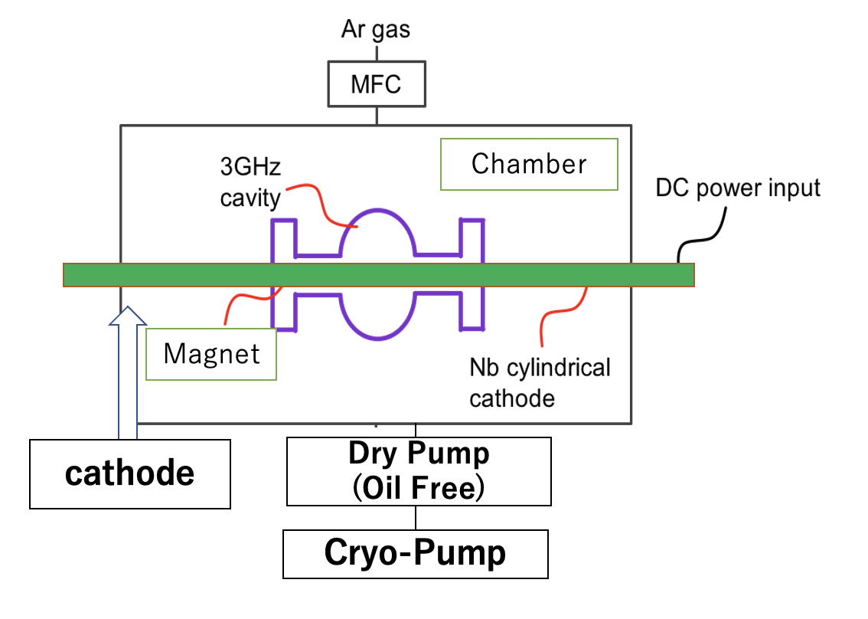
DC magnetron sputtering apparatus
For cavity, the schematic illustration is shown in the left figure.
Nb sputtering can be done with Nb rod cathode.
Composite cathode of Nb and Sn are under development.

Slide 8
Continued Effort Towards Ultimate Performance for Accelerator Cavities
Japan Part
Review of Thin Film Theory T. Kubo
Experimental Effort for TF R. Katayama
3GHz cavity H. Hayano
Vertical & HF free EP T. Goto
Penetration Depth Meas. Y. Iwashita

Slide 9
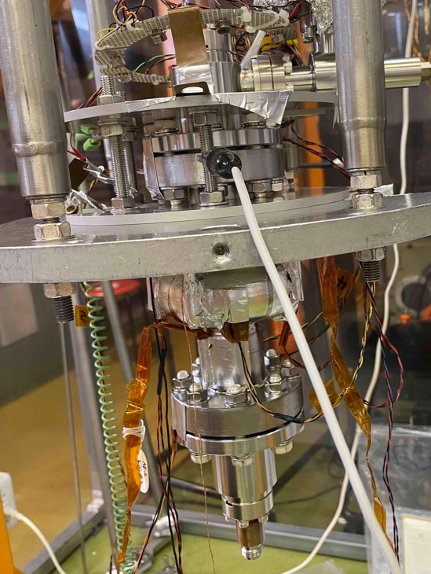
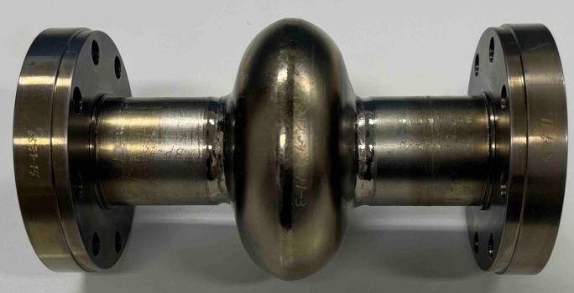
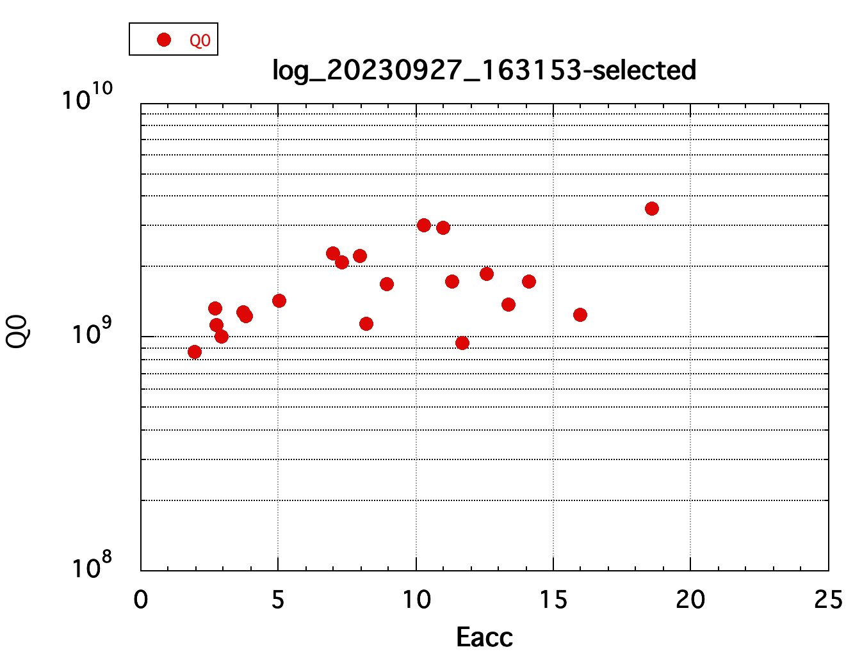
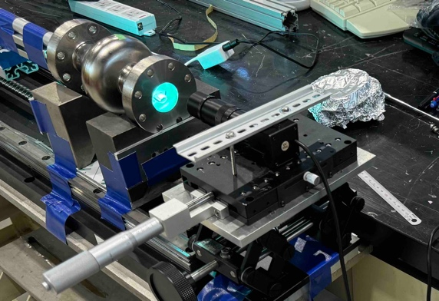
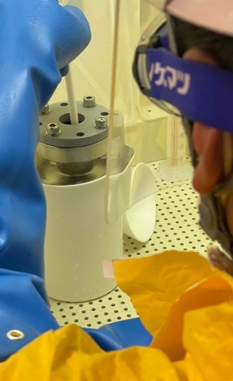
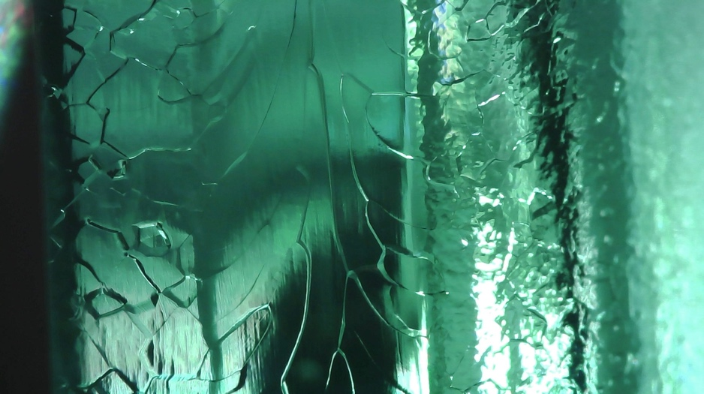
3GHz Cavity No.1 2K Vertical Test at STF
Cavity at STF VT
VT system is being set up.
Perform measurements prior to thin film coating.
Nb-flange with pure-AL hexagon seal, 158 µm BCP, no-EP, no-anneal, with 120degreeC baking
Nine CERNOX and six Fluxgate sensors are used.
Cavity observation
Eacc=18.6MV/m, Q0=2.8E9 at 2K
heating at 90 degree equator
f=2.992172GHz at 2K
Points scattered because phase lock did not work well.
Steps at EP-I, anneal, EP-II, HPR, 120º-bake are to be measured.
Inner surface 85 degree equator
close to the heating point 90degree.
No defect found.
BCP (158µm)

Slide 10
Continued Effort Towards Ultimate Performance for Accelerator Cavities
Japan Part
Review of Thin Film Theory T. Kubo
Experimental Effort for TF R. Katayama
3GHz cavity H. Hayano
Vertical & HF free EP T. Goto
Penetration Depth Meas. Y. Iwashita

Slide 11
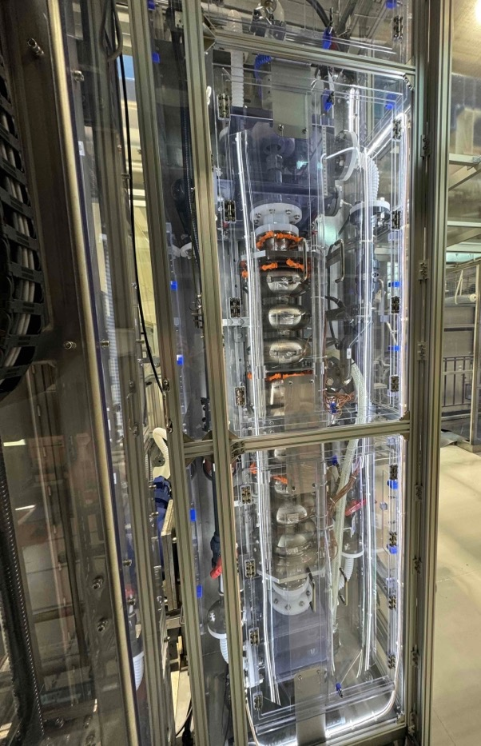
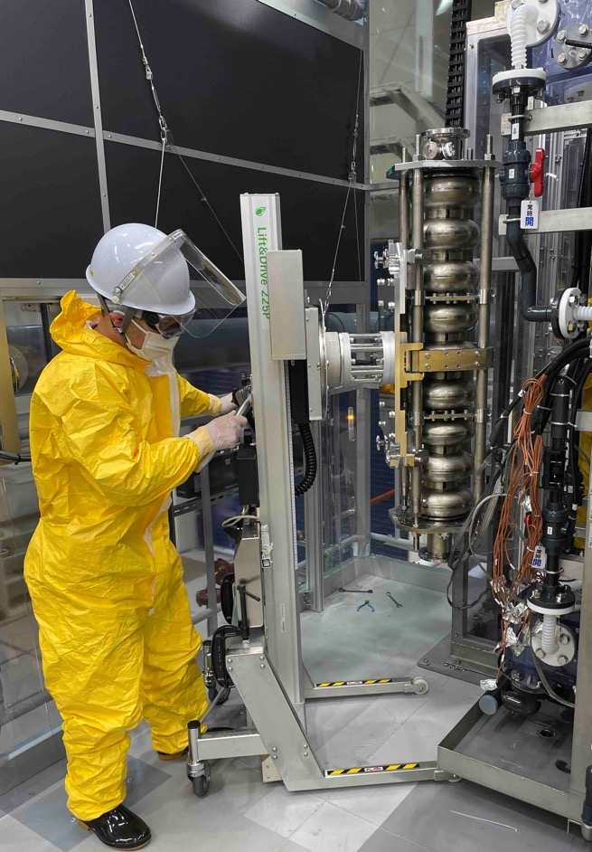
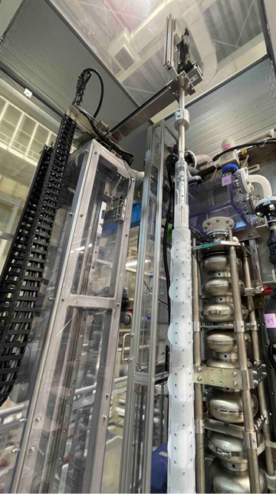
Development of Vertical electropolishing (EP) for 9-cell cavity at COI KEK
VEP operation started in December 2022.
- Improved operational safety and simplified mechanism compared to horizontal EP system.
- Ti-jacketed cavities can also be EP processed.
EP bed and cover to install cavity
Lifter to carry 9-cell cavity
Ninja cathode

Slide 12
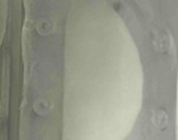
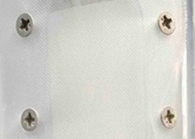
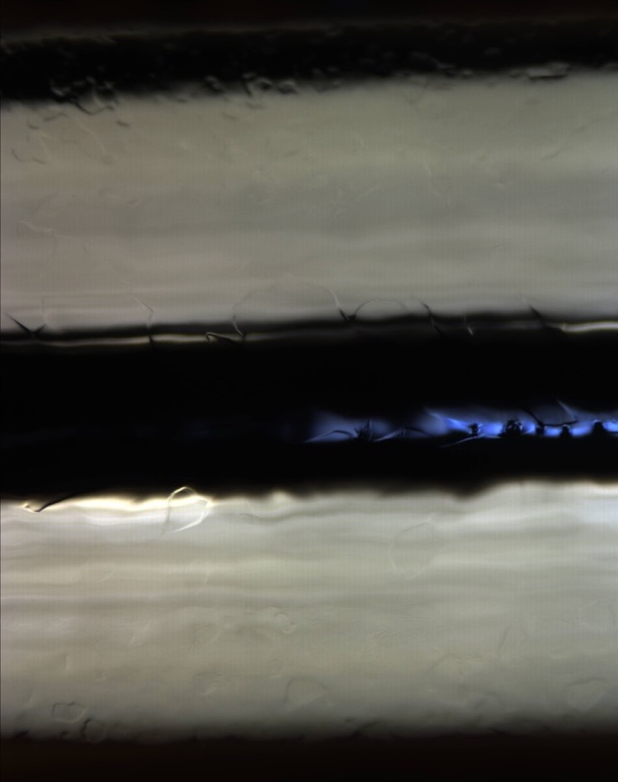

Fine EP (EP2): 10 μm (17 V，~10 mA/cm²).
- There were multiple scratches on a part of the iris.
>> The cathode countersunk screw on the cathode surface might be in contact.
>> These scratches were not found with the PTFE screws.
>> Ready for EP2 treatment of 9-cell cavities.
Inner surface of cavity after EP2
Ninja cathode surface
Replaced with PTFE screws
Iris

Slide 13
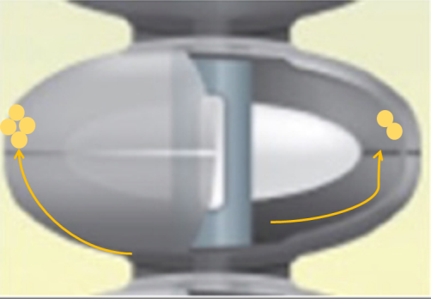
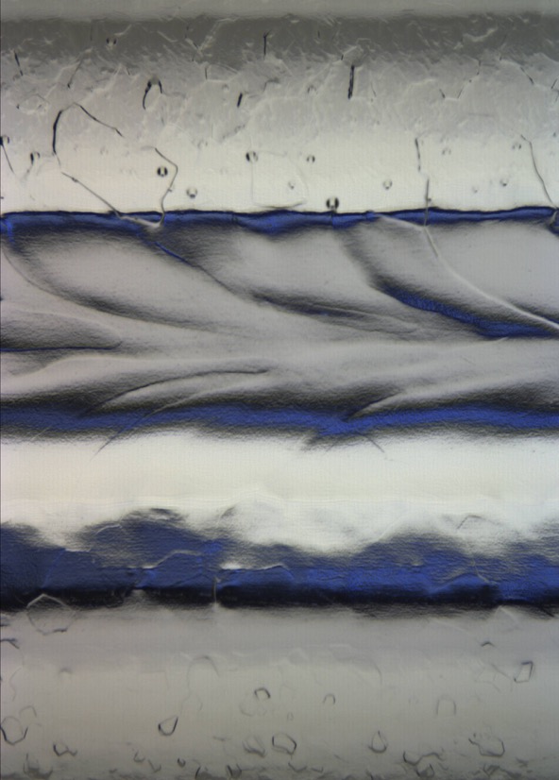
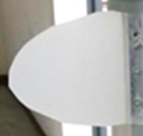
Bulk EP (EP1) 80 μm (~33 V，~40 mA/cm²)
- Cluster of pits observed above equatorial area of inner surface because of H₂ gas bubbles.
equator at cell#1 after EP
cluster of pits
PP wings
weld seam
The PTFE wings were replaced with more rigid polypropylene (PP) wings.
>> The PTFE wings were not rigid enough to stir the electrolyte, and the H₂ gas bubbles might stick on the cavity surface.
To reduce the formation of H₂ gas bubbles, lower the voltage to about 25V for the next time.

Slide 14
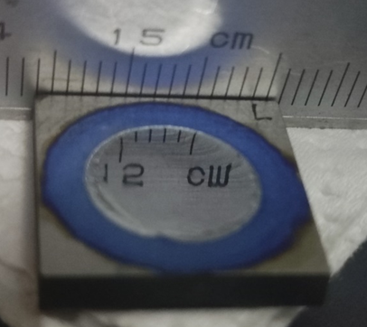
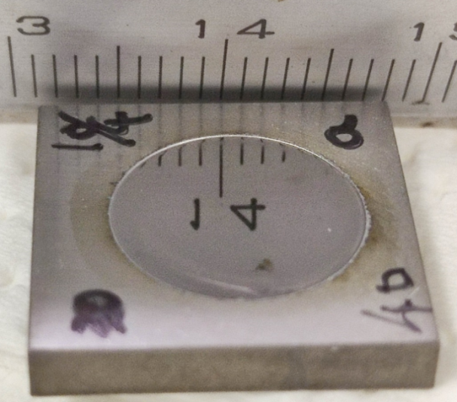
Development of HF free EP of Nb with organic solvents
Problems of HF-EP for Nb
- Hydrofluoric acid (+ sulfuric acid) is very dangerous as gas and liquid. >> high cost of EP process
- In the EP reaction, hydrogen atoms derived from water molecules in the electrolyte are absorbed into Nb.
>> Nb-H is formed in Nb, and the SRF performance of the cavity is very limited (especially, E_{acc}).
>> These problems can be solved by developing an EP process that uses organic solvents containing less water molecules in the electrolyte.
(1) Electrolyte: ethanol and sulfuric acid
>> 150~300 mA/cm^{2 .}
Current density is 5~10 times of HF-EP.
>> Polishing time is 1/5~1/10.
The flash point of ethanol is below room temperature. (11°C)
(2) Electrolyte: ammonium fluoride in ethylene glycol
>> ~70 mA/cm² >> Polishing time is the half.
Ethylene glycol has a high flash point and low fire hazard.
(3) Electrolyte: potassium fluoride in ethylene glycol + additives
>> ~110 mA/cm² >> Polishing time is 1/4.

Slide 15
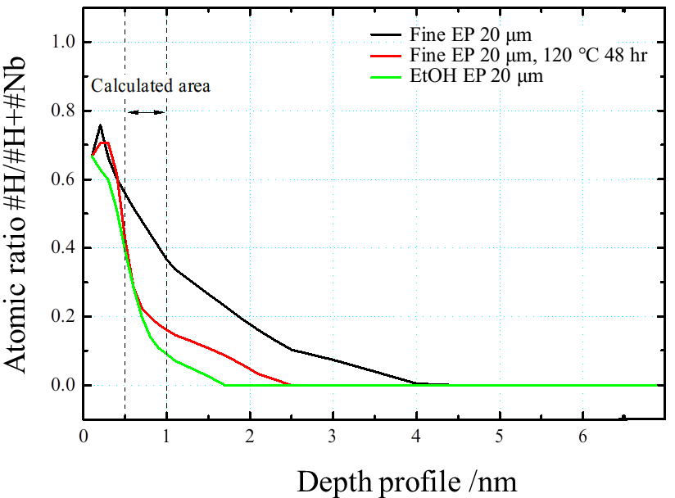
Quantitative analysis of hydrogen into Nb surface layer with high-resolution elastic recoil detection analysis (HR-ERDA)
EP1 + 800℃ anneal + EP2 + 300℃ for 3 h bake
EP1 + 800℃ anneal + 300℃ for 3 h bake
800℃ anneal + EtOH EP 20 μm
measurement condition:
instrument: HRBS500
(KOBELCO)
incident ion: N⁺(480 keV)，
scattering angle: 30º
detection angle : 70º
sampling current: ~4 nC,
irradiation: 0.06 μC.
Nb substrates treated with EtOH-sulfuric acid EP show more reduced hydrogen concentrations than HF EP2 and subsequently heat-treated substrates.
[H] = 0 at 4 (black)，2.5 (red), 1.7 nm (green).
>> Because the organic liquid electrolyte has fewer water molecules than conventional HF-H₂SO₄ solutions, less hydrogen is taken up when the oxide film is stripped during the EP reaction.

Slide 16
Continued Effort Towards Ultimate Performance for Accelerator Cavities
Japan Part
Review of Thin Film Theory T. Kubo
Experimental Effort for TF R. Katayama
3GHz cavity H. Hayano
Vertical & HF free EP T. Goto
Penetration Depth Meas. Y. Iwashita

Slide 17
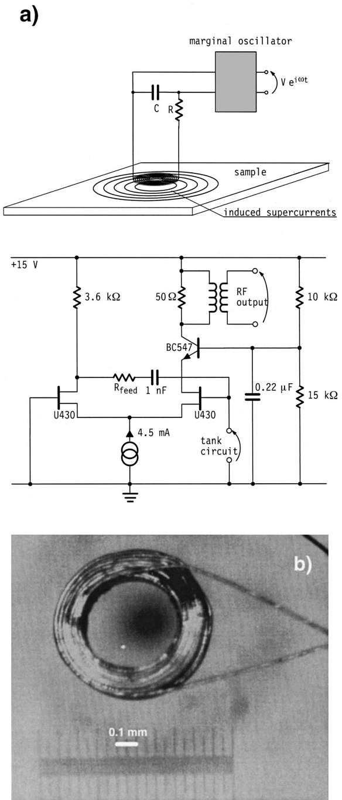
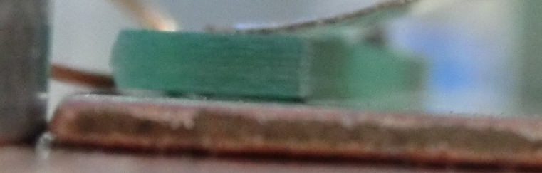
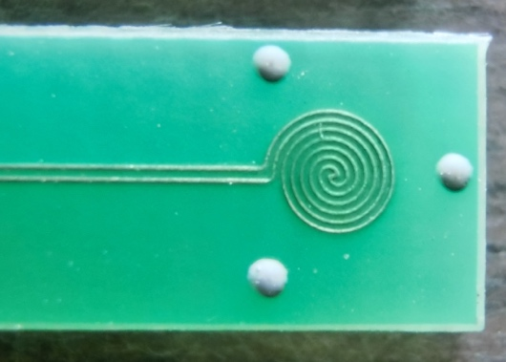
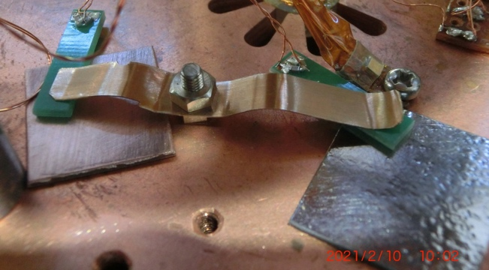
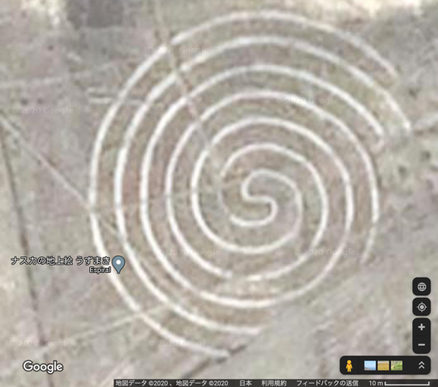
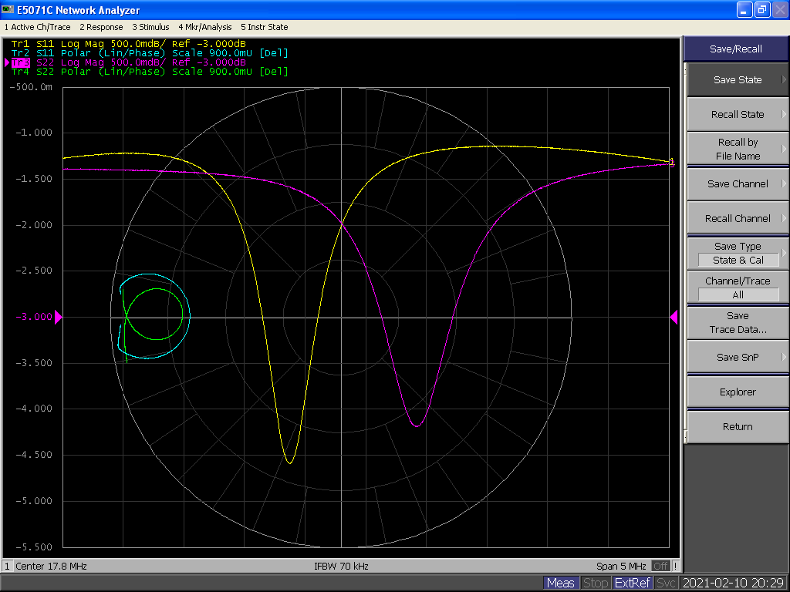
Penetration Depth Measurement
Spiral coil on PCB
Resonance circuit
~ø2mm
Gap is kept by the bumps
Coil-2
Coil-1
Insulating cover layer
Silk layer 20µm
Cu
Coil pattern
Nb
Preliminary
Ch1:Nb ,Ch2:Cu
Hz
Nazca terrestrial painting
K
(f_{Nb} - f_{Cu}) as a function of temperature.
Absolute calibration methods need to be established.
Too small to make!
“Very high resolution measurement of the penetration depth of superconductors by a novel single-coil inductance technique”, A. Gauzzi, et al., RSI 71, 2147–2153 (2000)

Slide 18
Continued Effort Towards Ultimate Performance for Accelerator Cavities
French Part
Vertical electropolishing F. Eozenou
Multilayers Y. Kalboussi / T.Proslier
  Principle
  Deposition
  Characterization

Slide 19
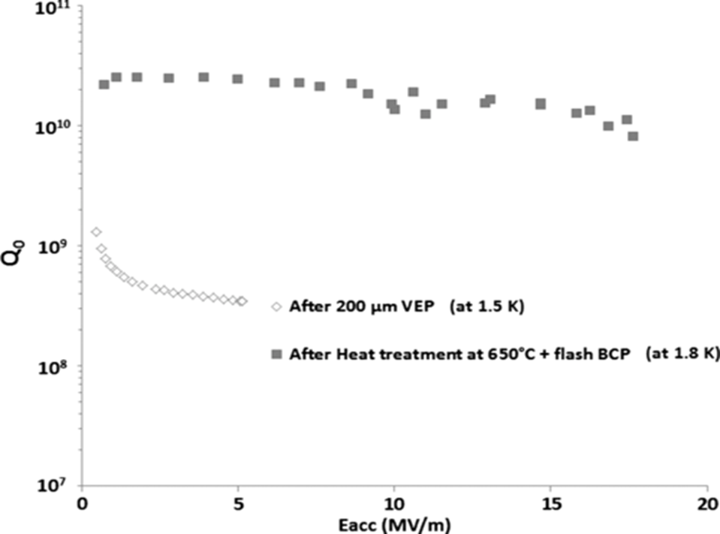
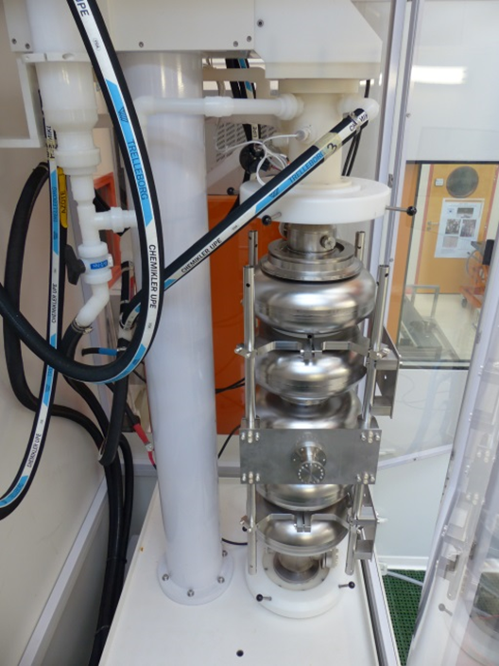
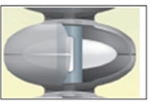
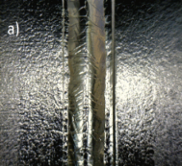
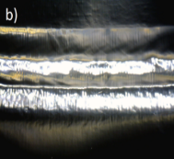
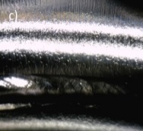
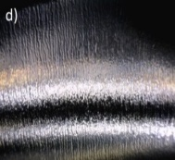
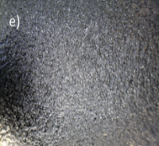
INCEPTION OF VEP AT SACLAY. TREATMENT OF SPL CAVITY (2014)
VEP Set-up at CEA Saclay. Designed for EP of large cavities such as SPL (1m40, 100L).
  Acid capacity 300L
  Power supply 20V 1.5kA
  Initial treatments with rod cathode
After Heat treatment at 650ºC +
flash BCP (@1.8K)
Continuous improvement of the process through previous FJPPN Accelerator R&D programs, implementing KEK-Marui Technology (704MHz & 1300MHz)
Strong Q-disease
After 200 µm VEP (@1.5K)
VEP USING ROTATING NINJA CATHODE
TECHNOLOGY BY MARUI GALVANIZING CPNY
ROTATING TEFLON WINGS FOR STIRRING
EFFICIENT HYDROGEN REMOVAL
IMPROVEMENT OF HYDROGEN
EVACUATION MANDATORY
PARAMETERS
Large cathode area
Rotation speed: 20rpm
Voltage 19-20V
Controlled temperature: cooled acid (T<15°C)
+ water spray
Removal rate 0.1µm/min
Strong Sulphur odor → Ethanol Rinsing
SPL cavity equipped with rod cathode
Typical surface morphologies after >100µm VEP with rod cathode at different locations.
  The weldings at a) equators, and b) irises are smooth.
  Bubbles stripes are observed at the proximity of irises c) and d).
  In the areas between equators and irises e) the surface is rougher.

Slide 20
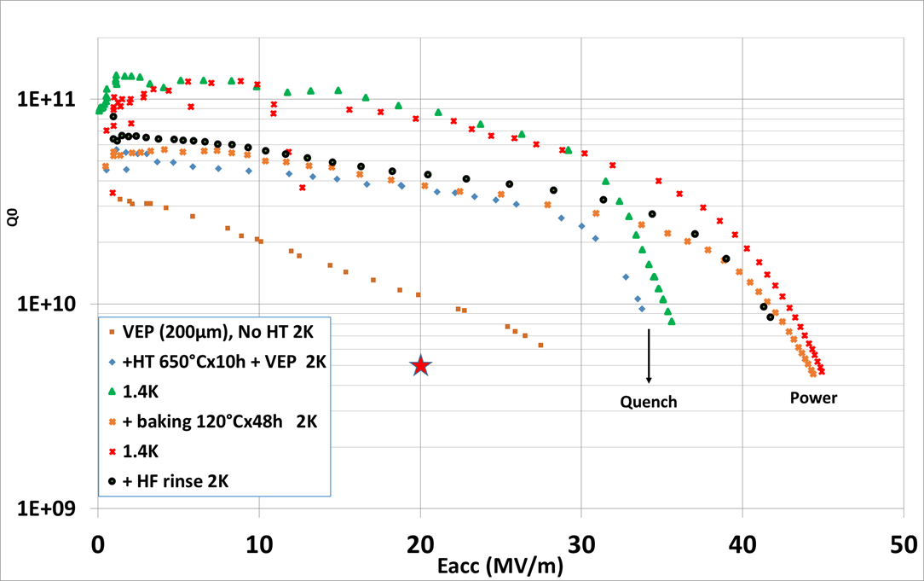
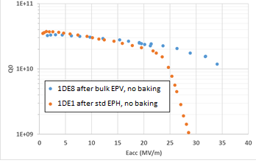
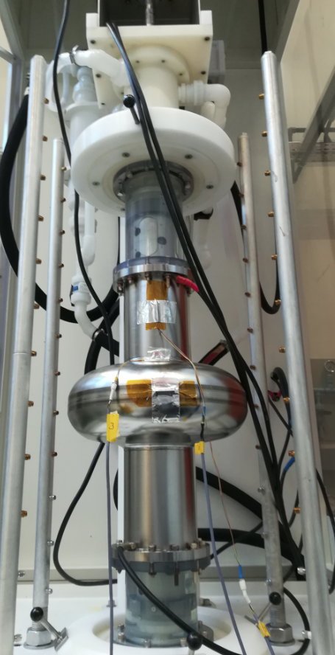
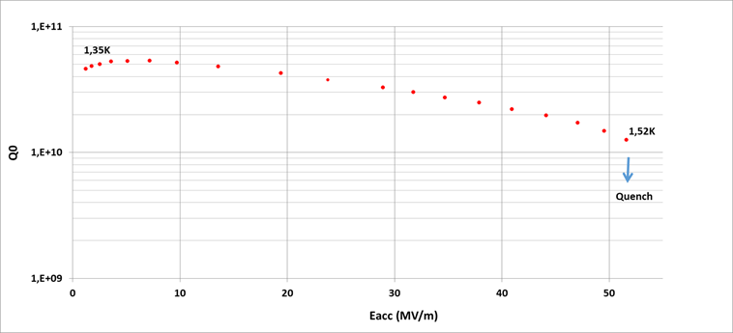
RESULTS ACHIEVED AT SACLAY USING KEK-MARUI TECHNOLOGY
  Results achieved with HF-H₂SO₄. HF concentration 0.5%
  1Cell ESS β=0.86 EH101: 45MV/m (standard baking)
  1Cell TESLA 1AC3: 52MV/m (2-step baking)
  Some cavities without HFQS
VT of EH101 cavity after VEP →
← Unusual performance achieved after VEP
of 1DE8 1.3 GHz cavity: no HFQS after baking
HF:0.5%
HF:3%
LINAC22
THPOGE23
← Eacc=52MV/m achieved after flash VEP followed by 2-step baking (75°C-120°C)
(FERMILAB Recipe)

Slide 21
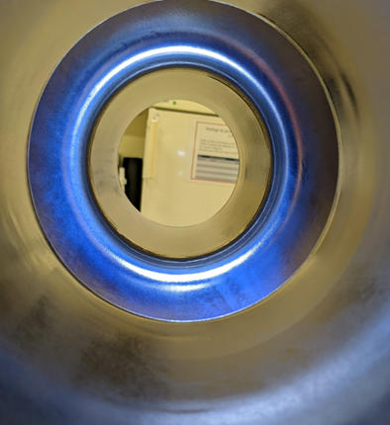
SPECIFICITY OF VEP AT SACLAY:
ACID CONCENTRATION
HF concentration 0.5% vs 3% for standard EP process
Effect of depleted HF concentration on performance?
Thicker oxyde might act as a barrier for Hydrogen?
New acid composition has been purchased: Theoretical Content of 0.25%
Toxicity lowered compared to standard mixture (skin contact H310 Vs H311)
No storage limitation constraint at Saclay
Blueish color obtained after VEP
on ESS 704 MHz single cell cavity

Slide 22
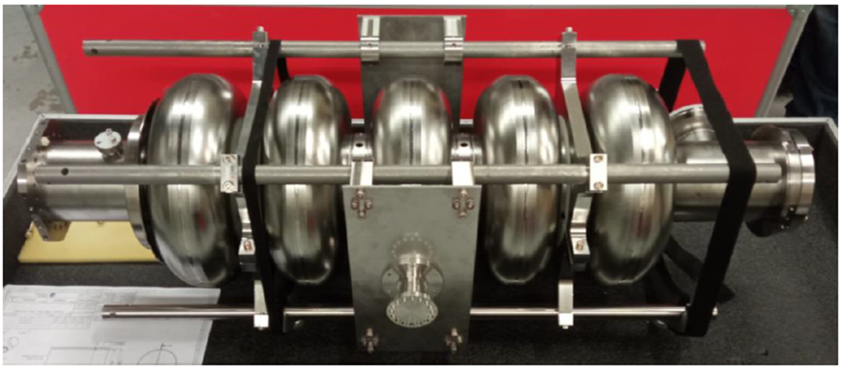
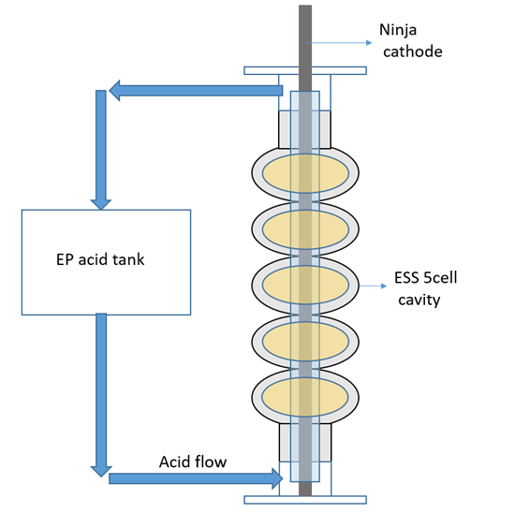
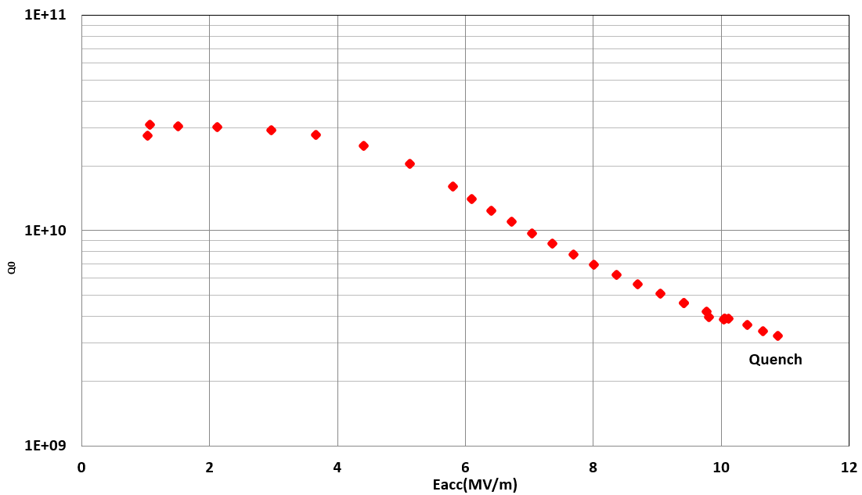
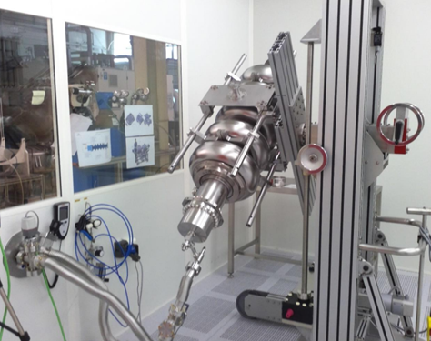
OUTLOOK FOR FY 2024
New VEP sequence of EH101 cavity: investigation of 2-step baking
VEP with new ‘depleted’ HF mixture: Tests on a dedicated 1Cell cavity (1.3GHz)
Comparison of results with previous mixtures
VEP of ESS HB03 5Cell cavity: Ninja cathode already at Saclay
Baseline of HB03 after bulk BCP treatment. Field Emission limitation
Cleanroom preparation of HB03 after BCP

Slide 23
Continued Effort Towards Ultimate Performance for Accelerator Cavities
French Part
Vertical electropolishing F. Eozenou
Multilayers Y. Kalboussi/ T. Proslier
  Principle
  Deposition
  Characterization

Slide 24

Multilayers theory
A theoretical approach proposed by A. Gurevich (2006) to improve RF cavities through depositing a superconducting multilayer to screen the magnetic field.
The thickness of the superconductor must be lower than its penetration depth.
The superconducting layer must have higher T_{c} than Nb.
24

Slide 25




Presentation of the lab at CEA -Deposition
Two ALD deposition systems:
  Research scale: small samples (Φ = 5 cm , L = 40 cm) - New chemistries
  Development scale: Macroscopic objects (Φ = 49 cm , L = 110 cm). 1.3, 0.7 GHz cavities
    Research topics:
      Superconductors (cavities, Qubits), multipacting, Corrosion, Filtration…

Slide 26



Presentation of the lab at CEA - Characterization
Tunneling spectroscopy (Superconducting properties: gap, local Tc, Mapping – 1,5 K – 1x1 cm²)
  Transport measurements (Tc, RRR)
  Projects:
      Collaboration USA (thesis, measurements)
      Collaboration with CERN (Nb₃Sn/Cu…)
    Research area:
        Qubits, cavities, ALD…

Slide 27


Multilayers- Thermal post treatment
To enhance the superconducting performances of NbTiN films, several thermal treatments have been tested. The best results on Nb coated samples were obtained with:
A first ramp of 6 °C/ minute up to 800°C
A second ramp of 18°C/minute up to 900°C
NbTiN (45 nm) –AlN (10 nm) – Niobium
NbTiN (45 nm) –AlN (10 nm) – Sapphire
Magnetometry measurement at platform MPBT
We find that theT_{c} is similar on Niobium and Sapphire substrate.

Slide 28



Multilayers: Effect of the thickness
The Niobium ellipsoids (provided by University of Victoria-Canada) was coated and annealed with the optimized NbTiN-AlN bilayer recipe.
Demagnetisation factor N=0.13
$$H_{equator}=\frac{H_{applied}}{1−N }$$
The first vortex penetration field is enhanced by 30 mT after bilayer coating.
Notes:
Add the refence

Slide 29

Multilayers: first cavity deposition
The Niobium cavity was coated with the optimized AlN- NbTiN bilayer recipe [*].
Coating had a bright golden and uniform colour.
The cavity was annealed @ 900°C.
Vacuum degradation during the annealing step on the first test.
( P>10⁻⁵ mbar )
Observed delamination in the beam tubes after annealing.
A degassing step is necessary.
[*] Surface Engineering by ALD for Superconducting RF Cavities, proceedings of 21st International Conference on Radio-Frequency Superconductivity SRF’23 . Available at https://accelconf.web.cern.ch/srf2023/papers/weiba01.pd
Notes:
Add a slide

Slide 30
First RF tests of NbTiN-AlN bilayers deposited on 1.3 GHz Nb cavity
The Niobium cavity was coated with AlN (7 nm) – NbTiN (50 nm ) bilayer .
1. 4 K
More investigations are ongoing ( Q₀ vs T ) …
Thermal treatment multilayer 2: IJCLAB
Yasmine Kalboussi - TTC 2023

Slide 31
Pursue the effort towards ultimate gradients and quality factors for SRF cavities.
 | CEA Saclay | KEK/Kyoto U.
VEP | VEP with a depleted HF concentration (<0.5%) with Ninja cathode - Single-cell 1300MHz cavities prior to ALD deposition - 704MHz single and 5-cell cavity. | New VEP facility for 1.3GHz 9-cell cavity, in addition to HEP facility. The Ninja cathode dedicated for the VEP process for cavity Hydrofluoric acid-free EP process Plasma electrolytic polishing (PEP)
Thin-film | #B_ML[indices1] = Bs[indices1] Multilayers Nb/AlN/NbTiN ALD layers deposition on 3000MHz Cu and Nb cavities. | AlN-NbN thin-film: coupon analysis AlN-NbN thin-film grown on single-cell 3000MHz Nb cavities. The cavities will be tested at 4K and 2K. Theoretical study of multilayer structure. Penetration Depth Measurement

