Slide 1





Ab-initio Shell Model for Nuclear Structure
Youngman Kim, Ik Jae Shin, Igor Mazur, Institute for Basic Science, Daejeon, Republic of Korea Nadezda A. Smirnova, Rivero Arturo, LP2IB, CNRS/IN2P3 – University of Bordeaux, France
In collaboration with
Andrey M. Shirokov, SINP, Moscow State University, Russia
Bruce R. Barrett, Arizona State University, USA
James P. Vary, Pieter Maris, Iowa State University, USA
Some slides from Nadezda A. Smirnova & Ik Jae Shin

Slide 2
Ab-initio Shell Model for Nuclear Structure
(ab initio) nuclear shell model and current status of microscopic interactions
Previous results: ab-initio effective sd-shell Hamiltonian from the NCSM solution for A=18 via Okubo-Lee-Suzuki (OLS) similarity transformation
Proposed project
- Improvement and charge-dependence of the Daejeon16 potential;
- Derivation of the effective interaction of p-sd-pf shell model space.
Conclusions and prospects

Slide 3
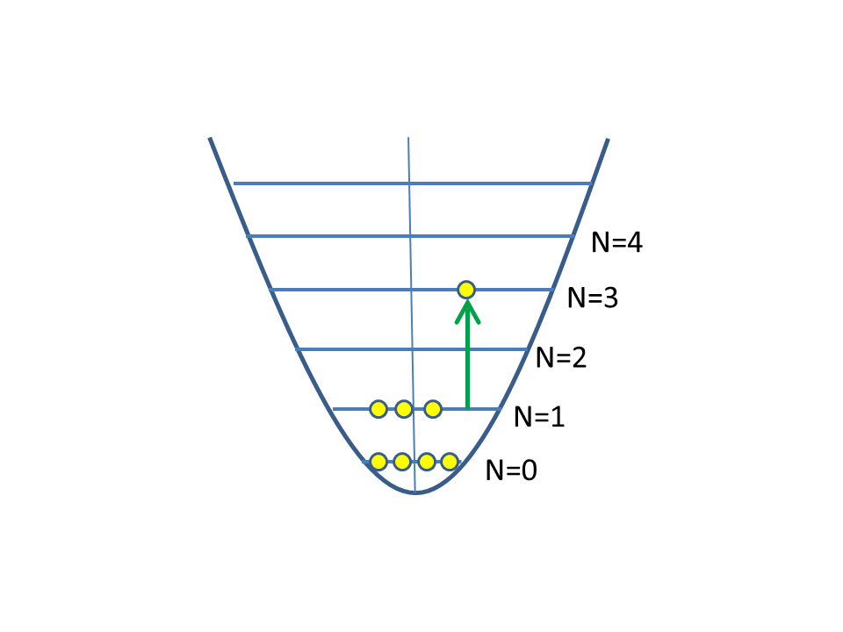
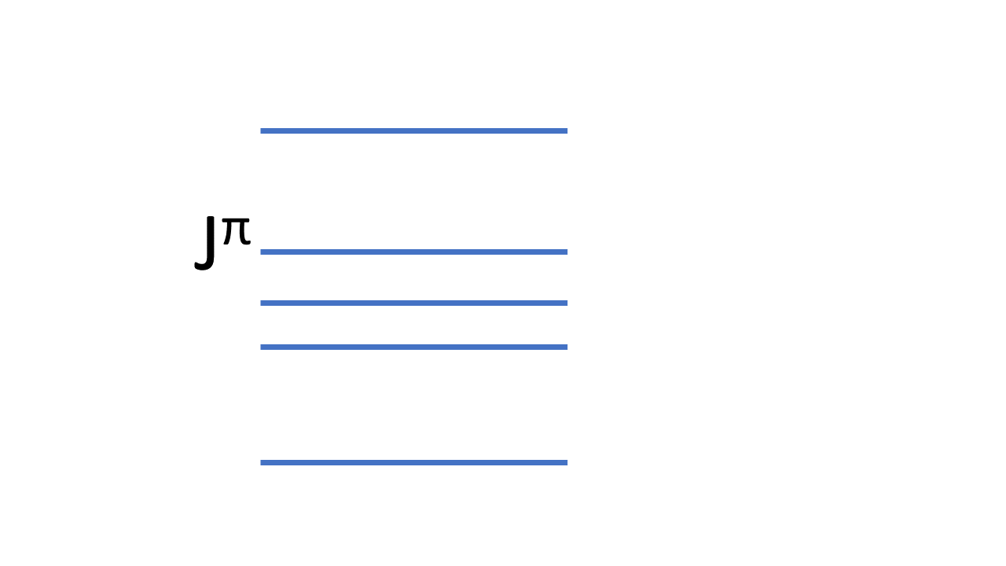

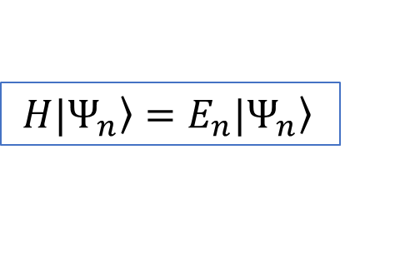
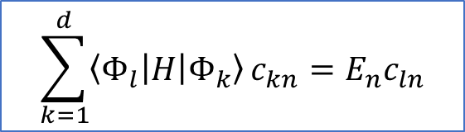
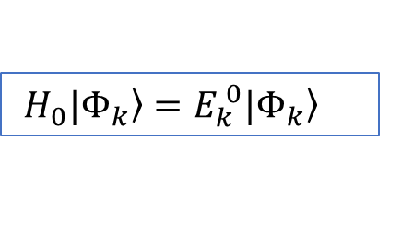

Shell model - (full) configuration-interaction approach
Ab-initio No-Core Shell Model : sufficiently large model space so that the results for A nucleons do not depend on the basis parameters (hw and Nmax)
Conservation of symmetries of the Hamiltonian, detailed information on low-energy states and transitions
$H=T+V=\left(T+U\right)+\left(V−U\right)=H_{0}+V_{res}$
Independent particle
Hamiltonian
residual interaction
$H\left.{|Ψ}_{n}\right\rangle =E_{n}\left.{|Ψ}_{n}\right\rangle$
$$\left.{|Ψ}_{n}\right\rangle =\sum_{k}{c_{kn}}|\left.Φ_{k}\right\rangle$$
$H_{0}\left.{|Φ}_{k}\right\rangle =E_{k}^{ 0}\left.{|Φ}_{k}\right\rangle$
$${\left\langle Φ_{k} | Φ_{l}\right\rangle =δ}_{kl}$$
$$\sum_{k=1}^{d}{\left\langle Φ_{l} | H | Φ_{k}\right\rangle }c_{kn}=E_{n}c_{ln}$$

Slide 4
Ab initio NCSM
Ab initio: nuclei from first principles using “fundamental” interactions without uncontrolled approximations.
- No core: all nucleons are active, no inert core.
- Shell model: harmonic oscillator basis
- Point nucleons

Slide 5
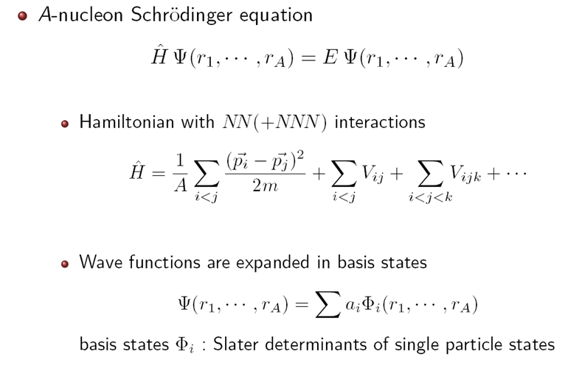

Slide 6
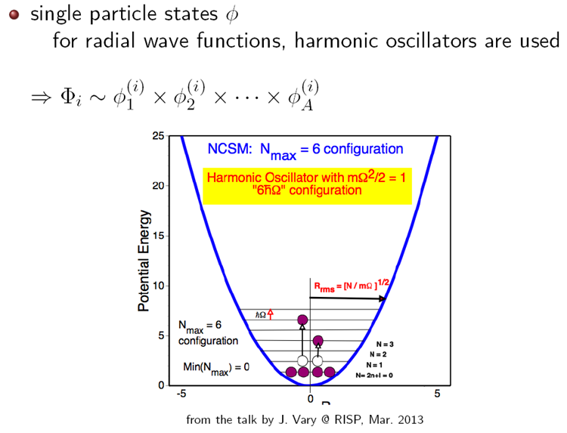

Slide 7
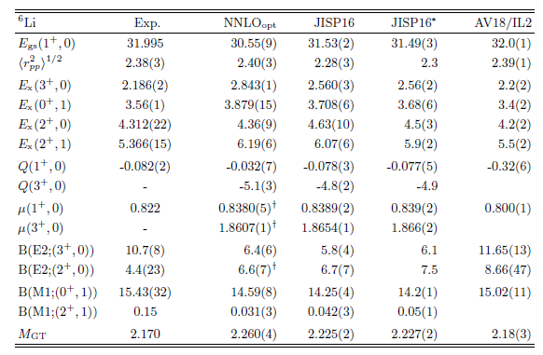
Ik Jae Shin, Y. Kim, P. Maris, J. P. Vary, C. Forssén, J. Rotureau, N. Michel, J .Phys. G44, 075103 (2017)

Slide 8
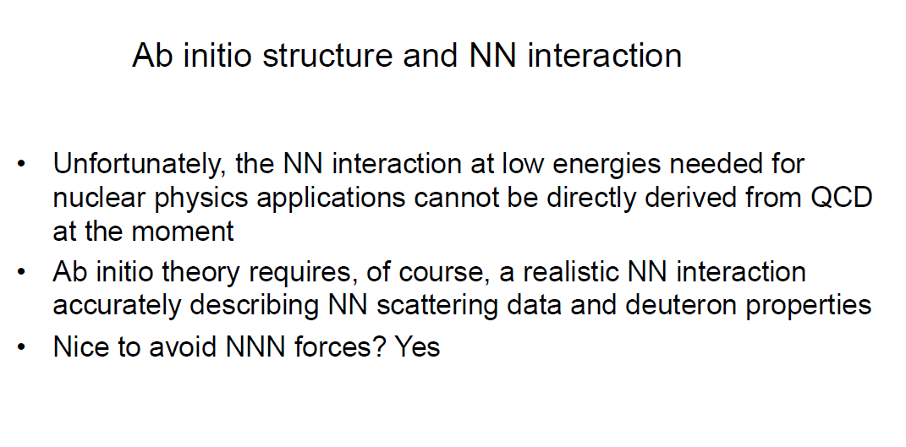
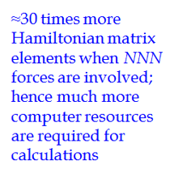

Slide 9
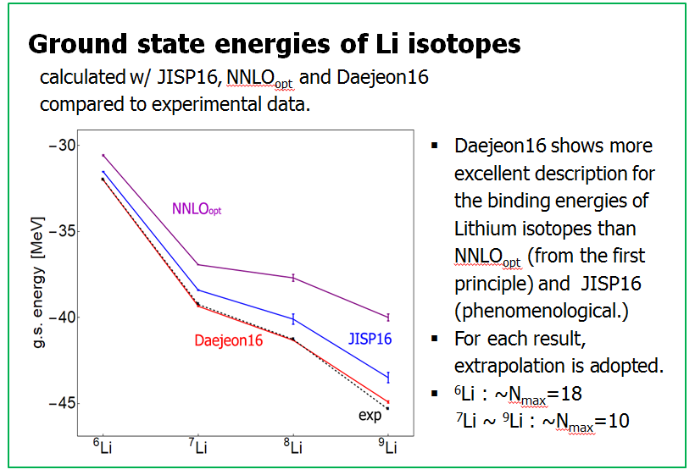
Daejeon 16 NN interaction
Used in many ab initio structure studies and more are planned
N3LO interaction
SRG
(similarity renormalization group)
SRG-evolved N3LO
PET (phase equivalent transformation)
Daejeon16
A.M. Shirokov, I.J. Shin, Y. Kim, M. Sosonkina, P. Maris, J.P. Vary, PLB761 (2016) 87

Slide 10
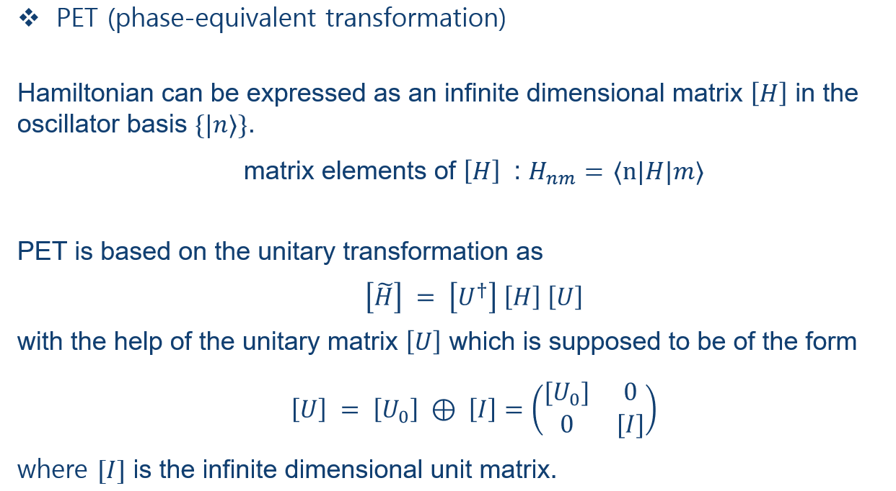

Slide 11
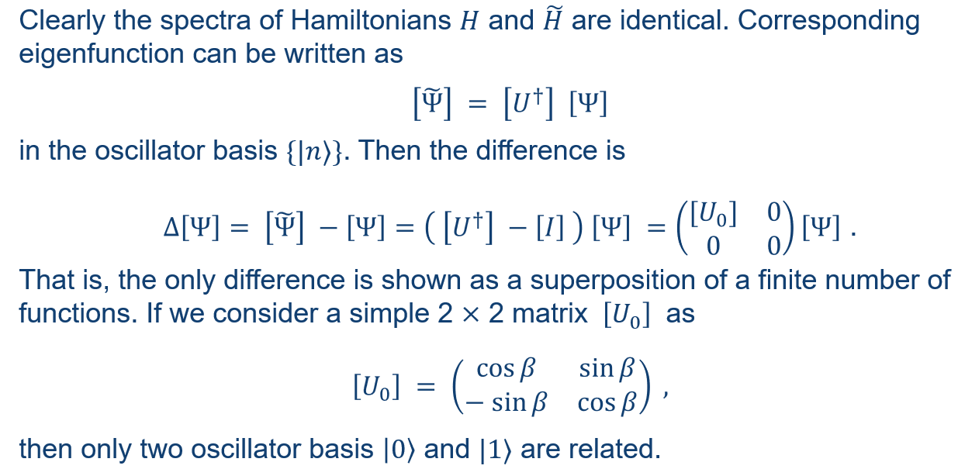

Slide 12
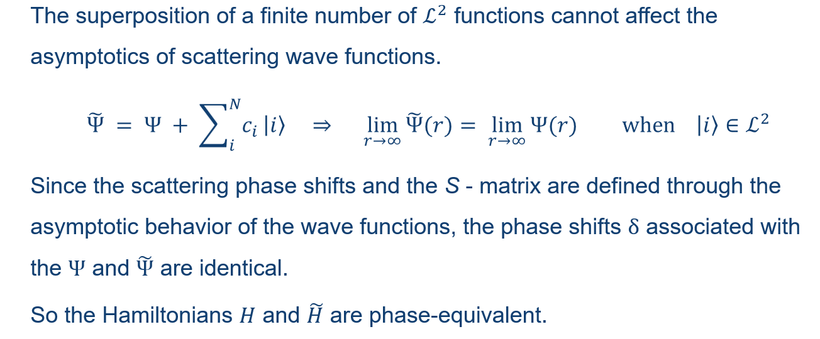

Slide 13
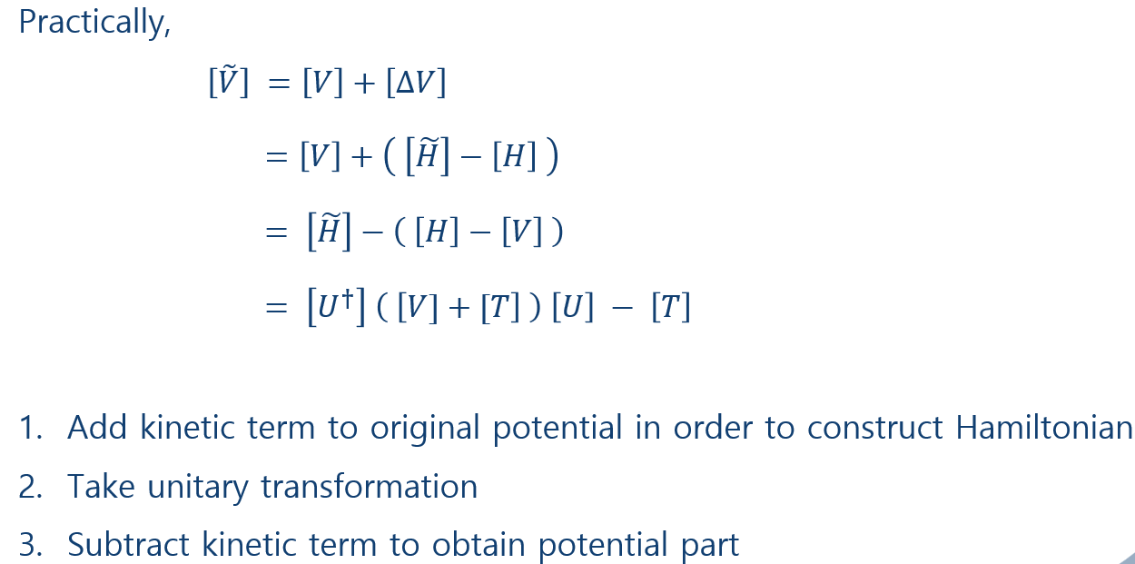

Slide 14
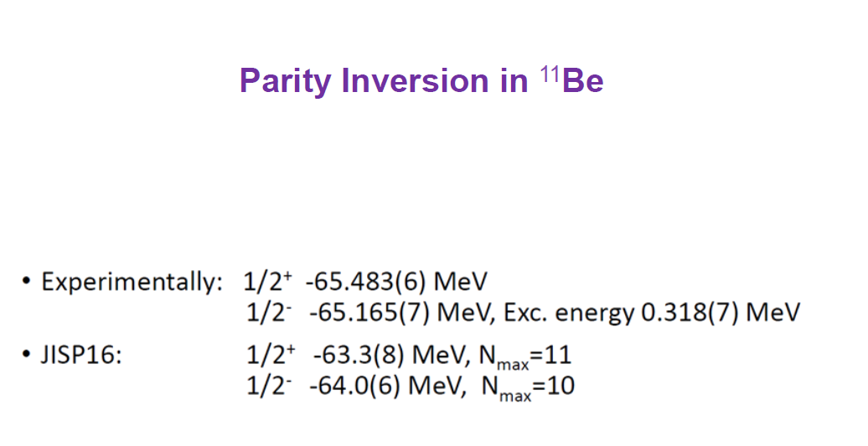

Slide 15
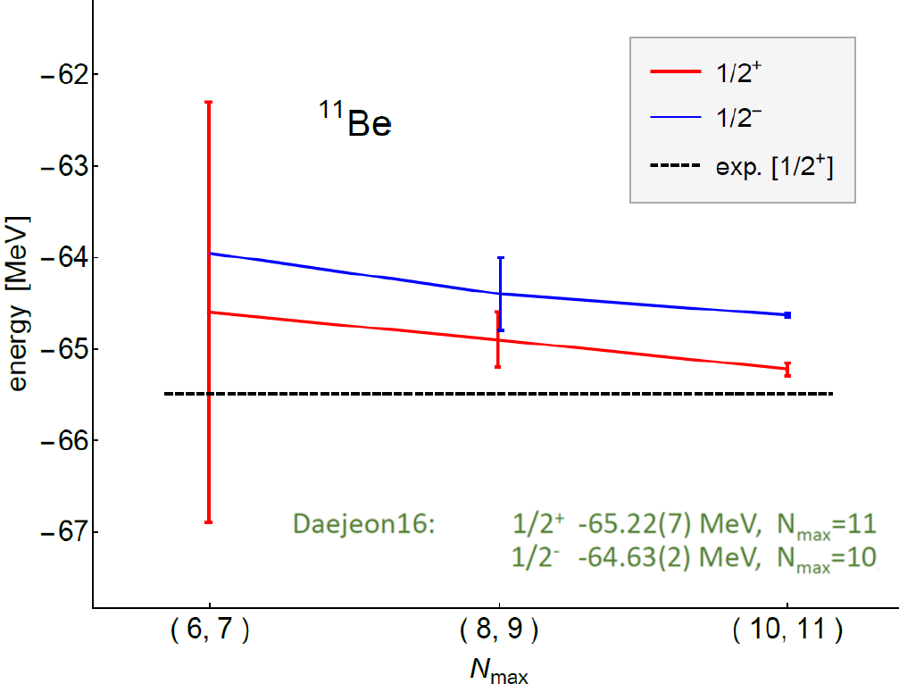

Slide 16
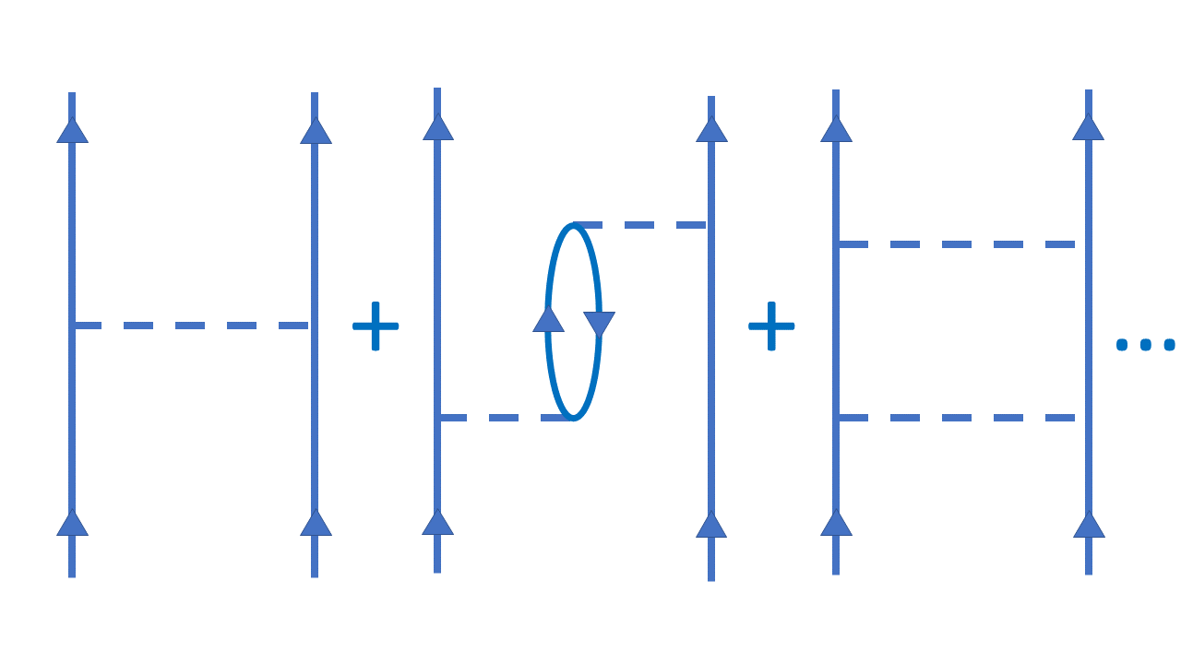
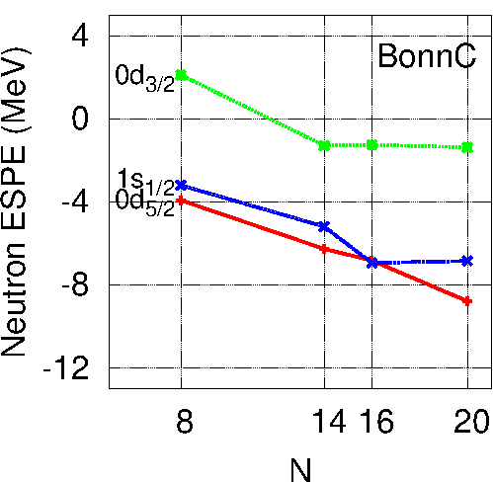
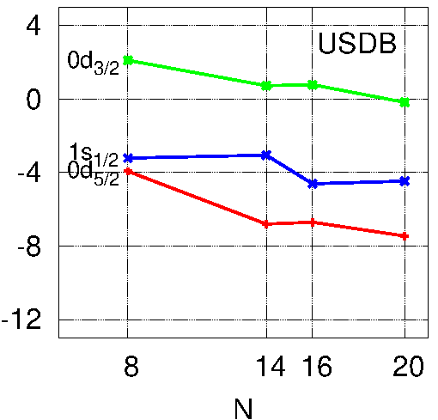
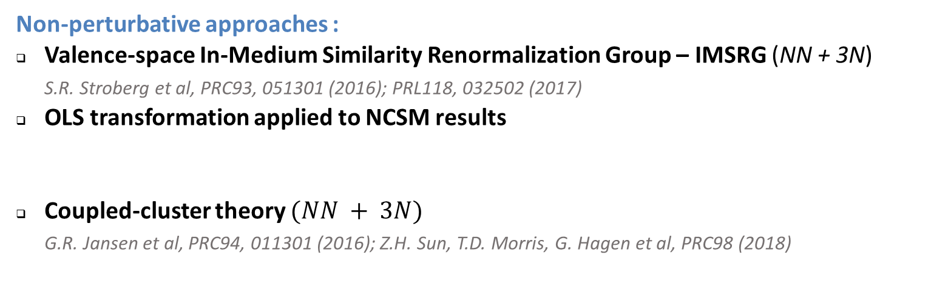
Microscopic approaches to valence space interactions
Many-body perturbation theory (G.F. Bertsch, T.T.S. Kuo, G.F. Brown, B.R.Barrett, M.Kirson, et al. - from 60’s)
Veff =
²²O
²²O
If NN force is use, then
poor description of the monopole term
(spherical mean-field)
Missing 3N forces
(inclusion requires
resources !)
Non-perturbative approaches :
Valence-space In-Medium Similarity Renormalization Group – IMSRG (NN + 3N)
S.R. Stroberg et al, PRC93, 051301 (2016); PRL118, 032502 (2017)
OLS transformation applied to NCSM results
Coupled-cluster theory $(NN + 3N)$
G.R. Jansen et al, PRC94, 011301 (2016); Z.H. Sun, T.D. Morris, G. Hagen et al, PRC98 (2018)
E. Dikmen, A. Lisetskiy, B.R. Barrett, P. Maris, A.M. Shirokov, J.P. Vary, PRC91, 064301 (2015)
N.Smirnova, B.R. Barrett, I.J. Shin, Y.Kim, A.M. Shirokov, E. Dikmen, P. Maris, J.P. Vary, PRC100, 054329 (2019)

Slide 17
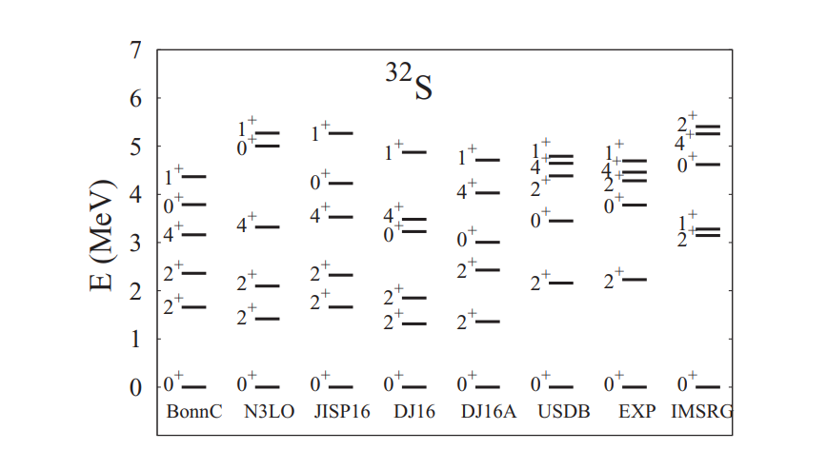
Effective shell-model interactions from Daejeon 16
A new (not fully though) microscopic effective shell-model interactions in the valence sd shell are obtained from the modern Daejeon16 nucleon-nucleon potential
N_{max} =4
N. A. Smirnova, B. R. Barrett, Y. Kim, I. J. Shin, et al, Effective interactions in the sd shell, Phys. Rev. C 100 (2019) 5, 054329

Slide 18
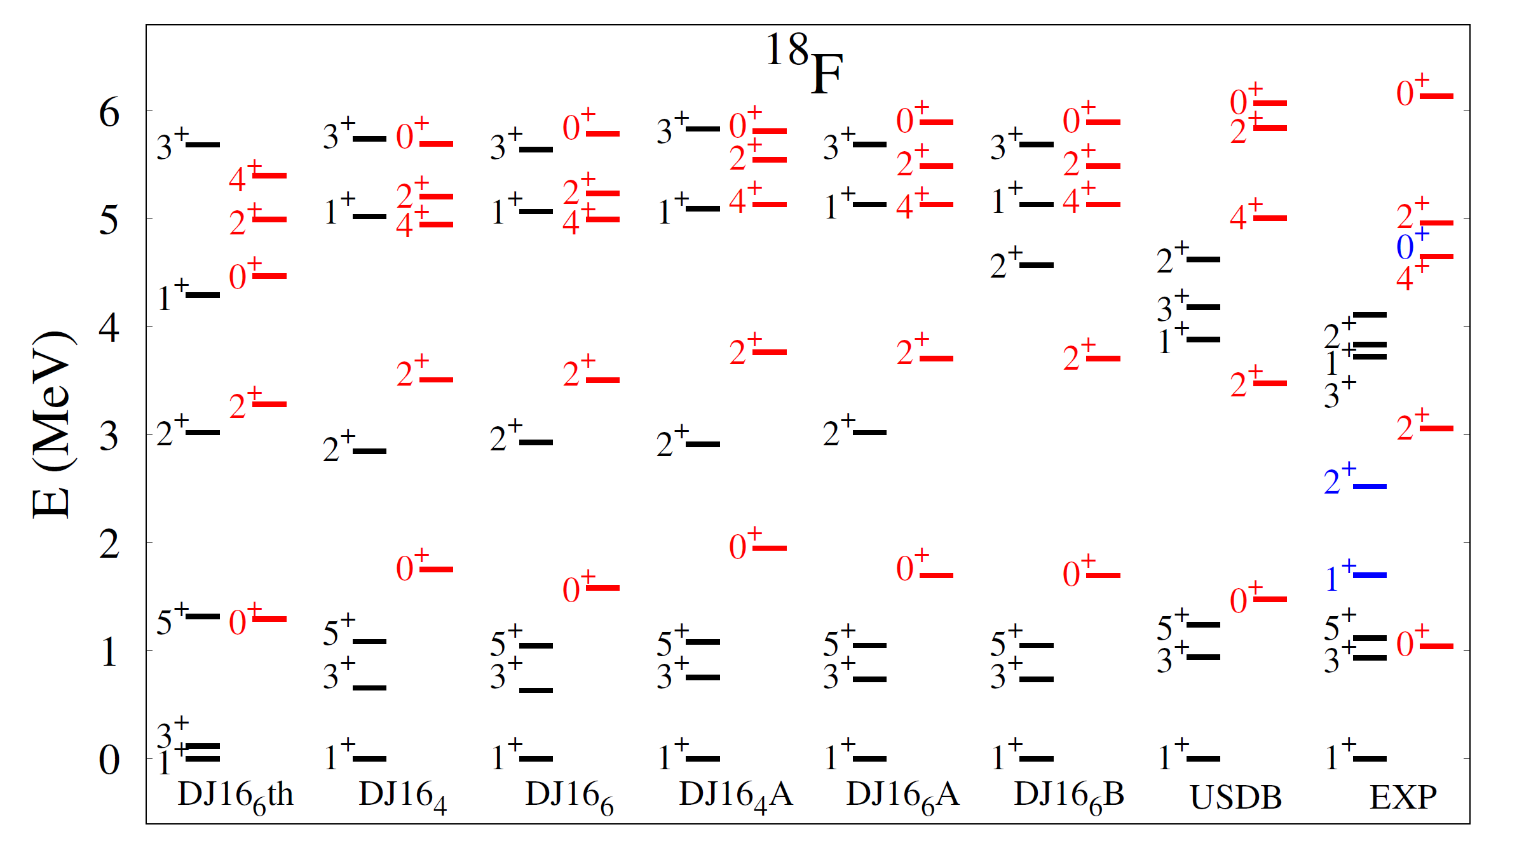
N_{max} =6
I. J. Shin, N. A. Smirnova, YK, et al, submitted to PRC

Slide 19
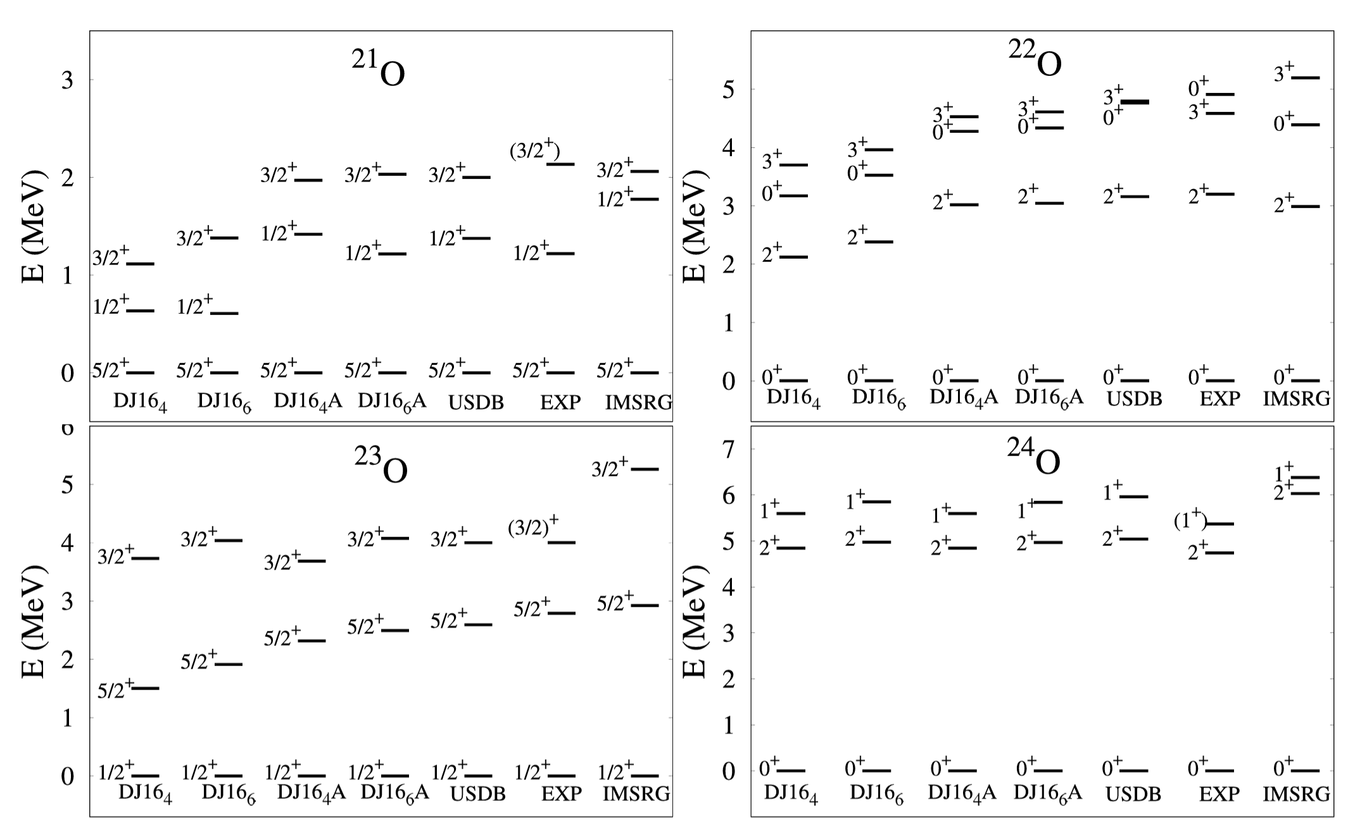
N_{max} =6
I. J. Shin, N. A. Smirnova, YK, et al, submitted to PRC

Slide 20
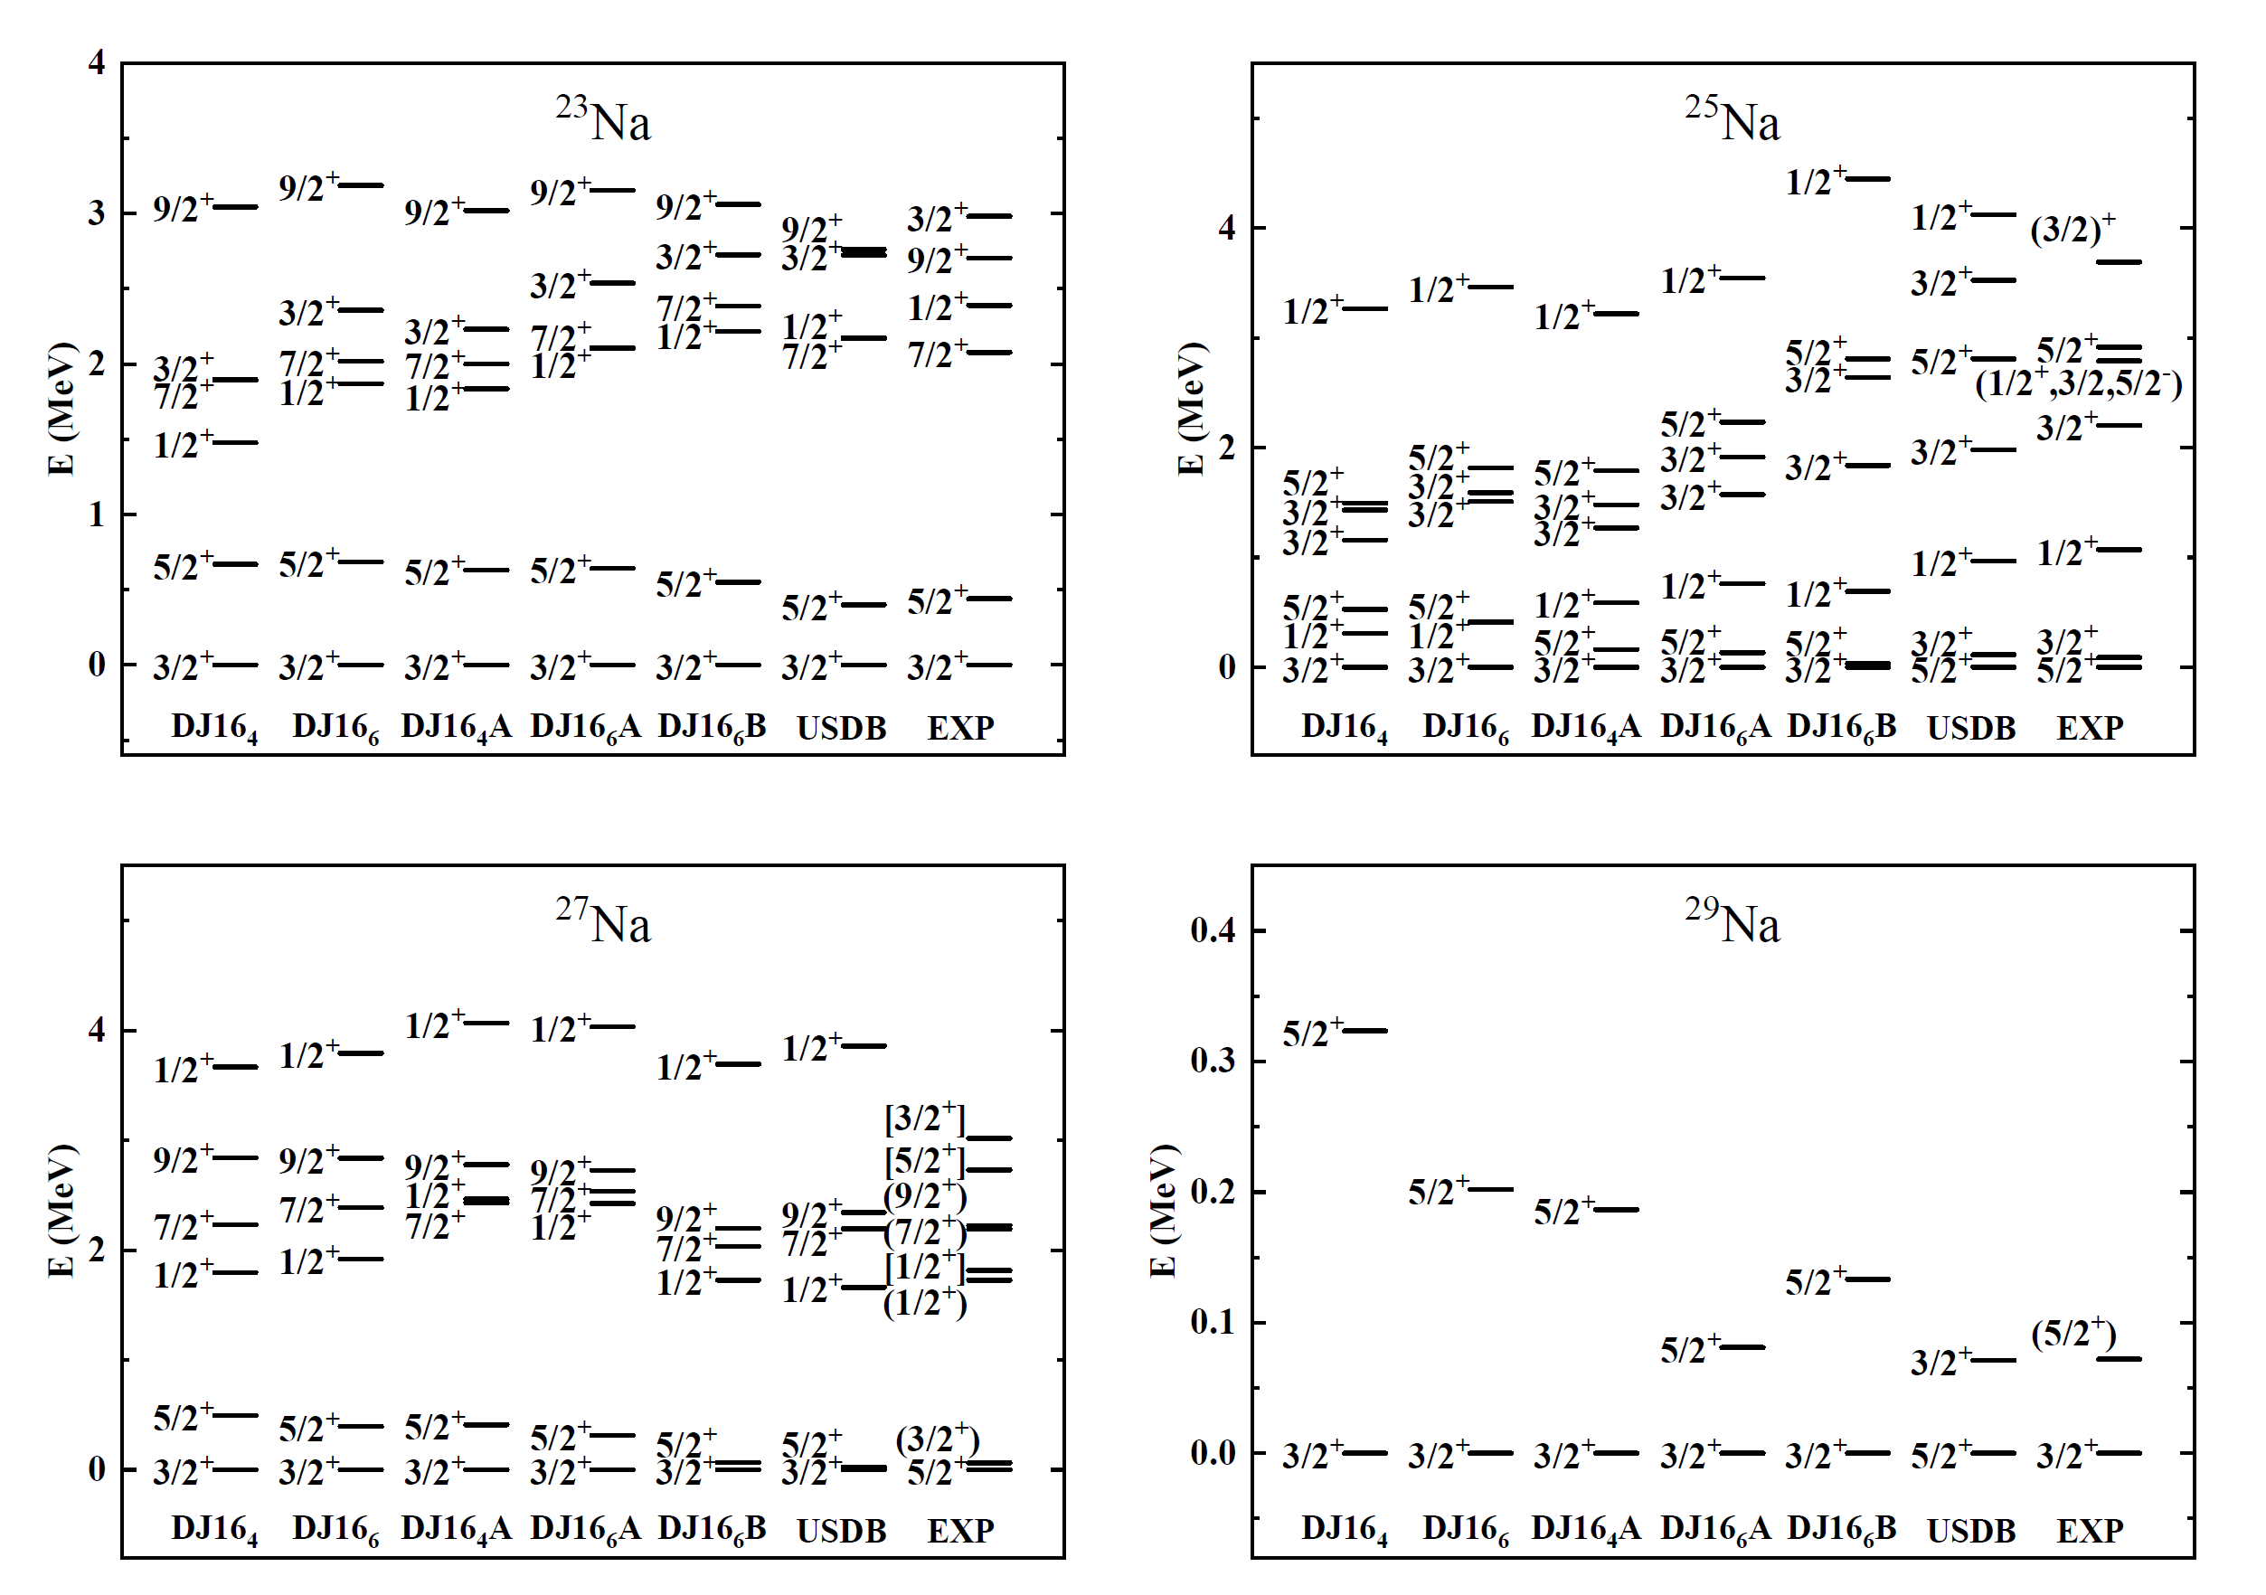
N_{max} =6
I. J. Shin, N. A. Smirnova, YK, et al, submitted to PRC

Slide 21
Goals of the proposed Project
Improvement of the Daejeon16 potential (refining of Phase-Equivalent Transformations up to A=17 to get robust single-particle energies and to avoid monopole adjustments and) – work in progress
Incorporation of the charge-dependence (pp, nn and pn channels) !
Derivation of the effective interaction of p-sd-pf shell model space

Slide 22
Conclusions and Perspectives
Micrscopic valence-space interactions obtained via OLS transformation of the NCSM solution look encouraging.
This work paves the way towards microscopic foundations of the nuclear shell model and links it to the ab-initio nuclear theory
Importance of further developments of microscopic approaches towards precision nuclear theory for spectroscopy of exotic nuclei, fundamental interaction studies and astrophysical applications

Slide 23
THANK YOU FOR YOUR ATTENTION !

Slide 24
Budget Requests
- A Short-term visit of French team members to Daejeon and
- A Short-term visit of the Korean team members to Bordeaux.

