Slide 1
A Natural Dark Matter–Dark Energy Interaction from Axion–Monopole Dynamics
2412.14239
Huangyu Xiao, Harvard U. and Boston U.
The 5th workshop on Symmetry and Structure of the Universe (SSU 2026 Busan)
2608.XXXXX: Hengameh Bagherian, Matthew Reece, Lian-Tao Wang, and HX

Slide 2
Energy Budget in the Universe
Visible Baryons
Dark matter candidates: WIMPS, Axions, PBH, etc.
Dark energy candidates: Cosmological constant, quintessence (light axion, scalar field), etc.
Are these sectors related? Any interactions?
Recently, DESI collaboration claims some evidence for DM-DE interaction.
Dark Matter
Dark Energy

Slide 3
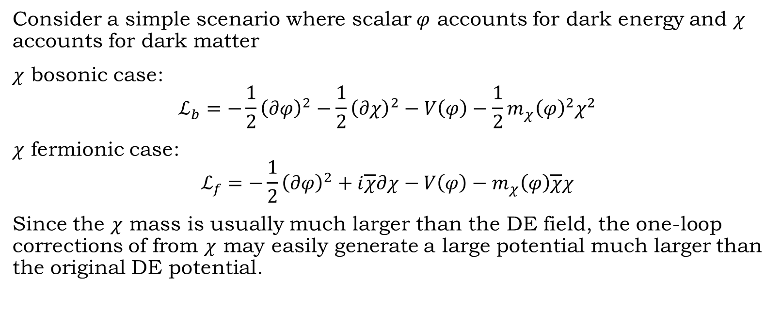
Naturalness of DM-DE interaction
Consider a simple scenario where scalar $φ$ accounts for dark energy and $χ$ accounts for dark matter
$χ$ bosonic case:
$$ℒ_{b}=−\frac{1}{2}{\left(∂φ\right)}^{2}−\frac{1}{2}{\left(∂χ\right)}^{2}−V\left(φ\right)−\frac{1}{2}m_{χ}{\left(φ\right)}^{2}χ^{2}$$
$χ$ fermionic case:
$$ℒ_{f}=−\frac{1}{2}{\left(∂φ\right)}^{2}+i\overline{χ}∂χ−V\left(φ\right)−m_{χ}\left(φ\right)\overline{χ}χ$$
Since the $χ$ mass is usually much larger than the DE field, the one-loop corrections of from $χ$ may easily generate a large potential much larger than the original DE potential.

Slide 4
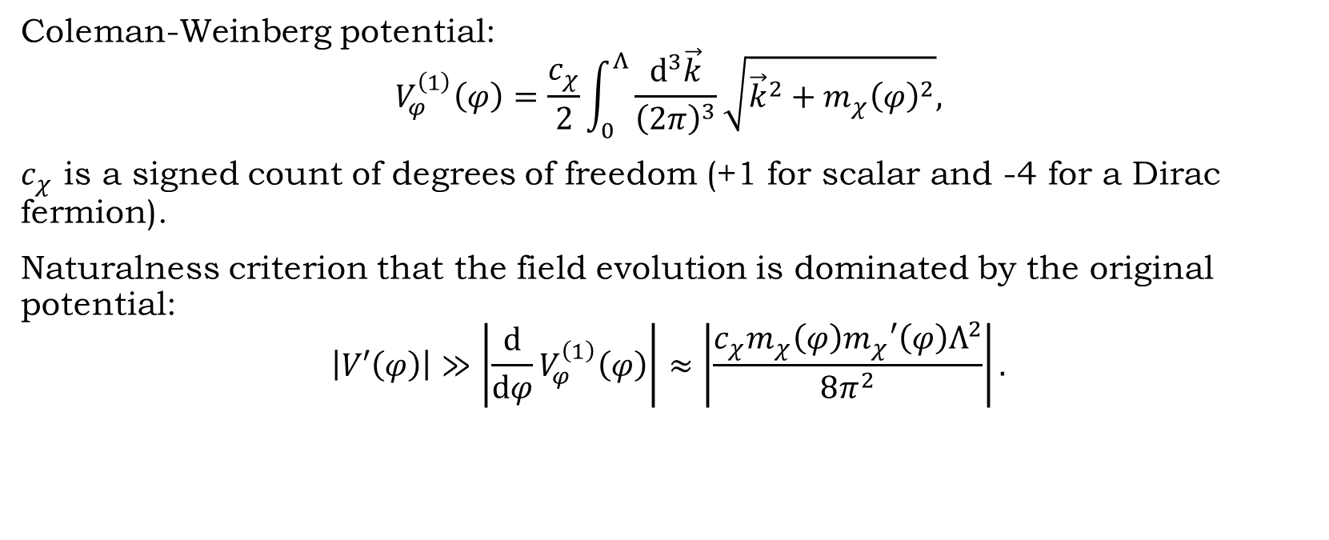
One-loop corrections
Coleman-Weinberg potential:
$$V_{φ}^{\left(1\right)}\left(φ\right)=\frac{c_{χ}}{2}\int_{0}^{Λ}{\frac{d^{3}\vec{k}}{{\left(2π\right)}^{3}}}\sqrt{{\vec{k}}^{2}+m_{χ}{\left(φ\right)}^{2}},$$
$c_{χ}$ is a signed count of degrees of freedom (+1 for scalar and -4 for a Dirac fermion).
Naturalness criterion that the field evolution is dominated by the original potential:
$$\left|V′\left(φ\right)\right|≫\left|\frac{d}{dφ}V_{φ}^{\left(1\right)}\left(φ\right)\right|≈\left|\frac{c_{χ}m_{χ}\left(φ\right)m_{χ}′\left(φ\right)Λ^{2}}{8π^{2}}\right|.$$

Slide 5
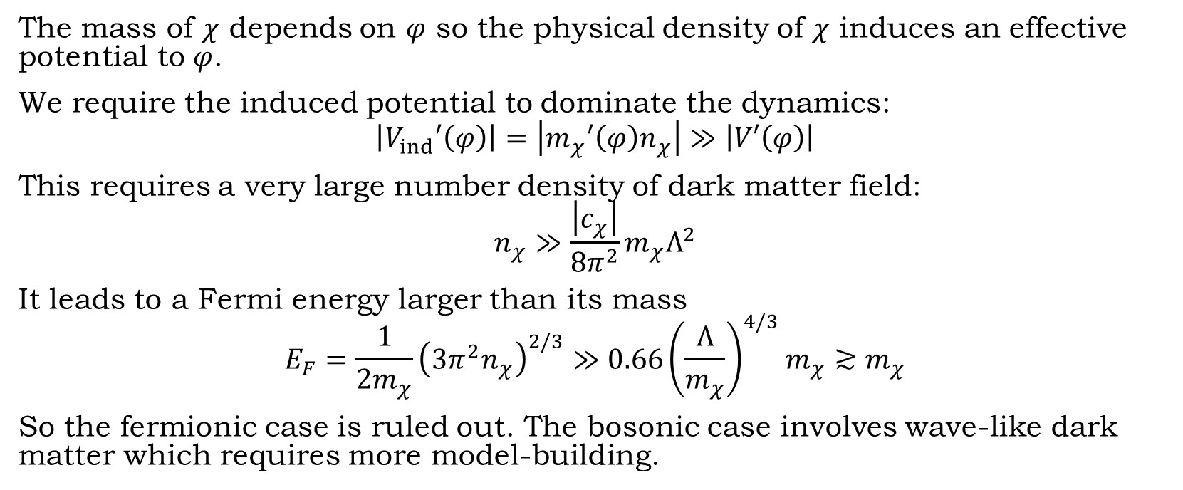
A large induced potential violates naturalness
The mass of $χ$ depends on $φ$ so the physical density of $χ$ induces an effective potential to $φ$.
We require the induced potential to dominate the dynamics:
$$\left|V_{ind}′\left(φ\right)\right|=\left|m_{χ}′\left(φ\right)n_{χ}\right|≫\left|V′\left(φ\right)\right|$$
This requires a very large number density of dark matter field:
$$n_{χ}≫\frac{\left|c_{χ}\right|}{8π^{2}}m_{χ}Λ^{2}$$
It leads to a Fermi energy larger than its mass
$$E_{F}=\frac{1}{2m_{χ}}{\left(3π^{2}n_{χ}\right)}^{2/3}≫0.66{\left(\frac{Λ}{m_{χ}}\right)}^{4/3}m_{χ}≳m_{χ}$$
So the fermionic case is ruled out. The bosonic case involves wave-like dark matter which requires more model-building.

Slide 6
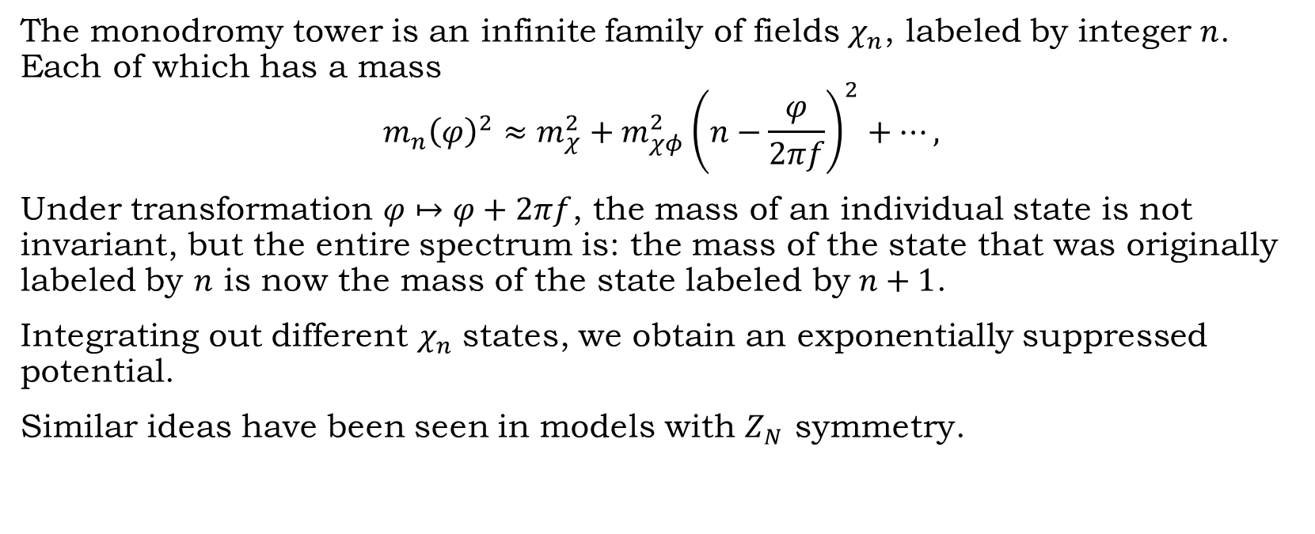
A way out: small potential from a monodromy tower
The monodromy tower is an infinite family of fields $χ_{n}$, labeled by integer $n$. Each of which has a mass
$$m_{n}{\left(φ\right)}^{2}≈m_{χ}^{2}+m_{χφ}^{2}{\left(n−\frac{φ}{2πf}\right)}^{2}+⋯,$$
Under transformation $φ↦φ+2πf$, the mass of an individual state is not invariant, but the entire spectrum is: the mass of the state that was originally labeled by $n$ is now the mass of the state labeled by $n+1$.
Integrating out different $χ_{n}$ states, we obtain an exponentially suppressed potential.
Similar ideas have been seen in models with $Z_{N}$ symmetry.

Slide 7
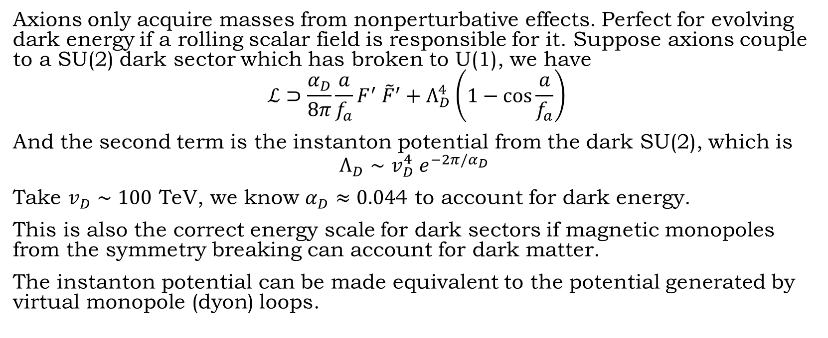
Small axion potential
Axions only acquire masses from nonperturbative effects. Perfect for evolving dark energy if a rolling scalar field is responsible for it. Suppose axions couple to a SU(2) dark sector which has broken to U(1), we have
$$ℒ⊃\frac{α_{D}}{8π}\frac{a}{f_{a}}F^{′} {\tilde{F}}^{′}+Λ_{D}^{4}\left(1−\cos{\frac{a}{f_{a}}}\right)$$
And the second term is the instanton potential from the dark SU(2), which is
$$Λ_{D}∼v_{D}^{4} e^{−2π/α_{D}}$$
Take $v_{D}∼100$ TeV, we know $α_{D}≈0.04$4 to account for dark energy.
This is also the correct energy scale for dark sectors if magnetic monopoles from the symmetry breaking can account for dark matter.
The instanton potential can be made equivalent to the potential generated by virtual monopole (dyon) loops.

Slide 8
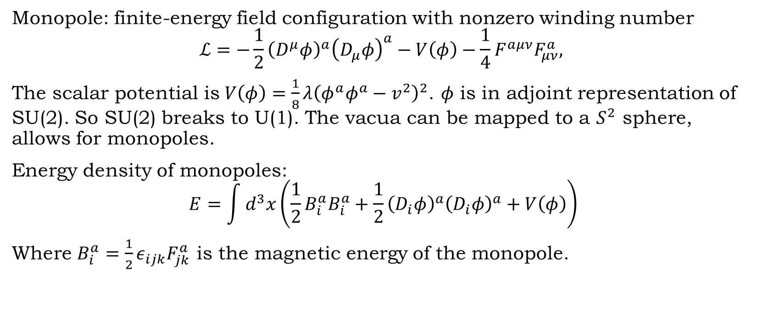
SU(2) Monopole
Monopole: finite-energy field configuration with nonzero winding number
$$ℒ=−\frac{1}{2}{\left(D^{μ}φ\right)}^{a}{\left(D_{μ}φ\right)}^{a}−V\left(φ\right)−\frac{1}{4}F^{aμν}F_{μν}^{a},$$
The scalar potential is $V\left(φ\right)=\frac{1}{8}λ{\left(φ^{a}φ^{a}−v^{2}\right)}^{2}$. $φ$ is in adjoint representation of SU(2). So SU(2) breaks to U(1). The vacua can be mapped to a $S^{2}$ sphere, allows for monopoles.
Energy density of monopoles:
$$E=\int{d^{3}x\left(\frac{1}{2}B_{i}^{a}B_{i}^{a}+\frac{1}{2}{\left(D_{i}φ\right)}^{a}{\left(D_{i}φ\right)}^{a}+V\left(φ\right)\right)}$$
Where $B_{i}^{a}=\frac{1}{2}ε_{ijk}F_{jk}^{a}$ is the magnetic energy of the monopole.

Slide 9
Dark monopoles as dark matter
We consider 't Hooft- Polyakov monopoles in the dark sector with a mass ~100 TeV.
The freeze-out abundance of this type of monopole will not overclose the Universe.
The number density will not be ruled out by Parker’s bound because it only carries dark magnetic charge.

Slide 10

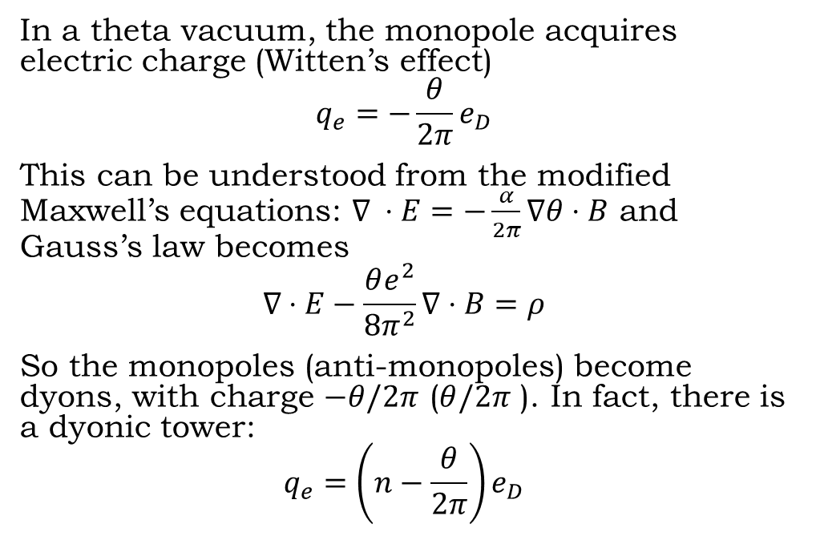

Axion-Monopole interactions
In a theta vacuum, the monopole acquires electric charge (Witten’s effect)
$$q_{e}=−\frac{θ}{2π}e_{D}$$
This can be understood from the modified Maxwell’s equations: $∇ ⋅E=−\frac{α}{2π}∇θ⋅B$ and Gauss’s law becomes
$$∇⋅E−\frac{θe^{2}}{8π^{2}}∇⋅B=ρ$$
So the monopoles (anti-monopoles) become dyons, with charge $−θ/2π$ ($θ/2π$ ). In fact, there is a dyonic tower:
$$q_{e}=\left(n−\frac{θ}{2π}\right)e_{D}$$
$$θ=0$$
$$θ≠ 0$$

Slide 11
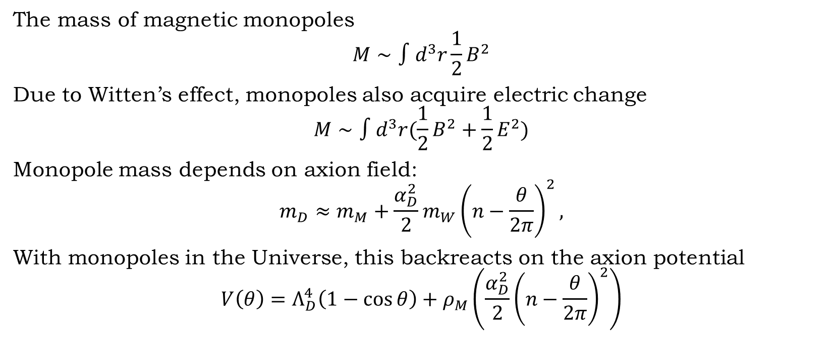
Axion induced monopole mass
The mass of magnetic monopoles
$$M∼∫d^{3}r\frac{1}{2}B^{2}$$
Due to Witten’s effect, monopoles also acquire electric change
$$M∼∫d^{3}r(\frac{1}{2}B^{2}+\frac{1}{2}E^{2})$$
Monopole mass depends on axion field:
$$m_{D}≈m_{M}+\frac{α_{D}^{2}}{2}m_{W}{\left(n−\frac{θ}{2π}\right)}^{2},$$
With monopoles in the Universe, this backreacts on the axion potential
$$V\left(θ\right)=Λ_{D}^{4}\left(1−\cos{θ}\right)+ρ_{M}\left(\frac{α_{D}^{2}}{2}{\left(n−\frac{θ}{2π}\right)}^{2}\right)$$

Slide 12
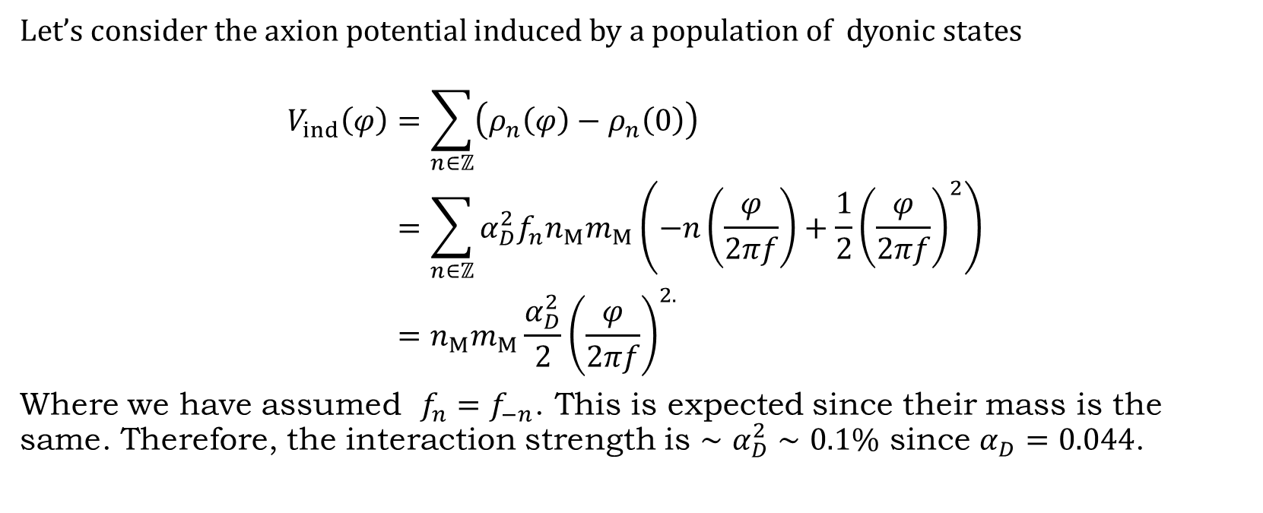
DM-DE interaction strength
Let’s consider the axion potential induced by a population of dyonic states
$$\begin{aligned}V_{ind}\left(φ\right)&=\sum_{n∈ℤ}{\left(ρ_{n}\left(φ\right)−ρ_{n}\left(0\right)\right)} \\ &=\sum_{n∈ℤ}{α_{D}^{2}f_{n}n_{M}m_{M}}\left(−n\left(\frac{φ}{2πf}\right)+\frac{1}{2}{\left(\frac{φ}{2πf}\right)}^{2}\right) \\ &=n_{M}m_{M}\frac{α_{D}^{2}}{2}{\left(\frac{φ}{2πf}\right)}^{2.}\end{aligned}$$
Where we have assumed $f_{n}=f_{−n}$. This is expected since their mass is the same. Therefore, the interaction strength is $∼α_{D}^{2}∼0.1\%$ since $α_{D}=0.044$.

Slide 13
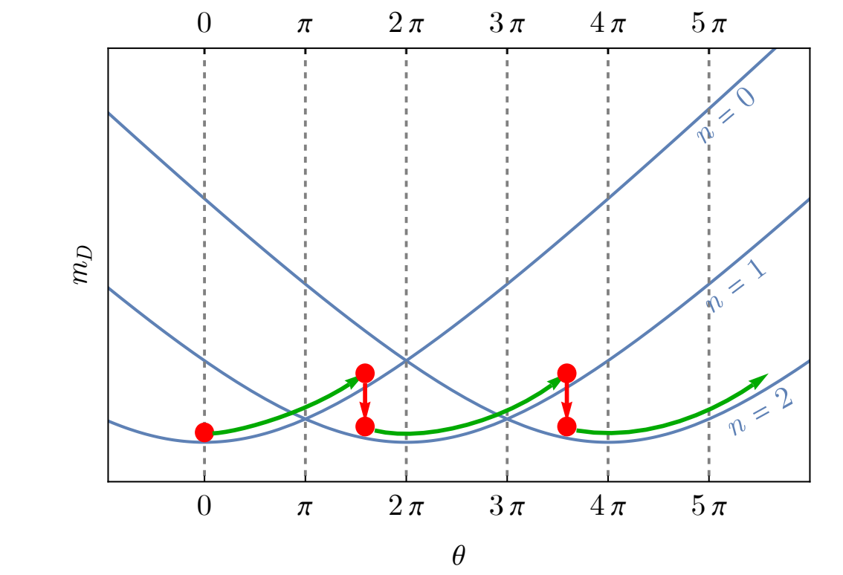
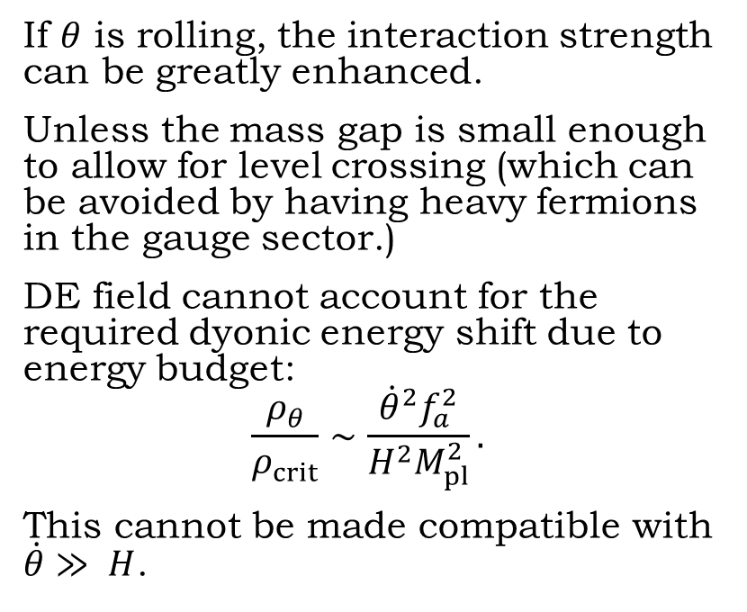
Enhancing the signal strength with a second axion
If $θ$ is rolling, the interaction strength can be greatly enhanced.
Unless the mass gap is small enough to allow for level crossing (which can be avoided by having heavy fermions in the gauge sector.)
DE field cannot account for the required dyonic energy shift due to energy budget:
$$\frac{ρ_{θ}}{ρ_{crit}}∼\frac{{\dot{θ}}^{2}f_{a}^{2}}{H^{2}M_{pl}^{2}}.$$
This cannot be made compatible with $\dot{θ}≫ H$.

Slide 14
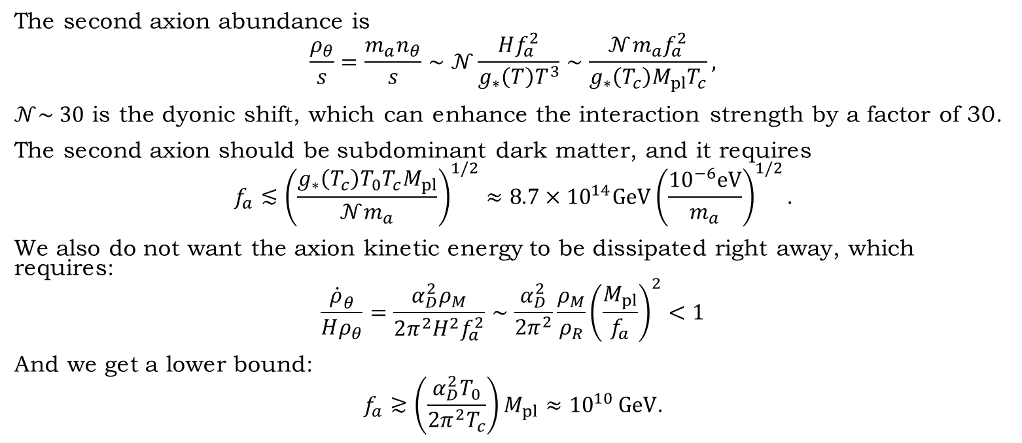
Enhancing the signal strength with a second axion
The second axion abundance is
$$\frac{ρ_{θ}}{s}=\frac{m_{a}n_{θ}}{s}∼𝒩\frac{Hf_{a}^{2}}{g_{∗}\left(T\right)T^{3}}∼\frac{𝒩m_{a}f_{a}^{2}}{g_{∗}\left(T_{c}\right)M_{pl}T_{c}},$$
$𝒩\sim 30$ is the dyonic shift, which can enhance the interaction strength by a factor of 30.
The second axion should be subdominant dark matter, and it requires
$$f_{a}≲{\left(\frac{g_{∗}\left(T_{c}\right)T_{0}T_{c}M_{pl}}{𝒩m_{a}}\right)}^{1/2}≈8.7×{10}^{14}GeV{\left(\frac{{10}^{−6}eV}{m_{a}}\right)}^{1/2}.$$
We also do not want the axion kinetic energy to be dissipated right away, which requires:
$$\frac{\dot{ρ}{}_{θ}^{​}​}{Hρ_{θ}}=\frac{α_{D}^{2}ρ_{M}}{2π^{2}H^{2}f_{a}^{2}}∼\frac{α_{D}^{2}}{2π^{2}}\frac{ρ_{M}}{ρ_{R}}{\left(\frac{M_{pl}}{f_{a}}\right)}^{2}<1$$
And we get a lower bound:
$$f_{a}≳\left(\frac{α_{D}^{2}T_{0}}{2π^{2}T_{c}}\right)M_{pl}≈{10}^{10} GeV.$$

Slide 15
Conclusion
It is very challenging to make DM-DE interaction natural.
Axion interactions with magnetic monopoles can provide a UV complete theory that introduces a small amount of interactions between dark matter and dark energy.
To generate a large enough signal, we need to break the C parity with another rotating axion field.

