Slide 1
Nuclear matter and nuclei in parity doublet model
Youngman Kim
(RISP, IBS)
In collaboration with
- M. Harada, Y. Motohiro, Y. Takeda (Nagoya U.)
- W. -G. Paeng (RISP, IBS), et al

Slide 2
Contents
Motivations
Asymmetric matter in a PD model
Finite nuclei in a PD model in brief
Summary

Slide 3
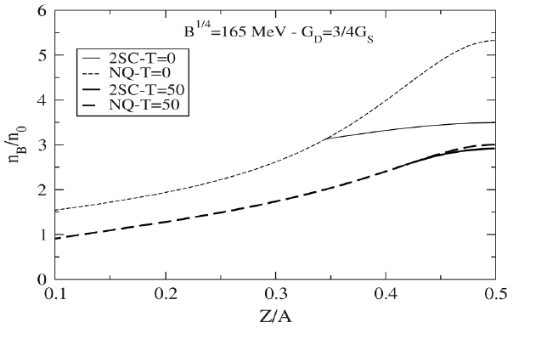
Motivations
Why asymmetric dense matter?
Partial restoration of chiral symmetry

Slide 4
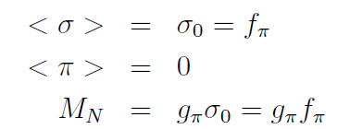
Why parity doublet model?
Origin of nucleon mass (in the chiral limit) other than chiral symmetry breaking?
PD says yes! One can talk about chiral invariant nucleon mass m₀. apart from
that due to chiral symmetry breaking.

Slide 5
Asymmetric matter in a PD model
Introduce two nucleon fields that transform in a mirror way under chiral transformations:
“Linear sigma model with parity doubling,” C. E. DeTar and T. Kunihiro, Phys. Rev. D 39, 2805 (1989)

Slide 6
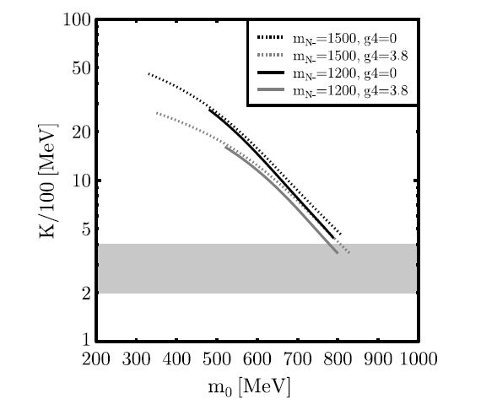
D. Zschiesche, L. Tolos, Jurgen Schaffner-Bielich, Robert D. Pisarski, Phys.Rev. C75 (2007) 055202

Slide 7
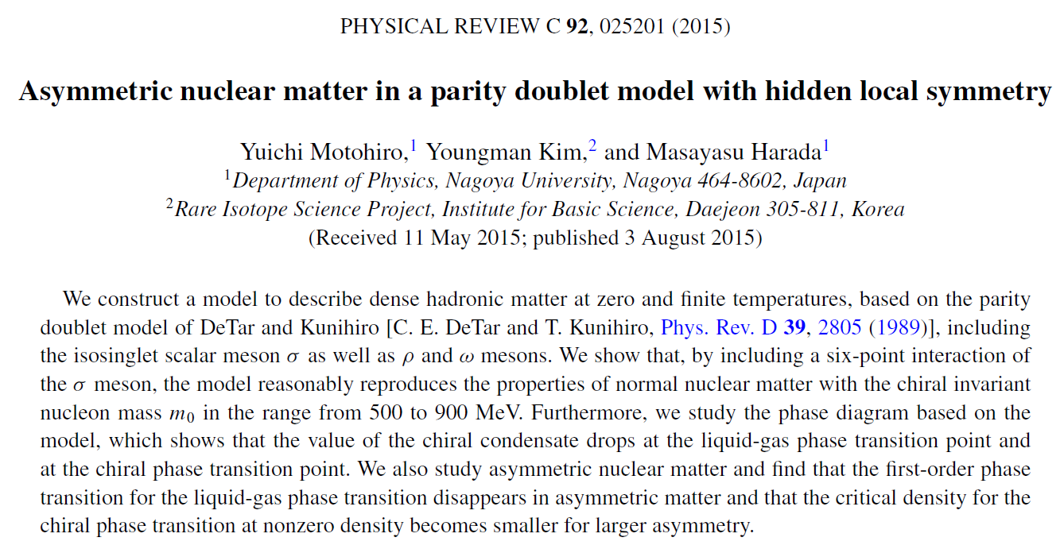
Any sensitive physical quantities to m₀?

Slide 8
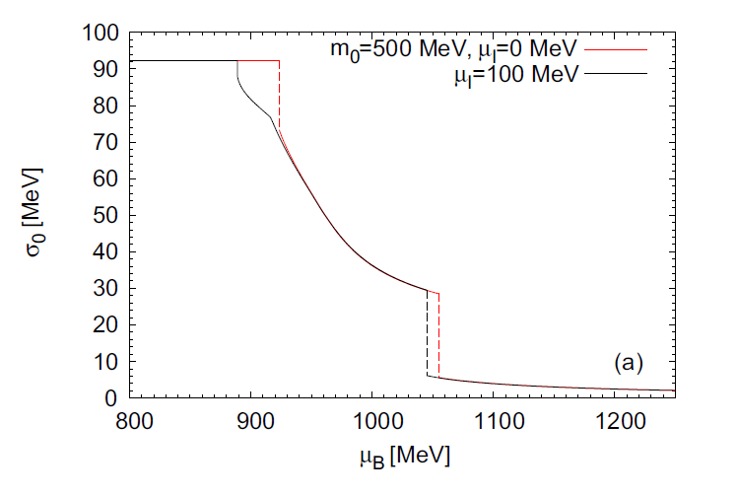

Slide 9
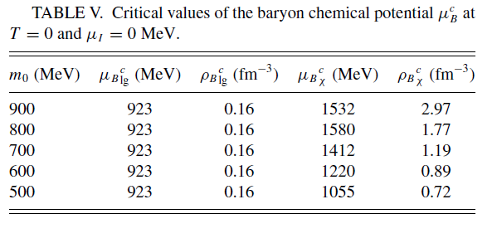
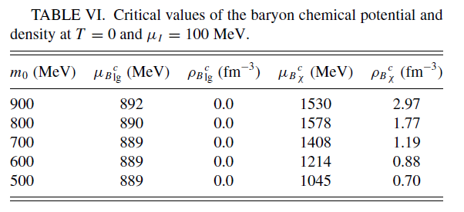

Slide 10
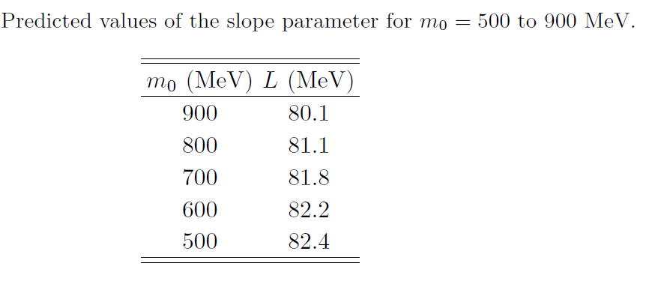

Slide 11
Delta matter in a parity doublet model
Yusuke Takeda, YK, Masayasu Harada, e-Print: arXiv:1704.04357 [nucl-th]
* The onset density of Δ matter can be smaller than two times the saturation density.
* In symmetric matter, the stable Δ-nucleon matter is realized in 3-4 times the saturation density, and the phase transition from nuclear matter to Δ-nucleon matter is of first order in the wide parameter region.
* In asymmetric matter, the phase transition from the nuclear matter to the stable Δ-nucleon matter can be of the second order for most parameter region.
* In symmetric dense matter, larger chiral invariant nucleon mass tends to lower the transition density to the stable N-Δ phase
* Partial restoration of chiral symmetry is enhanced by delta matter.

Slide 12
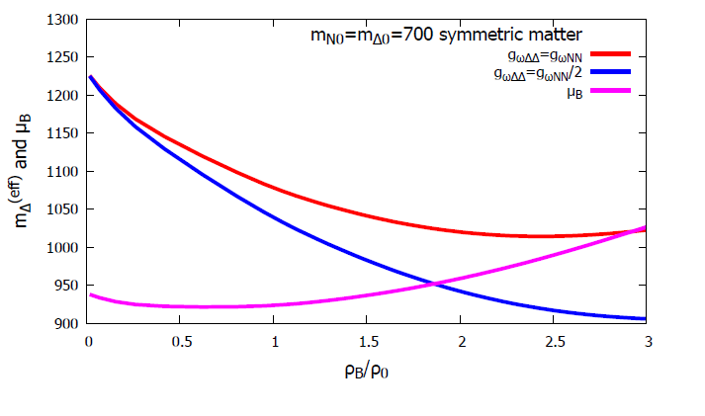

Slide 13
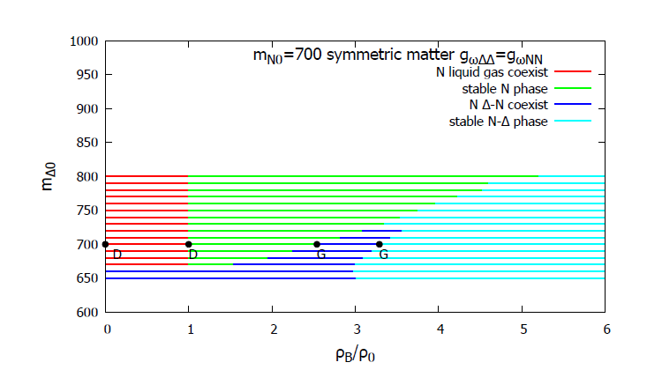

Slide 14
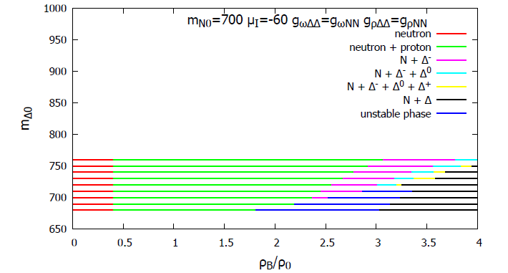

Slide 15
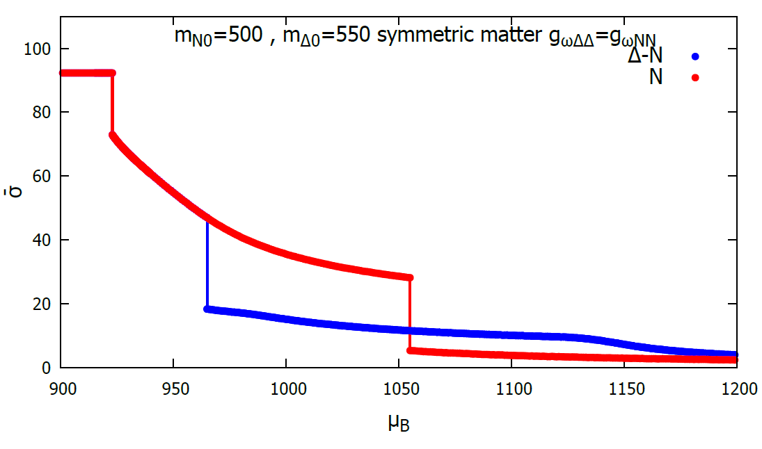
preliminary
Enhancement of partial chiral symmetry restoration by delta matter!

Slide 16
Finite nuclei in a PD model in brief
Parity doublet model
in relativistic continuum Hartree-Bogoliubov theory
W.-G. Paeng, et al, in progress
RCHB theory properly takes into account the pairing correlation
and the coupling to (discretized) continuum via Bogoliubov
transformation in a microscopic and self-consistent way.
[J. Meng, et al, Prog. Part. Nucl. Phys. 57 (2006) 470]
Spherical RCHB code was provided by Jie Meng (Peking Univ.).
Main difference is the behavior of sigma mean field.
Revised the code to incorporate the difference.
As a warm-up, we use the simple PD model by Zschiesche, et al, and assume spherical symmetry.

Slide 17
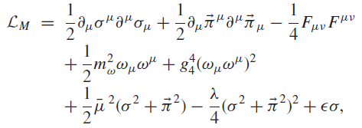
Cold, dense nuclear matter in a SU(2) parity doublet model
D. Zschiesche, L. Tolos, Jurgen Schaffner-Bielich, Robert D. Pisarski, Phys.Rev. C75 (2007) 055202

Slide 18
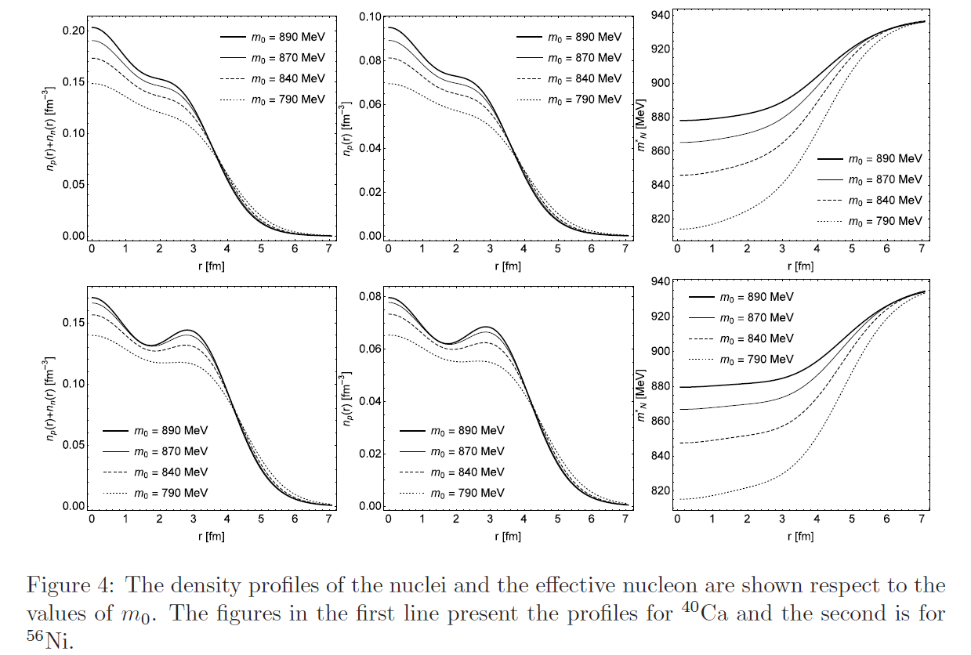

Slide 19
Summary
* Parity doublet model may reveal non-chiral component of nucleon mass
in asymmetric dense matter, which may be observed in heavy ion collisions
or in finite nuclei.
* Partial restoration of chiral symmetry, which may be studied at RAON, is
enhanced by the presence of delta matter.

