Slide 1




www.poscoas.com
2026
Notes:
Thank you for giving us the opportunity to introduce POSCO Air Solution.
Before I introduce P-AS,
I’d like to briefly explain why POSCO Group entered the rare gas business.
At one point, about 70% of the world’s rare gas supply came from Ukraine.
But as the war in Ukraine disrupted production facilities,
making the global rare gas supply very tight.
As a result, rare gas prices increased dramatically,
which had a significant impact on the semiconductor industry in Korea.
Accordingly, to strengthen supply chain security,
the Korean government included rare gases among the strategic supply chain items.
and POSCO Group took an important role in securing the supply chain.
Then, you may ask:
Why POSCO?
The reason is simple. Rare gas exists only in trace amounts in the atmosphere.
Therefore, large-scale air separation units are needed to recover rare gas economically.
This is where POSCO has a strong advantage.
With extensive Air separation units to support its large steel plants,
POSCO already had the right foundation for rare gas recovery.
Today, we are proud that, our rare gases can contribute not only to high-valued industries,
but also to fields of basic science such as nEXO experiments.

Slide 2


Contents
POSCO Group
POSCO Air Solution
Product
1
2
3
Notes:
So, with that background,
today I'd like to briefly introduce POSCO Group, POSCO Air Solution, and our high-purity rare gas products.

Slide 3



POSCO Group
1
Notes:
Let me start with a brief introduction to POSCO Group.

Slide 4





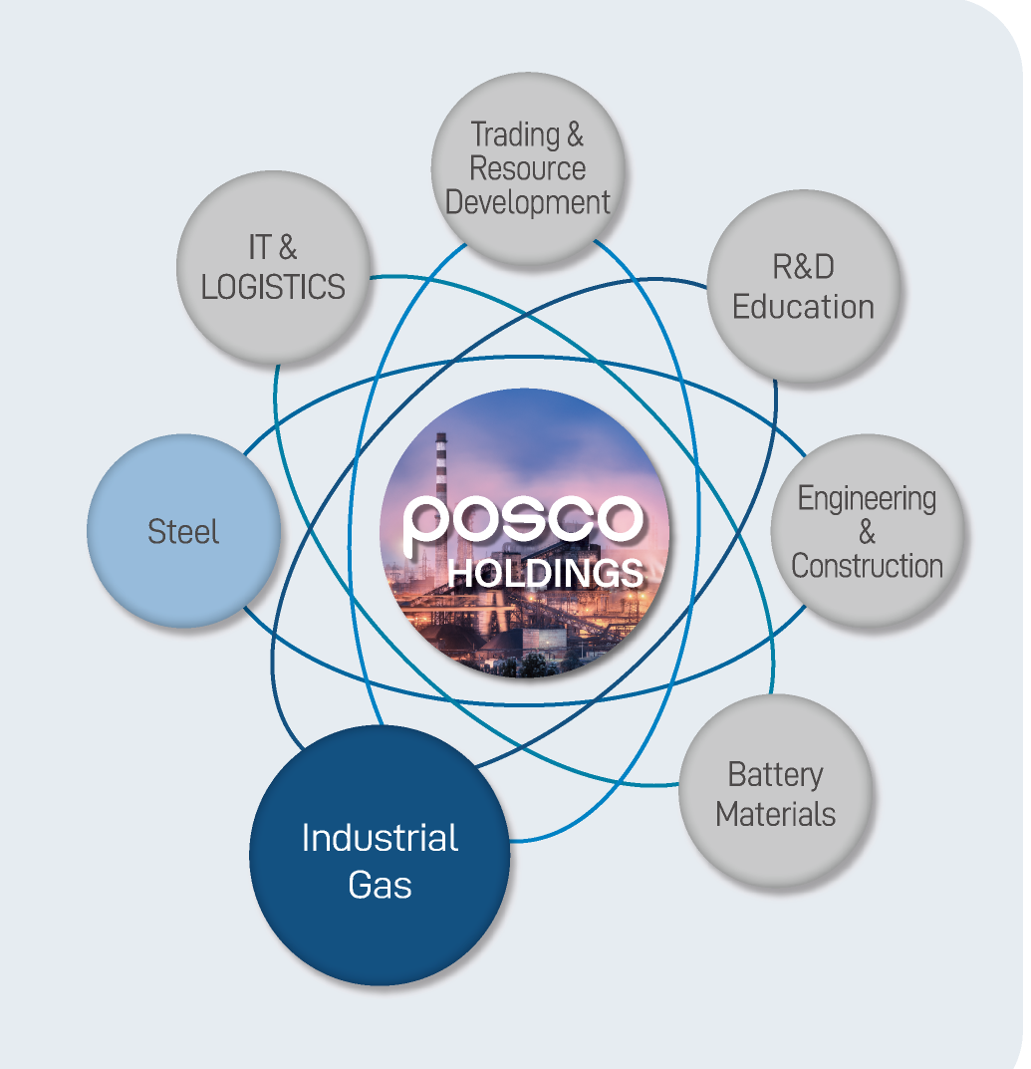
POSCO GROUP
POSCO Holdings is involved in a diverse range of businesses, including industrial gas,
battery materials, resource development, and IT, based on its core steel business.
Name | POSCO HOLDINGS
Establishment | April 1, 1968
Employees | 44,501
CEO | Chang, In-Hwa
Groups | 50
Business Performance | $53.1 bil. (2025 Consolidated Results)
Location | Headquarters: 6261, Donghaean-ro, Nam-gu, Pohang-si, Gyeongsangbuk-do Seoul Office: 440, Teheran-ro, Gangnam-gu, Seoul
Remarks | Maximizing group synergy
Notes:
POSCO Holdings is the holding company of the POSCO Group.
Founded in 1968 and built on its core steel business,
POSCO Group has grown into a diversified group with businesses including
industrial gas, battery materials, resource development, and IT.
As of 2025, the group has approximately 44,500 employees,
with consolidated business performance of about 53.1 billion US dollars.

Slide 5





Rare Gas Business in POSCO Group
POSCO handles Air gases & Crude gases and POSCO Air Solution produces
High-purity rare gases, while RIST & POSTECH are responsible for Research and Development.
&
POSCO Industrial Gas Business Unit
* CIC for Industrial Gases in POSCO
High Purity Rare Gas Manufacturer
Industrial & Academic Research
(RIST) (POSTECH)
▪ 23 ASUs in POSCO steel works
with operational know-how since 1973
- The largest size domestically
High Purity Rare Gas(Xe, Kr, Ne, He)
Production & Sales
▪ RIST : Research Institute of
Science & Technology
- Conducting practical research for
technology development
Production Capacity
- Xe 20 ton/y, Kr 100 ton/y
- Ne 100 ton/y, He 5 ton/y
▪ Production & Sales
- Air Gas : O₂, N₂, Ar etc.
- Crude Gas : Rare Gas, Specialty Gas
▪ POSTECH : Pohang University of
Science and Technology
- Conducting pure basic research
3
Notes:
Now, let me briefly explain the POSCO Group's gas business structure.
As you can see on this slide,
different companies play different roles in the gas business.
POSCO Air Solution focuses on the separation and purification of high-purity rare gases,
including Xenon, Krypton, Neon, and Helium.
In particular, we are responsible for building the full value chain for rare gases.
POSCO operates 23 Air Separation Units,
which provide the foundation for the industrial and rare gas business.
And RIST and POSTECH, the POSCO Research Institute,
supports practical research and development to strengthen our technology and product capabilities.
So, through this group-wide structure,
we cover different parts of the gas business,
from raw material for rare and industrial gases, rare gas purification and R&D.

Slide 6
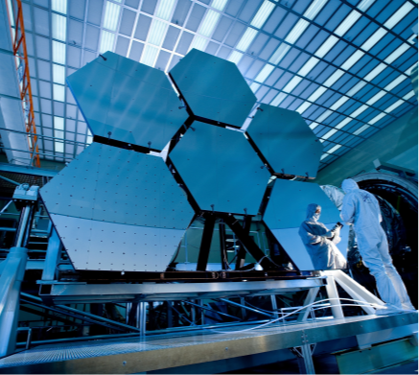
2
POSCO Air Solution
Notes:
Now, about POSCO Air Solution, rare gas manufacturer.

Slide 7

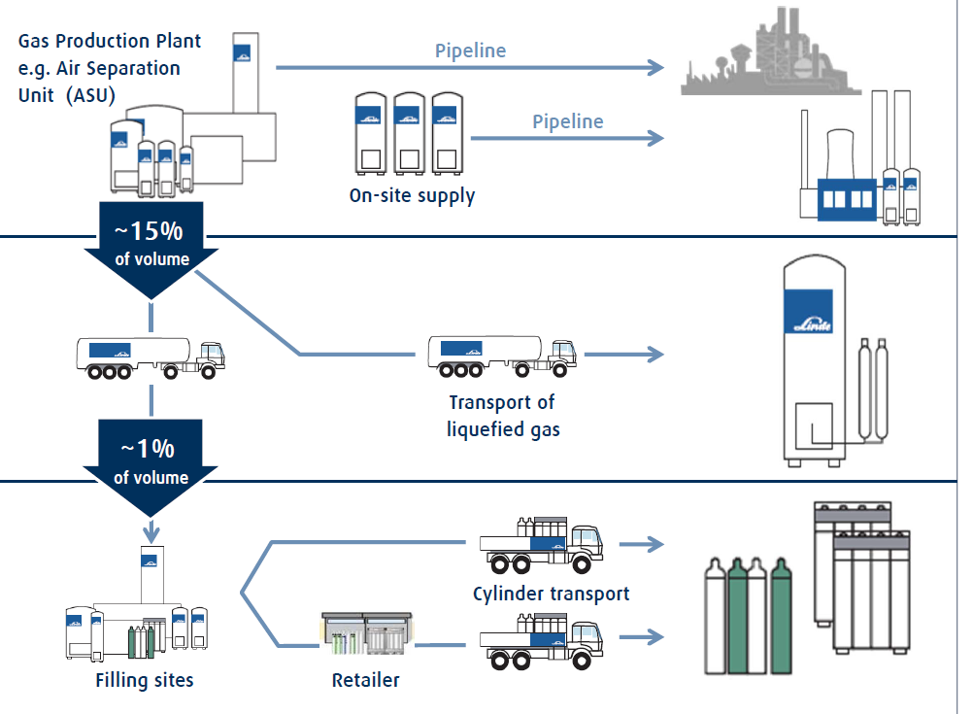
POSCO Air Solution
Business Structure
POSCO
Air Separation Unit
O₂/N₂
Name | POSCO Air Solution CO., LTD
Establishment | August 27, 2024
CEO | Kim, Dae-Yeon
Employees | 55
Location | 2626 Jecheol-ro, Gwangyang-si, Jollanamdo, Korea (Donghoan National Industrial Complex, Site area: 39,000m2)
Remarks | Commencement of commercial production (May.’26)
Crude
Extraction
Crude Gas
POSCO
AIR
SOLUTION
Separation/
Purification
High Purity
Rare Gas
End User
Notes:
POSCO Air Solution was established in August 2024,
and our plant is located in Gwangyang, the southern-most region Korea.
We started commercial production in May 2026.
Our business is simple:
We separate and purify rare gases.
We utilize crude gas generated from POSCO’s Air Separation Units which is O2 and N2,
and then further separate and purify the crude to produce high-purity rare gases including Xenon.
In other words,
we connect POSCO's upstream gas resources with our separation and purification technology,
and supply high-purity products to our end users.
That is our core business model.

Slide 8
[Annex] Air Separation Unit (ASU)
Air Separation Unit (ASU) cryogenically liquefies atmospheric air
and separates oxygen, nitrogen, and argon by boiling point differential
① Air Intake
② Compression &
Pre-Treatment
③ Distillation
④ Storage
N₂
Ne, He
LIN
-196℃
Compressor
Air
Ar
Pre-Treatment
(Remove H₂O, CO₂)
LAR
-186℃
O₂
Xe, Kr
LOX
-183℃
Notes:
Then what is Air Separation Unit?
This Unit separates atmospheric air based on differences in boiling points.
First, air is compressed and pre-treated to remove impurities such as water and carbon dioxide.
Then, the air is cryogenically distilled into oxygen, nitrogen, and argon.
And at our facility we distill Xe and Kr from oxygen and Ne and He from nitrogen.

Slide 9

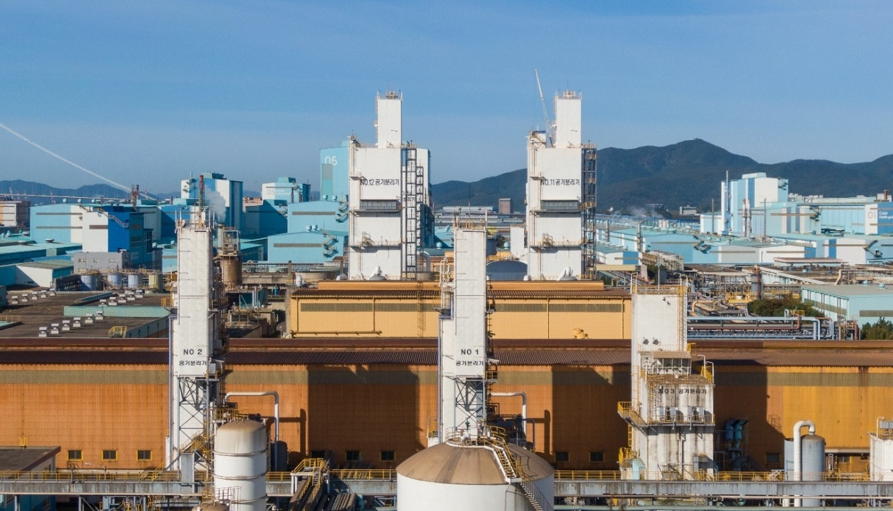





[Annex] Air Separation Unit (ASU)
POSCO ASU
Pohang Steel Works
Gwangyang Steel Works
+
ASU 12 Plant
ASU 11 Plant
Total ASU : 23 Plants
Notes:
POSCO steelworks currently operates 23 ASU plants, 12 in Pohang and 11 in Gwangyang.
which gives us a strong and reliable source of raw materials.

Slide 10
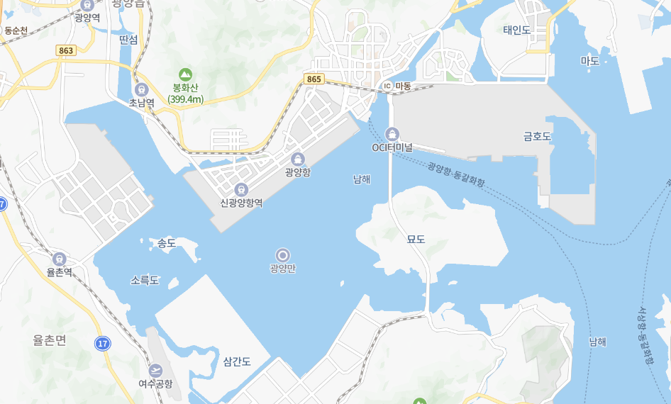
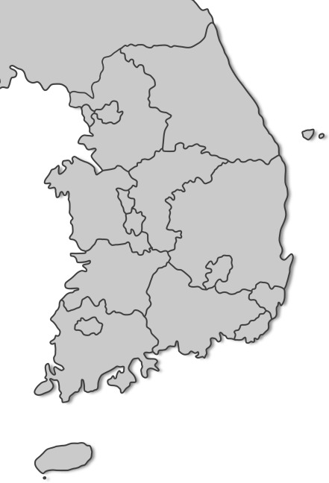




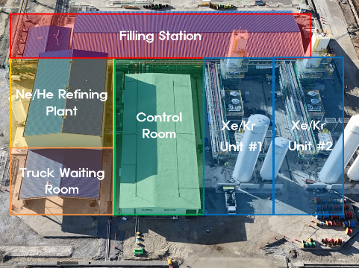

[Annex] Company Location
Our plant strategically operates within the premises of Gwangyang Steel works,
taking advantage of its proximity to Port and POSCO’s ASUs for efficient logistics.
POSCO
Gwangyang Steelworks
15Km
Seoul
Gwangyang Steelworks
330Km
Gwangyang Port
Battery Materials
Complex
New Business Area
POSCO AIR SOLUTION
Gwangyang
Chemical Complex
7
Notes:
Our plant is located close to the POSCO Gwangyang Steel Works and the port,
giving us an additional logistical advantage.

Slide 11

Products
3
Notes:
Now its about our products

Slide 12
Products
We are the largest domestic producer of Rare gases, specializing in the stable supply of
high-purity Xenon, Krypton, Neon, and Helium.
54
Xe
Xenon
36
Kr
Krypton
Application
- Electric propulsion of satellites and other spacecraft
- Etching process of manufacturing semiconductor
Annual Capacity : 20 ton
Application
- Electric propulsion of satellites and other spacecraft
- Etching process of manufacturing semiconductor
- Window insulation
Annual Capacity : 100 ton
10
Ne
Neon
2
He
Helium
Application
- Lithography process of manufacturing semiconductor
Annual Capacity : 100 ton
Application
- A wide variety of applications such as welding,
semiconductors, electronics & lighting, etc.
10
Notes:
Our main rare gas products are Xenon, Krypton, Neon, and Helium.
First, Xenon. Our annual production capacity is 20 tons.
Xenon is mainly used for Electric propulsion systems for satellites and spacecraft,
as well as semiconductor etching and of course also for nEXO experiment.
Second, Krypton. Our annual production capacity is 100 tons.
Krypton is used for Electric propulsion, semiconductor etching, and window insulation.
Third, Neon. Our annual production capacity is 100 tons. Neon is mainly used in semiconductor lithography,
including excimer laser gas applications.
Finally, we also supply Helium, which is used in a wide range of applications, including welding, semiconductors, electronics, and lighting.

Slide 13
Specification
Xenon
Analysis Item | Unit | 5N8 |  | 6N |  | Analysis Method
O₂+Ar | ppmv | < | 0.10 | < | 0.10 | GC
N₂ | ppmv | < | 0.10 | < | 0.10 | GC
H₂ | ppmv | < | 0.10 | < | 0.10 | GC
Kr | ppmv | < | 0.10 | < | 0.10 | GC
CO | ppmv | < | 0.10 | < | 0.10 | GC
CO₂ | ppmv | < | 0.10 | < | 0.10 | GC
C₂F₆ | ppmv | < | 0.10 | < | 0.10 | GC
SF₆ | ppmv | < | 0.10 | < | 0.10 | GC
THC(as CH₄) | ppmv | < | 0.10 | < | 0.10 | GC
N₂O | ppmv | < | 0.10 | < | 0.10 | GC
H₂O | ppmv | < | 0.20 | < | 0.10 | Moisture Analyzer
Notes:
In the semiconductor and aerospace industries,
purity and consistency are critical and I believe in nEXO experiment too.
We offer high Purity xenon in 5N8 and 6N grades,
with strict specifications for impurities as follows.
We strictly control major impurities to meet the requirements of demanding applications.

Slide 14
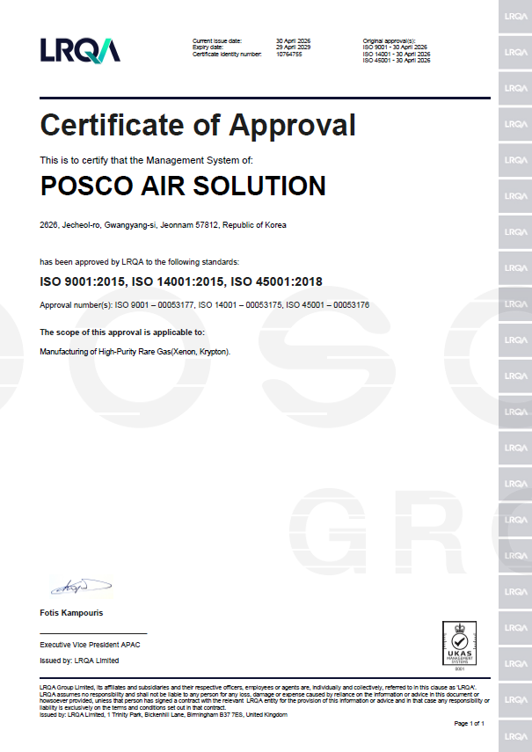
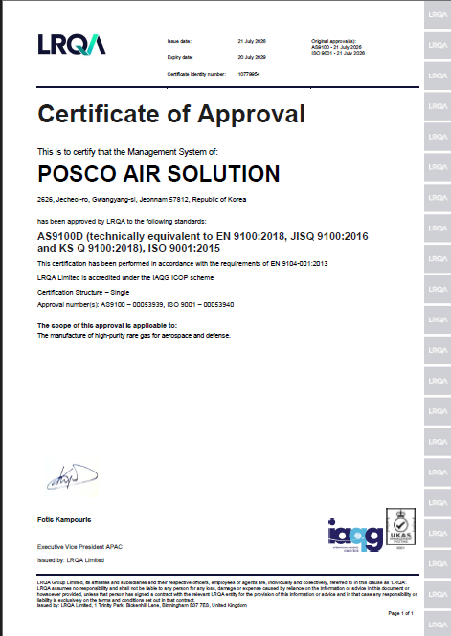
[Appendix] Certificate
POSCO Air Solution has obtained Triple ISO certifications(Quality, Environment, OH&S)
and became the first rare gas manufacturer in Asia to earn AS9100D
[ISO Certificate]
[AS9100 Certificate]
Notes:
In addition to product purity,
we place a strong emphasis on quality management and production reliability.
P-AS has obtained triple ISO certifications covering quality, environment, Occupational H&S.
More importantly,
we became the first rare gas manufacturer in Asia to obtain AS9100D,
Which is Defense and aerospace quality management certification.
These certifications demonstrate,
our commitment to meeting the strict quality and management requirements.

Slide 15
Q&A
Feel free to ask any questions about the conference!
PRESENTER
NOVEMBER 10, 9:00 AM - 4:00 PM
CONTACT
WWW.YOURACCOUNT.COM
Notes:
This is all about today.
Thank you very much for your attention.
To summarize,
POSCO Air Solution is building a strong rare gas business
And our goal is simple:
to become a reliable global supplier of high-purity rare gases.

