Slide 1

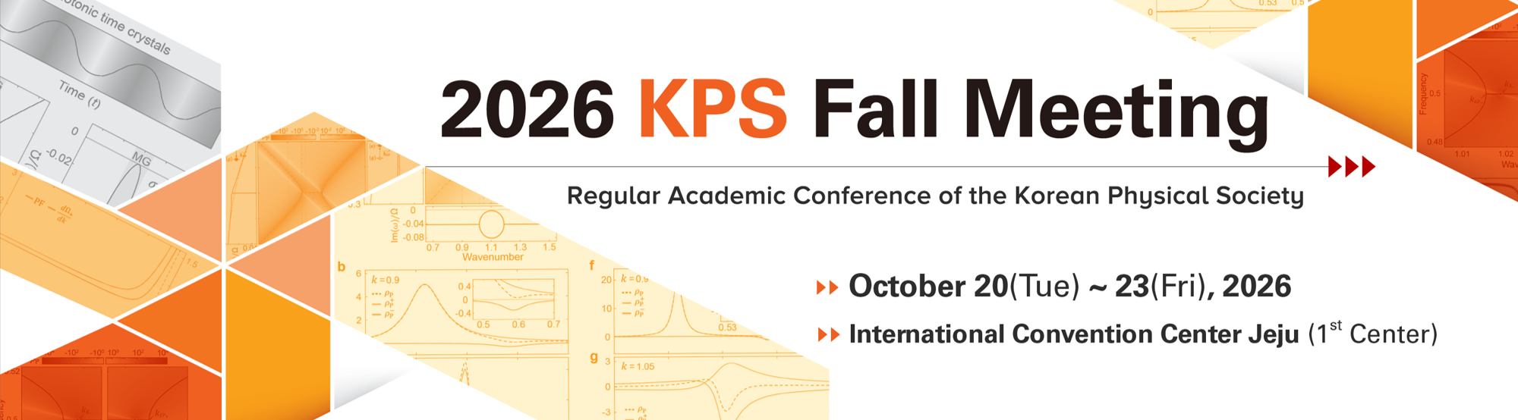


Bolometer-based readout for axion haloscope searches
Saebyeok Ahn, Boris Ivanov, Pallavi Parashar, Sergey Uchaikin, and SungWoo Youn
Dark Matter Axion Group, Institute for Basic Science, Daejeon, South Korea
in collaboration with
Priyank Singh and Mikko Mottonen
QCD Labs, Department of Applied Physics, Aalto university

Slide 2
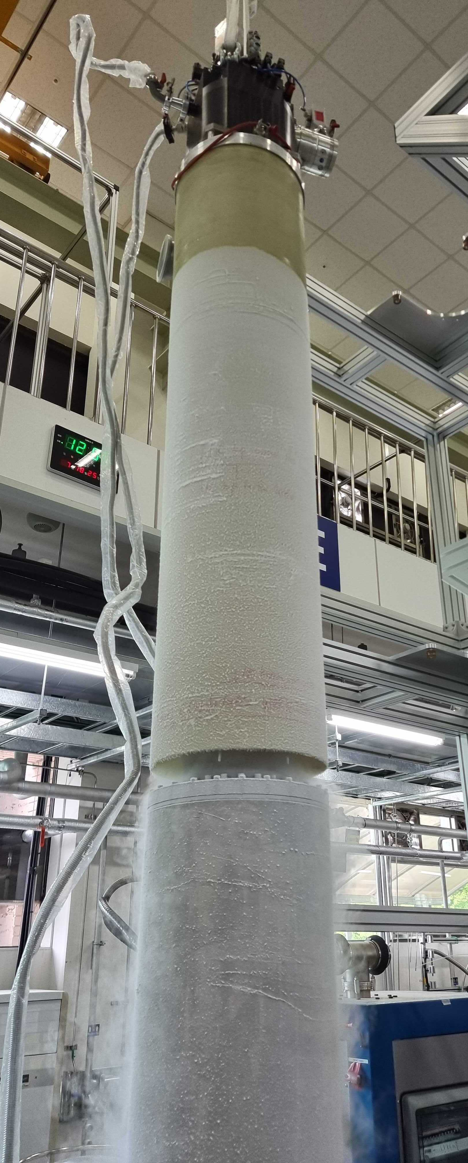
OUTLINE
P. Sikivie principle of haloscope search experiment
New detection principle
Zeptojoule Microwave Nanobolometer
Axion search readout based on the power bolometer
Notes:
Here is the outlie of my talk. First I would like to show the axion haloscope experiment proposed by Sikivie, than I will show you the current quantum noise limited amplifier readout for the experiment, next I will mention about the single photon detector based on the underdamped Josephson junction. After it I will explain the main idea of using the Josephson junction as a microwave photon detector, where I will remind you about the washboard potential. Next, the CBJJ as a single photon counter will be show with the main parameters and the measurement setup. And as a final I will show you the main diagram of the axion measurement system based on the CBJJ.

Slide 3
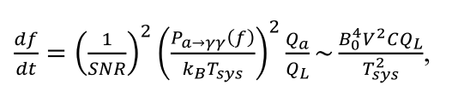
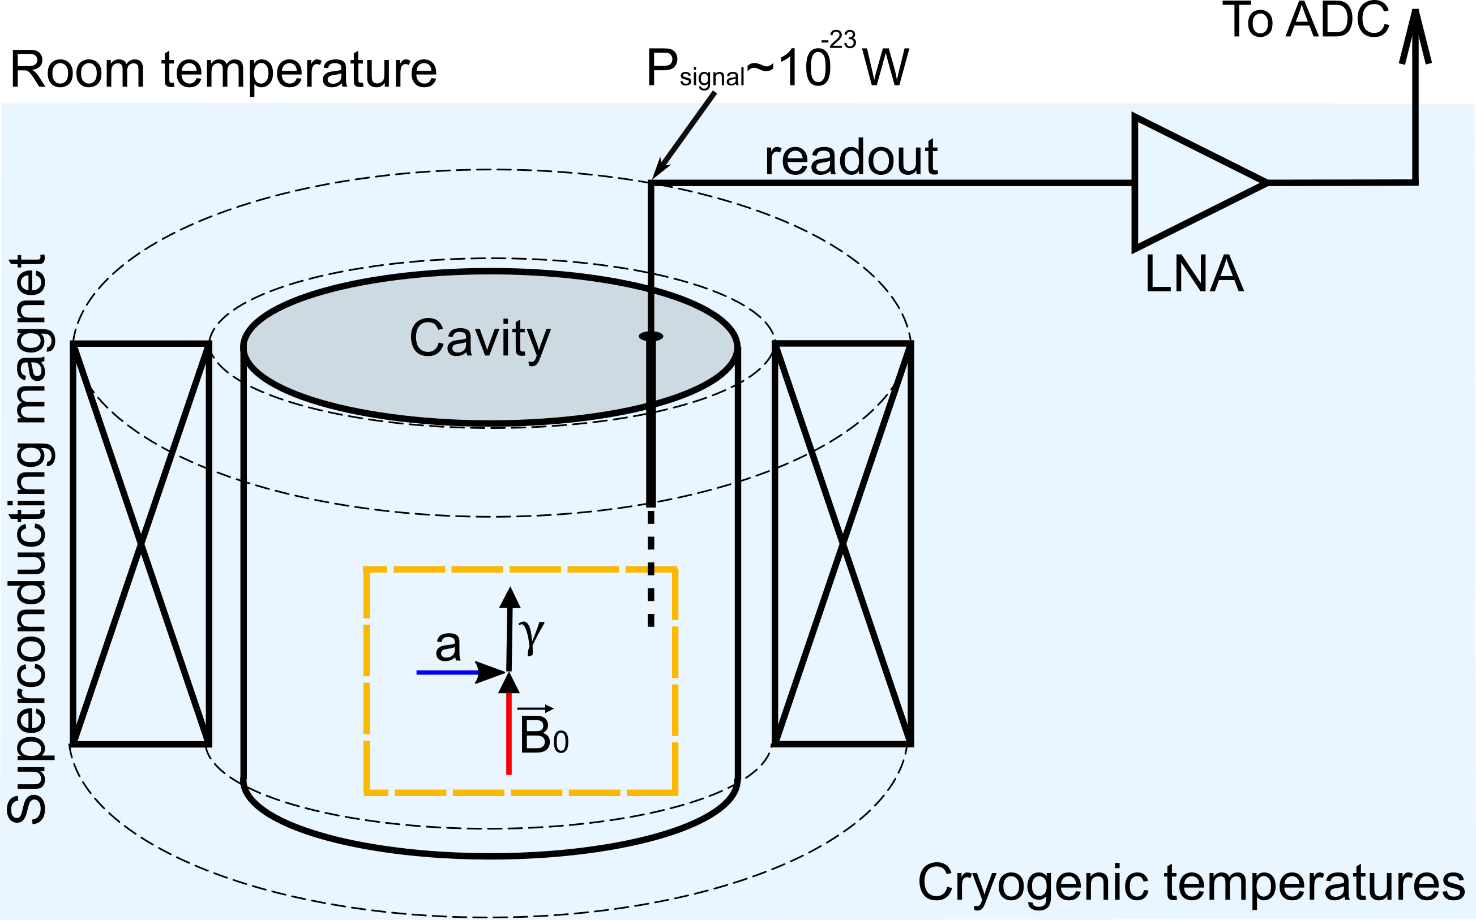
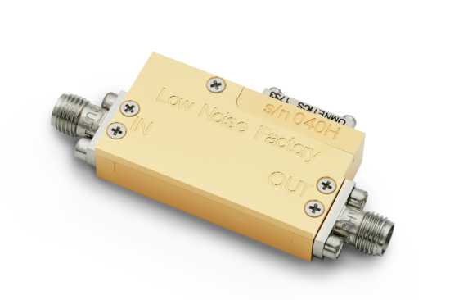
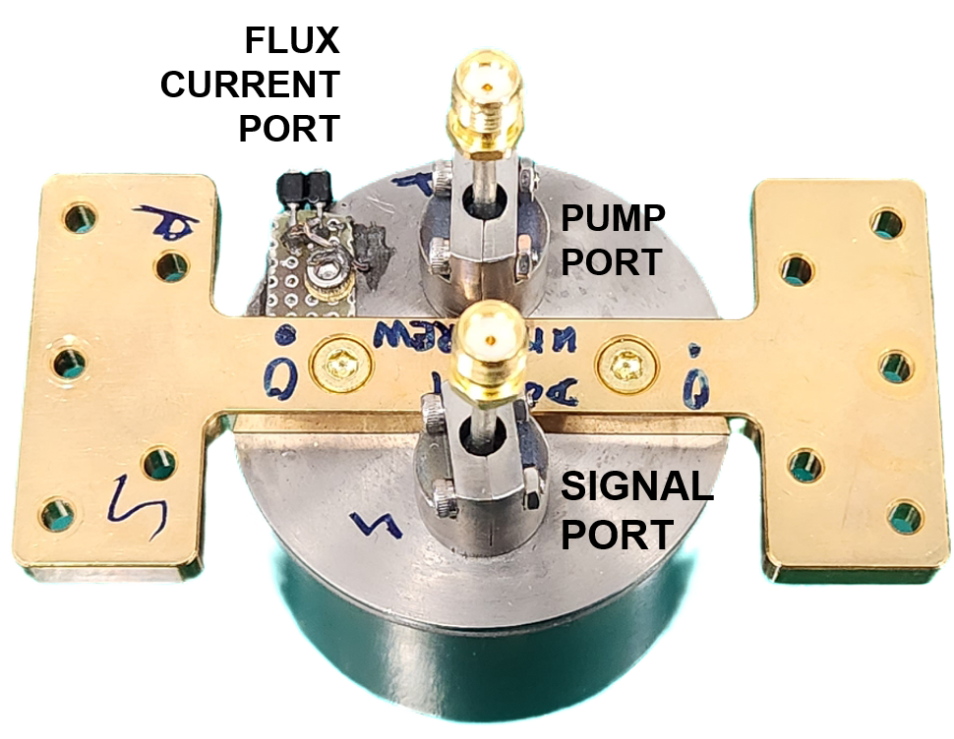
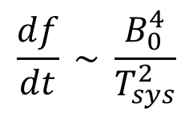
Motivation. Haloscope search experiment
The axion search haloscope principal proposed by Sikivie [1]:
$$\frac{df}{dt} \sim \frac{B_{0}^{4}}{T_{sys}^{2}}$$
Scanning rate
(1)
High electron mobility transistor amplifier (HEMT)
G ~ 30 dB,
T_{n} ~ 2 K.
Josephson parametric amplifier (JPA)
G ~ 20 dB,
T_{n} ~ 0.1 K.
[1] P. Sikivie, Phys. Rev. Lett. 1983, 51, 1415.
Notes:
- The experiment was proposed by Sikivie
Typical microwave detectors are based on linear ampliﬁers, that however have an irreducible noise level even at zero temperature, coming from quantum ﬂuctuations of the vacuum.
This quantum limit is now being reached by the most advanced detectors of this type (e.g. Josephson Parametric Ampliﬁers), and the truly frontier at this moment is deﬁning strategies to overcome this limit.

Slide 4
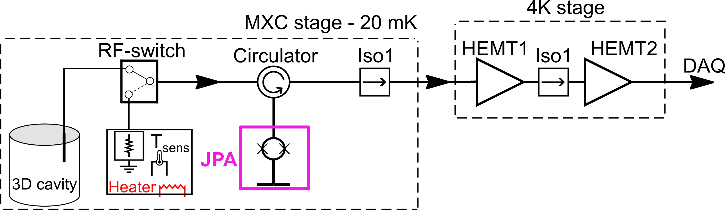
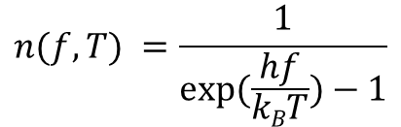




JPA - linear amplifier
$$Tsys=Ts+Tjpa+\frac{Tiso}{Gjpa}+\frac{THEMT1}{GjpaGiso}+\frac{THEMT2}{GjpaGisoGHEMT1}…$$
$Ts$- source noise
cavity
Noise source
(basically matched load)
$Ts$ = 20 mK, considering the Plank expression:
$$Pn=hfn\left(f,T\right)B$$
- noise power
$$n(f,T) =\frac{1}{exp⁡(\frac{hf}{kBT})−1}$$
- Bose-Einstein mean photon number at frequency f
If we consider f = 5 GHz, and 20 mK, we obtain:
2.04 x 10⁻²⁹ W/Hz → - 256,9 dBm/Hz

Slide 5
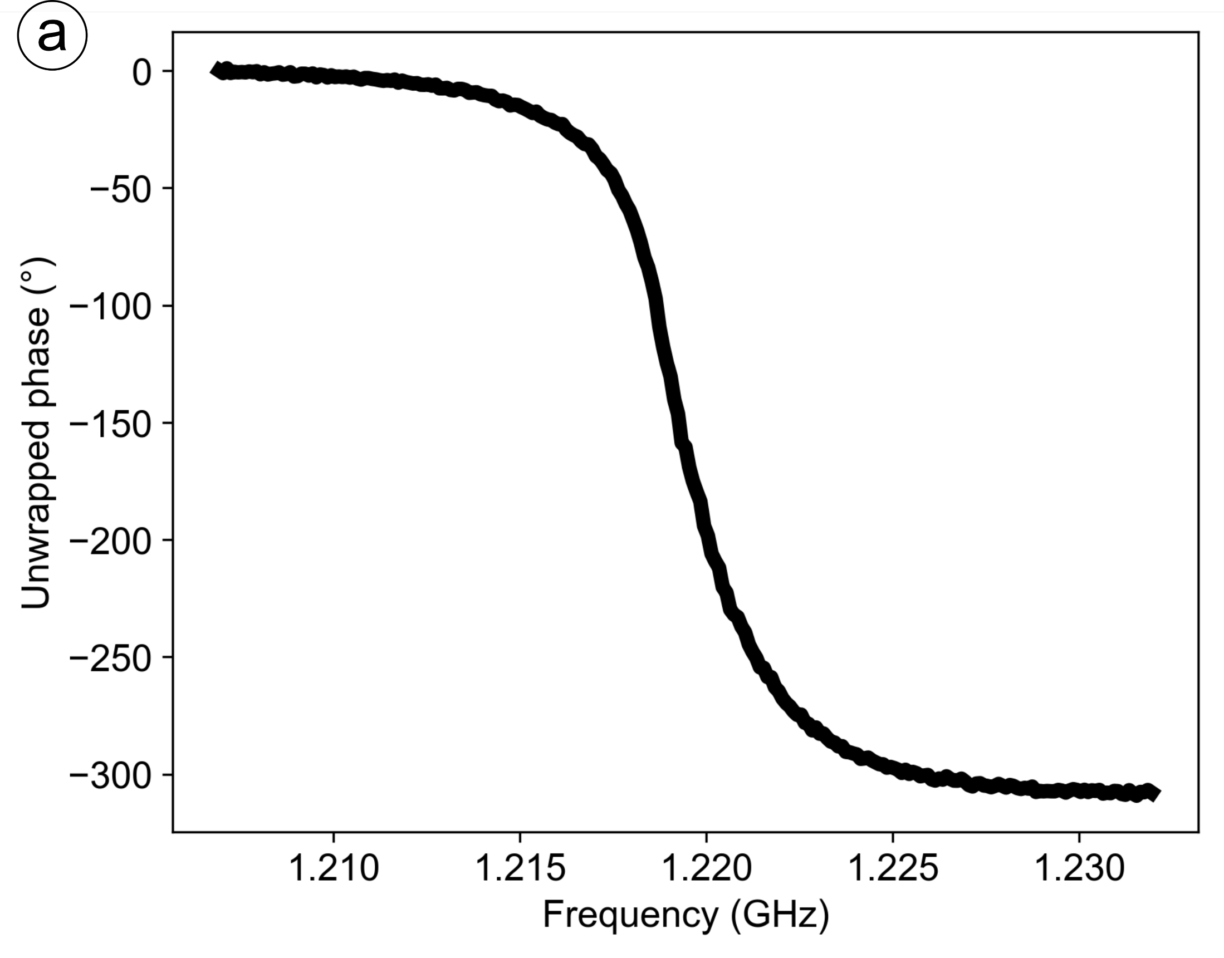
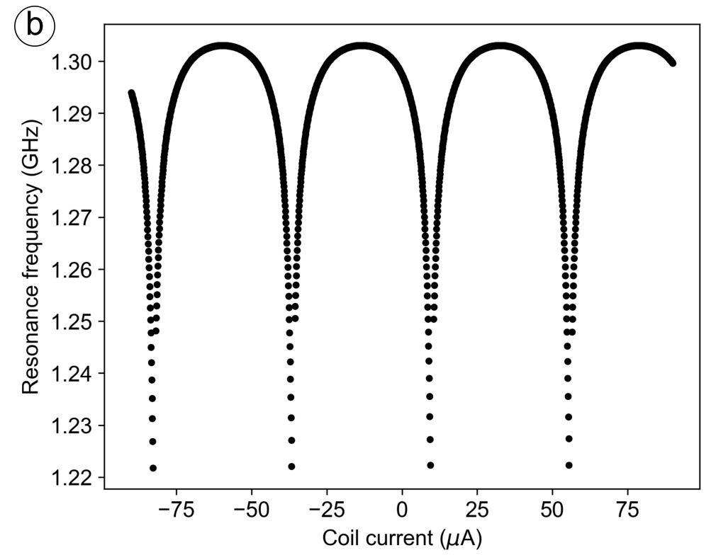
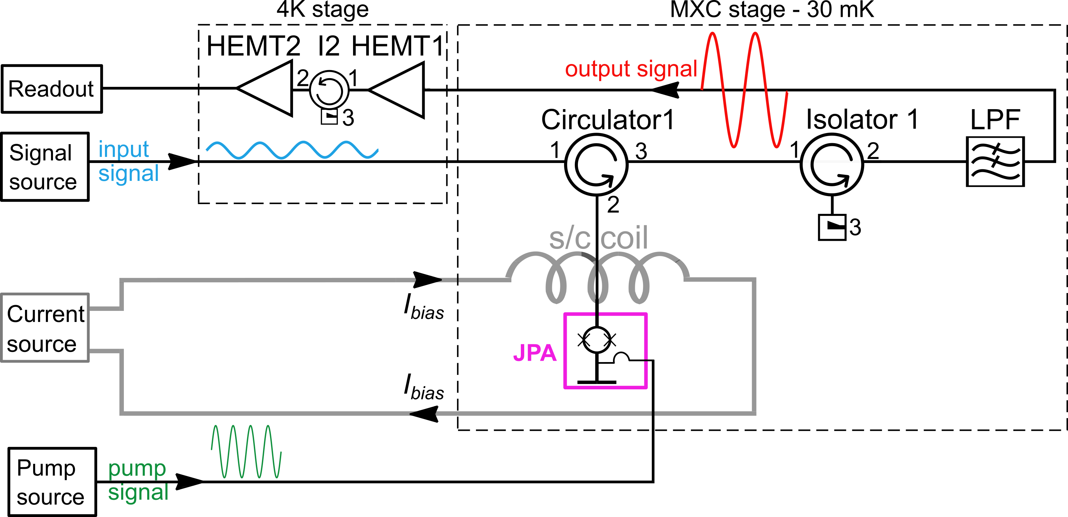
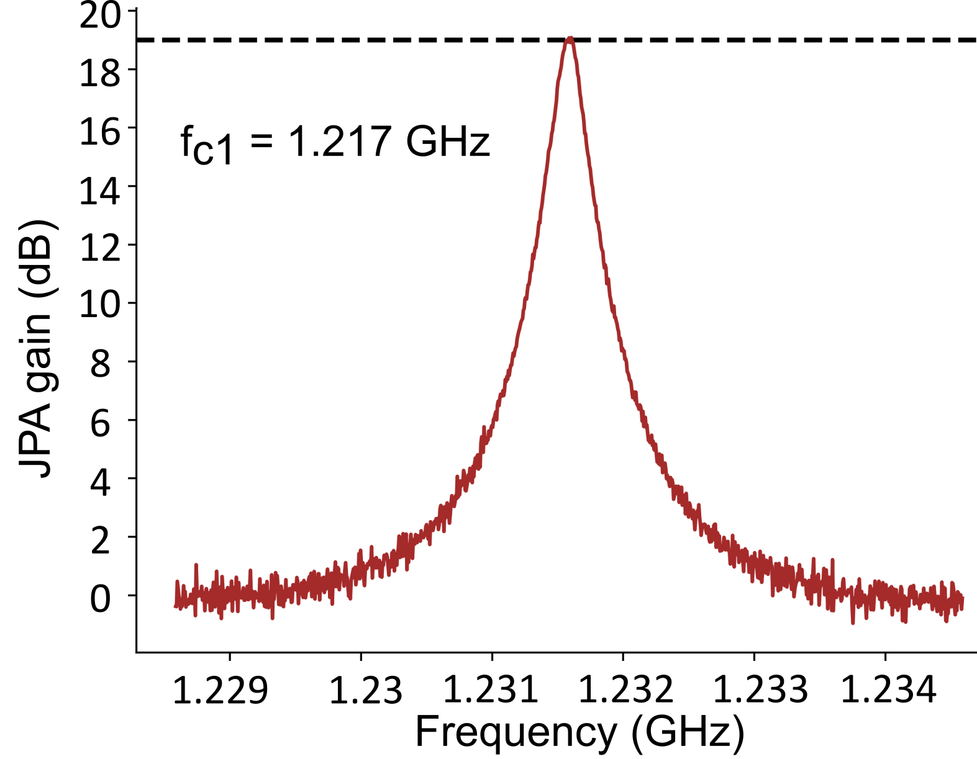
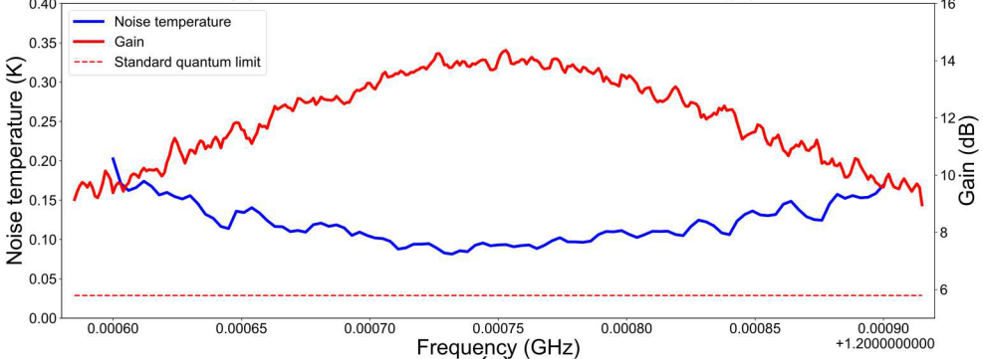
JPA - linear amplifier
60 MHz
[2] S.V. Uchaikin, et al. J Low Temp Phys 216, 14-20 (2024)
[3] S.V. Uchaikin et al. Front. Phys. 12, (2024)

Slide 6
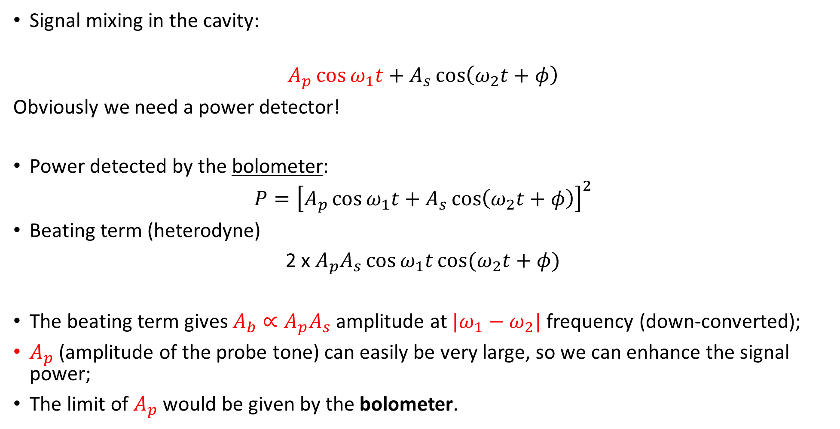
New principle – power detection
Signal mixing in the cavity:
$$A_{p}\cos{ω_{1}t}+A_{s}\cos\left(ω_{2}t+φ\right)$$
Obviously we need a power detector!
Power detected by the bolometer:
$$P={\left[A_{p}\cos{ω_{1}t}+A_{s}\cos\left(ω_{2}t+φ\right)\right]}^{2}$$
Beating term (heterodyne)
2 x $A_{p}A_{s}\cos{ω_{1}t}\cos{(ω_{2}t+φ)}$
The beating term gives $A_{b}∝A_{p}A_{s}$ amplitude at $|ω_{1}−ω_{2}|$ frequency (down-converted);
$A_{p}$ (amplitude of the probe tone) can easily be very large, so we can enhance the signal power;
The limit of $A_{p}$ would be given by the bolometer.
Coherent probe tone
Signal to detect

Slide 7
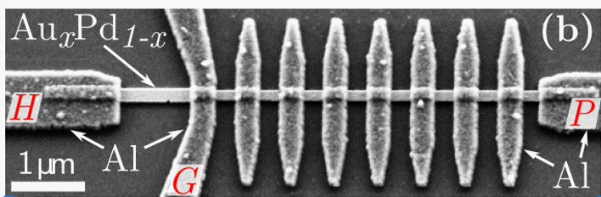
Zeptojoule NanoBolomer (ZNB)
Thermal photon detection → measure the temperature rise caused by the absorbed microwave photons with quantum sensitivity
Sample description:
Metallic Au_{x}Pd_{1-x} nanowire used for thermal radiation detection;
Superconductor – Normal metal – Superconductor (S/N/S) junctions are used as a photon detector.
Noise equivalent power down to 50 zW/Hz;
Response time down to 30 us.
Using the JPA readout
[4] J. Govenius et al., Phys. Rev. Lett. 117, 030802 (2016)
[5] R. Kokkoniemi et al., Commun Phys 2, 124 (2019)
Notes:
DFSZ level of the sensitivity for the whole frequency range;

Slide 8
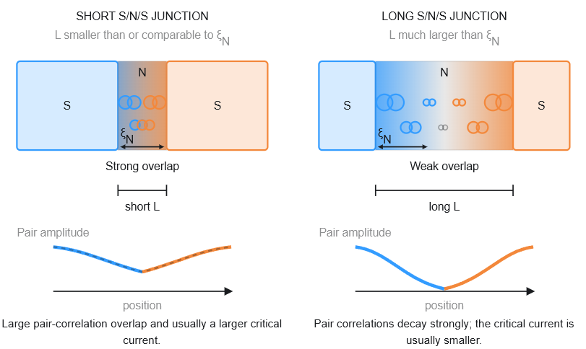
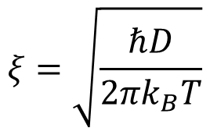


Bolometer is based on s/n/s junctions
S/N/S junction
$$ξ=\sqrt{\frac{ℏD}{{2πk}_{B}T}}$$
Superconducting coherence length
$$, D −electron diffusion coefficient in the normal metal$$
$$L≥ξ$$
$$L≤ξ$$
Notes:
In an S/N/S junction:
The normal metal does not create Cooper pairs by itself.
Contact with a superconductor causes electrons in the normal metal to acquire similar pair correlations.
The strength of this correlation decreases with distance from the S/N interface.
Correlations entering from both superconductors can overlap and carry a Josephson supercurrent. The pair amplitude measures the local quantum coherence associated with Cooper pairing.
Illustrative decay of the magnitudes of the left- and right-induced pair correlations

Slide 9
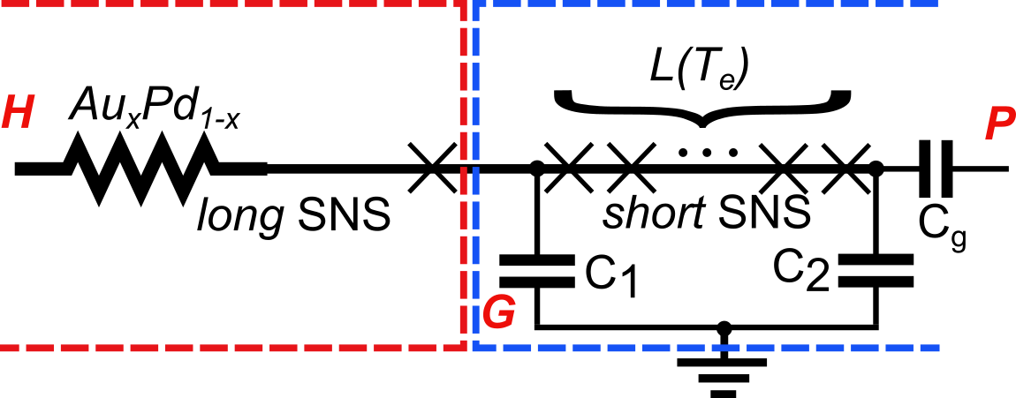
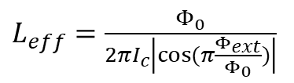

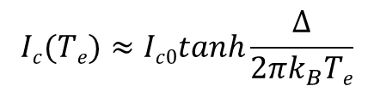


Bolometer design
$$L≤ξ$$
$$L≥ξ$$
T_{e} > T_{bath}, microwave power-hot electrons transformer
high sensitive detector
$$Ic(Te)≈Ic0tanh\frac{∆}{{2πk}_{B}Te}$$
$$A_{s}\cos{ω_{1}t}$$
$L_{eff}=$ $\frac{Φ_{0}}{2πI_{c}\left|cos⁡(π\frac{Φ_{ext}}{Φ_{0}})\right|}$
Notes:
In this case if we combine the fabrication process and within a single normal metal wire, like AuPd film together with Al islands we can create a robust chip design of the bolometer.
DFSZ level of the sensitivity for the whole frequency range;

Slide 10
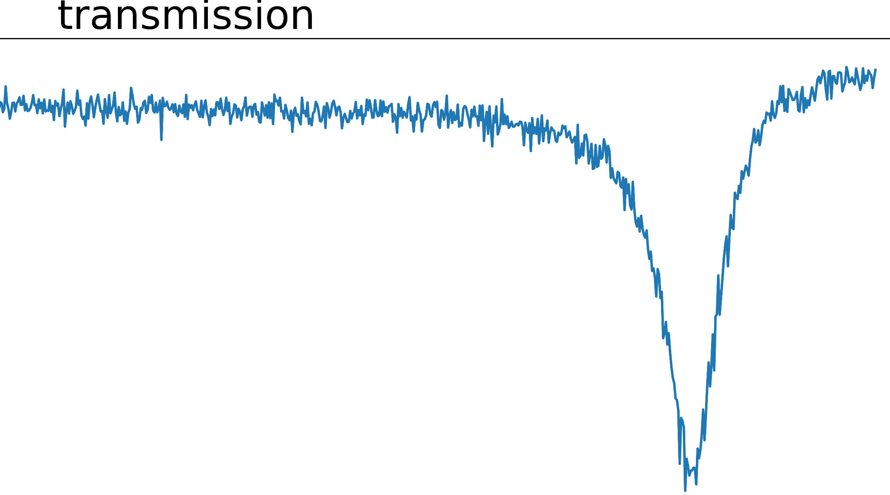
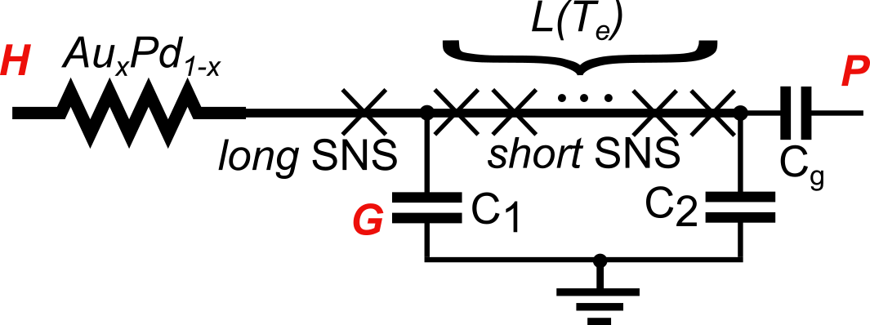
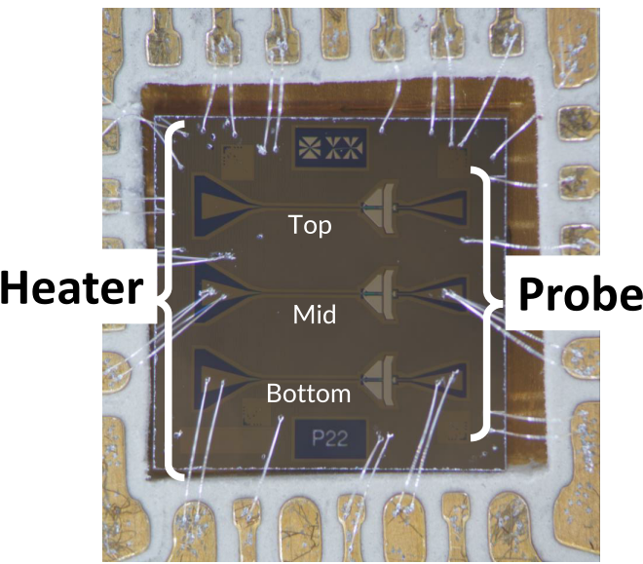
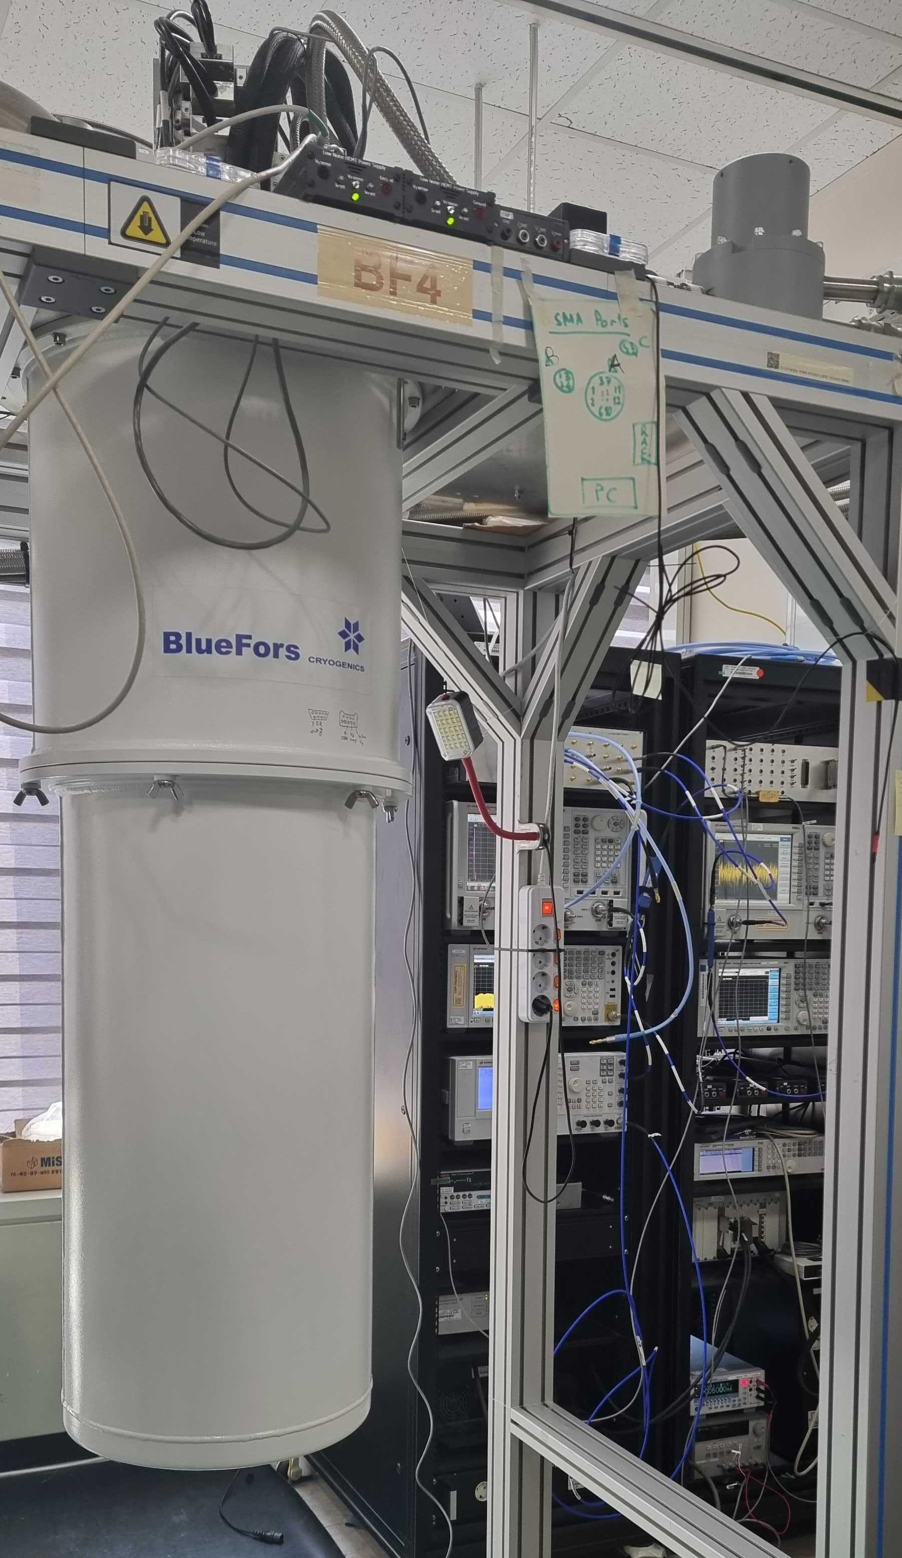
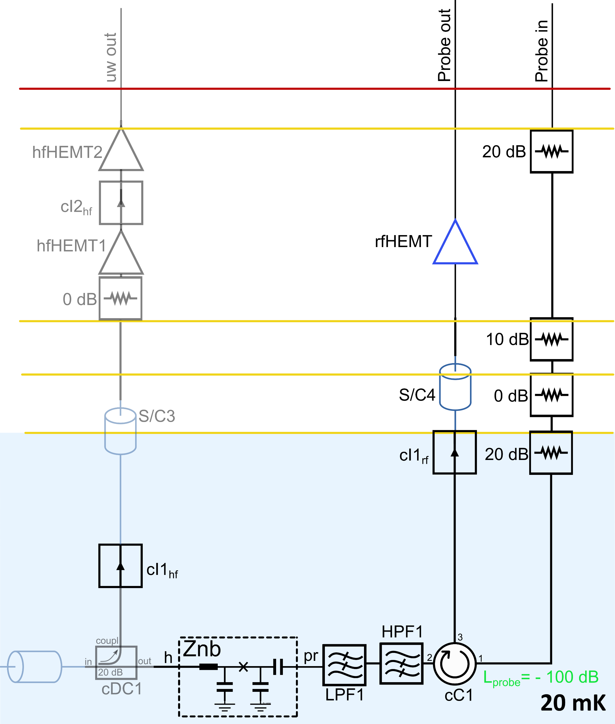
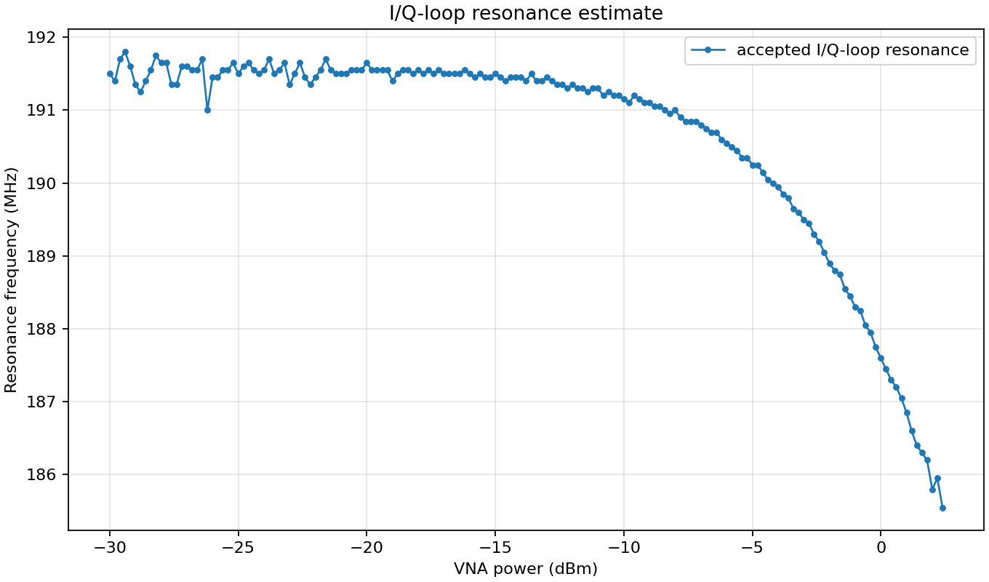
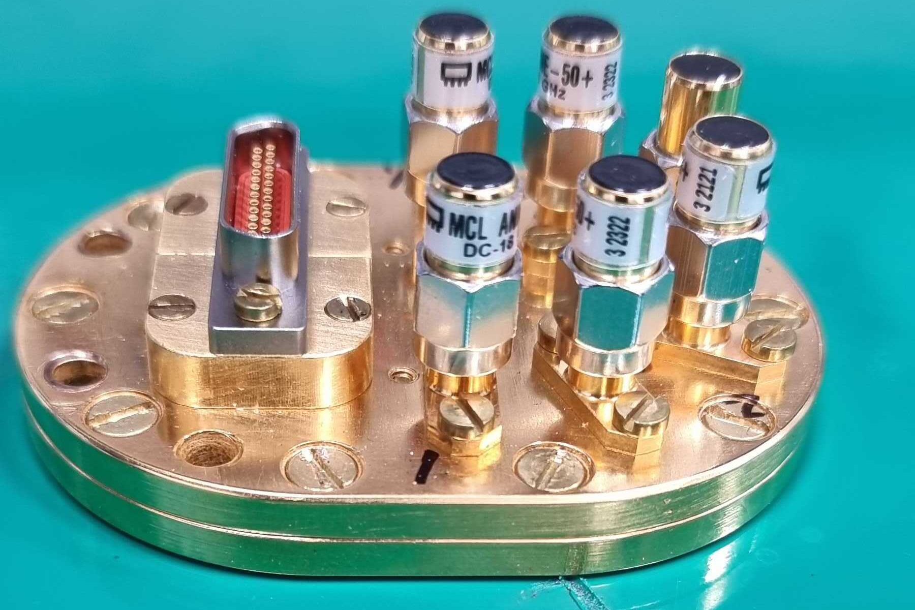



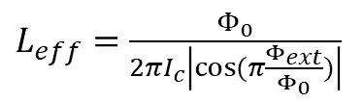
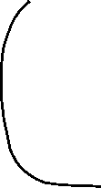
Bolometer calibration
$L_{eff}=$ $\frac{Φ_{0}}{2πI_{c}\left|cos⁡(π\frac{Φ_{ext}}{Φ_{0}})\right|}$
$$A_{pr}\cos{ω_{pr}t}$$
Heater
Probe
Defining the probe power working point
Notes:
DFSZ level of the sensitivity for the whole frequency range;

Slide 11
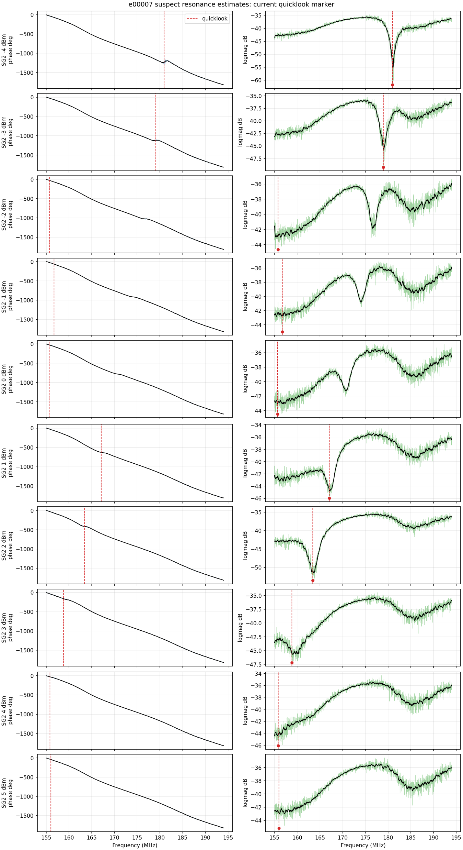
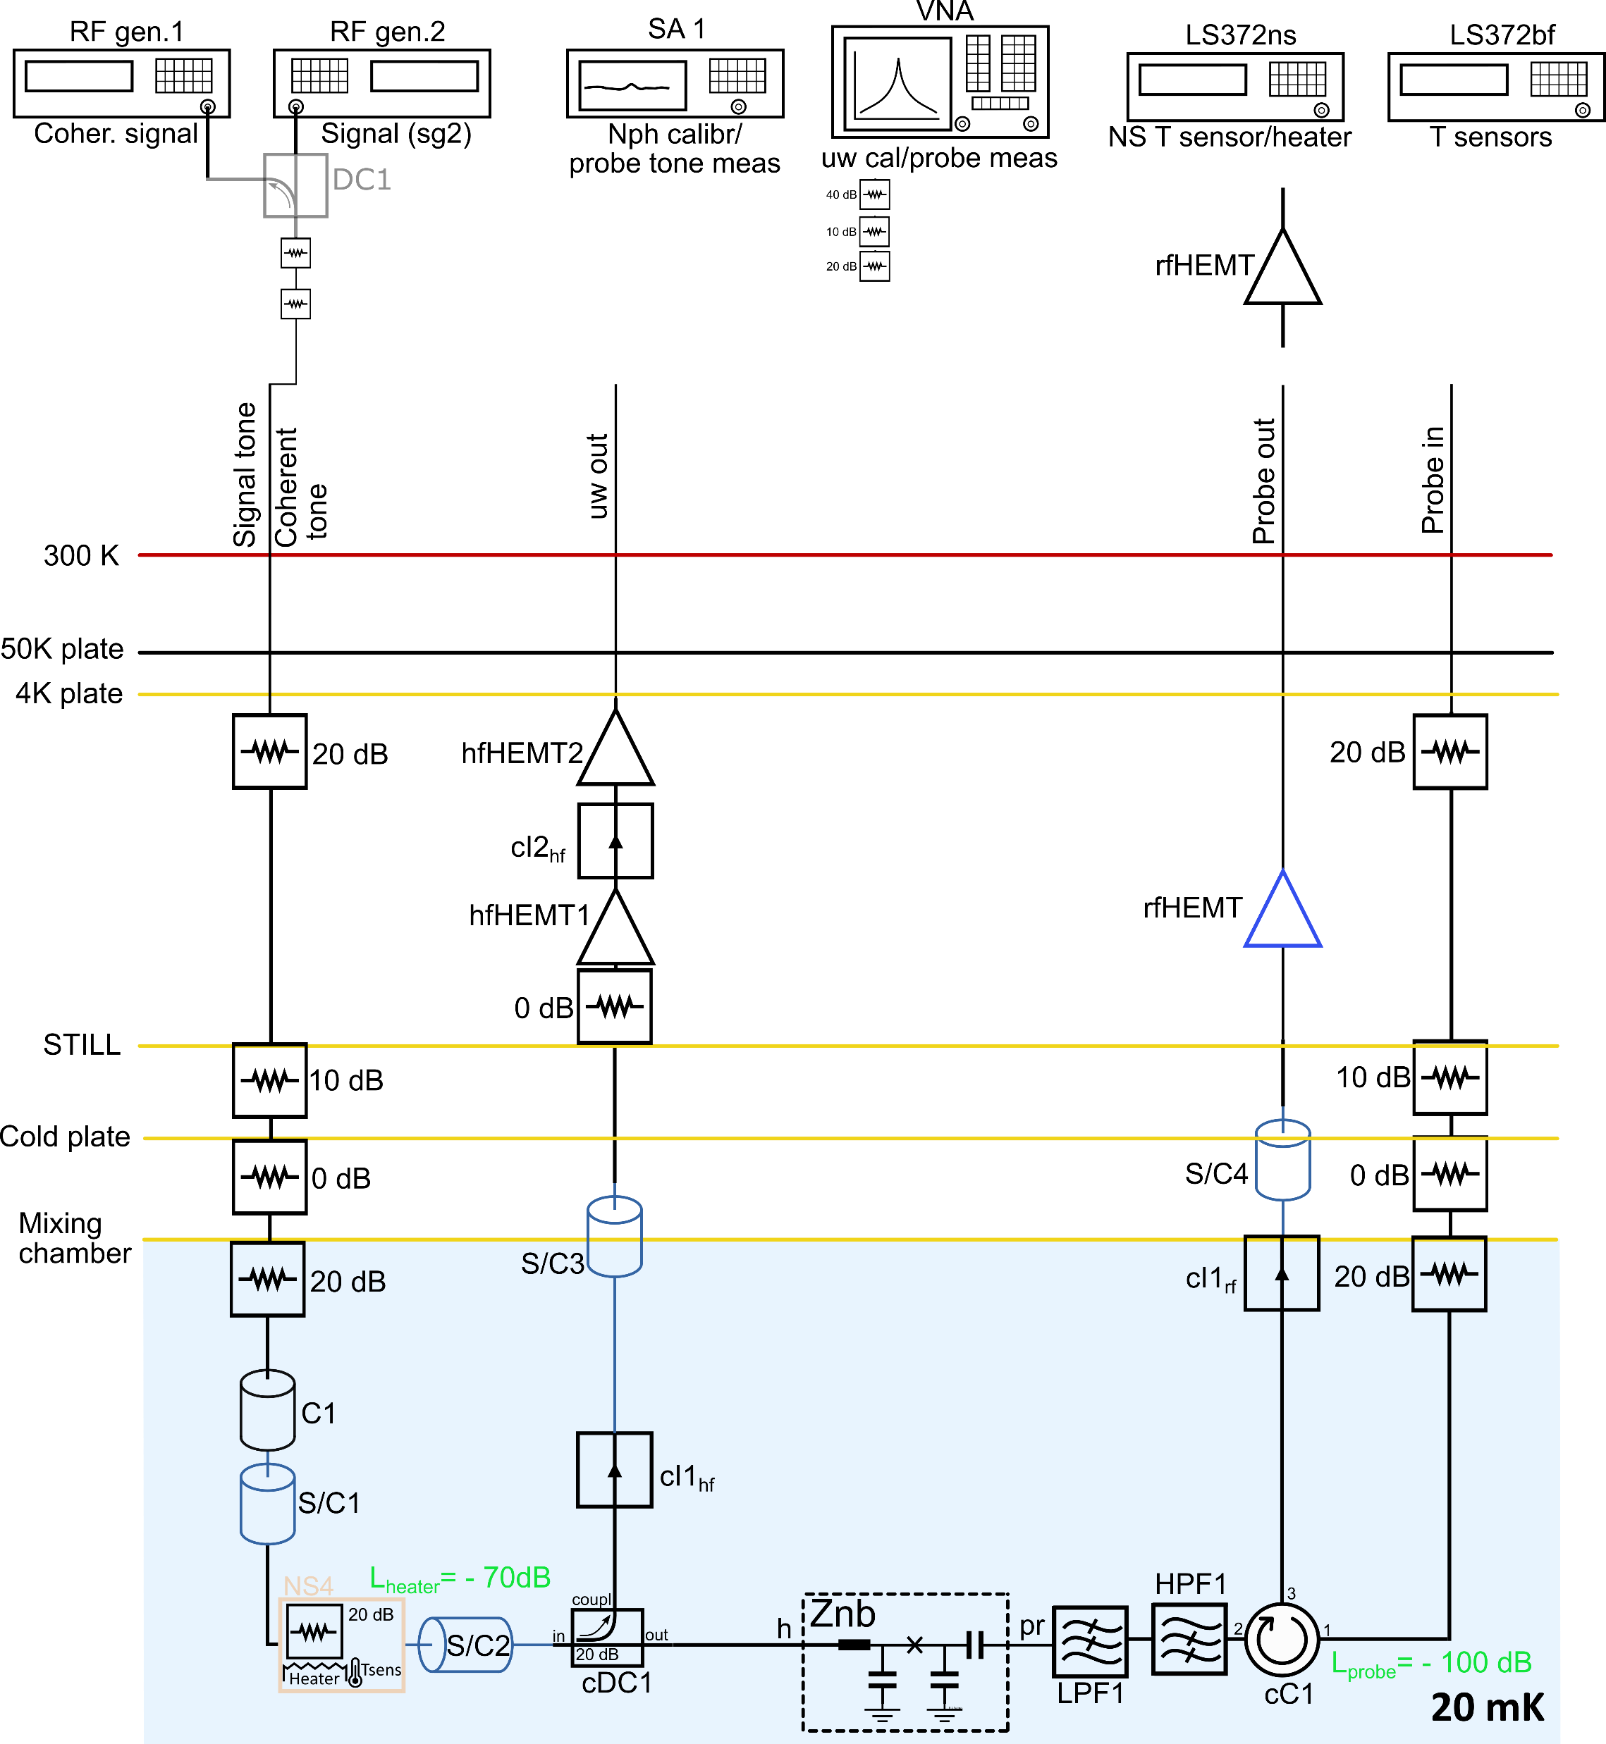
Bolometer calibration
Notes:
DFSZ level of the sensitivity for the whole frequency range;

Slide 12
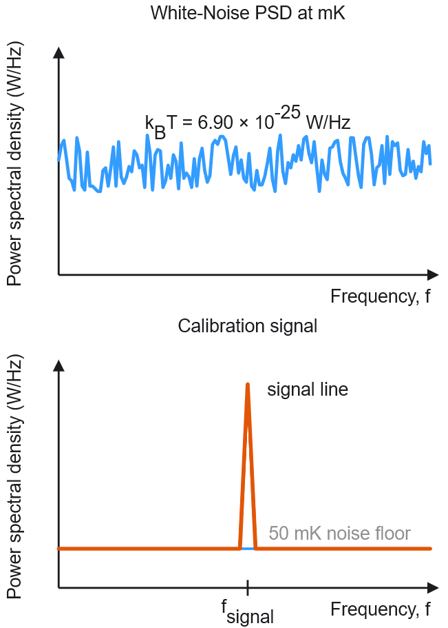
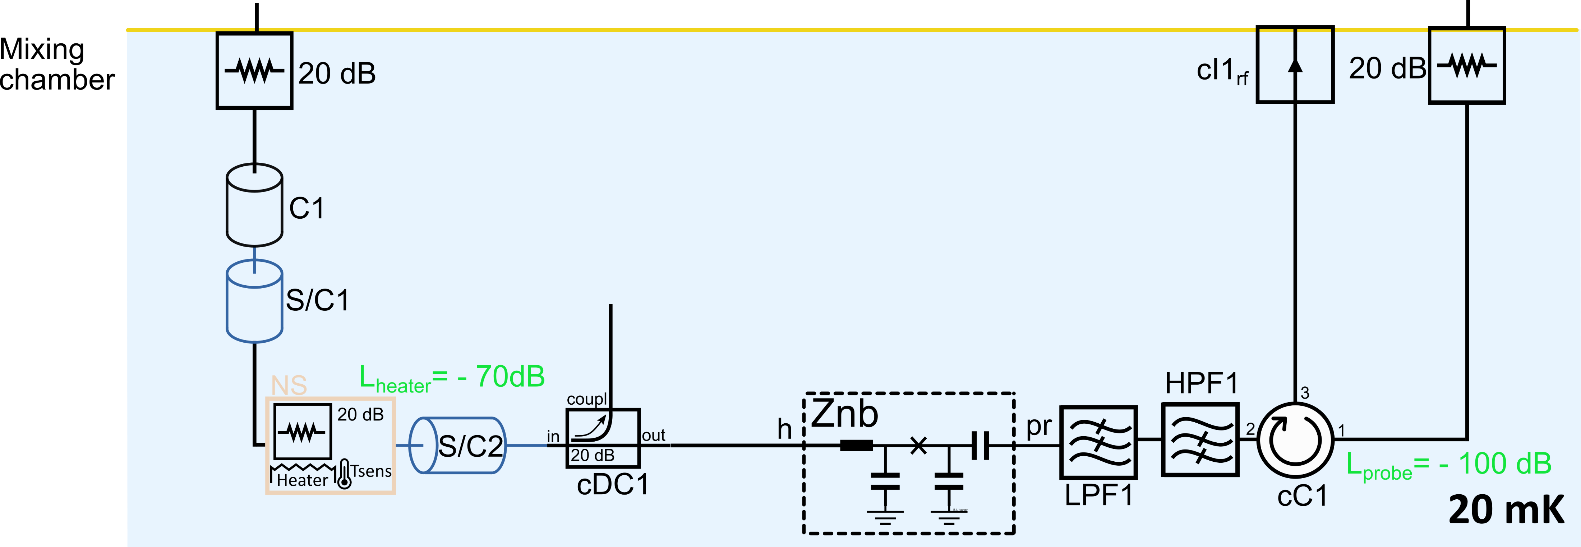
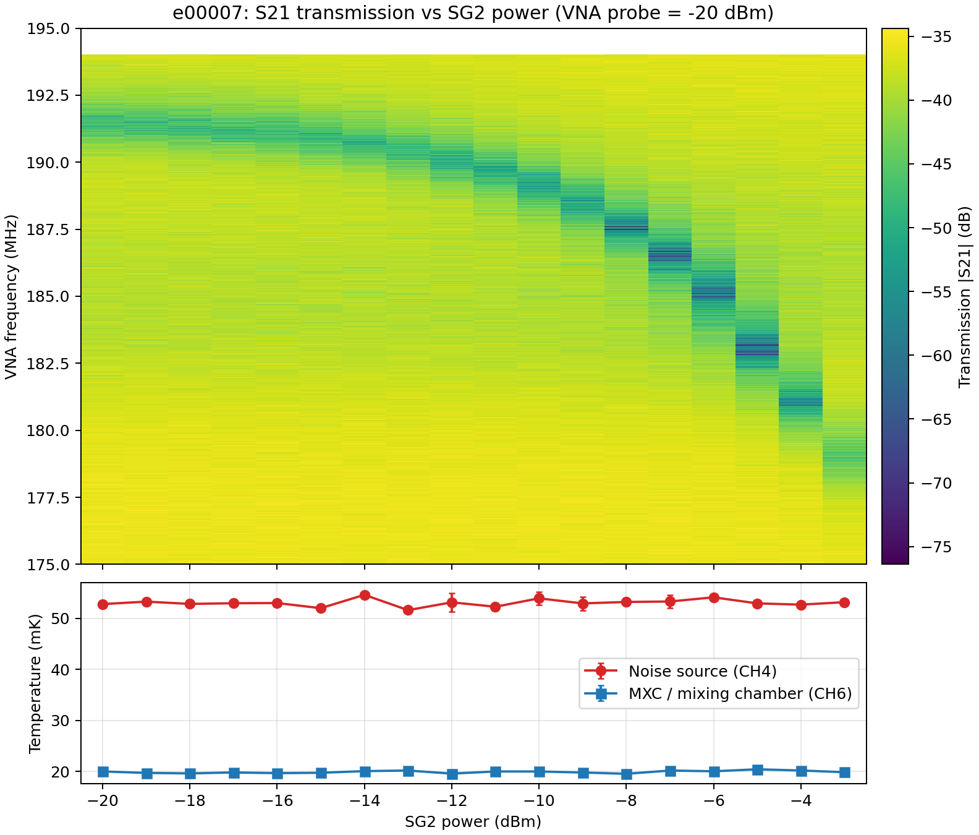
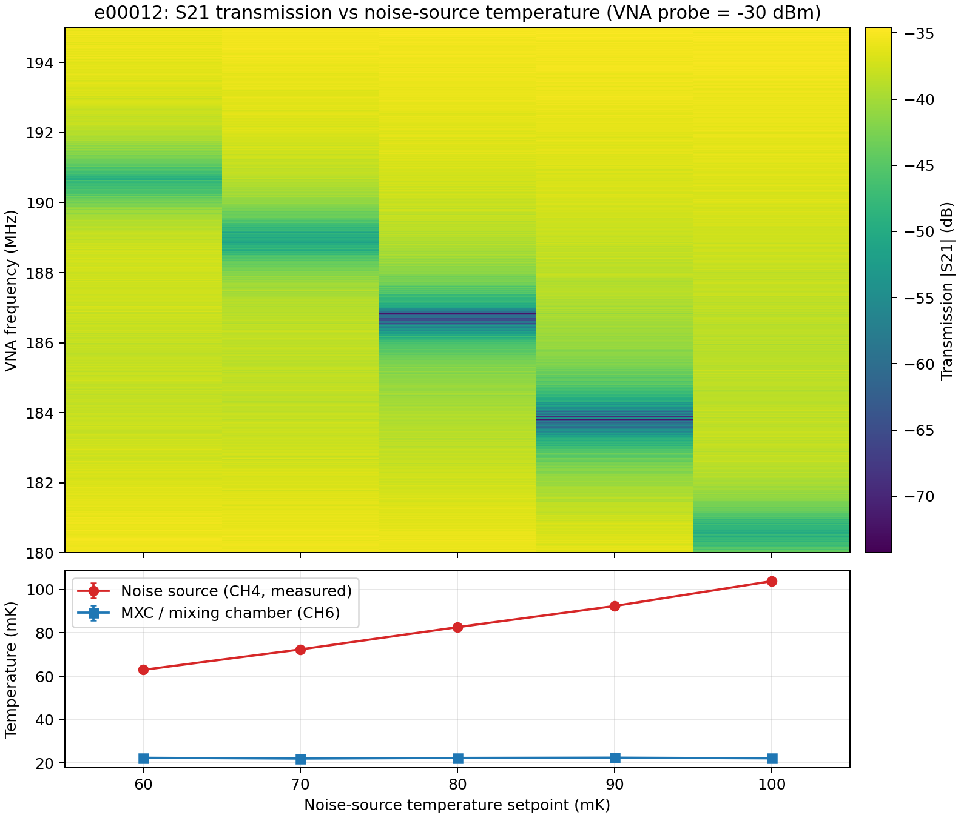

Bolometer calibration
$$A_{s}\cos{ω_{1}t}$$

Slide 13

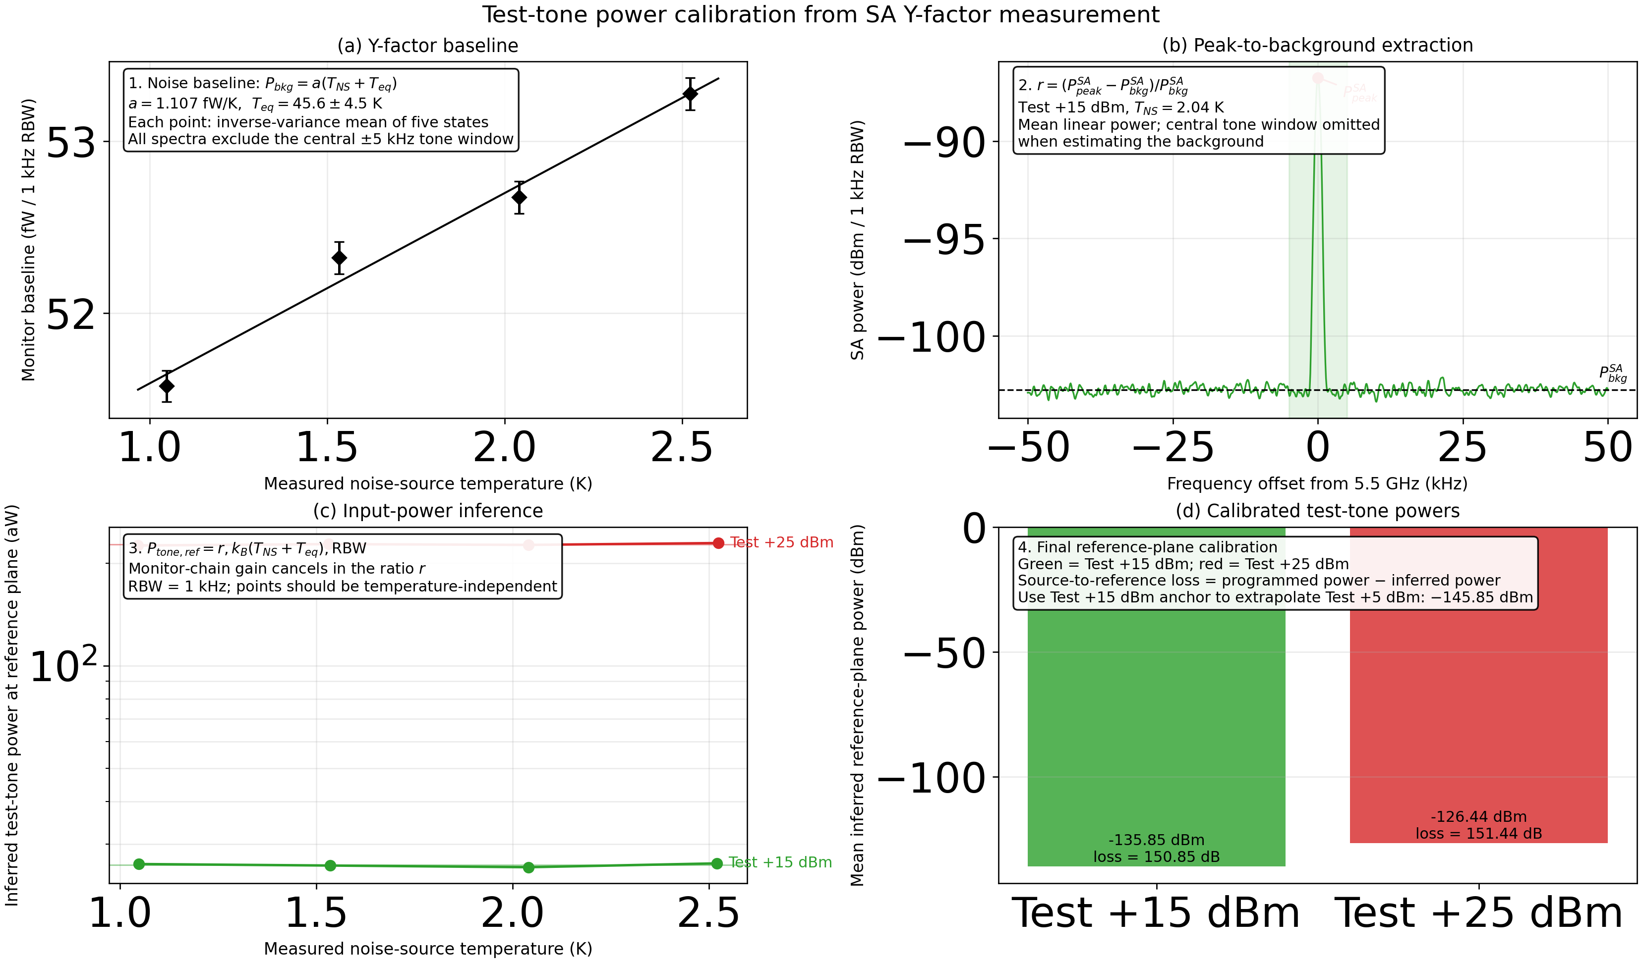
Bolometer calibration
Notes:
DFSZ level of the sensitivity for the whole frequency range;

Slide 14
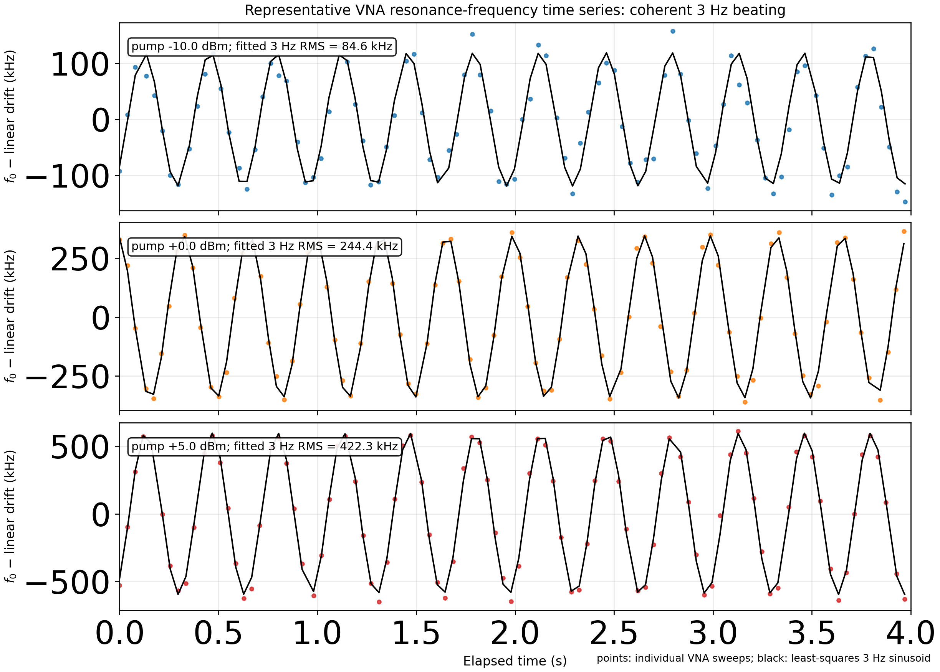

Bolometer calibration
2 x $A_{p}A_{s}\cos{ω_{1}t}\cos{(ω_{2}t+φ)}$
Notes:
DFSZ level of the sensitivity for the whole frequency range;

Slide 15
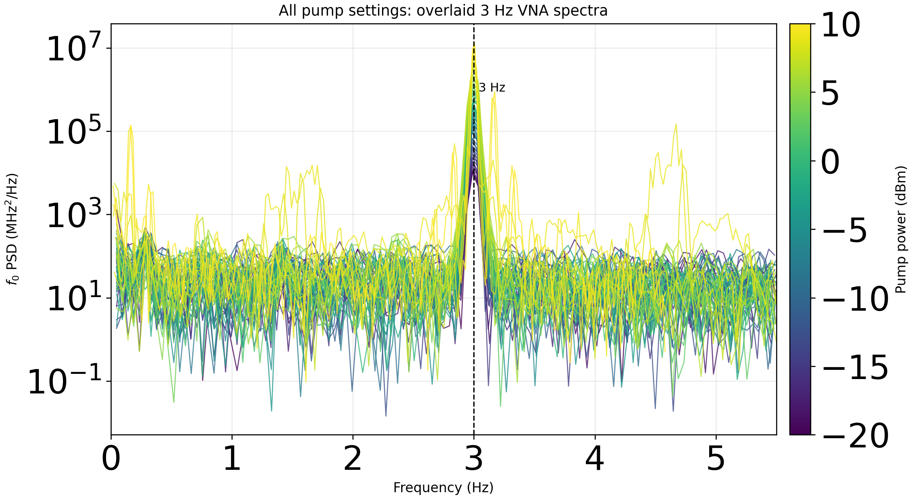
Bolometer calibration. Test tone (5.5 GHz + 3Hz) + Pump (5.5 GHz)
Notes:
DFSZ level of the sensitivity for the whole frequency range;

Slide 16
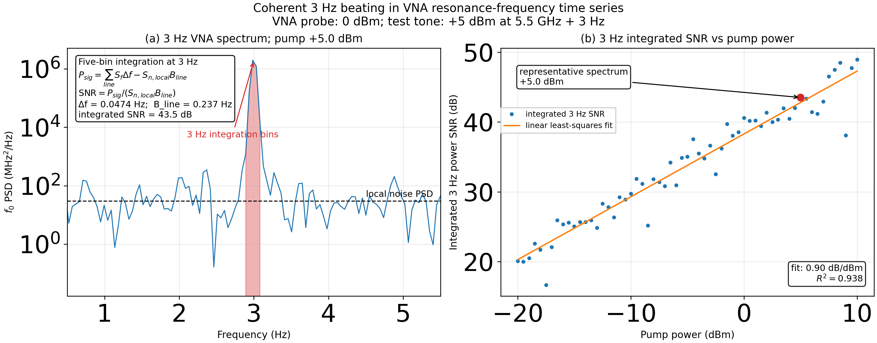
Bolometer calibration. Test tone (5.5 GHz + 3Hz) + Pump (5.5 GHz)
Notes:
DFSZ level of the sensitivity for the whole frequency range;

Slide 17
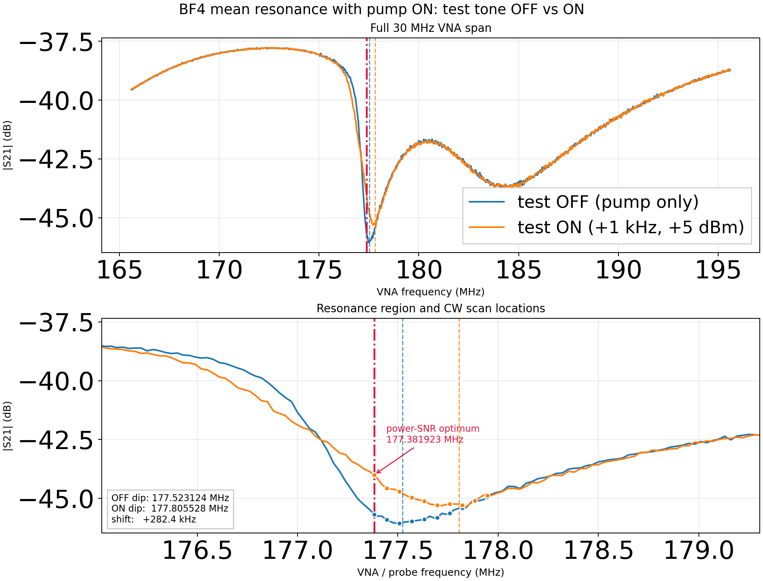
Bolometer calibration. Test tone (5.5 GHz + 3Hz) + Pump (5.5 GHz)
Notes:
DFSZ level of the sensitivity for the whole frequency range;

Slide 18
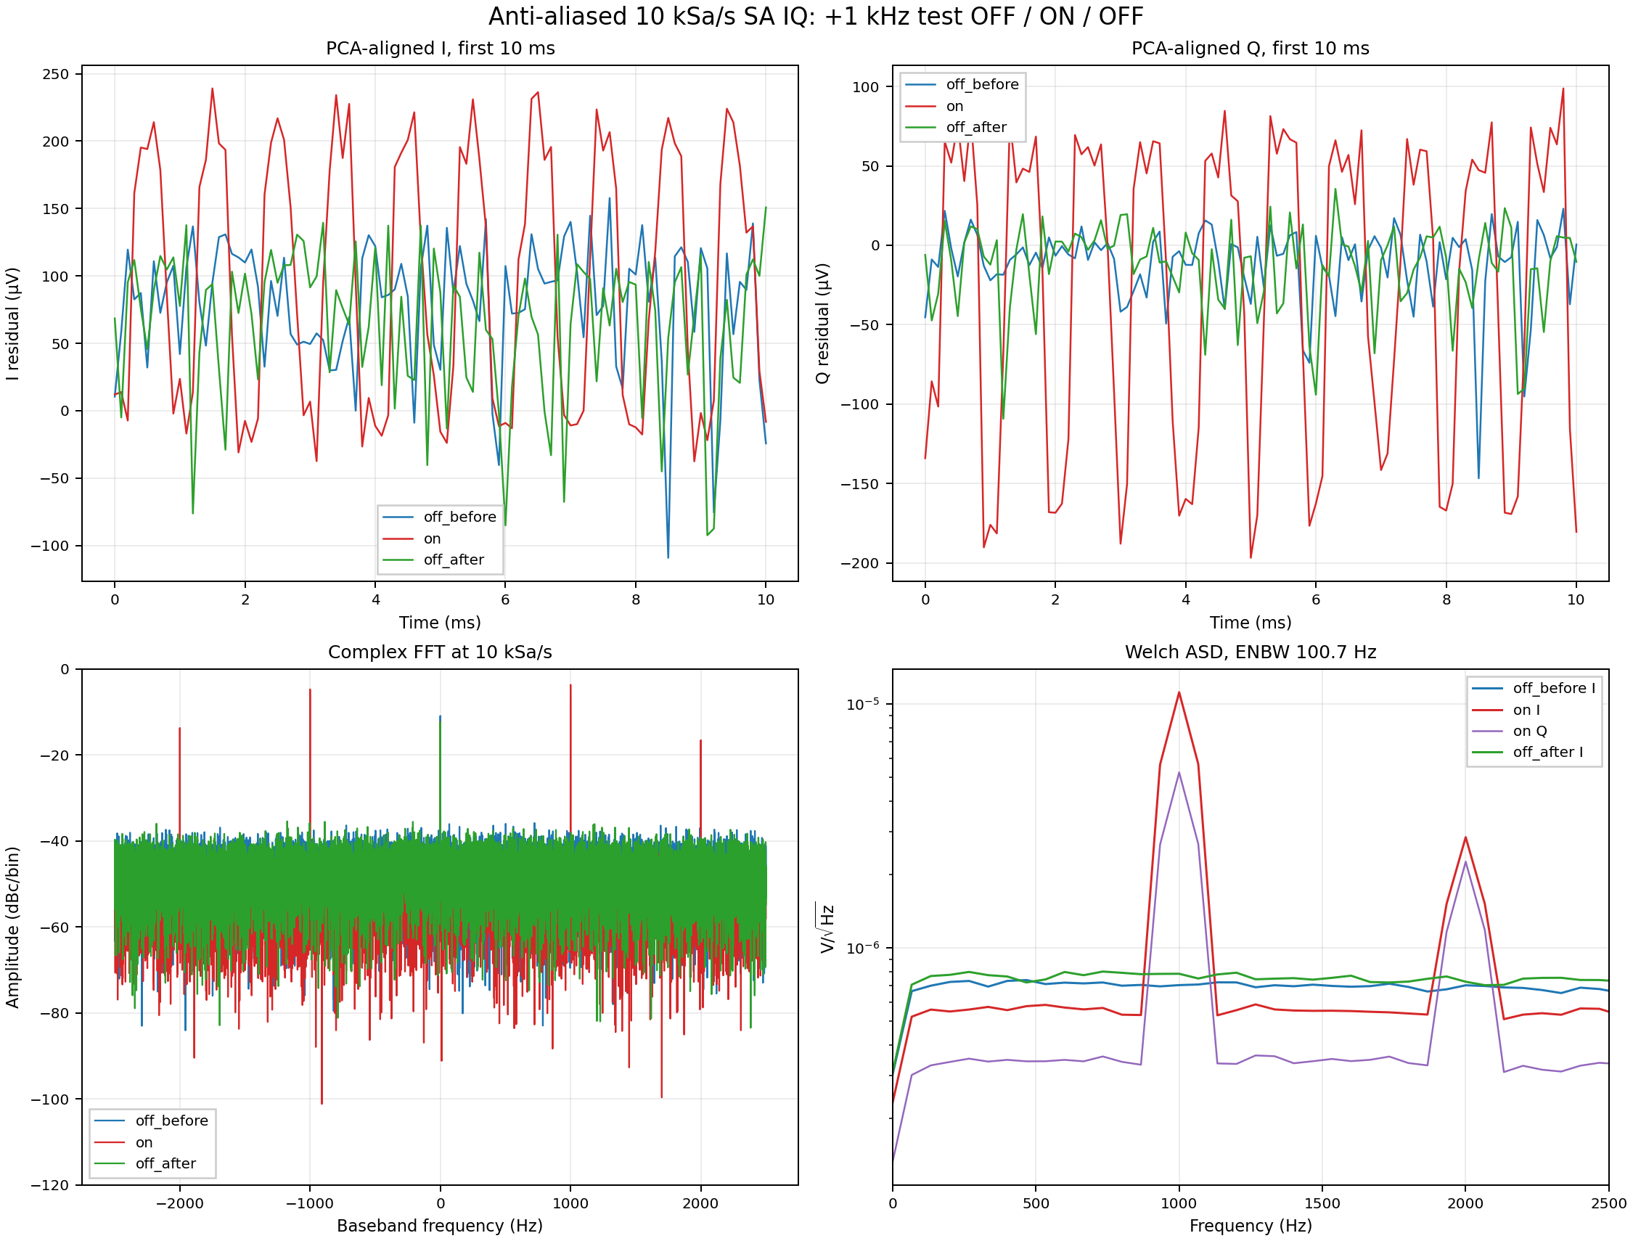
Bolometer calibration. Test tone (5.5 GHz + 3Hz) + Pump (5.5 GHz)
Notes:
DFSZ level of the sensitivity for the whole frequency range;

Slide 19
Summary
The heterodyne method using the power bolometer is shown
The different bolometer working regimes were tested and the equivalent spectral noise 6-8 K was measured
Future plans
Experiment on the input thermal noise versus bolometer sensitivity
Spectral noise limit of the bolometer
Bolometer transfer function experiment
SNR gain, equivalently noise temperature spectrum
Thank you for your attention!

