Slide 1
Molybdenum: properties and production
Roman Boiko
National University of Life and Environmental Sciences of Ukraine,
Institute for Nuclear Research,
Kyiv, Ukraine

Slide 2
outline
What is molybdenum?
Chemical properties of molybdenum and its compounds
Molybdenum production
Own experience working with molybdenum

Slide 3
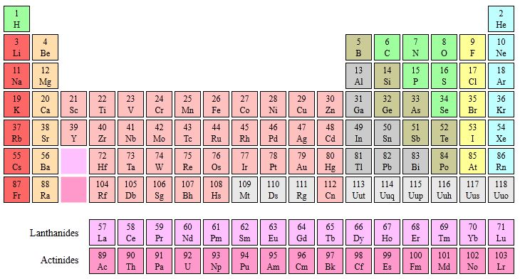
What is molybdenum?
1s²
2s² 2p⁶
3s² 3p⁶ 3d¹⁰
4s² 4p⁶ 4d⁵
5s¹
Mo

Slide 4
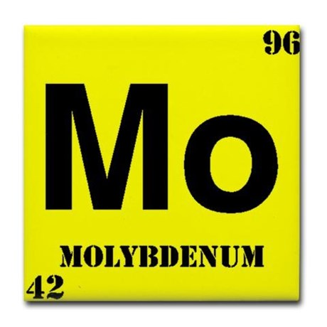
What is molybdenum?
Atomic Number: 42
Atomic Weight: 95.96
Period Number: 5 Group Number: 6
Element Classification: Metal, solid grey
Phase at Room Temperature: Solid
Melting Point: 2623°C (one of the highest melting metals)
Boiling Point: 4639°C
Density: 10.2 grams per cubic centimeter
Abundance:
Univerce: 5 ppb by weight (0.1 ppb by atoms)
Crustal rocks: 1100 ppb by weight (230 ppb by atoms)
Naturally Occurring Isotopes
Mass Number | 92 | 94 | 95 | 96 | 97 | 98 | 100
Natural Abundance, % | 14.53 | 9.15 | 15.84 | 16.67 | 9.60 | 24.39 | 9.82

Slide 5
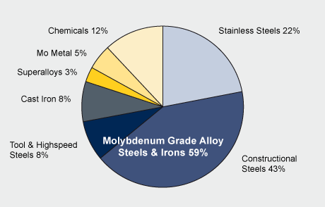
Molybdenum application
Uses of produced from mines “new Molybdenum”
About 20% of this material is used to make molybdenum grade stainless steel, while constructional steel, tool and high speed steel and cast iron, taken together use an additional 57%. The remaining 23% is used in upgraded products like lubricant grade MoS₂, molybdenum metal and molybdenum chemical compounds

Slide 6
Molybdenum application
Molybdenum grade stainless steels
“Stainless Steel” is a large group of iron-base alloys that contain chromium (at least 10.5%). The term “stainless” implies a resistance to staining or rusting in air is used only for Cr containing steel.
Molybdenum improves the corrosion resistance of all stainless steels.

Slide 7
Molybdenum application
Molybdenum grade Alloy Steels & Irons
Moly is used efficiently and economically in alloy steel & iron to
improve hardenability
reduce temper embrittlement
resist hydrogen attack & sulphide stress cracking
increase elevated temperature strength
improve weldability, especially in high strength low alloy steels (HSLA)

Slide 8
Molybdenum application
Molybdenum grade superalloys
Molybdenum is a very important alloying element in high performance nickel-based alloys. These alloys fall into two basic classes:
corrosion-resistant alloys
high temperature alloys:
solid-solution strengthened
age-hardenable

Slide 9
Molybdenum application
Molybdenum metal & alloys
Moly alloys have excellent strength and mechanical stability at high temperatures (up to 1900°C)
High temperature heating elements, radiation shields, extrusions, forging dies, etc;
Rotating X-ray anodes used in clinical diagnostics;
Glass melting furnace electrodes and components that are resistant to molten glass;
Heat sinks with thermal expansivity matching silicon for semiconductor chip mounts;
Sputtered layers, only Ångstroms (10⁻⁷ mm) thick, for gates and interconnects on integrated circuit chips;
Sprayed coatings on automotive piston rings and machine components to reduce friction and improve wear.

Slide 10
Molybdenum application
Molybdenum chemistry & uses
The chemistry of molybdenum is extraordinarily versatile:
oxidation states from (-II) to (VI), coordination numbers from 4 to 8
a very varied stereochemistry.
Materials made from moly chemicals are
Catalysts
Lubricants
Corrosion inhibitors
Paints and surface coatings
Smoke suppressors (or suppressants)
Pigments
Ceramics
Nanomaterials
Agricultural chemicals

Slide 11
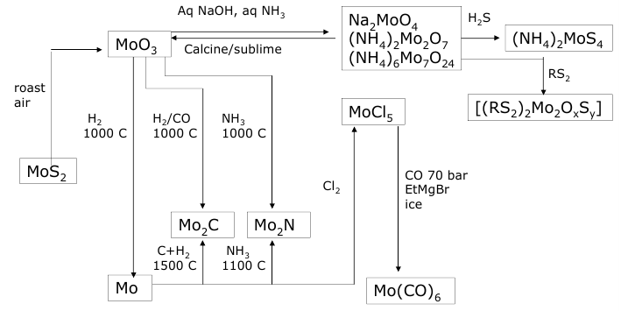
Preparative chemistry of molybdenum

Slide 12
Chemical properties of molybdenum and its compounds
Oxidation state | Example
-2 | Na₂[Mo₂(CO)₁₀]
0 | Mo (metal), Mo(CO)₆
+1 | Na[C₆H₆Mo]
+2 | MoCl₂
+3 | Na₃[Mo(CN)]₆
+4 | MoS₂
+5 | MoCl₅
+6 | MoO₃, Na₂MoO₄, (NH₄)₆Mo₇O₂₄ …

Slide 13
Metal Molybdenum
Mo – stable at room temperature in air, interacts with some nonmetals at high tº or with oxidizing agents (mineral acids)
Mo + 2S = MoS₂ at 600-700 ºC
2Mo + 3O₂ = 2MoO₃ at 600 ºC
2Mo + 5Cl₂ = 2MoCl₅ at 40-100 ºC
Mo + 6HNO₃ = MoO₃↓ + 6NO₂ + 3H₂O exothermal
Mo + 4H₂SO₄ = H₄[Mo(SO₄)O₄] + 3SO₂ + 2H₂O

Slide 14
Molybdenum binary compounds
Among many binary compounds, the following are emphasized
MoF₆ – molybdenum hexafluoride, white solid or liquid
(m.p. 17,6 ºC, b.p. 33,9 ºC)
Mo + 3F₂ = MoF₆ at 20-50 ºC
MoF₆ + H₂O = MoO₃↓ + HF
MoF₆ + 8NaOH = Na₂MO₄ + 6NaF + 4H₂O
MoCl₅ – pentachloride, black or dark green solid, high-volatile
(m.p. 194 ºC, b.p. 268 ºC)
MoCl₅ = MoCl₃ + Cl₂ at 300-350 ºC

Slide 15
Molybdenum binary compounds
MoS₂ – molybdenite, black powder or grey blue crystals,
Molybdenite is widely used as a solid lubricant, similar to graphite by the touch.
2MoS₂ + 7O₂ = 2MoO₃ + 4SO₂ at 400-600 ºC
Mo(CO)₆ – molybdenum hexacarbonyl, white solid
(m.p. 148 ºC, b.p. 155 ºC)
Mo(CO)₆ = Mo(atomic gas) + 6CO at 155 ºC
Mo + 6CO = Mo(CO)₆ at 200 ºC, under the pressure
3MoCl₅ + 6CO + 5Al = 3Mo(CO)₆ + 5AlCl₃ at 100 ºC, pressure

Slide 16
Molybdenum oxides
Mo forms series of oxides in which it exists in different oxidation states: Mo⁴⁺ - Mo⁶⁺
MoO₂ – Mo₈O₂₃ – Mo₉O₂₆ – Mo₄O₁₁ – Mo₁₇O₄₇ – MoO₃
Brown white or
light green
MoO₂ preparation
Mo + 2H₂O = MoO₂ + 2H₂ 700-800 ºC
Mo + 2CO₂ = MoO₂ + CO 1200 ºC
MoS₂ + O₂ = MoO₂ + SO₂
Hydrated oxides like Mo₈O₂₃•xH₂O or Mo₄O₁₁O•xH₂O are known as “molybdenum blue” that is used in analytical chemistrty

Slide 17
Molybdenum oxides
MoO₃ – molybdite, white or light green crystalline solid
m.p. 795 ºC; b.p. 1155 ºC; very volatile starting from 600 ºC
Temperature, ºC | 596 | 700 | 820 | 900 | 1000 | 1155
Vapor pressure, mm Hg | 0,0046 | 0,356 | 10,1-12,6 | 53,9 | 167,5 | 760
MoO₃ (solid) →Heating→Sublimation (evaporation)→ Cooling→Comdensing
Needle crystals are condensed
occupying very large volume

Slide 18
Molybdenum oxides
MoO₃ – acidic oxide
corresponding molibdic acid H₂MoO₄ doesn’t exist
MoO₃•H₂O white crystalline solid
MoO₄²⁻ + 2H⁺ + H₂O = MoO₃•H₂O ↓ at room temperature
MoO₃•2H₂O yellow solid
MoO₄²⁻ + 2H⁺ + 2H₂O = MoO₃•2H₂O ↓ at heating
MoO₃ preparation:
Mo + O₂ = MoO₃ at 600 ºC with simultaneous sublimation
Mo + 6HNO₃ = MoO₃↓ + 6NO₂ +2H₂O exothermal
(NH₄)₆Mo₇O₂₄ + 6HNO_{3(conc)} = 7MoO₃ ↓ + 6NH₄NO₃
Na₂MoO₄ +2HCl + H₂O = MoO₃•H₂O ↓ + 2NaCl at heating

Slide 19
Molybdenum oxides
MoO₃ properties
solubility in water (in form H₂MoO₄), g/L: 2,05 (20º) pH=4.0-4.5
With strong acids (exept HNO₃):
MoO₃ + HCl_{(conc)} = H₂[MoO₂Cl₄] + H₂O
MoO₃ + H₂SO_{4(conc)} + H₂O = H₄[MoO₄(SO₄)]
With alkali:
MoO₃ + NaOH = Na₂MoO₄
MoO₃ + 2NH_{3(conc)} + H₂O = (NH₄)₂MoO₄
7MoO₃ + 6NH_{3(diluted)} + 3H₂O = (NH₄)₆Mo₇O₂₄
With reducing agents:
MoO₃ + Zn + HCl = [Mo₈O₂₃•xH₂O or Mo₄O₁₁O•xH₂O] + ZnCl₂

Slide 20
Molybdates
The commonly encountered compounds of molybdenum in its applications are MoO₃ and molybdates (oxidation state VI)
There are many molybdates that can be classified:
Monomolybdates (normal):
Na₂MoO₄; (NH₄)₂MoO₄; CaMoO₄; PbMoO₄
Polymolydates:
di- (NH₄)₂Mo₂O₇
hepta- (NH₄)₆Mo₇O₂₄
octa- (NH₄)₄Mo₈O₂₆ low soluble
(tetra- (NH₄)₂Mo₄O₁₃)
All molybdates are colorless or colored by cation: NiMoO₄; CoMoO₄

Slide 21
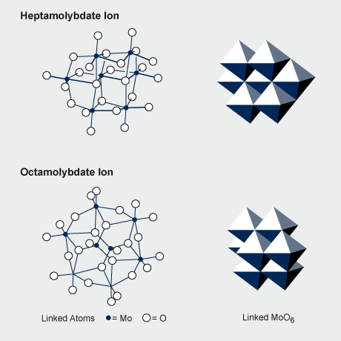
Molybdates
Normal molybdate crystals contain the discrete tetrahedral [MoO₄]²⁻ ion while the structures of the polymolybdates consist of linked polyhedra containing six- and four-, and less commonly five-coordinate Mo⁶⁺
Structure of the polymeric unit of ammonium dimolybdate

Slide 22
Molybdates in aqueous solution
Existing of specified molybdate anion in aqueous solution depends on pH level, temperature and concentration

Slide 23
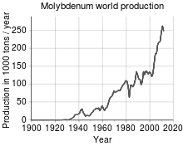
Molybdenum production
The world's production of molybdenum was 250,000 tonnes in 2011:
China (94 kt), US (64 kt), Chile (38 kt),Peru (18 kt) Mexico (12 kt)
The total reserves are estimated at 10 million tonnes
(China (4.3 Mt), US (2.7 Mt) and Chile (1.2 Mt))
By continent, 93% of world molybdenum production is split between North America, South America (mainly in Chile), and China. Europe and the rest of Asia (mostly Armenia, Russia, Iran and Mongolia) produce the remainder

Slide 24
Molybdenum mines
Molybdenum is contained in various minerals, but only molybdenite (MoS₂) is suitable for the industrial production of marketable molybdenum products.
Molybdenite can occur as the sole mineralization in an ore body, but is often associated with the sulphide minerals of other metals, notably copper. The Mo content of viable ore bodies ranges between 0.01 and 0.25%.
Ores classification:
Primary mines, where the recovery of molybdenite is the sole objective;
By-product mines, where the recovery of copper-bearing ores is the primary objective, and molybdenite recovery provides additional economic value
Co-product mines, where the commercial viability of the mine requires that both molybdenite and copper-bearing minerals be recovered.

Slide 25
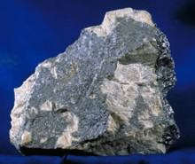
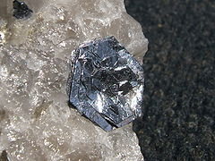
Molybdenum mines
Molybdenum ore; dark gray areas are MoS₂, while light areas are worthless rock called gangue
molybdenite on quartz

Slide 26
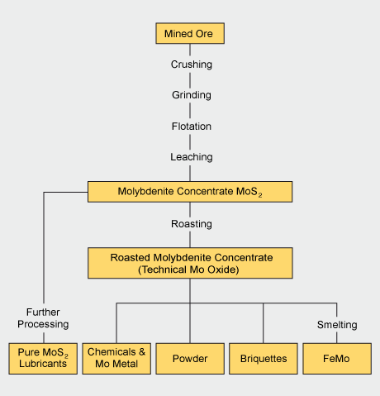

Slide 27
Molybdenum processing
Milling
Ball or rod mills crush and grind the mined ore to fine particles (to 10⁻³ mm)
Molybdenite is released from the gangue (worthless rock)
Flotation
The milled ore/gangue powder is mixed with a liquid and aerated
The less dense ore rises in the froth to be collected
The resulting MoS₂ concentrate contains between 85% and 92% MoS₂.
Further treatment by acid leaching can be used to dissolve impurities like copper and lead if necessary.

Slide 28
Molybdenum processing
Roasting
Roasting in air at temperatures between 500 and 650 °C converts MoS₂ concentrate into roasted molybdite concentrate, also known as tech Mo oxide:
2MoS₂ + 7O₂ → 2MoO₃ + 4SO₂
MoS₂ + 6MoO₃ → 7MoO₂ + 2SO₂
2MoO₂ + O₂ → 2MoO₃
The resulting roasted molybdite concentrate typically contains a minimum of 57% molybdenum (pure MoO₃ is 67% of Mo), and less than 0.1% sulfur

Slide 29
Molybdenum processing
Upgrading from Tech Oxide
About 25% of the roasted molybdite concentrate produced worldwide is processed into a number of chemical products.
Upgrading is performed
by sublimation to produce pure molybdic oxide MoO₃
(at 900-1100ºC in air flow)
by wet chemical processes to produce a wide range of pure molybdenum chemicals (mainly molybdic oxides and molybdates)

Slide 30
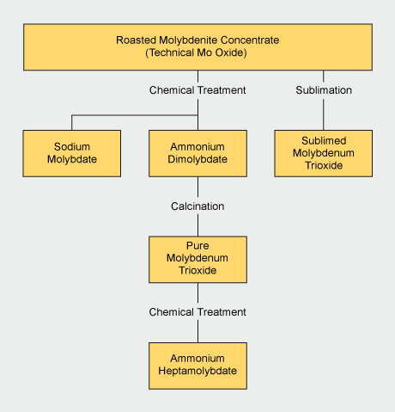
Molybdenum processing

Slide 31
Molybdenum processing
“Wet chemistry” involves several stages:
dissolution of the roasted concentrate in an alkaline medium (ammonium or sodium hydroxide)
MoO₃ + 2NH_{3(conc)} + H₂O = (NH₄)₂MoO₄
removal of impurities by precipitation and filtration
Fe³⁺, Th⁴⁺, UO₂²⁺ + NH₄OH = Fe(OH)₃↓ + Th(OH)₄↓ + UO₂(OH)₂↓
Cu²⁺, Pb²⁺ + NH₄HS = CuS↓ + PbS↓ (refers to high concrntration)
crystallisation or acid precipitation of ammonium molybdate solution .
(NH₄)₂MoO₄ = (NH₄)₆Mo₇O₂₄•4H₂O↓ heating at 70-80 ºC with evaporation
4(NH₄)₂MoO₄ + 6HCl = (NH₄)₂Mo₄O₁₃•2H₂O ↓ + 6NH₄Cl + H₂O
these can be further processed by calcination to pure molybdenum trioxide.

Slide 32
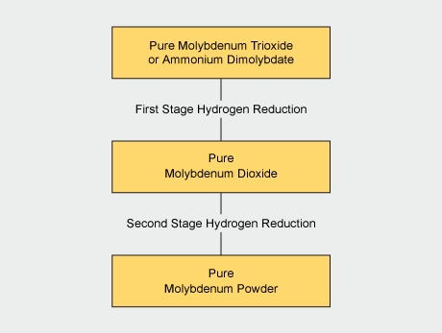
Molybdenum processing
MoO₃ + H₂ = MoO₂ + H₂O
MoO₂ + 2H₂ = Mo + 2H₂O

Slide 33
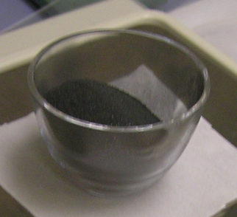
Own experience working with molybdenum
Experiment ARMONIA (LNGS) [1]
The aim of the ARMONIA experiment was a remeasurement of ≈1kg of Mo enriched in ¹⁰⁰Mo to 99.5% that was used before in [2]
Initial material – metallic ¹⁰⁰Mo powder with mass of 1009 g
Method of purification:
dissolving of metal into acid solution for recrystallization from aqueous solution in form of molybdic acid H₂¹⁰⁰MoO₄
Recovering of 100-molybdenum oxide ¹⁰⁰MoO₃
[1] P. Belli et al., Nuclear Physics A 846 (2010) 143–156
[2] D. Blum, et al., Phys. Lett. B 275 (1992) 506

Slide 34
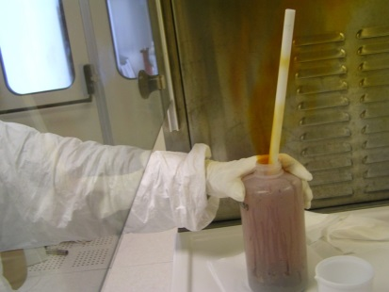
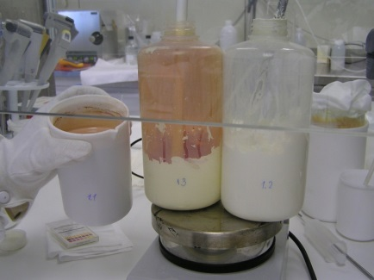
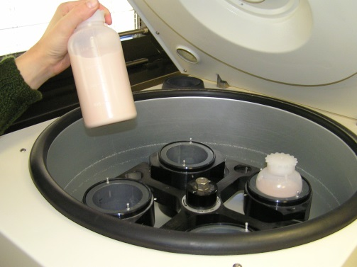
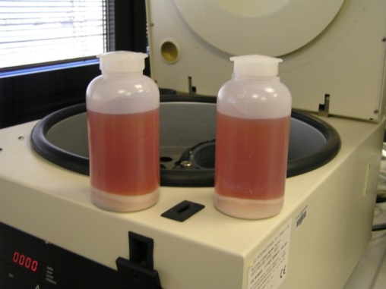
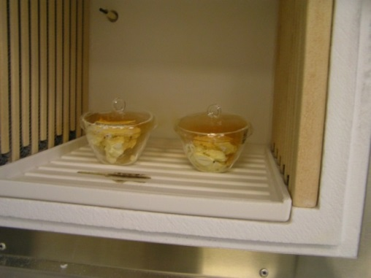
1. Dissolving of metallic molybdenum in 20% HNO₃ (ultrapure grade)
¹⁰⁰Mo + 6HNO₃ = H₂¹⁰⁰MoO₄↓+ 6NO₂↑ + 2H₂O
amorphous
viscous precipitate
2. Washing of molybdic acid (H₂¹⁰⁰MoO₄) and recovering of ¹⁰⁰MoO₃
H₂¹⁰⁰MoO₄ = ¹⁰⁰MoO₃ + H₂O ↑

Slide 35
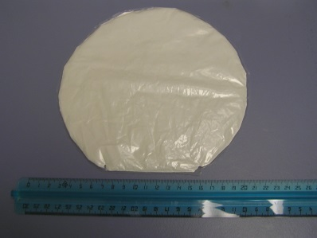
Purification of ¹⁰⁰Mo metallic sample
As a result 1199 g of puriﬁed molybdenum oxide (¹⁰⁰MoO₃) have been obtained
(yield – 80 %)
¹⁰⁰MoO₃ sample
Activity of the samples before and after purification procedure
Chain | Nuclei | ¹⁰⁰Мо, mBq/kg Before purification | ¹⁰⁰МоО3, mBq/kg After purification | Purification factor
232-Th | 228-Ac | 15,2 | 6 | 2,5
 | 212-Pb | 8,6 | 10 | 0,9
 | 208-Tl | 1,9 | 3 | 0,6
238-U | 214-Pb | 18,8 | 10 | 1,9
 | 214-Bi | 9,6 | 0(3) | > 3
 | 40-K | 659 | 37 | 18
 | 137-Cs | 8,1 | 5 | 1,6

Slide 36
Ways to improve the purification efficiency
Use recrystallization technique with applying of coprecipitation as additional effective method for purification
Use distillation of molybdenum oxide ¹⁰⁰MoO₃
Investigate a chromatography on ion-exchange resins with aim of its following application

Slide 37
Thank you for attention

