Slide 1
Introduction to the Standard Model
Wonju Spring School on Particle Physics and Cosmology
2015년 4월13일-18일
(원주 토지문화관)
강신규
(서울과학기술대학교)

Slide 2
Plan
Lagrangian of the Standard Model
Spontaneous Symmetry Breaking and Brout-Englert-Higgs mechanism
Flavor Mixing in the Standard Model

Slide 3
Some good references:
  Chris Quigg, Gauge Theories of the Strong, Weak, and
  Electromagnetic Interactions
  Michael Peskin, An Introduction to Quantum Field Theory
  Sally Dawson, TASI lectures, 2006:
  http://quark.phy.bnl.gov/~dawson/tasi06.html

Slide 4
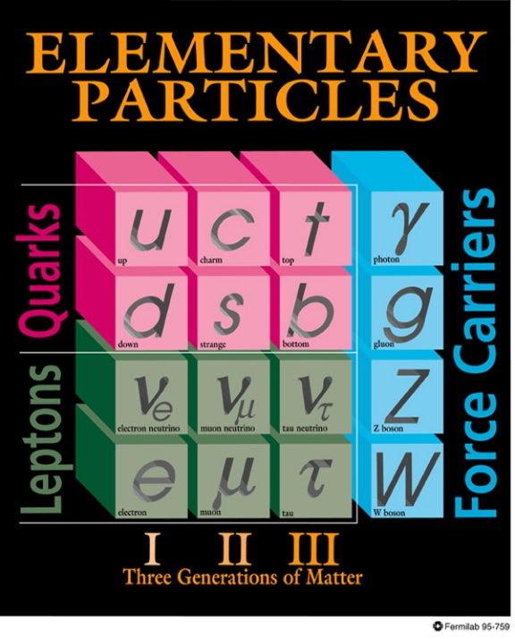
What we know :
The photon and gluon appear to be massless
The W and Z gauge bosons are heavy
  M_{W}=80.404 ± 0.030 GeV
  M_{Z} =92.1875 ± 0.0021 GeV
There are 6 quarks
  M_{t}=172.5 ±2.3 GeV
  M_{t} >> all the other quark masses
There appear to be 3 distinct neutrinos with small but non-zero masses
The pattern of fermions appears to replicate itself 3 times
  Why not more?

Slide 5
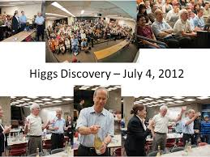
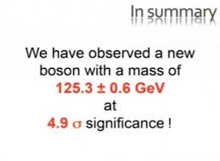

Slide 6
Implications of Finding a Higgs Boson
We found the missing piece in the standard model.
It help us to understand the big universal question,
what are we made out of ?
It allows us to understand how the particles acquire mass.
It helps us to explain how two of the fundamental forces of the universe, the electromagnetic force and the weak force can be unified.
It allows physicists to try to go where no scientist has gone before.

Slide 7
Theory of Weak Interactions
Fermi theory (1933) was the precursor to the theory for the weak interaction.
But, Fermi theory badly behaved if we do scattering at
energies much beyond 300 GeV -> violates unitarity
The principle of naturalness says that new physics should emerge at energies 300 GeV to cure this.

Slide 8
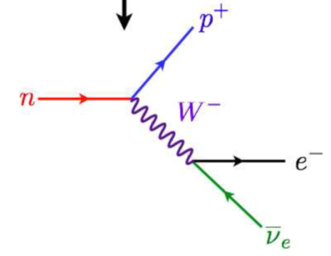
Theory of Weak Interactions
A very important step toward weak interaction was the discovery that the weak four-fermion interactions involved V and A rather than S, T or P.
V–A theory proposed by Marshak & Sudarshan (1957) and by Feynman & Gell-Mann (1958)
This meant that the weak interactions could be seen as due to the exchange of spin-1 W± bosons. This made them seem very similar to electromagnetic interactions mediated by photons.

Slide 9
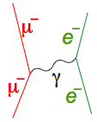
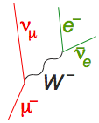
Similarity and Dissimilarity
Electromagnetic interaction
Weak interaction
exchange of
spin-1 γ
exchange of
spin-1 W±
But
long range
short range
large
parity conserving
parity violating
So, is there a symmetry relating γ and W±?

Slide 10
Early Unified Models
The first suggestion of a gauge theory of weak interactions mediated by W⁺ and W– was by Schwinger (1956), who suggested there might be an underlying unified theory, incorporating also the photon.
Glashow (1961) proposed a model with symmetry group SU(2) x U(1) and a fourth gauge boson Z⁰, showing that the parity problem could be solved by a mixing between the two neutral gauge bosons.
Salam and Ward (1964), unaware of Glashow’s work, proposed a similar model, also based on SU(2) x U(1)
— though neither model used the correct representation of leptons.
•

Slide 11
Massive vector bosons
• But, Gauge theories naturally predicted massless vector bosons.
• If masses were added by an explicit symmetry-breaking term, then the
vector-meson propagator would not be
But rather
• It generates a much worse divergence, and the theory is clearly not renormalizable.
• So the question started to be asked: could the symmetry breaking that gives rise to vector boson masses be spontaneous symmetry breaking?

Slide 13
Broken symmetries
Spontaneous breaking of gauge symmetry, giving mass to the plasmon, was known in superconductivity.
Nambu (1960) suggested a similar mechanism could give masses to elementary particles.
Nambu and Jona-Lasinio (1961) proposed a specific model
— phase symmetry is exact
— chiral symmetry is spontaneously broken

Slide 14
Spontaneous Symmetry Breaking
Spontaneous breaking of symmetry occurs when the ground state or vacuum state does not share the symmetry of the underlying theory.
— It is ubiquitous in condensed matter physics
Often there is a high-temperature symmetric phase, and a critical temperature below which the symmetry is spontaneously broken
— crystallization of a liquid breaks rotational symmetry
— so does Curie-point transition in a ferromagnet
— gauge symmetry is broken in a superconductor
• Could this work in particle physics too?

