Slide 1
Fermionic Schwinger current in 4-d de Sitter spacetime
Takahiro Hayashinaka (RESCEU, Univ. Tokyo)
Work in preparation with：
Tomohiro Fujita (Stanford), Jun’ichi Yokoyama (RESCEU)
15, Oct. CosPA2015 in Daejeon

Slide 2
Outline
Background
Large scale magnetic field and magnetogenesis
Models for magnetogenesis
Schwinger effect in de Sitter space
E.o.m. in gravitational/electric background field
Renormalized VEV of current operator
Summary

Slide 3
Magnetic field in our universe
There are magnetic fields in every scales (stellar - extragalactic).
Extragalactic (or cosmological) magnetic fields were found (A. Neronov, I. Vovk, Science, 328, 73 (2010)).
The strength of this cosmological magnetic fields is very low, but they got lower limit $\left|B_{k}\right|≥{10}^{−20 \sim −18}$ for $k∼1Mpc^{−1}$.
The origin is still unknown.

Slide 4
Magnetogenesis
Inflationary generation of the seed magnetic fields.
Produced from quantum fluctuation in the early universe
In the FLRW universe, B scales as $\left|B_{k}\right|∝a^{−2}$.
Quantum fluctuation of EM fields
classicalize
Stretched out by expansion
Modified Electromagnetism produce large fluctuation
Become large scale magnetic field today

Slide 5
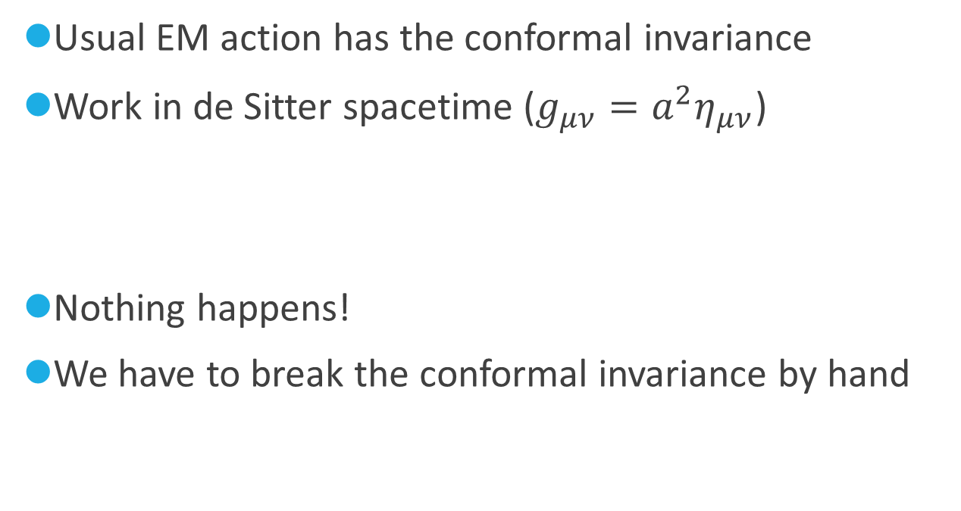
Why modified EM?
Usual EM action has the conformal invariance
Work in de Sitter spacetime ($g_{μν}=a^{2}η_{μν}$)
Nothing happens!
We have to break the conformal invariance by hand

Slide 6
Model for magnetogenesis
Conformal invariance
No electromagnetic field generation occurs
Conformal invariance breaking model
fFF(IFF) model
Coupling between a scalar (not necessary inflaton) and EM kinetic term
= Model with time-dependent effective coupling
We assume the scalar field depends only on the conformal time

Slide 7
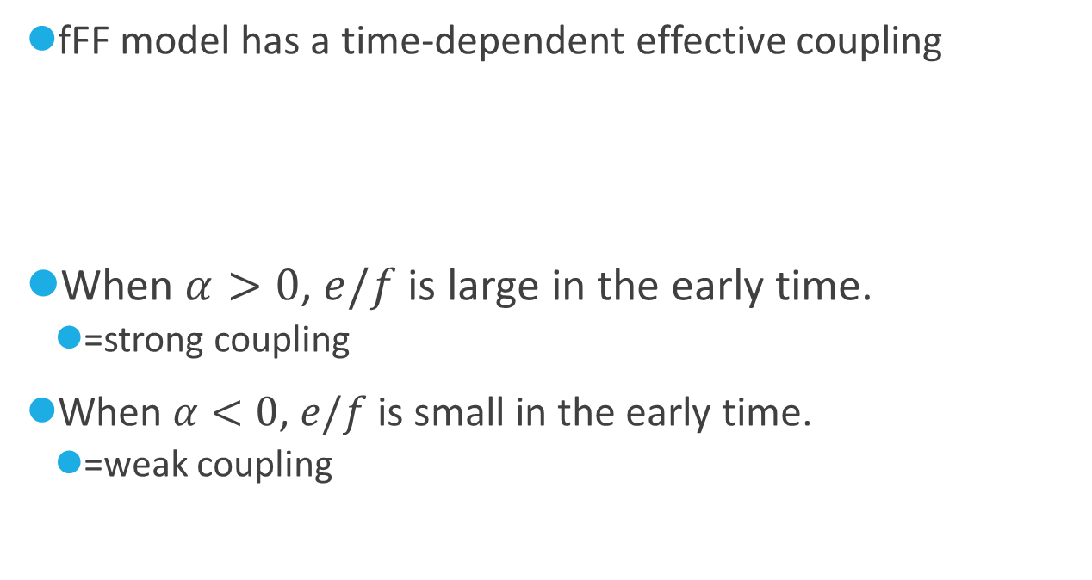
Effective coupling
Canonical variables
Effective coupling constant
fFF model has a time-dependent effective coupling
When $α>0$, $e/f$ is large in the early time.
=strong coupling
When $α<0$, $e/f$ is small in the early time.
=weak coupling

Slide 8
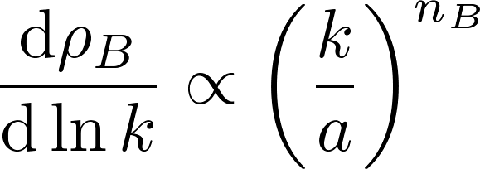
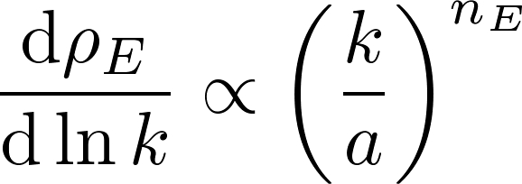
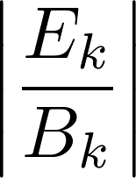
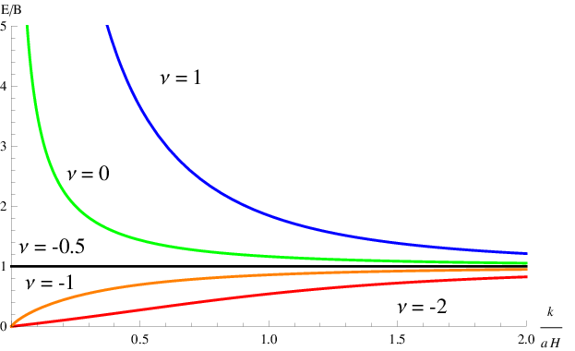
Spectrum of the EM fields produced by the fFF model
Spectrum index
E to B ratio
For large scale,
n(α)
α
J. Martin, J. Yokoyama, JCAP 01 025 (2008)

Slide 9
Problem of the fFF model
Strong coupling region
→ calculation is not reliable.
Weak coupling region
→ produce electric field too much, not magnetic field
Called “backreaction problem” because it breaks the inflation.
However, Schwinger effect (charged particle production) may be effective when the strong electric field exists.
V. Demozzi, V. Mukhanov, H. Rubinstein, JCAP 08, 025 (2009)

Slide 10
Schwinger Effect
One of the non-perturbative QED effect
Strong backgraound fields can produce particles from vacuum.
Schwinger’s original discussion (1951)
Determine the effective lagrangian (EH Lagrangian) from QED action.
Imaginary part of the effective action occurs.
（ ）
Effective action

Slide 11
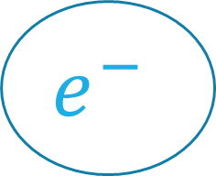
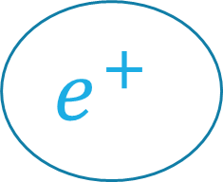
Physics of particle production (in Minkowski)
$$eEd∼\frac{eE}{m}∼m$$
Electric field Energy
Particle energy
（Compton wave length $d=\frac{1}{m}$）
$$e^{−}$$
$$e^{+}$$
E
Typical strength scale of particle production is given by
$$eE_{Sch}∼m^{2}$$

Slide 12
Induced Current
The produced particles run along the electric background field, then the electrical current is induced.
We consider following analytic case
Dirac eq.
Background field
Induced current

Slide 13
Adiabatic subtraction
Solution of the Dirac eq.
is used to evaluate the VEV of the induced current and this is indeed (UV-) divergent. To renormalize it, we subtract the adiabatic expansion (also known as WKB exoansion) of the quantity.

Slide 14
WKB solution for Fermion
e.o.m. for the mode function (KG type equation for the Dirac) is given by
Usual ansatz for WKB expansion does not work.
The correct ansatz of the WKB expansion is given by
and this gives the correct behavior in large momentum limit.

Slide 15
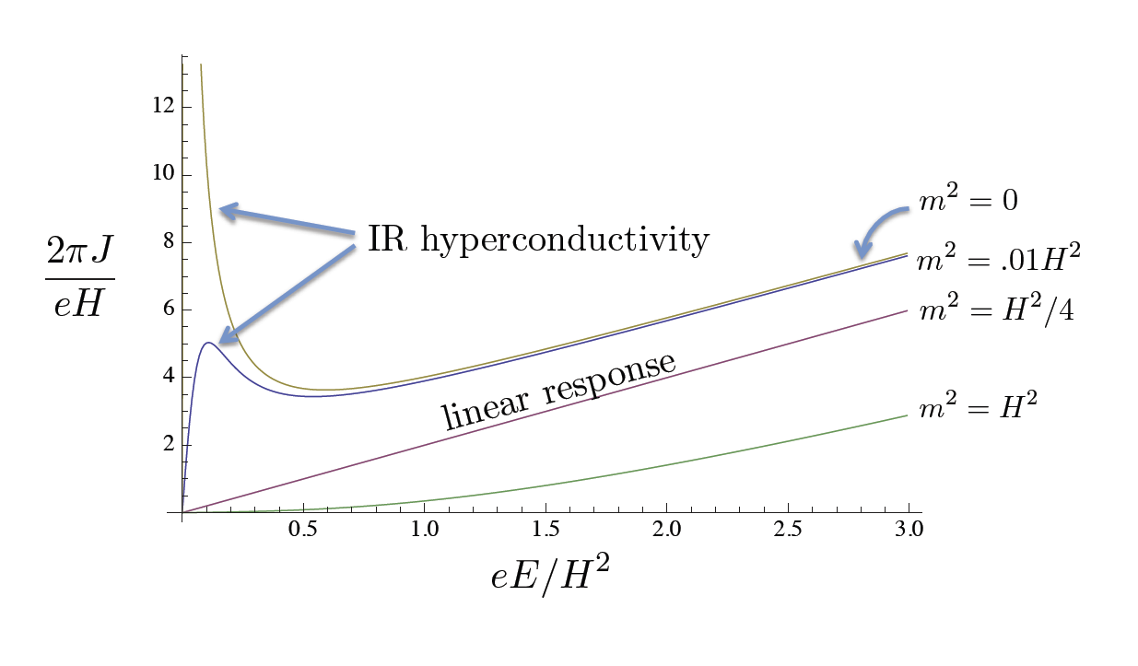
Induced Current 1
VEV of the current induced by charged scalar in 2 dimensional dS spacetime
M. Fröb et al. JCAP 1404 (2014) 009
M. Fröb et al. (2014)

Slide 16
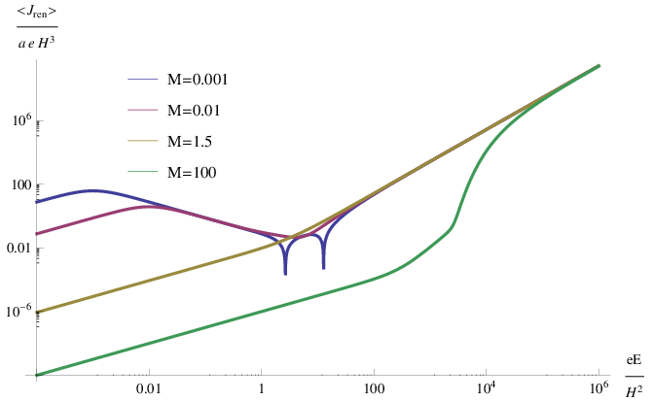
Induced Current 2
VEV of the current induced by charged scalar in 4 dimensional dS spacetime
Kobayashi, Afshordi, JHEP 1410 (2014) 166
Negative current!

Slide 17
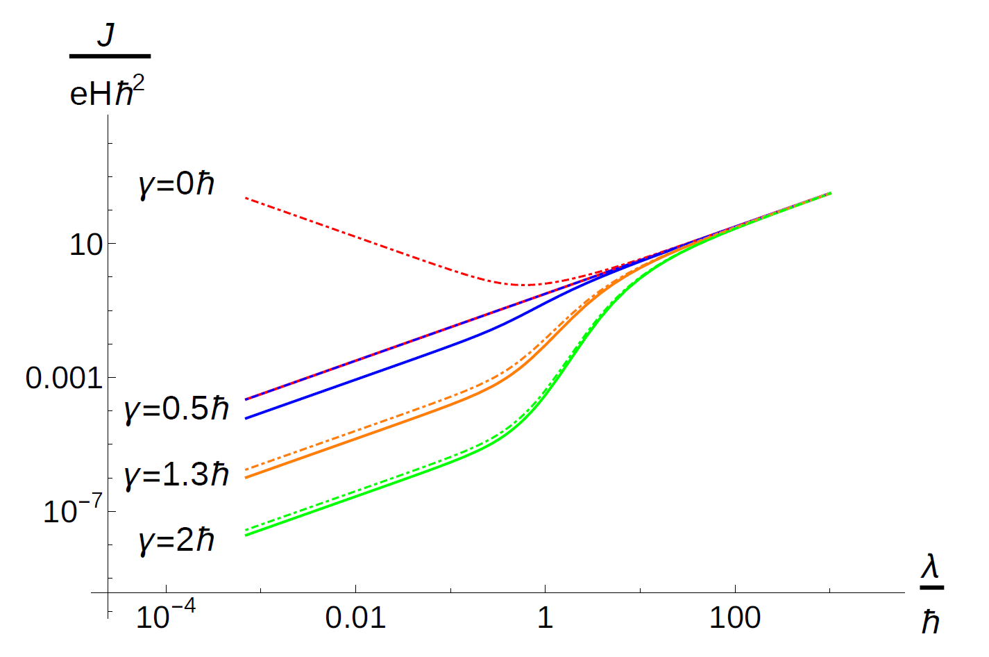
Induced Current 3
VEV of the current induced by Dirac fermion in 2 dimensional dS spacetime
C. Stahl et al. arXiv:1507.01686
No IR hyperconductivity
Solid line : Fermion
Dotted line : Boson
C. Stahl et al. (2015)

Slide 18
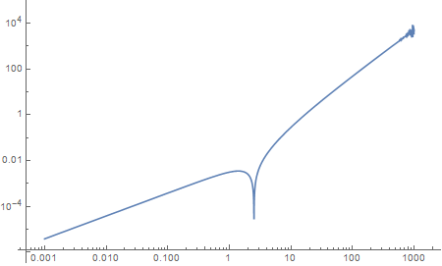
Induced Current 4 - preliminary
VEV of the current induced by Dirac femrmion in 4 dimensional dS spacetime
now proceeding
We find the negative current also happens in this case.
m/H=1

Slide 19
Summary
Inflationary magnetogenesis does not go well so far.
The over production of the electric field is the main cause.
Schwinger effect may remove the cause.
Property of Schwinger effect in dS spacetime is quite different from that in Minkowski spacetime.
Even the negative current appears in 4-dimensional case regardless of the spin of the charged particle .

