Slide 1
Neutrino properties deduced from the neutrinoless double beta decay study
Sabin Stoica
International Centre for Advanced Training and Research in Physics,
Horia Hulubei National Institute of Physics and Nuclear Engineering,
Bucharest-Magurele, Romania
S. Stoica, NDM2018, June 29-July 4, 2018, Daejeon, Korea
Notes:
OCA-Nice, June 28, 2016

Slide 2
Outline
Introduction: double beta decay – 2νββ, 0νββ
Theoretical challenges: nuclear matrix elements and phase space factors,
results
Connections with BSM physics, light neutrino mass parameters
Neutrinoless decays at high energy (analysis at LHC/LHCb-CERN)
Conclusions
S. Stoica, NDM2018, June 29-July 4, 2018, Daejeon, Korea

Slide 3
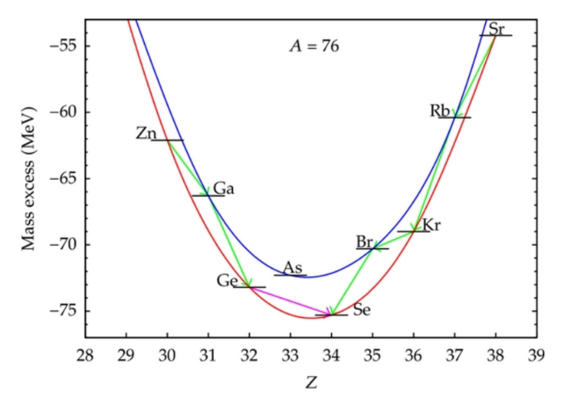
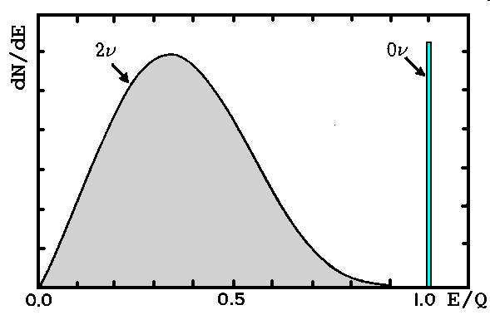
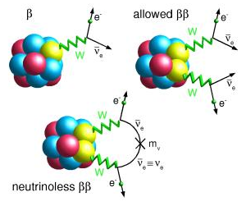
Double Beta Decay
Experimental results for DBD
(β⁻β⁻ & ECEC)
Is the rarest spontaneous nuclear decay measured until now, by which an even-even nucleus transforms into another even-even nucleus with its nuclear charge changed by two units. It occurs whatever single β decay can not occur due to energetic reasons or it is highly forbidden by angular momentum selection rules
Isotope | Q_{ββ}[MeV] | T^{2ν} [yr] [1]
⁴⁸Ca | 4.272 | 4.40 x 10¹⁹(d)
⁷⁶Ge | 2.039 | 1.65 x 10²¹(d)
⁸²Se | 2.995 | 9.20 x 10¹⁹(d)
⁹⁶Zr | 3.350 | 2.30 x 10¹⁹(d)
¹⁰⁰Mo | 3.034 | 7.10 x 10¹⁸(d)
¹¹⁶Cd | 2.814 | 2.87 x 10¹⁹(d)
¹²⁸Te | 0.866 | 2.00 x 10²¹(g)
¹³⁰Te | 2.527 | 6.90 x 10²⁰(d&g)
¹³⁶Xe | 2.458 | 2.19 x 10²¹(d)
¹⁵⁰Nd | 3.371 | 8.20 x 10¹⁸(d)
²³⁸U | 1.450 | 2.00 x 10²¹(r)
²³⁵Ba(2νECEC) | 2.619 | ~ 1.0 x 10²¹ (g)
¹⁰⁰Mo-¹⁰⁰Ru(0₁) | 1.903 | 6.70 x 10²⁰(d)
¹⁵⁰Nd-¹⁵⁰Sm(0₁) | 2.630 | 1.20 x 10²⁰ (d)
Experimentally, one can distinguish
2νββ, 0νββ by measuring the sum
electron energy
DBD modes
2νβ⁻β⁻ 0νβ⁻β⁻
2νβ⁺β⁺ 0νβ⁺β⁺
2νECβ⁺ 0νECβ⁺
2νECEC 0νECEC
S. Stoica, NDM2018, June 29-July 4, 2018, Daejeon, Korea

Slide 4
Neutrinoless DBD potential to investigate BSM physics
Lepton number conservation 0νββ: (A, Z) → (A, Z + 2) + 2 e⁻
Limits on different BSM parameters associated with different possible mechanisms that may contribute to 0νββ
- on the effective light Majorana neutrino mass: < m_{ββ}>² = | Σ_{i} | U_{ei}|² m_{i} |² in corroboration with ν oscillation data →
hints on the ν mass hierarchy (∋ of a lower limit ∼0.014 eV for the Majorana m_{ν} for IH, while for NH <m_{ββ}> could vanish
on parameters related to other possible mechanisms mediating 0νββ: exchange of heavy Majorana ν, Majoron, SUSY, etc.
Existence of RH currents: in the hypothesis of existence of RH components of the weak interaction currents their strength can be characterized by the phenomenological coupling constants η and λ (η describes the coupling between the RH lepton current and LH quark current, while λ describes the coupling when both currents are RH. The observation of the single electron spectra could, in principle, allow to distinguish this mechanism from the light Majorana ν exchange mode.
Tests of Lorentz violation (LV) in the neutrino sector
- 2νββ: to investigate deformations of the electron sum spectrum produced by isotropic LV (possible expt. signatures)
- 0νββ: LV Majorana couplings modify the ν propagator, introducing novel effects in 0νββ (one can constrain parameters
related to the possible occurrence of this decay mode in the event when <m_{ββ}> vanishes

Slide 5
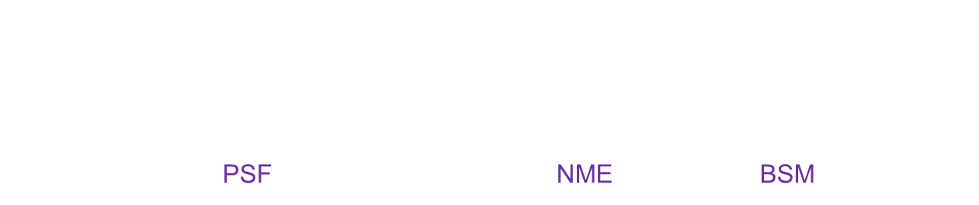
Theoretical challenges in the DBD study
Theoretical lifetimes
${ [T}_{1/2}^{2ν}]$⁻¹ = G^{2ν} (Q_{ββ}, Z) x ${ g}_{A}^{4}$ x | $mec2$M^{2ν} |²
2νββ lifetime
0νββ lifetime
${[T}_{1/2}^{0ν}]$⁻¹ = ∑_{k} G^{0ν} (Q_{ββ}, Z) x ${ g}_{A}^{4}$ x |$M_{k}^{0ν}$|² x <η_{k}>
↓ ↓ ↓
atomic physics nuclear physics particle physics
PSF NME BSM
Precise calculations of PSF and NME are needed to predict lifetimes, derive neutrino parameters,
extract information on neutrino properties
S. Stoica, NDM2018, June 29-July 4, 2018, Daejeon, Korea

Slide 6
Calculation of NME carry the largest uncertainties,
many works devoted to their calculations:
different methods, different groups
Current main methods: pnQRPA (different versions)
Shell Model
IBM2
Density functional method
Projected HFB
S. Stoica, NDM2018, June 29-July 4, 2018, Daejeon, Korea

Slide 7
Uncertainties in the theoretical calculations for DBD
Nuclear matrix elements
method of calculation (pnQRPA, ShM, IBA2, PHFB, GCM with EDF, etc.) differing by the choice and way of building the model spaces and type of correlations taken into account
ii) Nuclear approximations involved in calculations: FNS, SRC(parametrization in different ways of the correlation function, nuclear currents (higher order terms-tensor contribution, RH components), closure/non-closure approximation, etc.
ii) nuclear parameters: - R_{A} = r₀ A^{1/3} (r₀ = (1.1 or 1.2) fm (1.2/1.1)² ~ 1.19 → ~ 20%
- <E_{N}> (average energy for the int. states in the odd-odd nucleus)~(2-5)%
- Λ_{A} , Λ_{B} cut-off parameters used for inclusion of FNS ~ 7%
- g_{A} (1.0 = quark value; 1.27=free nucleon value; quenched value ~(0.4-0.9)
Phase space factors
method of calculation of the electron w.f. (Primakoff& Rosen RPP1959- non-relativistic approx.,
Suhonen&CivitaresePR1998-relativistic, but approx. w.f.; IachelloPRC2012, StoicaPRC2013- exact Dirac functions
Besides different values provided by different groups, the NME and PSF values provided by different groups were subject of confusion due to the different units in which they were provided, different nuclear approximations and input parameters.
ii) accuracy of integration of the PSF
S. Stoica, NDM2018, June 29-July 4, 2018, Daejeon, Korea

Slide 8
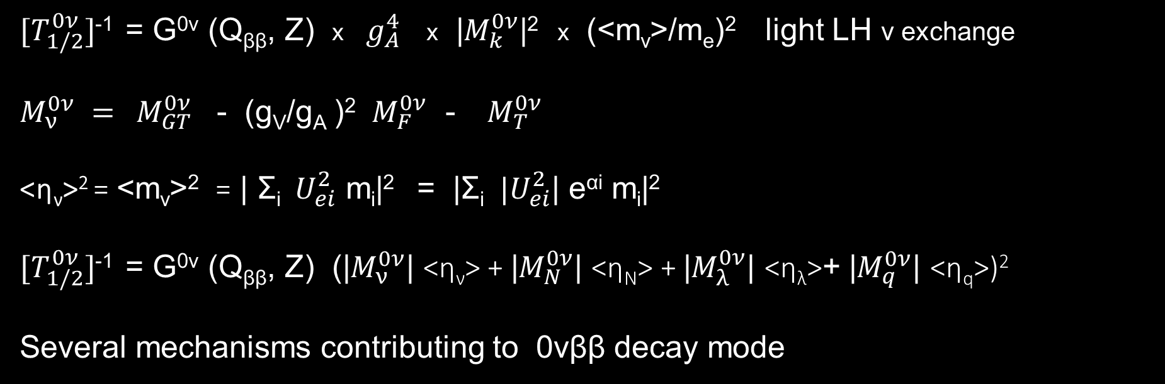
Theoretical calculations for 0νββ lifetime
${[T}_{1/2}^{0ν}]$⁻¹ = G^{0ν} (Q_{ββ}, Z) x ${ g}_{A}^{4}$ x |$M_{k}^{0ν}$|² x (<m_{ν}>/m_{e})² light LH ν exchange
$M_{ν}^{0ν} =$ $M_{GT}^{0ν}$ - (g_{V}/g_{A} )² ${ M}_{F}^{0ν}$ - $M_{T}^{0ν}$
<η_{ν}>² = <m_{ν}>² = | Σ_{i} $U_{ei}^{2}$ m_{i}|² = |Σ_{i} ${|U}_{ei}^{2}$| e^{αi} m_{i}|²
${[T}_{1/2}^{0ν}]$⁻¹ = G^{0ν} (Q_{ββ}, Z) (|$M_{ν}^{0ν}$| <η_{ν}> + |$M_{N}^{0ν}$| <η_{N}> + |$M_{λ}^{0ν}$| <η_{λ}>+ |$M_{q}^{0ν}$| <η_{q}>)²
Several mechanisms contributing to 0νββ decay mode
S. Stoica, NDM2018, June 29-July 4, 2018, Daejeon, Korea

Slide 9
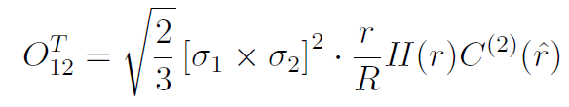
Horoi, Stoica, PRC81, 024321 (2010)
Neacsu, Stoica, Horoi, PRC 86, 067304 (2012), Neacsu, Stoica, JPG 41, 015201 (2014)
Fast numerical code for computing the TBME
S. Stoica, NDM2018, June 29-July 4, 2018, Daejeon, Korea

Slide 10
a, b, c parameters that take different balues for different methods of parameterization:
MS, CCM – AV18, CCM - CDBonn
S. Stoica, NDM2018, June 29-July 4, 2018, Daejeon, Korea

Slide 11
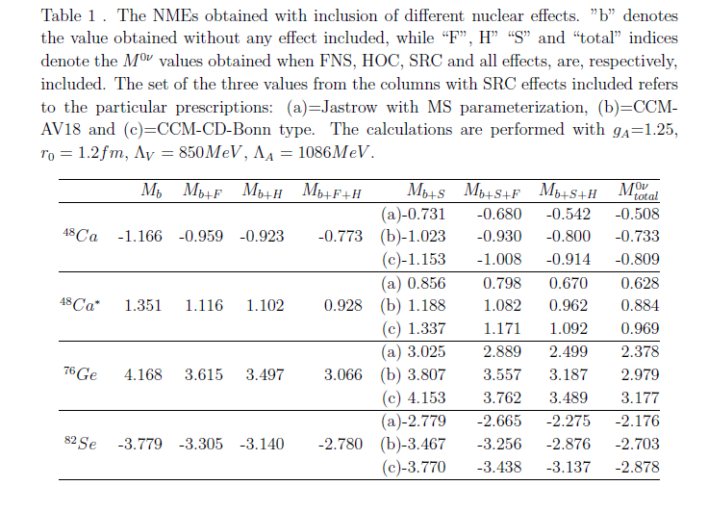
S. Stoica, NDM2018, June 29-July 4, 2018, Daejeon, Korea

Slide 12
Study of the effect of different nuclear ingredients on NMEs
their overall effect is to decrease the NME values
SRC inclusion: J-MS prescription decreases significantly the NME value as compared with softer CCM prescriptions.
however, NME values calculated with inclusion of only SRC by J-MS prescription, are close (within 10%) to the values calculated with SRC by CCM prescriptions and with the inclusion of other nuclear ingredients (FNS+HOC)→ a kind a compensation effect
inclusion of HOC is important → correction up to ~ 20%
tensor component: contribution of (4-9)% (has to be taken with correct sign)
dependence of NN interactions: up to 17%
dependence on input nuclear parameters:
- axial vector coupling constant g_{A} quenched/un-quenched – (10-14)%
- nuclear radius; R = r₀A^{1/3} (r₀=1.1fm or 1.2fm) ~ 7%
- nuclear form factors (Λ_{A}, Λ_{V}) ~ 8%;
- average energy used in closer approx. <E> - negligible
S. Stoica, NDM2018, June 29-July 4, 2018, Daejeon, Korea

Slide 13
PSF: less attention has been paid, since were considered to be calculated with enough accuracy.
Kotila & Iachello (K&I) PRC2012; PRC872013 re-computed PSF for the DBD within an improved method
(exact electron w.f.: Dirac eq. in a Coulomb with inclusion of finite nuclear size and screening effects. Found
relevant differences as compared with the previous PSF values for some cases.
Our work: an independent computation of the PSF, improving further K&I’s approach. New ingredients: Coulomb
potential derived from a more realistic proton distribution inside the nucleus, up-dated Q^{ββ} (2012),
routines with controlled, improved precision: Stoica, Mirea, PRC88 (2013), RRP66,68 (2014, 2015)
S. Stoica, NDM2018, June 29-July 4, 2018, Daejeon, Korea

Slide 14

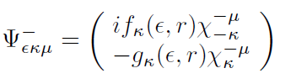

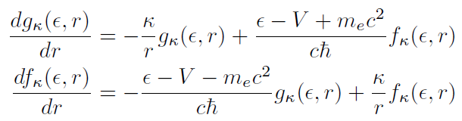
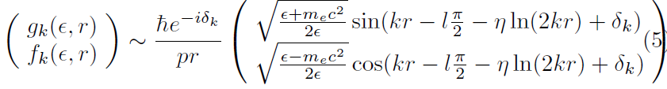
Calculation of the PSF
Relativistic treatment: the electron w.f. are expressed as a superposition of s and p Coulomb distorted spherical waves, solutions of the Dirac equation with a central (Coulomb) potential
for β⁻ decay
for β⁺ decay
The positive/negative solutions of the radial Dirac eq. for a given V potential. They can be expanded in spherical w.f. s and p. They are normalized such that they have the asymptotic behavior:
k=is the electron wave number
η = Ze²/hv, and δ_{k} = phase shift
S. Stoica, NDM2018, June 29-July 4, 2018, Daejeon, Korea

Slide 15

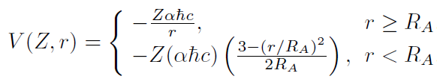


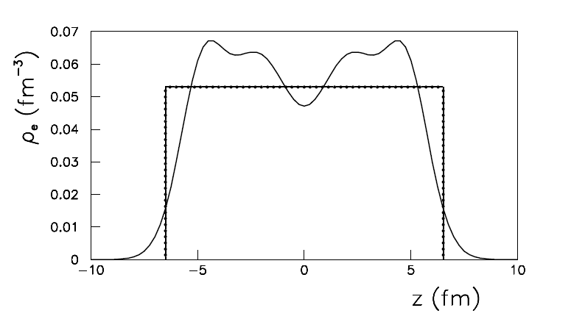

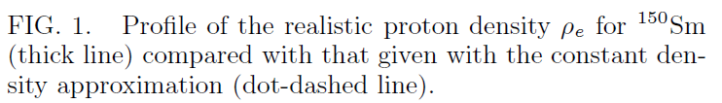
v) Present work: taking into account the influence of the nuclear structure by determining a potential V(r) from a realistic proton density distribution in the daughter nucleus.
This was done by solving a Schrodinger equation for a Wood-Saxon potential well.
We obtained V (r) as:
Ѱ_{i} = proton (WS) w.f. of the s.p. state i; v_{i} = its occupation amplitude
S. Stoica, NDM2018, June 29-July 4, 2018, Daejeon, Korea

Slide 16
– very good agreement with [27] both for G2ᵛ and G0ᵛ for the majority of nuclei
exceptions: 128Te(~20%) and 238U(factor of 7)
- in comparison with older calculations there are some notable differences
S. Stoica, NDM2018, June 29-July 4, 2018, Daejeon, Korea

Slide 17
- several cases, especially for heavier nuclei, where the differences are
of (10-40)%; again, for 238U our G2ᵛ value is 3 times smaller than
KI result
- notable differences with older results
S. Stoica, NDM2018, June 29-July 4, 2018, Daejeon, Korea

Slide 18
S. Stoica, NDM2018, June 29-July 4, 2018, Daejeon, Korea

Slide 19
Computation of products
[T^{0ν}]_{A}⁻¹ = G^{0ν} _{A} ∙ g²_{A} ∙| M^{0ν}|² _{A} ∙ <η> [T^{2ν}]_{A}⁻¹ = G^{2ν}_{A} ∙ g²_{A} ∙ | M^{2ν}|² _{A}
[T^{0ν}]_{B}⁻¹ = G^{0ν} _{B} ∙ g²_{A} ∙| M^{0ν}|² _{B} ∙ <η> [T^{2ν}]_{B}⁻¹ = G^{2ν}_{B} ∙ g²_{A} ∙ | M^{2ν}|² _{B}
Define products of G^{(2,0)ν} x |M(^{2,0)ν}|² and calculate them at once, and with the same nuclear
parameters and using an (eventual) consensus on the nuclear approximations involved in calculation as: FNS, SRC, higher order terms in nuclear current expression, etc.
2νββ P^{2ν} ⁼ G^{2ν} x |m_{e}c² M^{2ν}|² dimension= [yr⁻¹]
[T^{2ν}]⁻¹ = (g^{2ν}_{A,eff} )⁴ x P ^{2ν}
0νββ P^{2ν}_{l} ⁼ G^{0ν} x |M^{0ν}_{l}|² , l = mechanism; dimension= [yr⁻¹]
[T^{0ν}]⁻¹ = (g^{0ν}_{A,eff} )⁴ x P ^{2ν}_{l} x <η_{l}>²
S. Stoica, NDM2018, June 29-July 4, 2018, Daejeon, Korea

Slide 20
Nucleus | T^{2ν} [yr] | P ^{2ν} [yr-1] | T^{0ν} [yr] | P _{ν}^{0ν} [yr-1]
⁴⁸_{Ca} | 6.40 x 10¹⁹ [1] | 123.81 x 10⁻²¹ g_{A,eff} = 0.65/0.71 [8] | > 2.0 x 10²² [1] | 7.30 x 10⁻¹⁵
⁷⁶Ge | 1.92 x 10²¹ [2] | 5.16 x 10⁻²¹ g_{A,eff} = 0.56/0.60[7] | > 5.3 x 10²⁵ [9] | 9.95 x 10⁻¹⁵
⁸²_{Se} | 0.92 x 10²⁰ [2] | 186.62 x 10⁻²¹ g_{A,eff} = 0.49/0.60[7] | > 3.6 x 10²³ [3] | 34.45 x 10⁻¹⁵
¹³⁰_{Te} | 8.20 x 10²⁰ [4] | 25.26 x 10⁻²¹ g_{A,eff} = 0.47/0.57[7] | > 4.0 x 10²⁴ [5] | 71.45 x 10⁻¹⁵
¹³⁶ _{Xe} | 2.16 x 10²¹[1] | 20.30 x 10⁻²¹ g_{A,eff} = 0.45/0.39[7] | > 1.8 x 10²⁵ [6] | 71.01 x 10⁻¹⁵
[1] NEMO-3 PRD 93(2016); [2] Patrignani, C.; et al. (PDG), China Phys. C 40(2016);
[3] GERDA II, Nature, 544(2017); [4] CUORE, EPJ C 77(2017) ; [5] CUORE, PRL115 (2015);
[6] EXO, PRL510 (2018); [7]Caurier, PLB71(2012); [8]Iwata et al., PRL116(2016);
[9] V.I. Tretyak, NEMO3, AIP 1417 (2011).
S. Stoica, NDM2018, June 29-July 4, 2018, Daejeon, Korea

Slide 21


A measurement of the 0νββ decay rate combined with neutrino oscillation data and a reliable calculation of the NMEs, would yield insight into all three neutrino mass eigenstates.
Based on the present data one can extract limits for the neutrino mass scale.
NH:
IH:
S. Stoica, NDM2018, June 29-July 4, 2018, Daejeon, Korea

Slide 22
Search of LNV processes at high energy: like sign dilepton processes
Check: - lepton number violation
- neutrino character: Dirac or Majorana
- existence of heavy sterile neutrino(s):
dd −> uu W^{*-}W^{*-} −> uu e⁻e⁻ : 0νββ
Σ⁻ −> Σ⁺ e⁻e⁻ ; Ξ⁻ −> p μ⁻ μ- : hyperon decays
Ξ⁺_{c} −> Ξ- p μ⁺ μ⁺ ; Λ_{c}⁺ −> Σ⁻ μ⁺ μ⁺
c) τ⁻ −> l⁺ M⁻₁ M⁻₂ τ⁻ →μ⁺μ⁻μ⁻ _{: tau decays}
d) M±₁ −> l±₁ l±₂ M^{-/+}₂ : rare meson decays (B, D, K,..)
e) t −> b l⁺₁ l⁺₂ W⁻ W⁻ : top-quark decay
f) pp −> l⁺₁ l⁺₂ X : same sign dileptonic production
g) H±± −> l±₁ l±₂ X : double-charged Higgs decays
S. Stoica, NDM2018, June 29-July 4, 2018, Daejeon, Korea

Slide 23
Results on the search of LNV processes @ LHC already published:
CMS: JHEP 06 (2011) 077 [pp → l⁺₁ l⁺₂ X; l_{1,2} = e, μ, τ]
ATLAS: JHEP 10 (2011) 107 [pp → l⁺₁ l⁺₂ X; l_{1,2} = e, μ]
LHCb: [B⁺ → (π⁻, K⁻) μ⁺ μ⁺ ] (PRL108, 2012)
[B⁻ → (D^{(*,0)+} _{(s)}, π⁺) μ⁻ μ⁻ ] (PRD85, 2012); PLB 724, 36 (2013)
[τ⁻ → μ⁺μ⁻μ⁻ ] PRL112, 131802 (2014)
Hyperon decays future promising LNV channels for analysis
S. Stoica, NDM2018, June 29-July 4, 2018, Daejeon, Korea

Slide 24
Conclusions
Neutrinos play a key role in many processes from nuclear and particle physics, astrophysics and cosmology
Neutrinos fundamental properties as: absolute masses and mechanism of generating them, mass hierarchy, character (Dirac or Majorana?), number of flavors (sterile neutrinos?), etc., are still unknown
DBD- 0νββ, a BSM process occurring with LNV: very appealing to provide information on these issues
Theoretically: NME and PSF are two important quantities entering the 0νββ lifetimes→ need for precise calculations. Idea is to compute at once their product. Understanding the mechanisms of this decay.
Improvements, in computation of both NME and PSF. Computation directly the product PSF x NME.
Fixing the g_{A} value.
New opportunity: LNV processes are now searched at HE, as well, specially at LHC experiments. This is possible due to the present and future integrated luminosity, which make the analysis competitive to that from 0νββ
S. Stoica, NDM2018, June 29-July 4, 2018, Daejeon, Korea

Slide 25
Thank you for your attention

