Slide 1

Self-anisotropizing universe in Horndeski theory
Hiroaki W. H. Tahara
RESCEU, U Tokyo
2018-08-30
COSMO-18@IBS, Daejeon, Korea
  HWHT, S.Nishi, T.Kobayashi, J.Yokoyama, JCAP07(2018)058

Slide 2
Content
In GR, inflation dilutes anisotropies.
  Wald’s cosmological no-hair theorem
  We can say there is only an isotropic attractor.
In some class of modified gravity,
the theorem does not hold anymore.
  Anisotropic attractors emerge.
  See this with Horndeski theory.
    General case
    Specific case

Slide 3




Weak cosmological principle works well
Spatially homogeneous and isotropic
FLRW metric
$$k=−1$$
$k=$0
$$k=+1$$
© NASA/WMAP Science Team

Slide 4
To smooth out initial conditions
Very early universe may have:
Inhomogeneity,
Anisotropy… etc.
Inflation: efficient way to dilute them

Slide 5
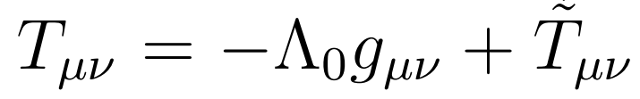
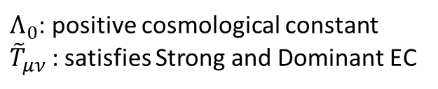
Anisotropies vanish with positiveΛ
R.M. Wald, Phys. Rev. D 28 (1983) 2118
Bianchi models
all types of background anisotropies
in 3-dim. space
$Λ_{0}$: positive cosmological constant
${\tilde{T}}_{μν}$ : satisfies Strong and Dominant EC
All of Bianchi types (except IX) approach FLRW metric
Wald’s cosmic no-hair theorem (in GR)

Slide 6
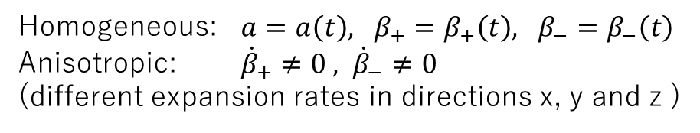
Introduce the simplest anisotropies
FLRW metric (k=0)
Kasner metric (=diagonal Bianchi type I)
Homogeneous: $a=a\left(t\right), β_{+}=β_{+}\left(t\right), β_{−}=β_{−}\left(t\right)$
Anisotropic: ${\dot{β}}_{+}≠0 , {\dot{β}}_{−}≠0$
(different expansion rates in directions x, y and z )

Slide 7
“Anisotropic” Friedmann eqns.
General relativity
or
Kasner metric
From (0,0) component
From (i, j) component

Slide 8
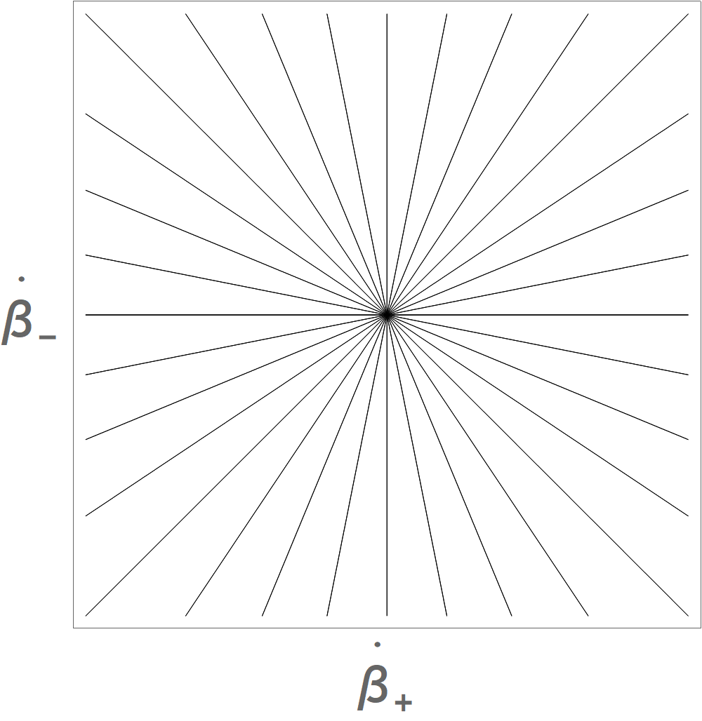
Anisotropy vanishes faster
In GR, expansion decreases anisotropies efficiently.

Slide 9
Horndeski theory
Discovered by Horndeski (1974):
  As the most general tensor theory with a scalar field which has the second-order EoMs.
Rediscovered by Deffayet+ (2011):
  In a different context (Galileon).
Equivalence is indicated by Kobayashi+ (2011).

Slide 10
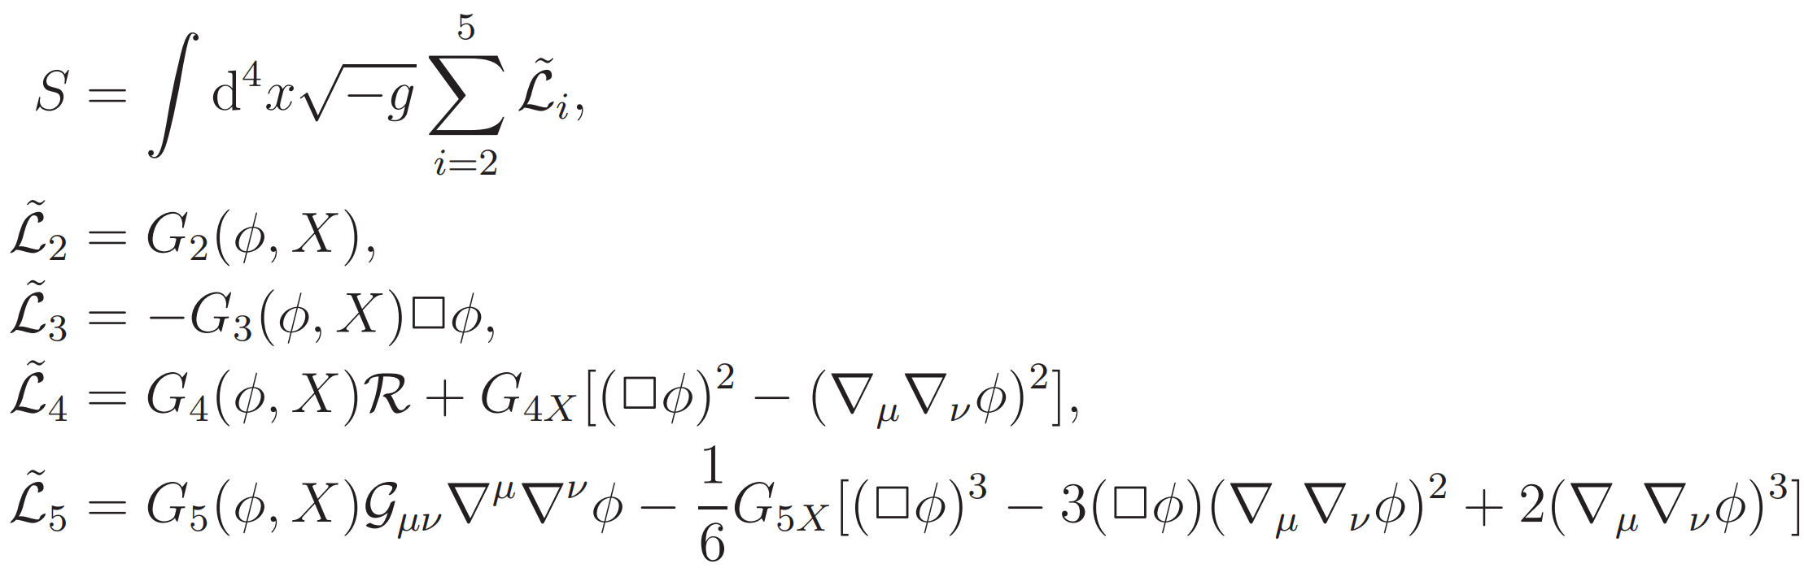
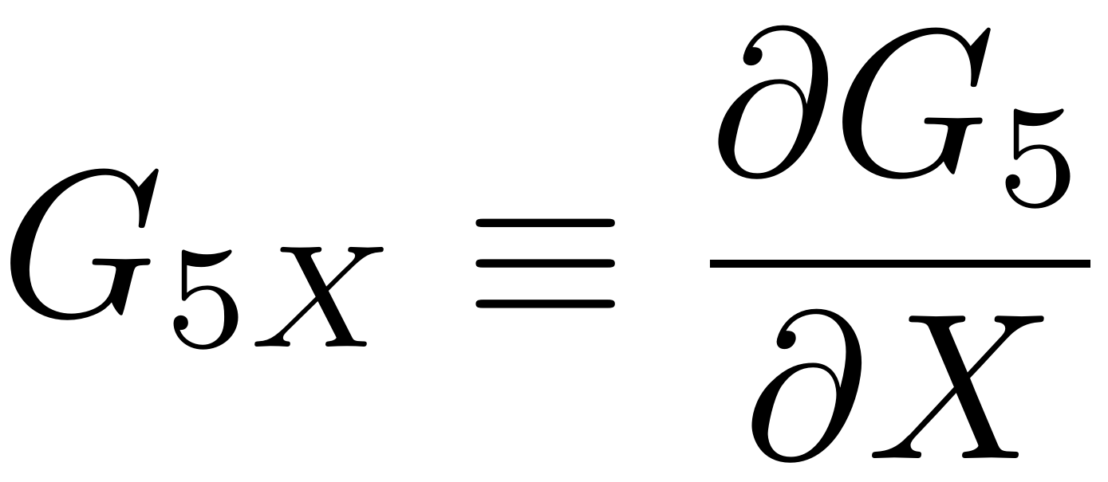
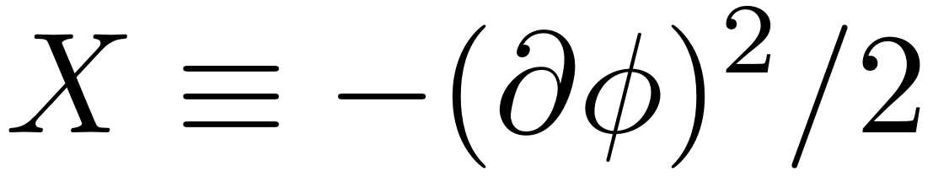
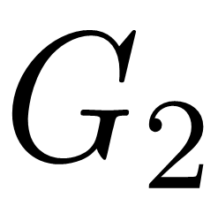
Horndeski action
Horndeski 1974, Deffayet+ 2011, Kobayashi+ 2011
The most general single-field scalar-tensor theory with the second-order EoM.
Feature:
No Ostrogradsky ghost
4 functional DOF
: a canonical kinetic term
: arbitrary functions

Slide 11
Horndeski theory includes:
General relativity
Brans-Dicke gravity
Kaluza-Klein compactification
of higher-dimensional Lovelock gravity

Slide 12
Behavior of anisotropies
We start with Kasner metric:
Substituting this in the Horndeski action, we get:
As seen, it has β± only as their time derivatives:
Where

Slide 13
Conservation of momenta of
As a(t) increses, these approach zero.
  → [ … ]=0 gives the position of attractor.
(i) G5X=0 (or GR)
c.f.
in GR
(ii) G5X≠0

Slide 14
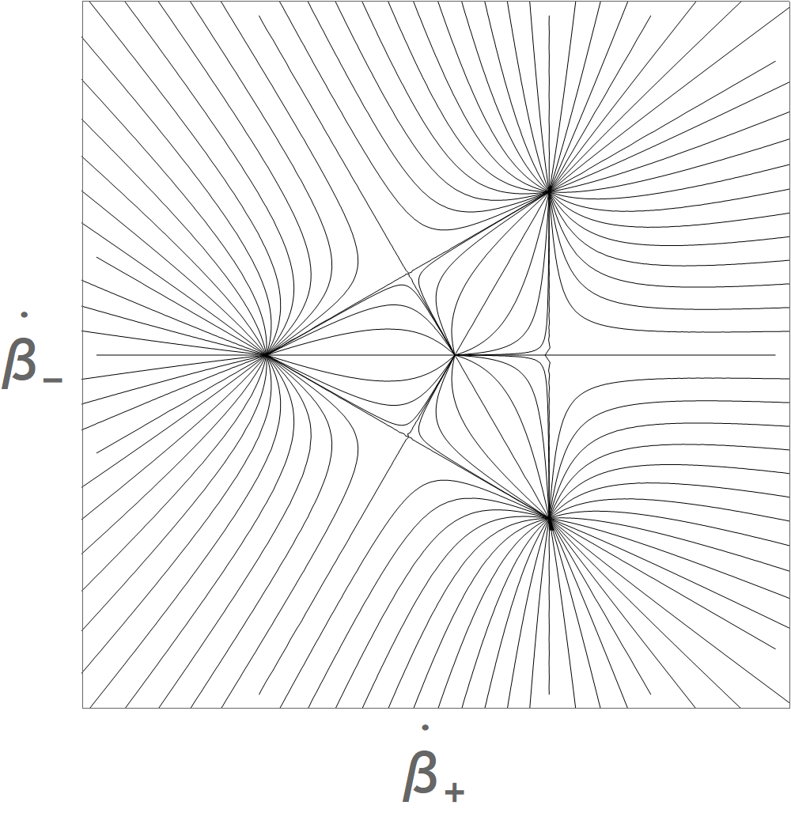

Evolution of
G5X=0 (or GR)
G5X≠0
$$\sim b$$
We can draw trajectories with

Slide 15
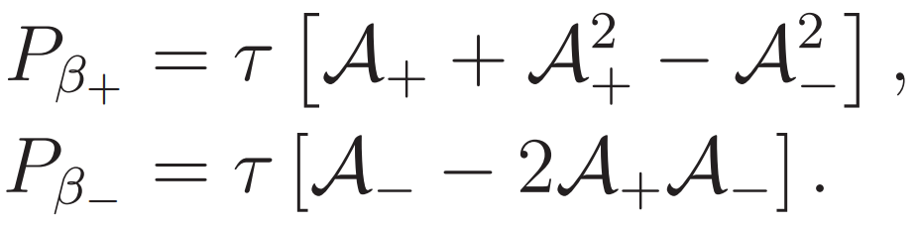
To fix the triangle in a phase space
We normalize :
where

Slide 16
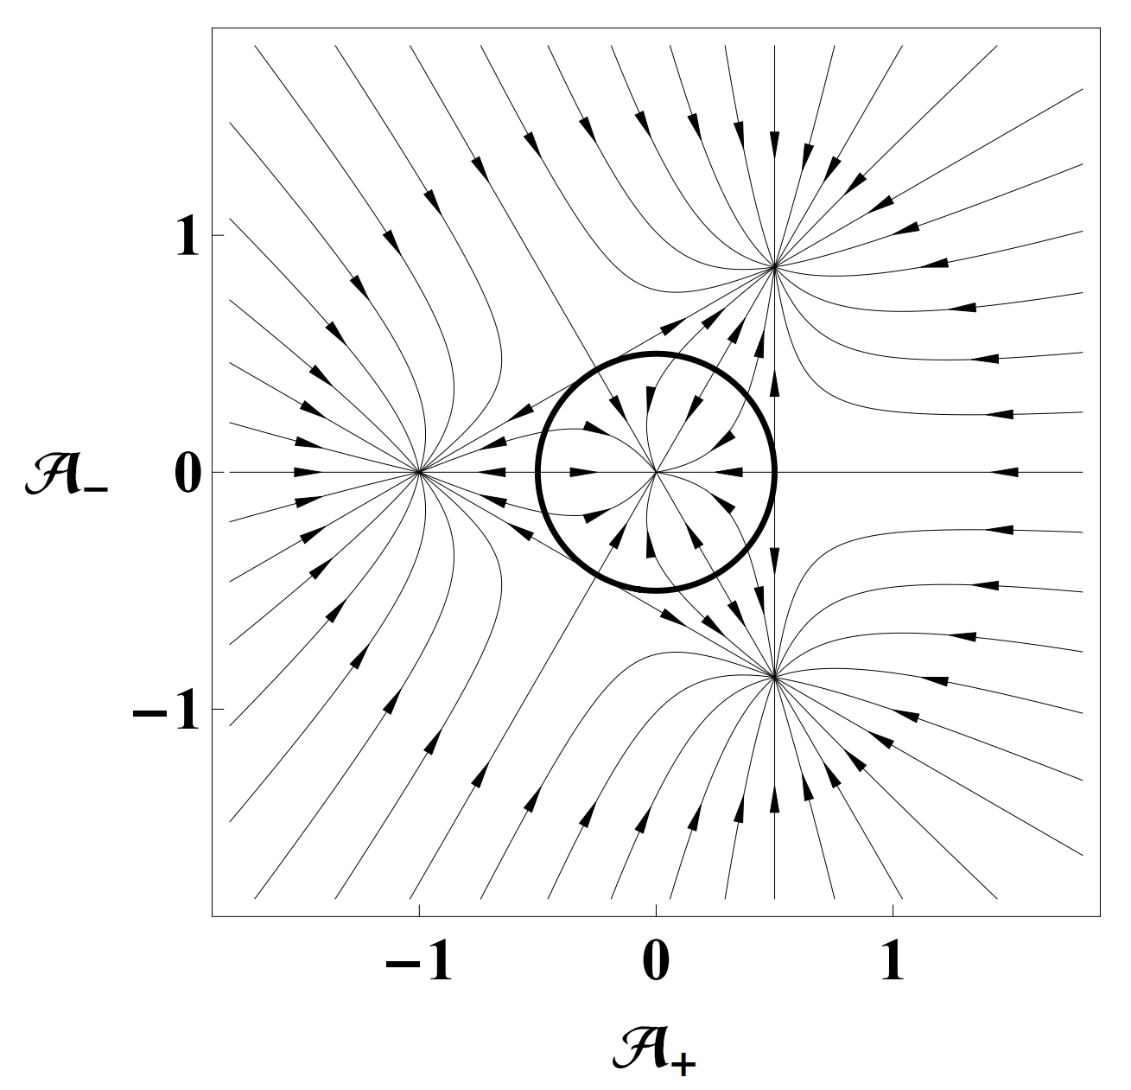

Evolution of
G5X≠0
As $\left|τ\right|$ increases:
Isotropic
attractor
Inside of the circle
→ Isotropic attractor
Outside of the circle
→ Anisotropic attractor
Anisotropic
attractors
We call such solutions
“self-anisotropizing universe”
This might challenge the robustness of inflation?

Slide 17
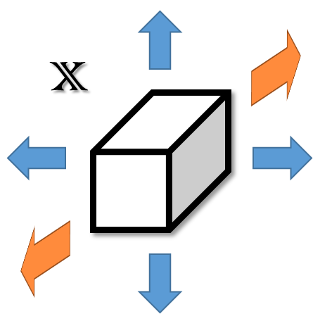
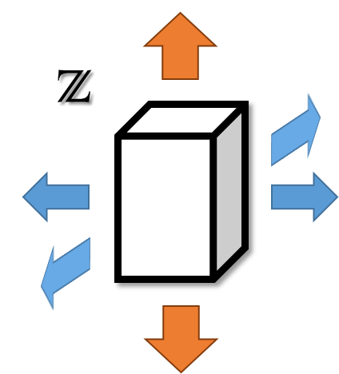
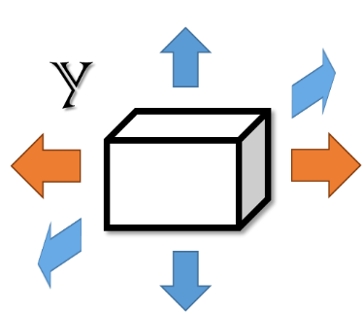

Anisotropic attractors
Iso.

Slide 18
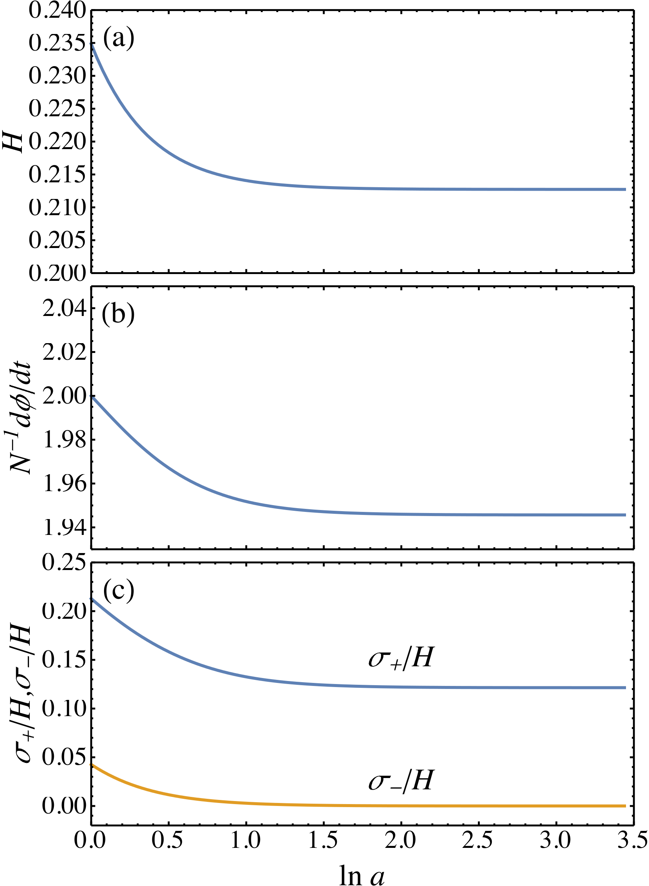

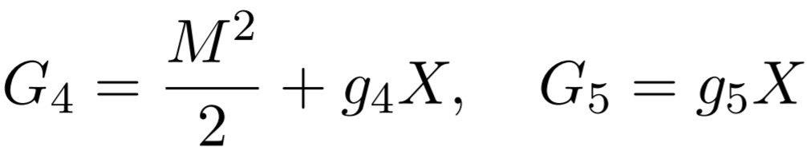
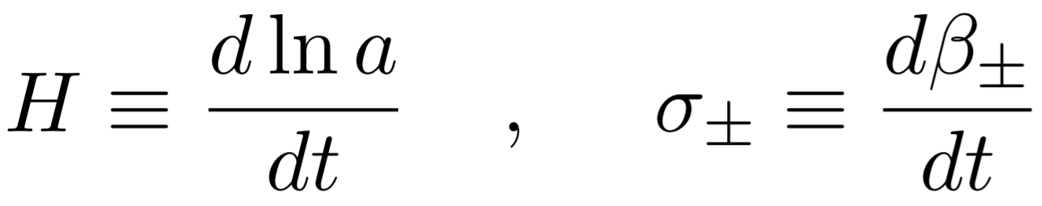
An example

Slide 19
Conclusion
A positive cosmological constant isotropizes homogeneous universes in GR.
G5X changes the dynamics of spacetime and the anisotropic attractors emerge.
  For example, slow-roll inflation can satisfy the condition to approach attractors.
    → Anisotropic inflation
  Terminal state is depend on the initial condition.

