Slide 1


The evolution and decay of hadronic
inhomogeneities in the early universe
Soma Sanyal
University of Hyderabad, India
(Work done in collaboration with
Sovan Sau and Sayantan Bhattacharya)
Based on arXiv : 180506241
COSMO 2018
Daejeon, Korea
August 27 - 31, 2018.

Slide 2
Plan of the talk
Brief description of baryon inhomogeneities
Previous studies of their decay
Diffusion coefficient of nucleons in presence of muons
Decay of inhomogeneities in multiparticle plasmas
Effect on neutrino chemical potential
Summary
Acknowledgements

Slide 3
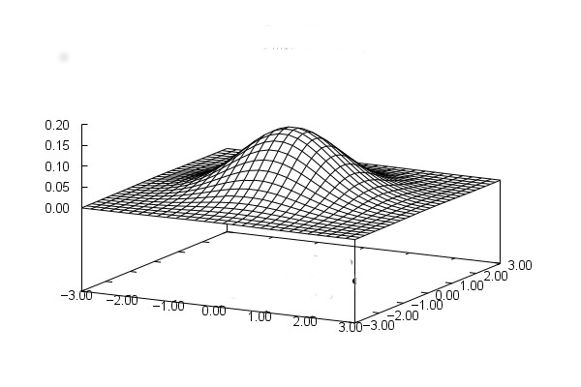
Baryon inhomogeneities
Generated by the trapping of a higher density of baryon number in small regions after the quark – hadron phase transition.
They can be formed irrespective of the order of the phase transition

Slide 4
Decay of Baryon Inhomogeneities
Decay due to the diffusion of neutrons and protons from higher density regions to lower density regions
Decay is important as the neutron/proton ratio is a crucial input to the big bang nucleosynthesis calculations
Plasma consists predominantly of leptons, neutrons and protons
Previously diffusion of neutrons and protons were studied in such a plasma
Collision with muons was neglected as their contribution is considered to be too small

Slide 5
Can we really neglect muons ?
Inhomogeneities formed from collapsing Z(3) domain walls lead to accumulation of a large number of strange quarks
Hadronization of these inhomogeneities result in hyperons
Hyperons decay into pions and muons
Metastable quark nuggets emit kaons which decay to muons

Slide 6


Diffusion Coefficients
$$\frac{\left(1−x_{i}\right)}{D_{i}}=\sum_{i≠j}{\frac{x_{j}}{D_{ij}}}$$
$$x_{i}=\frac{n_{i}}{N}$$
We calculate the diffusion coefficient of neutrons in the presence of muons
Since it is a multiparticle plasma, average diffusion coefficient is given by
If N be the total number of particles then

Slide 7

Calculation of Diffusion Coefficients
$D_{ne}=\frac{M^{2}}{32m^{3}} \frac{1}{ακ^{2}} \frac{e^{\frac{1}{T}}}{T f\left(T\right)}$
We obtain the diffusion constants from the scattering cross – section of the particles
Since both electrons and muons are similar in their interaction with the neutron, the difference in their diffusion constants will be by a factor and the difference in their masses

Slide 8


Calculation of Diffusion Coefficient
Differential Cross section of the neutron and the muon is given by
The diffusion coefficient is :
Since the net diffusion constant depends on the densities of the particles we keep the density of one particle constant
$$\frac{dσ}{dΩ}≈K\frac{α^{2}κ^{2}}{\begin{aligned}4 M^{2} \\ \end{aligned}}\left[1+ {cosec}^{2}θ/2\right]$$
Here T’ depends on mass of muon
$D_{nμ}=\frac{M^{2}}{32m^{3}} \frac{1}{ακ^{2}} \frac{e^{\frac{1}{T^{′}}}}{T f\left(T^{′}\right)}$

Slide 9
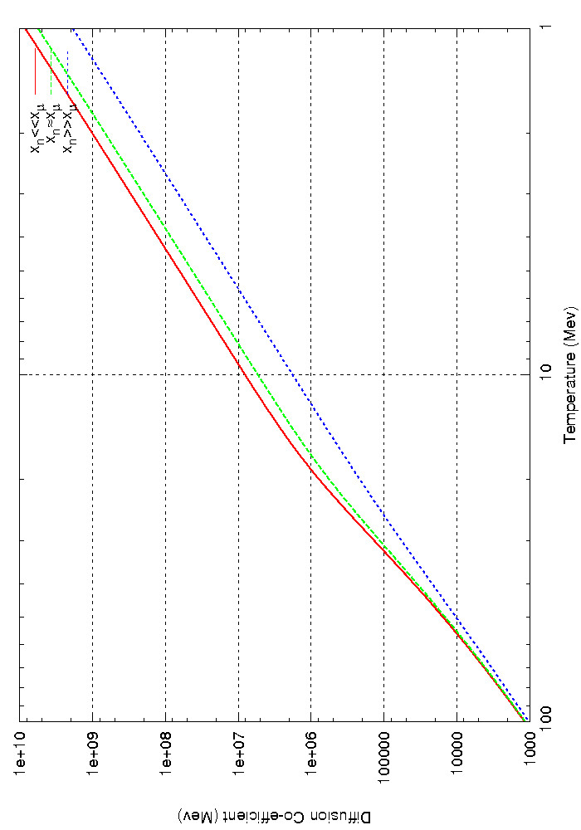
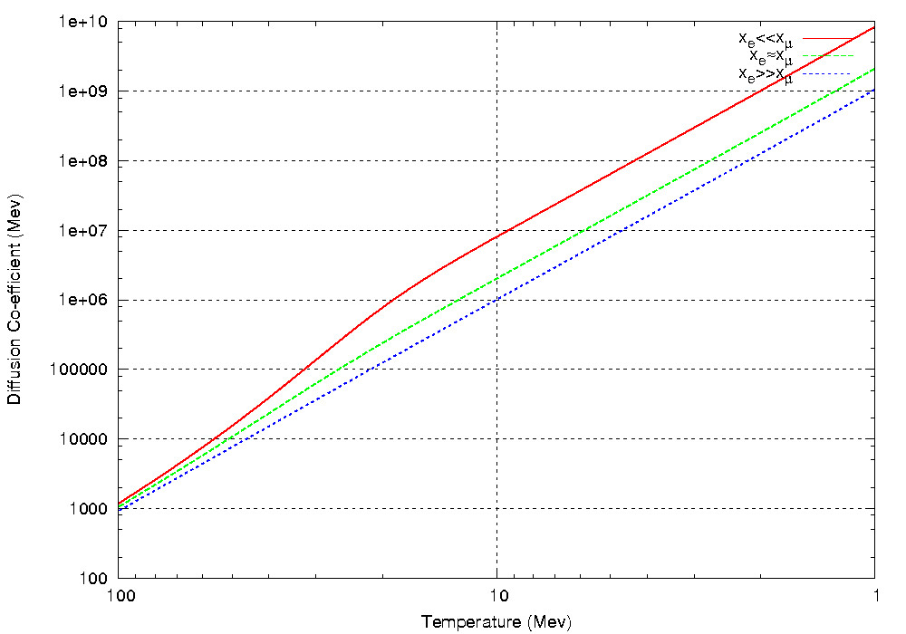
Density dependency of the diffusion coefficients
Neutron density is kept
constant
Electron density is kept
Constant

Slide 10
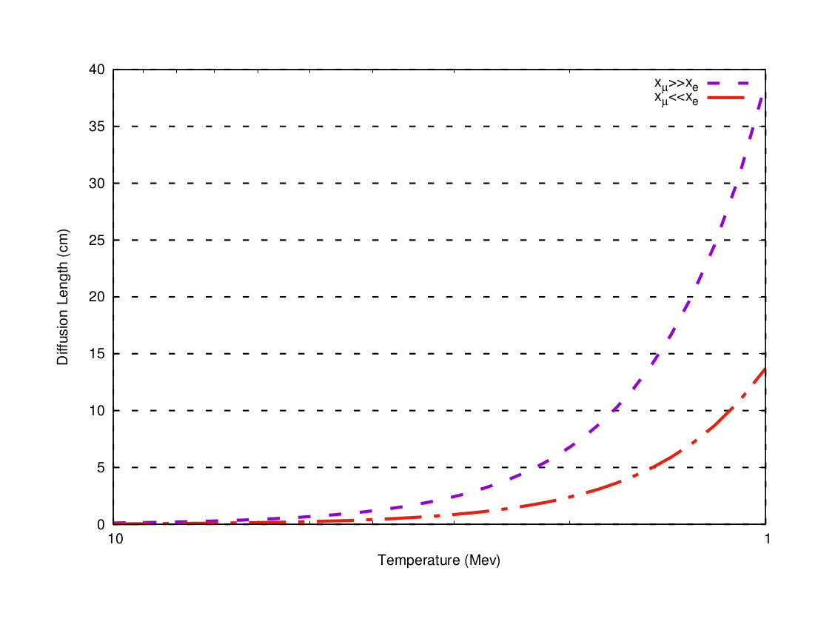
The Diffusion Length
We also calculate the
Diffusion length of
the neutrons in the
nucleon, electron and
muon plasma

Slide 11

Decay of overdensities
We assume the over densities to be Gaussian and evolve them using the diffusion equation
The decay of the over density is studied with respect to both space and time
Diffusion coefficient is dependent on time so the equation is solved numerically
$$\frac{D(t)}{a^{2}} \frac{∂^{2}n(x,t)}{∂x^{2}}= \frac{∂n(x,t)}{∂t}=−λ^{2}$$

Slide 12
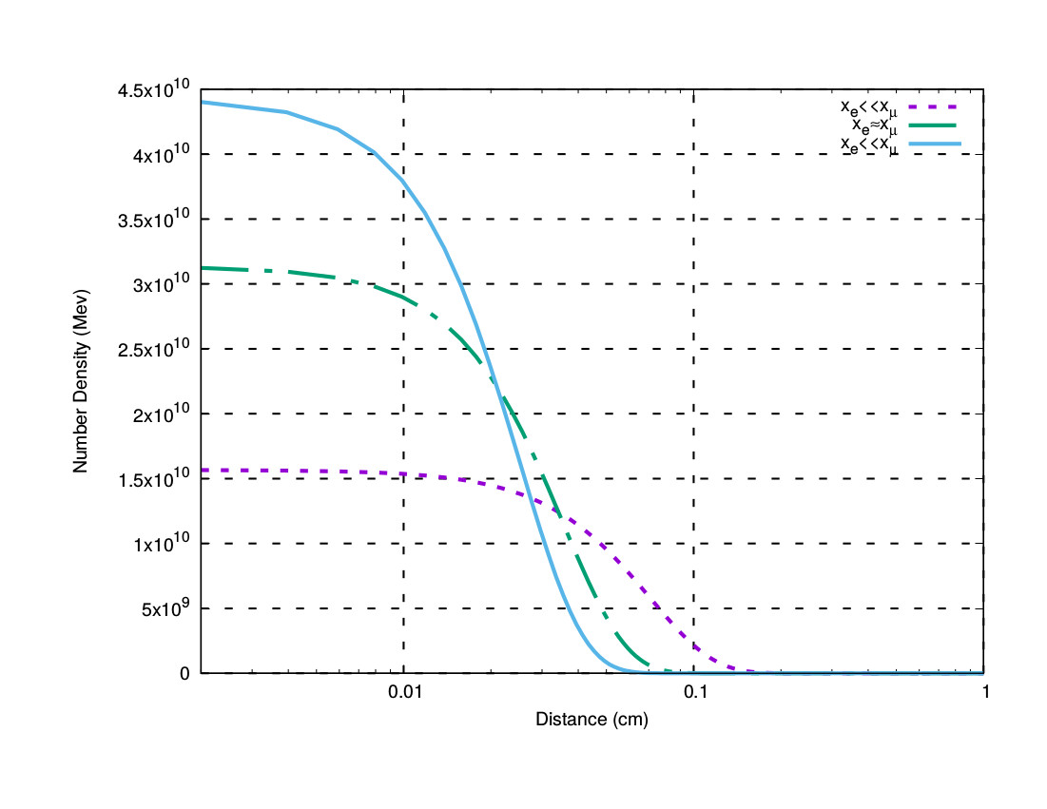
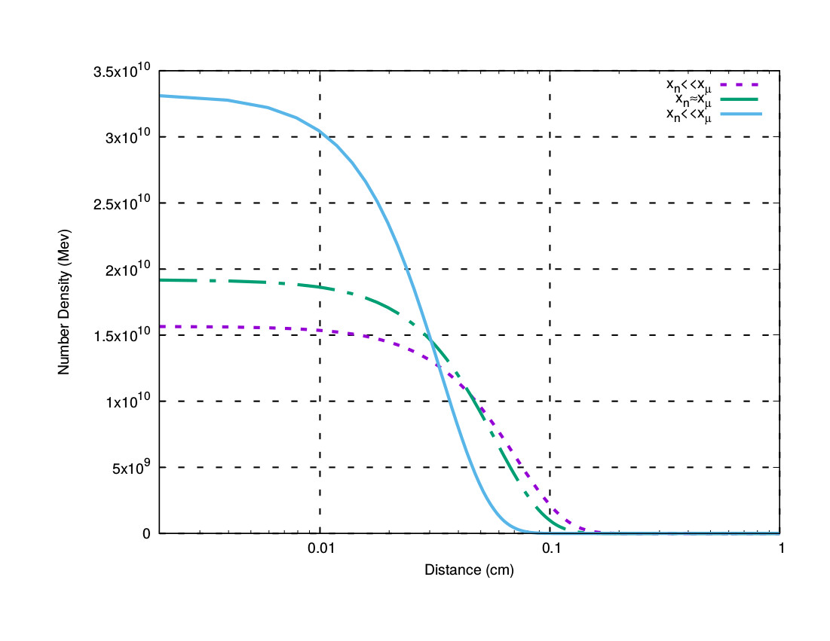
Decay of overdensities (At constant temperature)
Neutron density is kept Electron density is kept
constant constant

Slide 13
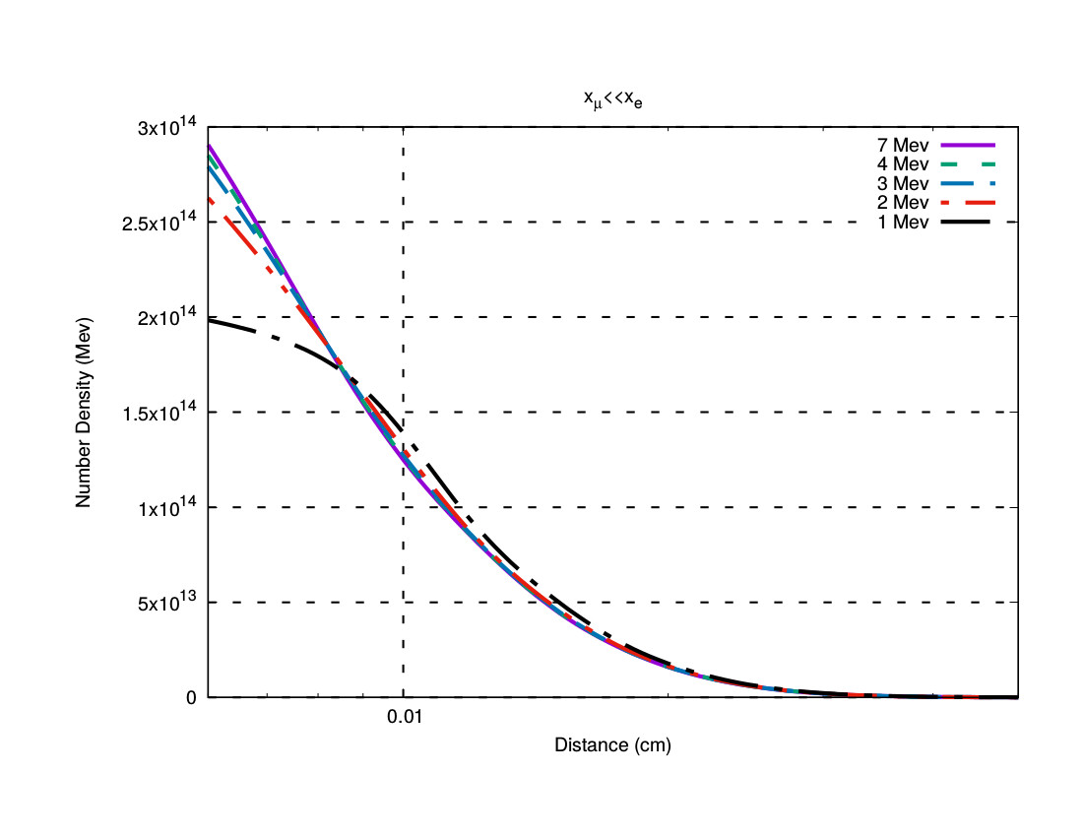
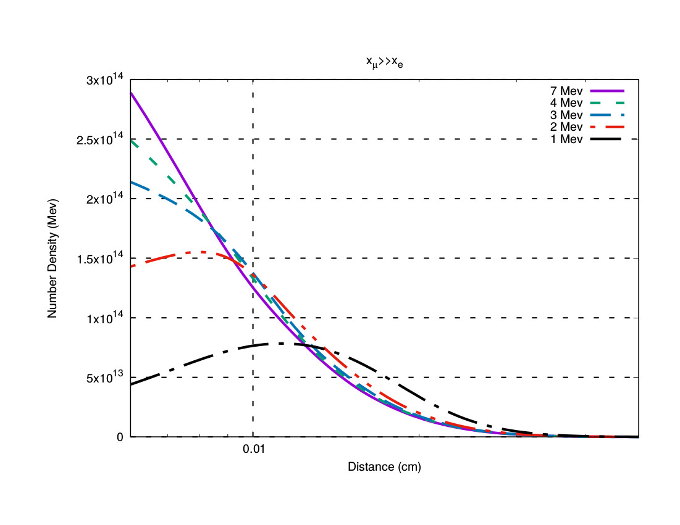
Decay of overdensities (As temperature decreases)
In Electron Rich Plasma
In Muon Rich Plasma

Slide 14
Generation of neutrinos
Hyperon decay leads to generation of pions and muons as well as neutrinos
Eg : Ω‾ can decay into charged kaon and Λ. The decay of K‾ will generate a νμ
Similarly νe can also be generated
Chemical potential of the neutrinos are an important input to nucleosynthesis calculations

Slide 15


Neutrino Degeneracy parameters
The lepton numbers are given by
$$L_{ν_{i}}≈\frac{Π^{2}}{12ζ\left(3\right)}{\left(\frac{T_{ν}}{T_{γ}}\right)}^{3}\left(ξ_{i}+\frac{ξ_{i}^{3}}{2Π^{2}}\right)$$
Chemical Potential
Thus if $L_{νμ}>L_{νe}$ or vice versa, nucleosynthesis results would
be affected by such inhomogeneities

Slide 16
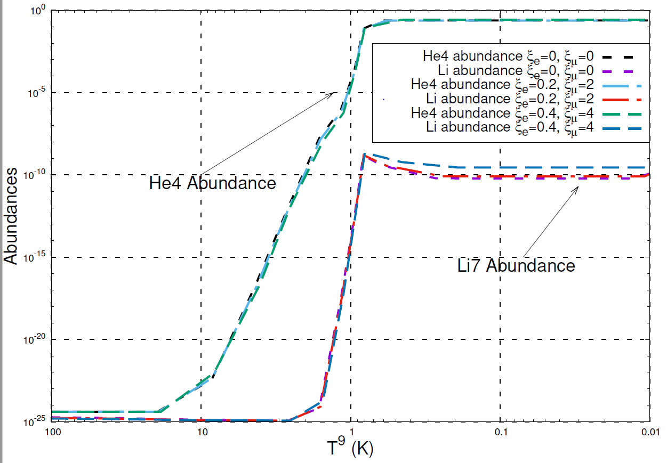
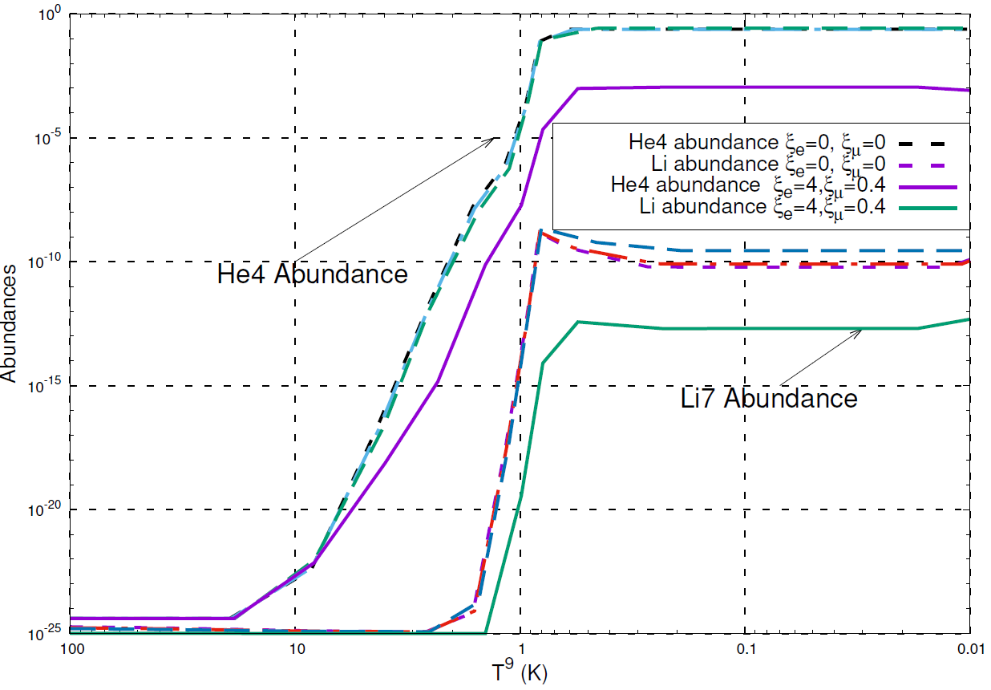
Comparison of abundances
Muon neutrino > Electron
neutrino
Electron neutrino > Muon
neutrinos

Slide 17
Conclusions
Baryonic inhomogeneities decay faster in a muon rich plasma compared to an electron rich plasma
Inhomogeneities generated for scenarios where the strange quarks are selectively filtered will decay before nucleosynthesis
A large muon neutrino degeneracy parameter will make insignificant changes to the production of the primordial elements
However Inhomogeneities which enhances the electron degeneracy factor should be studied further as they affect the primordial abundances significantly

Slide 18
Main References
B.Banerjee and S. M. Chitre Phys. Letts. B 258 247 (1991)
In-Saeng Suh and G.J. Mathews Phys.Rev D 58 123002 (1998)
B.D.Fields, S. Dodelson and M.S. Turner Phys. Rev D 47 4309 (1993)
B. Layek, A. P. Mishra , A. M. Srivastava and V. K. Tiwari, Phys. Rev. D 73 103514 (2006)
A. Atreya, A. Sarkar and A. M. Srivastava, Phys. Rev. D 90 (4) 045010 (2014)
A. Ray and S. Sanyal Phys. Letts. B 726, 83 (2013)

Slide 19
Acknowledgements
We have used a publicly available standard code of nucleosynthesis based on the Wagoner – Kawano code and modified by S. Dodelson to study the primordial abundances.
Department of Science and Technology, India (PURSE Grant)

