Slide 1
Gravitational Radiation driven capture of two Black Holes
Yeong-Bok Bae (NIMS)
Asia-Pacific School and Workshop on Gravitation and Cosmology 2020
2020. 02. 12. IBS

Slide 2
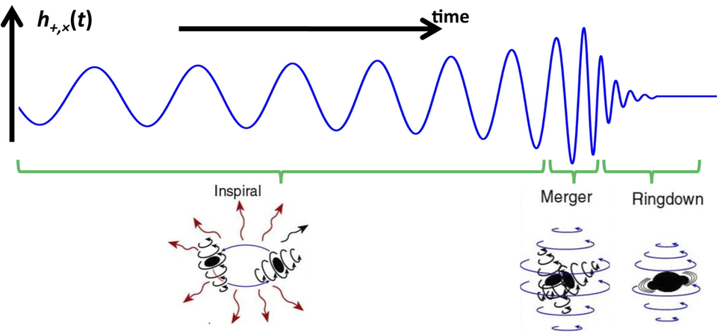
Introduction
Black Hole (BH) binaries
Main sources of Gravitational Waves (GWs)
Detectable frequency & strength for current interferometric GW detectors
Predictable wave forms
Inspiral-Merger-Ringdown (M. Favata, SXS, K. Thorne)
BBH formation
Field – Evolution of stellar binary
Cluster – Dynamical formation

Slide 3
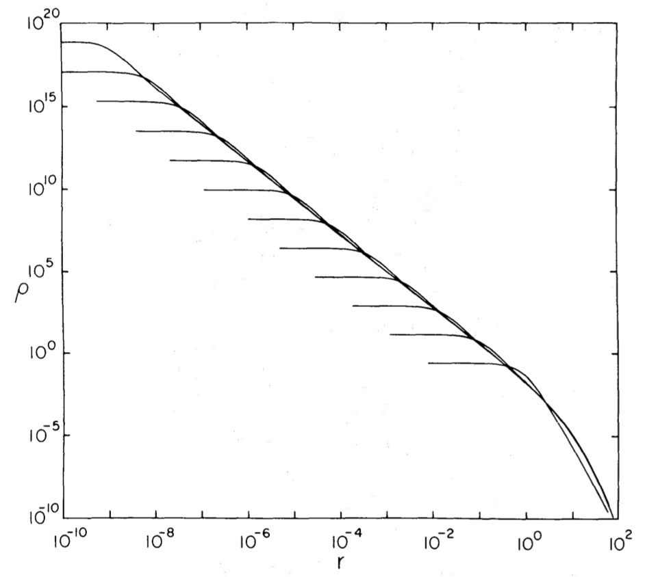
Introduction
Dynamics in cluster
Core collapse
Mass segregation
Formation of high density central region
BH-BH binary formation
Hardening by interactions
Merging by emitting GWs
Core collapse (Cohn 1980)

Slide 4
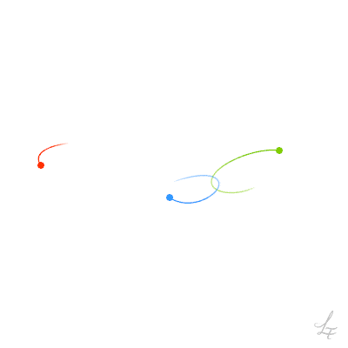
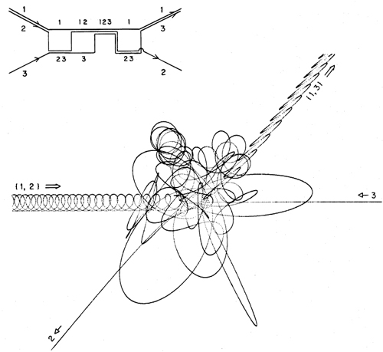
Introduction
Three-body process
Interaction of three bodies
https://imgur.com/gallery/OkUBjPu
Hut & Bahcall 1983

Slide 5
Introduction
Gravitational Radiation driven capture (GR capture, or GW capture)
Unbound orbit to bound orbit by emitting GWs
Energy radiation > orbital energy

Slide 6
GR capture

Slide 7
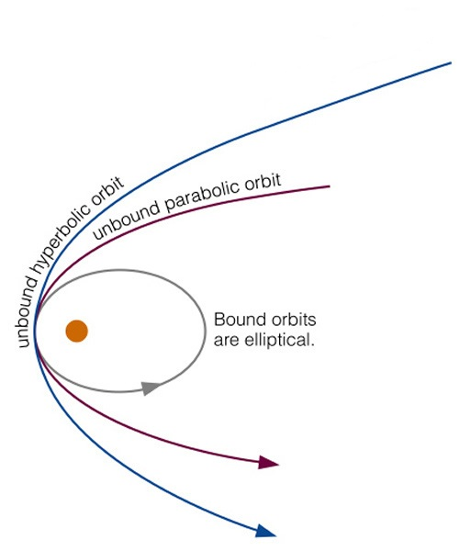
Parabolic approximation (Quinlan & Shapiro 1989)
Due to the difficulties in finding the marginally capturing orbit
Hyperbolic orbit has similar paths with parabolic orbit around the pericenter where most GWs are radiated.
Assumption: GW radiation from hyperbolic orbit is the same with that from parabolic orbit.
The orbital energy of marginally capturing hyperbolic orbit can be obtained from parabolic orbit.
e.g.) ΔE=0.01 in parabolic orbit → hyperbolic orbit with orbital E=0.01 can be captured.

Slide 8
Critical impact parameter
$$v_{∞}$$
Orbital energy & angular momentum
$E=\frac{1}{2}μ{v_{∞}}^{2}, L=bμv_{∞}$
Critical impact parameter (cross section)
$b=\frac{L}{μv_{∞}}=\frac{L}{2μE}, σ=πb^{2}$
$$b$$
$$σ=πb^{2}$$

Slide 9
Approach to GR capture - Newtonian orbit
1. Newtonian orbit + GWs from quadrupole formula
Weak encounter
Point mass, No spin
Time average of energy emission rate of eccentric orbit (Peters 1964)
$\left\langle \frac{dE}{dt}\right\rangle =−\frac{32}{5}\frac{G^{4}{m_{1}}^{2}{m_{2}}^{2}(m_{1}+m_{2}) }{c^{5}a^{5}{(1−e^{2})}^{7/2}}\left(1+\frac{73}{24}e^{2}+\frac{37}{96}e^{4}\right)$

Slide 10
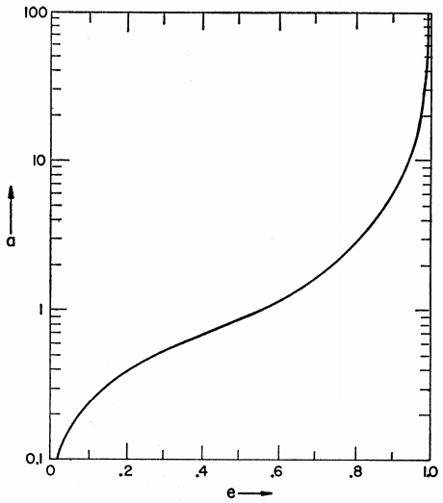
Approach to GR capture - Newtonian orbit
Circularization
$\left\langle \frac{de}{dt}\right\rangle$
=$−\frac{304}{15}e\frac{G^{3}m_{1}m_{2}(m_{1}{+m}_{2})}{c^{5}a^{4}{(1−e^{2})}^{5/2}}\left(1+ \frac{121}{304}e^{2}\right)$
For parabolic orbit (Quinlan & Shapiro 1989),
$∆E=\frac{85πG^{7/2}{m_{1}}^{2}{m_{2}}^{2}{(m_{1}+m_{2})}^{1/2}}{12\sqrt{2}c^{5}{r_{p}}^{7/2}}$
Peters 1964

Slide 11
Approach to GR capture - Post-Newtonian corrected orbit
2. Post-Newtonian equation of motion (Blanchet 2014)
Point mass, spin
e.g.) up to 2.5 PN,
$\frac{dv}{dt}=−\frac{Gm}{r^{2}}\left[\left(1+A\right)n+Bv\right]$

Slide 12
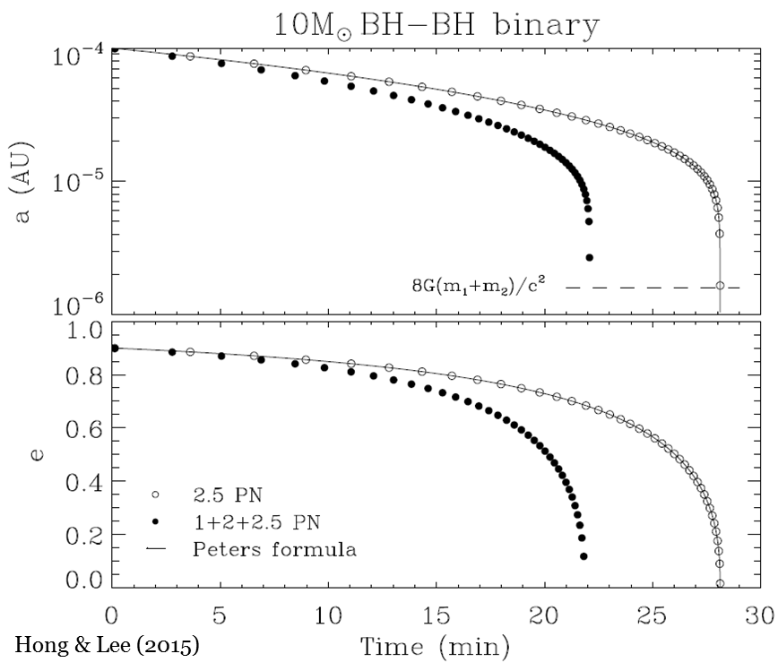
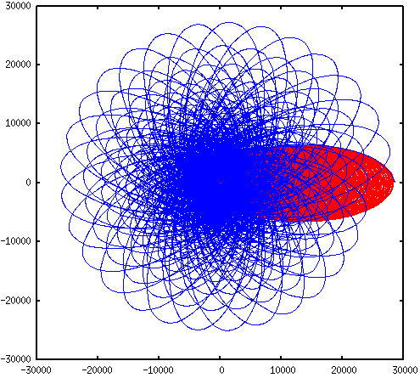
Approach to GR capture - Post-Newtonian corrected orbit

Slide 13
Approach to GR capture
3. Numerical relativity
Numerical solutions of Einstein’s equations
Extended object, spin
Strong encounter, Merger & Ringdown
Expensive

Slide 14
Several features of GR capture

Slide 15
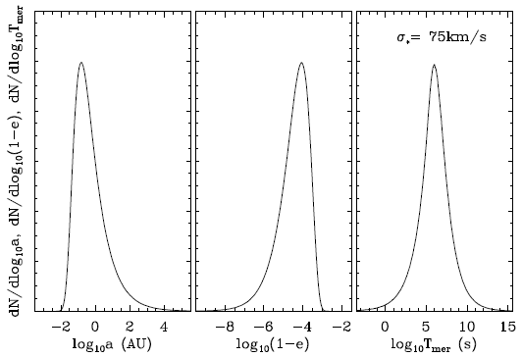
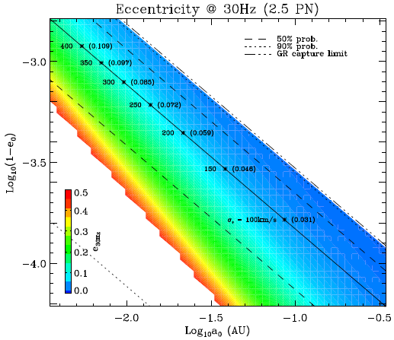
Highly eccentric orbit
Hong & Lee (2015)

Slide 16
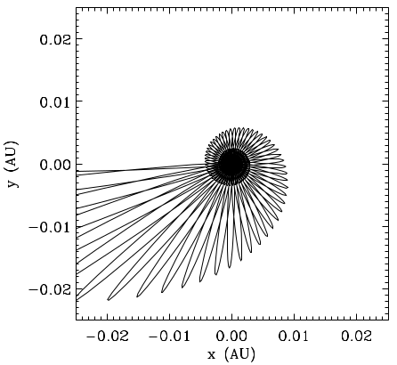
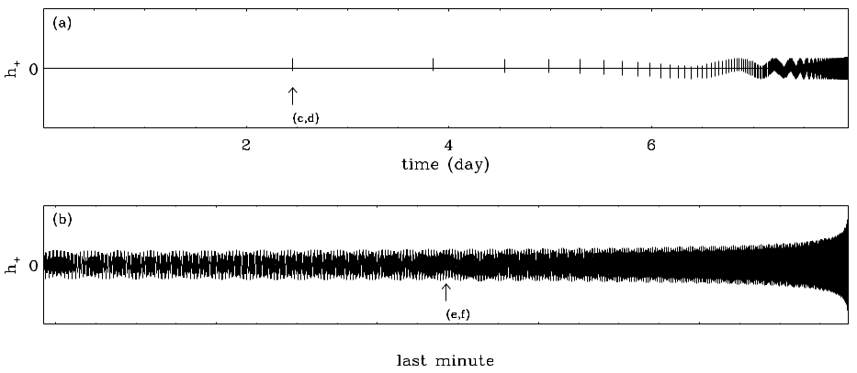
Waveforms
Sporadic burst
Hong & Lee (2015)
a=0.153AU
ecc=0.99989

Slide 17
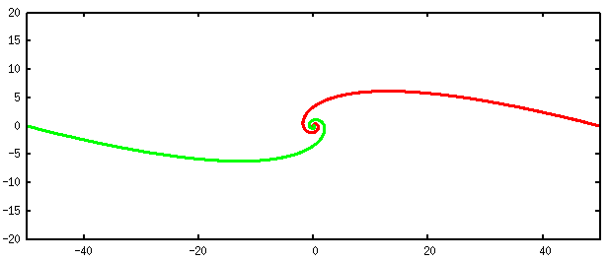
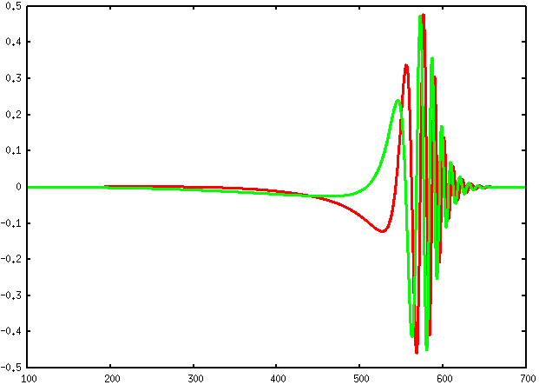
Waveforms
Merger-Ringdown without inspiral

Slide 18
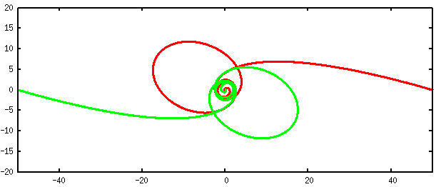
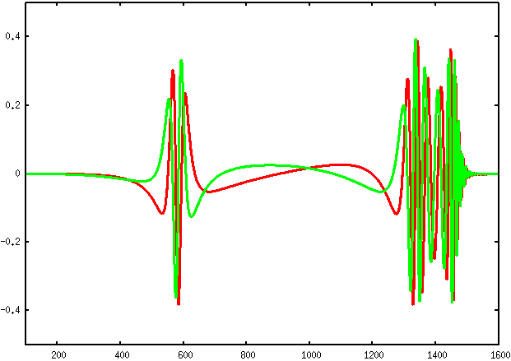
Waveforms
Zoom & whirl orbit

Slide 19
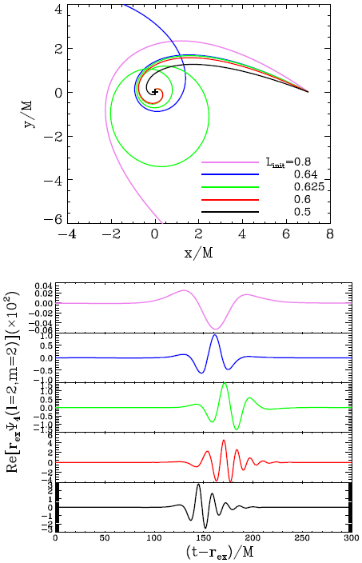
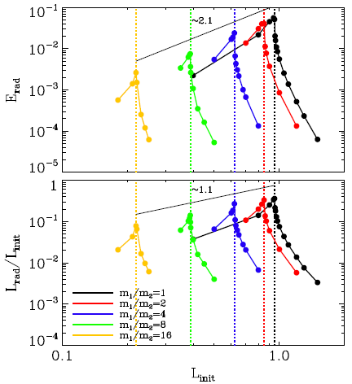
Radiated energy
Bae et al. 2017

Slide 20
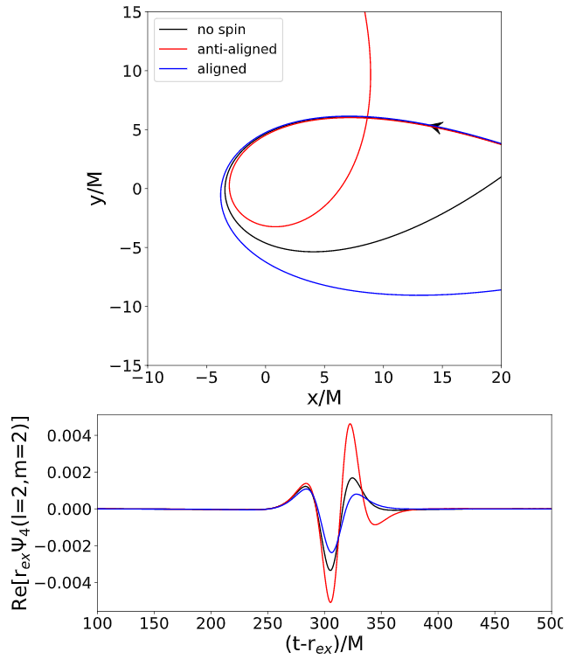
BH spins
More radiations for anti-aligned spin in fly-by orbit
→ larger cross section
Bae et al. (in prep.)

Slide 21
Summary
BBH can be formed by very close encounters with emitting GWs.
Highly eccentric orbit can be formed from GR capture.
Approach to GR capture – parabolic approximation
Newtonian orbit
Post-Newtonian corrected orbit
Numerical relativistic simulation
Highly eccentric Waveforms
Sporadic burst
Merger-ringdown without inspiral
Zoom & whirl orbit

