Slide 1
Semi-inclusive lepton jet function in $SU{\left(2\right)}_{L}$
Taehyun Kwon
in Korea University
with Junegone Chay, Taewook Ha
Arxiv : 2105.06672
PASCOS 2021 15. 06. 2021
Notes:
I’m Taehyun Kwon in Korea university. Today, I’m going to talk about the semi-inclusive lepton jet function in SU(2)_Left

Slide 2
Introduction – Motivation
Let’s consider the world without QCD, where there is only electroweak gauge theory. Then, what happens?
The particles in QCD are always observed as hadrons, that are the color singlet states. However, in the electroweak gauge theory, the particles can be observed as non-singlets. For example, we can observe an electron, not a quark alone.
In the electroweak gauge theory, at high energy, a lot of leptons can be produced by the weak interaction. They make leptonic jets.
How do we describe the leptonic jet? What are the differences between the QCD jet function and the leptonic jet function?

Slide 3
Introduction – Problem Setup
We consider for the 2-jettiness,
$$e^{+}+e^{−} →μ^{+} jet+μ^{−} jet+X$$
Unlike QCD, the leptonic jet can be the non-singlet. We focus on the non-singlet contributions. For simplicity, we will consider only $SU{\left(2\right)}_{L}$.
In the high energy where the masses of all particles are regarded as small, we can use unbroken gauge theory.

Slide 4
2-Jettiness
$$τ=τ_{1}+τ_{2}+τ_{3}+τ_{4}$$
$τ_{i}$ is defined as
$$n_{3}$$
$$τ_{4}$$
where $n_{i}$’s are jet directions.
$$τ_{2}$$
$$τ_{1}$$
$$τ_{3}$$
$τ_{i}$ corresponds to sharpness of the jet.
$$n_{2}$$
$$n_{1}$$
$τ_{i}$ is large.
$τ_{i}$ is small.
$$n_{i}$$
$$n_{i}$$
$$n_{4}$$
We consider this case
with SCET.

Slide 5
SCET
Soft Collinear Effective Theory
$n_{3}$-Collinear
Useful theory to factorize the cross section with 2 modes.
- Collinear mode
- Soft mode
$n_{1}$-Collinear
Soft
Hard
$n_{2}$-Collinear
Modes | Power counting
n-collinear | $$p_{c}=\left(\overline{n}∙p,n∙p,p_{⊥}\right) \\ ≈Q(1,λ^{2},λ)$$
Soft | $$p_{S}≈Q(λ^{2},λ^{2},λ^{2})$$
$n_{4}$-Collinear

Slide 6
SCET factorization for the 2-jettiness
The cross section for the 2-jettiness is written as
$$J_{3}$$
$$\frac{dσ}{dτ}∝\sum_{cdef}{C_{cdef} }δ(τ−(τ_{1}+τ_{2}+τ_{3}+τ_{4}+τ_{S})) \\ ⊗B_{1}^{d}\left(t_{1}=ω_{1} τ_{1}\right)⊗B_{2}^{c}\left(t_{2}=ω_{2} τ_{2}\right) \\ ⊗J_{3}^{e}\left(p_{3}^{2}=ω_{3} τ_{3}\right){⊗J}_{4}^{f}\left(p_{4}^{2}=ω_{4} τ_{4}\right)$$ $⊗H_{JI} S_{IJ}^{cdef}(τ_{S})$,
$$B_{1}$$
S
H
$$B_{2}$$
$$J_{4}$$
where $ω_{i}$ are the large momenta in the light-cone coordinate, $t_{i}$ and $p_{i}^{2}$ are the offshellness of the beams and the jets, respectively.

Slide 7
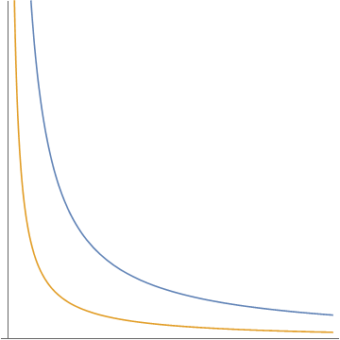
Rapidity divergence
Rapidity divergence
UV divergence
There is rapidity divergence in the region where $n∙p$ (or $\overline{n}∙p$) is infinite, while $n∙p×\overline{n}∙p$ is fixed.
Dimensional regularization cannot handle the rapidity divergence.
We need a new regularization. - Rapidity regulator.
$\overline{n}$-collinear
Ultrasoft
$n$-collinear
Rapidity
divergence
($ν$ is rapidity scale.)

Slide 8
Semi-inclusive lepton jet functions
Singlet
Non-singlet

Slide 9
At order $α$
Singlet
Non-singlet
Sudakov double logarithm
$ν$ dependence

Slide 10
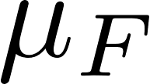
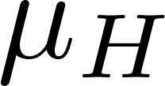
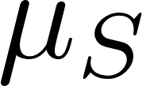
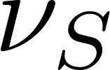
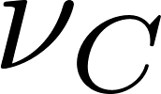
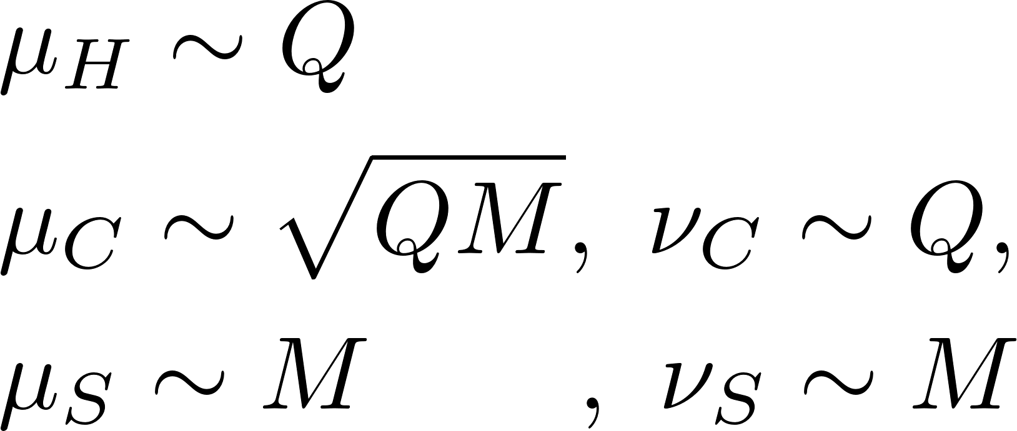
The resummation of the large logarithm
$$σ∝H_{JI}\left(μ_{F}\right)⊗B_{1}^{d}\left(μ_{F},ν_{F}\right)⊗B_{2}^{c}\left(μ_{F},ν_{F}\right)⊗J_{3}^{e}\left(μ_{F},ν_{F}\right)⊗J_{4}^{f}\left(μ_{F},ν_{F}\right)⊗S_{IJ}^{cdef}\left(μ_{F},ν_{F}\right)$$
All the factorized parts have common scales $μ_{F}$ and $ν_{F}$, which can make the logarithms large in some of the parts.
We have to resum the logarithm by evolving each part.

Slide 11
Renormalization Group Equation (RGE)
Singlet
Cusp.
Non-Cusp.
where
Non-singlet

Slide 12
The solutions of RGE for singlet
Singlet
Note that

Slide 13
The solutions of RGE for non-singlet
Non-singlet
The evolution is path-independent by the following relation.
Note that

Slide 14
Conclusion
The leptonic jets including a lepton are described by semi-inclusive lepton jet functions.
In contrast to the QCD jet function for the jettiness, the non-singlet semi-inclusive lepton jet function has the rapidity divergence that is handled by the rapidity regulator, not the dimensional regularization.
Because of the rapidity divergence, the non-singlet semi-inclusive jet function is evolved with respect to the two scales, $μ$ and $ν$, while the singlet is evolved with respect to only $μ$.
What we have done. - Calculation of the other factorized parts. - Confirmation that cross-section is independent of $μ$ and $ν$.

Slide 15
Backup

Slide 16
Conclusion
The leptonic jets including a lepton are described by semi-inclusive lepton jet functions.
In contrast to the QCD jet function for the jettiness, the non-singlet semi-inclusive lepton jet function has the rapidity divergence that is handled by the rapidity regulator, not the dimensional regularization.
Because of the rapidity divergence, the non-singlet semi-inclusive jet function is evolved with respect to the two scales, $μ$ and $ν$, while the singlet is evolved with respect to the one, $μ$.
What to do next. - Extension to $SU{\left(2\right)}_{L}×U(1)$ gauge theory for studying real world. - Matching the unbroken theory to the broken theory. - Other analysis ($P_{T}$-mearsurement, sub-jet structure, etc..)

Slide 17
Introduction – Motivation
The particles in QCD are confined. Let’s consider the imaginary world where any particle is not confined. We can think QCD with non-singlet free particles, but for simplicity, Let’s consider the world without QCD.
In the imaginary world without QCD, at high energy, a lot of leptons can be produced by the weak interactions. They make leptonic jets.
The particles in the QCD jets must be the color singlets while the particles in the leptonic jets can be the non-singlets.

Slide 18
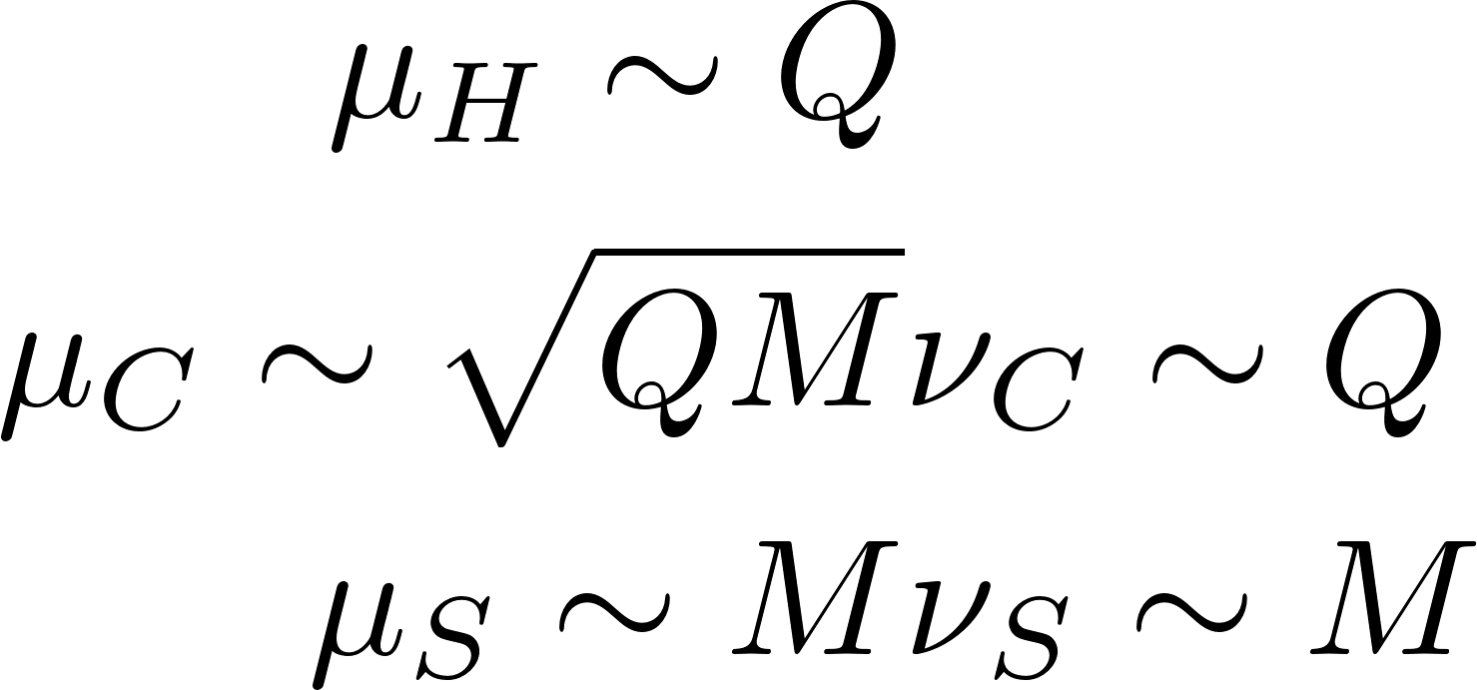
The common scales
$σ∝H_{JI}\left(μ_{F}\right) B_{1}^{d}\left(μ_{F},ν_{F}\right) B_{2}^{c}\left(μ_{F},ν_{F}\right) J_{3}^{e}\left(μ_{F},ν_{F}\right) J_{4}^{f}\left(μ_{F},ν_{F}\right) S_{IJ}^{cdef}(μ_{F},ν_{F}$)

