Slide 1
Superheavy Dark Matter from String Theory
Rouzbeh Allahverdi
PASCOS 2021
IBS, Center for Theoretical Physics of the Universe
June 14-18, 2021
Based on:
R.A., Broeckel, Cicoli, Osinski JHEP 1810, 02, 026 (2021)

Slide 2
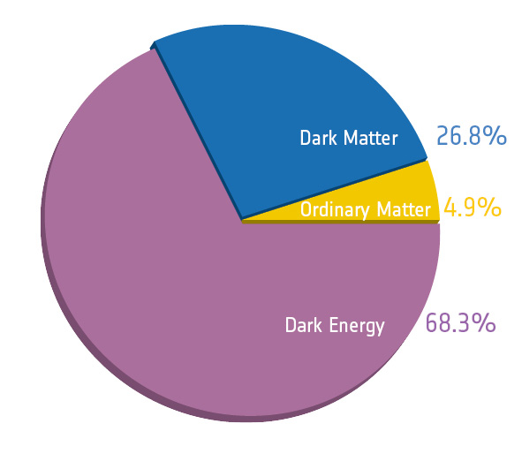
Introduction:
The present universe according to observations:
BSM needed to explain 95% of the universe.
Important questions about DM:
What is the identity of DM?
How did it acquire its relic abundance?
Profound consequences for:
Particle Physics (BSM)
Cosmology (thermal history)
String constructions provide a UV complete description of the early
universe (inflation to BBN), as well as BSM.

Slide 3
Type IIB flux compactifications typically predict:
$H_{inf}≾m_{3/2}$
Obtaining the correct amplitude for density perturbations results in:
$H_{inf}∼{10}^{10}−{10}^{11} GeV$
How to reconcile this with low-energy SUSY ?
$$m_{soft}∼O(TeV)$$
(1)
KKLT with two exponents (as in the racetrack model) → tuned situation
(2)
Sequestered LVS → very specific brane configurations and Kahler metric
$H_{inf}≫ m_{3/2}$
$$m_{soft}∼O(TeV)$$
Kallosh, Linde JHEP 12, 004 (2004)
$H_{inf} {≲m}_{3/2} ≫ m_{soft} ∼O(TeV)$
Blumenhagen, Conlon, Krippendorf, Moster, Quevedo JHEP 09, 007 (2009)

Slide 4

Lets consider the more natural case:
$H_{inf}≲ m_{3/2} m_{soft}≫O(TeV)$
This will result in thermal overproduction of DM.
Griest, Kamionkowski PRL 64, 615 (1990)
But, string constructions generically result in non-standard thermal histories that involve epoch(s) of EMD driven by string moduli.
Kane, Sinha, Watson IJMPD 24, 1530022 (2015)
The entire DM abundance can be directly produced from decay of a modulus :
“Branching scenario”
$φ$
$T_{R}∼{\left(\frac{m_{φ}^{3}}{M_{P}}\right)}^{1/2}$
Gelmini, Gondolo PRD 74, 023510 (2006)
R.A., B. Dutta, Sinha PRD 83, 083502 (2011)

Slide 5
This scenario can be implemented in sequestered LVS, volume modulus plays the role of .
$φ$
R.A., Cicoli, B. Dutta, Sinha PRD 88, 095015 (2013)
However, the simplest realization does not work for superheavy DM:
(1)
(2) decay produces an excess of DR.
$${Br}_{χ}≳O({10}^{−3})⇒\frac{n_{χ}}{s}≫{\left(\frac{n_{χ}}{s}\right)}_{obs}≃4.2×{10}^{−10}\left(\frac{1 GeV}{m_{χ}}\right)$$
$φ$
R.A., Cicoli, B. Dutta, Sinha JCAP 10, 004 (2014)
The “branching scenario” should be modified in this case so that it:
(1) Gives rise to a sufficiently small DM relic density.
(2) Does not produce an excessive amount of DR.
R.A., Broeckel, Cicoli, Osinski JHEP 02, 026 (2021)

Slide 6
The Scenario:
$$σ:$$
inflaton
$φ$:
modulus
$$m_{σ}>m_{χ}>m_{φ}$$
Post-inflationary thermal history:
(1) : EMD from inflaton oscillations. Inflaton decay
produces DR and a subdominant component of DM.
$$Γ_{σ}≲H<H_{inf}$$
(2) : Inflationary reheating completes, transition to RD.
$$H_{D}≲H<Γ_{σ}$$
(3) : EMD driven by modulus oscillations. Entropy
generation at the end of this stage dilutes DR and DM from (1).
$$Γ_{φ}≲H<H_{D}$$
(4) : Modulus decay completes. Transition to RD prior to
the onset of BBN by modulus oscillations.
$$Γ_{φ}≲H<H_{D}$$

Slide 7
: final reheating temperature
Note:
Expected: a longer EMD epoch results in a larger dilution factor.
$$Y_{φ}↑ ⇒ \frac{n_{χ}}{s}↓ , \frac{ρ_{DR}}{ρ_{R}}↓$$

Slide 8

EMD also affects inflationary observables:
$r$:
tensor-to-scalar ratio
The scalar spectral index follows:
In our model (also for Starobinsky model & Higgs inflation):
$a=2$
$$Y_{φ}↑ ⇒ N_{e}↓ , n_{s,min}↓$$
$$\frac{n_{χ}}{s}$$
Opposite constraints from and on the duration of EMD.
$$n_{s}$$

Slide 9
The Model:
Type IIB model with three Kahler moduli:
Mass spectrum:

Slide 10
$$⟶$$
DM is the LSP
MSSM-like hidden sector:
(1) .
(2) R-parity violation.
(3) Very light hidden electrons (similar to visible sector neutrinos).
$${Λ_{QCD}^{hid}≫Λ}_{QCD}$$
Couplings:

Slide 11
Giudice-Masiero contribution:
$$N_{g}^{hid}=12$$

Slide 12
Inflationary observables:
Obtaining the right density perturbations gives the following relation:

Slide 13
Results:
We impose the requirement from density perturbations, and find the
DM mass that corresponds to the observed abundance.
We perform this over the expected range of parameters (1444 points):
$$W_{0}∈[1,{10}^{3}]$$
$$g_{s}∈[{10}^{−3},0.1]$$
$$λ∈[10,{10}^{4}]$$
$$Y_{φ}∈[0.01,1]$$
Cicoli, K. Dutta, Maharana, Quevedo JCAP 08, 006 (2016)
72% of the parameter set gives rise to the correct DM abundance.
The resulting DM mass is always in the following range:
$m_{χ}∼{10}^{10}−{10}^{11} GeV$

Slide 14
Points that yield the correct density perturbations and DM abundance:
$$\frac{n_{χ}}{s}∝Y_{φ}^{−2}{ g_{s}^{−21/8} V}^{−13/4}$$

Slide 15
Subsets according to Subsets according to
$g_{s }: Y_{φ}$:

Slide 16
Black:
Red:
$n_{s} in the 2σ range$
$$0.9565<n_{s}<0.9733$$
$$0.9523<n_{s}<0.9775$$
$n_{s} in the 3σ range$
$(but outside 2σ$)
Planck 2018 Astron. Astrophys. 641, A10 (2020)

Slide 17
Numerical Analysis:
System of Boltzmann equations governing various species:
Benchmark point to numerically solve this system:

Slide 18
Evolution of the various energy densities:
Evolution of the visible sector temperature:

Slide 19
Conclusions:
Superheavy DM can arise typically within string theory
Epoch(s) of EMD from moduli can yield the observed DM abundance
Presented a type IIB LVS model with an epoch of modulus domination
Successful inflation & right DM content for
Multiple epochs of modulus domination possible, not advantageous
$m_{χ}∼{10}^{10}−{10}^{11} GeV$
Possible indirect detection signal from decaying superheavy DM
Work in progress

