Slide 1
Simulation for Nuclear Physics Experiments: based on Geant4 and NPTool
NIC School 2023
11 September 2023
Jongwon Hwang
Center for Exotic Nuclear Studies
Institute for Basic Science

Slide 2
Outline
Simulation for Nuclear Physics Experiments
Basic concepts and definitions
Practices using the Geant4 – NPTool
Practice 1: Proton elastic scattering on the ²⁰⁸Pb target
Practice 2: Simulation of gamma-ray spectroscopy

Slide 3
Basic concepts and definitions

Slide 4
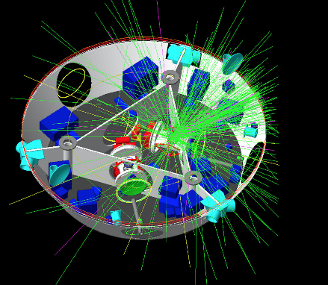
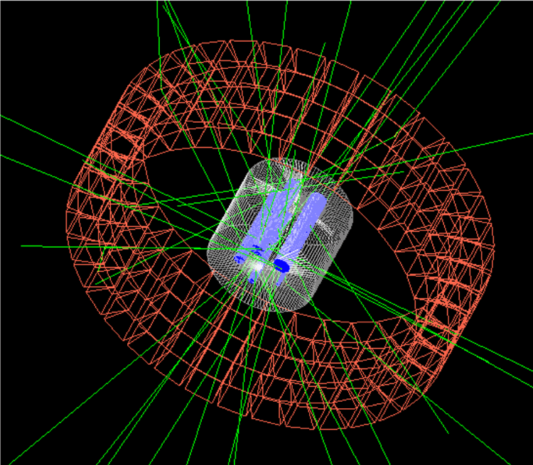
Geant4
Geant4 is a toolkit to create simulations of the passage of particles or radiation through matter. Applications built on Geant4 can simulate any setup or detector and radiation source, and record chosen output of physical quantities due to source particles and secondaries interacting with the material of the setup. (cited from Geant4 homepage)
Scientific libraries based on C++ to enable simulations of particle physics, nuclear physics experiment
A software library: a pre-compiled binary containing useful resources such as classes, subroutines and functions → users can make their own program utilizing the resources.
Open source → It is freely available for everyone. It can be modified and redistributed if necessary.

Slide 5
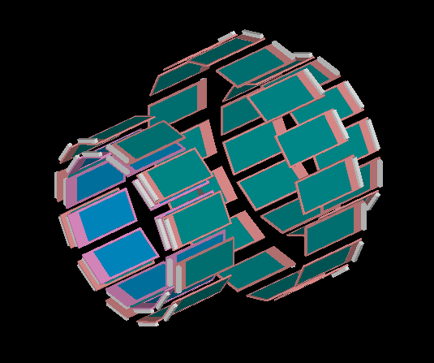
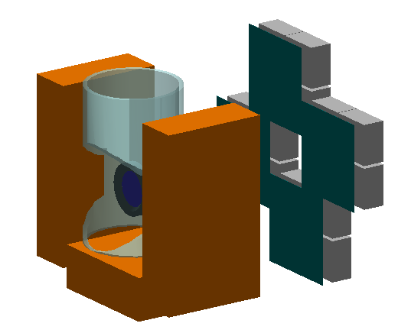
NPTool
NPTool, which stands for Nuclear Physics Tool, is an open source and freely distributed data analysis and Monte Carlo simulation package for low-energy nuclear physics experiments. The NPTool package aims to offer a unified framework for preparing and analysing complex experiments, making an efficient use of Geant4 and ROOT toolkits. (cited from NPTools github)
It is a scientific library running with Geant4 and ROOT libraries for nuclear physics experiment simulations.
It contains many libraries of nuclear reaction process and detector configuration connected with Geant4.
The simulation can be performed by running commands such as npsimulation or npanalysis.
Users can add additional detectors or reactions if necessary.

Slide 6
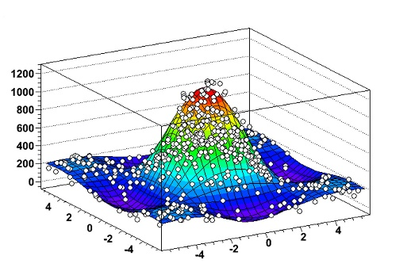
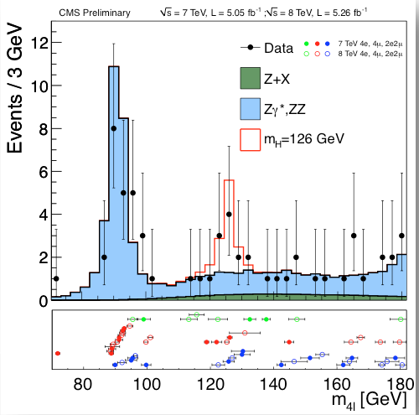
ROOT
ROOT is a framework for data processing, born at CERN, at the heart of the research on high-energy physics. Every day, thousands of physicists use ROOT applications to analyse their data or to perform simulations. (cited from https://root.cern/about/)
Data analysis framework and library based on C++
It provides a data structure, the tree, that is extremely powerful for fast access of huge amounts of data - orders of magnitude faster than accessing a normal file.
It also provides analysis tools and many plots (e.g., graph or histogram)
Geant4, NPTool can save simulation results with ROOT data structure to perform further analysis.

Slide 7
Preparation of tutorials
Installing Docker & How to use Docker

Slide 8
Docker
A platform and a tool that simplifies the process of developing, deploying, and managing applications
Using Container
containerization technology to package an application and its dependencies into a standardized unit
isolated environments that can run consistently across different systems, making it easier to manage and deploy software
Docker simplifies the development and deployment of applications by providing a consistent and reproducible environment.
We will use Docker in our practice!

Slide 9
How to install Docker
Docker website
https://www.docker.com
”Get started”
Download
Check your platform
Windows
Mac
Intel chip
Apple chip
Linux
Guide
“Learn how to install Docker”

Slide 10
How to install Docker: Mac & Linux
Following the guide
Mac: https://docs.docker.com/desktop/install/mac-install/
Linux: https://docs.docker.com/desktop/install/linux-install/
64-bit Ubuntu, Debian, Fedora (maybe, available for other linux platforms?)
Procedures
Check the prerequisites and install them if necessary.
Download the Docker package and install it.
Setup the environments to run Docker if necessary.

Slide 11
How to install Docker: Windows (10, 11)
More complicated than Mac or Linux cases……
WSL2 (Windows Subsystem for Linux) is required.
We will use the WSL 2 backend for Docker.
Now Windows container
Guide
https://docs.docker.com/desktop/install/windows-install/

Slide 12
How to install WSL2 on Windows 10/11
https://learn.microsoft.com/en-us/windows/wsl/install
Search for Command Prompt, right-click the top result, and select the Run as administrator option.
Type the following command to install the WSL on Windows 10 and press Enter:
wsl –install
Restart your computer to finish the WSL installation on Windows 10.
Search for Command Prompt, right-click the top result, and select the Run as administrator option.
wsl --list –online
wsl --install -d Ubuntu-22.04
wsl --update

Slide 13
How to install WSL2 on Windows 10(old)
https://pureinfotech.com/install-windows-subsystem-linux-2-windows-10/
Search for Turn Windows features on or off and click the top result to open the app.
Check the “Windows Subsystem for Linux” option.
Search for PowerShell, right-click the top result, and select the Run as administrator option.
Type the following command to enable the Virtual Machine Platform feature and press Enter:
Enable-WindowsOptionalFeature -Online -FeatureName VirtualMachinePlatform
Then, follow the same procedure as the previous slide.

Slide 14
After installing WSL,
Double-click Docker Desktop Installer.exe to run the installer.
When prompted, ensure the Use WSL 2 instead of Hyper-V option on the Configuration page is selected.
Follow the instructions on the installation wizard to authorize the installer and proceed with the install.
When the installation is successful, select Close to complete the installation process.
If your admin account is different to your user account, you must add the user to the docker-users group. Run Computer Management as an administrator and navigate to Local Users and Groups > Groups > docker-users. Right-click to add the user to the group. Sign out and sign back in for the changes to take effect.

Slide 15
How to use Docker
Run “Docker Desktop”
Let’s use a command-based interface. (Terminal, Command Prompt, etc.)
Check that we can use Docker.
> docker
Get the “Docker image” to be used in this practice.
> docker pull censdaq/nicschool
> docker images
Docker Hub
https://hub.docker.com/r/censdaq/nicschool/tags

Slide 16
How to use Docker: Windows
Run a docker container
> docker run -t -d --ipc=host --net=host -e QT_X11_NO_MITSHM=1 –e DISPLAY=$DISPLAY -v /tmp/.X11-unix:/tmp/.X11-unix:rw –v ~/.Xauthority:/root/.Xauthority --device /dev/dri --privileged=true --name nicschool censdaq/nicschool:latest /bin/bash
Log in the docker container
> docker exec -it nicschool /bin/bash

Slide 17
How to use Docker: Mac
Xquartz setting
Install the latest XQuartz X11 server
Set a XQuartz setting in the terminal to enable GLX (OpenGL)
> defaults write org.xquartz.X11 enable_iglx -bool true
Run XQuartz
Activate the option ‘Allow connections from network clients’ in XQuartz settings
Quit & restart XQuartz (to activate the setting)
Set for GUI display
> xhost + 127.0.0.1
Run a docker container
> docker run -t -d --ipc=host --net=host -e DISPLAY=host.docker.internal:0 --device /dev/dri --privileged=true --name nicschool censdaq/nicschool:latest /bin/bash
Log in the docker container
> docker exec –it nicschool /bin/bash

Slide 18
How to use Docker: Linux
Set for GUI display
> xhost +local:docker
Run a docker container
> docker run -t -d --ipc=host --net=host -e DISPLAY=$DISPLAY -v /tmp/.X11-unix:/tmp/.X11-unix:rw -v ~/.Xauthority:/root/.Xauthority --device /dev/dri --privileged=true --name nicschool censdaq/nicschool /bin/bash
Log in the docker container
> docker exec -it nicschool /bin/bash

Slide 19
Working environment setup
Environment setup and ‘alias’
Run a script
> source nic_setup.sh
Run it at the root directory (“cd /”)
Now, working directory is created (/nic)
You can use the command ‘ncd’ to return to this working directory.
Check that files are created well.
> ls

Slide 20
Check if ROOT is running
ROOT test
Run ROOT: > root
Run a macro file: > .x macros/root_test.C
Check if ROOT shows any output.
Quit ROOT: > .q
Open the macro file.

Slide 21
Check if NPTool is running
NPTool test
GUI mode: > npsimulation –D detectors/DALI.det –E sources/gamma.src
Check if NPTool shows any output.
Control view point (might be slow)
Run a simulation
One event only: /run/beamOn 1
Several events: /run/beamOn 100
Quit
Batch mode: > npsimulation –D detectors/DALI.det –E sources/gamma.src -B batch.mac –O test.root
Check if NPTool shows any output.
Open the batch.mac file: > gedit batch.mac
Open the test.root file: > root root/simulation/test.root

Slide 22
Open a file in Linux
Using the gedit
> gedit (filename)
Using emacs, vi and vim

Slide 23
Practice 1
STARK

Slide 24
Practice: setup check
Run the simulation
Run the practice #1 script in a terminal
> ./practice1.sh 0
STARK:
Silicon Telescope Array for Reaction studies for inverse Kinematics

Slide 25
Practice: normal kinematics
Run the simulation
Run the practice #1 script in a terminal
> ./practice1.sh 1
Check the result
Run the ROOT: > root
Run the ROOT macro
> .L macros/elastic.C
> normal()

Slide 26
Practice: inverse kinematics
Run the simulation
Run the practice #1 script in a terminal
> ./practice1.sh 2
Check the result
Run the ROOT: > root
Run the ROOT macro
> .L macros/elastic.C
> inverse()
Compare it with previous result.
> normal()

Slide 27
Practice 2
Gamma-ray spectroscopy

Slide 28
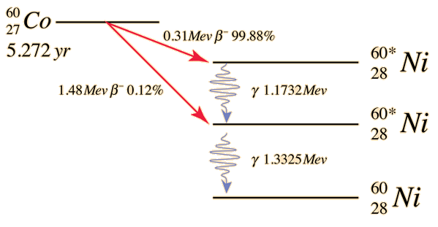
Practice: “At-rest” spectroscopy
Gamma-ray spectroscopy to simulate.
Simulation configuration
Two gamma-rays from ⁶⁰Ni
1.33 MeV, 1.17 MeV
Measurements of the gamma-rays using the DALI2 detector array
DALI2: a gamma-ray detector array at RIKEN, consisting more than 200 NaI:Tl crystals.
At-rest: a decay of ⁶⁰Ni happened at rest.

Slide 29
Practice: setup check
Run the simulation
Run the practice #2 in a terminal
> ./practice2.sh 0
DALI2

Slide 30
Practice: At-rest
Run the simulation
Run the practice #2 in a terminal
> ./practice2.sh 1
Check the result
Run the ROOT : > root
Run the ROOT macro
> .L macros/gamma.C
> atrest()

Slide 31
Homework #1
https://www.nature.com/articles/nature09048
Produce kinematics curves of ¹³²Sn(d,p)¹³³Sn in inverse kinematics for
Produce kinematics curves of ¹³²Sn(d,p)¹³³Sn in normal kinematics for
the ground state
the 854-keV state
the 1363-keV state
the 2005-keV state
Plot two results in the same graph and explain the differences.
the ground state
the 854-keV state
the 1363-keV state
the 2005-keV state

Slide 32
Homework #2
Produce kinematics curves of ¹⁹O(d,p)²⁰O in inverse kinematics for
the ground state
the 1.67-MeV state
the 3.57-MeV state
the 4.07-MeV state
Search previous experimental studies of ¹⁹O(d,p)²⁰O in normal/inverse kinematics and compare it with your result.

Slide 33
Homework #3
Search levels of ²⁹Mg from NNDC and produce kinematics curves of ²⁸Mg(d,p)²⁹Mg in inverse kinematics.
Search levels of ³¹Mg from NNDC and produce kinematics curves of ³⁰Mg(d,p)³¹Mg in inverse kinematics.
Reference: P. T. MacGregor et al. Phys. Rev. C 104, L051301

