Slide 1
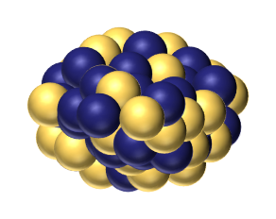
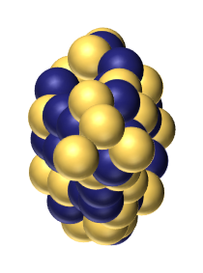


Determination of Prolate or Oblate Shape
via Low-energy α Inelastic Scattering
S. Watanabe^{A,B}, Y. Suzuki^{C}, M. Kimura^{B}, K. Ogata^{D,C}
NIT, Gifu Coll.^{A}, RIKEN^{B}, RCNP ^{C}, Kyushu Univ.^{D}
?
$$β_{2}<0$$
$$β_{2}>0$$
2025/05/29
The 29th International Nuclear Physics Conference
DCC, Deajeon, Korea

Slide 2
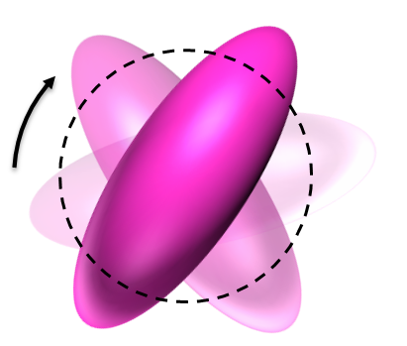


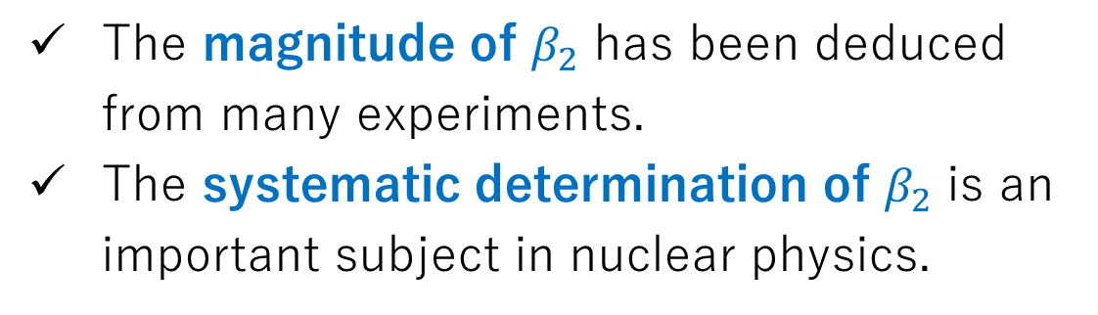





Nuclear Deformation and its Determination
$$4_{1}^{+}$$
The magnitude of $β_{2}$ has been deduced from many experiments.
The systematic determination of $β_{2}$ is an important subject in nuclear physics.
rotation
$$2_{1}^{+}$$
$$E2$$
$$0_{gs}^{+}$$
Examples:
B(E2): S. Raman et al., Atomic Data and Nuclear Data Tables 78, 1 (2001).
σ(inel): T. Motobayashi, Phys. Lett. B 346, 9 (1995).
σ(reac): M. Takechi et al., Phys. Rev. C 90, 061305 (2014).
Oblate
Prolate
?
Despite the numerous studies on $\left|β_{2}\right|$, the determination of its sign is still a challenging task.
$$β_{2}<0$$
$$β_{2}>0$$

Slide 3
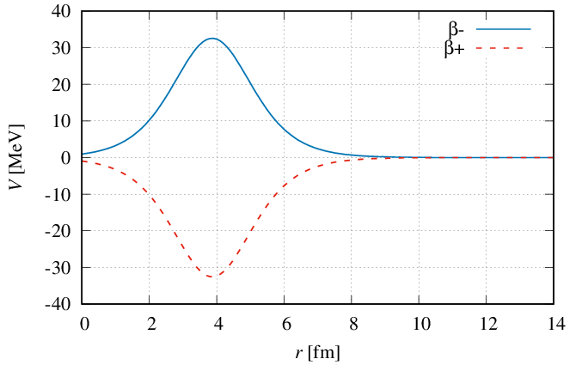







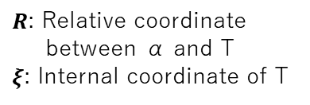
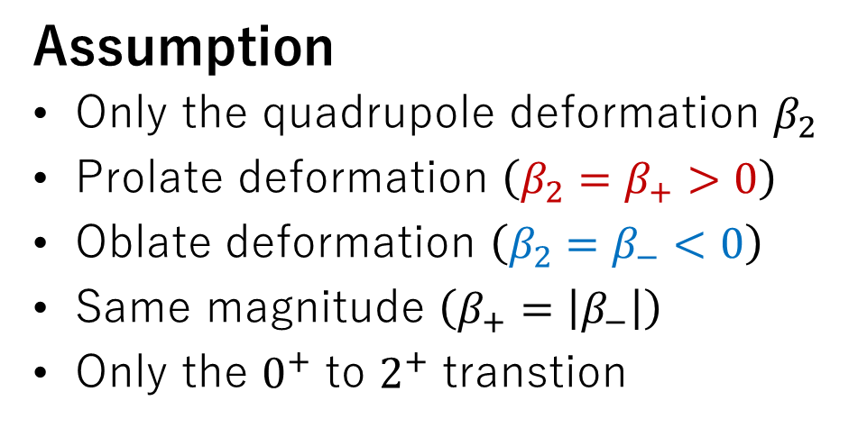




Difficulty in determining the sign of deformation: Case of $σ_{inel}$
Deformed potential between α and T
α
T
$$V\left(R,ξ\right)=U\left(R\right)+W\left(R,ξ\right)$$
$R$: Relative coordinate
between α and T
$ξ$: Internal coordinate of T
$$ξ$$
$$R$$
Example: Deformed Woods-Saxon Potential (1st order)
$U\left(R\right)=\frac{−\left(V_{0}+W_{0}\right)}{1+\exp\left[\frac{R−R_{0}}{a}\right]},$
$$W\left(R,ξ\right)=−β_{2}R_{0}\frac{dU\left(R\right)}{dR}Y_{20}\left(θ^{′}\right)$$
$$\cos{θ^{′}}=\hat{R}⋅ξ$$
Assumption
Only the quadrupole deformation $β_{2}$
Prolate deformation $\left(β_{2}=β_{+}>0\right)$
Oblate deformation $\left(β_{2}=β_{−}<0\right)$
Same magnitude $\left(β_{+}=\left|β_{−}\right|\right)$
Only the $0^{+}$ to $2^{+}$ transtion
Radial part of $W$
$$β_{−}$$
$$−β_{2}R_{0}\frac{dU\left(r\right)}{dr} \left(MeV\right)$$
Opposite phase
$$β_{+}$$
$$R \left(fm\right)$$

Slide 4
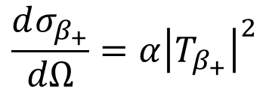
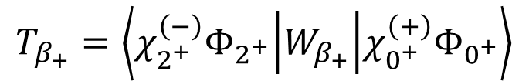
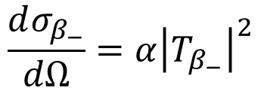
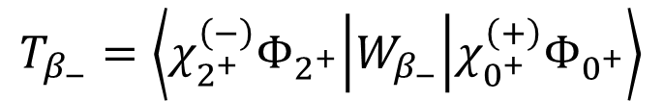
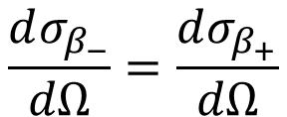
Difficulty in determining the sign of deformation: Case of $σ_{inel}$
Deformed potential between α and T
α
T
$$V\left(R,ξ\right)=U\left(R\right)+W\left(R,ξ\right)$$
$R$: Relative coordinate
between α and T
$ξ$: Internal coordinate of T
$$ξ$$
$$R$$
Example: Deformed Woods-Saxon Potential (1st order)
$U\left(R\right)=\frac{−\left(V_{0}+W_{0}\right)}{1+\exp\left[\frac{R−R_{0}}{a}\right]},$
$$W\left(R,ξ\right)=−β_{2}R_{0}\frac{dU\left(R\right)}{dR}Y_{20}\left(θ^{′}\right)$$
$$\cos{θ^{′}}=\hat{R}⋅ξ$$
Inelastic T-matrix elements for $β_{±}$ in DWBA
DWBA: Distorted wave
Born Approximation
$$T_{β_{−}}=\left\langle χ_{2^{+}}^{\left(−\right)}Φ_{2^{+}} | W_{β_{−}} | χ_{0^{+}}^{\left(+\right)}Φ_{0^{+}}\right\rangle$$
$$\frac{dσ_{β_{−}}}{dΩ}=α{\left|T_{β_{−}}\right|}^{2}$$
Opposite phase
$$\frac{dσ_{β_{−}}}{dΩ}=\frac{dσ_{β_{+}}}{dΩ}$$
Identical
Identical
$$T_{β_{+}}=\left\langle χ_{2^{+}}^{\left(−\right)}Φ_{2^{+}} | W_{β_{+}} | χ_{0^{+}}^{\left(+\right)}Φ_{0^{+}}\right\rangle$$
$$\frac{dσ_{β_{+}}}{dΩ}=α{\left|T_{β_{+}}\right|}^{2}$$
Impossible to distinguish between $β_{+}$ and $β_{−}$ in DWBA.

Slide 5

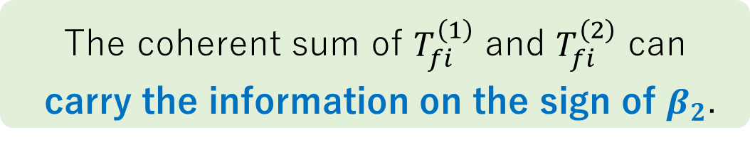






Reorientation Effect and Distorted-Wave Born Series
Distorted-Wave Born Series
(Exact inelastic T matrix)
$$T_{fi}\left(β_{2}\right)=T_{fi}^{\left(1\right)}\left(β_{2}\right)+T_{fi}^{\left(2\right)}\left(β_{2}^{2}\right)+⋯$$
Reorientation effect (RE):
Self-coupling effect of excited states
$$T_{fi}^{\left(1\right)}\left(β_{2}\right)=\left\langle χ_{f}^{\left(−\right)}ψ_{f} | W | χ_{i}^{\left(+\right)}ψ_{i}\right\rangle$$
$$T_{fi}^{\left(1\right)}\left(β_{−}\right)=−T_{fi}^{\left(1\right)}\left(β_{+}\right)$$
Reorientation
$$T_{fi}^{\left(2\right)}\left(β_{2}^{2}\right)=\left\langle χ_{f}^{\left(−\right)}ψ_{f} | W{\tilde{G}}^{\left(+\right)}W | χ_{i}^{\left(+\right)}ψ_{i}\right\rangle$$
$$T_{fi}^{\left(2\right)}\left(β_{−}^{2}\right)=+T_{fi}^{\left(2\right)}\left(β_{+}^{2}\right)$$
2⁺
${\tilde{G}}^{\left(+\right)}={\left(E−K−U−h_{ξ}+iε\right)}^{−1}$: Distorted-wave Green’s function
Independent of $β_{2}$
$$\left(M_{I}=−2,−1,0,1,2\right)$$
0⁺
The coherent sum of $T_{fi}^{\left(1\right)}$ and $T_{fi}^{\left(2\right)}$ can
carry the information on the sign of $β_{2}$.
$$\left(M_{I}=0\right)$$

Slide 6
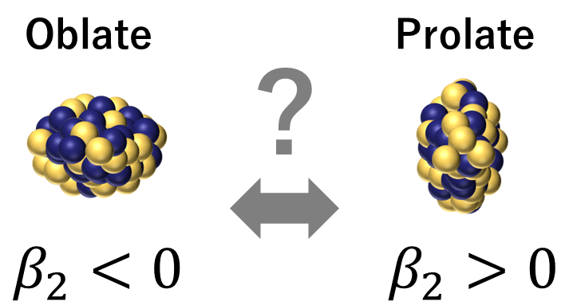
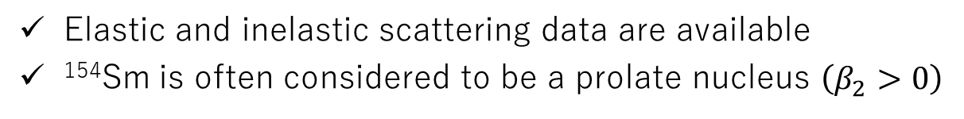


Purpose and Method
Purpose
We propose a method for determining the sign of quadrupole deformation using αinelastic scattering and demonstrate its effectiveness.
Method
Standard coupled-channel method based on the macroscopic model
α inelastic scattering data
Well established
theoretically and experimentally
α
¹⁵⁴Sm
Example: α+¹⁵⁴Sm at 50 MeV
$$ξ$$
Elastic and inelastic scattering data are available
¹⁵⁴Sm is often considered to be a prolate nucleus $\left(β_{2}>0\right)$
$$R$$

Slide 7


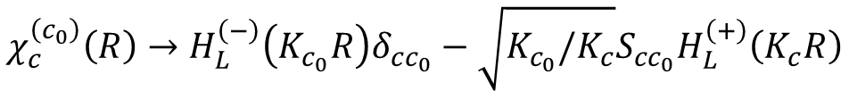
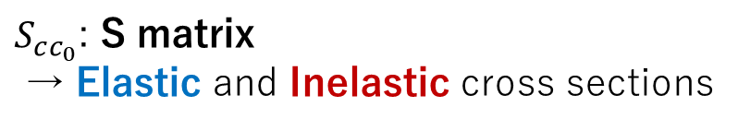
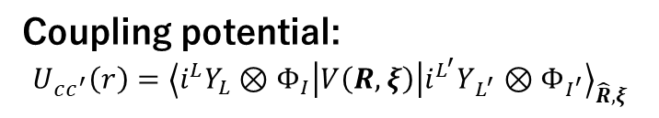
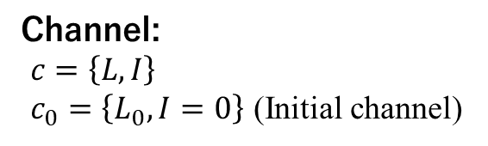
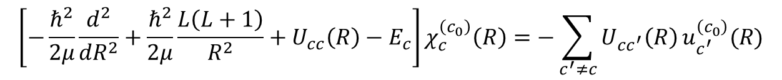

Coupled-channel method based on the macroscopic model
Schrödinger equation
α
¹⁵⁴Sm
$$ξ$$
$$\left[K_{R}+V\left(R,ξ\right)+h_{ξ}−E\right]Ψ_{JM}\left(R,ξ\right)=0$$
$$R$$
Total wave function
$$I=0 or 2$$
$$Ψ_{JM}^{\left(c_{0}\right)}\left(R,ξ\right)=\frac{χ_{L0}^{\left(c_{0}\right)}\left(R\right)}{R}{\left[i^{L}Y_{L}\left(\hat{R}\right)⊗Φ_{0}\left(ξ\right)\right]}_{JM}+\frac{χ_{L^{′}2}^{\left(c_{0}\right)}\left(R\right)}{R}{\left[i^{L^{′}}Y_{L^{′}}\left(\hat{R}\right)⊗Φ_{2}\left(ξ\right)\right]}_{JM}+⋯$$
ground state
excited state
Couple-channel equation
Channel:
$c=\left\{L,I\right\}$
$c_{0}=\left\{L_{0},I=0\right\}$ (Initial channel)
$$\left[−\frac{ℏ^{2}}{2μ}\frac{d^{2}}{{dR}^{2}}+\frac{ℏ^{2}}{2μ}\frac{L\left(L+1\right)}{R^{2}}+U_{cc}\left(R\right)−E_{c}\right]χ_{c}^{\left(c_{0}\right)}\left(R\right)=−\sum_{c^{′}≠c}{U_{cc^{′}}\left(R\right)}u_{c^{′}}^{\left(c_{0}\right)}(R)$$
Coupling potential:
$U_{cc^{′}}\left(r\right)={\left\langle i^{L}Y_{L}⊗Φ_{I} | V\left(R,ξ\right) | i^{L^{′}}Y_{L^{′}}⊗Φ_{I^{′}}\right\rangle }_{\hat{R},ξ}$
Boundary condition
$$χ_{c}^{\left(c_{0}\right)}\left(R\right)→H_{L}^{\left(−\right)}\left(K_{c_{0}}R\right)δ_{cc_{0}}−\sqrt{K_{c_{0}}/K_{c}}S_{cc_{0}}H_{L}^{\left(+\right)}\left(K_{c}R\right)$$
$S_{cc_{0}}$: S matrix
→ Elastic and Inelastic cross sections

Slide 8
Determining the sign
of deformation
from experimental data

Slide 9
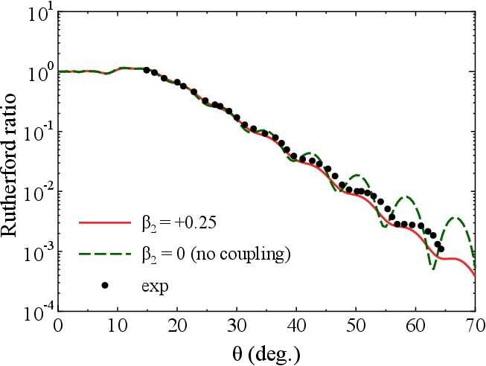
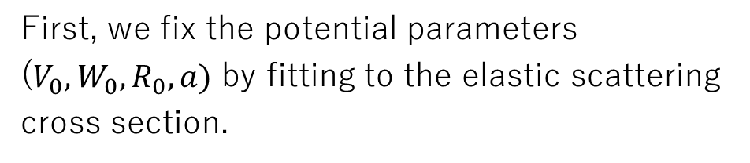
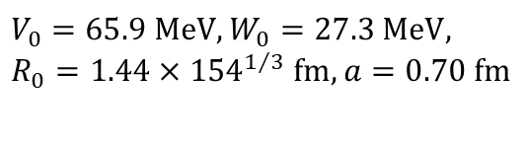
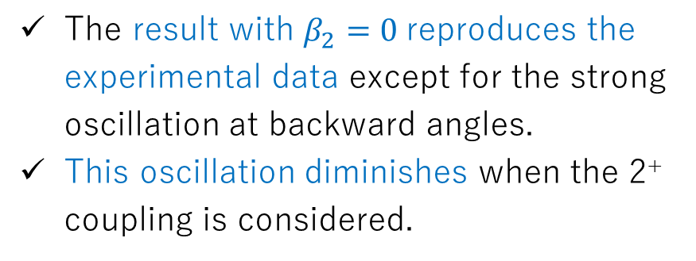
Elastic cross section and the determination of the potential
Elastic scattering cross section
for α+¹⁵⁴Sm at 50 MeV
First, we fix the potential parameters ($V_{0}, W_{0}, R_{0}, a)$ by fitting to the elastic scattering cross section.
$V_{0}=65.9 MeV, W_{0}=27.3 MeV,$
$R_{0}=1.44×{154}^{1/3} fm, a=0.70 fm$
Exp: D. L. Hendrie et al., Phys. Lett. B 26, 127 (1968).
The result with $β_{2}=0$ reproduces the experimental data except for the strong oscillation at backward angles.
This oscillation diminishes when the 2⁺ coupling is considered.

Slide 10
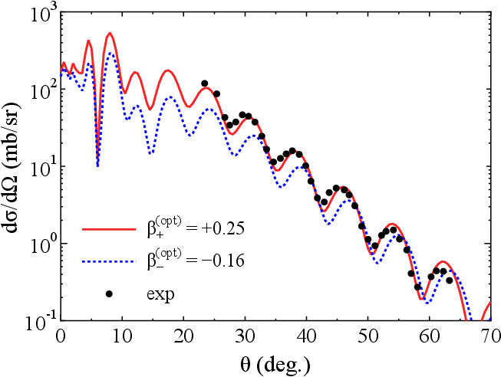

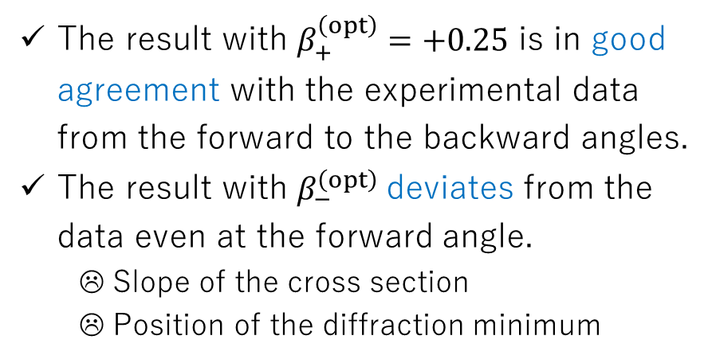
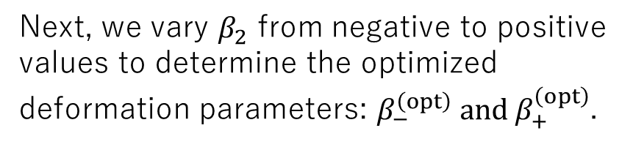
Determining the Sign of $β_{2}$ from the Experimental Data
Next, we vary $β_{2}$ from negative to positive values to determine the optimized deformation parameters: $β_{−}^{\left(opt\right)} and β_{+}^{\left(opt\right)}$.
Inelastic scattering cross section
for α+¹⁵⁴Sm at 50 MeV
The result with $β_{+}^{\left(opt\right)}=+0.25$ is in good agreement with the experimental data from the forward to the backward angles.
The result with $β_{−}^{\left(opt\right)}$deviates from the data even at the forward angle.
☹ Slope of the cross section
☹ Position of the diffraction minimum
Only $β_{+}^{\left(opt\right)}$ can reproduce the data
The sign of deformation can be determined by analyzing the RE in low-energy α inelastic scattering.

Slide 11
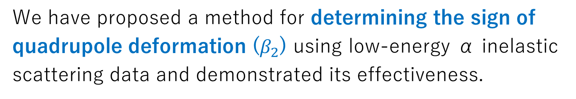
Summary
We have proposed a method for determining the sign of quadrupole deformation ($β_{2}$) using low-energy α inelastic scattering data and demonstrated its effectiveness.
Our approach is the standard coupled-channel method based on the macroscopic model.
We utilize the nuclear reorientation effect as a probe sensitive to the sign of deformation.
We apply this method to the realistic case (α+¹⁵⁴Sm at 50 MeV) and numerically confirm its effectiveness.
The broad applicability of α inelastic scattering will make this approach a powerful tool to study shapes of nuclei, especially unstable nuclei.
S. Watanabe, Y. Suzuki, M. Kimura, and K. Ogata, Phys. Rev. C 110, 034618 (2024).

Slide 13
Numerical demonstration of the reorientation effect

Slide 14
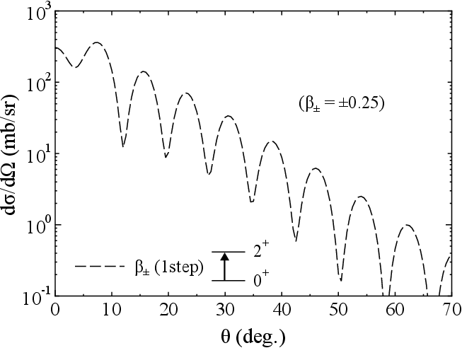
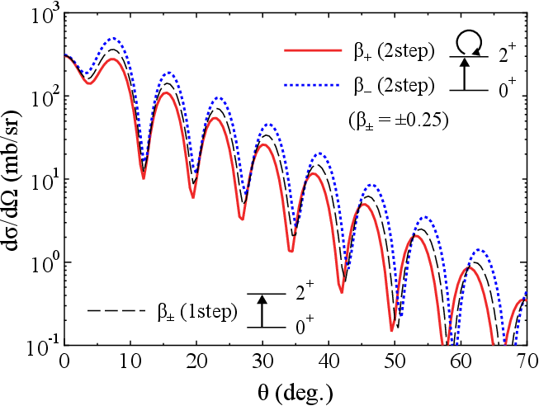
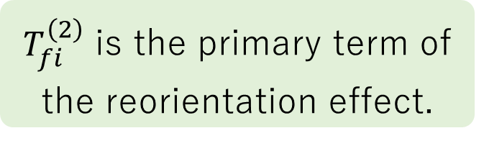
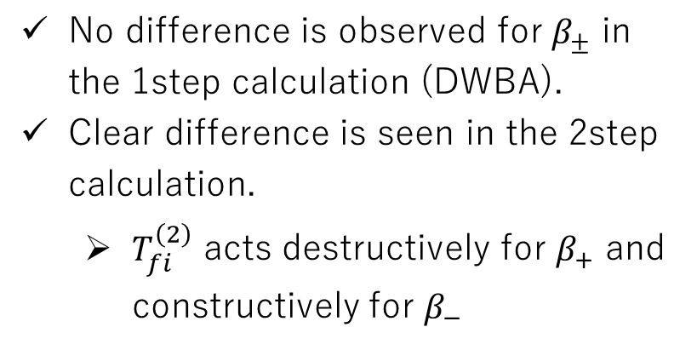

Reorientation Effect: One- and Two-Step Calculations
We will clarify the main part of the RE on the cross section.
Inelastic scattering cross section
for α+¹⁵⁴Sm at 50 MeV
Distorted-Wave Born Series
$$T_{fi}\left(β_{2}\right)=T_{fi}^{\left(1\right)}\left(β_{2}\right)+T_{fi}^{\left(2\right)}\left(β_{2}^{2}\right)+⋯$$
No difference is observed for $β_{±}$ in the 1step calculation (DWBA).
Clear difference is seen in the 2step calculation.
$T_{fi}^{\left(2\right)}$ acts destructively for $β_{+}$ and constructively for $β_{−}$
$T_{fi}^{\left(2\right)}$ is the primary term of the reorientation effect.

Slide 15
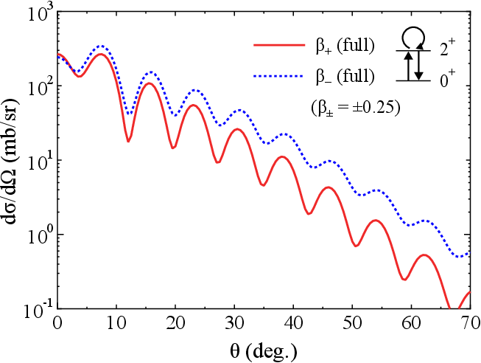
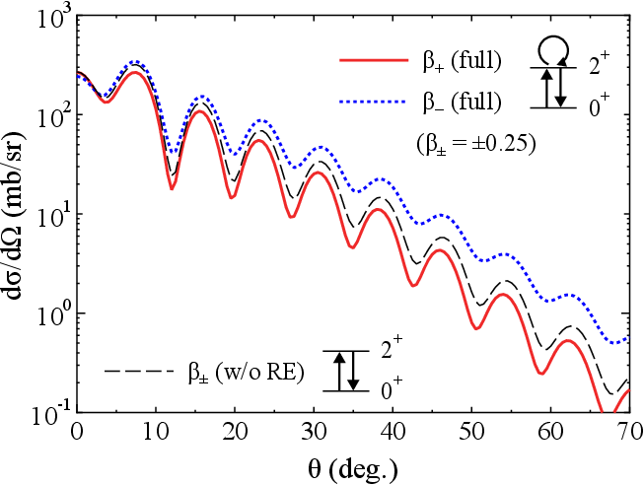
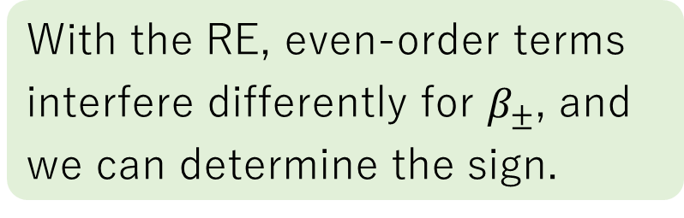

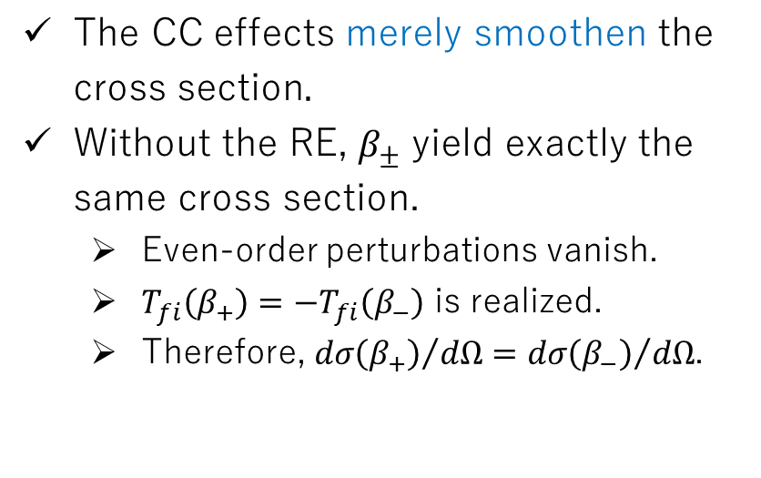
Channel-Coupling Effect and Reorientation
Inelastic scattering cross section
for α+¹⁵⁴Sm at 50 MeV
Distorted-Wave Born Series
$$T_{fi}\left(β_{2}\right)=T_{fi}^{\left(1\right)}\left(β_{2}\right)+T_{fi}^{\left(2\right)}\left(β_{2}^{2}\right)+⋯$$
The CC effects merely smoothen the cross section.
Without the RE, $β_{±}$ yield exactly the same cross section.
Even-order perturbations vanish.
$T_{fi}\left(β_{+}\right)=−T_{fi}\left(β_{−}\right)$ is realized.
Therefore, ${dσ\left(β_{+}\right)}/{dΩ}={dσ\left(β_{−}\right)}/{dΩ}$.
With the RE, even-order terms interfere differently for $β_{±}$, and we can determine the sign.

