Slide 1
Quantum Adiabatic Perturbation Theory
Nicholas Cariello Graduate Research Assistant cariello@frib.msu.edu
30 May 2025

Slide 2
Overview
Motivation
Adiabatic Analysis
Implementation on a Quantum Computer
Conclusion

Slide 3
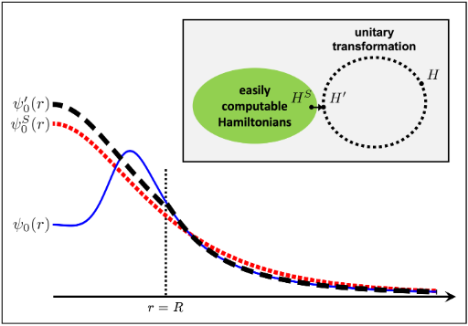
Motivation
Elhatisari, S., Bovermann, L., Ma, YZ. et al. Wavefunction matching for solving quantum many-body problems. Nature 630, 59–63 (2024).

Slide 4

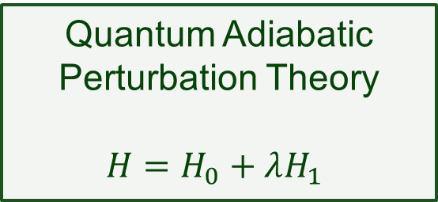
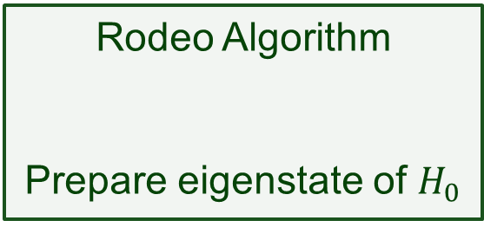
Motivation
Wavefunction Matching
$$H_{difficult}→H$$
Rodeo Algorithm
Prepare eigenstate of $H_{0}$
Quantum Adiabatic Perturbation Theory
$$H=H_{0}+λH_{1}$$
Elhatisari, S., Bovermann, L., Ma, YZ. et al. Wavefunction matching for solving quantum many-body problems. Nature 630, 59–63 (2024).
Choi, Kenneth, et al. "Rodeo algorithm for quantum computing." Physical Review Letters 127.4 (2021): 040505.
Notes:
Lattice EFT does calculations based on perturbative orders. This is a useful application for QAPT.

Slide 5


Adiabatic Theorem
‘A physical system remains in its instantaneous eigenstate if a given perturbation is acting on it slowly enough and if there is a gap between the eigenvalue and the rest of the Hamiltonian’s spectrum.’
Born and Fock (1928)
$$H\left(s\right)= H_{0}+ λf_{k}\left(s\right)H_{1}$$
Reduced Time
$$s=\frac{t}{T}$$
Interpolation Function
k - ‘smoothness’
M. Born and V. A. Fock (1928). "Beweis des Adiabatensatzes". Zeitschrift für Physik A. 51 (3–4): 165–180.

Slide 6

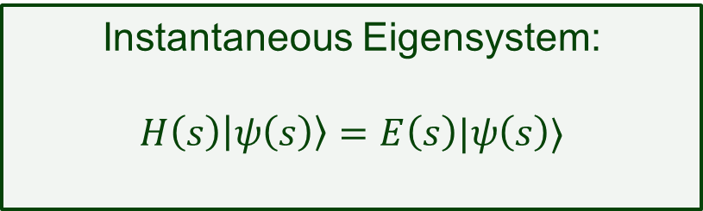
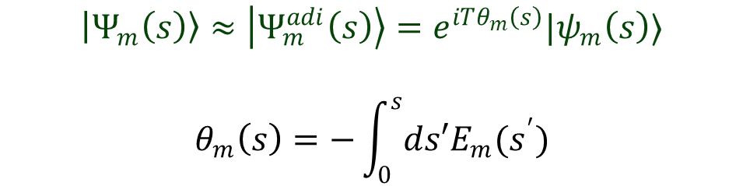


Adiabatic Approximation
$$H\left(1\right)= H_{0}+ λH_{1}$$
$$H\left(s\right)= H_{0}+ λf_{k}\left(s\right)H_{1}$$
$$H\left(0\right)= H_{0}$$
$$\left|Ψ_{m}\left(s\right)\right\rangle ≈\left|Ψ_{m}^{adi}\left(s\right)\right\rangle =e^{iTθ_{m}\left(s\right)}|ψ_{m}\left(s\right)⟩$$
$$θ_{m}\left(s\right)=−\int_{0}^{s}{ds′E_{m}(s^{′})}$$
Instantaneous Eigensystem:
$$H\left(s\right)\left|ψ\left(s\right)\right\rangle =E\left(s\right)|ψ\left(s\right)⟩$$
M. Born and V. A. Fock (1928). "Beweis des Adiabatensatzes". Zeitschrift für Physik A. 51 (3–4): 165–180.
Notes:
The geometric or Berry phase appears for cyclical evolutions. In this case it is 1. Expanding out the phase perturbatively, one sees that the geometric phase vanishes at every order due to the normalization constraints of perturbation theory.
Instantaneous Eigensystem: At every point in time, we define a new orthonormal basis to the inst. Hamiltonian.

Slide 7
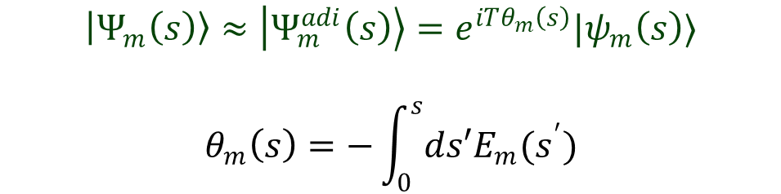


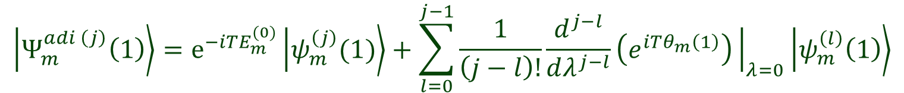

Perturbative Expansion of the Adiabatic Term
$$\left|Ψ_{m}\left(s\right)\right\rangle ≈\left|Ψ_{m}^{adi}\left(s\right)\right\rangle =e^{iTθ_{m}\left(s\right)}|ψ_{m}\left(s\right)⟩$$
$$θ_{m}\left(s\right)=−\int_{0}^{s}{ds′E_{m}(s^{′})}$$
Looking at the $j^{th}$-order perturbative term at the end of the evolution:
$$\left|Ψ_{m}^{adi \left(j\right)}\left(1\right)\right\rangle =e^{−iTE_{m}^{(0)}}\left|ψ_{m}^{\left(j\right)}(1)\right\rangle +\sum_{l=0}^{j−1}{\frac{1}{\left(j−l\right)!}\frac{d^{j−l}}{dλ^{j−l}}\left(e^{iTθ_{m}\left(1\right)}\right){\left.​\right|}_{λ=0}\left|ψ_{m}^{\left(l\right)}\left(1\right)\right\rangle }$$
$j^{th}$-order term of interest
Lower order terms that diverge in $T$
Notes:
Note that the divergences are all proportional to lower order terms AND lower order energy corrections: therefore, this is a method that we solve iteratively one order at a time.
As we take derivatives, energy corrections (and orders of T) will come down from the exponent

Slide 8
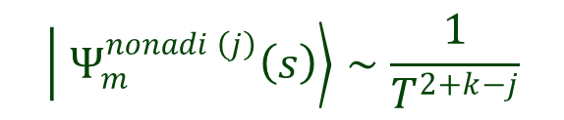

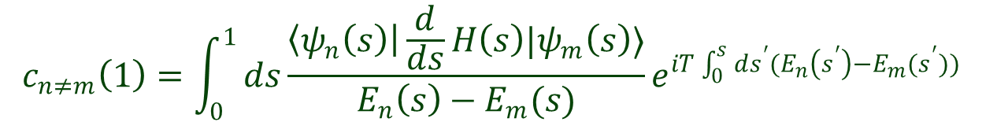
Non-Adiabatic Term
$$\left|Ψ_{m}\left(s\right)\right\rangle =\left|Ψ_{m}^{adi}\left(s\right)\right\rangle +\left|Ψ_{m}^{nonadi}\left(s\right)\right\rangle$$
Probability amplitudes that the final system transitioned into a different state:
$$c_{n≠m}\left(1\right)=\int_{0}^{1}{ds\frac{\left\langle ψ_{n}\left(s\right)\right|\frac{d}{ds}H\left(s\right)|ψ_{m}\left(s\right)⟩}{E_{n}\left(s\right)−E_{m}(s)}}e^{iT\int_{0}^{s}{ds^{′}(E_{n}\left(s^{′}\right)−E_{m}(s^{′}))} }$$
Successive integration by parts yields powers of $T$ in the denominator
$$\left| Ψ_{m}^{nonadi \left(j\right)}\left(s\right)\right\rangle ∼\frac{1}{T^{2+k−j}}$$
Notes:
Full evolution is adi term added to nonadi term.
Probability amplitudes for a transition away from the state of interest.
Integration by parts will put powers of T into denominator. But looking at higher orders j, will add powers of T into numerator.
K is smoothness. Can choose k such that the nonadi error vanishes for large T.

Slide 9
Implementation – Dyson Series
$$H\left(1\right)= H_{0}+ λH_{1}$$
$$H\left(s\right)= H_{0}+ λf_{k}\left(s\right)H_{1}$$
$$H\left(0\right)= H_{0}$$
Solve the time-dependent Schrödinger equation perturbatively:
$$\left|Ψ_{m}\left(s\right)\right\rangle =\left[ 1 −iλT\int_{0}^{1}{ds_{1}V\left(s_{1}\right)}−λ^{2}T^{2}\int_{0}^{1}{\int_{0}^{s_{2}}{ds_{1}ds_{2}V\left(s_{2}\right)V\left(s_{1}\right)+…}}\right] |ψ_{m}^{(0)}⟩$$
$$V\left(s\right)=e^{+iTH_{0}s}f_{k}\left(s\right)H_{1}e^{−iTH_{0}s}$$
Raimes, S. (1972) Many-Electron Theory. North-Holland, Amsterdam.
Notes:
Solve recursively in the interaction picture.
Power of this expansion: it is already expanding in terms of lambda. And the time evolution is only over H_0.
H_1 is inserted j times for j-order. And that’s it.
Evolve H_0 insert H_1 and evolve H_0. repeat for higher orders.
Dyson series has the same divergences as shown in our adiabatic analysis.
If time, go over how you can think of divergences in terms of integrating over f(s).

Slide 10
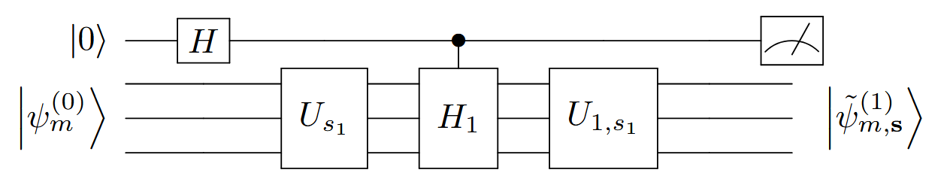
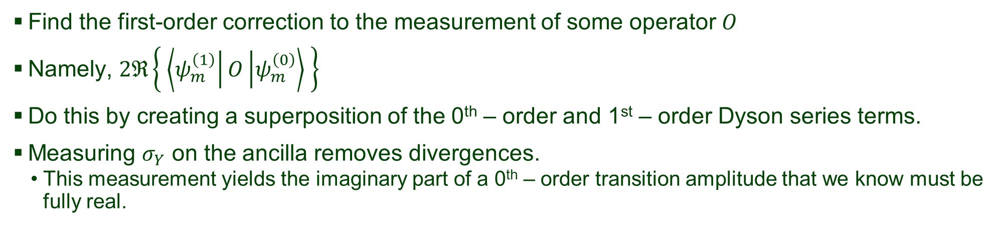
Circuit Schematic
Find the first-order correction to the measurement of some operator $O$
Namely, $2ℜ\left\{ \left\langle ψ_{m}^{\left(1\right)}\right|O\left|ψ_{m}^{\left(0\right)}\right\rangle \right\}$
Do this by creating a superposition of the 0th – order and 1st – order Dyson series terms.
Measuring $σ_{Y}$ on the ancilla removes divergences.
This measurement yields the imaginary part of a 0th – order transition amplitude that we know must be fully real.
Notes:
Show circuit schematic and explain. Maybe do do first order. We get first order for free thru orthogonality in the complex plane
Measure Pauli Y to get the right terms. This is because the Dyson series terms have an –i prefactor. It results in Im <0|O|0> = 0.

Slide 11
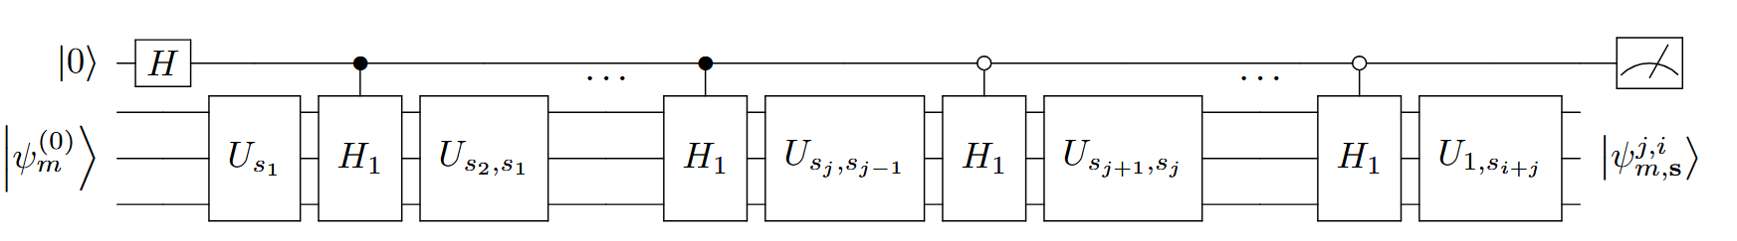
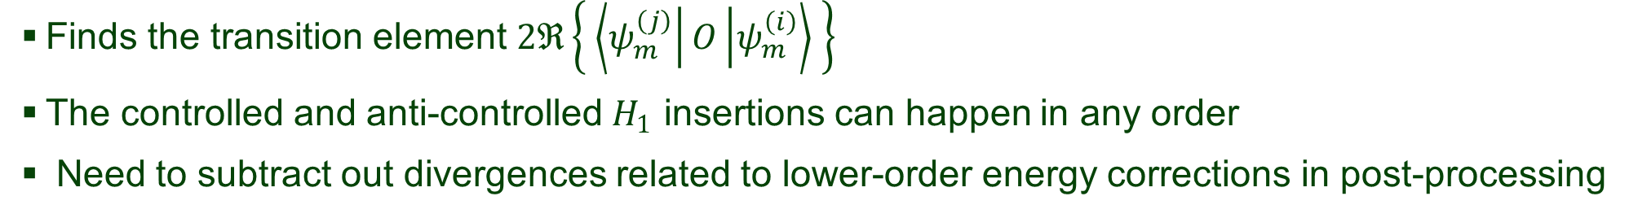
General Circuit Schematic
j controlled insertions
i anti-controlled insertions
Finds the transition element $2ℜ\left\{ \left\langle ψ_{m}^{\left(j\right)}\right|O\left|ψ_{m}^{\left(i\right)}\right\rangle \right\}$
The controlled and anti-controlled $H_{1}$ insertions can happen in any order
Need to subtract out divergences related to lower-order energy corrections in post-processing

Slide 12
Conclusions
Method to find perturbative corrections to a wavefunction using a quantum computer
Able to recursively find higher order corrections
When run in tandem with other methods, this can be a powerful tool to solve large, difficult to simulate Hamiltonians

Slide 13
Acknowledgements
Advisors
Dean Lee
Morten Hjorth-Jensen
Group Members
Danny Jammooa
Patrick Cook
Gabriel Given
This material is based upon work supported by the U.S. Department of Energy under Award Number DE-SC0023658, as well as being supported by the Office of Science, Office of Nuclear
Physics and used resources of the Facility for Rare Isotope Beams (FRIB) Operations, which is a DOE Office of Science User Facility under Award Number DE-SC0023633.

Slide 14
Thank You

