Slide 1
Investigating the sd-shell structure of ^{16,17}C via (d, p) transfer reactions in inverse kinematics
Speaker : Bolong Xia*
Supervisor：Jianling Lou
Department of Technical Physics, Peking University
2025-05-30
*E-mail: 2101110132@pku.edu.cn

Slide 2
Contents
Motivation
Experimental setup
Experimental result
Summary

Slide 3
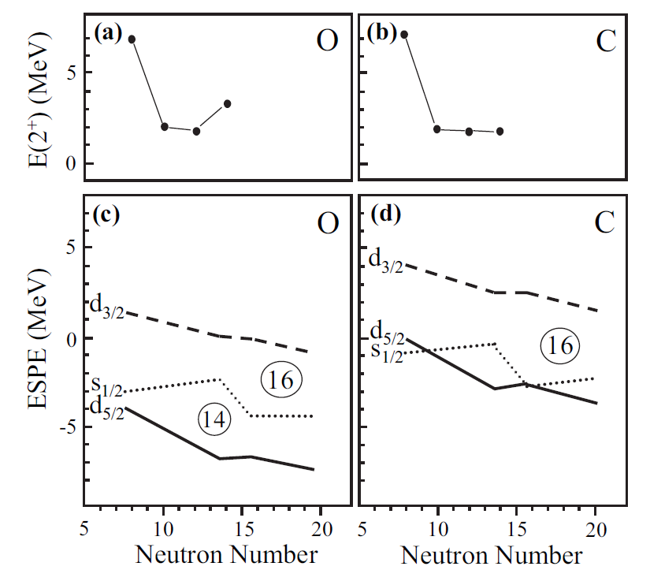
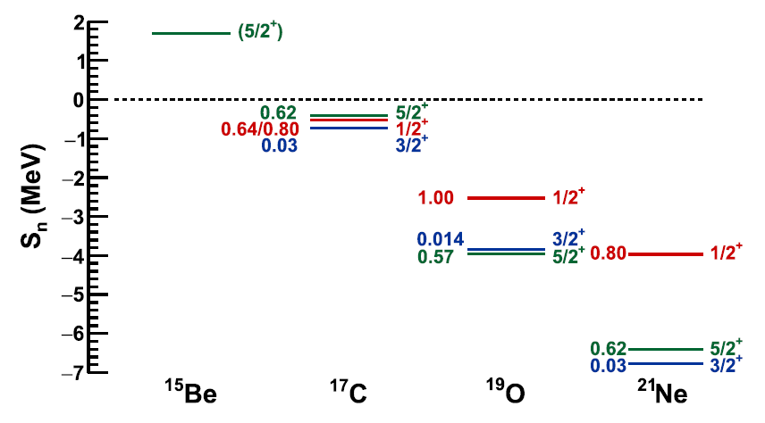
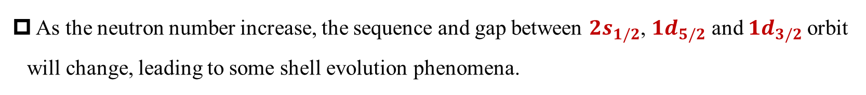
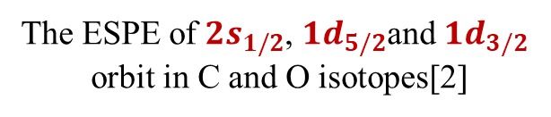
Rearrangement of sd orbit in neutron-rich nuclei
As the neutron number increase, the sequence and gap between ${2s}_{1/2}$, ${1d}_{5/2}$ and ${1d}_{3/2}$orbit will change, leading to some shell evolution phenomena.
The disappearance of N = 14 magic number[1]
The ESPE of ${2s}_{1/2}$, ${1d}_{5/2}$and ${1d}_{3/2}$
orbit in C and O isotopes[2]
[1] X. Pereira-López et al., Phys. Lett. B, 811, 135939 (2020).
[2] M. Stanoiu, D. Sohler et al., Phys. Rev. C 78, 034315(2008).

Slide 4
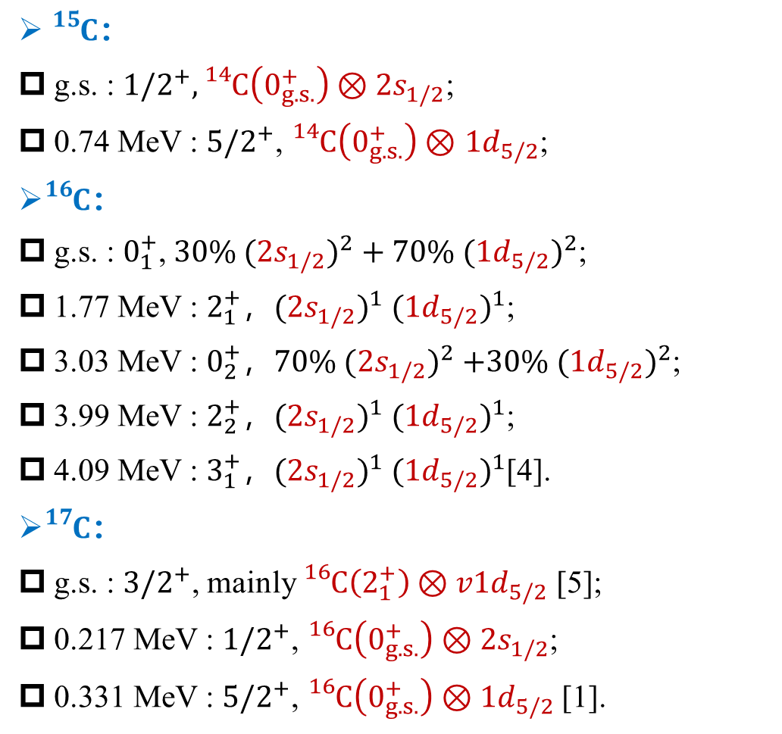
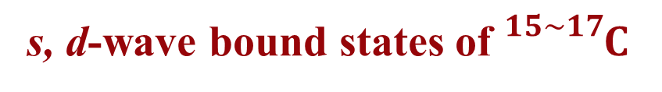
s, d-wave bound states of ${}_{}^{15\sim 17}C$
${}_{}^{15}C$：
g.s. : ${1/2}^{+},{}_{}^{14}C\left(0_{g.s.}^{+}\right)⊗{2s}_{1/2}$;
0.74 MeV : ${5/2}^{+}$, ${}_{}^{14}C\left(0_{g.s.}^{+}\right)⊗$ ${1d}_{5/2}$;
${}_{}^{16}C$：
g.s. : $0_{1}^{+}$, $30\%{ ({2s}_{1/2})}^{2}+70\%{ ({1d}_{5/2})}^{2}$;
1.77 MeV : $2_{1}^{+}$，${({2s}_{1/2})}^{1}$ ${({1d}_{5/2})}^{1}$;
3.03 MeV : $0_{2}^{+}$，$70\%{ ({2s}_{1/2})}^{2}$ $+30\%{ ({1d}_{5/2})}^{2}$;
3.99 MeV : $2_{2}^{+}$，${({2s}_{1/2})}^{1}$ ${({1d}_{5/2})}^{1}$;
4.09 MeV : $3_{1}^{+}$，${({2s}_{1/2})}^{1}$ ${({1d}_{5/2})}^{1}$[4].
${}_{}^{17}C$：
g.s. : ${3/2}^{+}$, mainly ${}_{}^{16}C\left(2_{1}^{+}\right)⊗v1d_{5/2}$ [5];
0.217 MeV : ${1/2}^{+}$, ${}_{}^{16}C\left(0_{g.s.}^{+}\right)⊗2s_{1/2}$;
0.331 MeV : ${5/2}^{+}$, ${}_{}^{16}C\left(0_{g.s.}^{+}\right)⊗1d_{5/2}$[1].
Level scheme of ${}_{}^{15\sim 17}C$s, d-wave states[1,3~5]
[3] S. E. Darden et al., Phys. Rev. C 32, 1764 (1985).
[4] A. H. Wuosmaa et al., Phys. Rev. Lett. 105, 132501 (2010).
[5] V. Maddalena et al., Phys. Rev. C 63, 024613 (2001).

Slide 5
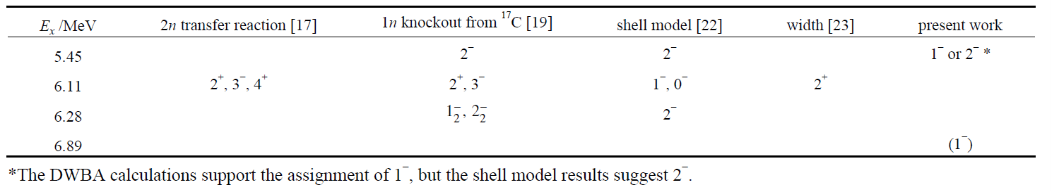


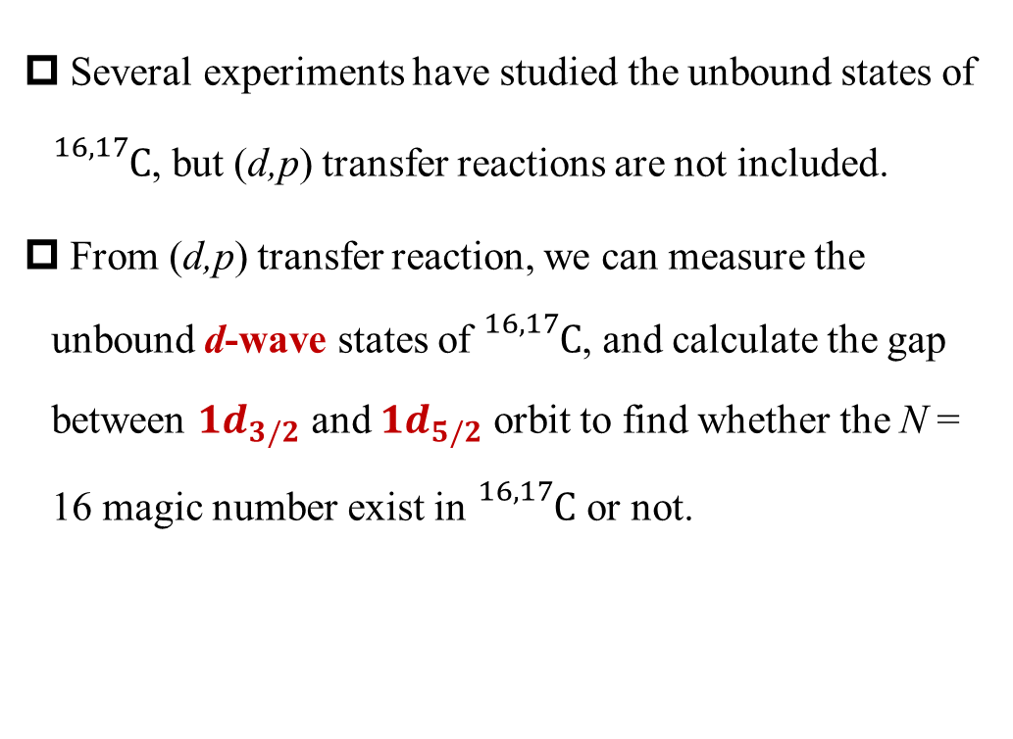
Unbound d-wave states of ${}_{}^{16,17}{C }$
Several experiments have studied the unbound states of ${}_{}^{16,17}C$, but (d,p) transfer reactions are not included.
From (d,p) transfer reaction, we can measure the unbound d-wave states of ${}_{}^{16,17}C$, and calculate the gap between $1d_{3/2}$ and $1d_{5/2}$ orbit to find whether the N = 16 magic number exist in ${}_{}^{16,17}C$ or not.
Level scheme of ${}_{}^{17}C$[1,6~8]
Summary of ${}_{}^{16}C$ negative-parity states[9]
[6] S. Kim et al., Phys. Lett. B 836, 137629 (2023). [7] Y. Satou et al., Phys. Lett. B 660,320 (2008).
[8] H. Ueno et al., Phys. Rev. C 87, 034316 (2013). [9] Z. W. Tan et al., Chin. Phys. C 46, 054001 (2022)

Slide 6
Contents
Motivation
Experimental setup
Experimental result
Summary

Slide 7
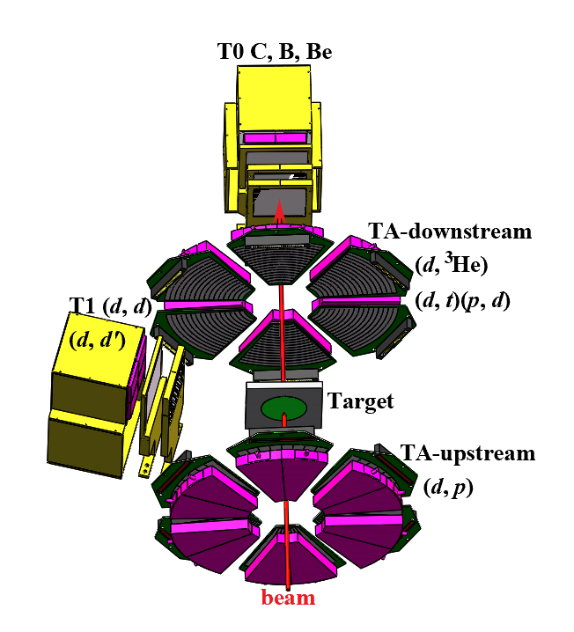
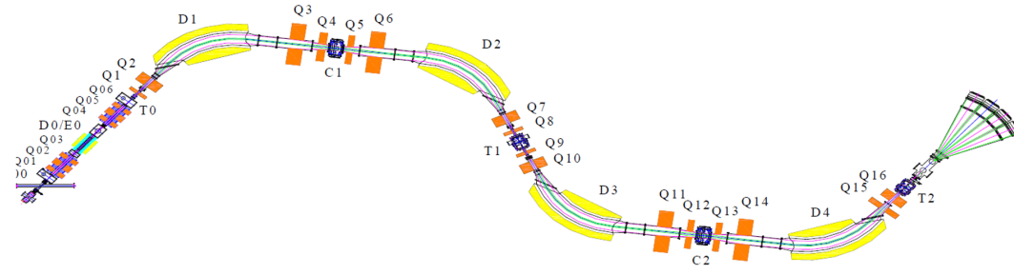

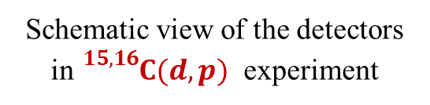
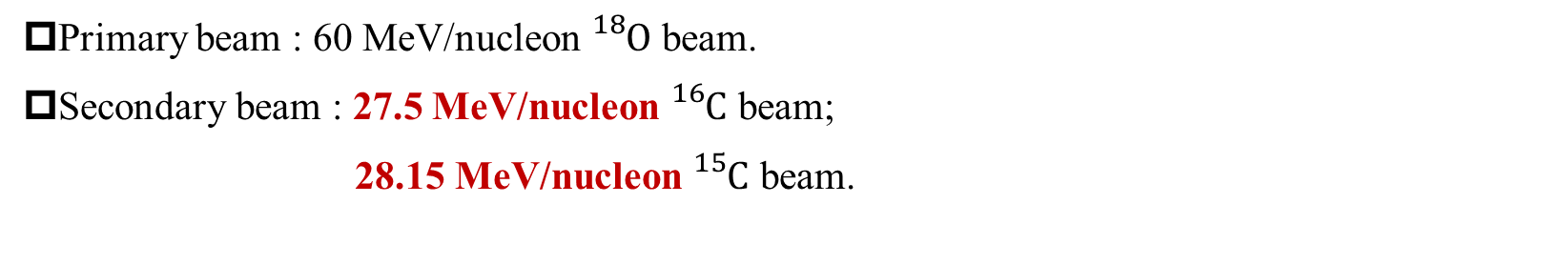
Setup of ${}_{}^{15, 16}{C(d,p)}$ experiment
Schematic view of RIBLL1 beam line[6]
Schematic view of the detectors in ${}_{}^{15, 16}{C(d,p)}$ experiment
Primary beam : 60 MeV/nucleon ${}_{}^{18}O$ beam.
Secondary beam : 27.5 MeV/nucleon ${}_{}^{16}C$ beam;
28.15 MeV/nucleon ${}_{}^{15}C$ beam.
[10] Z. Sun et al., Nucl. Instr. Meth. A 503, 496 (2003).

Slide 8
Contents
Motivation
Experimental setup
Experimental result
Summary

Slide 9
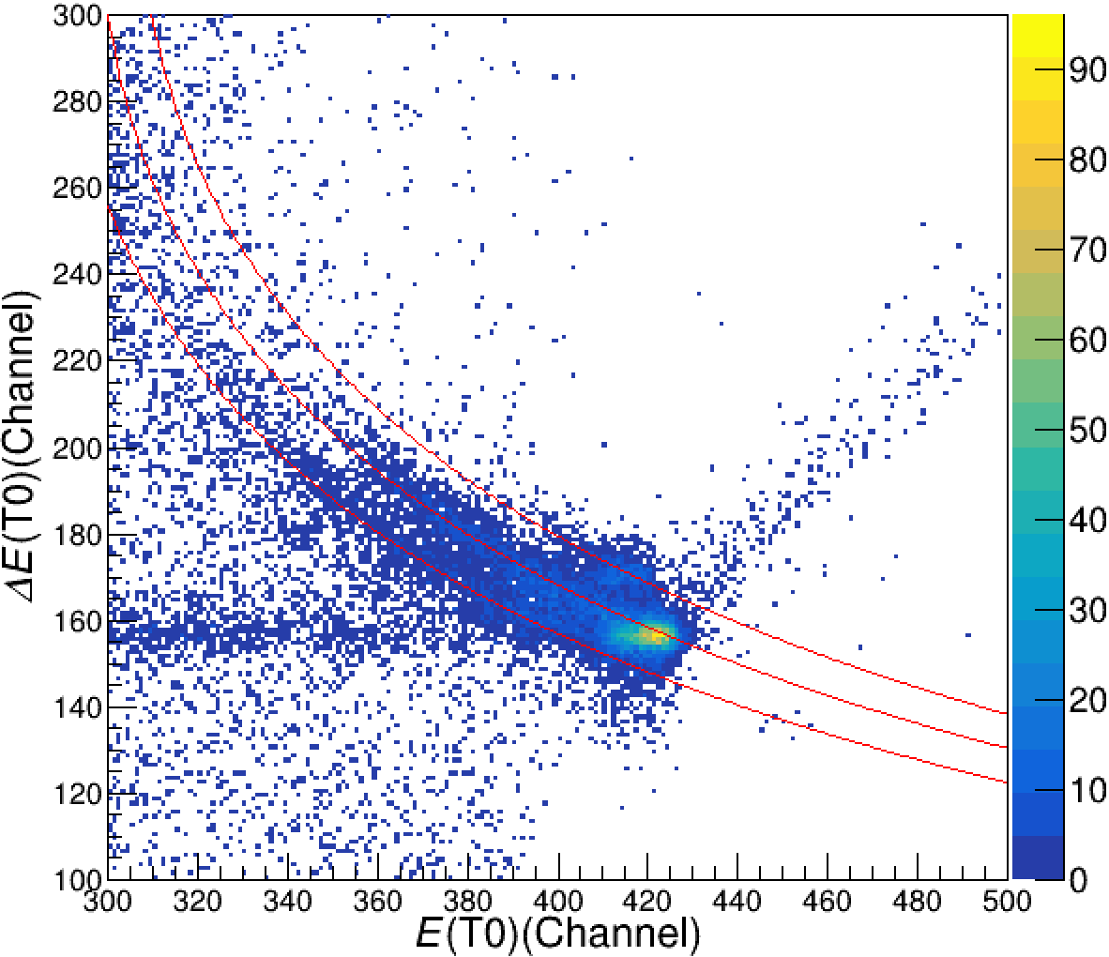
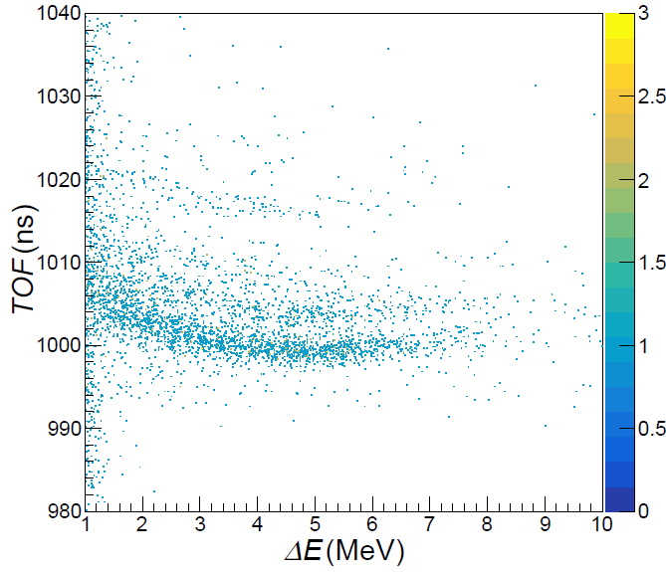



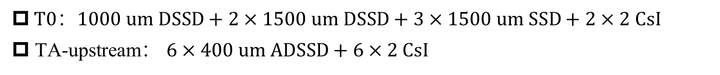

Particle identification
$T0$：$1000 um DSSD+2×1500 um DSSD+3×1500 um SSD+2×2 CsI$
$\text{TA}\text{−}\text{upstream}$： $6×400 um ADSSD+6×2 CsI$
135° incident proton’s penetration energy :8.87 MeV
$${}_{}^{16}C$$
$${}_{}^{15}C$$
$${}_{}^{14}C$$
$ΔE−E$ particle identification of T0 telescope
$TOF−ΔE$ particle identification of TA-upstream telescope

Slide 10
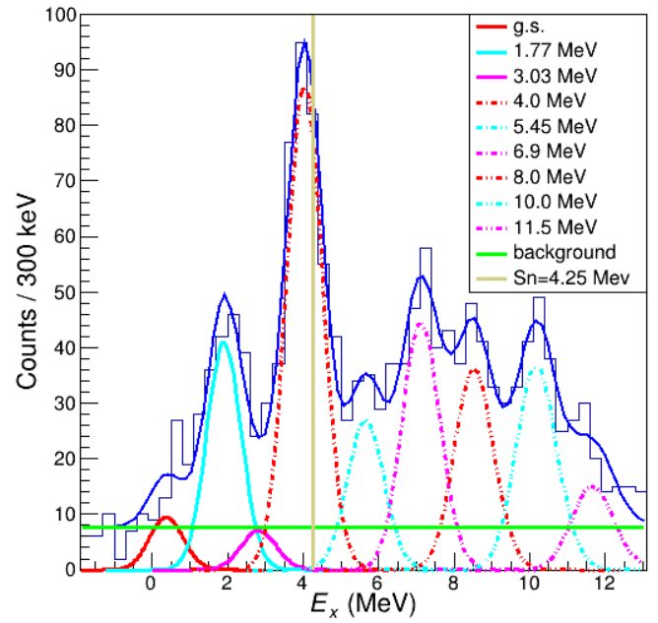
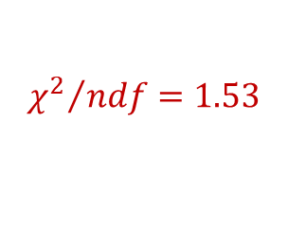
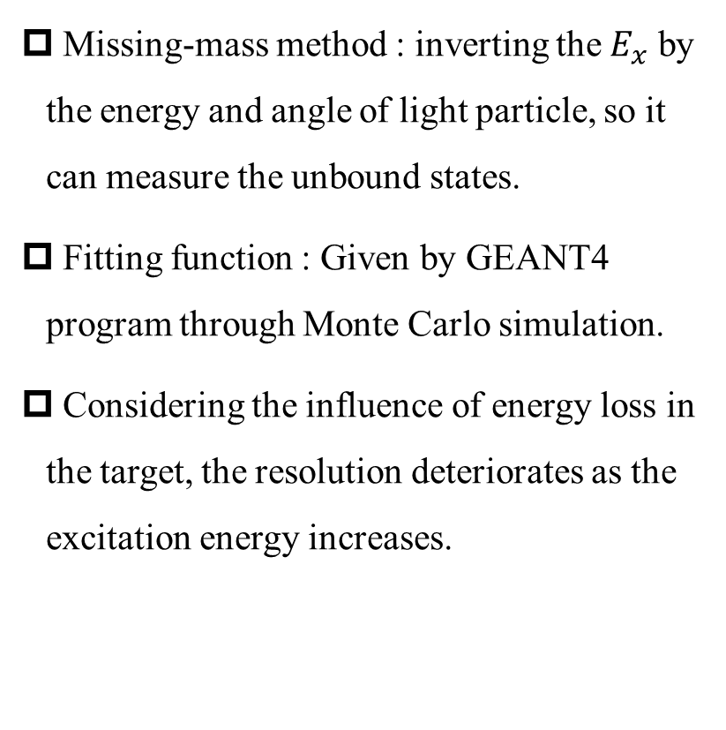
Excitation energy spectra of${}_{}^{15}{C(d,p)}$ reaction
$${χ^{2}}/{ndf}=1.53$$
Missing-mass method : inverting the $E_{x}$ by the energy and angle of light particle, so it can measure the unbound states.
Fitting function : Given by GEANT4 program through Monte Carlo simulation.
Considering the influence of energy loss in the target, the resolution deteriorates as the excitation energy increases.
The excitation energy spectrum of ${}_{}^{16}C$

Slide 11
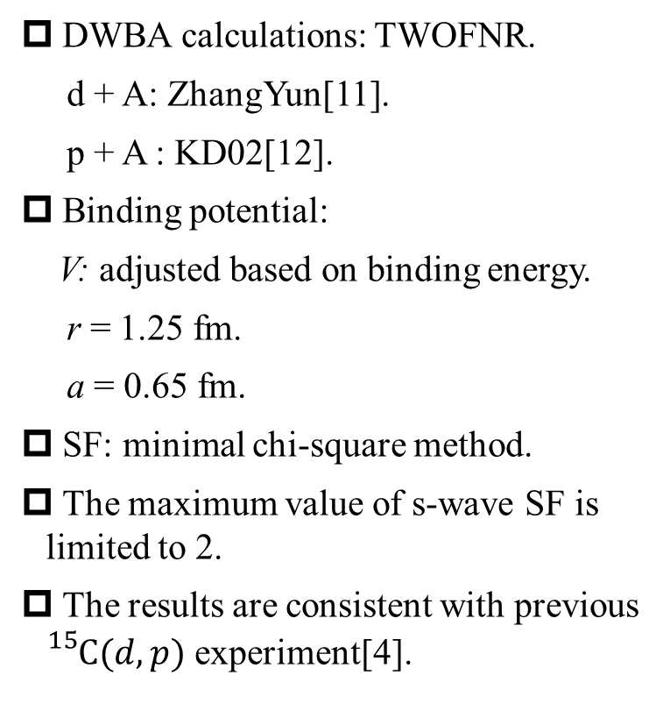
Differential cross section of ${}_{}^{15}{C(d,p)}$ reaction
DWBA calculations: TWOFNR.
d + A: ZhangYun[11].
p + A : KD02[12].
Binding potential:
V: adjusted based on binding energy.
r = 1.25 fm.
a = 0.65 fm.
SF: minimal chi-square method.
The maximum value of s-wave SF is limited to 2.
The results are consistent with previous ${}_{}^{15}{C(d,p)}$ experiment[4].
Differential cross sections of ${}_{}^{16}C$ bound states
[11] Y. Zhang et al., Phys. Rev. C 94, 014619 (2016)
[12] Koning-Delaroche et al., Nucl Phys A 713, 231 (2003).

Slide 12
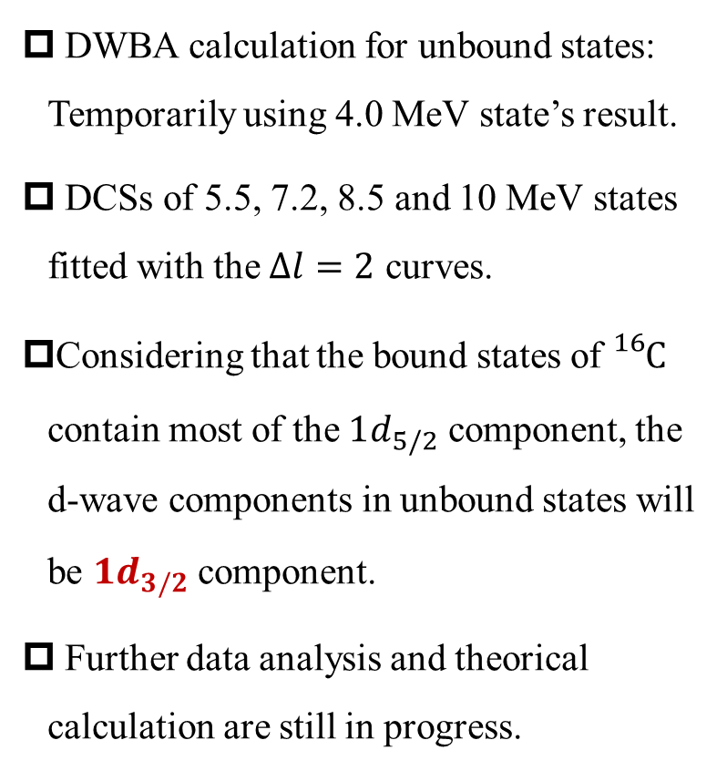
Differential cross section of ${}_{}^{15}{C(d,p)}$ reaction
DWBA calculation for unbound states: Temporarily using 4.0 MeV state’s result.
DCSs of 5.5, 7.2, 8.5 and 10 MeV states fitted with the $∆l=2$ curves.
Considering that the bound states of ${}_{}^{16}C$ contain most of the $1d_{5/2}$ component, the d-wave components in unbound states will be $1d_{3/2}$ component.
Further data analysis and theorical calculation are still in progress.
Differential cross sections of ${}_{}^{16}C$ unbound states

Slide 13
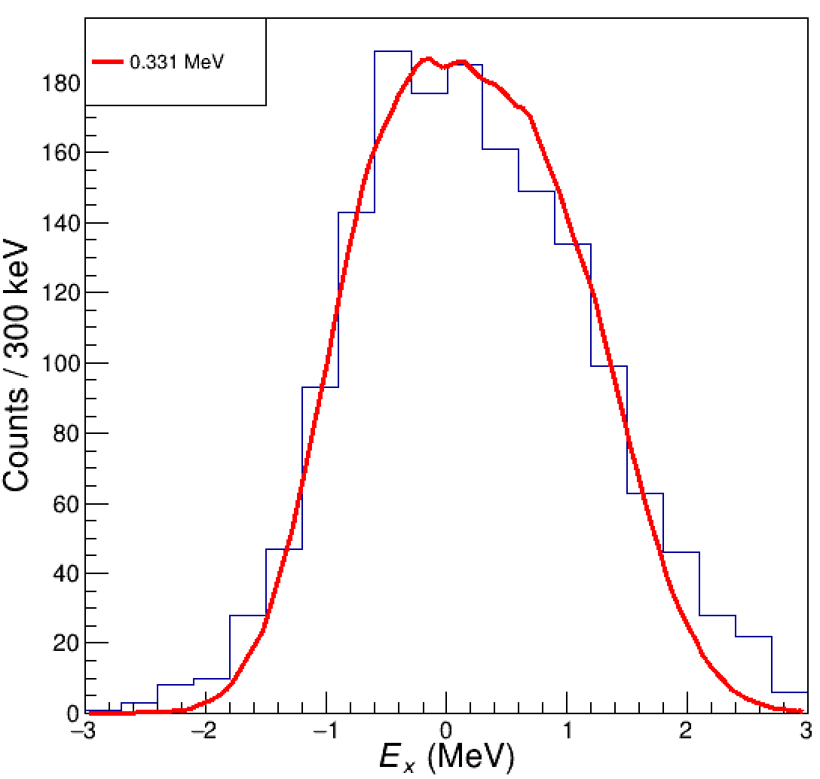
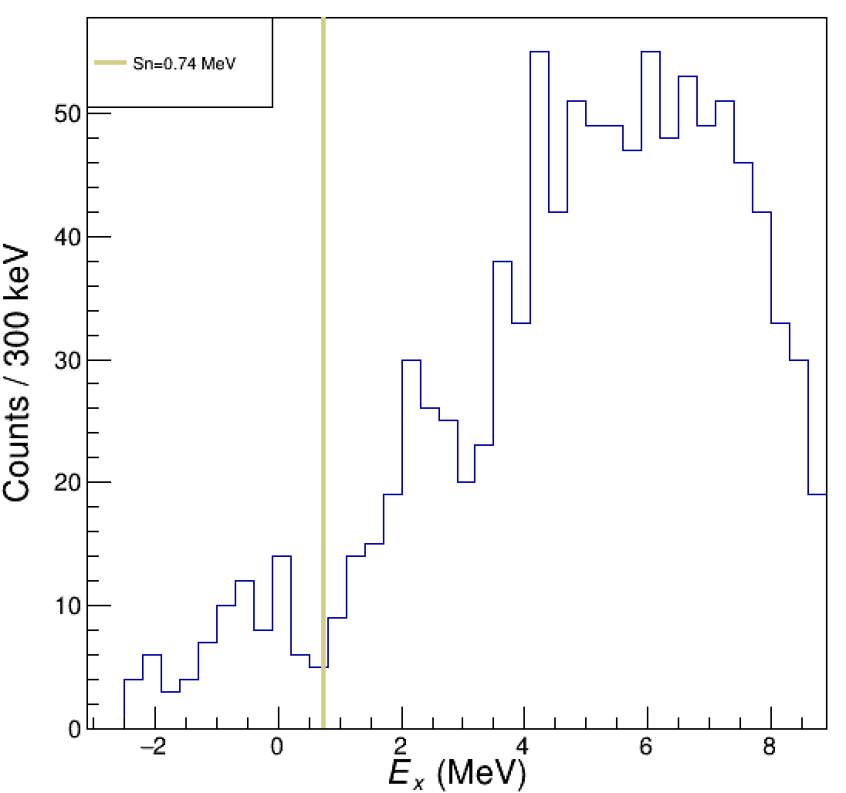
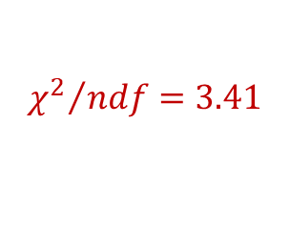
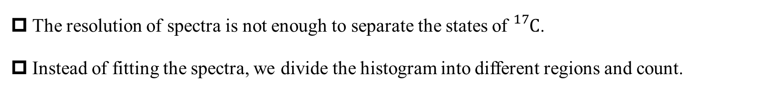
Excitation energy spectra of${}_{}^{16}{C(d,p)}$ reaction
The resolution of spectra is not enough to separate the states of ${}_{}^{17}C$.
Instead of fitting the spectra, we divide the histogram into different regions and count.
$${χ^{2}}/{ndf}=3.41$$
The excitation energy spectra of bound(left) and unbound(right) states of ${}_{}^{17}C$

Slide 14
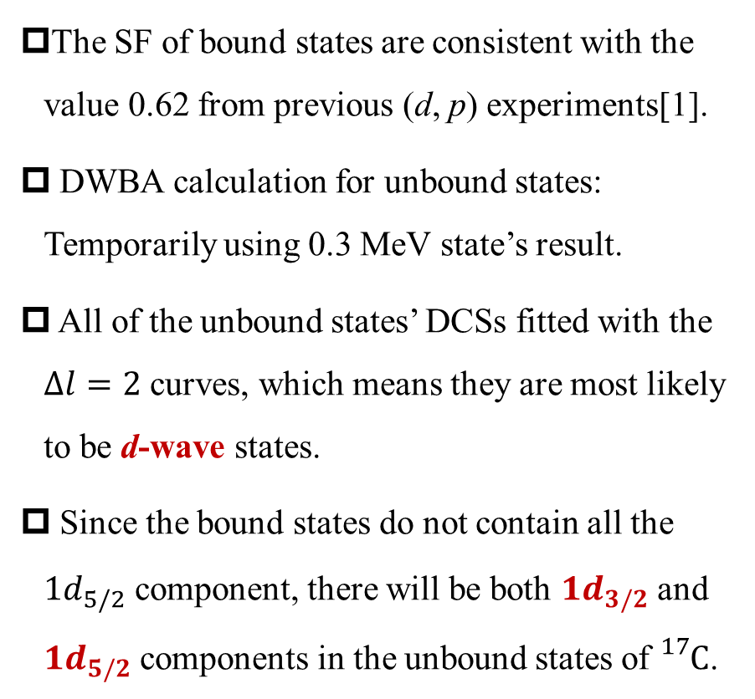
Differential cross section of ${}_{}^{16}{C(d,p)}$ reaction
The SF of bound states are consistent with the value 0.62 from previous (d, p) experiments[1].
DWBA calculation for unbound states: Temporarily using 0.3 MeV state’s result.
All of the unbound states’ DCSs fitted with the $∆l=2$ curves, which means they are most likely to be d-wave states.
Since the bound states do not contain all the $1d_{5/2}$ component, there will be both $1d_{3/2}$ and $1d_{5/2}$ components in the unbound states of ${}_{}^{17}C$.
Differential cross section of ${}_{}^{17}C$ bound and unbound states

Slide 15
Contents
Motivation
Experimental setup
Experimental result
Summary

Slide 16
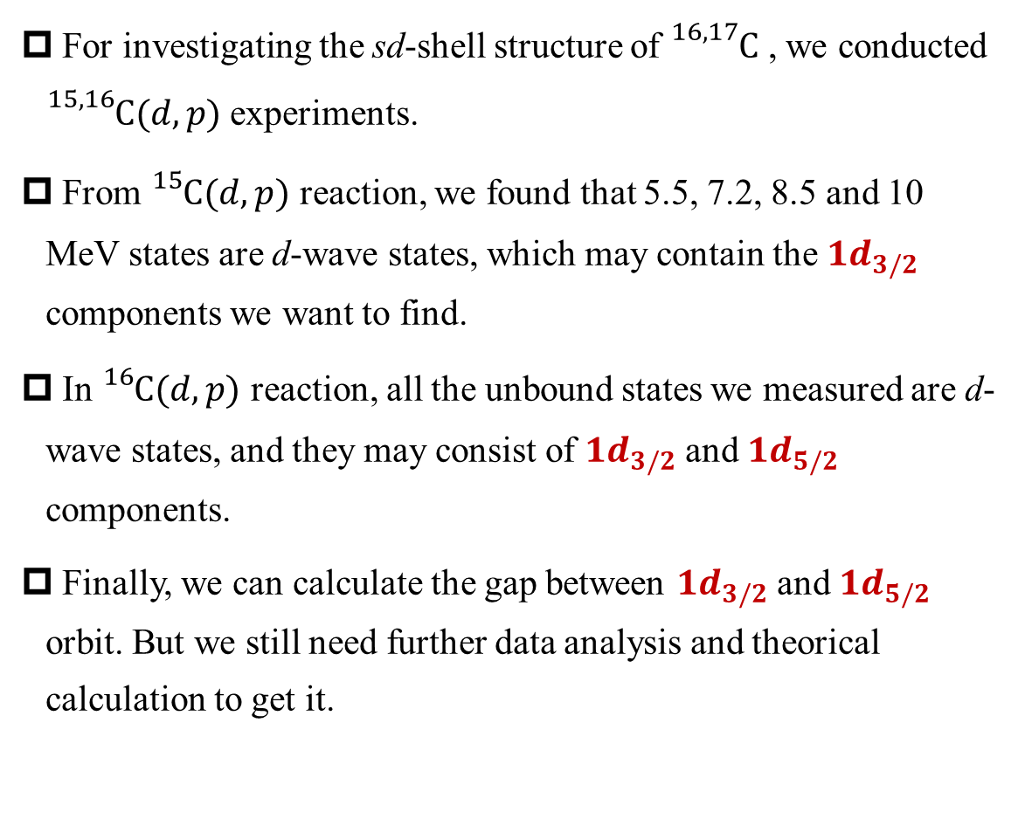
Summary
For investigating the sd-shell structure of ${}_{}^{16,17}C$ , we conducted ${}_{}^{15,16}{C(d,p)}$ experiments.
From ${}_{}^{15}{C(d,p)}$ reaction, we found that 5.5, 7.2, 8.5 and 10 MeV states are d-wave states, which may contain the $1d_{3/2}$ components we want to find.
In ${}_{}^{16}{C(d,p)}$ reaction, all the unbound states we measured are d-wave states, and they may consist of $1d_{3/2}$ and $1d_{5/2}$ components.
Finally, we can calculate the gap between $1d_{3/2}$ and $1d_{5/2}$ orbit. But we still need further data analysis and theorical calculation to get it.

Slide 17
Thanks!
Collaborators:
Peking University:
Yanlin Ye, Jianling Lou, Lisheng Yang, Weiliang Pu, Hongyu Zhu, Haoyu Ge, Kang Wei,
Ying Chen, Ziyao Hu, Jiahao Chen, Kai Ma, Wenwu Wan, Shiqi Liang;
Institute of Modern Physics:
Hooijin Ong, Yanyun Yang, Shiwei Xu, Kang Wang, Fangfang Duan, Junbin Ma, Zhen Bai,
Peng Ma and Ruofu Chen;
Beihang University:
Danyang Pang.
Reporter : Bolong Xia
2025/05/30

