Slide 1



Functional renormalization group method for finite nuclei
Youngman Kim
CENS, Institute for Basic Science, Daejeon, Korea

Slide 2
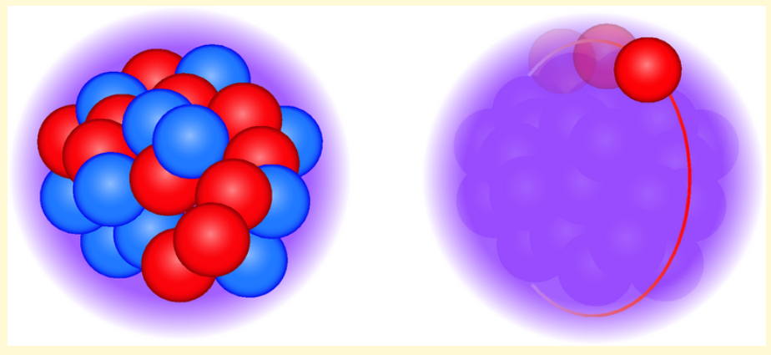
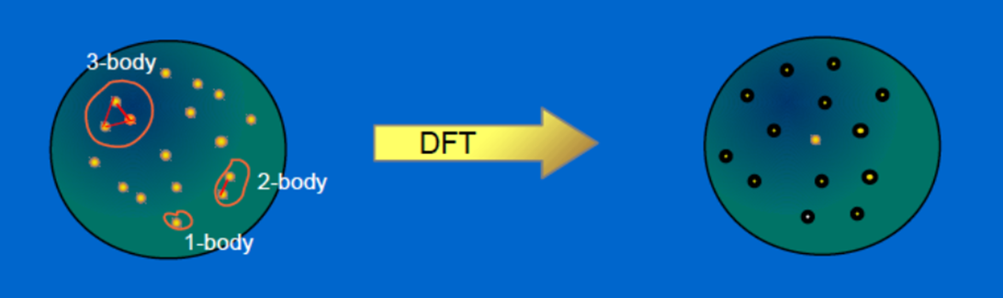
Mean field Approximation

Slide 3
Fluctuations
Nucleons, though massive, can fluctuate near the Fermi surface as p-h excitations.
The pion and sigma mesons can fluctuate.
Vector mesons such as omega mesons may not fluctuate because they are massive. Only as mean field.

Slide 4
Beyond the mean field approximation: FRG
The FRG combines functional approach with the renormalization group idea and deals with the fluctuations not all at once but successively from scale to scale or shell by shell.
FRG is a good way to handle the fluctuations and a handy tool for those who are familiar with relativistic formalism.
My goal is to use the FRG method for exotic nuclei, neutron stars and heavy ion collisions!

Slide 5
Renormalization group method with different goals
To remove infinities (UV divergences)
To describe the scale dependence of physical parameters
To re-sum the perturbation expansion in QFT
To solve strongly coupled theories
…

Slide 6
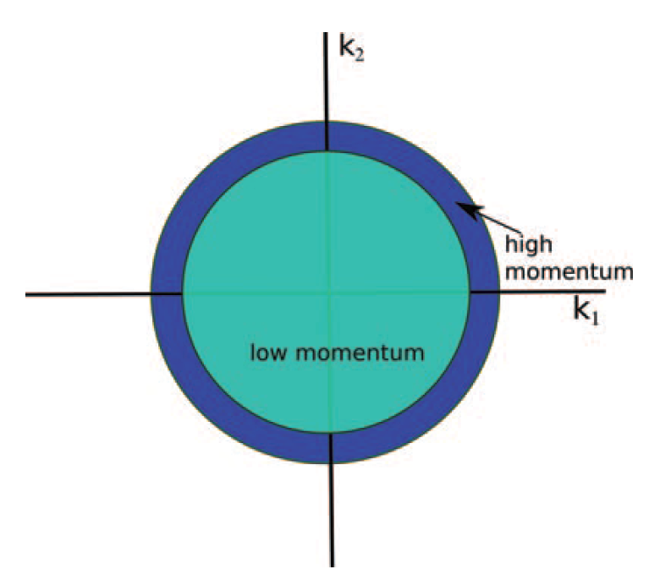
Wilsonian (effective action) approach
It is about how a theory changes as we scale down the momentum scale.

Slide 7
In practice, however, non-local interactions are generated and a derivative expansion is not possible.
The Wetterich equation, the scale dependence (or flow) of the effective action, provides a better analytical and numerical accessibility and stability and practical realization of the Wilson (-Kadanoff) RG idea.

Slide 8
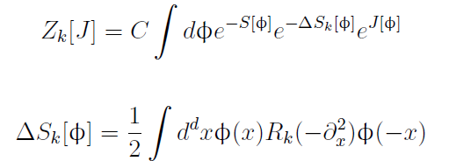
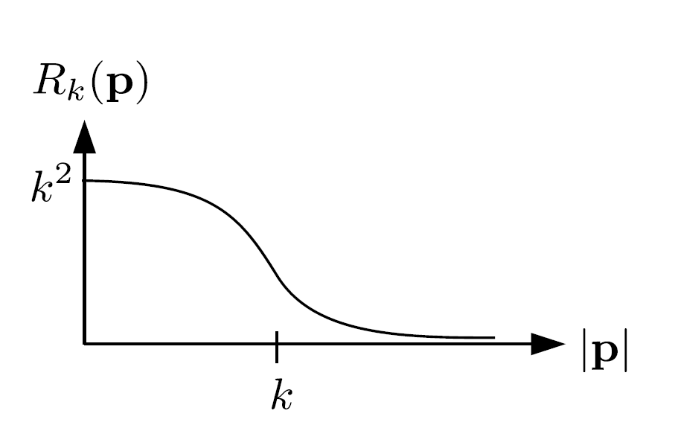
Momentum-dependent mass-like term that gives a mass of order k² to the low-energy modes and thus suppresses their fluctuations.

Slide 9
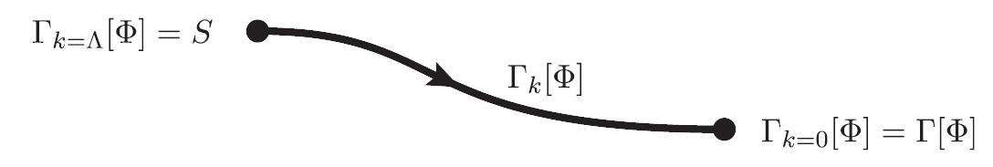

Slide 10
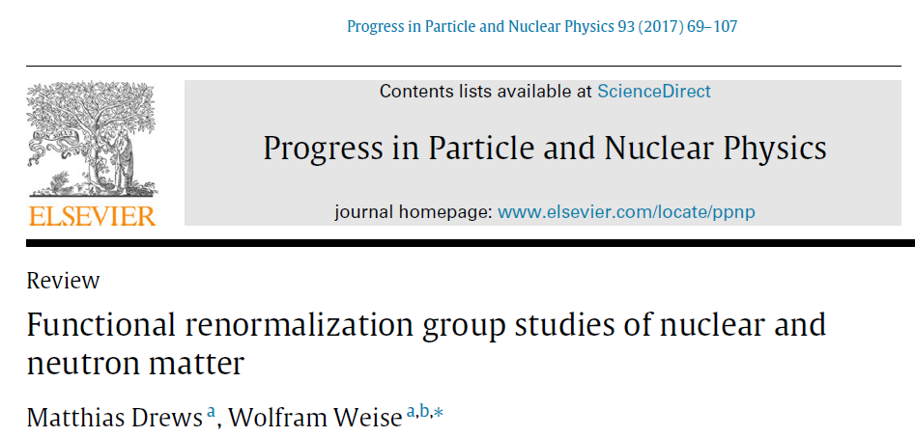


Slide 11
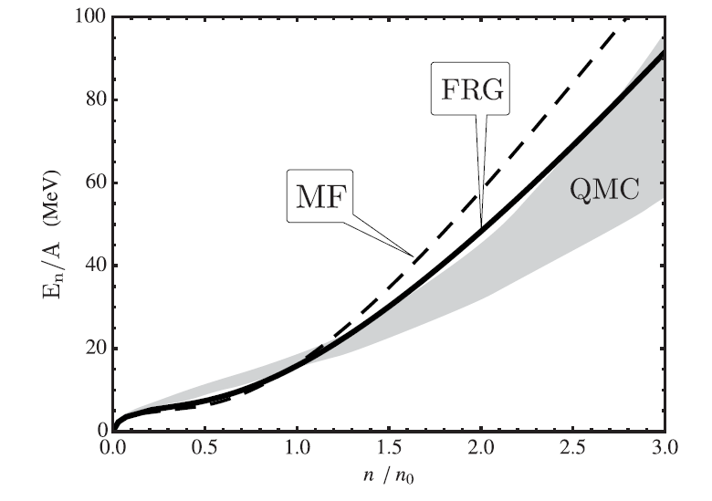

Slide 12
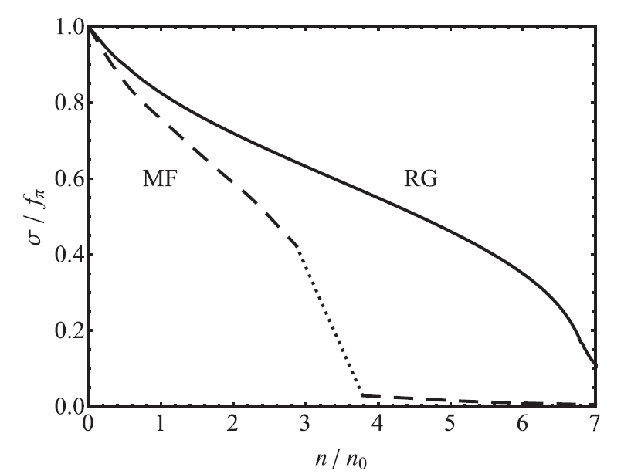

Slide 14
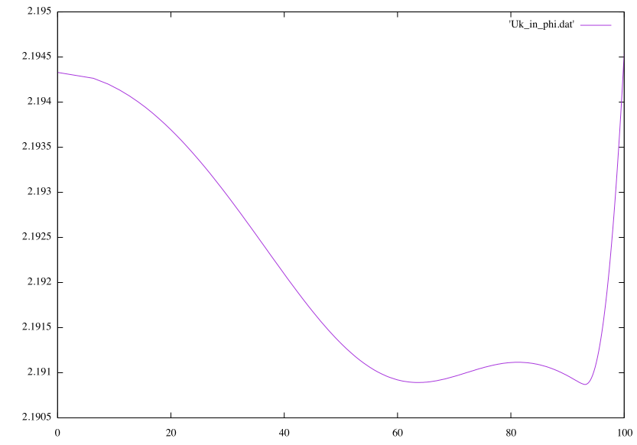
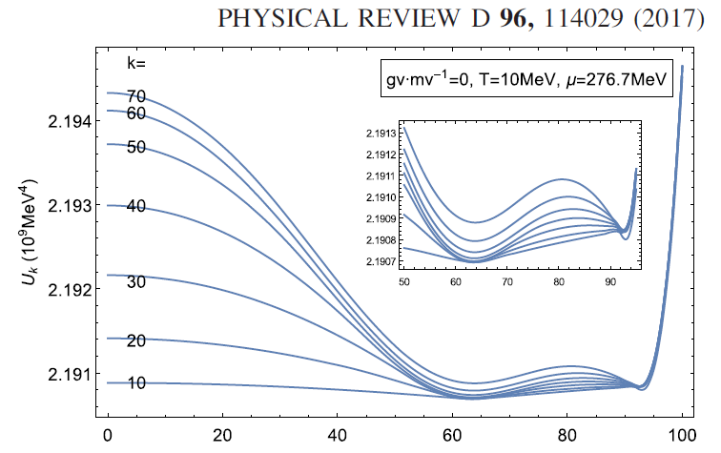
S. Jeon, YK, et al

Slide 15
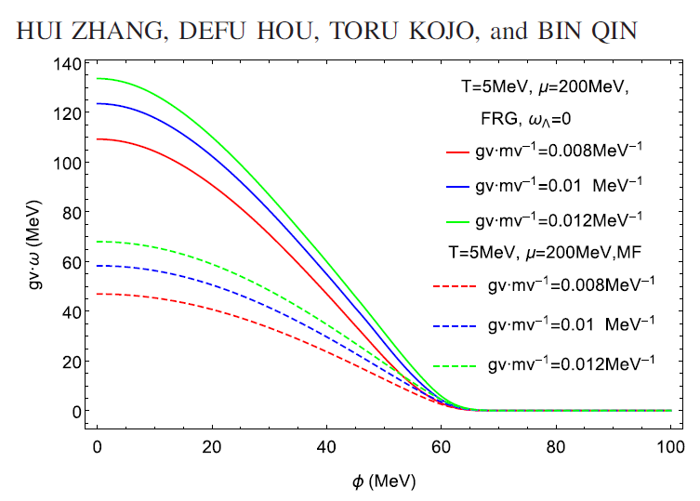
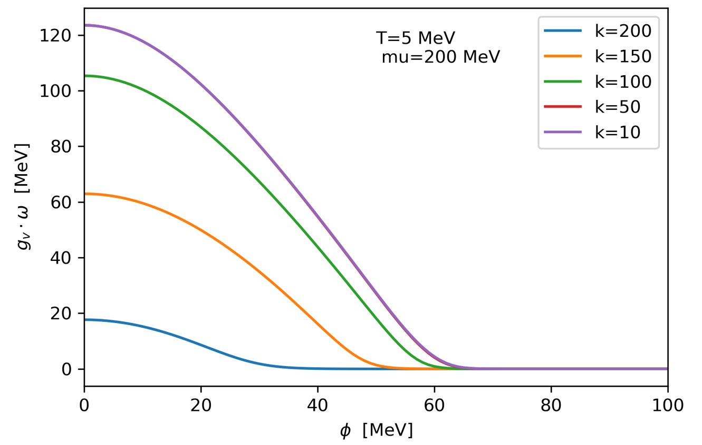

Slide 16
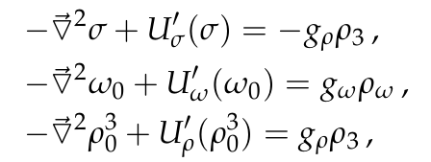
FRG for finite nuclei
Solutions of the FRG equations

Slide 17
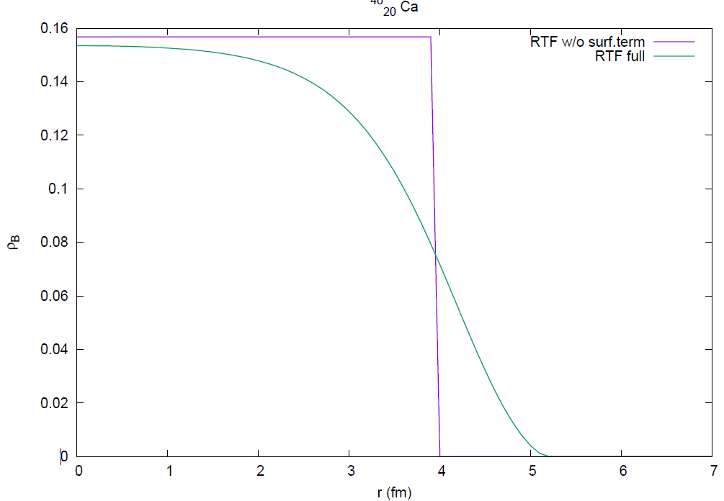
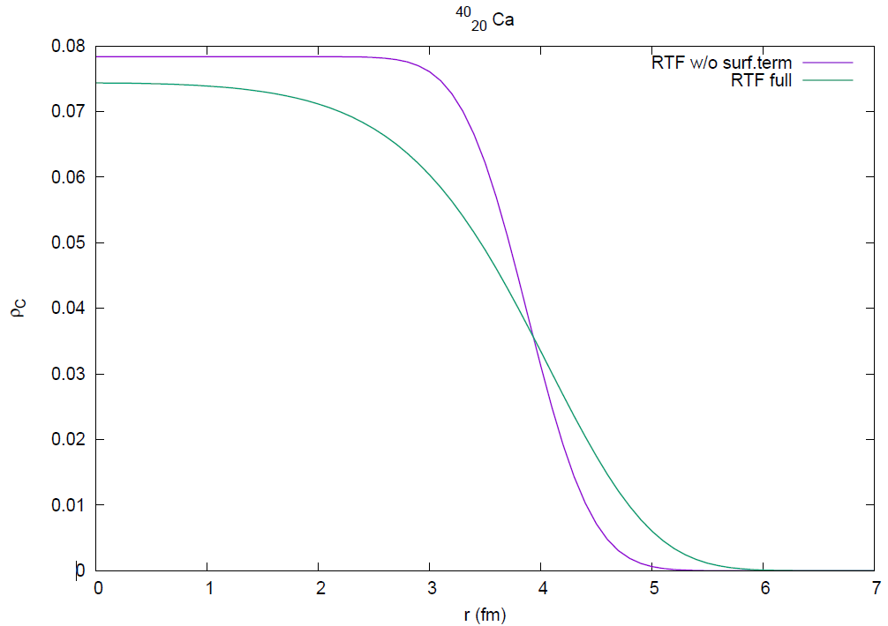
preliminary

Slide 18
Summary
The FRG method has been widely used in dense nuclear matter to deal with fluctuations. (also in various fields in physics such as electroweak phase transitions, ultra-cold atoms, etc. )
We have developed a numerical code to solve the FRG equations in the chiral nucleon-sigma model
Application to finite nuclei is underway.

