Slide 1



The identification of (axial) vector meson polarization through its 2-body decay
In Woo Park
Yonsei University, Nuclear Theory and Hadron Group
Advisor: Su Houng Lee
Coworker: Hiroyuki Sako(JAEA), Kazuya Aoki(KEK), Philipp Gubler(JAEA), Su Houng Lee(Yonsei University)
Notes:
Good morning, my name is In Woo Park. I am currently a graduate student and my advisor is Prof Su Houng Lee. Today I am going to talk about the identification of vector meson polarization through its 2-body decay. This work has been done together with the help of Hiroyuki Sako, Kazuya Aoki, Philipp Gubler and Prof Lee.

Slide 2
Introduction: Why do we need to know about the vector meson polarization?
(Axial) Vector meson 2-body decay
Effective Lagrangian
Disentanglement of transverse and longitudinal mode via polarization tensor
General angular distribution
Result: Angular dependent decay distribution + Final vector meson polarization in A→VP
Summary
Contents.
Notes:
The main idea is by analyzing the direction and momentum of the decay particles, we can figure out the polarization of the original vector meson.
I’ll first introduce the reason why we need to know about the vector meson polarization. Then I’ll present the effective Lagrangian we used to describe the vector meson decay. By making use of the polarization tensor, we can untangle the decay amplitude for each polarization mode. Furthermore, the general angular distributions can not only be derived from the effective Lagrangian, but also from the helicity formalism. Finally I’ll show the angular dependence of the decay product for each polarization mode then summarize my talk.

Slide 3
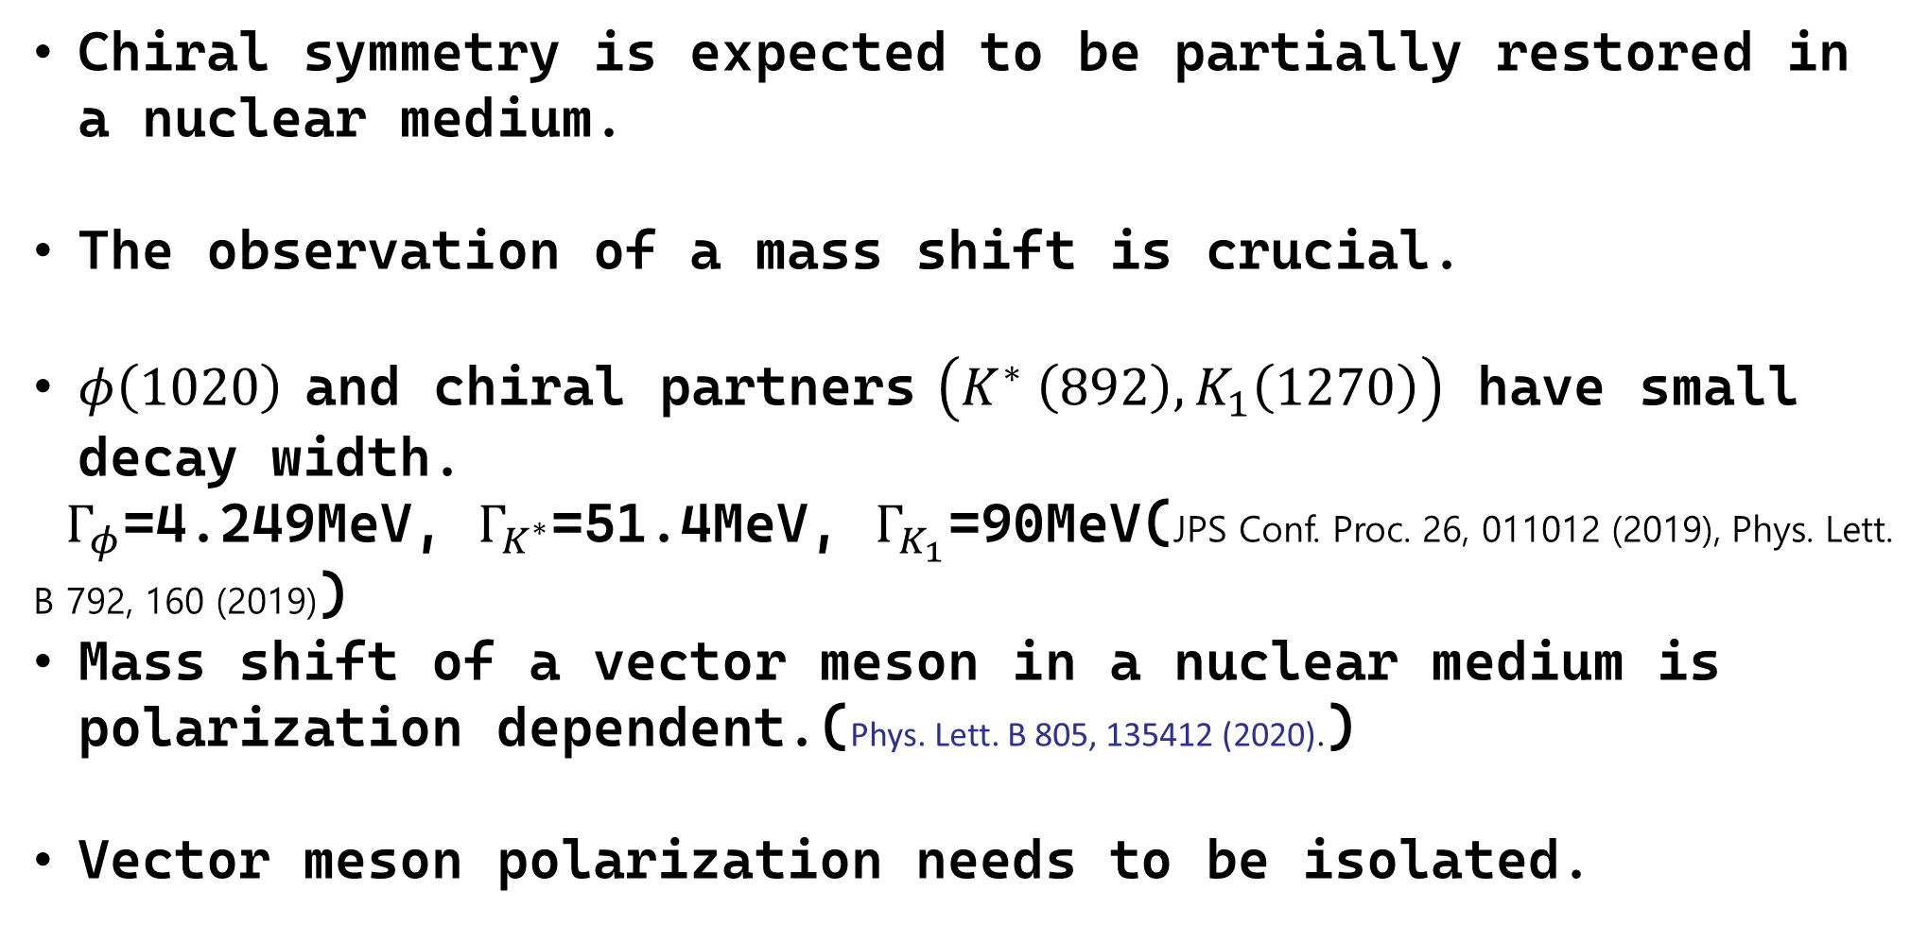
Introduction: Why do we need to know about $J^{P}=1^{±}$ polarization?
Chiral symmetry is expected to be partially restored in a nuclear medium.
The observation of a mass shift is crucial.
$φ\left(1020\right)$ and chiral partners $\left(K^{∗} \left(892\right), K_{1}\left(1270\right)\right)$ have small decay width.
$Γ_{φ}$=4.249MeV, $Γ_{K^{∗}}$=51.4MeV, $Γ_{K_{1}}$=90MeV(JPS Conf. Proc. 26, 011012 (2019), Phys. Lett. B 792, 160 (2019))
Mass shift of a vector meson in a nuclear medium is polarization dependent.(Phys. Lett. B 805, 135412 (2020).)
Vector meson polarization needs to be isolated.
Notes:
The necessity for the vector meson polarization is because QCD expects that the chiral symmetry is expected to be partially restored in hot and dense nuclear matter such as heavy ion collision.
Thus observing the mass shift, for example of a phi meson, or K* and K_1 which are chiral partners, is crucial.
However the mass shift of a vector meson in a nuclear medium is known to depend on its polarization modes so we need to isolate them separately.

Slide 4
Effective Lagrangian
Effective lagrangian reference: 10.1016/j.physletb.2021.136388
Notes:
We have studied 3 decay modes. The vector meson decaying into two pseudoscalar mesons such as phi to K^+K^-, rho to pi pi and K*(892) to K pi. The second is the phi meson decaying into a pair of positron and electron by making use of the Vector Meson Dominance hypothesis.
The last one is the axial vector meson K1(1270) decaying into a vector meson and pseudoscalar meson, which are rho K and K* pi.
Using the Lagrangian, we extract the relevant coupling constants and the momenta of the decay products. We analyze three types of decays:

Slide 5
Coupling constant and momentum of produced particle
Notes:
Using the effective Lagrangian, we can obtain the momentum of the produced particle in the c.m. frame and the coupling constants for each decay process as follows.

Slide 6
V → PP & V → ll & A → VP
Notes:
Here I present the result that the decay amplitude for transverse and longitudinal polarization mode of the initial vector meson can be computed using the corresponding polarization tensor. The subscript T and L denote the initial meson polarization. The polar angle theta is defined to be the decay angle of the produced particle with respect to the momentum of the vector meson in the Lab frame. Alpha is the dilepton decay is the fine structure constant.
The angular distribution of the decay products is a key observable. Different polarization states lead to distinct angular patterns. This provides a way to infer the polarization of the initial or final state mesons.

Slide 7
$J^{P}=1^{±}$ 2-body decay angular distribution is unified
Notes:
Moreover the decay angular distribution of three decay processes we computed can be unified into the linear combination of a decay amplitude for each polarization mode and the density matrix of the initial vector meson where rho_00 is the mixing amplitude of a longitudinal spin component Jz=0.

Slide 8

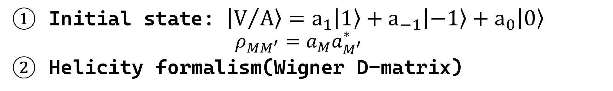
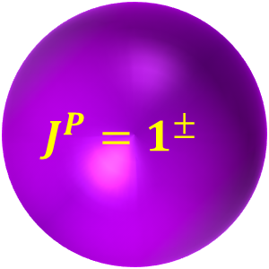
General angular distribution
Initial state: $\left.{\left|V\right.}/A\right\rangle =a_{1}\left.\left|1\right.\right\rangle +a_{−1}\left.\left|−1\right.\right\rangle +a_{0}\left.\left|0\right.\right\rangle$
$$ρ_{MM^{′}}=a_{M}a_{M^{′}}^{∗}$$
Helicity formalism(Wigner D-matrix)
$$J^{P}=1^{±}$$
Notes:
The more general angular distribution including the azimuthal angle can be derived using the effective lagrangian but now assuming that the initial state is a mixture of three different vector meson angular momentum eigenstate with the respective amplitude a_M.
Another method is the helicity formalism which makes use of the Wigner D-matrix. This is done by boosting along the z-axis from the rest frame of the initial particle then making a rotation so that the z-axis aligns with the momentum of the produced particle in the initial particle rest frame.

Slide 9
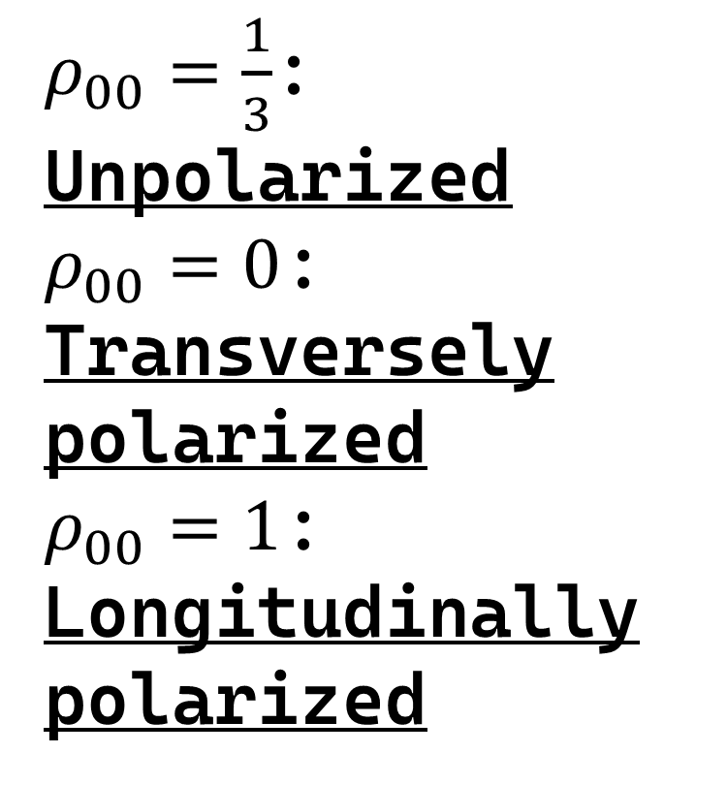
$ρ_{00}=\frac{1}{3}$:
Unpolarized
$ρ_{00}=0$:
Transversely polarized
$ρ_{00}=1$: Longitudinally polarized
Notes:
Both methods yield the same result for each decay process as follows. The general angular distribution of the produced particle is now expressed in terms of the polar angle theta, the azimuthal angle phi and the spin density matrix element. Averaging over the azimuthal angle we obtain the same polar angle distribution which is previously mentioned. When rho_00 term is 1/3, the initial particle is said to be unpolarized. If it is 0 or 1, each indicates the transversely and longitudinally polarized state, respectively.

Slide 10


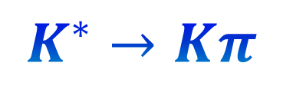


Result 1: Initial particle polarization analysis
$$φ→K^{+}K^{−}$$
Forward / Backward: Longitudinal(O)
Transverse(X)
Perpendicular: Transverse(O)
Longitudinal(X)
$$ρ→ππ$$
$$K^{∗}→Kπ$$
Notes:
Now we present the result for each decay process. These 3 figures are decay distribution in terms of cos theta for each polarization mode of the initial vector meson. We see that the longitudinal vector meson is found in the forward or backward direction and the transverse mode is found in the perpendicular direction. This happens because the decay amplitude is proportional to the dot product of the relative momentum and the polarization vector. The polarization vector is transverse to the z-axis for the transverse mode and parallel for the longitudinal mode.
First, we consider the decay of an initially polarized vector meson. In V → PP, forward and backward emission corresponds to longitudinal polarization. In contrast, for V → ll, forward and backward emission corresponds to transverse polarization. So these two decay modes provide complementary information.

Slide 11
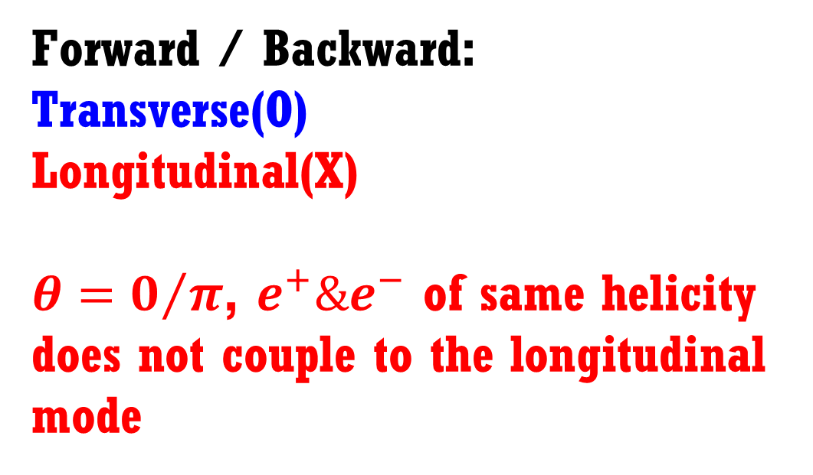

$$φ→e^{+}e^{−}$$
Forward / Backward:
Transverse(O)
Longitudinal(X)
$θ=0/π$, $e^{+}\&e^{−}$ of same helicity does not couple to the longitudinal mode
V→PP and V→ll are complementary!
Notes:
On the other hand, the phi meson decaying into a pair of dilepton exhibits the opposite behavior such that the transverse mode is found in the forward and backward direction. Because in the forward and backward direction, positron and electron of the same helicity state do not couple to the longitudinal phi meson. So we can see that the phi K+K- and phi e+e- are complementary to each other.

Slide 12
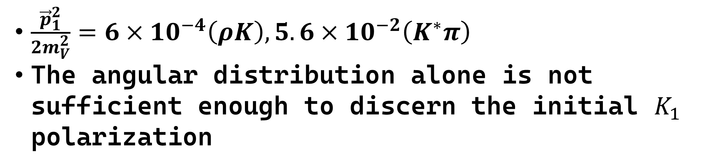

$$K_{1}→ρK \& K_{1}→K^{∗}π$$
$\frac{{\vec{p}}_{1}^{2}}{{2m}_{V}^{2}}=6×10^{−4}\left(ρK\right), 5.6×10^{−2}\left(K^{∗}π\right)$
The angular distribution alone is not sufficient enough to discern the initial $K_{1}$ polarization
Notes:
As for the K1 decay, the distinction of angular distribution between different polarization modes is blur. If we compare p_1^2 and 2m_V^2 term, the final vector meson momentum is suppressed compared to its mass, which increases its ambiguity.

Slide 13



Result2: Final vector meson polarization in A→VP
Specifying the final vector meson polarization.
(It should be feasible in future J-PARC experiment)
Initial $K_{1}$ polarization is distinguished by observing forward or backward.
Notes:
However this matter can be resolved by measuring the final vector meson polarization, which is expected to be feasible in future J-PARC experiment. If we decompose the decay amplitude previously derived with respect to the polarization of the final vector meson, we can obtain the following decay amplitude.

Slide 14
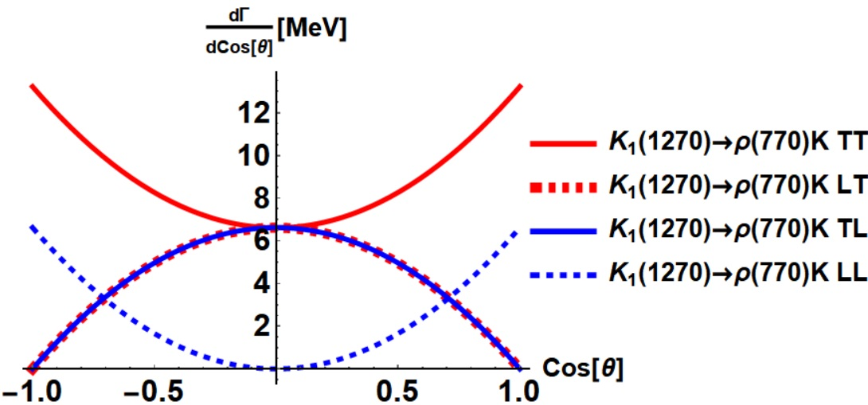
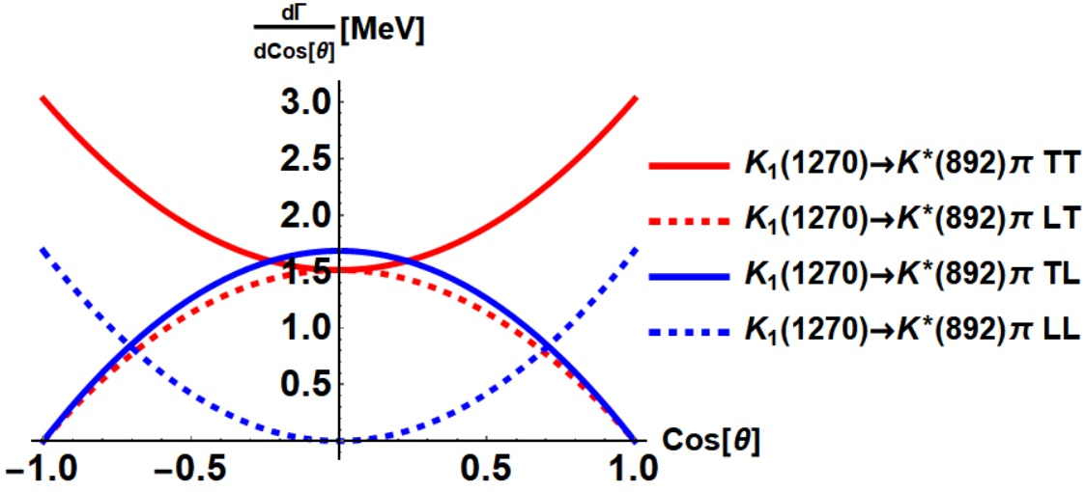
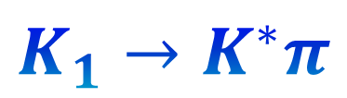

$$K_{1}→ρK$$
$$K_{1}→K^{∗}π$$
Notes:
Now we can see that the separation of polarization is clear. If we isolate the longitudinal K*, we can also isolate the initial K1 polarization by measuring the forward or backward direction.
Next, we analyze the final vector meson in A → VP decay. By measuring the angular distribution of this final meson, we can infer its polarization state. This helps us distinguish whether the parent particle was an axial-vector meson.

Slide 15
Summary of today’s talk
Effective Lagrangian and helicity formalism yield the same result.
In V → PP, forward & backward → Longitudinal vector meson.
In V → ll, forward & backward → Transverse vector meson.
In A → VP, final vector meson polarization measure required.
Discerning (axial) vector meson polarization will help to find more clues about mass shift.
Notes:
To summarize my talk, we have calculated the angular distribution of a vector meson decay using the effective lagrangian and helicity method and they yield the same result. When vector meson decays into two pseudoscalar mesons, we can find longitudinal vector meson in the forward or backward direction while when it decays into dilepton, we can find the transverse thus they are complementary to each other. Moreover when axial vector meson decays into vector and pseudoscalar meson, we can figure out the initial k1 polarization by measuring the final vector meson polarization. Discerning the vector meson’s polarization will provide more clues about its mass shift inside the nuclear matter. Thank you for listening to my talk.
Both the effective Lagrangian method and helicity formalism yield consistent results.
The polarization of vector mesons can be extracted from angular distributions.
Different decay modes highlight different polarization directions.
Most importantly, identifying (axial) vector meson polarization could offer new clues about possible mass shifts, which are important in understanding medium modifications in QCD.

