Slide 1


High School Student’s Interest in Particle Physics
Su-Kyeong Lee^{1,2}, Hyukjoon Choi²
(¹Jeonbuk National University, ²Korea National University of Education)
2025. 5. 30

Slide 2
1. Necessity of the Study
1. Advancement and Impact of Particle Physics
Particle physics explores the fundamental particles and their interactions that constitute nature, based on quantum mechanics and the theory of relativity.
Its technologies have been applied to medical imaging (PET, MRI), radiation therapy, semiconductors, the internet (WWW), and precision sensors, significantly influencing both daily life and industry.
It is not only a theoretical science but also a key driver of technological and societal advancement.
These scientific outcomes are closely linked to our everyday lives. (Sarah, 2022; Anja, 2022; Hasnain, 2021)
2. Increasing Importance of Quantum Physics Education
Since the 2000s, the importance of quantum physics education has been emphasized.
Technologies such as smartphones, semiconductors, and medical devices are based on quantum mechanics, so understanding quantum mechanics is important. (Im Sungmin, 2022)
3. High School Students’ Perceptions and Interest in Particle Physics
Helping students recognize the connection between particle physics and everyday life is a key goal of science education.
For students who choose science tracks, it offers opportunities for career exploration and academic growth.
This study investigates students’ interest in particle physics and how they perceive its relevance to their daily experiences.

Slide 3
1-1. Research Questions
What is the level of high school students’ interest in particle physics?
2. How does the level of interest in particle physics differ depending on students’ subject choices for the College Scholastic Ability Test (CSAT)—social studies or science?
3. What effect does participation in a basic nuclear physics education program have on the perceptions of science high school students?

Slide 4
2. Research Method
1) Research Subjects
303 students from general high schools
2) Survey Method and Period
online survey
IPPI questionnaire(5-point Likert scale)
3) Research Procedures and Tools
- Reliability analysis (internal consistency)
- Interest distribution: frequency analysis, descriptive statistics
- Comparison by elective subjects: independent samples t-test
- Tool: IBM SPSS Statistics

Slide 5
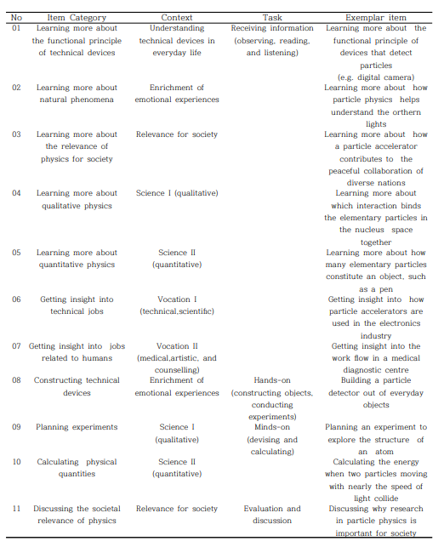
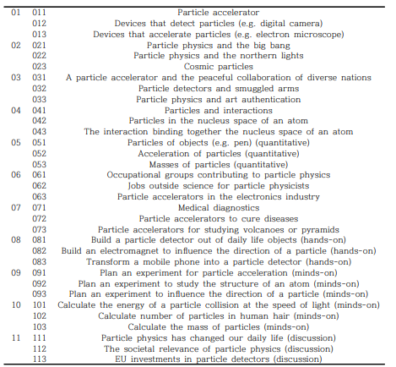
2. Research Method
Sarah , Martin, Julia & Sascha(2022). Students’ interest in particle physics: conceptualisation, instrument development, and evaluation using Rasch theory and analysis, International Journal of Science Education, 44(15), 2353-2380.

Slide 6
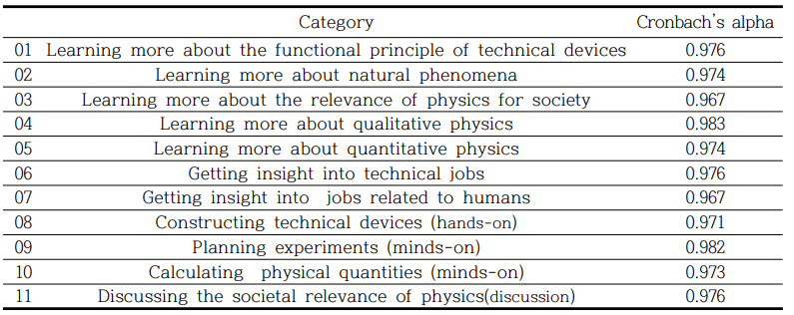
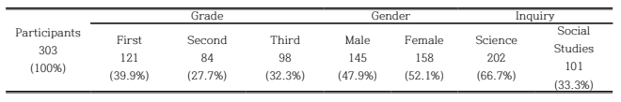
3. Results
Reliability analysis
Internal consistency of the Category (Cronbach’s alpha): .994
2) Frequency analysis

Slide 7
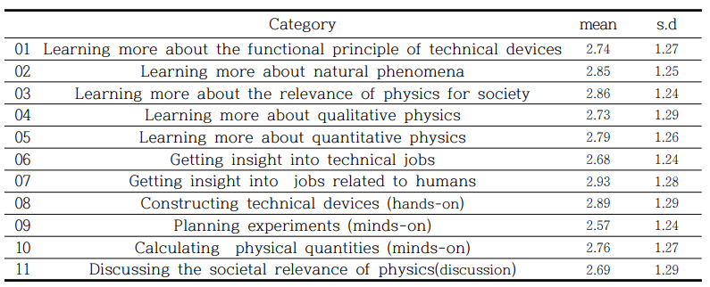
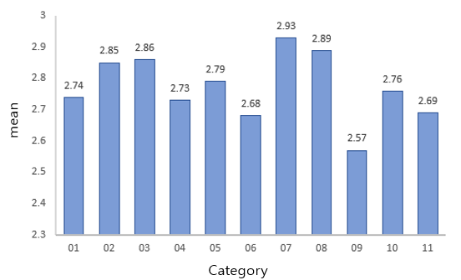
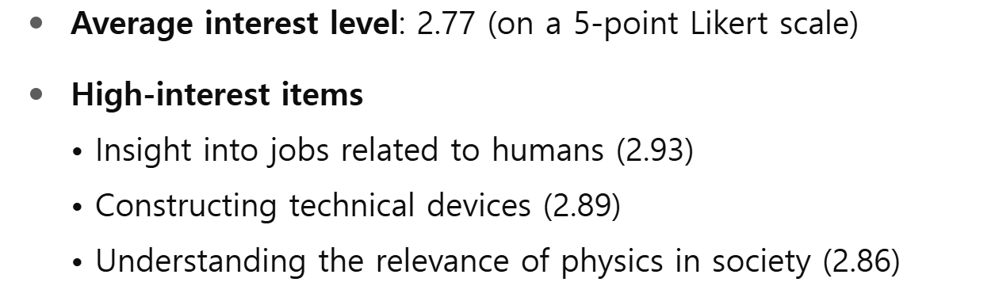
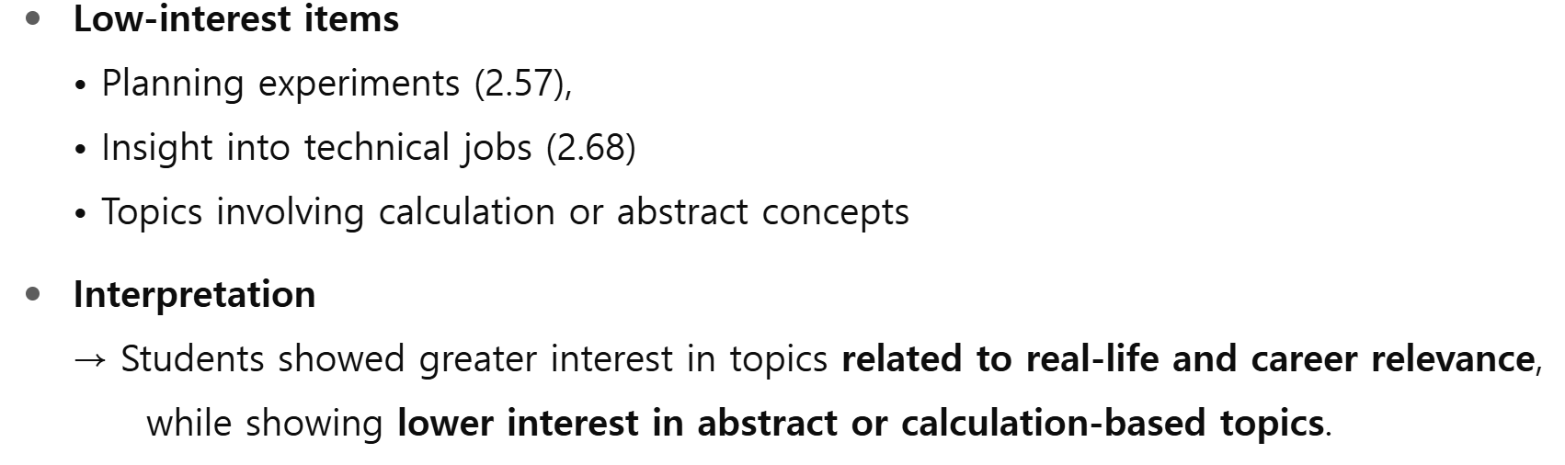
3. Results
< 1. Distribution of high school students’ interest in particle physics >
 | mean | s.d
Interest in particles | 2.77 | 1.16

Slide 8
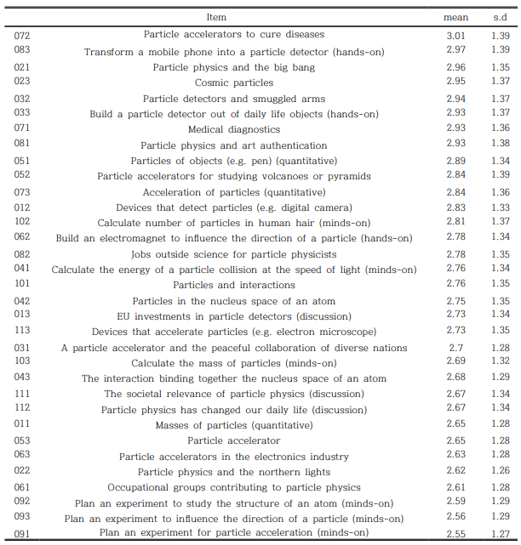
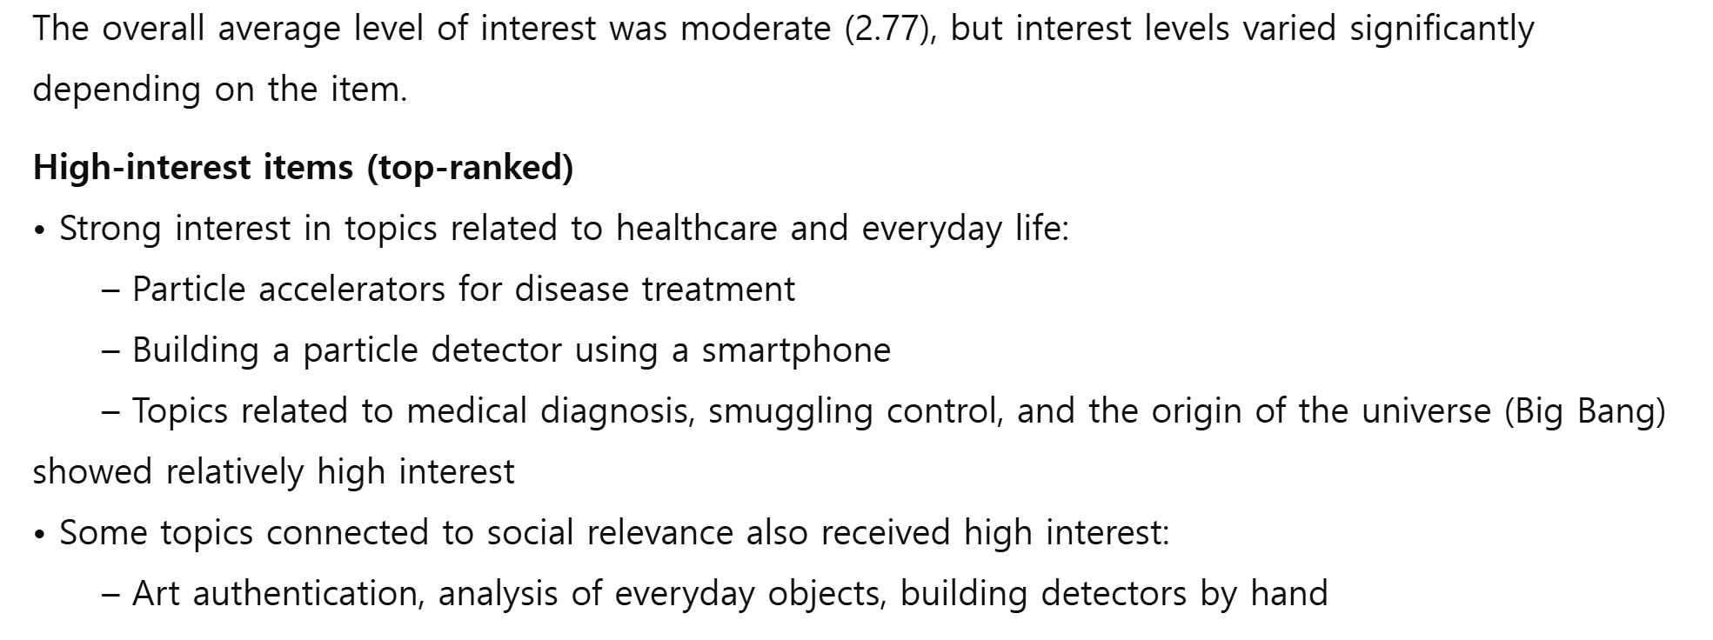
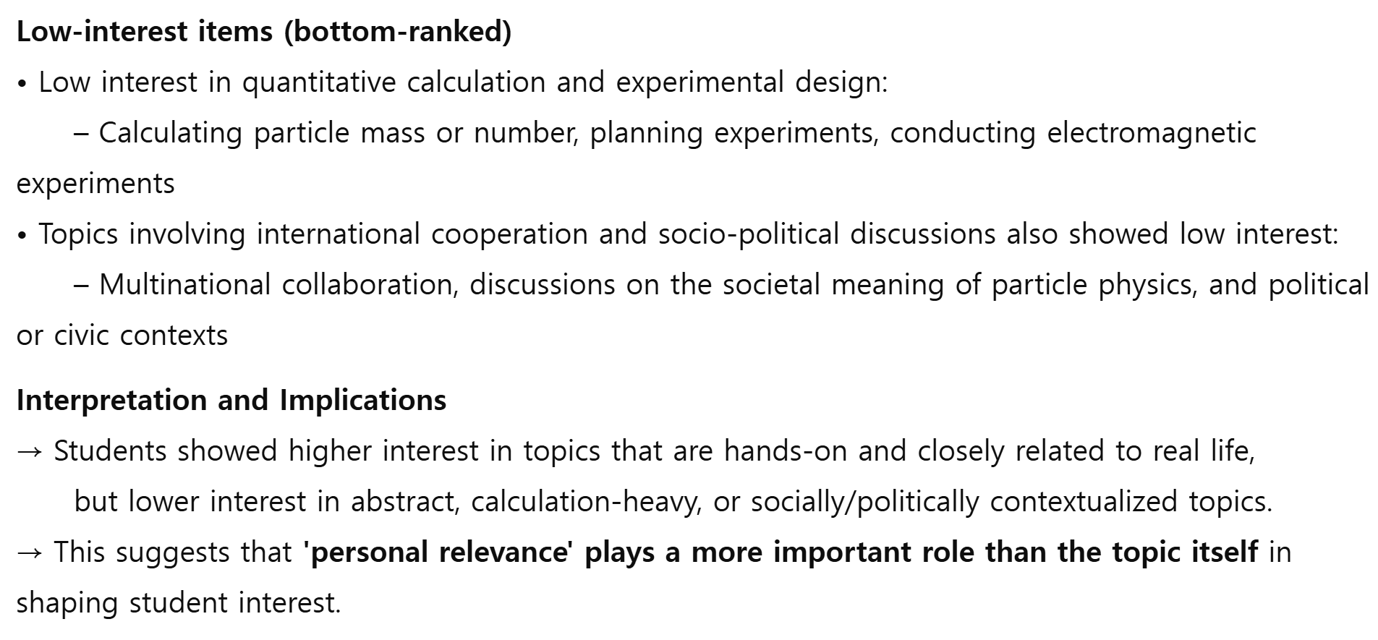
3. Results
< 1. Distribution of high school students’ interest in particle physics >

Slide 9
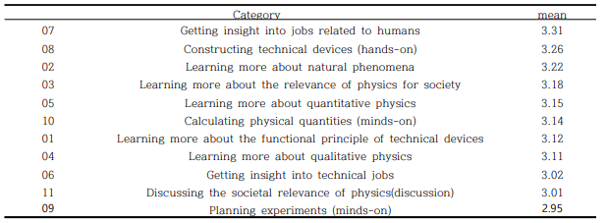
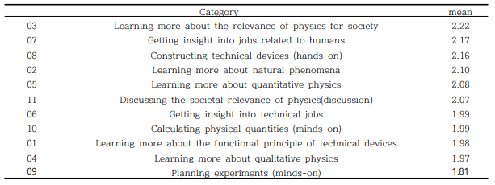
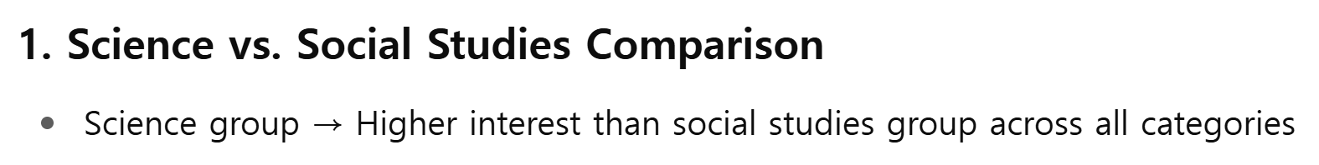
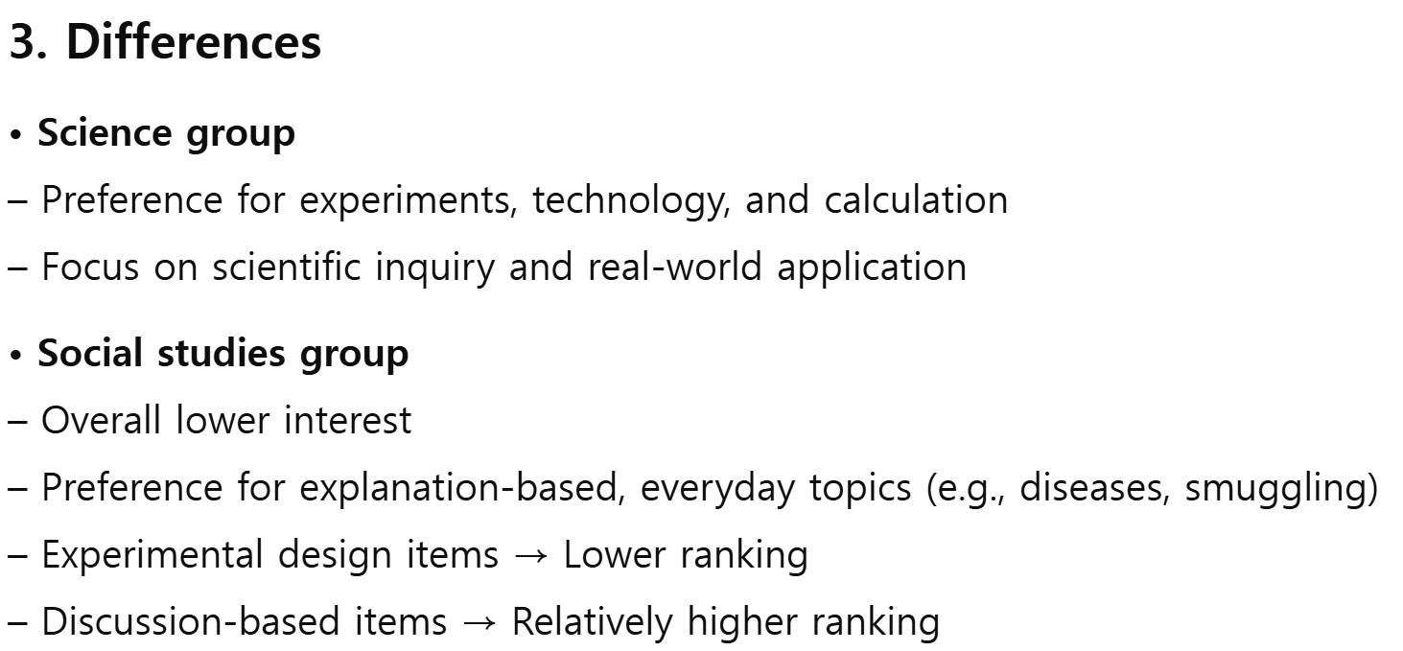
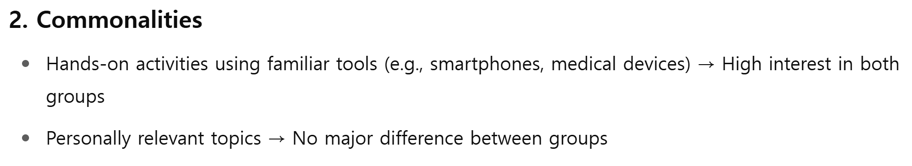
3. Results
< 2. Differences in the distribution of high school students’ interest in particle physics – by elective subject>
<Science>
<Social Studies>

Slide 10
3. Results
1. Overall Interest in Particle Physics among High School Students
- Average interest level: moderate (2.77 out of 5, Likert scale)
- High interest:
Topics related to careers (e.g., disease treatment, medical diagnosis)
Hands-on activities using everyday tools (e.g., turning a smartphone into a particle detector)
- Low interest: Experimental design, abstract concepts, quantitative calculation
Social Issues
High interest in real-life social examples such as disease treatment, safety, smuggling control, and art authentication
In contrast, lower interest in topics related to international issues, global cooperation, or abstract social systems
Also low interest in discussion-based items, such as “the societal meaning of particle physics”
→ Interest is shaped more by 'personal relevance' than by the topic itself
2. Differences by Elective Subject
1) Commonalities
- Both groups showed high interest in activities using familiar tools connected to everyday life
- Ex: Building a particle detector from a smartphone, exploring how medical devices work
→ No subject-based differences for personally relevant topics
2) Differences
- Science
Generally showed higher interest
Actively engaged in activities related to experiments, technology, and calculation
Viewed particle physics as a topic for scientific inquiry and application ( Strong interest in experiment-driven topics)
- Social Studies
Generally showed lower interest
Responded more to explanation-based items with clear connections to daily life
Ex: Disease treatment, smuggling control, hospital-related examples
Low interest in experimental design, calculation, and discussion-focused topics

Slide 11
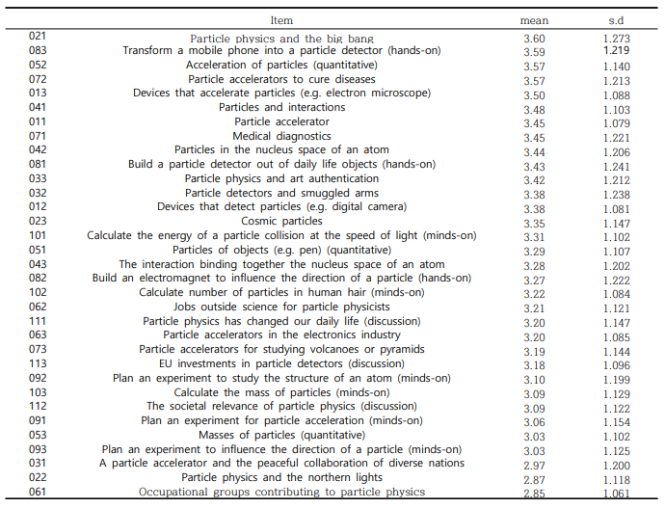
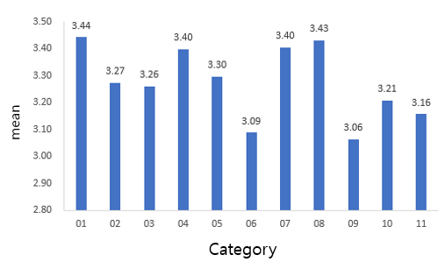
3. Results
< 3. Science High school students’ interest in particle physics (N=117) >
 | mean | s.d
Interest | 3.18 | 0.989490
- Interest Level: Above average (3.18 out of 5, Likert scale)
High Interest:
Understanding the operating principles of technical devices, and constructing experimental tools
Interest in careers related to people, and in qualitative and quantitative physics concepts
Low Interest:
Planning experiments, understanding technical careers, discussing the social relevance of particle physics
Students showed steady interest not only in topics related to everyday life, but also in areas involving technology, experimentation, and scientific calculation.

Slide 12
< Introductory Program in Nuclear Physics Education (with RAON) : Science High School >
1. Program Title: Introductory Nuclear Physics Program for Future Researchers
2. Participants: High school students or above interested in nuclear physics
3. Curriculum: Online lectures and on-site training in basic nuclear physics and experimental data analysis
< Online (ZOOM) and On-site Lectures > (5 sessions × 2 hours = 10 hours total)
1. The Big Bang and the Origin of Cosmic Elements
2. Nuclear Structure and Nuclear Force
3. RAON Nuclear Physics: Oppenheimer or Iron Man?
4. Overview of Particle Accelerators
< Field Practical Training (Research Institute Visit) >
1. Day 1: Introduction to Heavy Ion Accelerators
  Practical Training 1: Isotope Production Simulation using LISE++
  Practical Training 2: KoBRA Data Analysis – Gamma Spectrum, Half-life Calculation
2. Day 2
  Facility Introduction: Rare Isotope Production and Measurement (ISOL, IF Devices)
  Field Tour: ISOL and IF Experimental Laboratories
- Introductory nuclear physics education program jointly operated by RAON and Jeonbuk Science High School
- Volunteer participants from Jeonbuk Science High School
- Analysis of participant changes based on pre- and post-program surveys (16 out of - 21 participants completed both surveys)
-

Slide 13

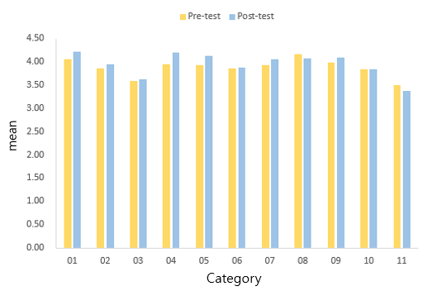
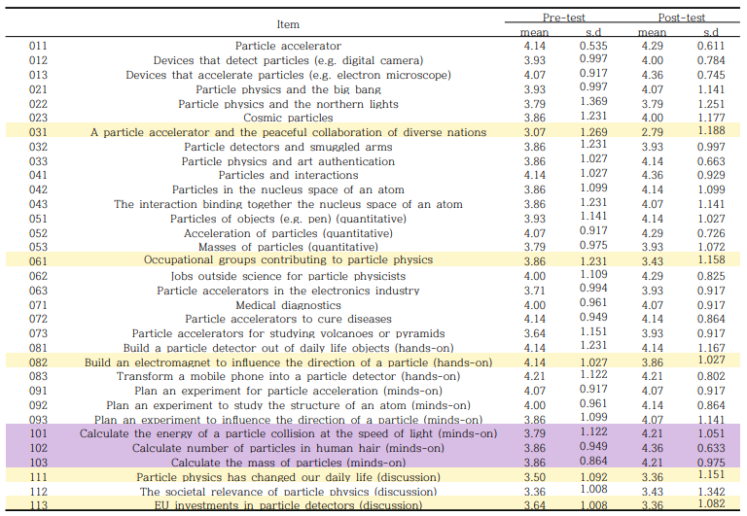
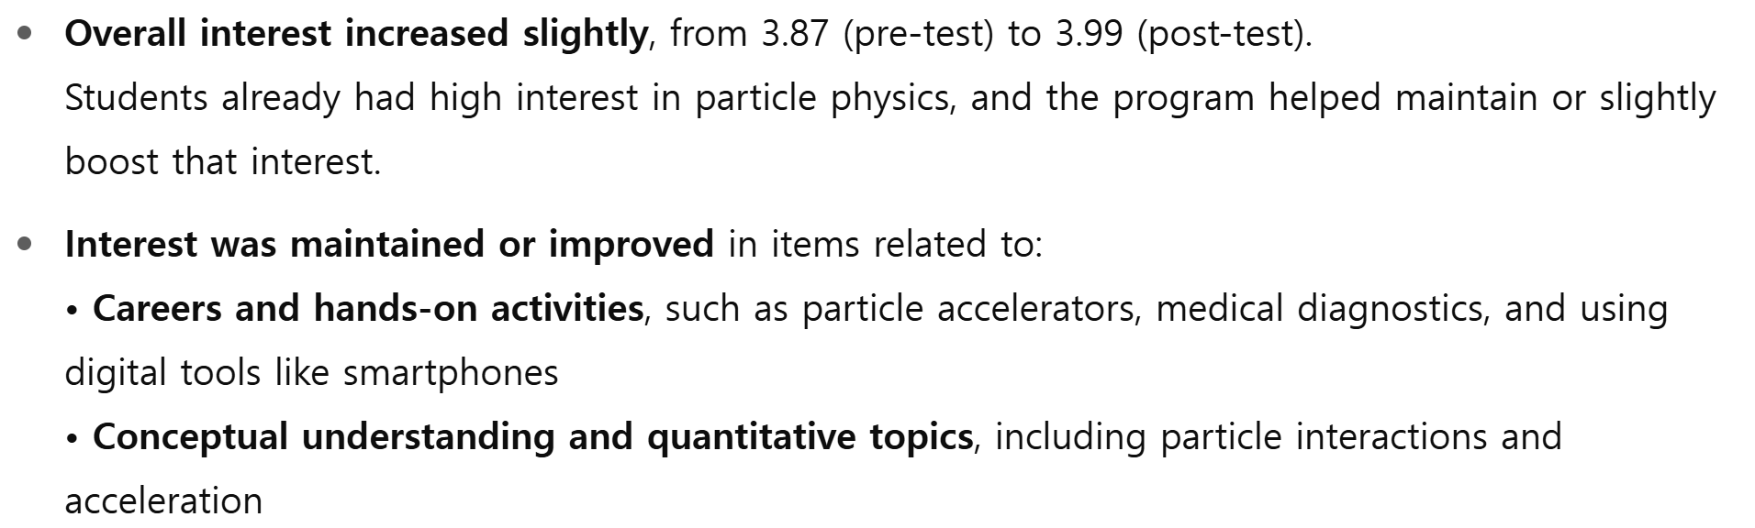
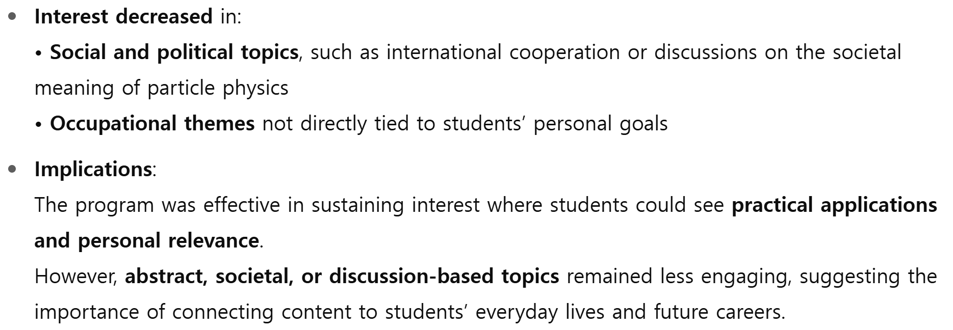
3. Results
< 3-1. Introductory Program in Nuclear Physics Education (with RAON) : Science High School (N=16)>

Slide 14
3. Results
1. Pre-Post Average Interest Level: Pre 3.87 → Post 3.99
Participating students already had high interest in nuclear/particle physics, and their level of interest remained stable even after the program.
Changes in interest showed varied responses depending on the content and context of each item.
2. Analysis of Interest Changes by Major Item
Maintained and Improved: Concept understanding, hands-on experiment activities, technology application, and job-related items.
Decreased: Discussions on the relevance of physics and society, international cooperation (multinational accelerators), and discussion topics on socio-political relevance
3. Post-Program Survey
1) Changes in Understanding of Nuclear and Particle Physics
Students specifically mentioned practical application areas such as "medical treatment, diagnosis, robotics, and rare isotopes."
They demonstrated a deeper understanding of concepts beyond simple definitions, specifically mentioning concepts like "fermion structure," "elementary particles," and "heavy ion accelerators."
  "It was good to learn more about the structure of fermions."
  "I used to think of accelerators as simple devices, but I realized they are used in multiple scientific applications."
2) Changes in Perception of Accelerator Experiments
Accelerators were perceived as moving from simple physical devices to tools connected to complex and diverse fields.
Specifically mentioned applications in life sciences, rare element detection, and medical diagnosis.
  "I didn't know it was used so much in life sciences."
3) Changes in Career-Related Perception
Some students specifically set career directions such as "nuclear physicist," "semiconductor specialist," or "medical device developer."
Students recognized the relevance between their career paths and the field of physics (including both direct and indirect connections).
  "I was able to have greater interest in the field of physics, including nuclear physics."
  "I thought I wanted to become someone who creates medical devices or software."

Slide 15
4. Conclusion
1. Designing Career-Linked Topics (General Recommendation)
Connect nuclear and particle physics with actual career fields, including medicine, semiconductors, and diagnostic technologies.
2. Strengthening Concrete Experience-Based Teaching and Learning Methods
Provide hands-on activities using familiar tools and materials, such as simple experiments and model construction.
3. Relationship between Nuclear & Particle Physics and Society
Incorporate discussion activities to help students understand the social implications and relevance of nuclear and particle physics.
4. Activating Collaborative Programs with Research Institutes
Offer opportunities for in-depth learning in relation to career development.
Facilitate program connections with active research sites, such as RAON.

Slide 16
Thank you.

