Slide 1
The 29th International Nuclear Physics Conference, May 25-30th, 2025
Origin of the Low-Energy Enhancement in the γ-Ray Strength Function
Fang-Qi Chen
Lanzhou University

Slide 2
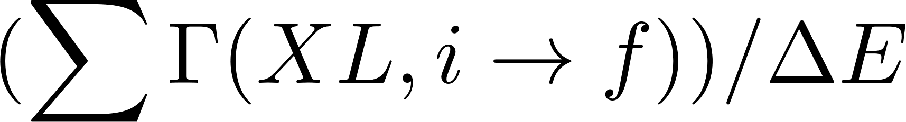
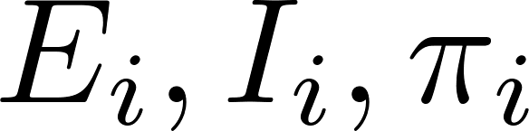

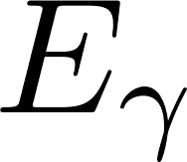
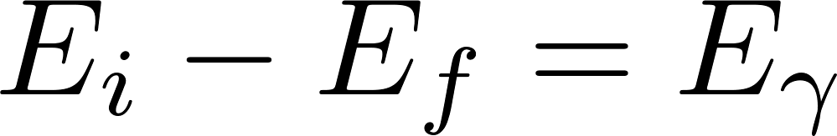
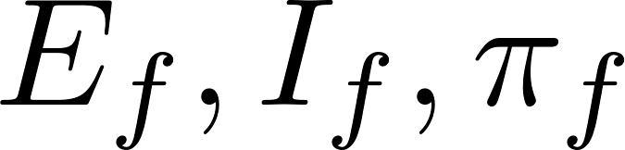
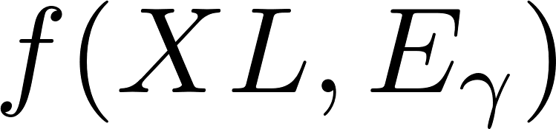
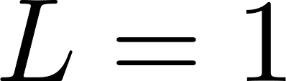
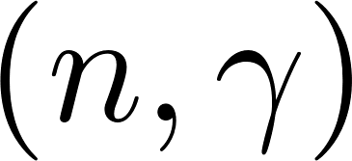
The γ-Ray Strength Function
A statistical measure of the reduced transition width in the quasi-continuum
Initial & final states intervals
Transition width averaged over given initial & final interval
Converted to reduced transition width using
Averaged over all intervals with
γ-ray strength function
dominated by
Applications in radiative neutron capture
level densities, optical potentials,…
γ-ray strength function
Hauser-Feshbach model
reaction rates

Slide 3
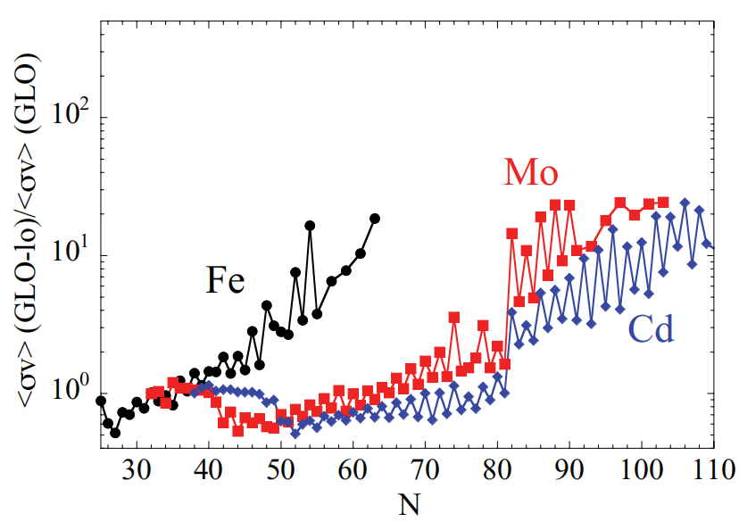
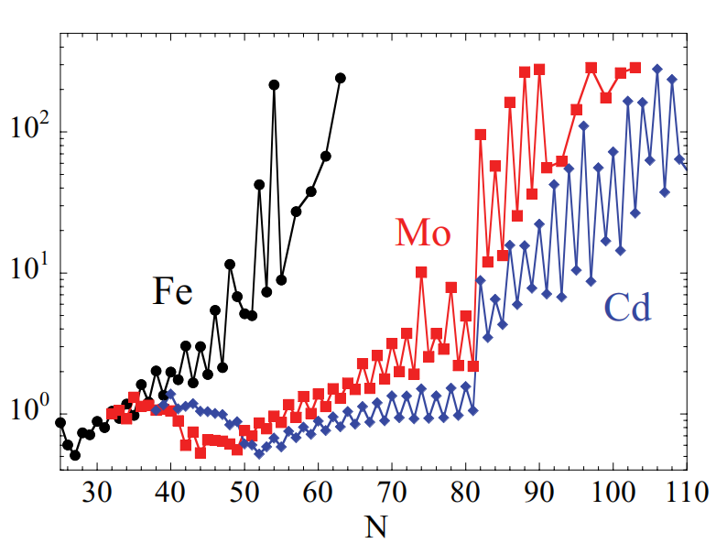
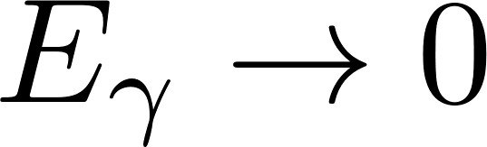
Low-Energy Enhancement (LEE) in the γ-ray strength function
Low-Energy Enhancement
Impact on the neutron capture and r-process
PRL 93, 142504 (2004)
PRC 82 014318 (2010)
Reaction rates (normalized)
~10 times
⁵⁷Fe
⁵⁶Fe
w/o LEE
With LEE
Exponential enhancement at
Neutron capture rate significantly enhanced in the neutron-rich region
Observed in more and more nuclei (mostly weakly deformed)
Non-negligible effect on the r-process expected

Slide 4
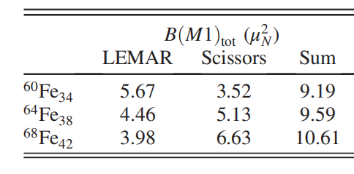
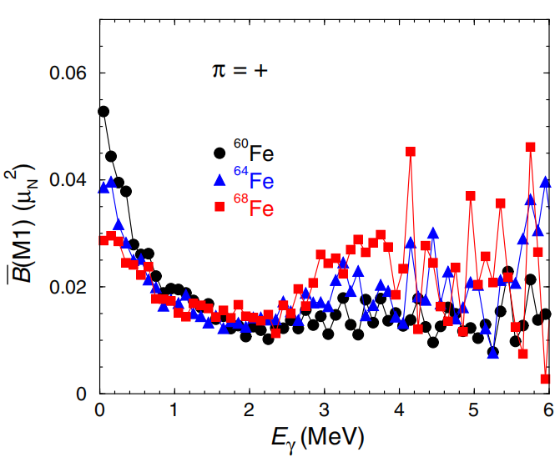
Low-Energy Enhancement and the scissors motion
Possible connection between LEE and the scissors motion suggested by shell model calculation
PRL 118 092502 (2017)
LEE
scissors resonance
LEE
towards open shell
decrease
increase
Approximately conserved
“Conservation” supported by one Oslo data in odd-mass Sm isotopes (PRC 99 054331 (2019))
But not by the later observations for the Nd isotopes
not confirmed experimentally
Origin remains unknown
LEE
Scissors motion

Slide 5
Nuclear scissors motion and the aim of this work
Nuclear scissors motion
Oscillation between intrinsic orientations of protons & neutrons
neutrons
3
protons
2
Scissors motion:
Small-amplitude oscillation in well deformed nuclei
1
The “scissors motion” in weakly deformed case
oscillation
LEE:
observed mostly in weakly deformed nuclei
The aim of this work
Theoretical description of the scissors motion
Scissors motion in weakly deformed case
Origin of LEE in terms of scissors motion

Slide 6
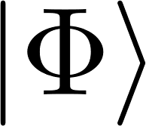
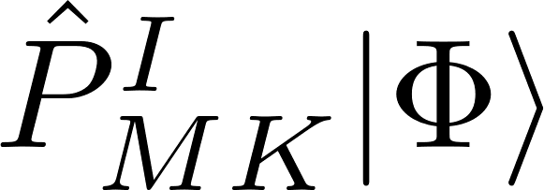
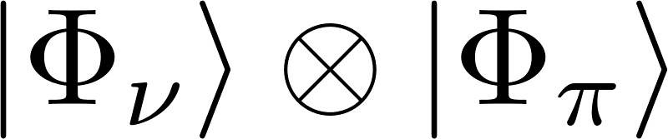
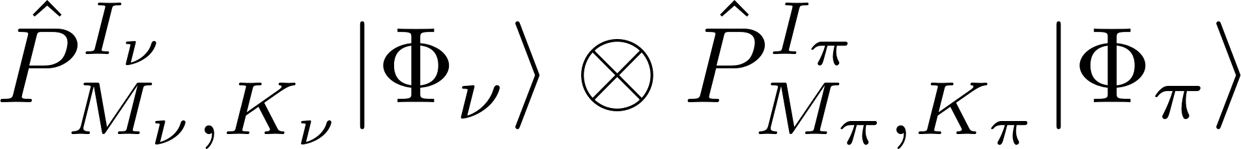
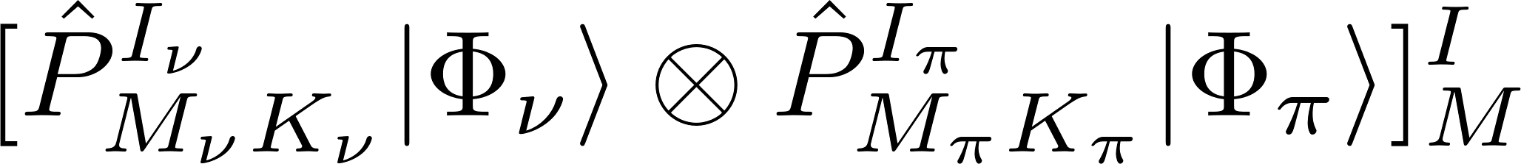
Theoretical description of the scissors motion (I)
Scissors motion as the motion of two rotors described by angular momentum projection
Angular momentum projection for a single rotor:
intrinsic state
laboratory state
basis for
Hamiltonian diagonalization
angular momentum
projection
generalization
Angular momentum projection for a neutron and a proton rotors:
intrinsic state
projected state
does not have a good total angular momentum
angular momentum coupling
basis for
Hamiltonian diagonalization
laboratory state

Slide 7
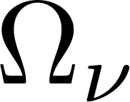
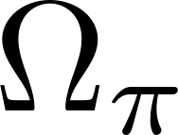
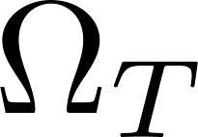
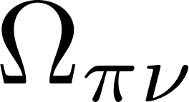
Theoretical description of the scissors motion (II)
Illustration of the scissors motion
Illustration of the scissors motion
Probability distribution of the scissors angle
Wave function in terms of the scissors angle
Wave function expanded on
Orientation of the neutrons
Orientation of the protons
transformation
Relative orientations between protons & neutrons
Orientation of the principle axes for the whole nucleus
(the scissors angle)
Illustration of the collective rotation of the scissors mode
Illustration of the intrinsic motion between protons and neutrons (the scissors motion)

Slide 8
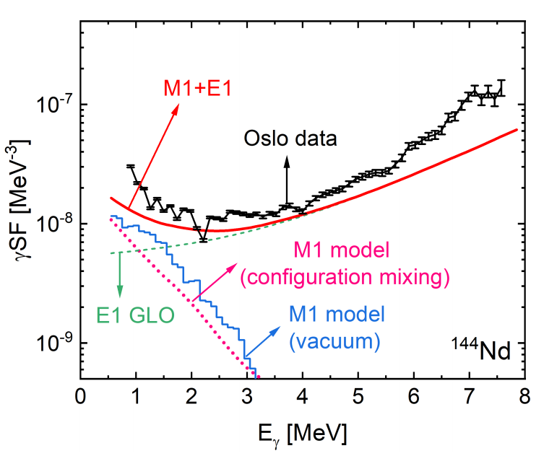
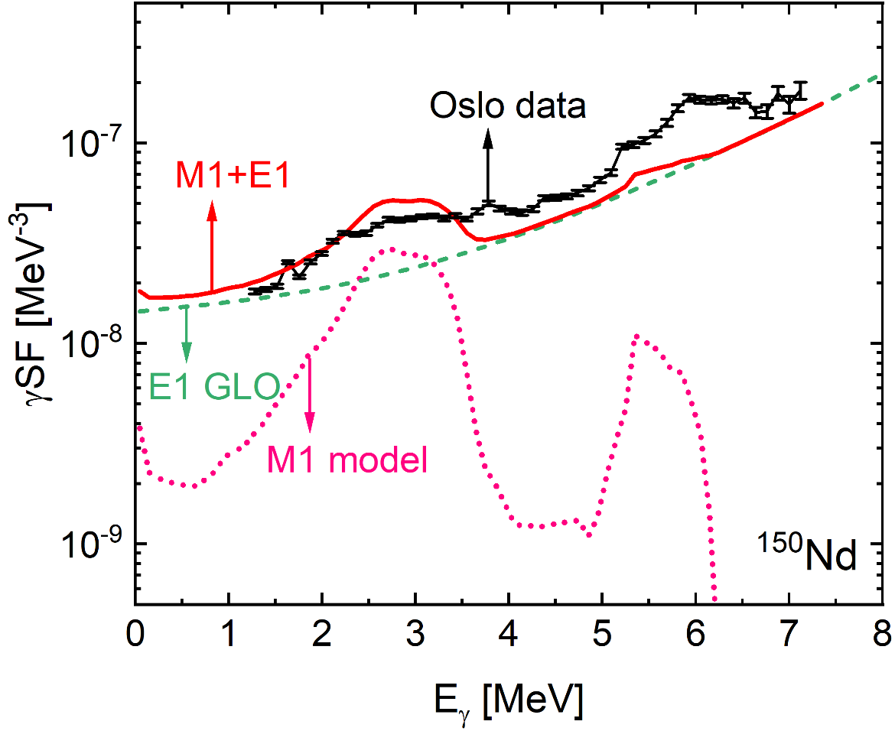
Calculated γ-Strength Function
Exp reference: M. Guttormsen et al, PRC 106, 034314 (2022)
Exp data: https://www-nds.iaea.org/PSFdatabase
Weakly deformed nucleus
Well-deformed nucleus
LEE appears as expected
LEE disappears as expected
even with a single intrinsic g.s. configuration
and is replaced by the scissors resonance
Origin of the LEE is embedded in the model, even with the intrinsic g.s. configuration only

Slide 9
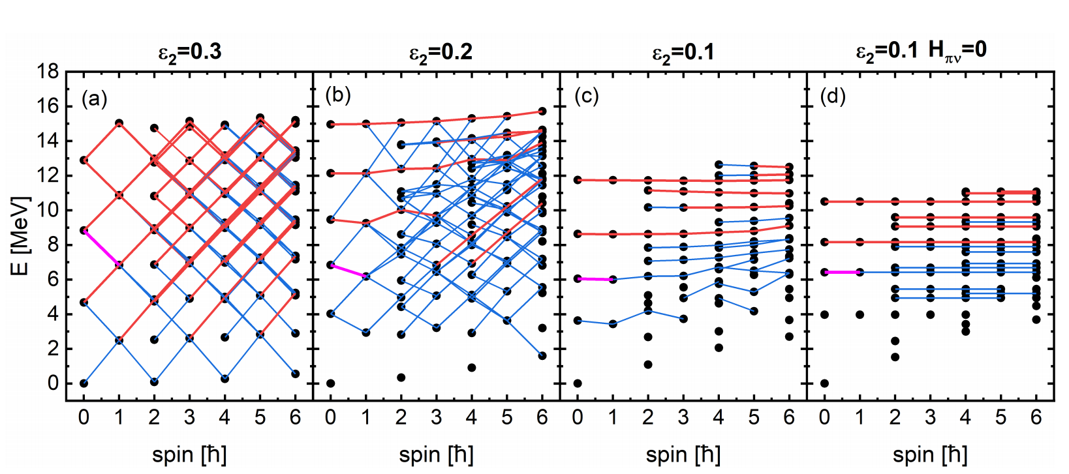
Scissors spectra obtained with the intrinsic g.s. configuration
similarity
Rhombus-like regularity
Rhombus corroded
Band-like structure
dominates
Band-like structure from free scissors motion
Harmonic oscillation
Band-like structure
(leading to LEE)

Slide 10
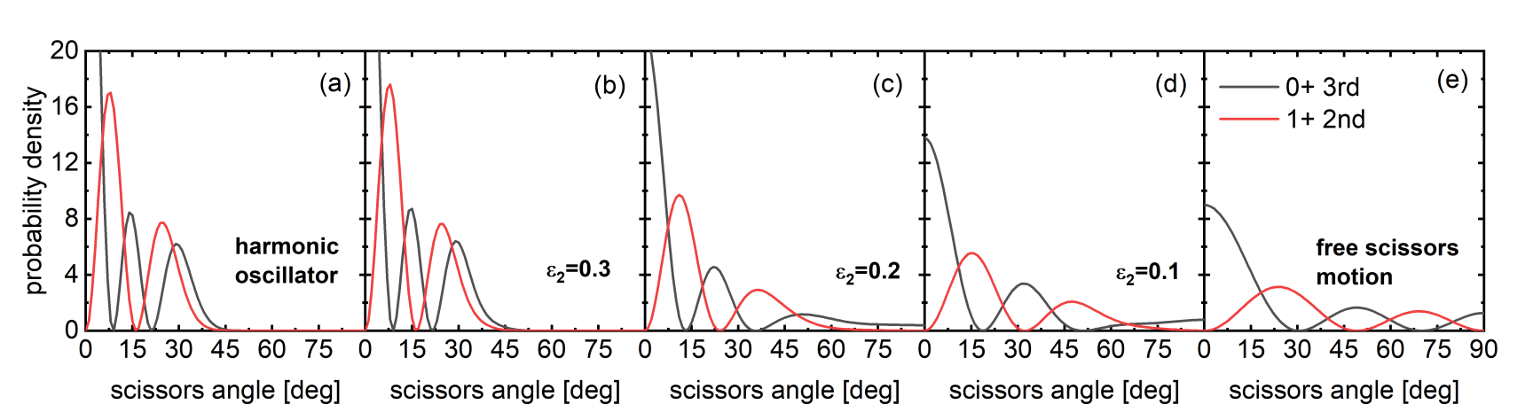
Evolution towards free scissors motion
strong M1 transition
0+ 3rd
Probability distribution of the scissors angle:
1+ 2nd
Harmonic limit
Large deformation
Intermediate deformation
Small deformation
Free limit
Harmonic oscillator
Almost harmonic
Development of
anharmonicity
Closer to free scissors motion
Free scissors motion
Deformation decreases
Harmonic scissors oscillation
Free scissors motion

Slide 11
How does the scissors motion becomes free
Scissors angle
Reduced n-p spatial overlap
Energy cost
Large deformation
Small deformation
Sharp reduction of n-p overlap
Mild reduction of n-p overlap
Large energy cost
Small energy cost
Steep energy surface
Flat energy surface
Well confined scissors motion
Approximately free
scissors motion
LEE: A simple geometrical effect due to weak deformation
However, ……

Slide 12
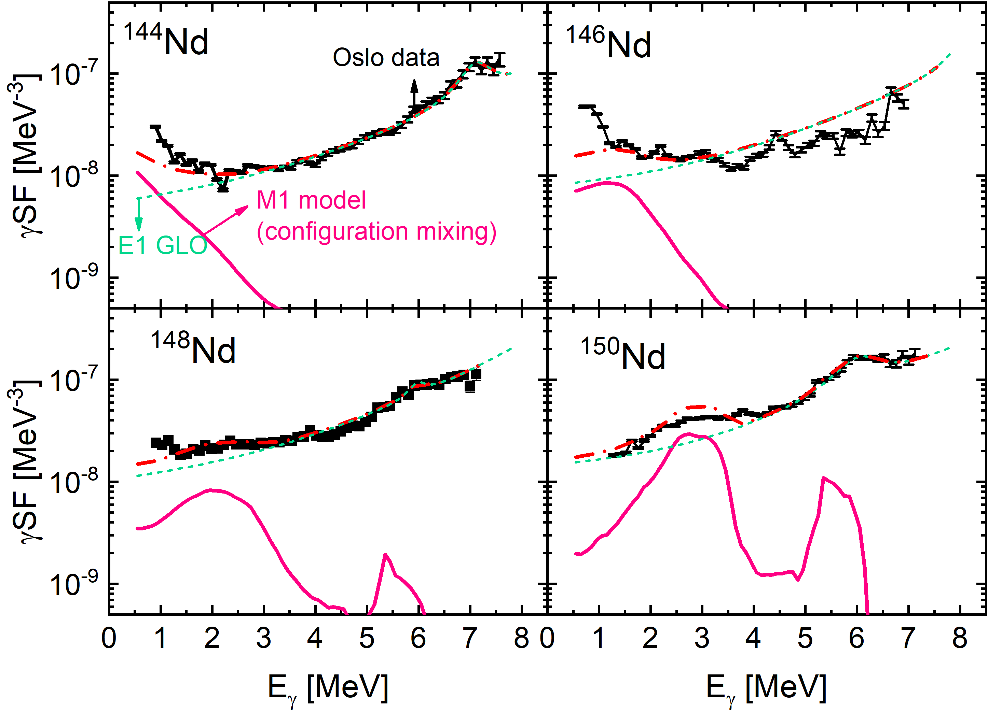
Systematic underestimation of the LEE strength
Exp reference: M. Guttormsen et al, PRC 106, 034314 (2022)
Exp data: https://www-nds.iaea.org/PSFdatabase
Underestimation of the LEE
Possible overestimation of the scissors resonance
Coexistence of LEE & scissors resonance?

Slide 13
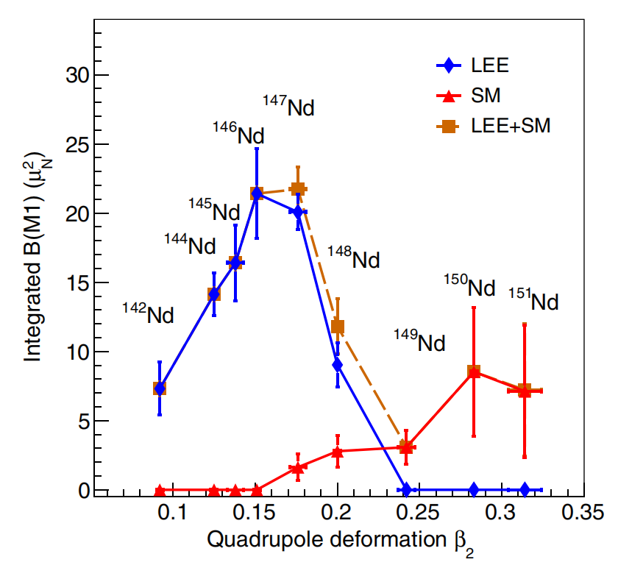
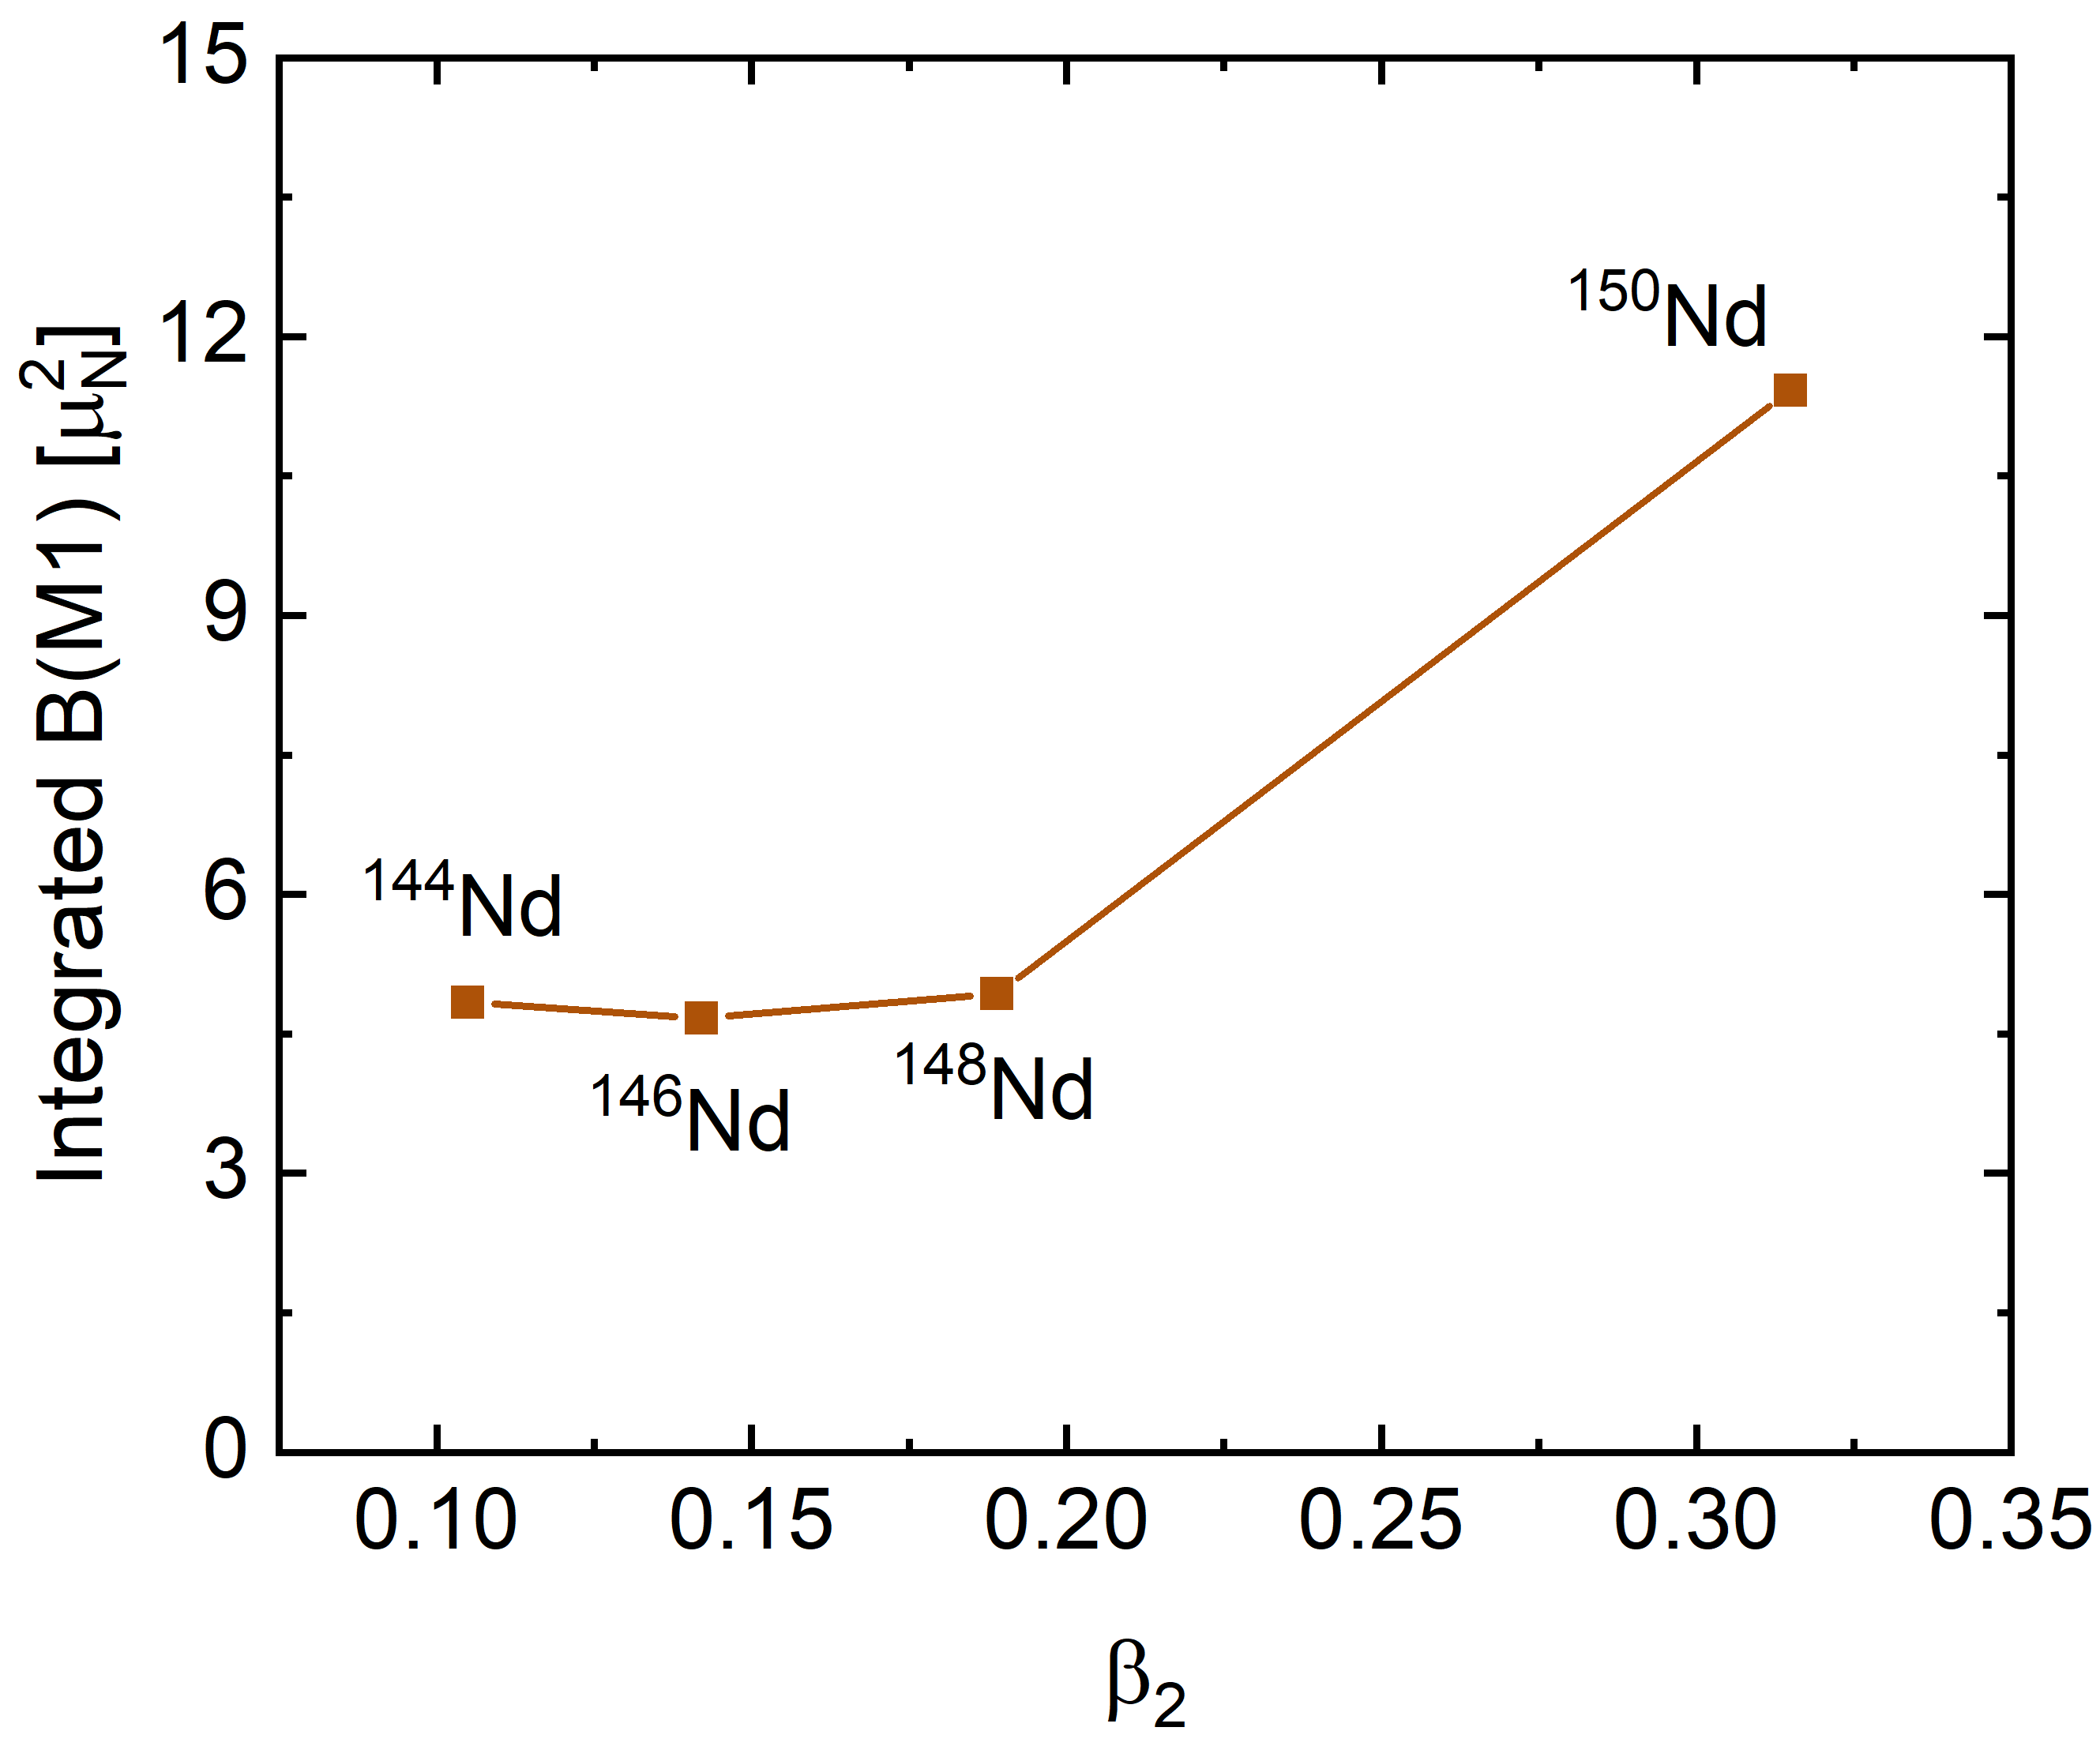
Evolution of the total strength of LEE and scissors resonance
Experimental result
(using exponential/SLO fited data)
Calculated result
LEE region > Scissors resonance region
LEE region < Scissors resonance region

Slide 14
Summary
Scissors motion is described as the relative motion between a neutron and a proton rotors, which is not restrict to the picture of the well-known scissors oscillation.
Scissors motion in weakly deformed nuclei becomes approximately free, as a straightforward result of the weak deformation.
The approximately free scissors motion leads to characteristic spectra that generates the Low-Energy Enhancement in the γ-Ray Strength Function.
However, the LEE strength is systematically underestimated by the present framework, and the evolution of the total strength of LEE and scissors resonance is not understood.

Slide 15
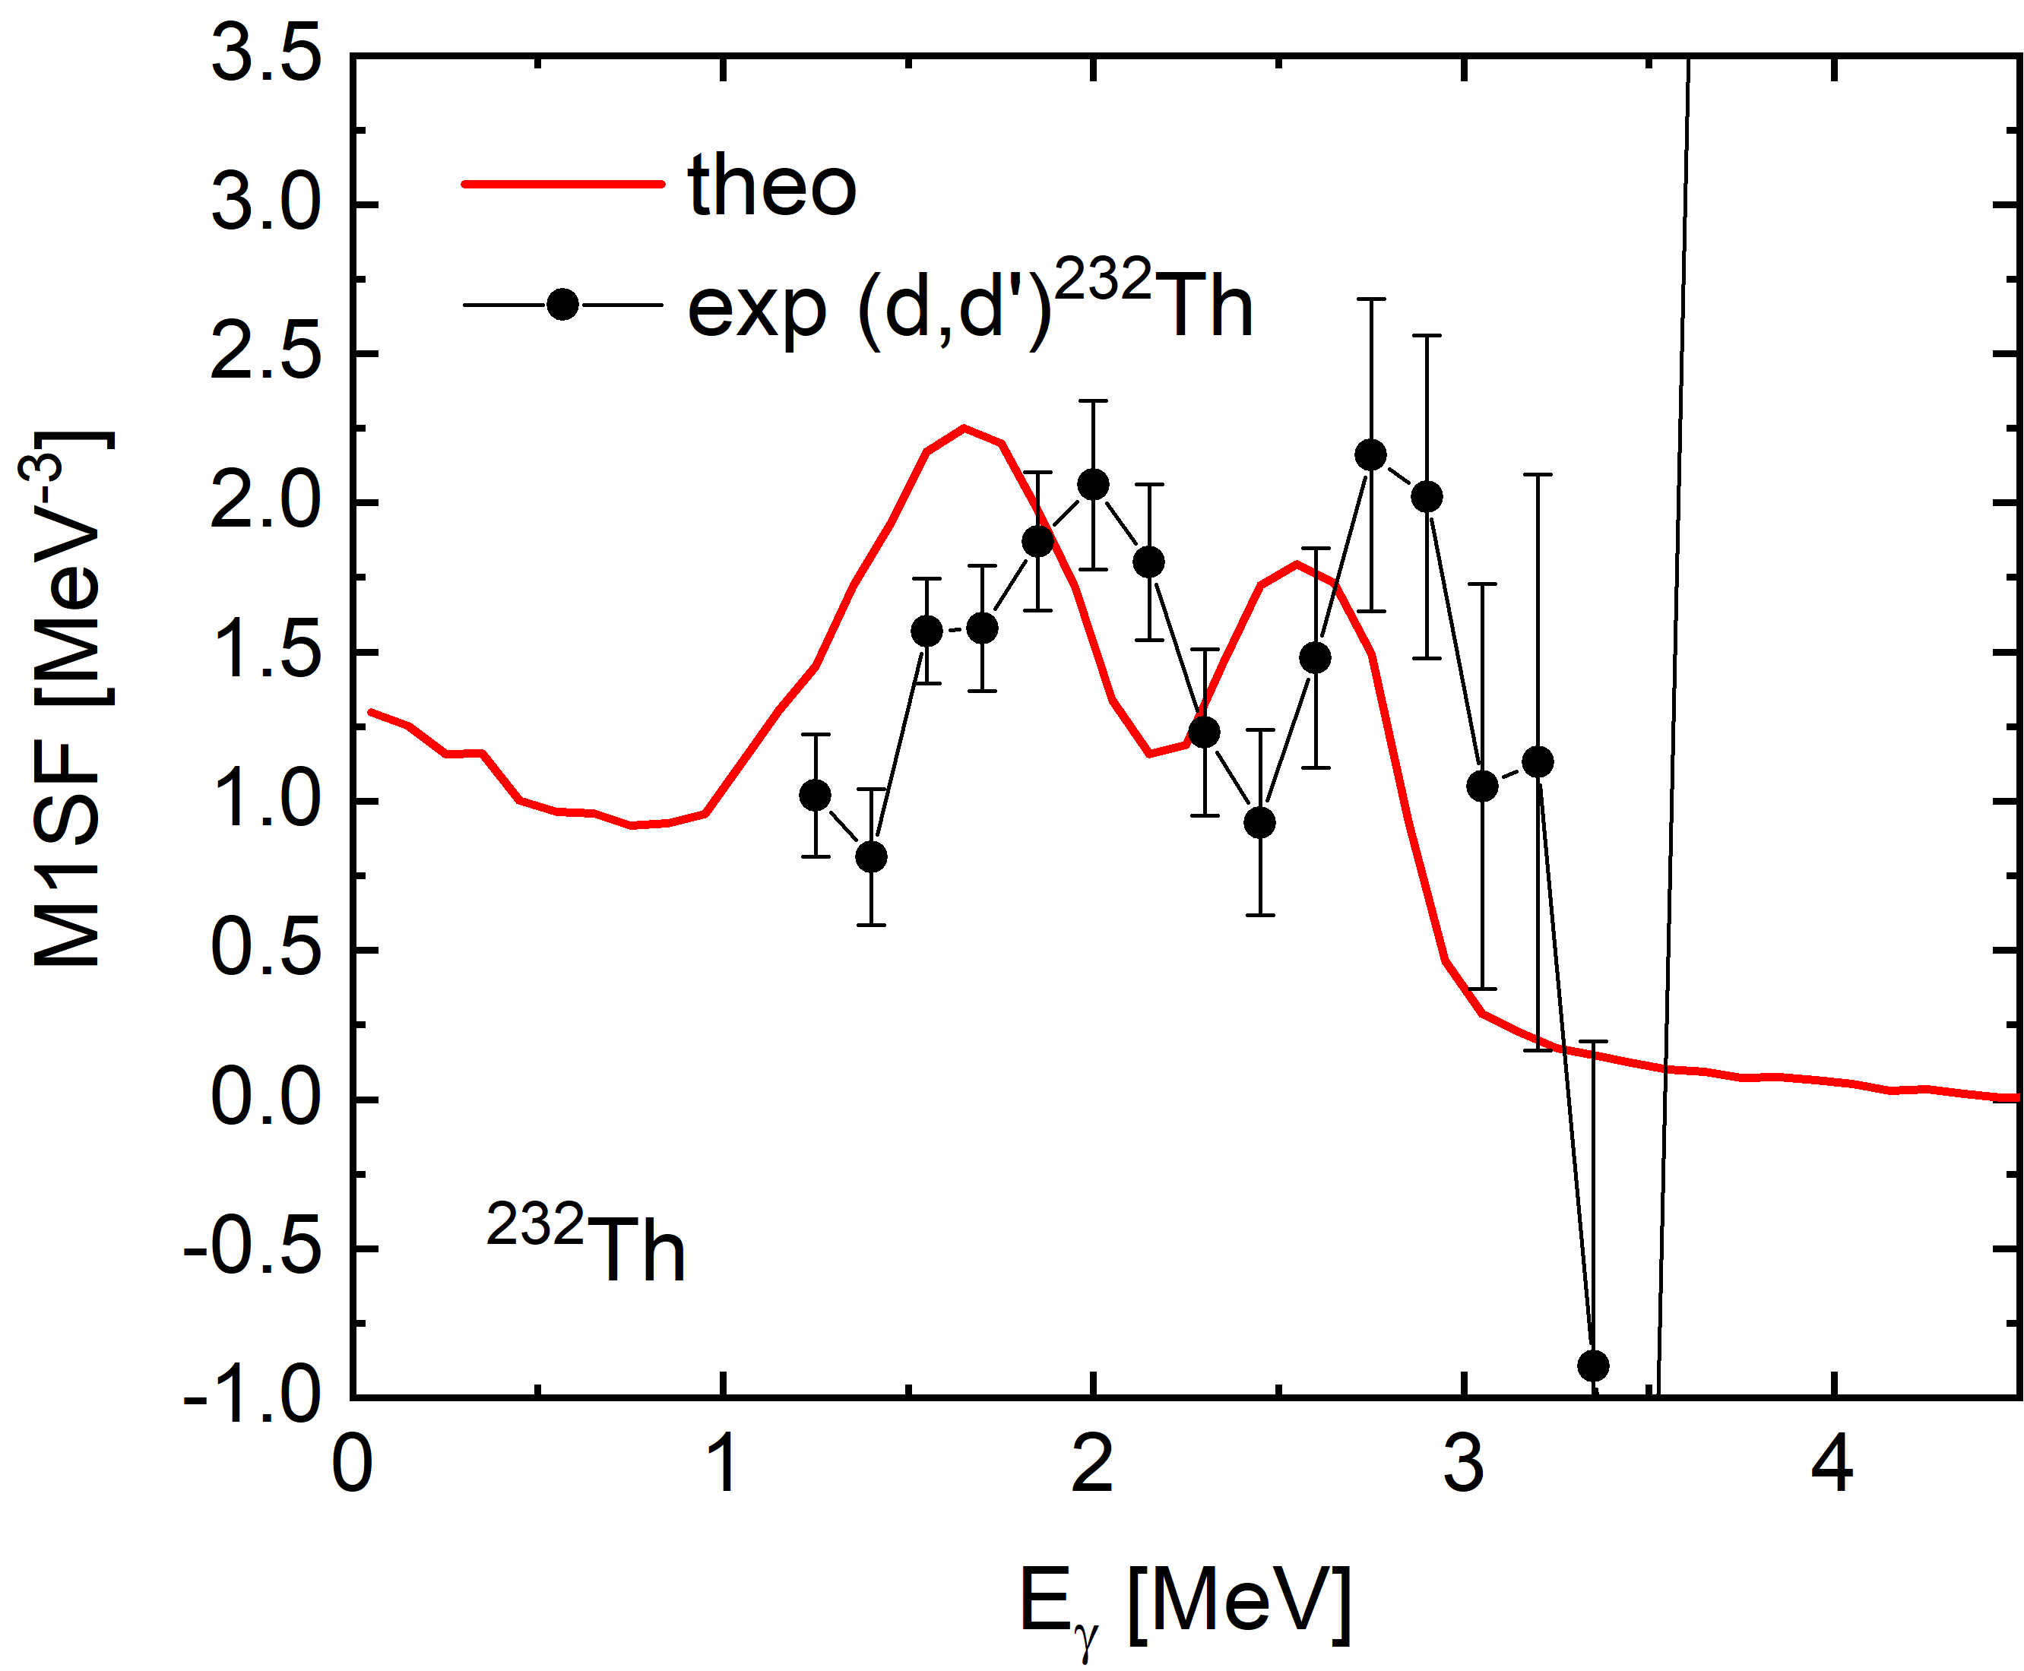
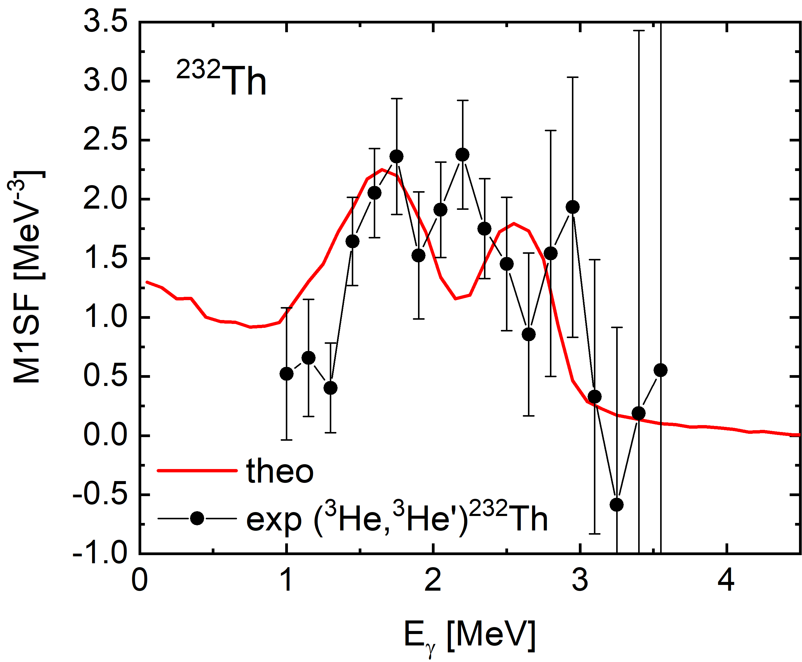
Prospect: Splitting of the scissors resonance in the actinide region
Exp reference: M. Guttormsen et al, PRC 89, 014302 (2014)
Exp data: https://www-nds.iaea.org/PSFdatabase
Preliminary
Preliminary
Preliminary
Splitting of the scissors resonance reproduced qualitatively
Discussion on the splitting mechanism is ongoing ……

Slide 16
Collaborators:
Y. F. Niu (Lanzhou University)
Yang Sun (Shanghai Jiao Tong University)
Mathis Wiedeking (LBNL)
Acknowledgment to Zhi-Xiang Huang for the help in preparing the last two figures.
Thanks a lot for your attention!

