Slide 1

Explainable AI meets Feynman Integral
——AI assist IBP reduction
Zhuo-Yang Song ,Tong-Zhi Yang ,Qing-Hong Cao ,Ming-Xing Luo ,Hua Xing Zhu
arXiv:2502.09544
2025/02/27
Notes:
The motivation of this research is to apply AI on HEP theory field, and bridge between the two area.

Slide 2

Artificial Intelligence is not precise
$$50\% → 99\% → 100\%$$
Machine Learning
Black box
Interpolation
?
Explainable
Scalable
Robust
Schwartz M D. Modern machine learning and particle physics[J]. arXiv preprint arXiv:2103.12226, 2021, 26.
Notes:
However, this attempt faces one main challenge. That’s : AI is not a precise method, but a great approximation.
Though neural network has been applied on LHC dataset for so long time and made so many progress that we may say HEP experimenters are one of the first who do AI4S. Relatively little progress has been made in theoretical field. Maybe it’s because that solving a theory problem directly by AI is hard. Since we do not want the right answer for 99% inputs, nor for 99.9% inputs , but for 100% inputs.

Slide 3

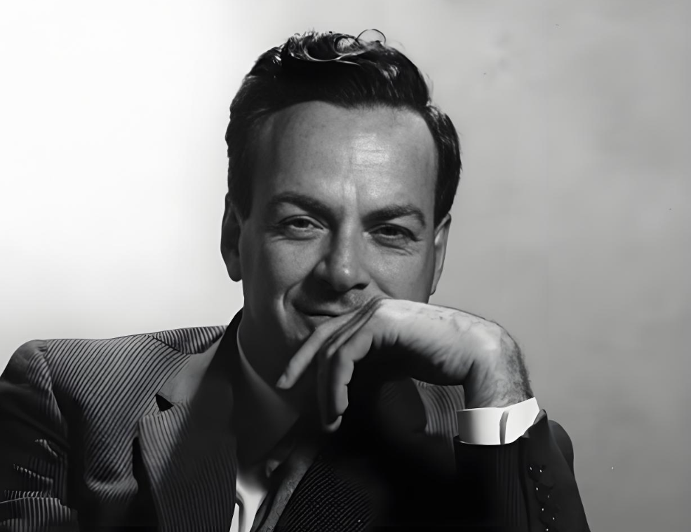
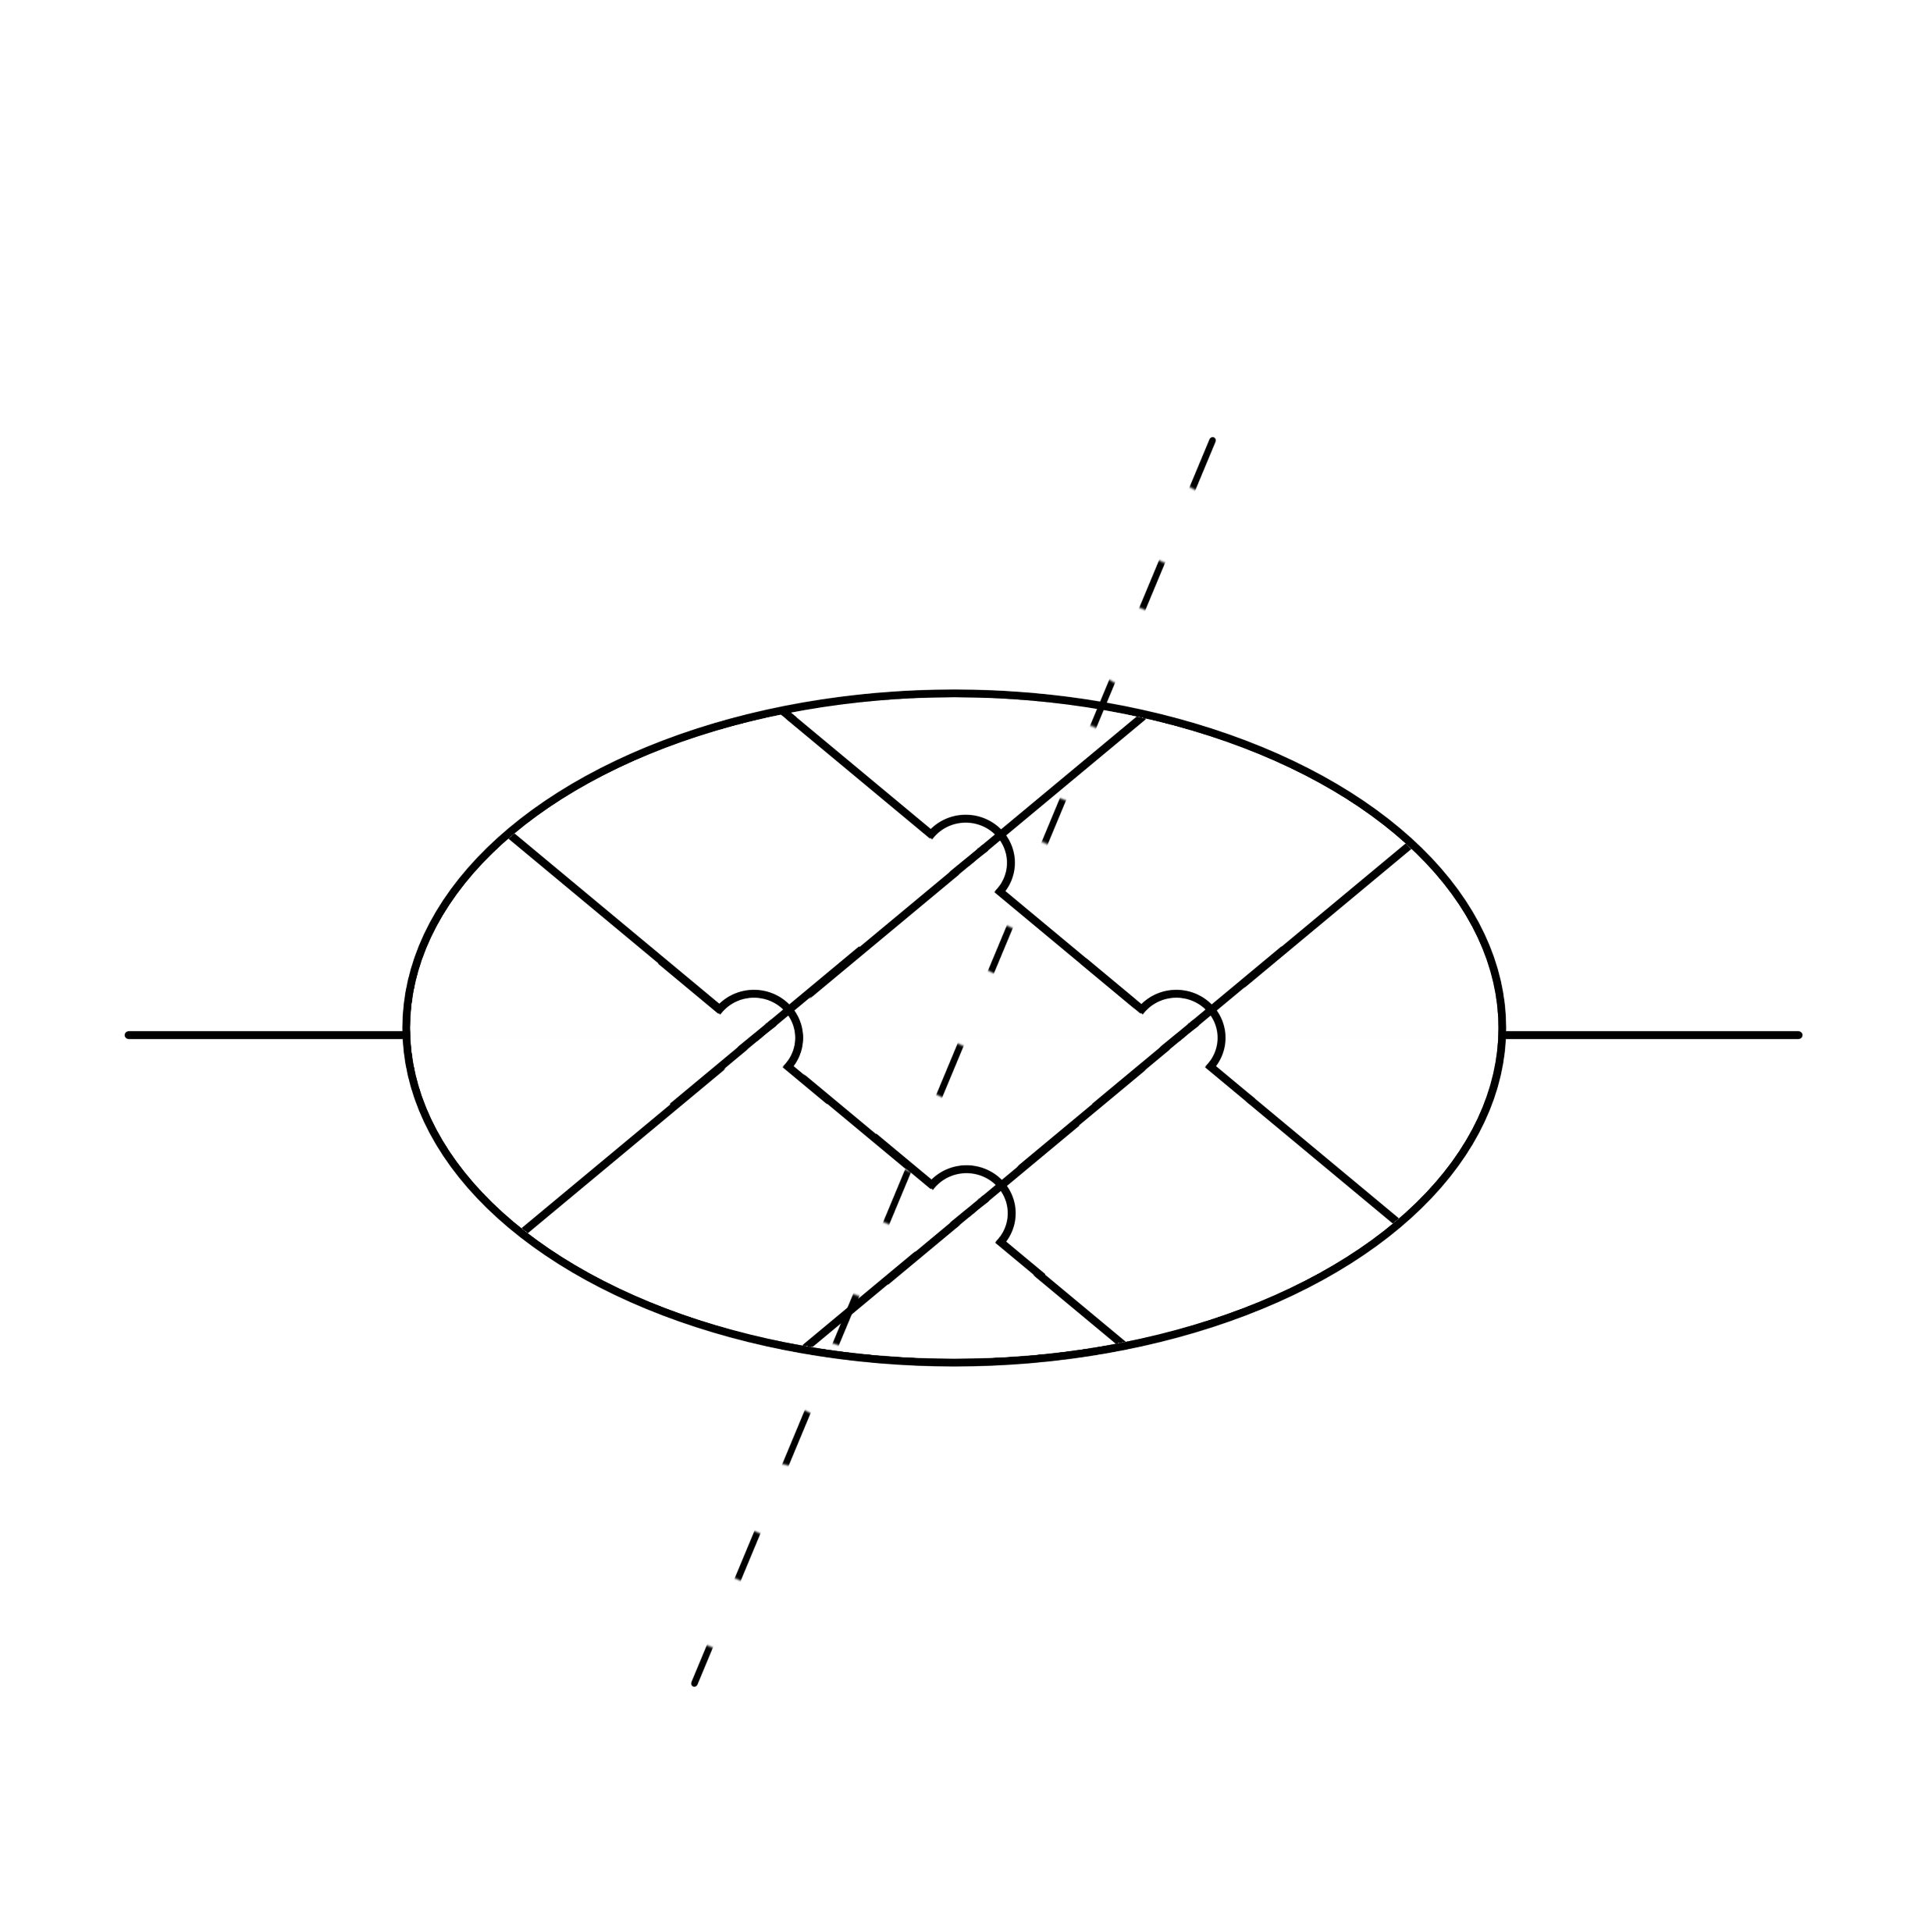

Feynman Integrals and its calculation method
calculating Feynman integrals efficiently remains challenging due to the computational demands of traditional methods.
Notes:
Maybe we should keep this question mark in mind, and see the special question to find out how to solve it. Now, The second part of the title is Feynman integral, and we can start right here.
Someone said that every theory in theoretical physics is trying to calculate the path integral by a special way. Maybe it’s biased, but showing the importance of the path integral. And with his talent, Feynman also invited Feynman integral to separate path integral to some pieces where we only need to calculate a finite dimension of integrals, and also, can draw a picture for each integral (laugh).

Slide 4
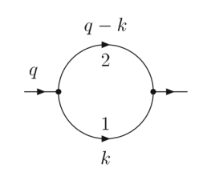
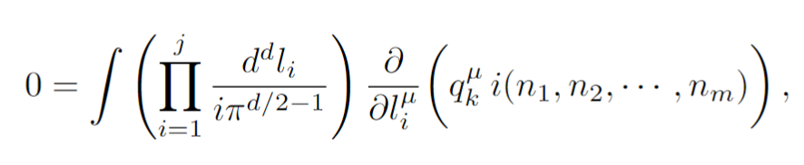
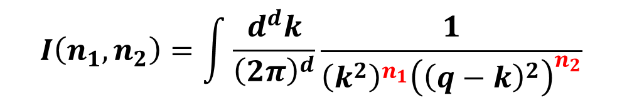
Integration By Parts (IBP)
$$I\left(n_{1},n_{2}\right)=\int{\frac{d^{d}k}{{\left(2π\right)}^{d}}\frac{1}{{\left(k^{2}\right)}^{n_{1}}{\left({\left(q−k\right)}^{2}\right)}^{n_{2}}}}$$
IBP eq.
Notes:
Now let’s focus on the Feynman integrals. I will not bother you with those difficult formulas. Instead, I invite you to see this simple example.
On my right side, it’s a Feynman diagram. And on my left side is a group of Feynman integrals. One would ask if these(抬右手) are corresponding to this（抬左手）.

Slide 5
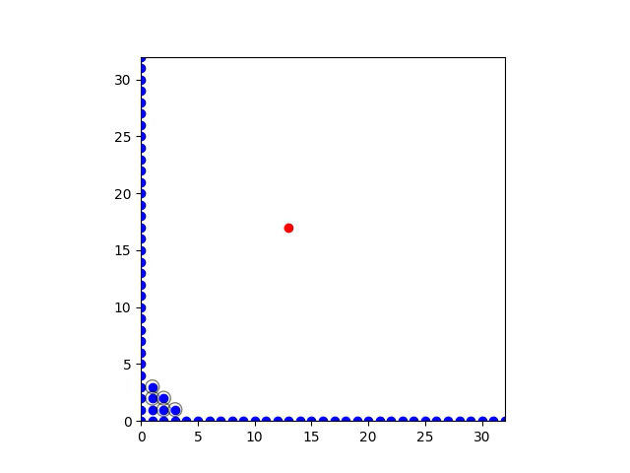
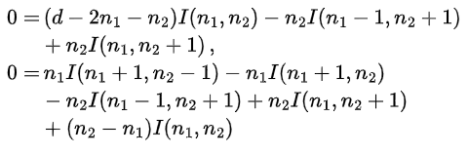


Integration By Parts (IBP) reduction
$$n_{2}$$
$$n_{1}$$
Notes:
Actually, by the following equation above（指上面）, anyone with knowledge of advanced mathematics should be able to calculate the formular. Such formulars represent that we only need to calculate several integrals so called master integrals. The IBP equations allow us to obtain any other integrals in this group. As shown in the animation（播放动画）, each integrals are mapped to a dot using its indexes, the recurrence can be done immediately. And get the formular of a complex integral, just like the red dot.

Slide 6
Laporta seeding
Heuristic
Solve simple integrals first
Solve a little complex next
$$I\left(n_{1},n_{2};n_{1}+n_{2}<20\right)$$
$$I\left(n_{1},n_{2};n_{1}+n_{2}<15\right)$$
Laporta S. High-precision calculation of multiloop Feynman integrals by difference equations[J]. International Journal of Modern Physics A, 2000, 15(32): 5087-5159.

Slide 7
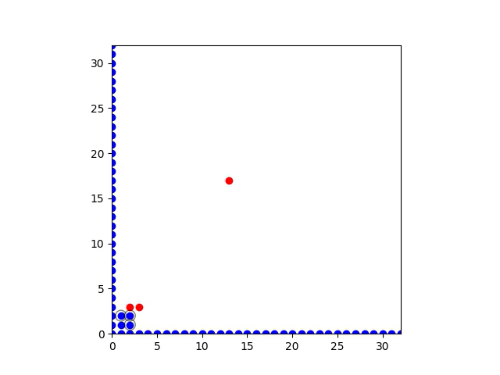
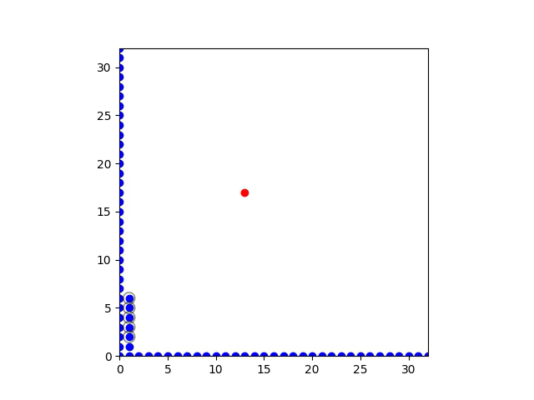

Different ways to target
$$priority= −n_{1}−n_{2}$$
$$3\max\left(n_{1},n_{2}\right)−n_{1}−n_{2}$$
$$−n_{1}−n_{2}−\left|t_{1}−n_{1}\right|−\left|t_{2}−n_{2}\right|$$
Notes:
Wait, we remember that IBP reduction is actually the bottleneck of calculating the high loop integrals because of too many redundant integrals. Maybe you can see directly from the animation which people called Laporta seeding in a one loop——which is two dimension——diagram. But various of different seeding schemes describing priority of seeding and indexes can be simply written down（引用better seeding和golden rule）. For example, in the next two animations. One is to seed the integrals with two similar index first ,and another one is to seed in a box. So, which kind of seeding is the best or better than other schemes humans ever designed?

Slide 8
Seeding scheme is good for AI to search
$$50\% → 99\% → 100\%$$
Machine Learning
?
A scheme of seeding
Notes:
Well, going back to the question mark, we now see that a scheme of seeding is good for AI to search. Because it is obviously not requiring the only solution but a better solution. Think how an under graduated student——not me——, they may try a lot of different schemes and evaluate every one using a program given by their boss. They will finally find a good scheme if they really try hard, even without knowing what they are doing.

Slide 9
Seeding scheme is good for AI to search
$$50\% → 99\% → 100\%$$
Machine Learning
?
A scheme of seeding
Infinite scheme created by AI
Notes:
Now if we ask an AI, actually a LLM to repeat generating the seeding schemes, it will surely try every possible scheme even more patient than an under graduated student. See, a scheme describing relation between priority and the indexes instead of a specific seeding, thus easy to understand and to scale.
That’s cool, right. We put a student into the machine to help us solve something that really requires creativity, and it’s legal! The only thing we need to do is to tell AI how to exactly evaluate a scheme, and give it some time.

Slide 10
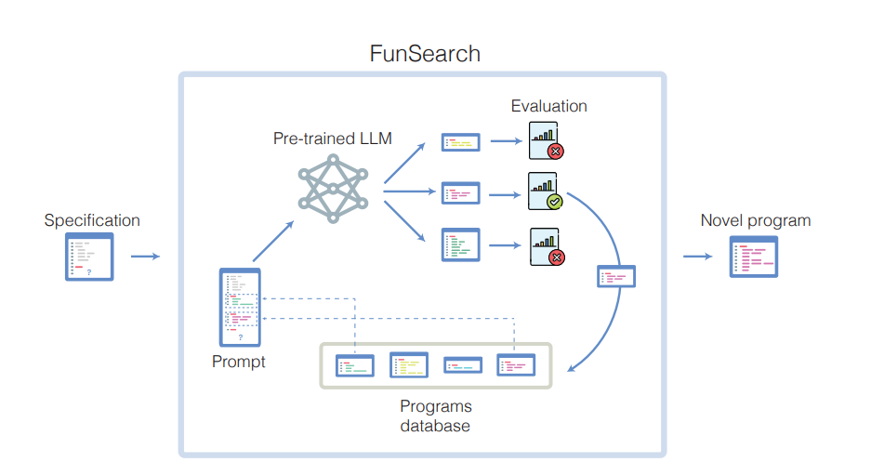
FunSearch: from 99% to 100%
FunSearch
A scheme of seeding
Infinite scheme created by AI
Romera-Paredes B, Barekatain M, Novikov A, et al. Mathematical discoveries from program search with large language models[J]. Nature, 2024, 625(7995): 468-475.
von Hippel M, Wilhelm M. Refining Integration-by-Parts Reduction of Feynman Integrals with Machine Learning[J]. arXiv preprint arXiv:2502.05121, 2025.
Notes:
Actually, a very creative way to realize this is created by DeepMind in 2024, Which they call FunSearch, combined genetic algorithm to improve its efficiency,. Give it time, and give it a great evaluator, I’m sure it will be able to solve the Riemann hypothesis eventually. So what we gonna do is to write a good evaluator.
Good news, no redundant repeating, the IBP reduction itself is of course the best evaluator for this problem. So we adopted one loop diagram and 30 different target integrals to test what kind of schemes are the best——of course by AI.

Slide 11
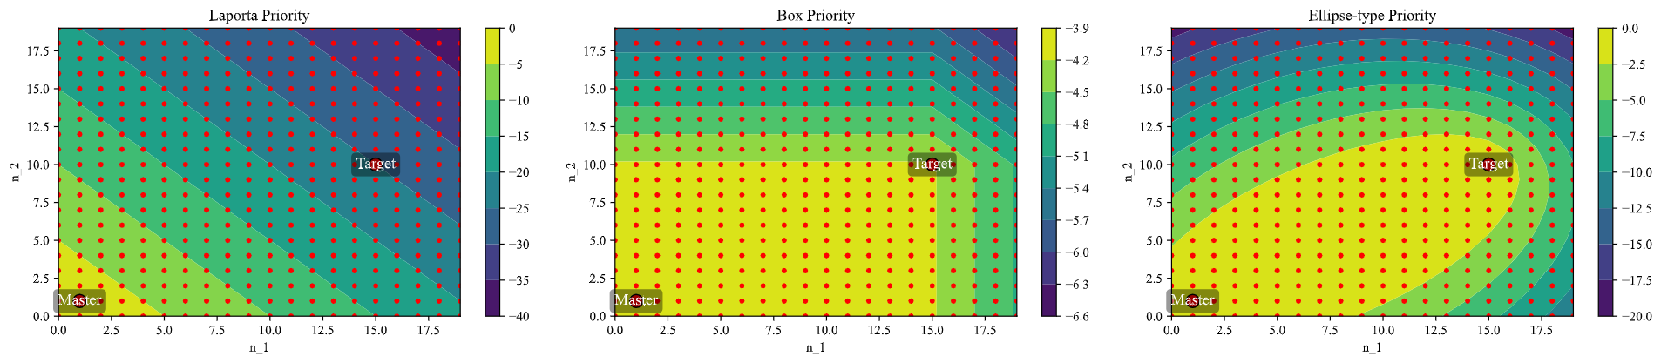
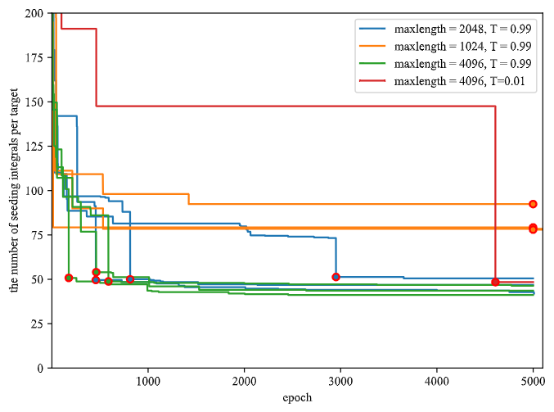
The evolution of AI-found schemes
Notes:
Now, check what our AI has made. By initializing with a simple triangle priority——Laporta seeding. We can find a lot different priority functions describing how priority vary with the indexes. As shown below（指向下方的图）,the evolution finally reduced the Laporta seeding for about 5 times fewer seedings.

Slide 12
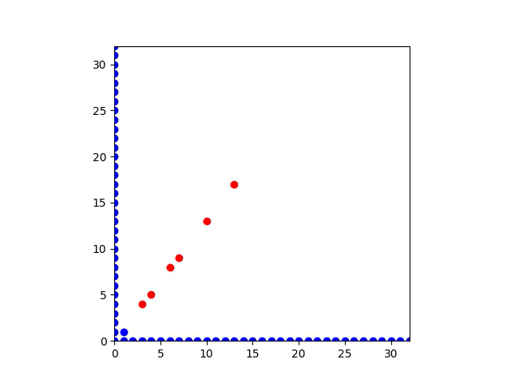
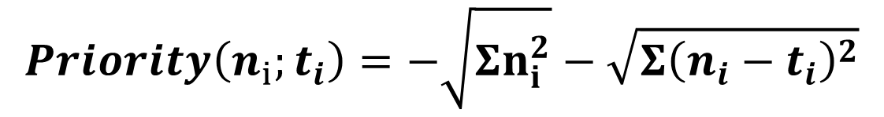
Explainability
$$Priority\left(n_{1},n_{2};t_{1},t_{2}\right)=−\sqrt{n_{1}^{2}+n_{2}^{2}}−\sqrt{{\left(n_{1}−t_{1}\right)}^{2}+{\left(n_{2}−t_{2}\right)}^{2}}$$
Scalability
$$Priority\left(n_{i};t_{i}\right)=−\sqrt{Σn_{i}^{2}}−\sqrt{Σ{\left(n_{i}−t_{i}\right)}^{2}}$$
Notes:
I think you may ask what’s the difference between a neural network result and ours. I will explain. So the first advantage is that it is explainable, as the evolution process, the priority seems to dense along the line between the master integral and the target integral. If the evolution happens inside a traditional neural network, it is a black box, and you will have to train it on a very question——like one loop or two loop ibp equations. And worry if the solution will loss efficiency under some cases. But we find a function ,so we can just explain it and be at ease that it will not run out.

Slide 13
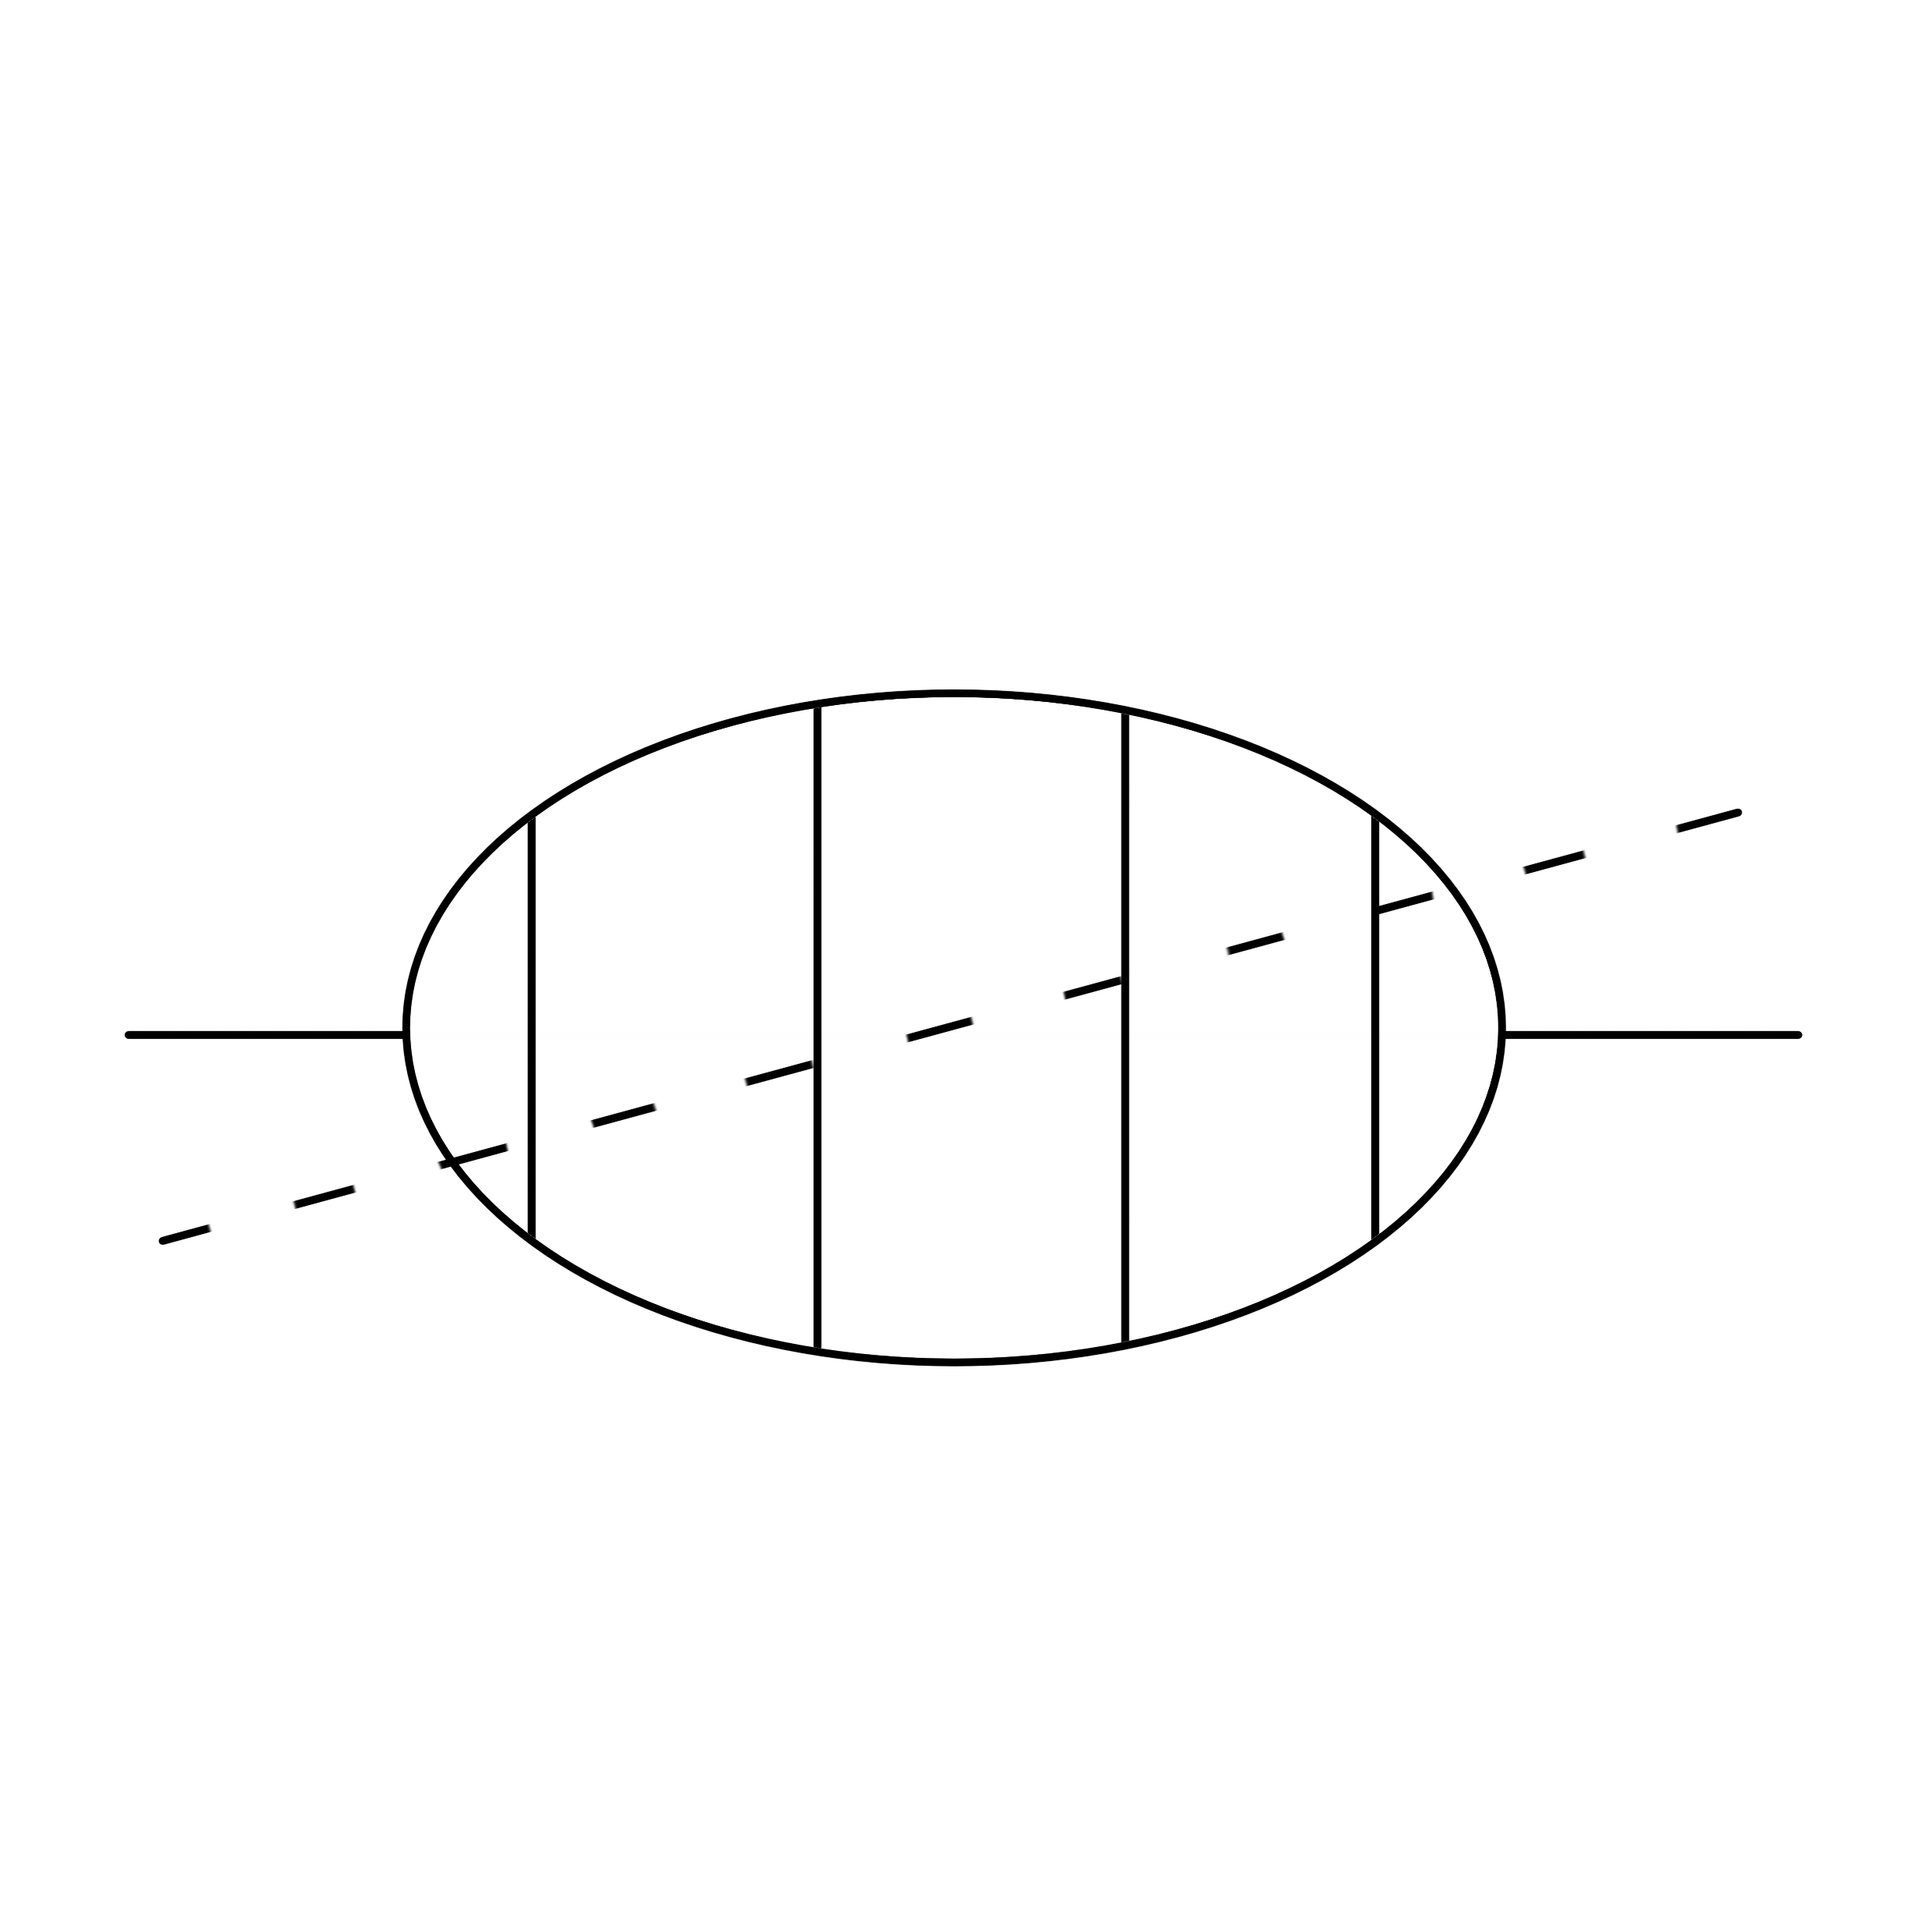

Comparation : Scalability
Laporta seeding
Improved seeding
(Best human-found seeding)
Priority Function

Slide 14





Best human-found seeding
$$t=1$$
$$t_{p}=2$$
$$s=Σ\left(θ_{i}−1\right)n_{i};r=Σθ_{i}n_{i}$$
$$t=Σθ_{i} ;d=r−t$$
Laporta seeding
$$s≤s_{max};d≤d_{max}$$
Improved seeding($t=t_{p}−n$)
$$s≤s_{max}−\left(n+f\right);d≤d_{max}$$
$$t=0$$
$$t=1$$
Driesse M, Jakobsen G U, Mogull G, et al. Conservative black hole scattering at fifth post-Minkowskian and first self-force order[J]. Physical Review Letters, 2024, 132(24): 241402.
Guan X, Liu X, Ma Y Q, et al. Blade: A package for block-triangular form improved Feynman integrals decomposition[J]. Computer Physics Communications, 2025: 109538.
Bern Z, Herrmann E, Roiban R, et al. Amplitudes, supersymmetric black hole scattering at $$\mathcal {O}\left ({G}^ 5\right) $$, and loop integration[J]. Journal of High Energy Physics, 2024, 2024(10): 1-47.

Slide 15
Scalability
Integrals | Laporta | Improved | Priority | Ratio
s2 | 1 299 923 | 3061 | 2985 | 1.03
s3 | 7 276 962 | 4125 | 3708 | 1.11
s4 | 20 549 627 | 10 803 | 7144 | 1.51
s5 | 81 359 547 | 35 065 | 19 052 | 1.84
s6 | 237 961 845 | 108 215 | 46 390 | 2.33
s8 | - | 791 164 | 101 549 | 7.79
s10 | - | 4 388 968 | 268 909 | 16.32
s12 | - | 19 901 220 | 802 488 | 24.8
d1 | 523 596 | 154 700 | 1791 | 86.38
d3 | 2 940 855 | 2 775 780 | 3466 | 800.9
d5 | 11 654 385 | 21 740 796 | 7109 | 3058
Notes:
With the function of priority, we can also expand it to larger problems, for example, five loop integrals, to evaluate the efficiency. Such Scalability makes our solution different from others.
For a planar five loop diagram which can be mapped to a 20 dimensions indexes spaces. It is much larger than one loop diagram, but the priority can still work and reduce the seeding required.
So far, the best human-developed seeding we know is the better seeding, and we can always reduce 10 times of seedings compared to the better seeding. And it even works better for complex target integrals for 25 times and target integrals not in top-sector for 3000 times.

Slide 16
Scalability
Integrals | Improved | Priority | Ratio
s2 | 34 755 | 34 755 | 1
s3 | 34 755 | 34 755 | 1
s4 | 59 157 | 59 157 | 1
s5 | 160 377 | 160 377 | 1
s6 | 492 401 | 93 297 | 5.3
d2 | 598 428 | 1337 | 447.59
d4 | 4 779 738 | 4709 | 1015.02
d5 | 11 519 163 | 10 859 | 1060
Notes:
Also, for a non-planar diagram, our priority can also work from 5 times reducing in top sector to 1000 times reducing out of top sectors. As a compare, the Laporta seeding has long be out of memory.

Slide 17
Take Home Message
an AI-assist explainable method to solve heuristic theoretical problems
identified an optimal priority function that reduces the number of required seeding integrals by up to 3058x.
the potential of AI in advancing theoretical research.
Notes:
Ok, so here is the take home messages. First, we have found one of the method to solve theoretical problems. Then, we identified an optimal priority function to reduce the seeding and improved the bottleneck of solving Feynman intergral,ibp, by up to thousands times.
Finally, our result shows the enormous potential AI can do in advancing theoretical research.

Slide 18
Thank You

Slide 19

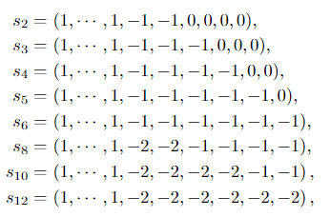
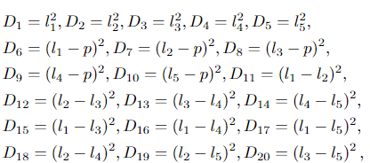

Definition : Scalability

