Slide 1
WG4: Topical Session on Special Cryomodules and Advanced Auxiliary Systems
Convenors:
Hongtao Hao (SARI)
Crispin Contreras-Martinez (FNAL)
Alan Wheelhouse (STFC)

Slide 2
Discussion
Tuner (stepper motor and piezo actuator)
RAON HWR stepper motor: vibrations from motor and slip in steps
LCLS-II and Shine 3.9 GHz third harmonic cavities: The tuner response has different regions
Availability of actuators
EIC and LHC crab cavities
HOM and FPC
Crab cavity HOM coaxial feedthrough reliability
Effects of transportation on the FPC

Slide 3
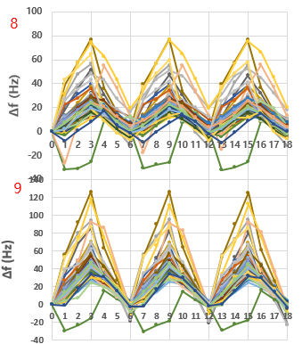
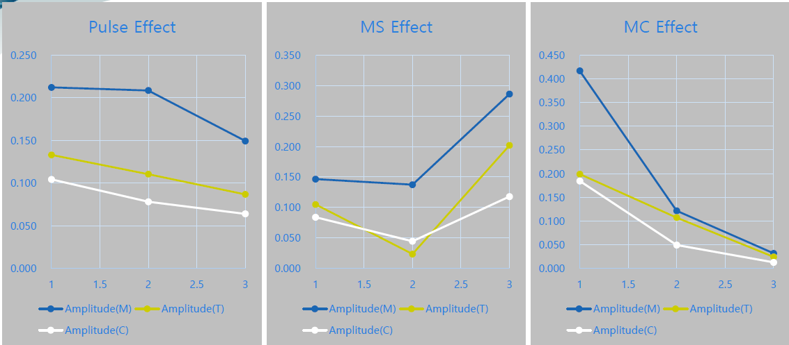
Tuner [with Phytron cryo stepper motor] operation
1,000 pulse
Vibration(amplitude) measurements vs. operation setting
motor pulse
motor speed
(micro)stepping
2,000 pulse
5000 1000 500
600 500 400
1/2 1/8 1/32
RAON setting: pulse(<1,000), speed(500), stepping(1/32)
Observation/difficulties to use slow tuner @GDR
Occasional slip observed on few tuners
mechanical vibration, especially at the start/end of tuner operation
- results in control lose due to a large (Δf0/ΔΦ)
- observed the vibration on cavities in the same cryomodule
Tuner operation tests @SEL
Plans: R&D to reduce the vibration including design changes

Slide 4
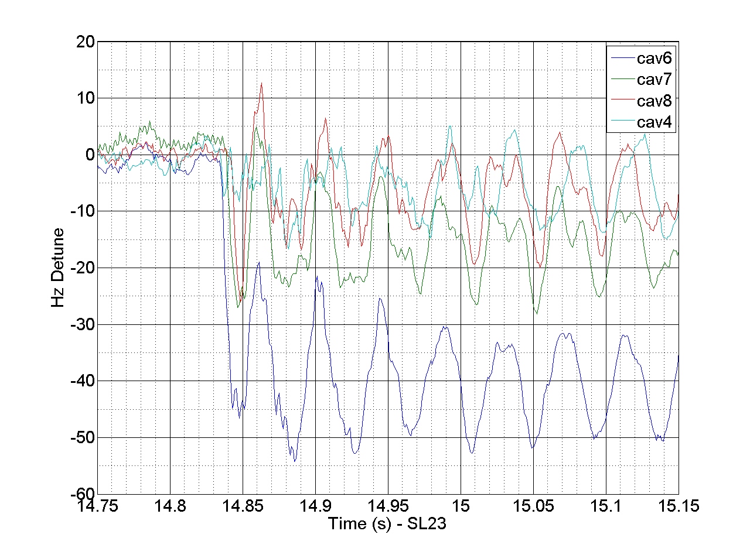
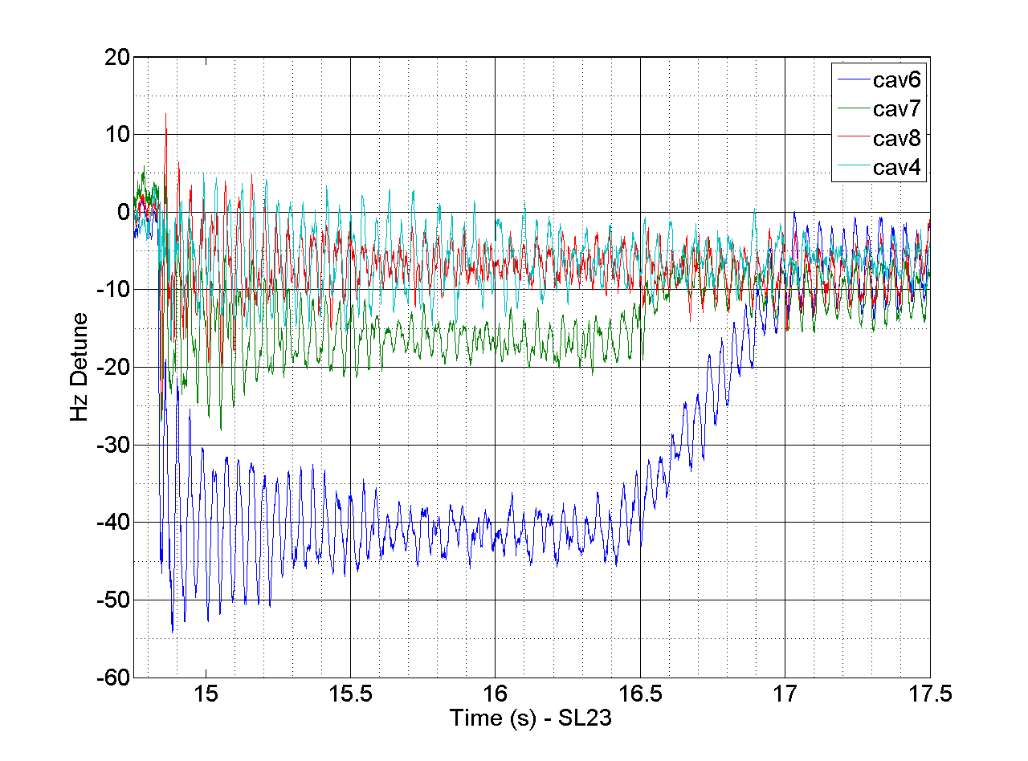
Coupled Cavities
C100-4 Cavities 4, 6, 7, 8 responding to an applied PZT step voltage change from 4 to 3 volts in cavity 5
Cavity 5 PZT
moved 460 Hz
Adjacent Cavity
coupling is ~ 10%
between 1-4 and
5-8 cavities
Cavities 4 and 5
have a “quasi”
mechanical
support between
them.
Ringing is the
21 Hz mechanical
Mode
Cavity Gradients
10 MV/m
Locked in GDR Mode
Klystron had the
overhead to keep
cavities locked
Stepper Motor
kicks in to tune
the cavities

