Slide 1
Thoughts about high Ql operation
TTC 2025
Julien Branlard
Daejeon, 8.4.2025

Slide 2
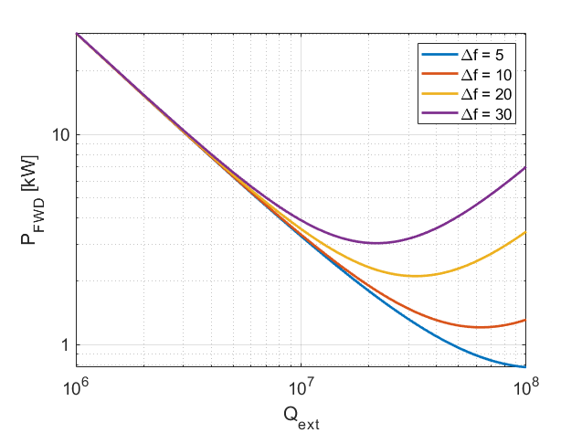
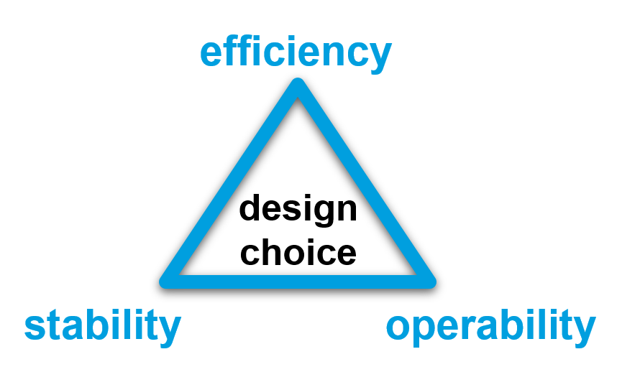
Why is bandwidth and resonance control crucial for efficiency
Bandwidth (Qext) and Resonance (Δf) control
Operating at higher Qext (narrower bandwidth)
reduces the power needs IF resonance control can be guaranteed
makes resonance control extremely challenging
Parameters for SRF gun
r/Q = 208 Ohm V_{acc} = 5 MV (energy gain from the gun at 50 MV/m -> 5 MeV) I_{b} = 100 uA (100 pC at 1 MHz)
φ_{b} = 0 deg.
4 kW
3.3 kW
2 kW
1.3 kW
The challenge is to find the highest Qext one can operate the cavity at while still meeting the resonance control goals and without compromising operability and reliability of the system.
1 kW
Q_{ext} = 1e7
Q_{ext} = 4e7

Slide 3
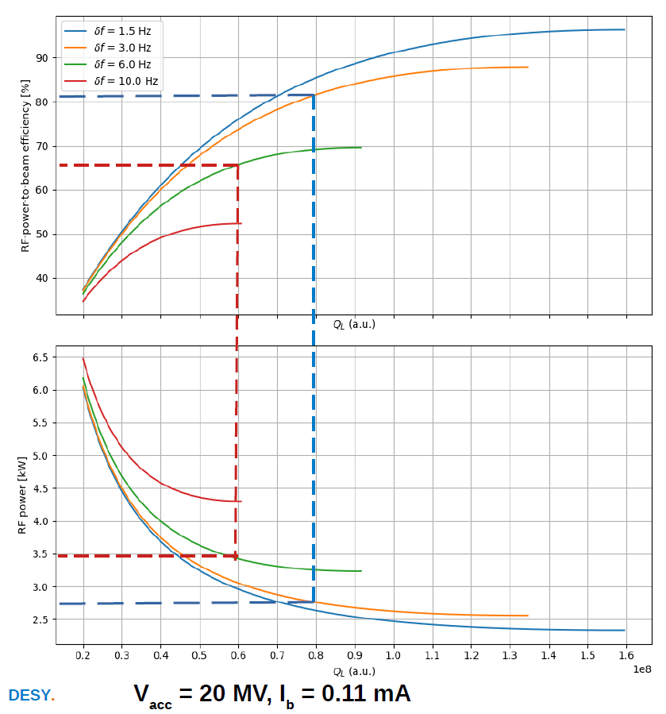
Why operating at high Qext ?
Motivation
Improve RF-to-beam efficiency by reducing the input power needs
It really pays off if resonance control works
i.e. don’t need a huge RF budget for resonance control → piezo
Courtesy A. Bellandi

Slide 4
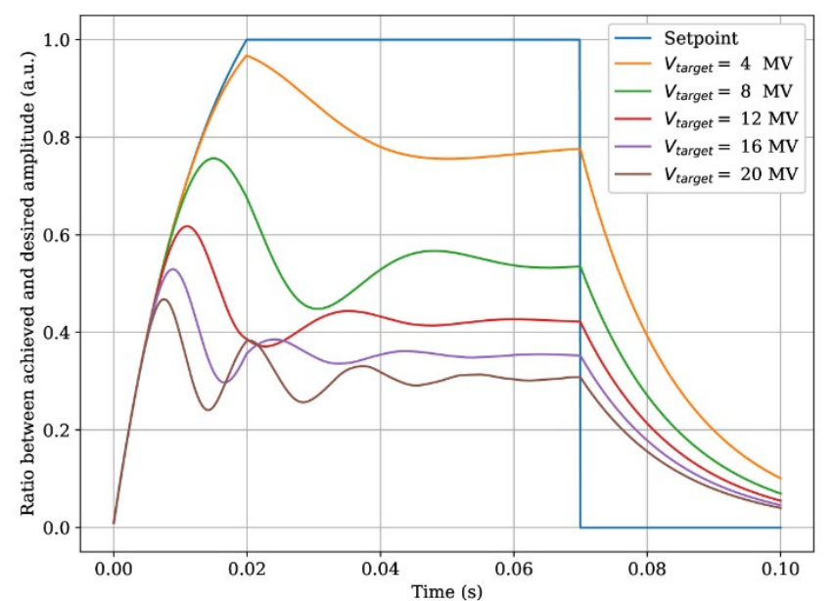
Challenges at high Qext
Microphonics control
Ponderomotive drops / oscillations
Pulsed operation (transients)
High gradient (LFD)
Courtesy A. Bellandi

Slide 5
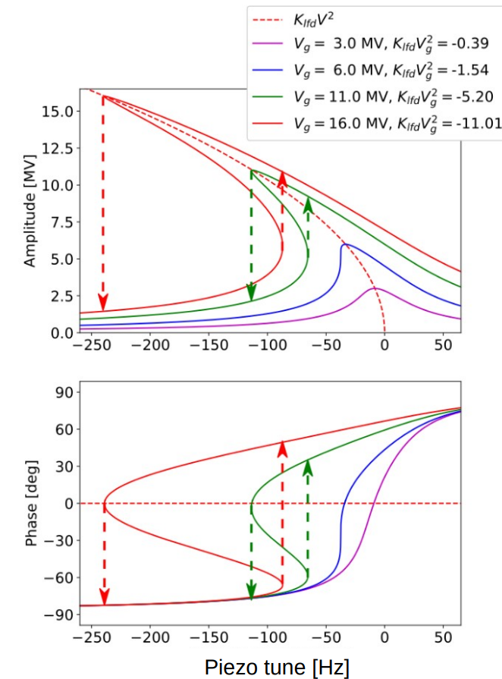
Challenges at high Qext
Ponderomotive drops
Ponderomotive drops / oscillations
Lorentz Force Detuning constant
Cavity half-bandwidth
Cavity voltage
For TESLA cavities, ponderomotive drops start occuring when this ratio becomes smaller than -1.54
Courtesy A. Bellandi

Slide 6
Challenges at high Qext
Ponderomotive drops
Ponderomotive drops / oscillations
 |  | Burst (now) | HDC (upgrade)
Qext | x10^6 | 4,6 | 60
f0 | GHz | 1,3 | 1,3
f1/2 | Hz | 0 | 0
Klfd | Hz/MV^2 | -0,9 | -0,9
Vcav | MV | 25 | 20
KlfdVcav^2 / f/12 |  | -4,0 | -33,2
Courtesy A. Bellandi

Slide 7
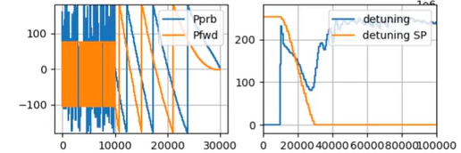
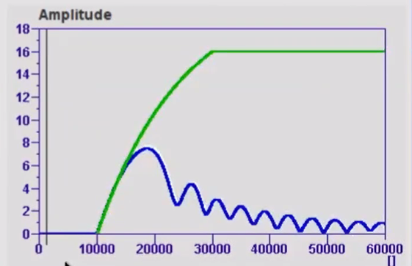
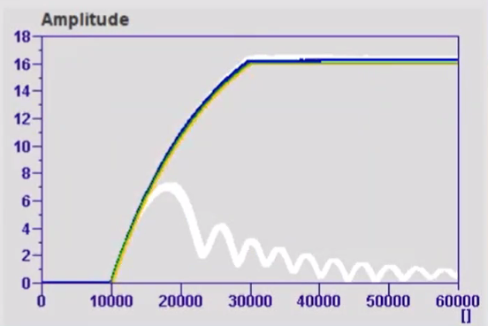
Challenges at high Qext
Vector sum operation
IDEA: emulate SEL in pulsed operation during fill
Rotate common RF phase drive
Absorb Klfd differences using piezo
Courtesy B. Richteri

Slide 8
Questions
Qext
At what Qext are the cavities set to ? (facilities / test stand)
How is Qext set ?
Is it remote controllable ?
How much does it change with operation (thermal effect) ?

Slide 9
Questions
Detuning
What is the level of background microphonics ?
Is there detuning control ?
how ?
Contribution slow tuner / fast tuners ?

Slide 10
Questions
Who is using SEL to drive cavities ?
at what gradient ?
SELAP ?
analogue / digital ?
Visualization tools ? “Cheeto”
Experience with operating high Qext cavities
in pulsed mode ?
in vector sum ?
Experience with ponderomotive drop ?
At what gradient / Qext
Frequency of drops
Recovery time ? How is it handled wrt. to beam operation

Slide 11
Discussion
Facility | Cavity f0 | Qext [x1e6] | Voltage [MV/m] | Klfd [Hz/MV^2] | CW / pulsed | Field Control | Resonance control
EuXFEL (pulsed) | TESLA 1.3 GHz | 4.6 | 23 | -0.9 | pulsed | VS | Piezo FB
EuXFEL (HDC) | TESLA 1.3 GHz | 6 | 18 | -0.9 | CW pulsed | single | Piezo FB

Slide 13
BACKUP

Slide 14
Quench movie

